Slide 1

Unit 16 Seasons and the weather
Lesson 3 – Period 6

Slide 2
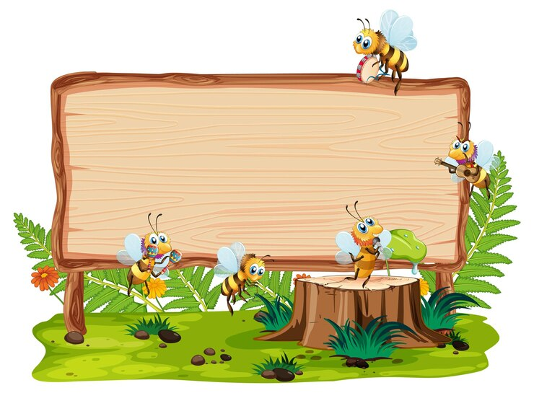

01
Warm-up and Review

Slide 3

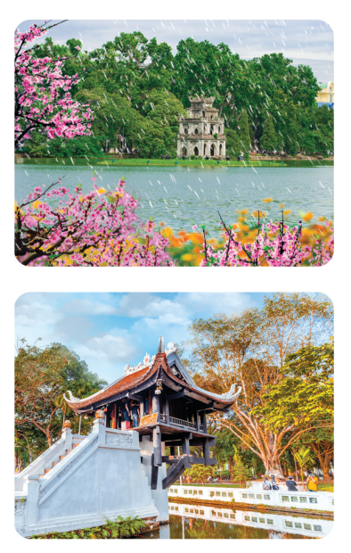
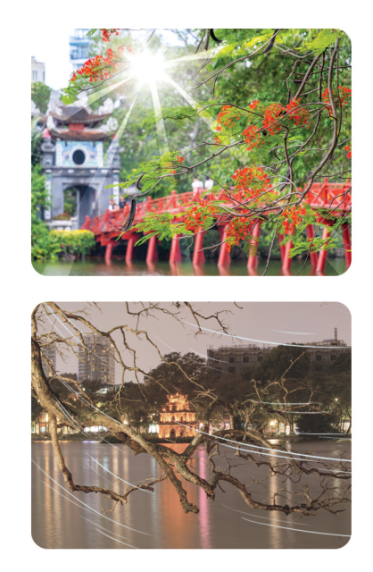
Let’s sing.
How’s the weather in Ha Noi?
How’s the weather in spring?
It’s warm and rainy.
How’s the weather in summer?
It’s hot and sunny.
What’s the weather like in autumn?
It’s cool and cloudy.
What’s the weather like in winter?
It’s cold and dry.

Slide 4
02
Read and complete.

Slide 5
Read.
There are different climates in Viet Nam. In the north, there are four seasons: spring, summer, autumn and winter. Spring is warm and humid. It has blooming flowers and festivals. Summer is sunny and hot. It is ideal for holidays. Autumn is cool and cloudy. Many festivals are in autumn. Winter is cold and dry. It is ideal for indoor sports.
In the south, there are two seasons: the dry season and the rainy season. In the dry season, the weather is dry and cool, but in the rainy season, it is rainy and humid.

Slide 6
Read and complete.
There are different climates in Viet Nam. In the north, there are four seasons: spring, summer, autumn and winter. Spring is warm and humid. It has blooming flowers and festivals. Summer is sunny and hot. It is ideal for holidays. Autumn is cool and cloudy. Many festivals are in autumn. Winter is cold and dry. It is ideal for indoor sports.
In the south, there are two seasons: the dry season and the rainy season. In the dry season, the weather is dry and cool, but in the rainy season, it is rainy and humid.
Viet Nam | Seasons | Weather
In the north | – spring – summer – autumn – winter | – warm and humid – (1) ______________ – (2) ______________ – (3) ______________
In the south | – (4) ___________ – (5) ___________ | – dry and cool – rainy and humid

Slide 7
Read and complete.
There are different climates in Viet Nam. In the north, there are four seasons: spring, summer, autumn and winter. Spring is warm and humid. It has blooming flowers and festivals. Summer is sunny and hot. It is ideal for holidays. Autumn is cool and cloudy. Many festivals are in autumn. Winter is cold and dry. It is ideal for indoor sports.
In the south, there are two seasons: the dry season and the rainy season. In the dry season, the weather is dry and cool, but in the rainy season, it is rainy and humid.
Viet Nam | Seasons | Weather
In the north | – spring – summer – autumn – winter | – warm and humid – (1) _______________________ – (2) _______________________ – (3) _______________________
In the south | – (4) _______________________ – (5) _______________________ | – dry and cool – rainy and humid

Slide 8
Read and complete.
There are different climates in Viet Nam. In the north, there are four seasons: spring, summer, autumn and winter. Spring is warm and humid. It has blooming flowers and festivals. Summer is sunny and hot. It is ideal for holidays. Autumn is cool and cloudy. Many festivals are in autumn. Winter is cold and dry. It is ideal for indoor sports.
In the south, there are two seasons: the dry season and the rainy season. In the dry season, the weather is dry and cool, but in the rainy season, it is rainy and humid.
Viet Nam | Seasons | Weather
In the north | – spring – summer – autumn – winter | – warm and humid – (1) _______________________ – (2) _______________________ – (3) _______________________
In the south | – (4) _______________________ – (5) _______________________ | – dry and cool – rainy and humid
sunny and hot
cool and cloudy
cold and dry
the dry season
the rainy season

Slide 9
03
Let’s write.

Slide 10
Let’s write.
– How many seasons are there in your area?
– How’s the weather in each season?
– What do you usually wear in each season?
There are ____ seasons ___. It’s ___________.
__________________
__________________.

Slide 11
Let’s write.
Suggested answer:
I live in Can Tho, a city in the south of Viet Nam. There are only two seasons in my place: the dry season and the rainy season. In the dry season, it’s dry and cool. I usually wear summer outfits: shorts and a blouse or trousers and a T-shirt. In the rainy season, it’s rainy and humid. I usually wear jeans and a jacket.

Slide 12
Let’s write
– How many seasons are there in your area?
– How’s the weather in each season?
– What do you usually wear in each season?
There are ____ seasons ___. It’s ___________.
__________________
__________________.

Slide 13

Let’s write.

Slide 14
04
Project

Slide 15
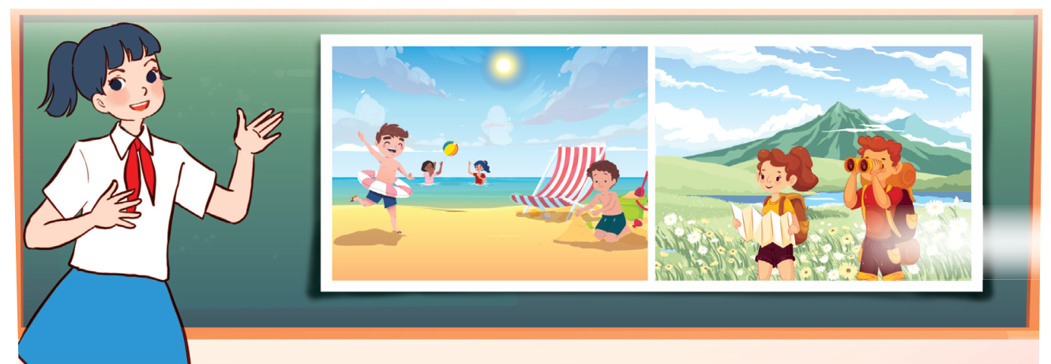
Project
Posters about the seasons
My favourite season is ___. It’s ___.
I usually wear ___.

Slide 16
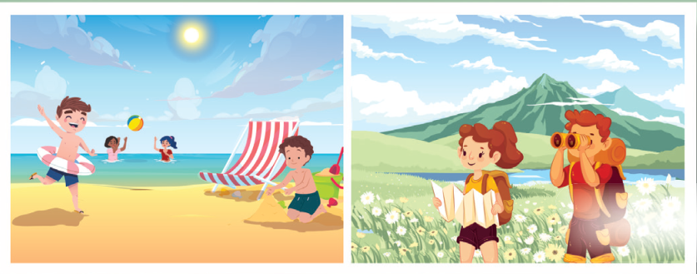
Project
Suggested answer:
Hello, everyone! My name’s Long. I live in Nha Trang, a coastal city in the south of Viet Nam. There are only two seasons in my place: the dry season and the rainy season. My favourite season is the dry season. The weather is dry and cool. I usually wear summer outfits in this season. Look at the pictures on the poster. l wear shorts when I go swimming in the sea. And I wear jeans and a T-shirt when I take photos in the mountains. The dry season is really cool for me!
Thank you for your listening.

Slide 17

Project

Slide 18
05
Fun corner and Wrap-up

Slide 19
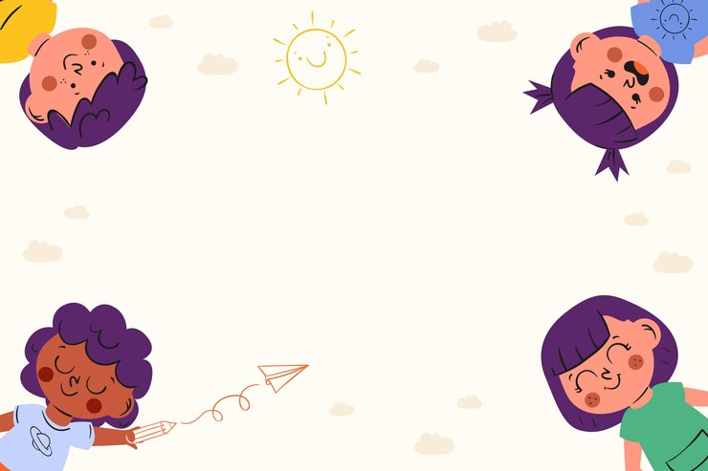

Rock, paper, scissorsr
Game

Slide 20

How’s the weather in Ha Noi in _____?
It’s _____.
What do you usually wear in ______?
I wear _____.
Notes:
GV ghi điểm cho HS bằng cách nháy vào tên team. Mỗi lần nháy 1 ngôi sao xuất hiện.

