Slide 1





UNIT 17
STORIES
FOR CHILDREN
Lesson 1 – Period 1

Slide 2

GUESSING GAME

Slide 3

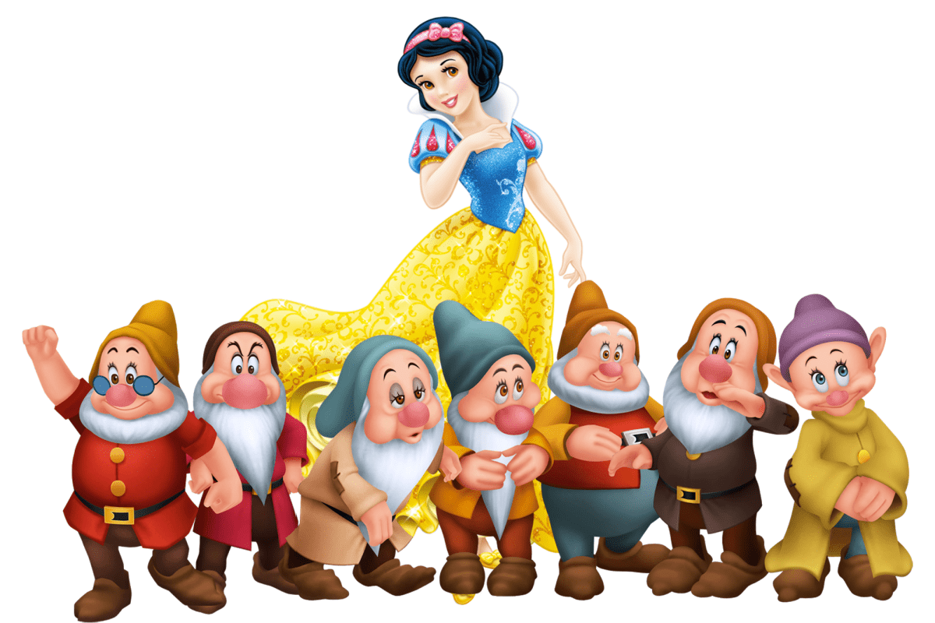
Snow White and the seven dwarfs

Slide 4
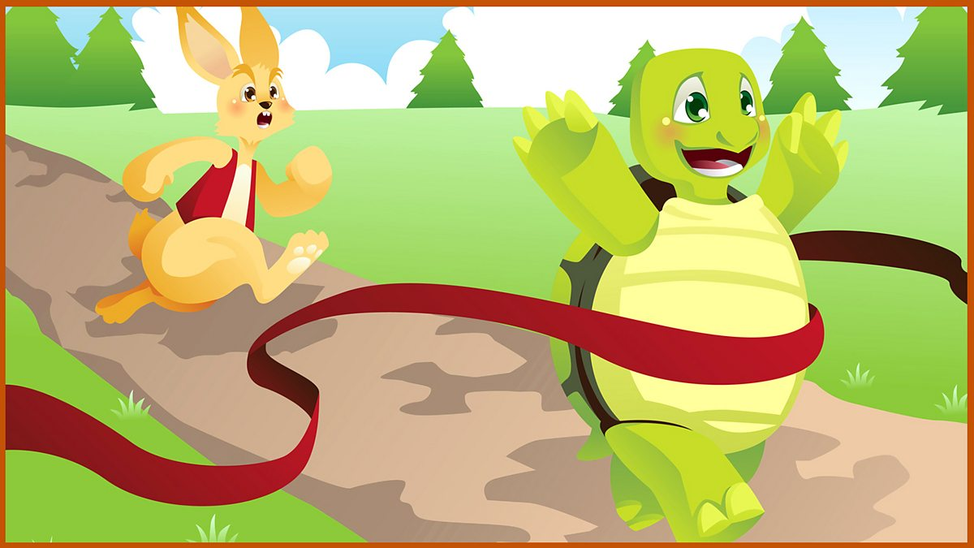
The Tortoise and the Hare

Slide 5
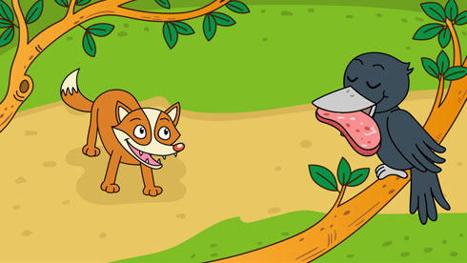
The Fox and the Crow

Slide 6
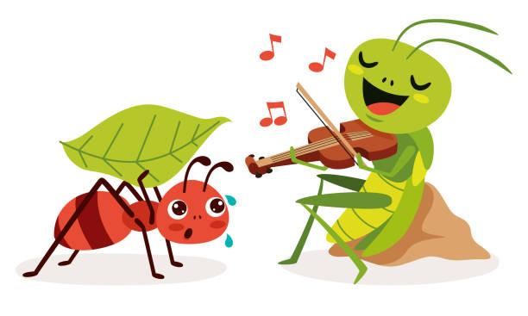
The Ant and the Grasshopper

Slide 7


02
Look, listen and repeat.

Slide 8


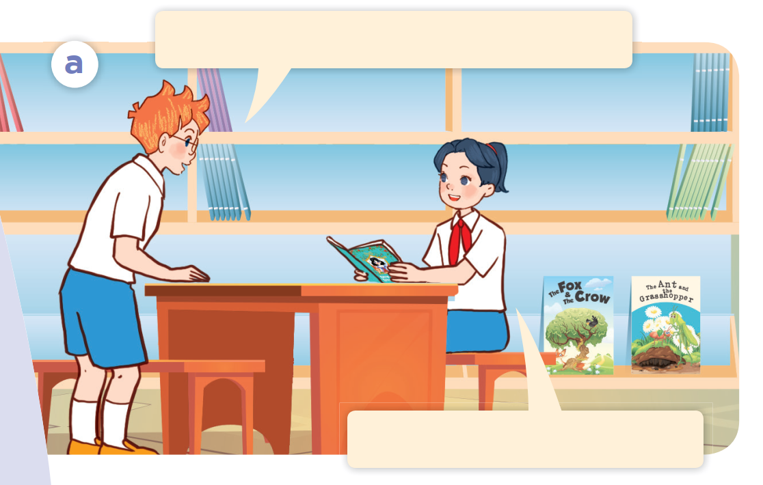
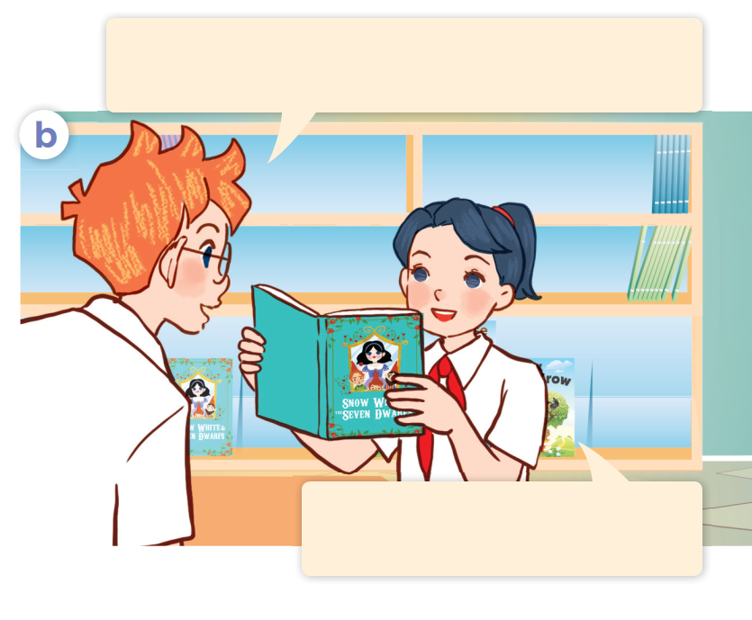



Listen and point.

Slide 9
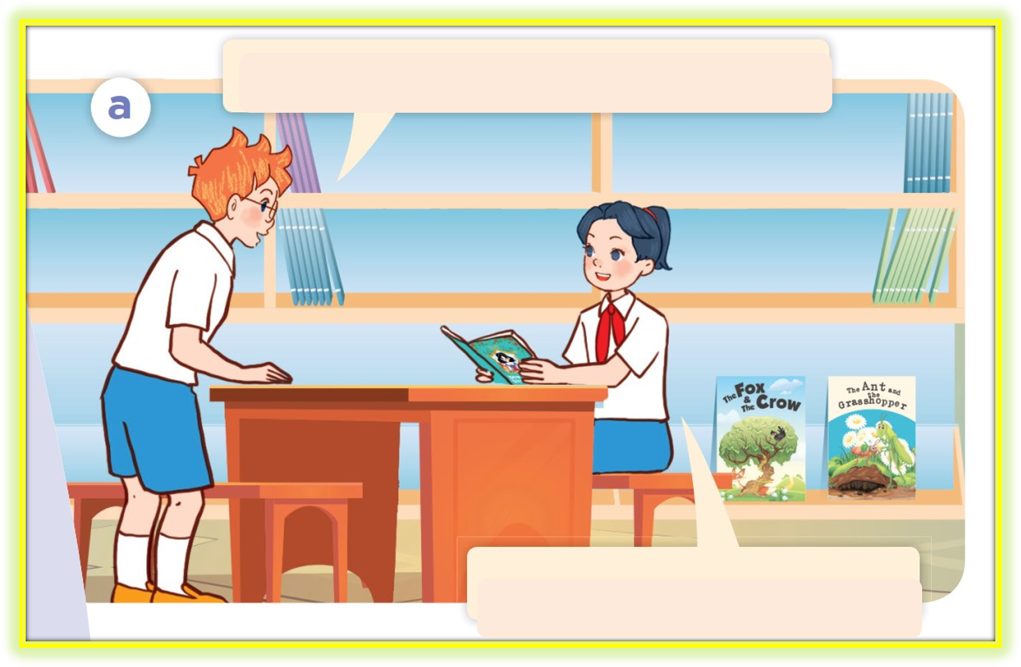
Listen, point and repeat.
Hi, Mai. What are you reading?
I’m reading a fairy tale.

Slide 10
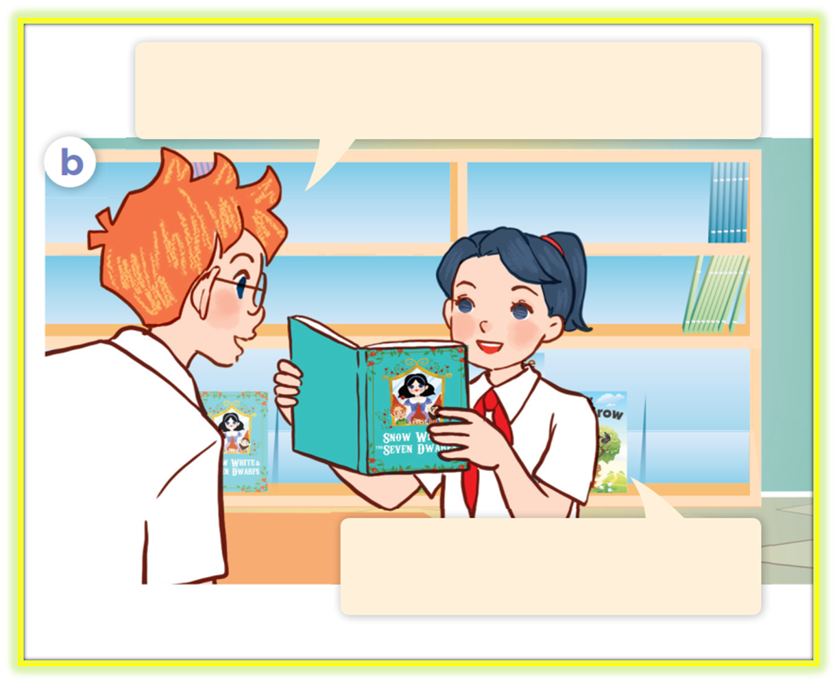
Listen, point and repeat.
That sounds interesting. Who are the main characters in the fairy tale?
They’re Snow White and the seven dwarfs.

Slide 11
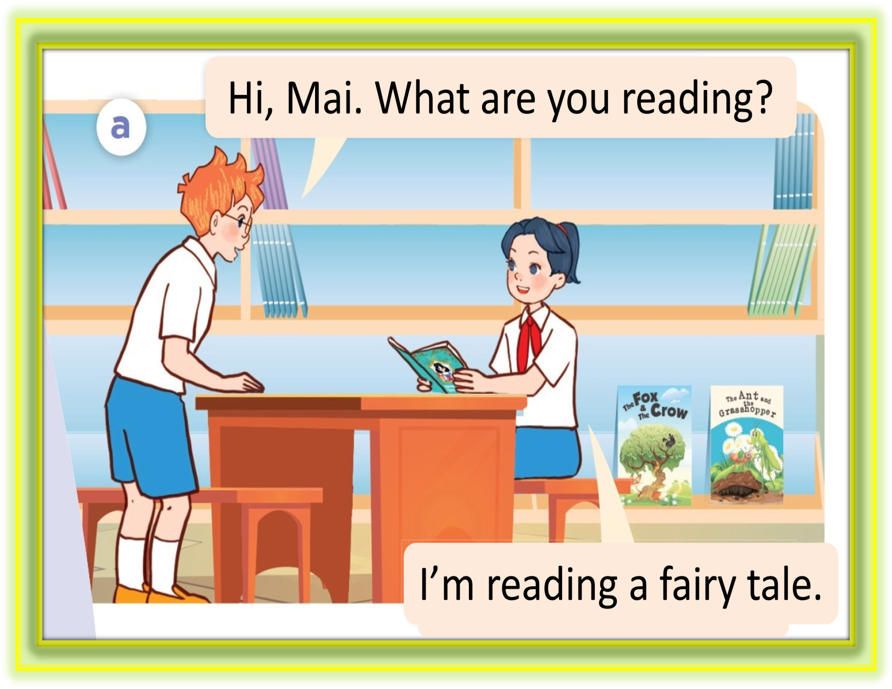
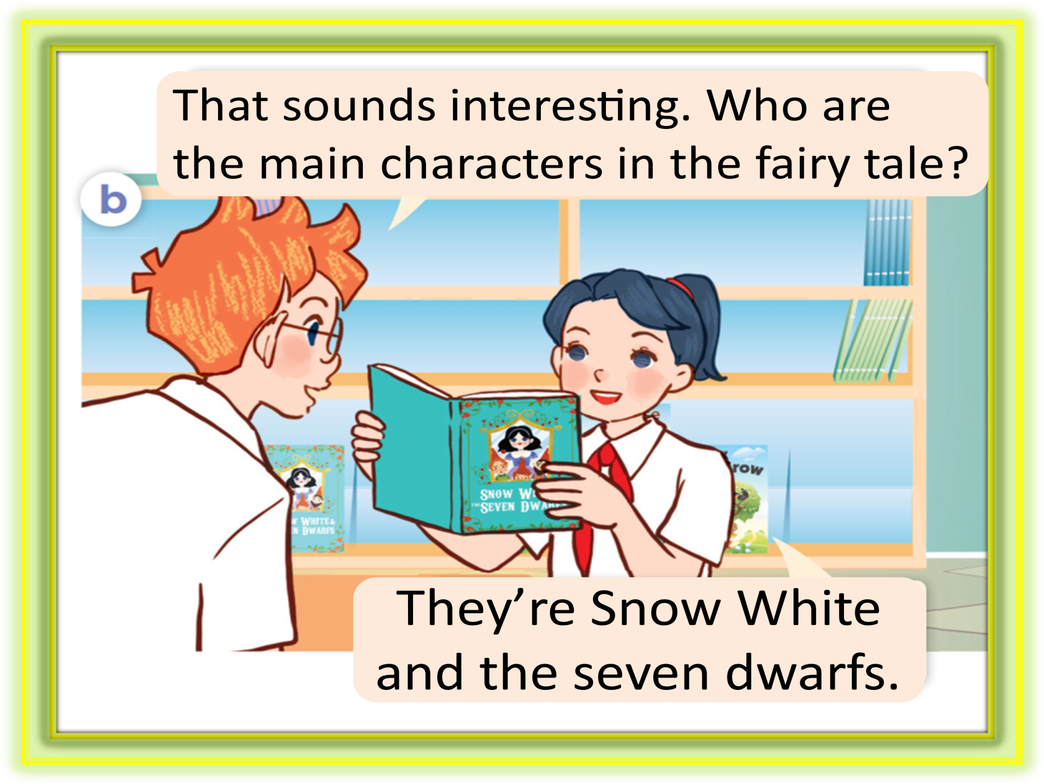
Look and answer.

Slide 12
03
Listen, point and say.

Slide 13

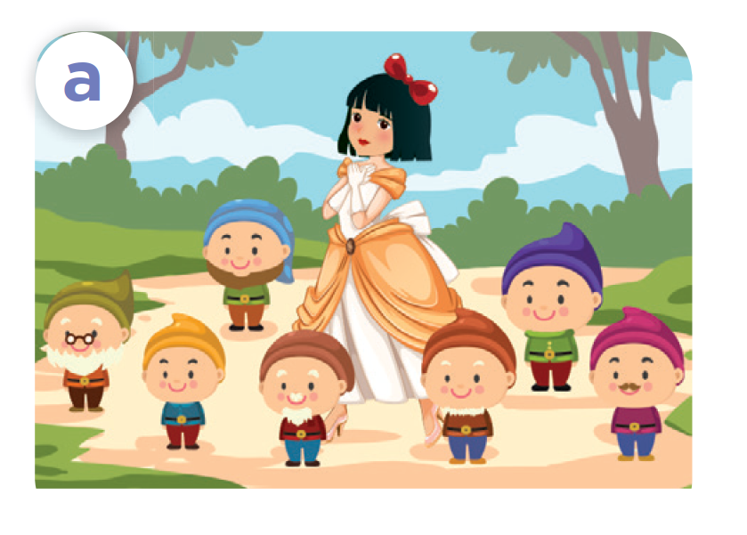
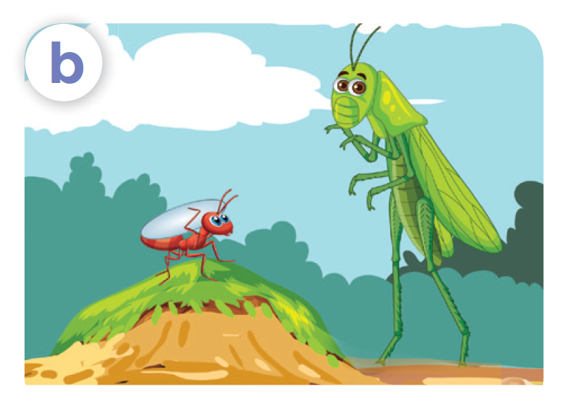
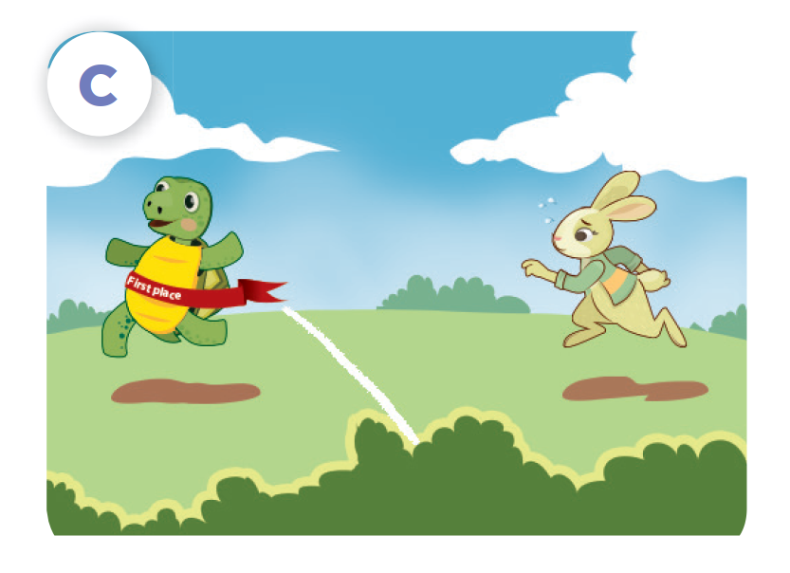
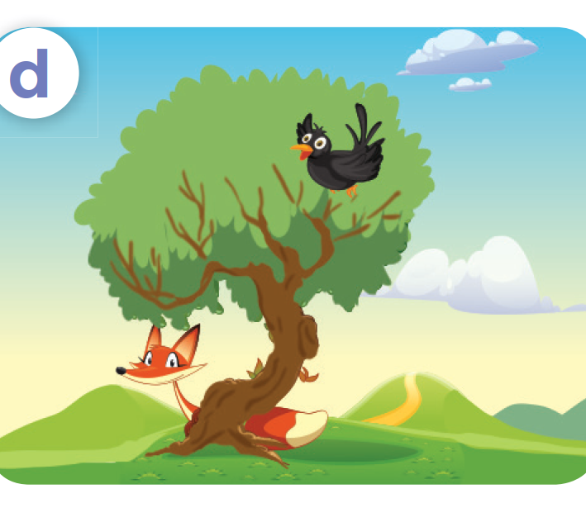

Look and say.
Snow White, the seven dwarfs
the ant, the grasshopper
the tortoise, the hare
the fox, the crow

Slide 14
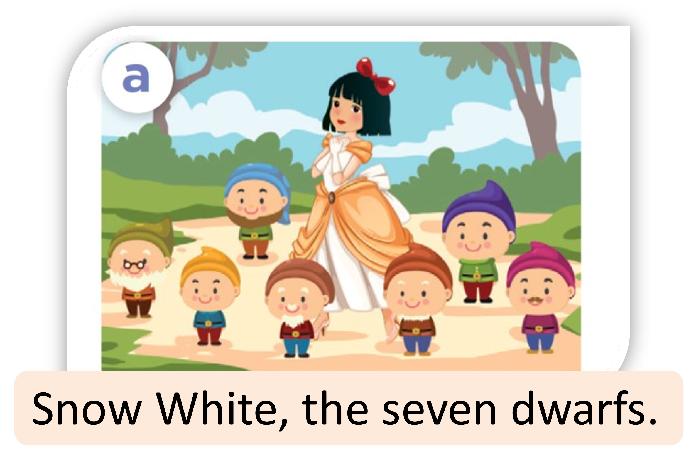
Listen, point and say.

Slide 15
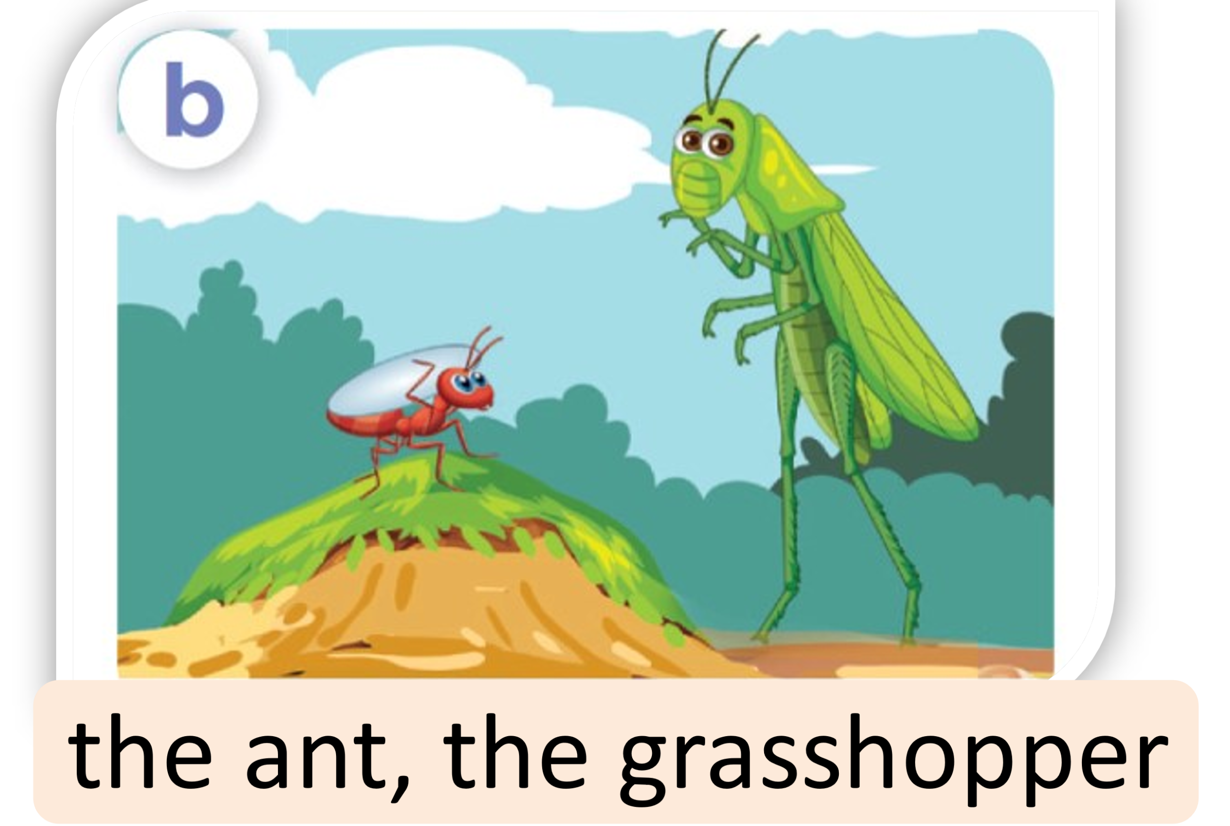
Listen, point and say.

Slide 16
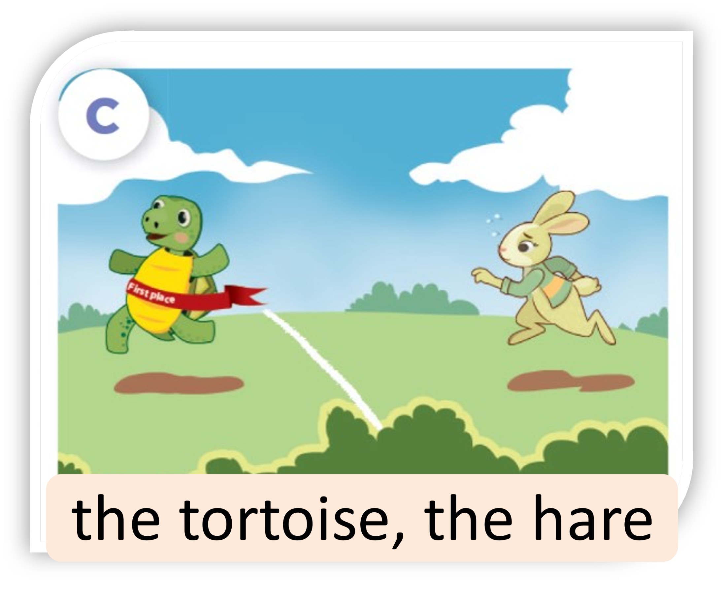
Listen, point and say.

Slide 17
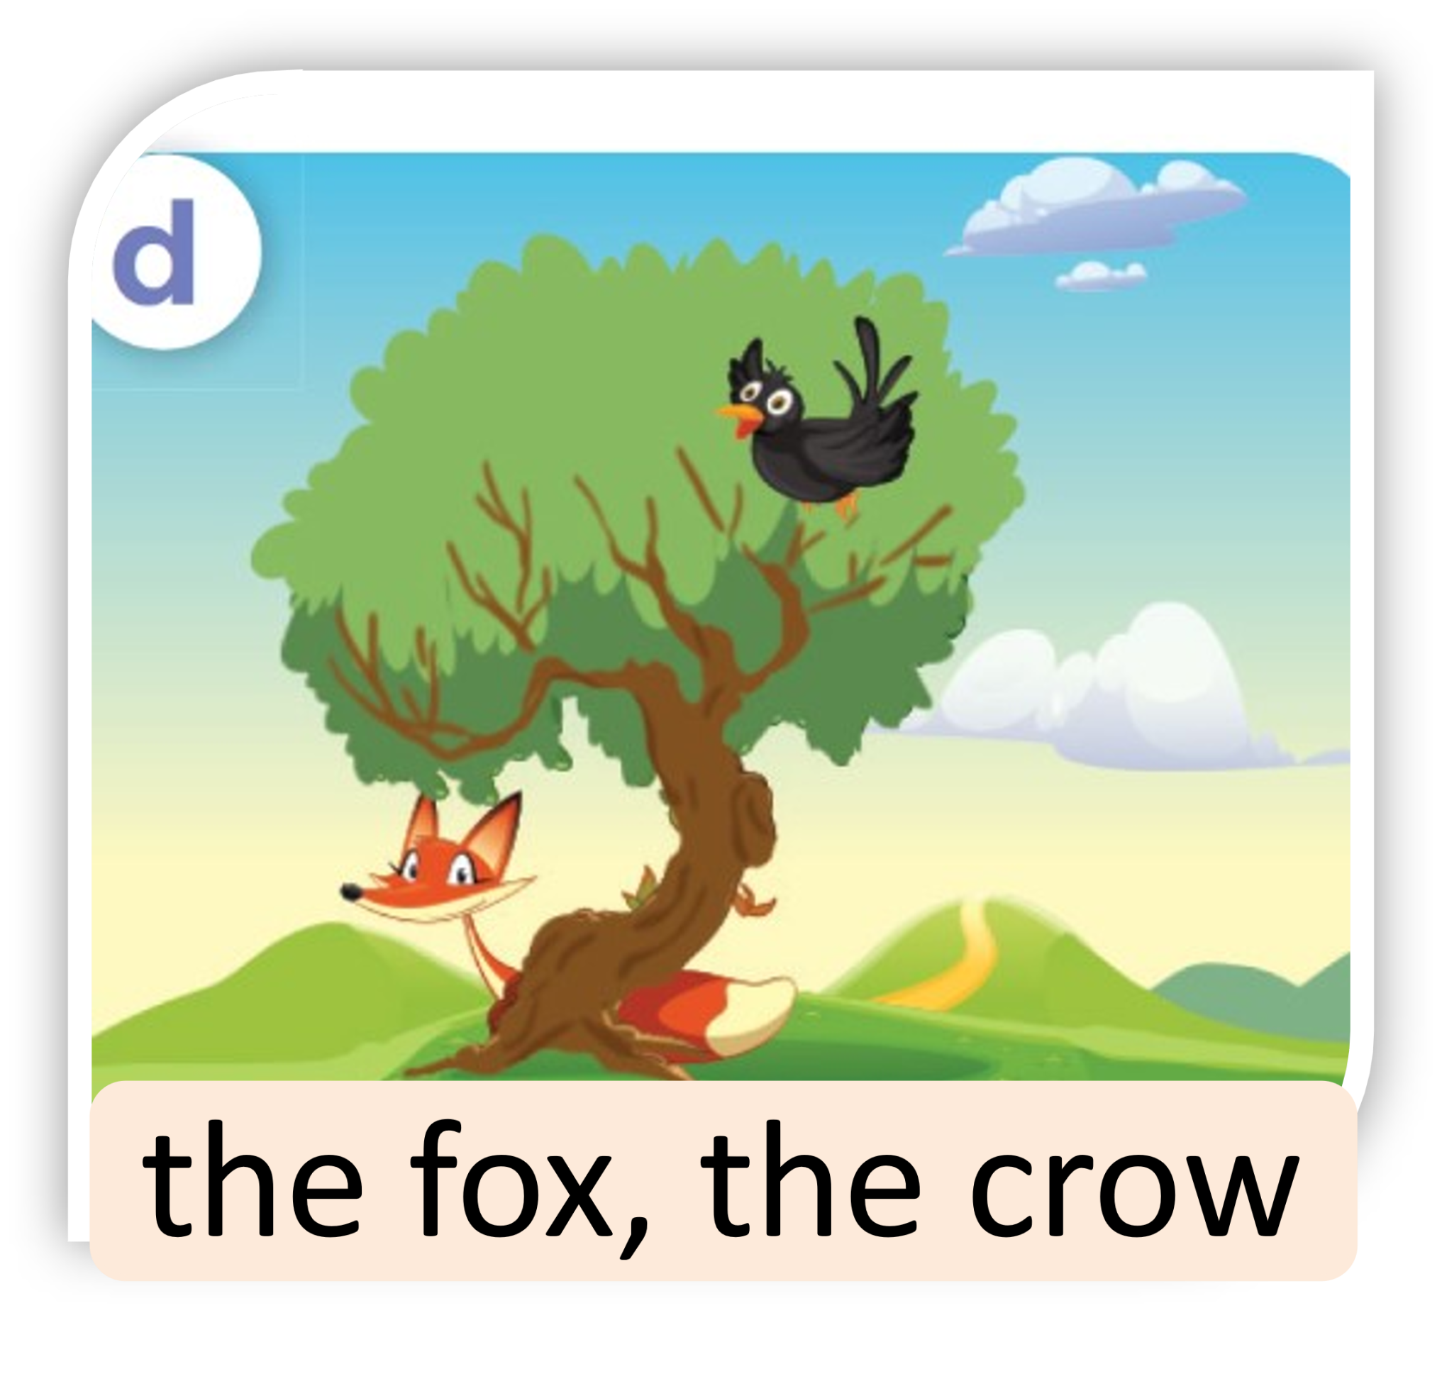
Listen, point and say.

Slide 18
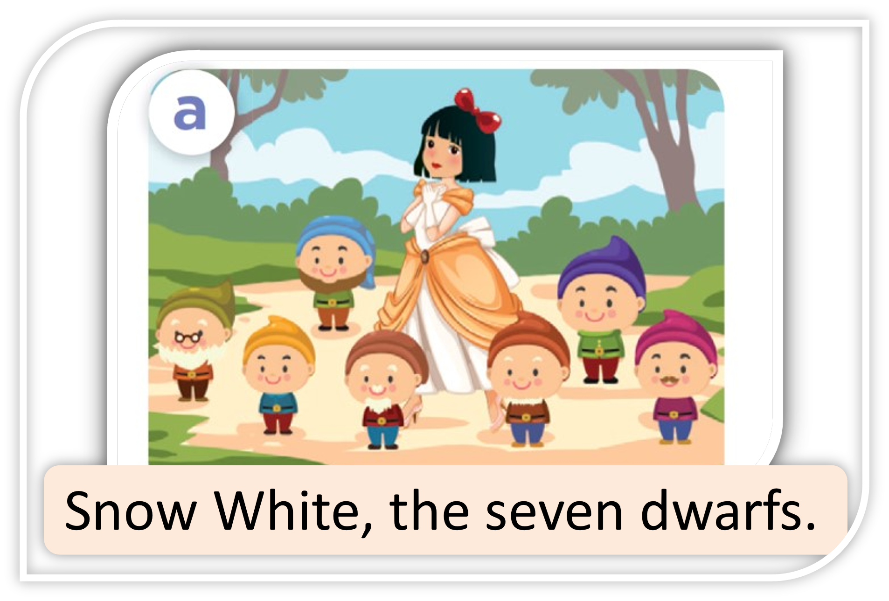
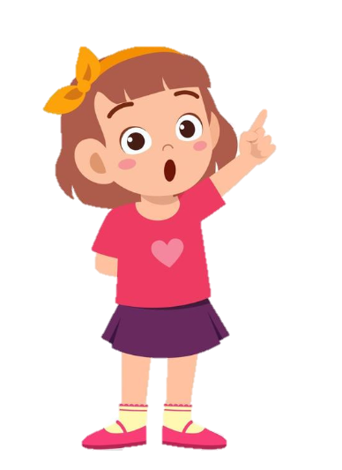
Listen, point and say.
They’re Snow White and the seven dwarfs.
Who are the
main characters
in the story?

Slide 19
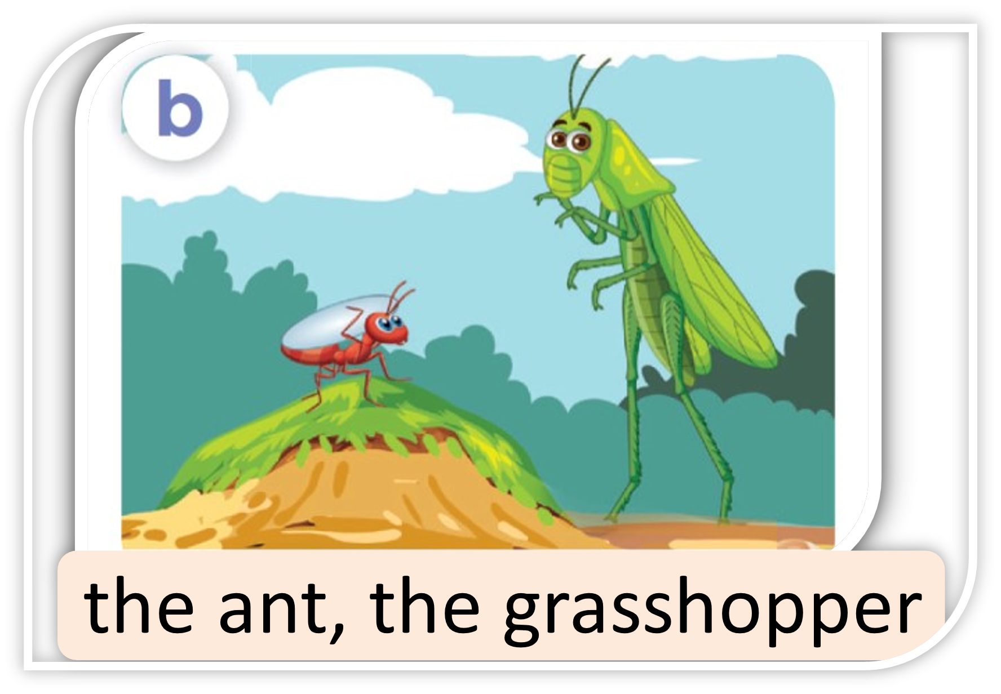
Listen, point and say.
They’re the ant and
the grasshopper.
Who are the main characters in the story?

Slide 20
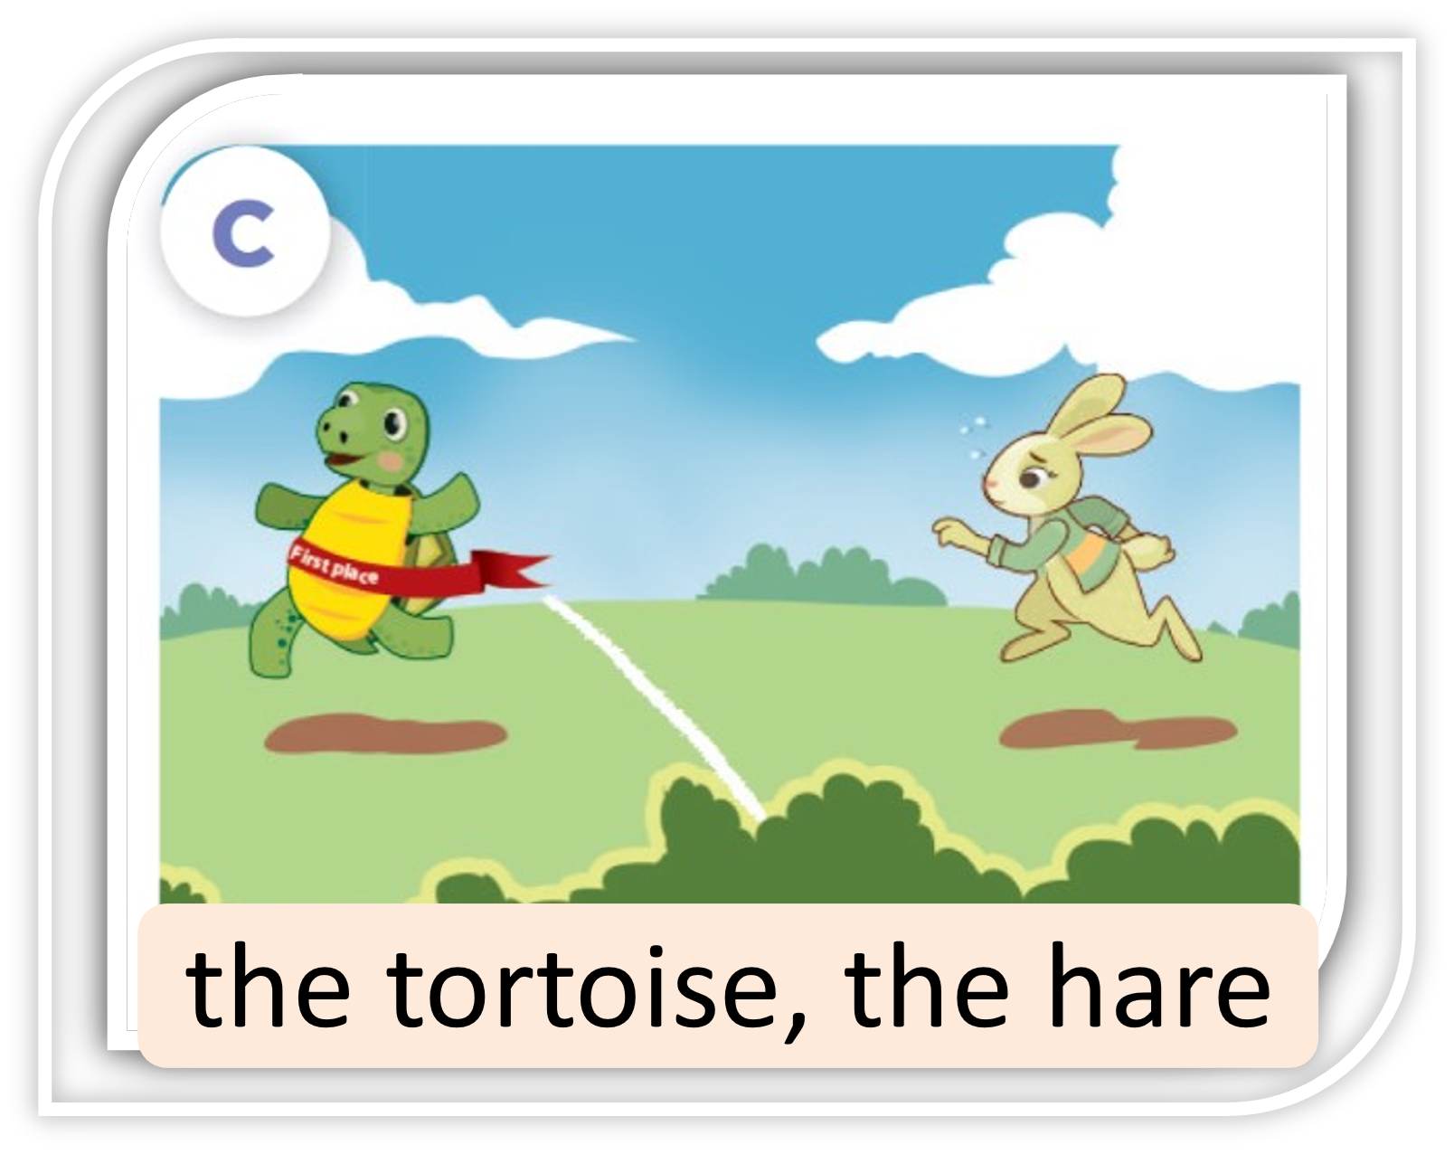
Listen, point and say.
They’re the tortoise
and the hare.
Who are the main characters in the story?

Slide 21
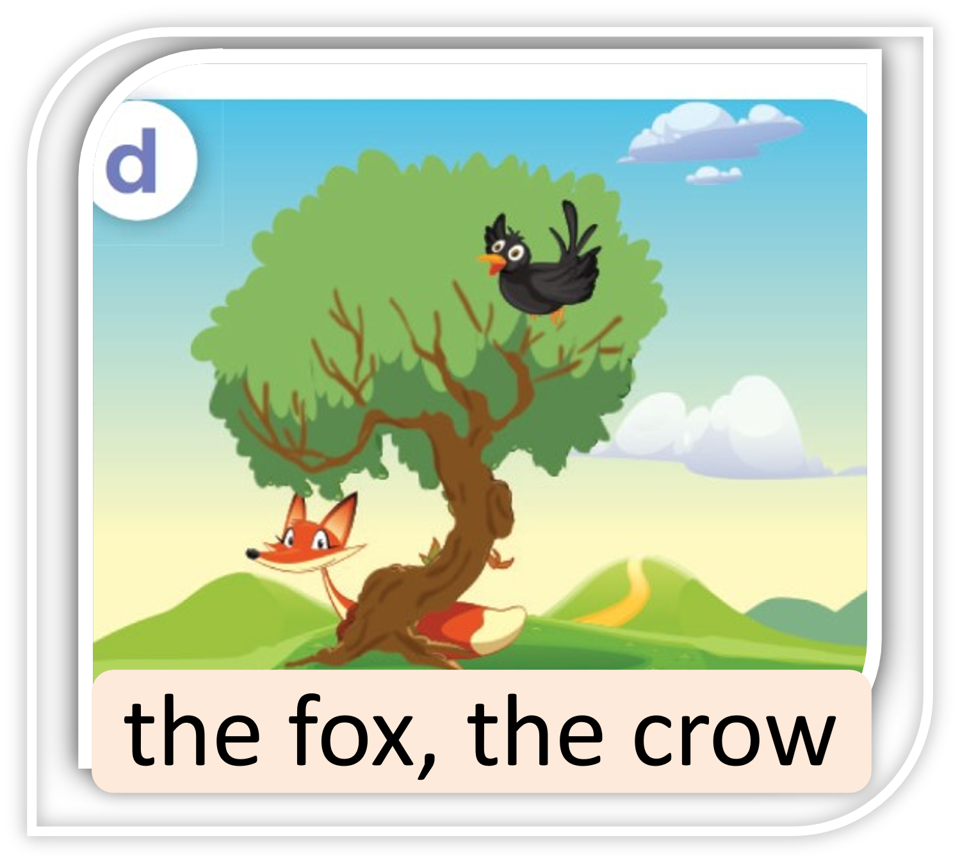
Listen, point and say.
They’re the fox
and the crow.
Who are the main characters in the story?

Slide 22


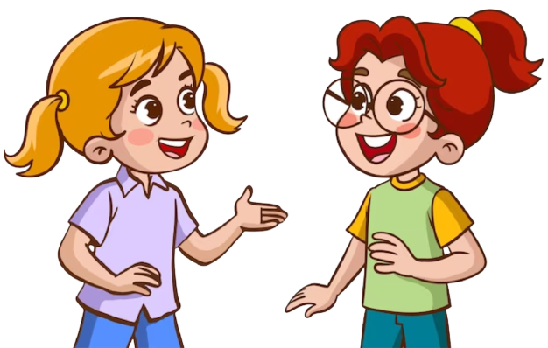
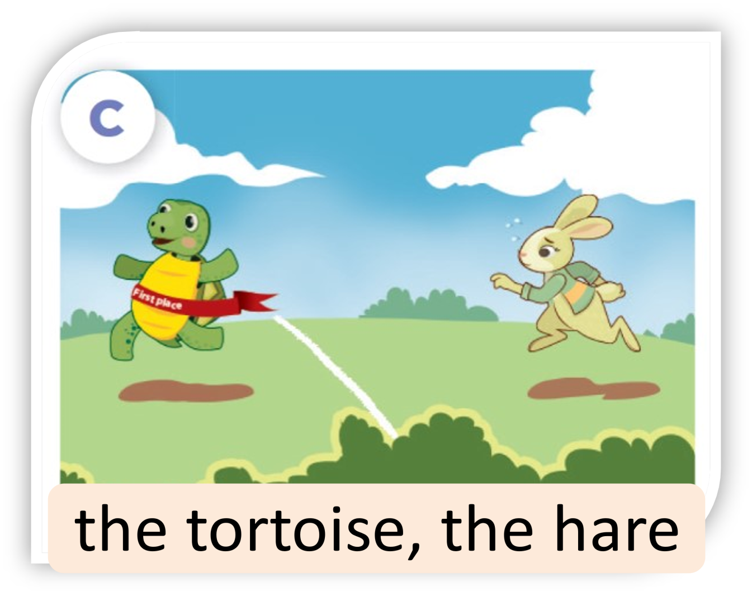

Ask and answer.

Slide 23
04
Let’s talk.

Slide 24


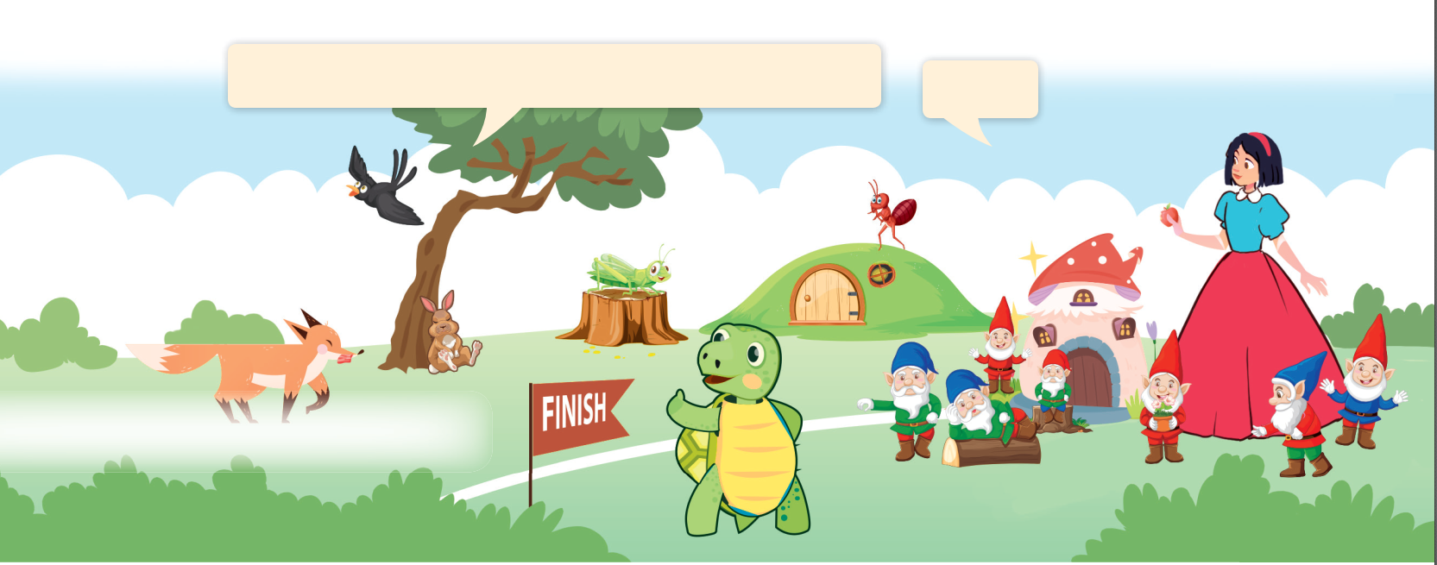
Look and say.

Slide 25
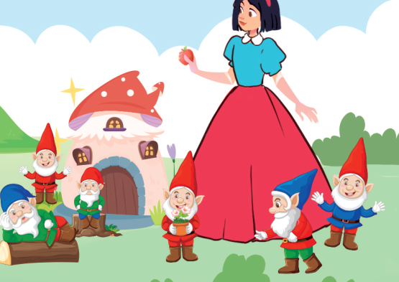
Look, read and answer.
Who are the main characters in the story?
They’re ____________.

Slide 26

Ask and answer.

Slide 27
Look, read and answer.
Who are the main characters in the story?
They’re Snow White and the seven dwarfs.

Slide 28
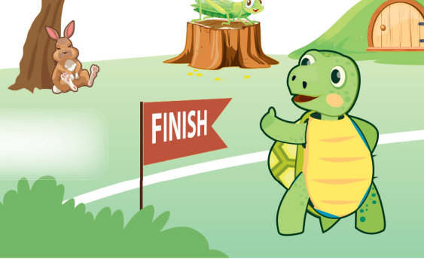
Look, read and answer.
Who are the main characters in the story?
They’re the Tortoise and the Hare.

Slide 29
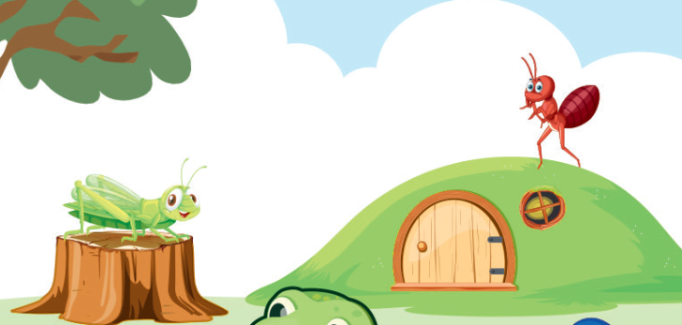
Look, read and answer.
Who are the main characters in the story?
They’re the Ant and the Grasshopper.

Slide 30
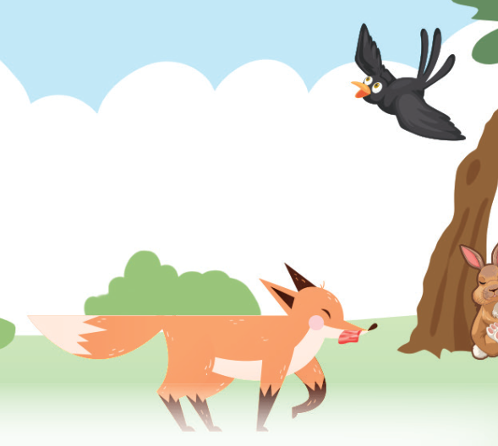
Look, read and answer.
Who are the main characters in the story?
They’re the Fox and the Crow.

Slide 31
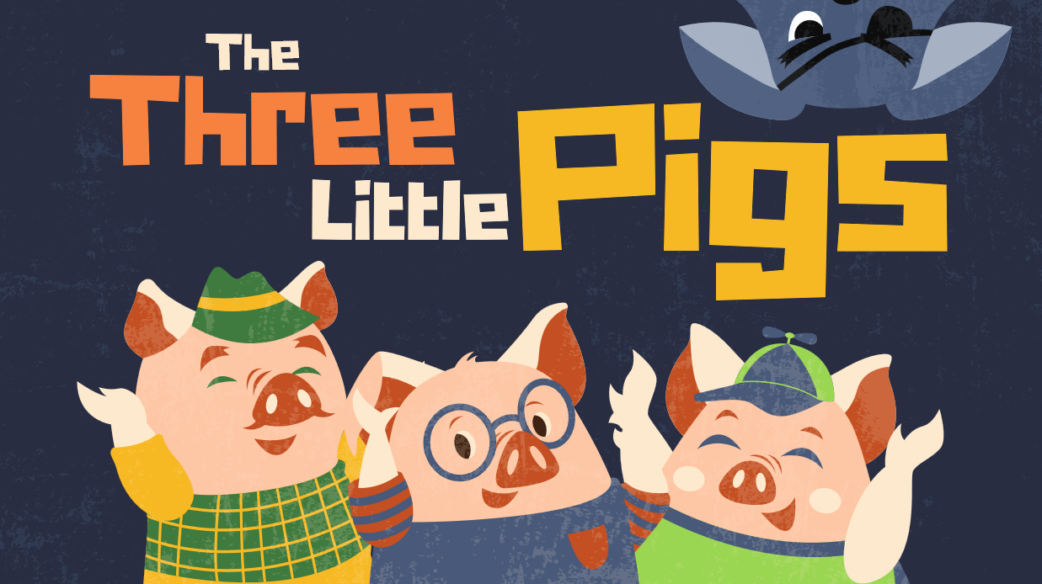
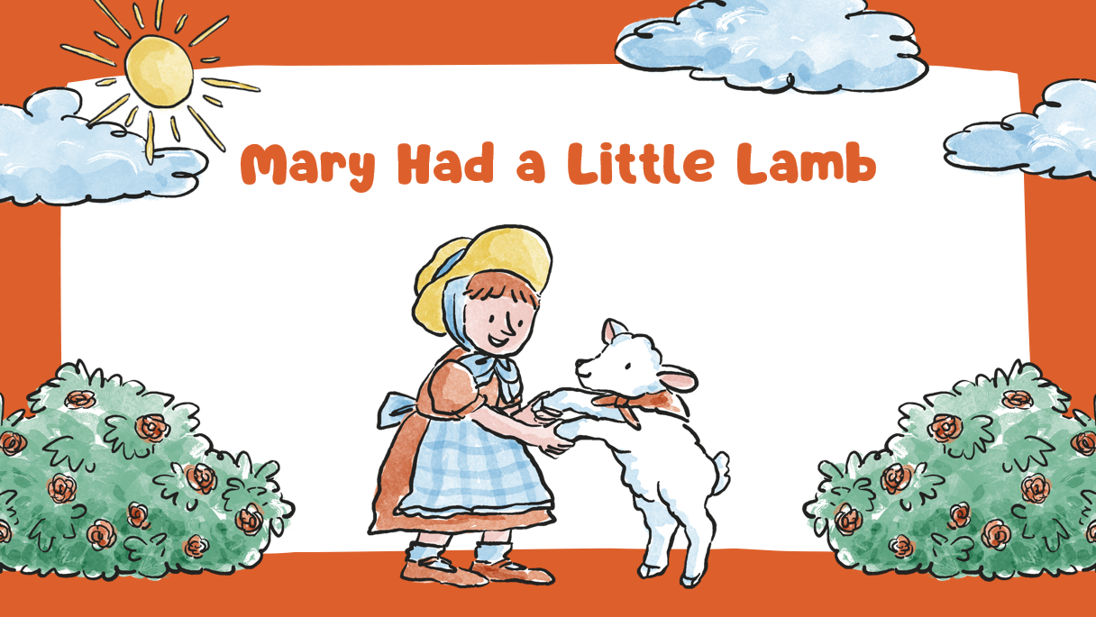
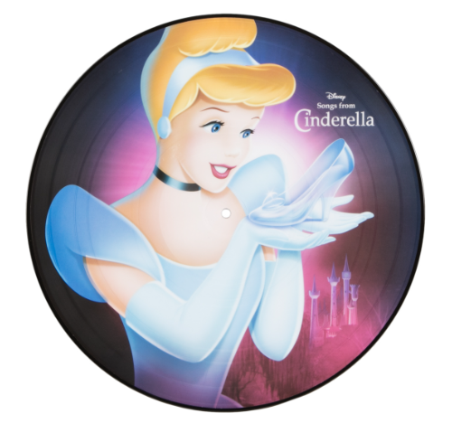



Think more about your stories.

