Slide 2






UNIT 17
STORIES
FOR CHILDREN
Lesson 1 – Period 2

Slide 3











Table of Contents
Warm-up and Review
Listen and circle.
Read and complete.
Let’s play.
Fun corner and Wrap-up

Slide 4


01
Warm-up and review

Slide 5
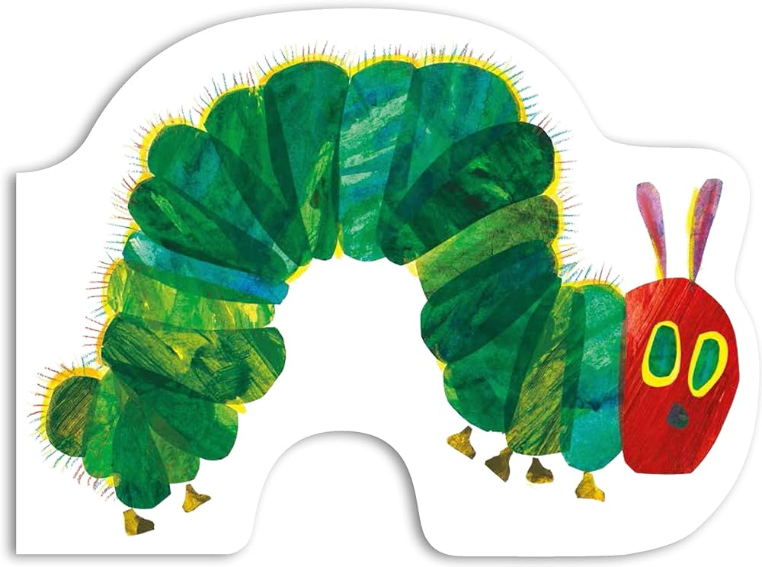

Hidden Picture
caterpillar

Slide 6
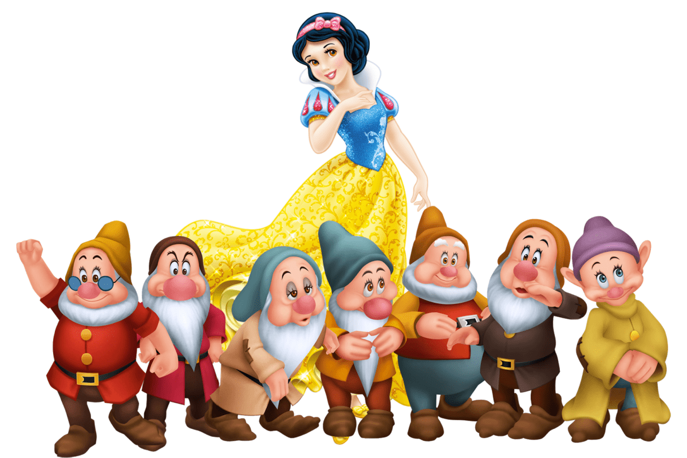
Hidden Picture
Snow White and the seven dwarfs

Slide 7
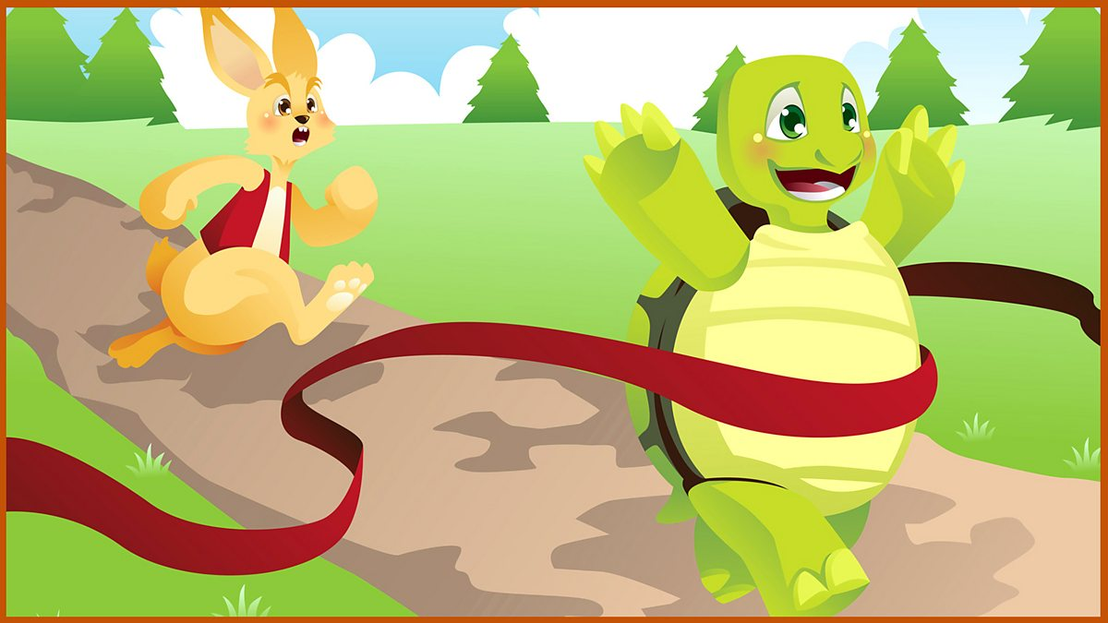
Hidden Picture
The tortoise and the hare

Slide 8
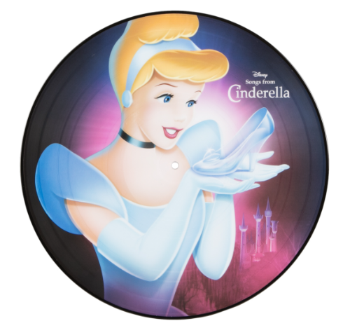
Hidden Picture
Cinderella

Slide 9
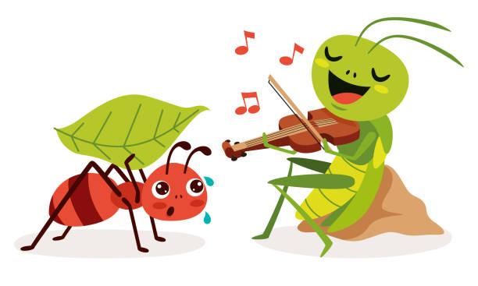
Hidden Picture
the ant and the grasshopper

Slide 10
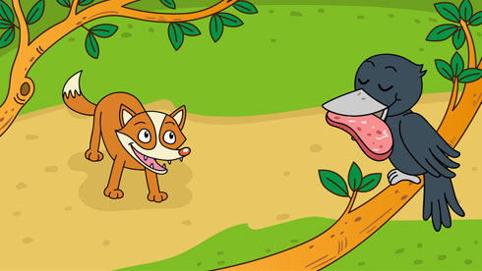
Hidden Picture
the fox and the crow

Slide 11



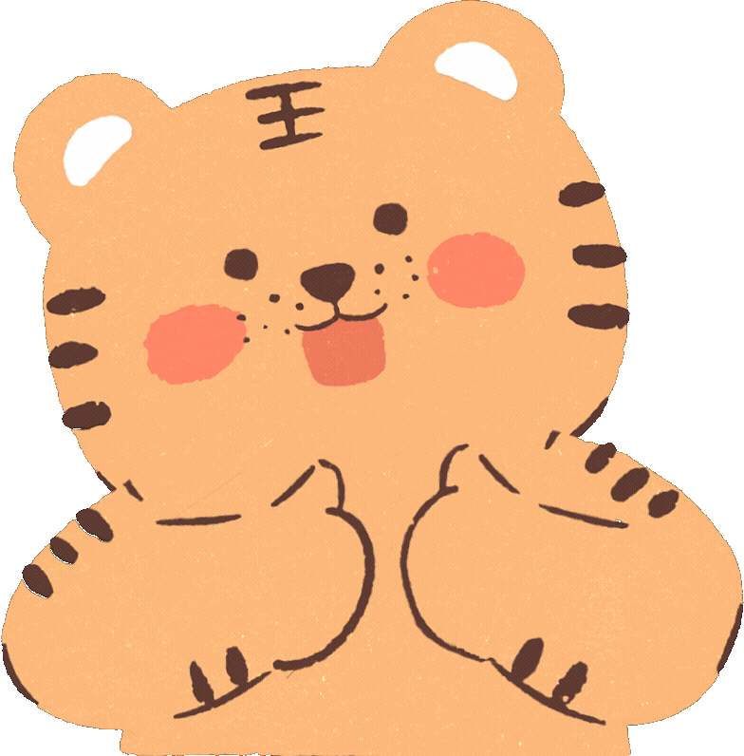



Slide 12
02
Listen and circle.

Slide 13


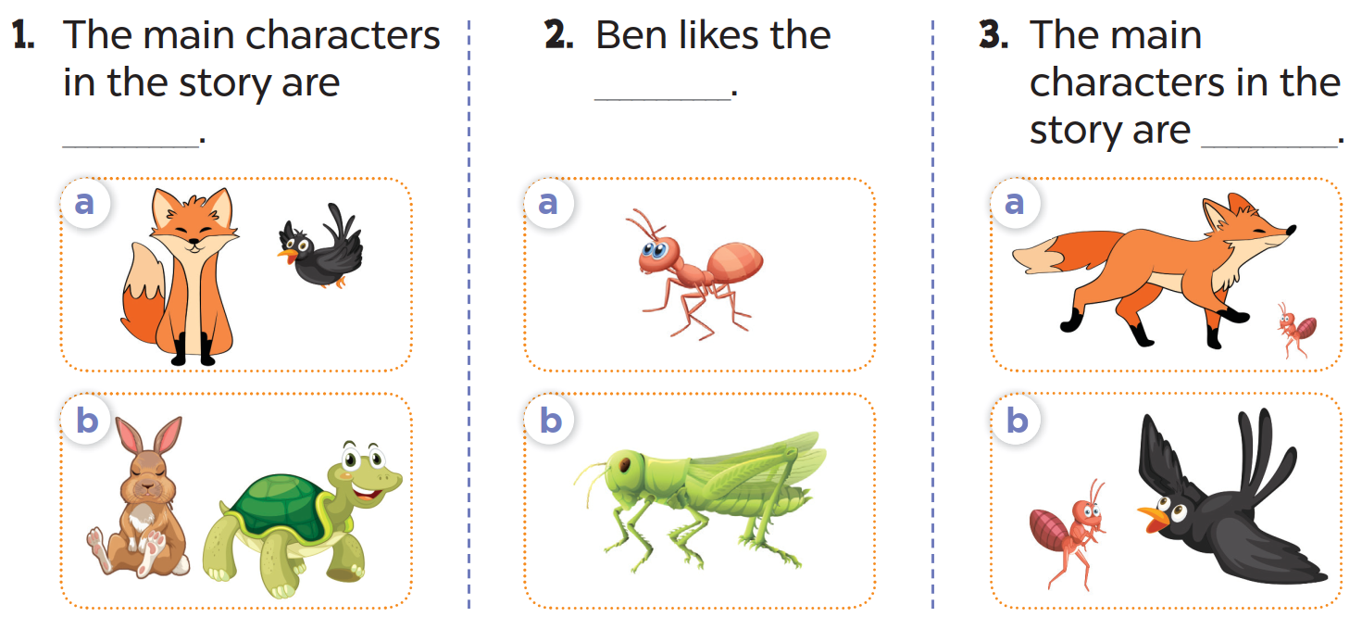
Look and answer.
crow
ant
fox
hare
tortoise
grasshopper

Slide 14
Listen and circle.

Slide 15
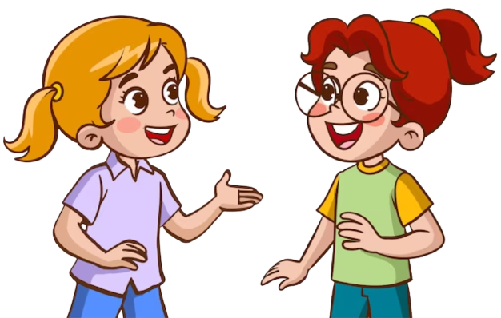
Ask and answer.

Slide 16
Let’s check the answers.

Slide 17

Listen and tell the story.

Slide 19
03
Read and complete.

Slide 20

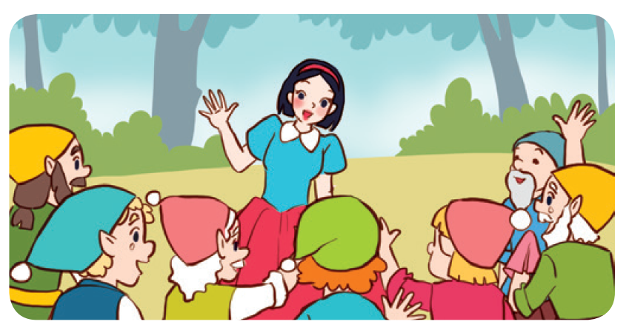
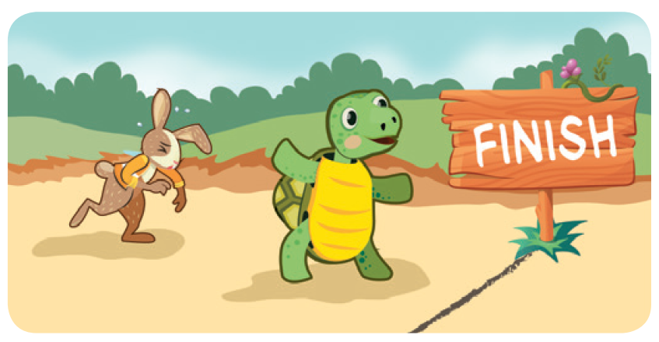
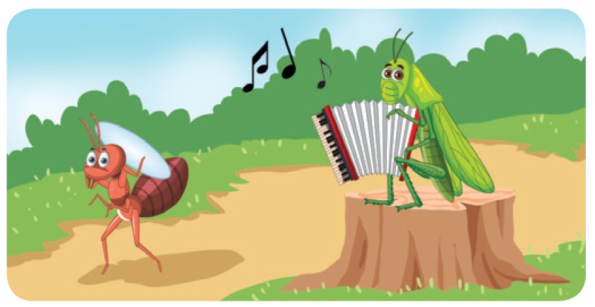
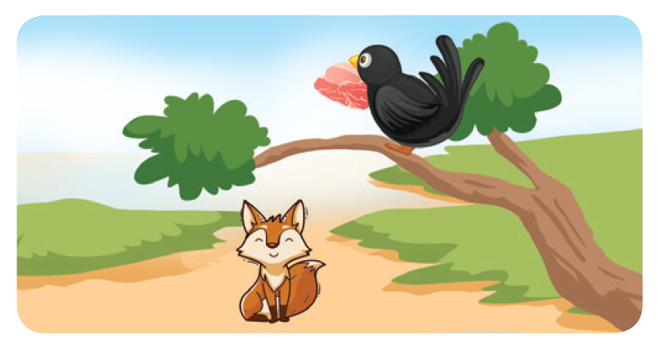
Look and say.
Snow White, the seven dwarfs
the tortoise, the hare
the ant, the grasshopper
the fox, the crow

Slide 21
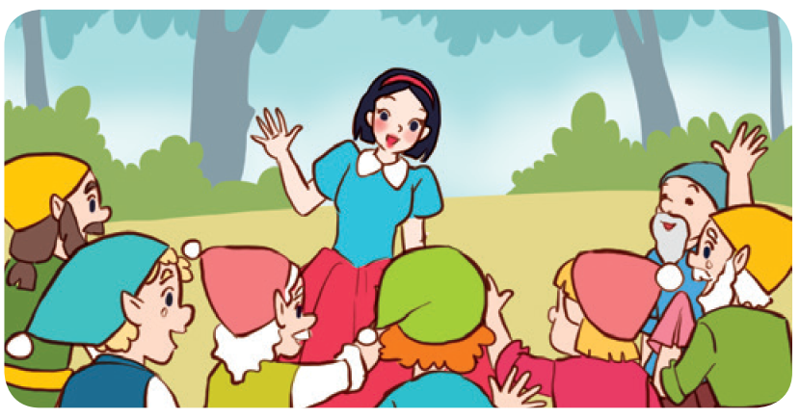
Read and complete.
1.
A: Look at the story.
Who are the main
characters?
B: They’re ______________
and the seven dwarfs.
Snow White

Slide 22
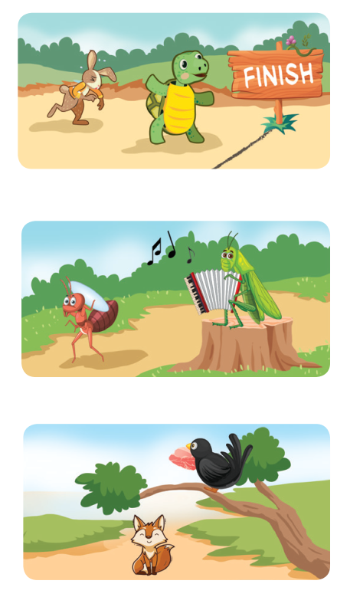
Read and complete.
2. A: Are the hare and the ___________ the main
characters in this story?
B: Yes, they are.
3. A: Are the ___________ and the grasshopper
the main characters in this story?
B: Yes, they are.
A: Which ___________ do you prefer?
B: I prefer the ant.
4. A: What story are you ___________?
B: I’m reading The Fox and the Crow.
A: Do you like the ___________ or the crow?
B: I like the fox.

Slide 23
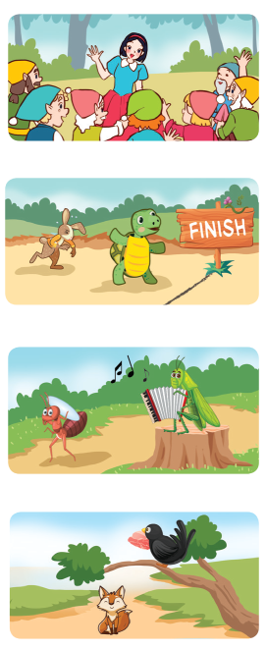
Work in pairs. One is A and the other is B.
1. A: Look at this story. Who are the main characters?
B: They’re ___________ and the seven dwarfs.
2. A: Are the hare and the ___________ the main
characters in this story?
B: Yes, they are.
3. A: Are the ___________ and the grasshopper
the main characters in this story?
B: Yes, they are.
A: Which ___________ do you prefer?
B: I prefer the ant.
4. A: What story are you ___________?
B: I’m reading The Fox and the Crow.
A: Do you like the ___________ or the crow?
B: I like the fox.

Slide 24
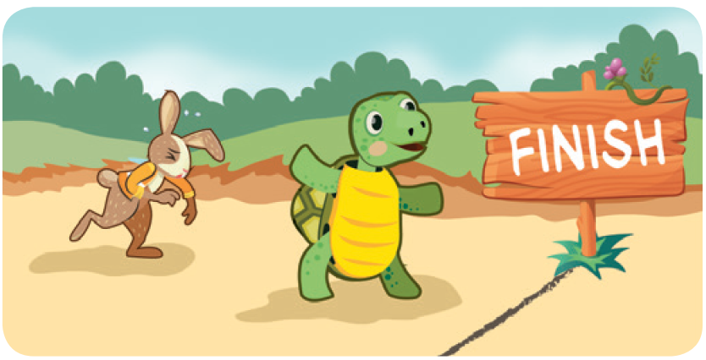
Read and complete.
2.
A: Are the hare and the ________ the main characters in this story?
B: Yes, they are.
tortoise

Slide 25
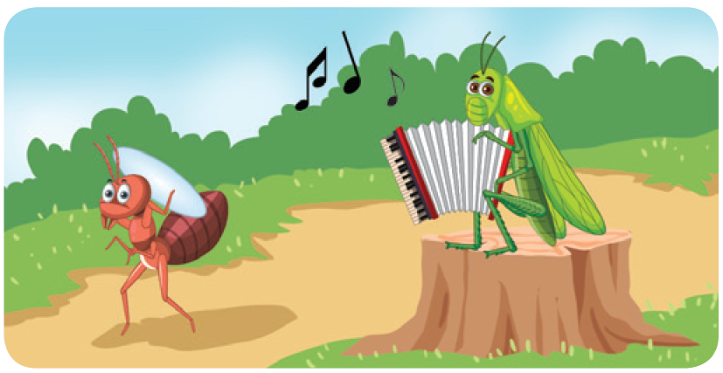
Read and complete.
3.
A: Are the _____ the grasshopper
are the main characters in this story.
B: Yes, they are.
A: Which ________________ do you prefer?
I prefer the ant.
ant
character
/ one

Slide 26
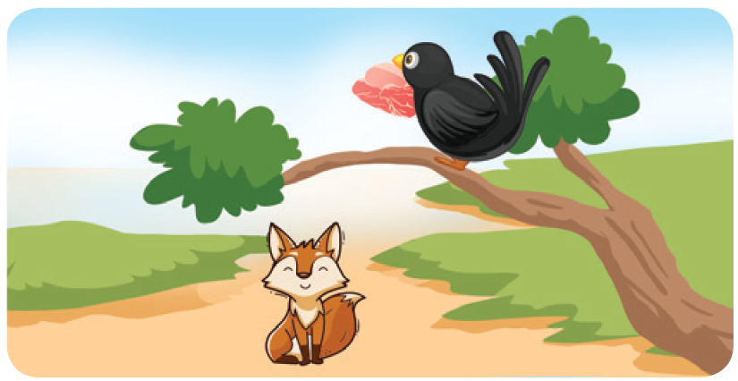
Read and complete.
4.
A: What story are you __________?
B: I’m reading The Fox and the Crow.
A: Do you like the ____ or the crow?
B: I like the fox.
reading
fox

Slide 28
04
Let’s play.

Slide 29


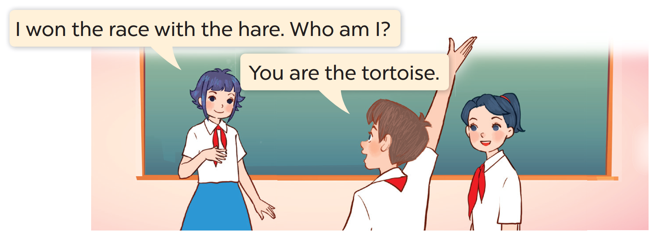
Listen and work in groups.
Who am I?
I won the race with the hare. Who am I?
You are the tortoise.

Slide 30




Score Board
Team 1
Team 5
Team 2
Team 6
Team 3
Team 7
Team 4
Team 8

Slide 31
Talk to your partner.
Who am I?
I won the race with the hare. Who am I?
You are the tortoise.

Slide 33
05
Fun corner and Wrap-up

Slide 34







Pictionary Game

Slide 35



Snow White
Notes:
Whisper to the pupil. He/ She will draw a picture. Then click the “drawing pictures” symbol to show the answer.

Slide 36
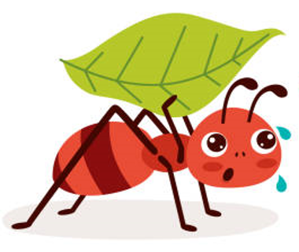
the ant

Slide 37
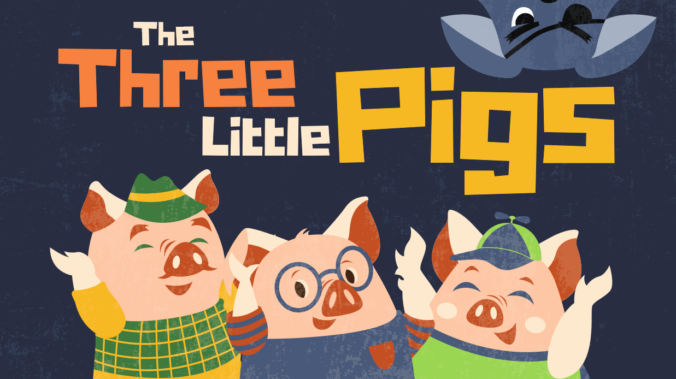
the pig

Slide 38
Cinderella

Slide 39
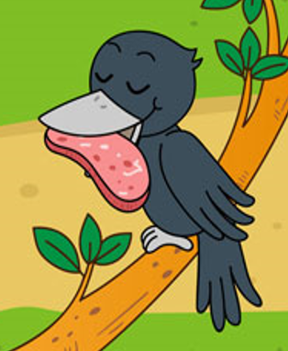
the crow

Slide 40
the hare

Slide 42
Website: hoclieu.vn
Fanpage: https://www.facebook.com/tienganhglobalsuccess.vn/

