Slide 1





UNIT 17
STORIES
FOR CHILDREN
Lesson 2 – Period 3

Slide 2



01
Warm-up and Review

Slide 3

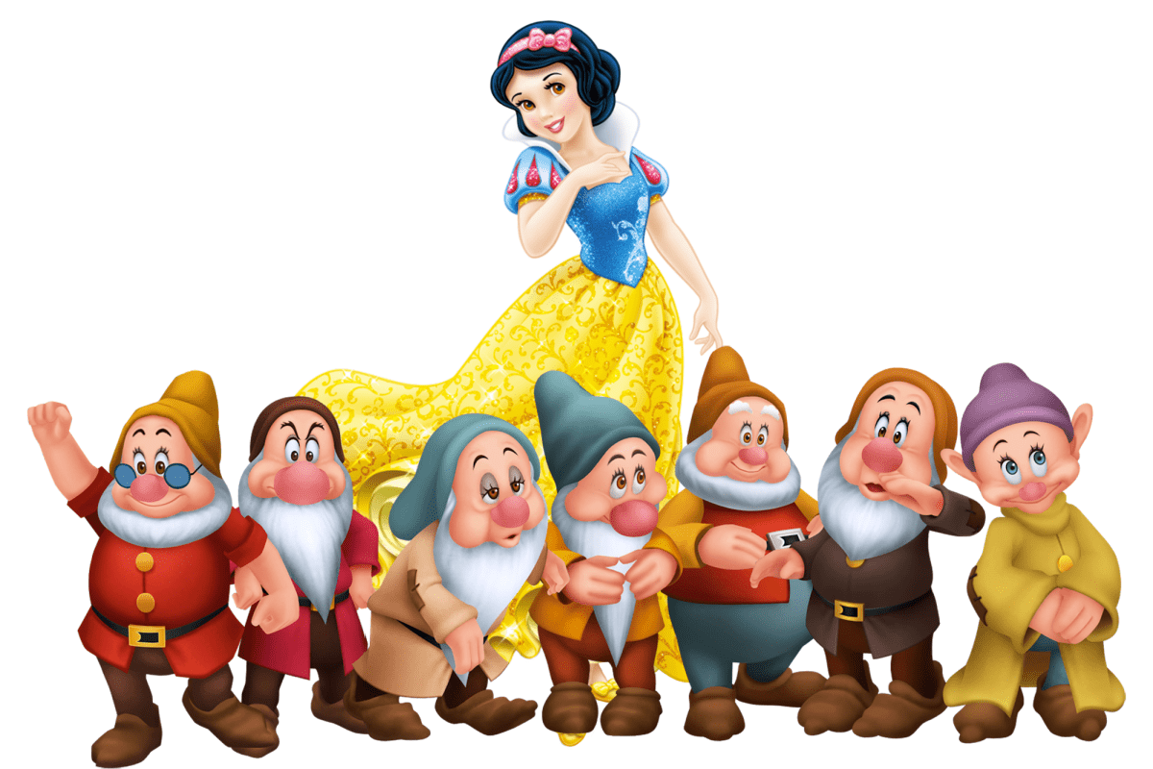

Who are the main characters in this story?
Snow White and the seven dwarfs

Slide 4
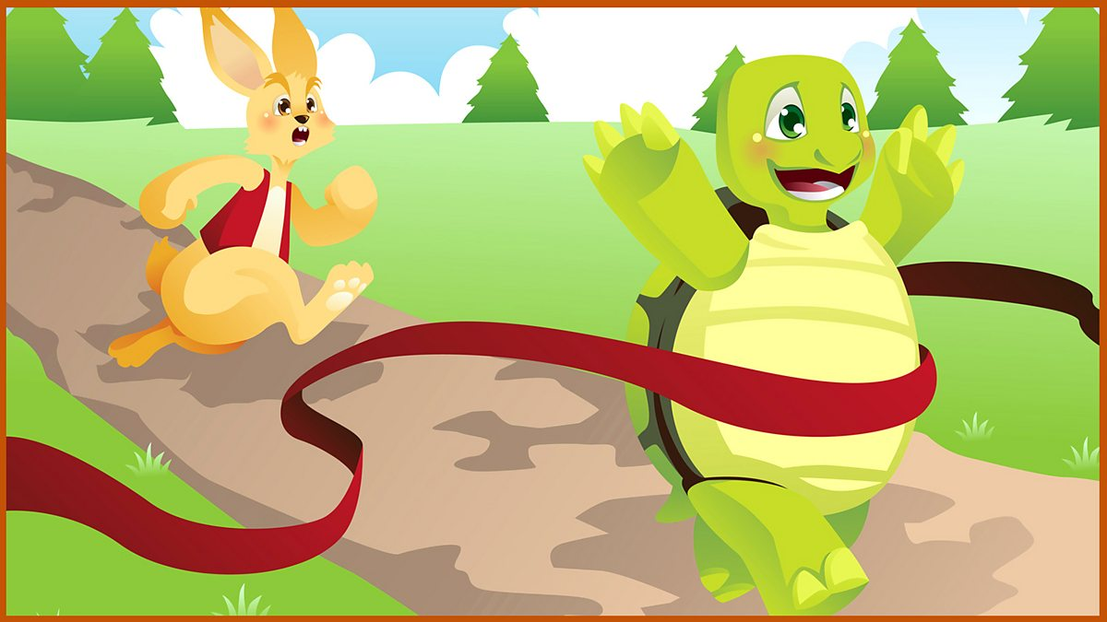
Who are the main characters in this story?
The tortoise and the hare

Slide 5
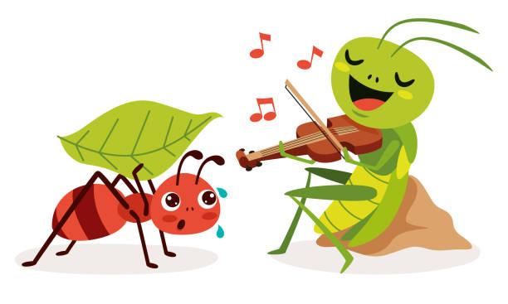
Who are the main characters in this story?
the ant and the grasshopper

Slide 6
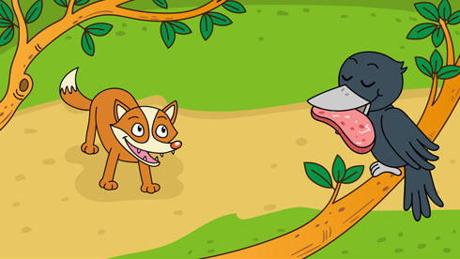
Who are the main characters in this story?
the fox and the crow

Slide 7
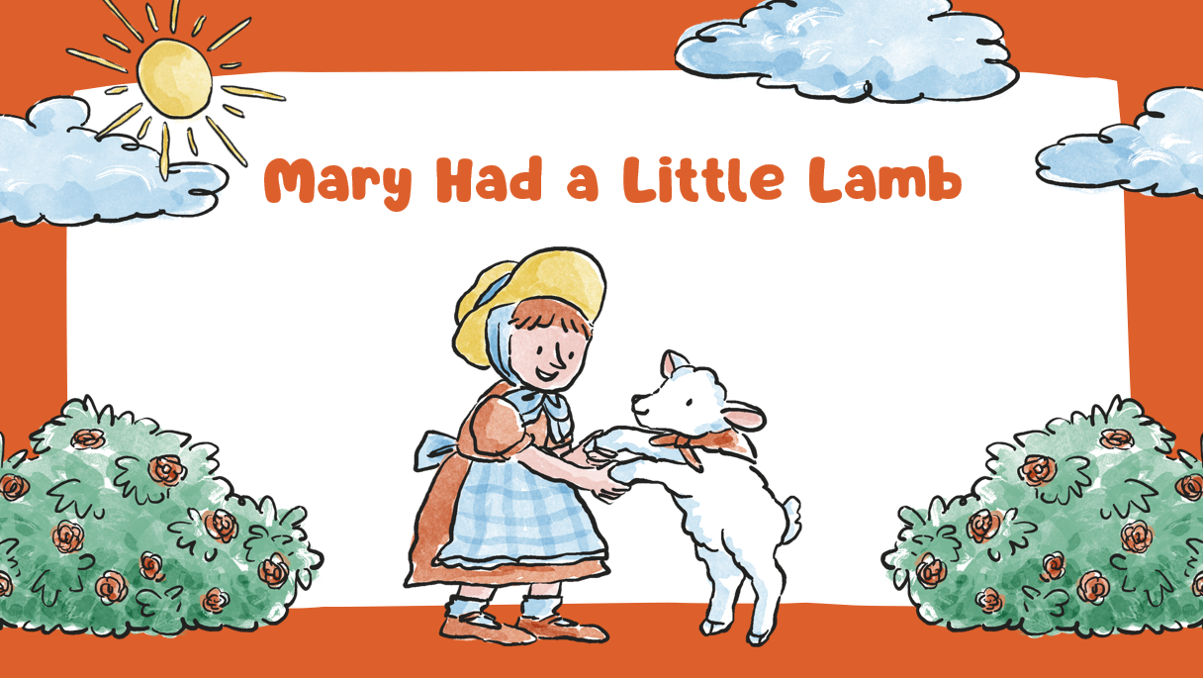
Who are the main characters in this story?
Mary and the lamb

Slide 8
02
Look, listen and repeat.

Slide 9


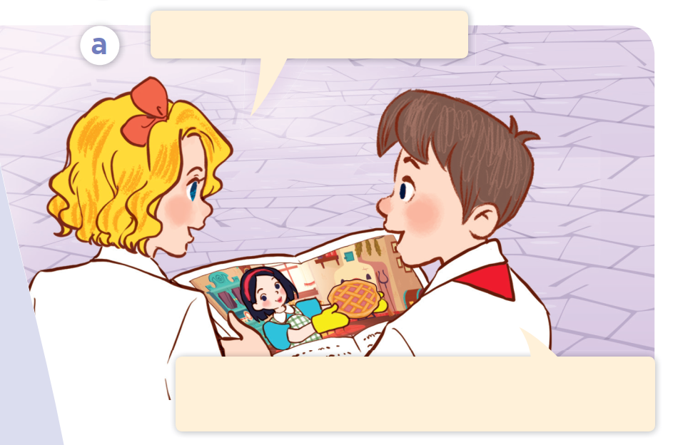

Look and say.

Slide 10
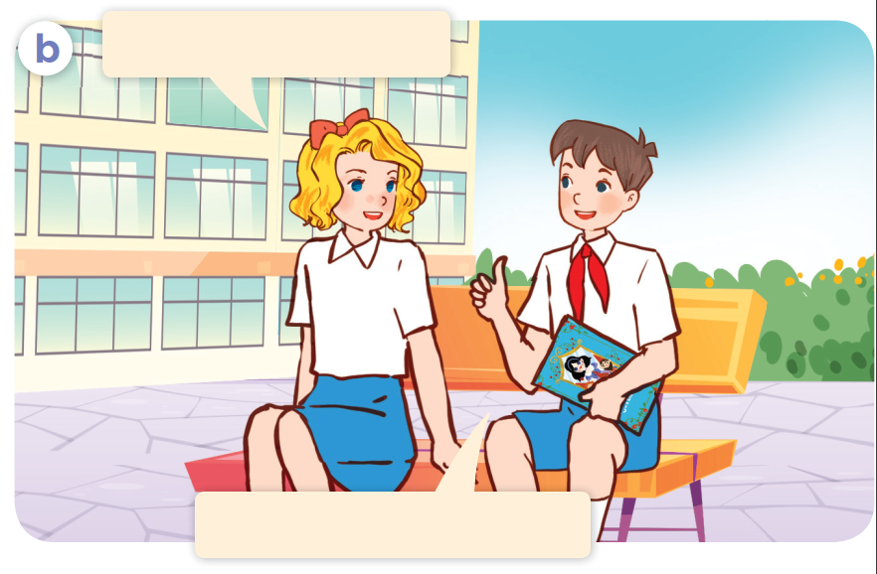
Look and say.

Slide 11

Listen and point.

Slide 12
Listen, point and repeat.
Do you like Snow White?
Yes, I do. She was kind. She cooked
meals every day for the seven dwarfs.

Slide 13
Listen, point and repeat.
How did she cook?
She cooked very well.

Slide 14
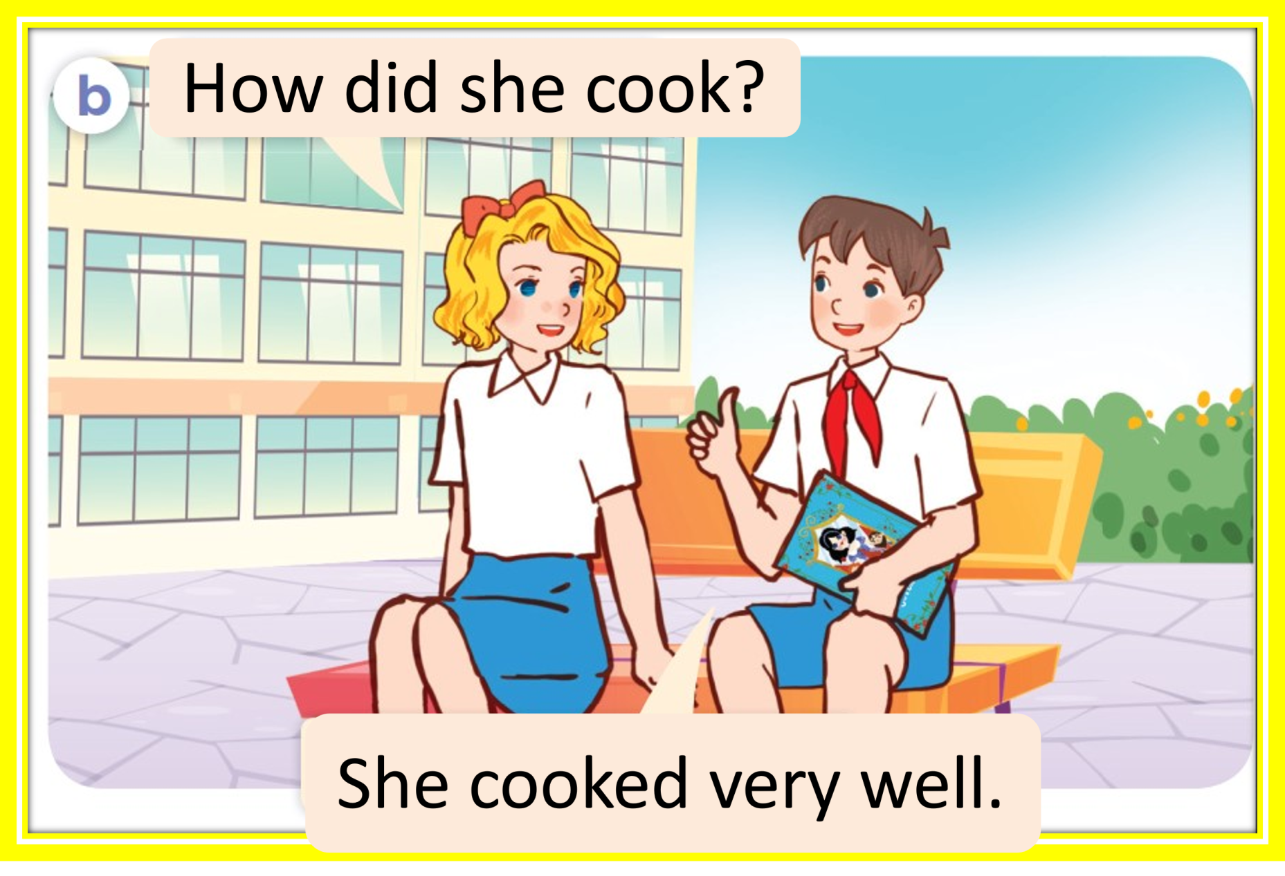
Look and answer.
Do you like Snow White?
Yes, I do. She was kind. She cooked
meals every day for the seven dwarfs.
Notes:
.

Slide 15
Listen and complete.
like
Do you _____Snow White?
cook
How did she ______?
She _______ very well.
cooked

Slide 16
03
Listen, point and say.

Slide 17

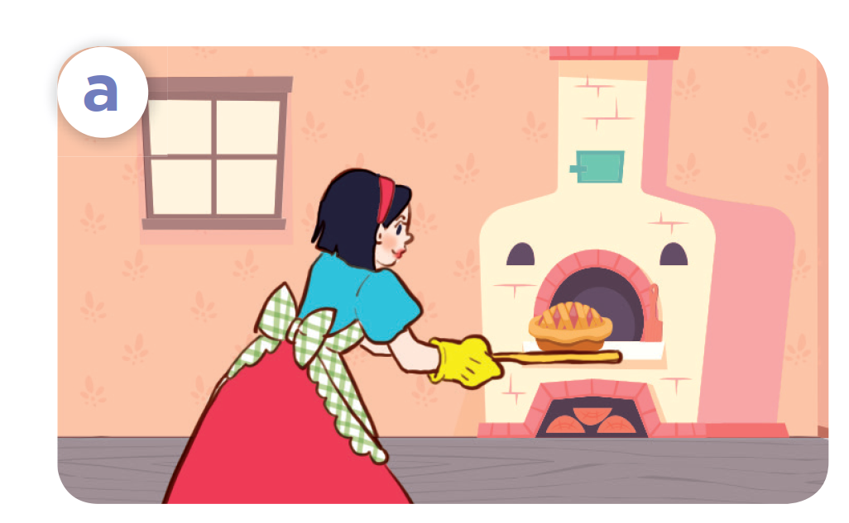
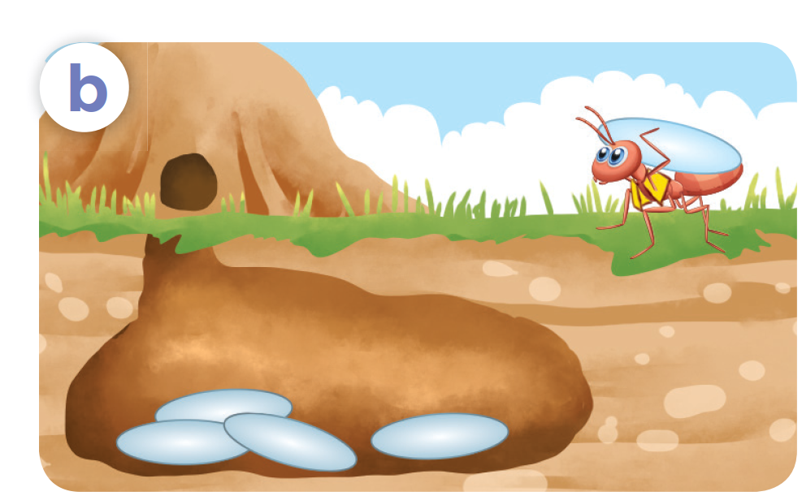
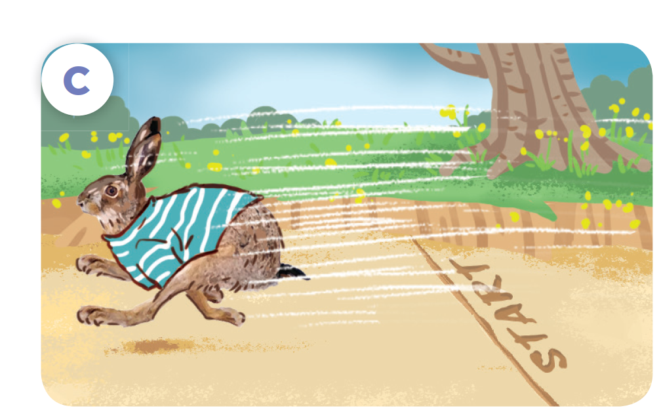
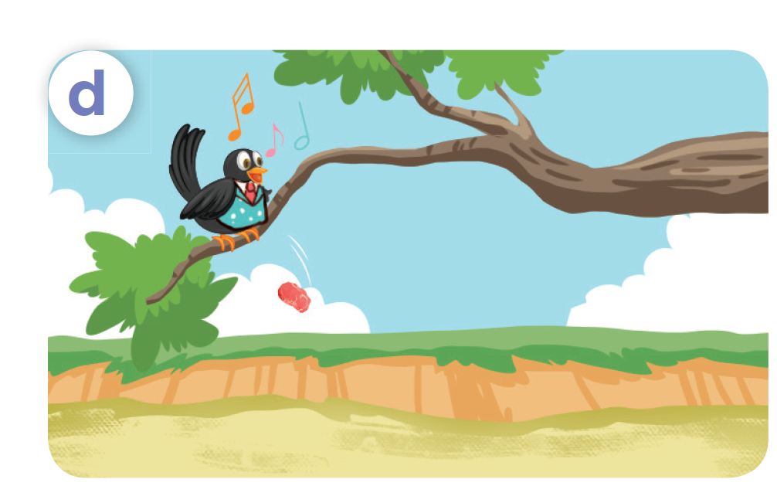

Look and say.
she / cook / cook well
he / work / work hard
he / run / run fast
he / sing / sing beautifully

Slide 18
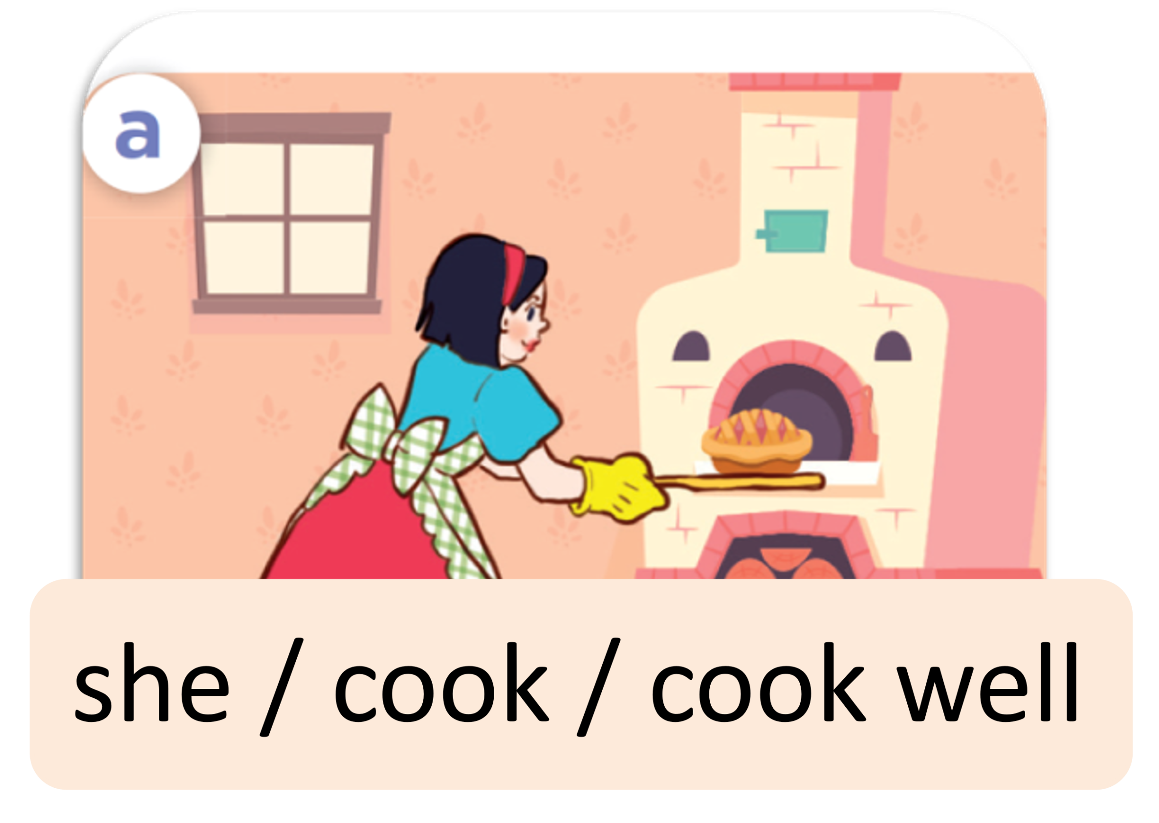
Listen and repeat.
she / cook / cook well

Slide 19
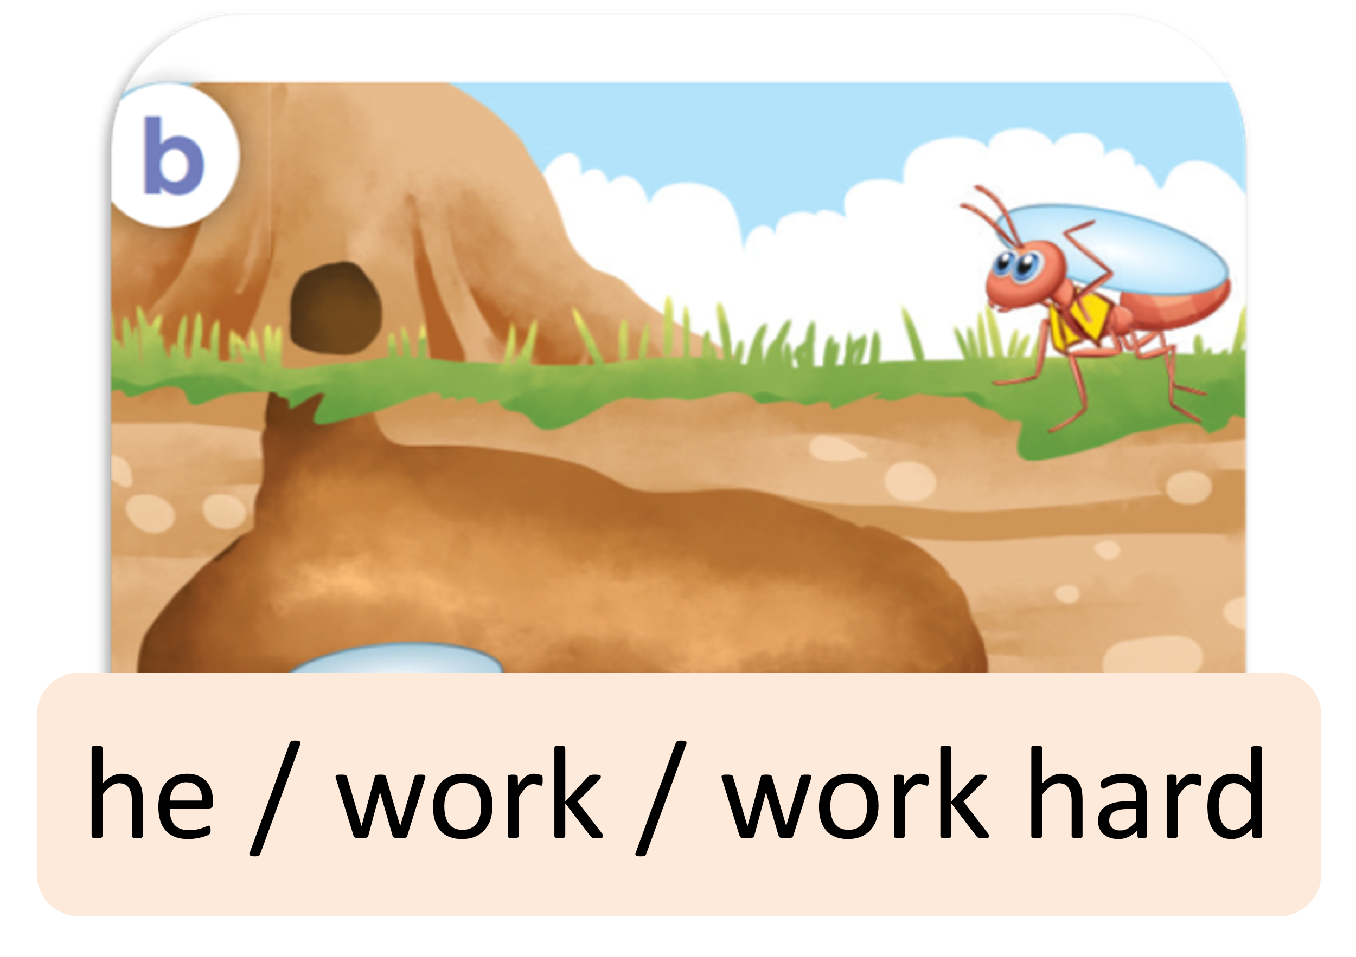
Listen and repeat.
he / work / work hard

Slide 20
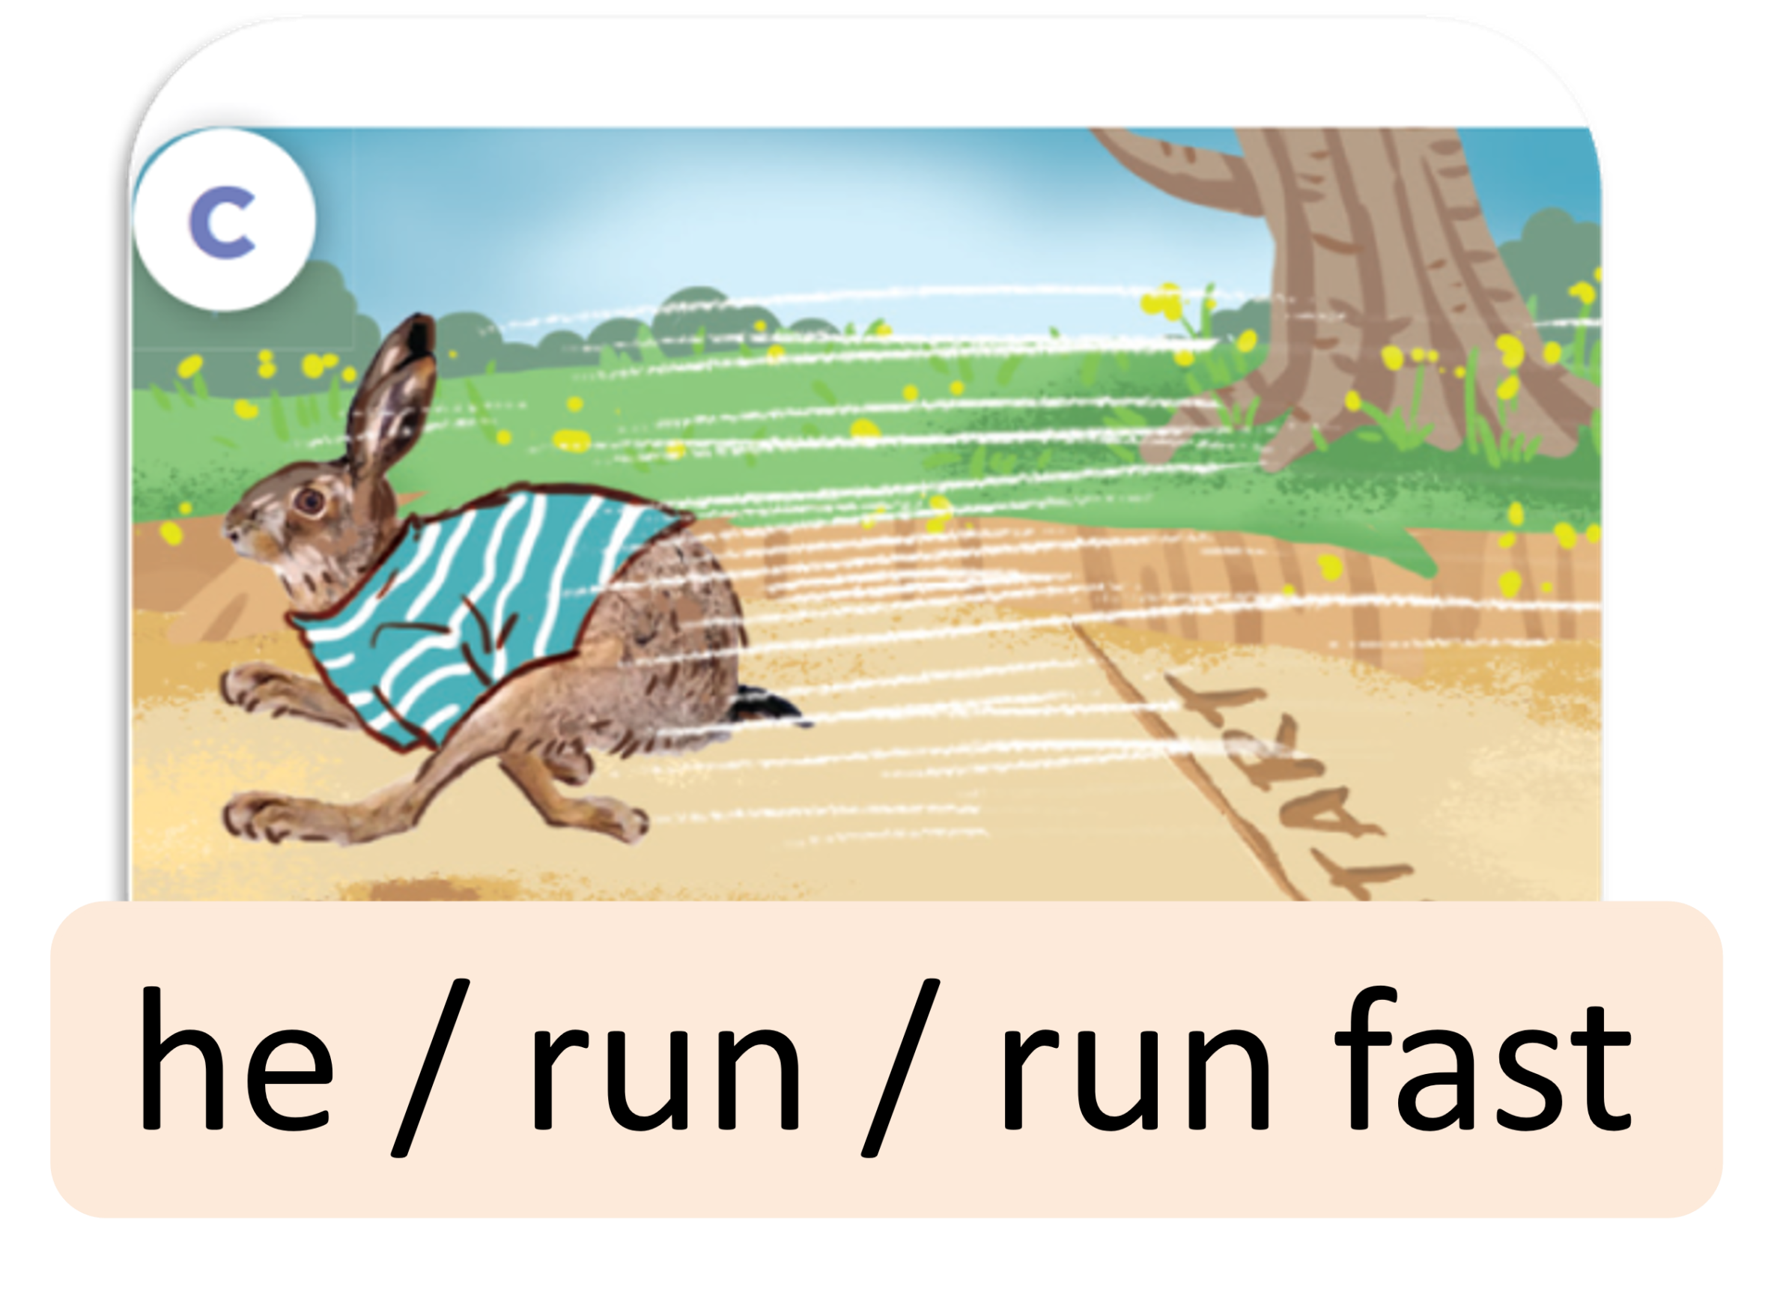
Listen and repeat.
he / run / run fast

Slide 21
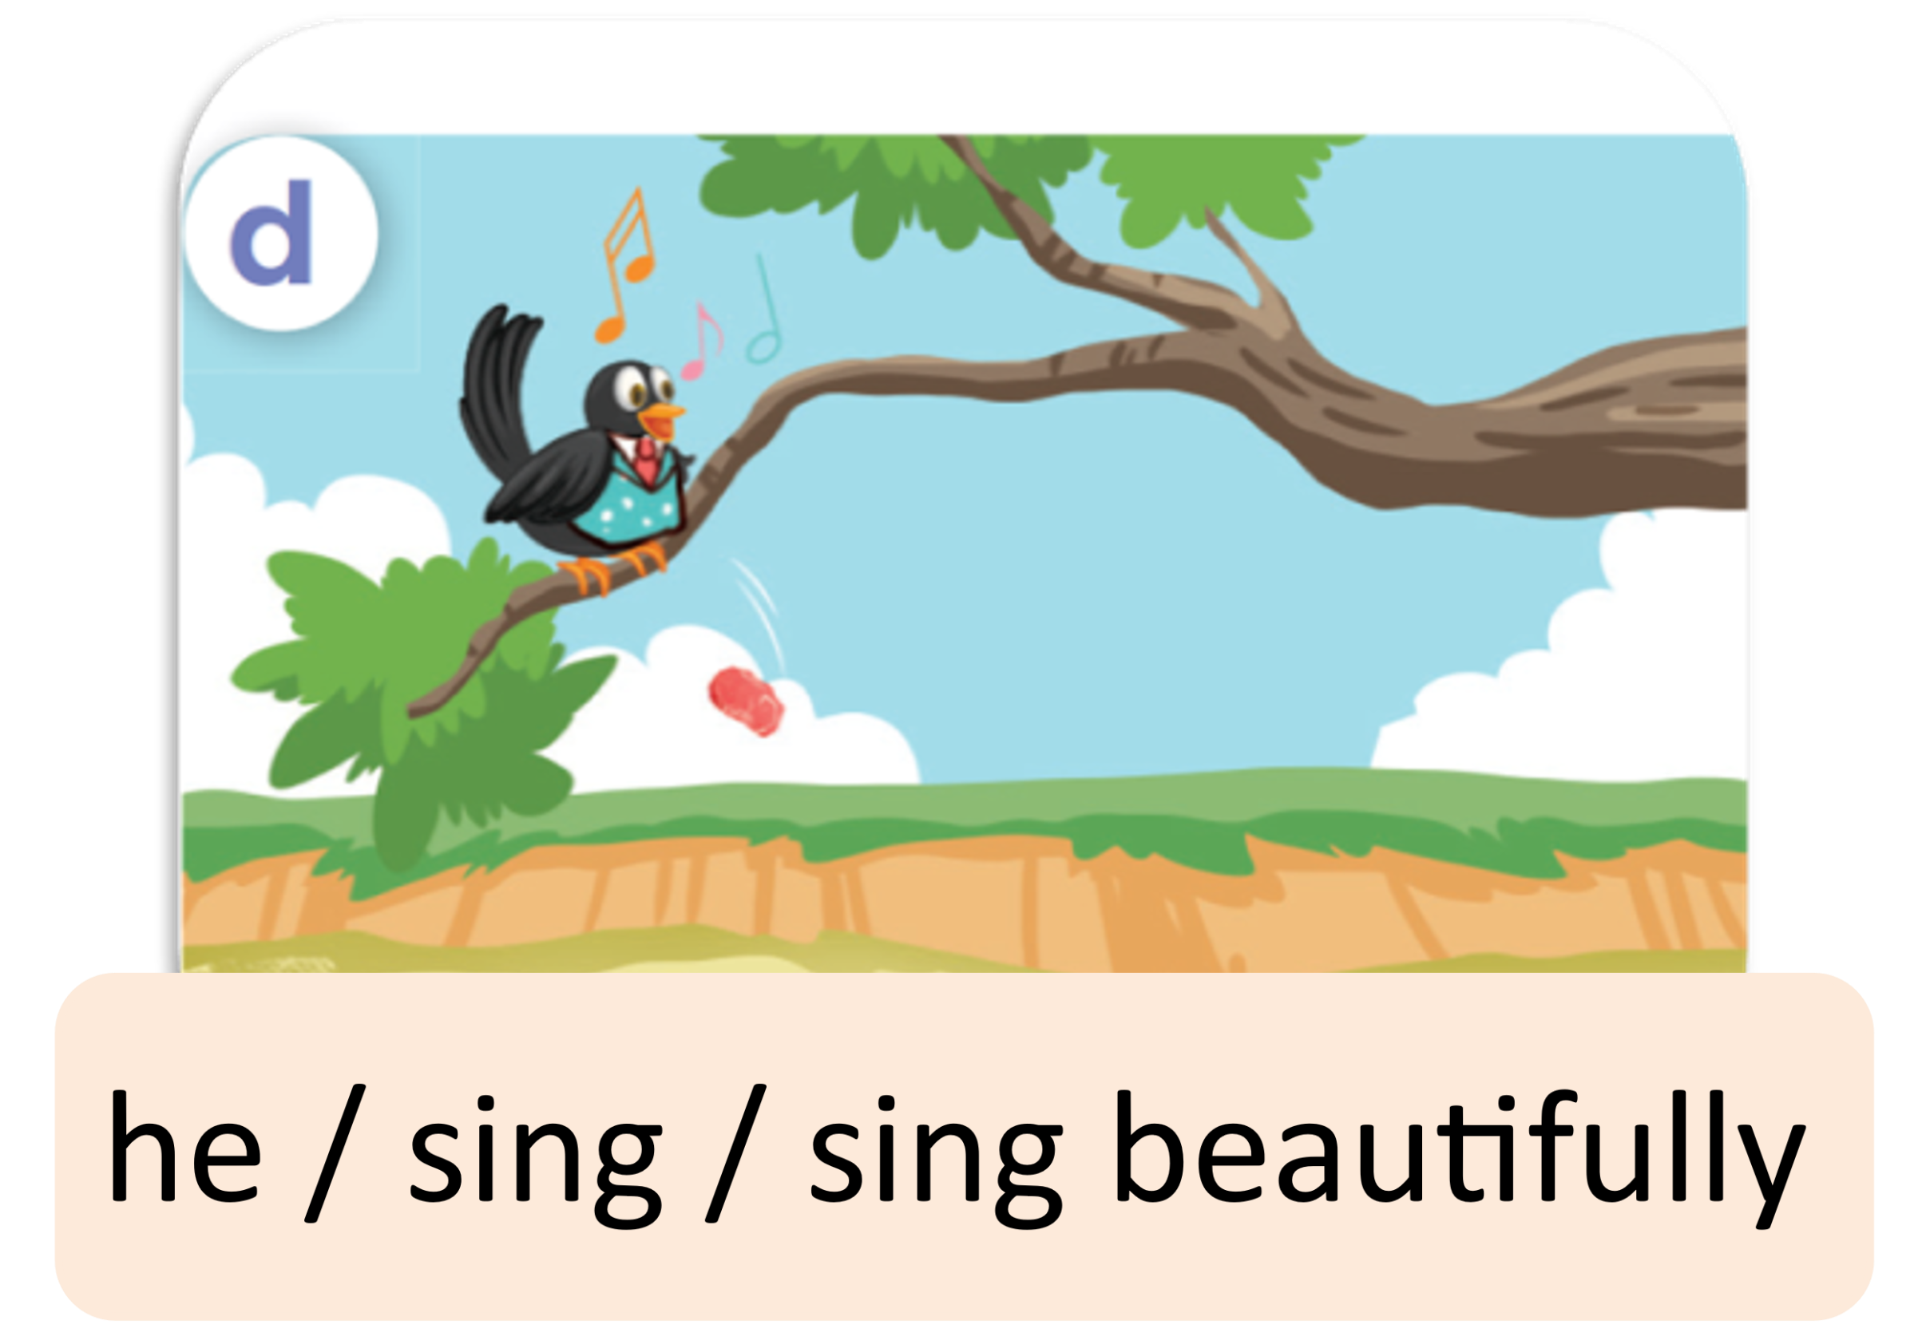
Listen and repeat.
he / sing / sing beautifully

Slide 22

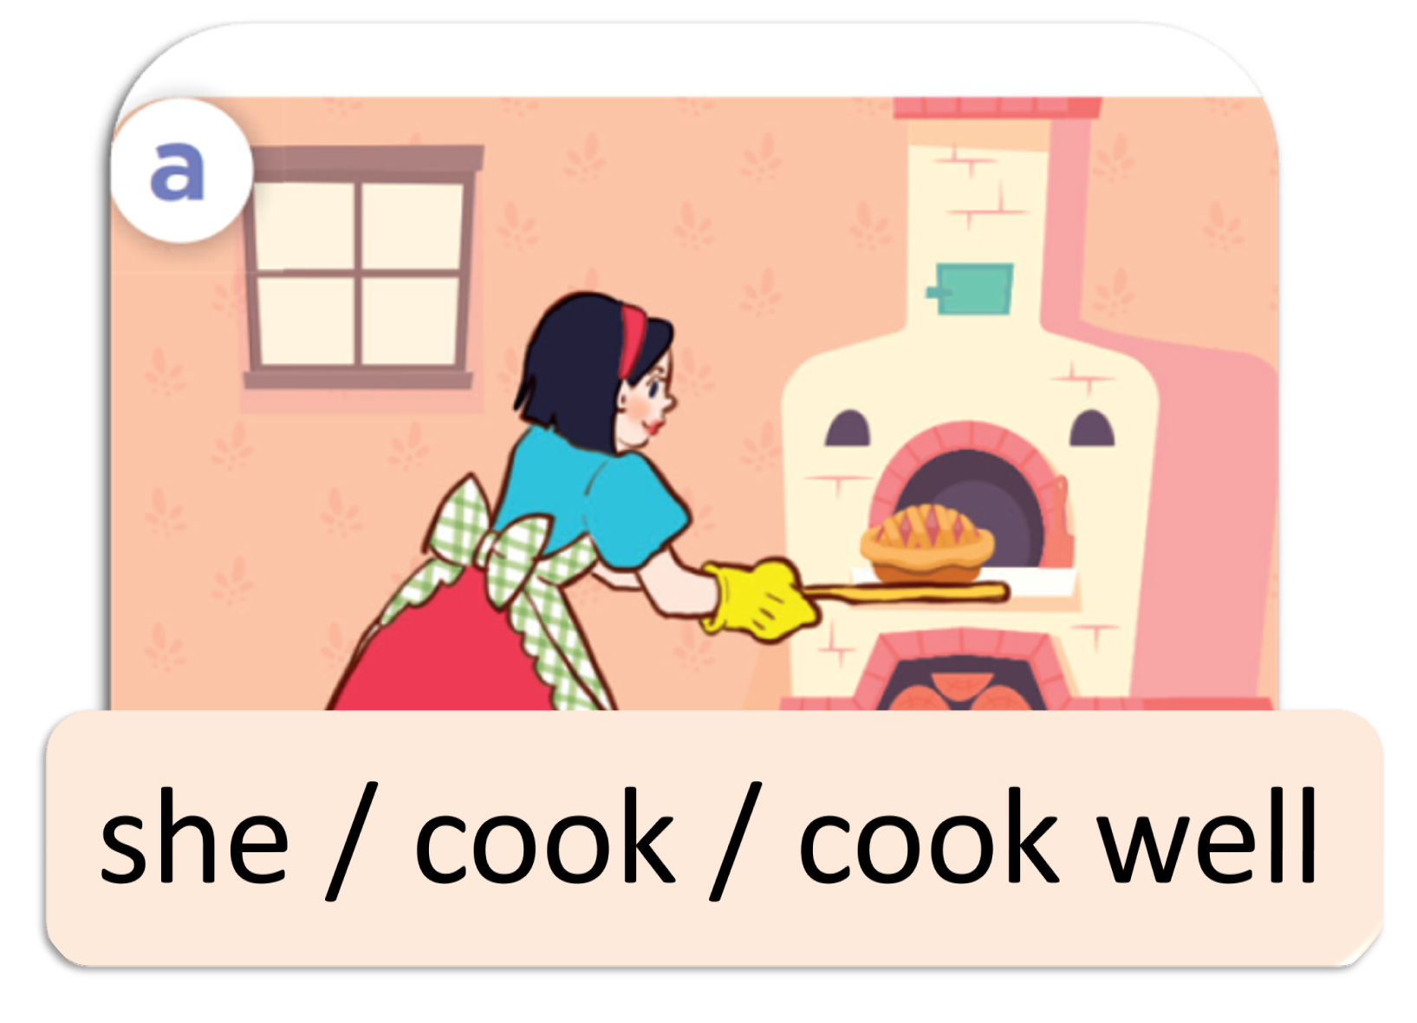
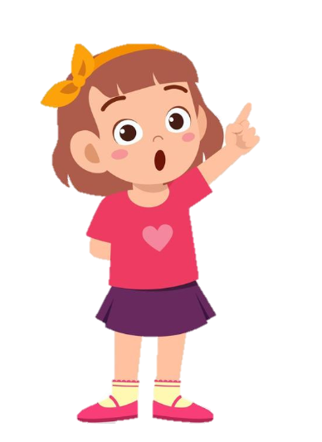
Listen, point and say.
She cooked well.
How did she cook?
she / cook / cook well

Slide 23
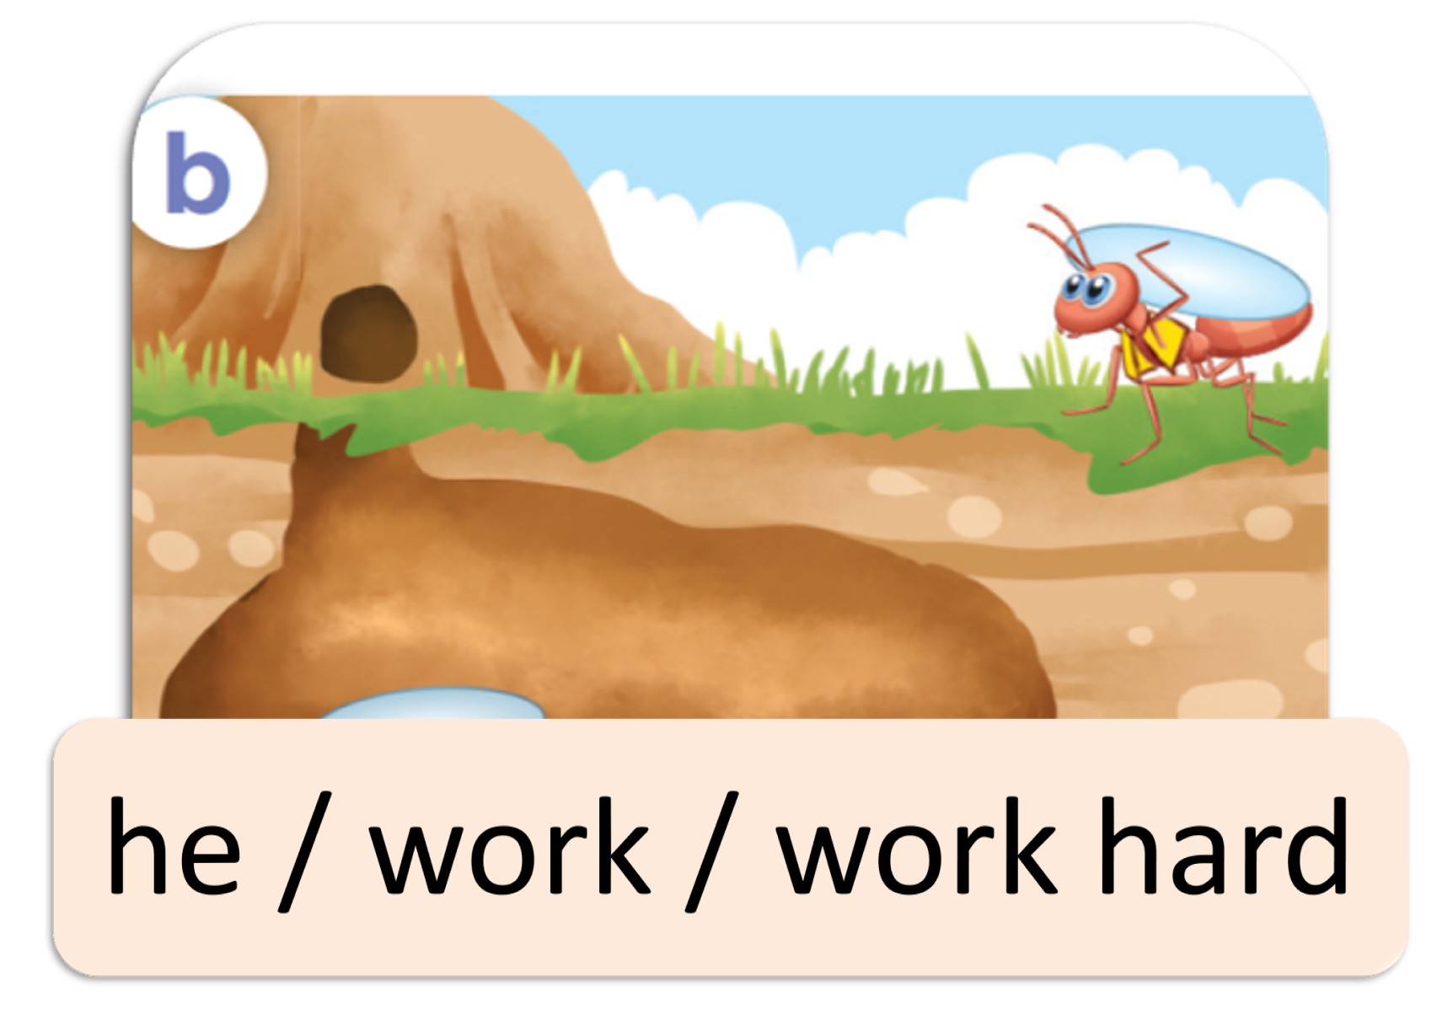
Listen, point and say.
He worked hard.
How did he work?
he / work / work hard

Slide 24
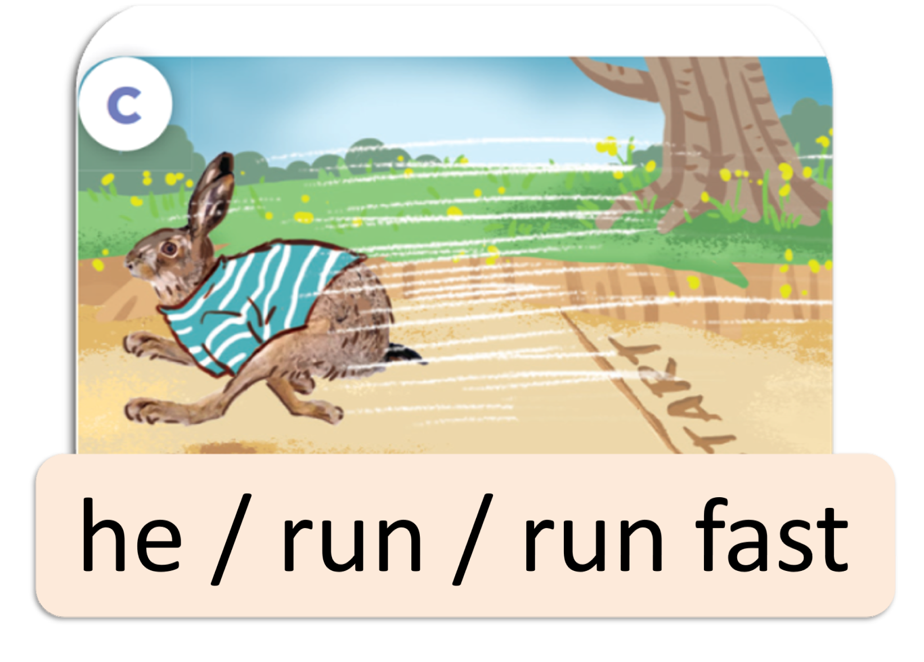
Listen, point and say.
He ran fast.
How did he run?
he / run / run fast

Slide 25
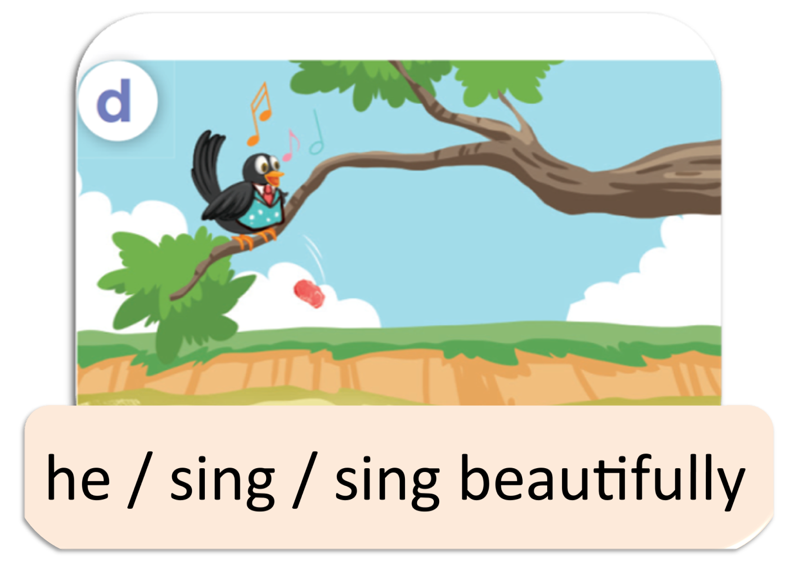
Listen, point and say.
He sang beautifully.
How did he sing?
he / sing / sing beautifully

Slide 26


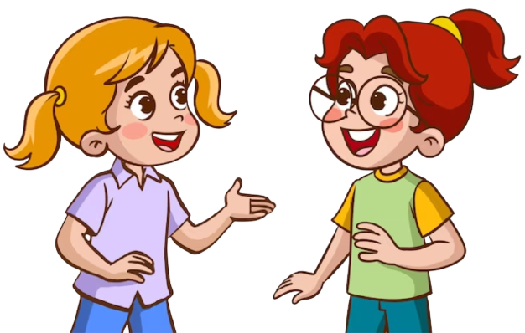
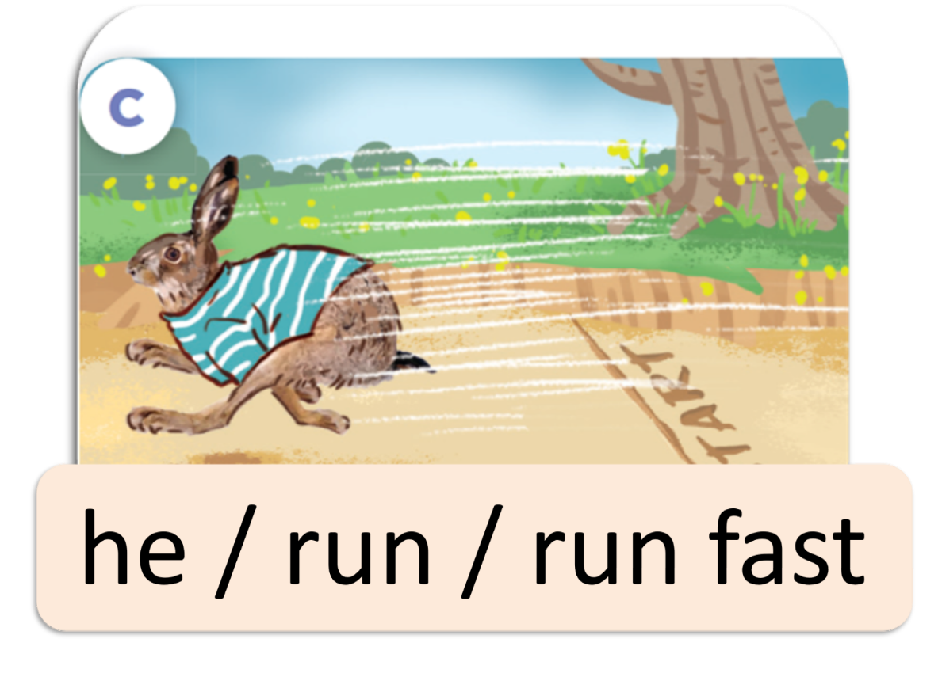
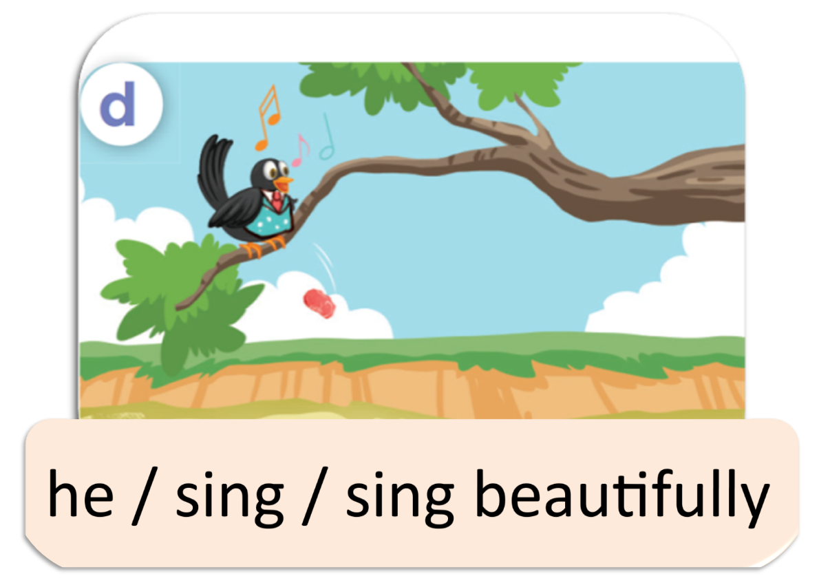
Listen, point and say.
she / cook / cook well
he / work / work hard
he / run / run fast
he / sing / sing beautifully

Slide 27
04
Let’s talk.

Slide 28


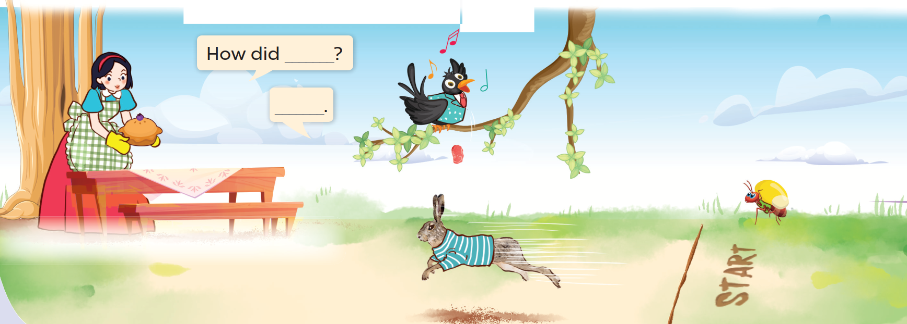
Look and say.

Slide 29
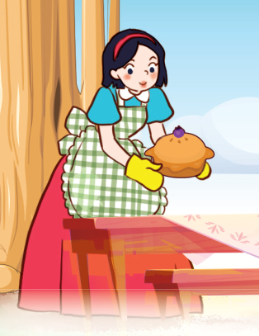
Look, read and answer.
She cooked well.
How did she cook?

Slide 30
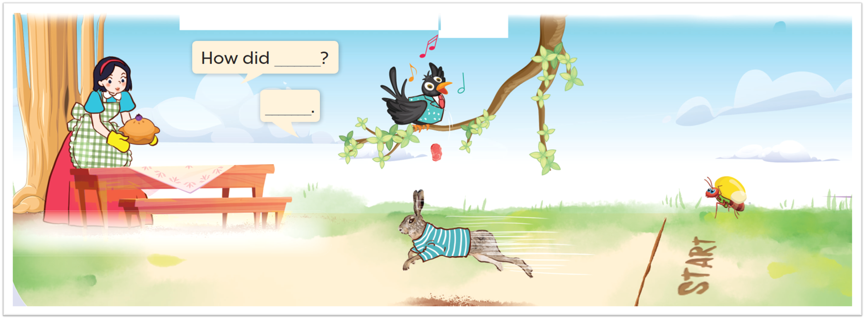
Ask and answer.

Slide 31
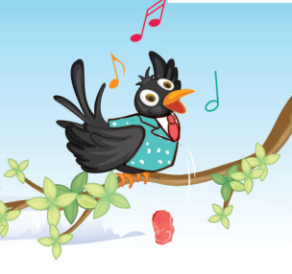
Look, read and answer.
He sang beautifully.
How did he sing?

Slide 32
Look and say.

Slide 33
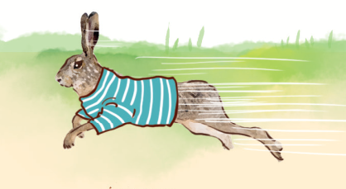
Look, read and answer.
He ran fast.
How did he run?

Slide 34
Look and say.

Slide 35
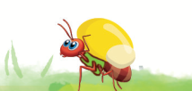
Look, read and answer.
He cooked hard.
How did he work?

Slide 36
05
Fun corner and Wrap-up

Slide 37



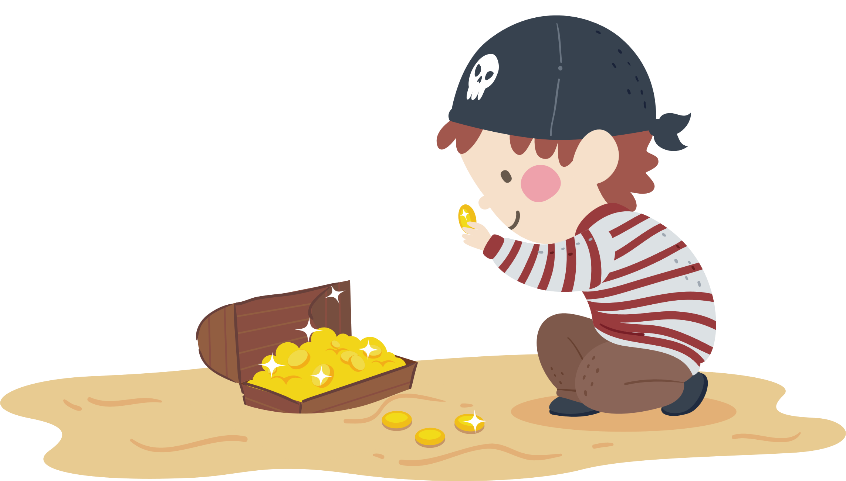


TREASURE HUNT

Slide 38
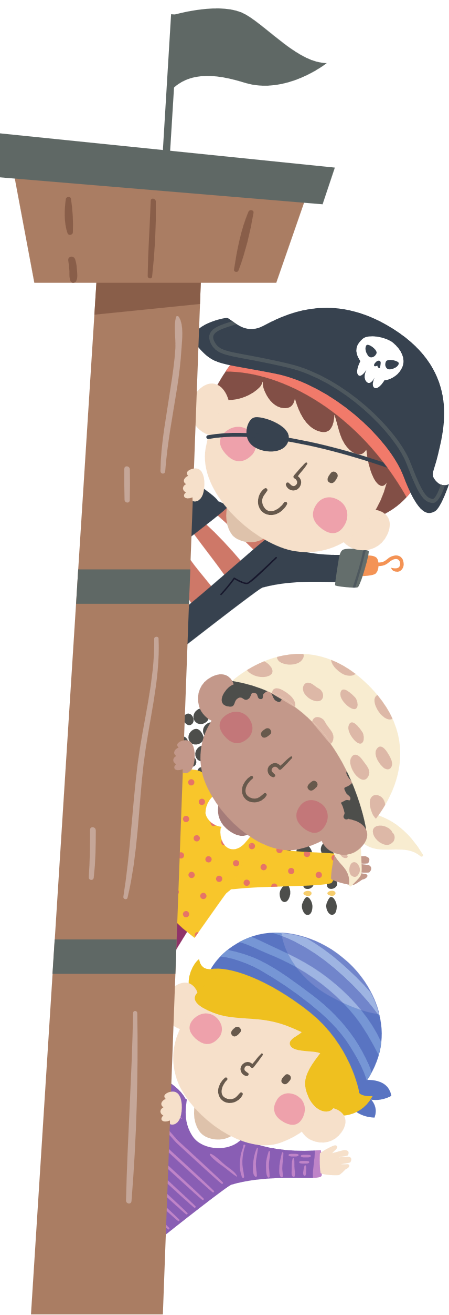
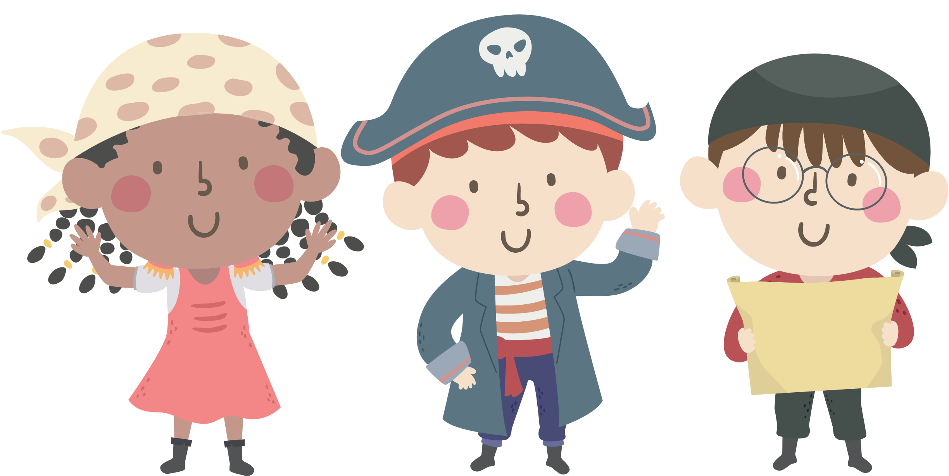
Hello Treasure Hunters!
We will be your captain today.

Slide 39



Listen carefully!
Notes:
Divide class into five groups.
Discuss the riddle within the group.
The first one to find the object inside the classroom will get points!

Slide 40
Are you ready?

Slide 41


Riddle 1
This is a story.
You can see the Fox in this story.
What is the name of this story?

Slide 42

Answer
The Fox and the Crow

Slide 43
Riddle 2
Do you like the Hare?

Slide 44
Answer
Yes, I do.
No, I don’t.

Slide 45
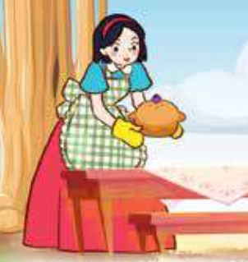
Riddle 3
How did Snow White cook?

Slide 46
Answer
She cooked very well.

Slide 47
Riddle 4
I like this story very much
because I can see the seven dwarfs.

Slide 48
Answer
Snow White and the seven dwarfs

Slide 49
Riddle 5
Talk about the main characters in this story.

Slide 50
Answer
They are the Ant and the Grasshopper.

Slide 51
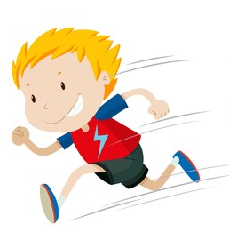
Riddle 6
How did the boy run?

Slide 52
Answer
The boy ran very fast.

Slide 53
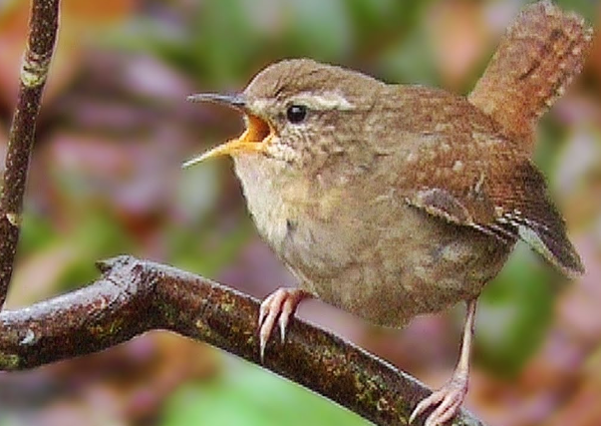
Riddle 7
How did the bird sing?

Slide 54
Answer
It sang beautifully.

Slide 55

Riddle 8
How did he work?

Slide 56
Answer
He worked very hard.

Slide 57
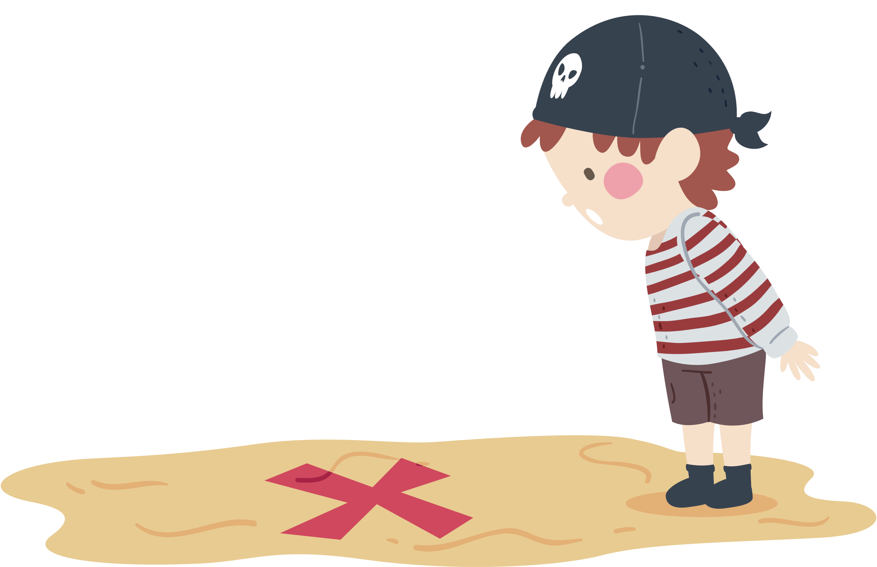
and the group that found the most treasures is...

Slide 58
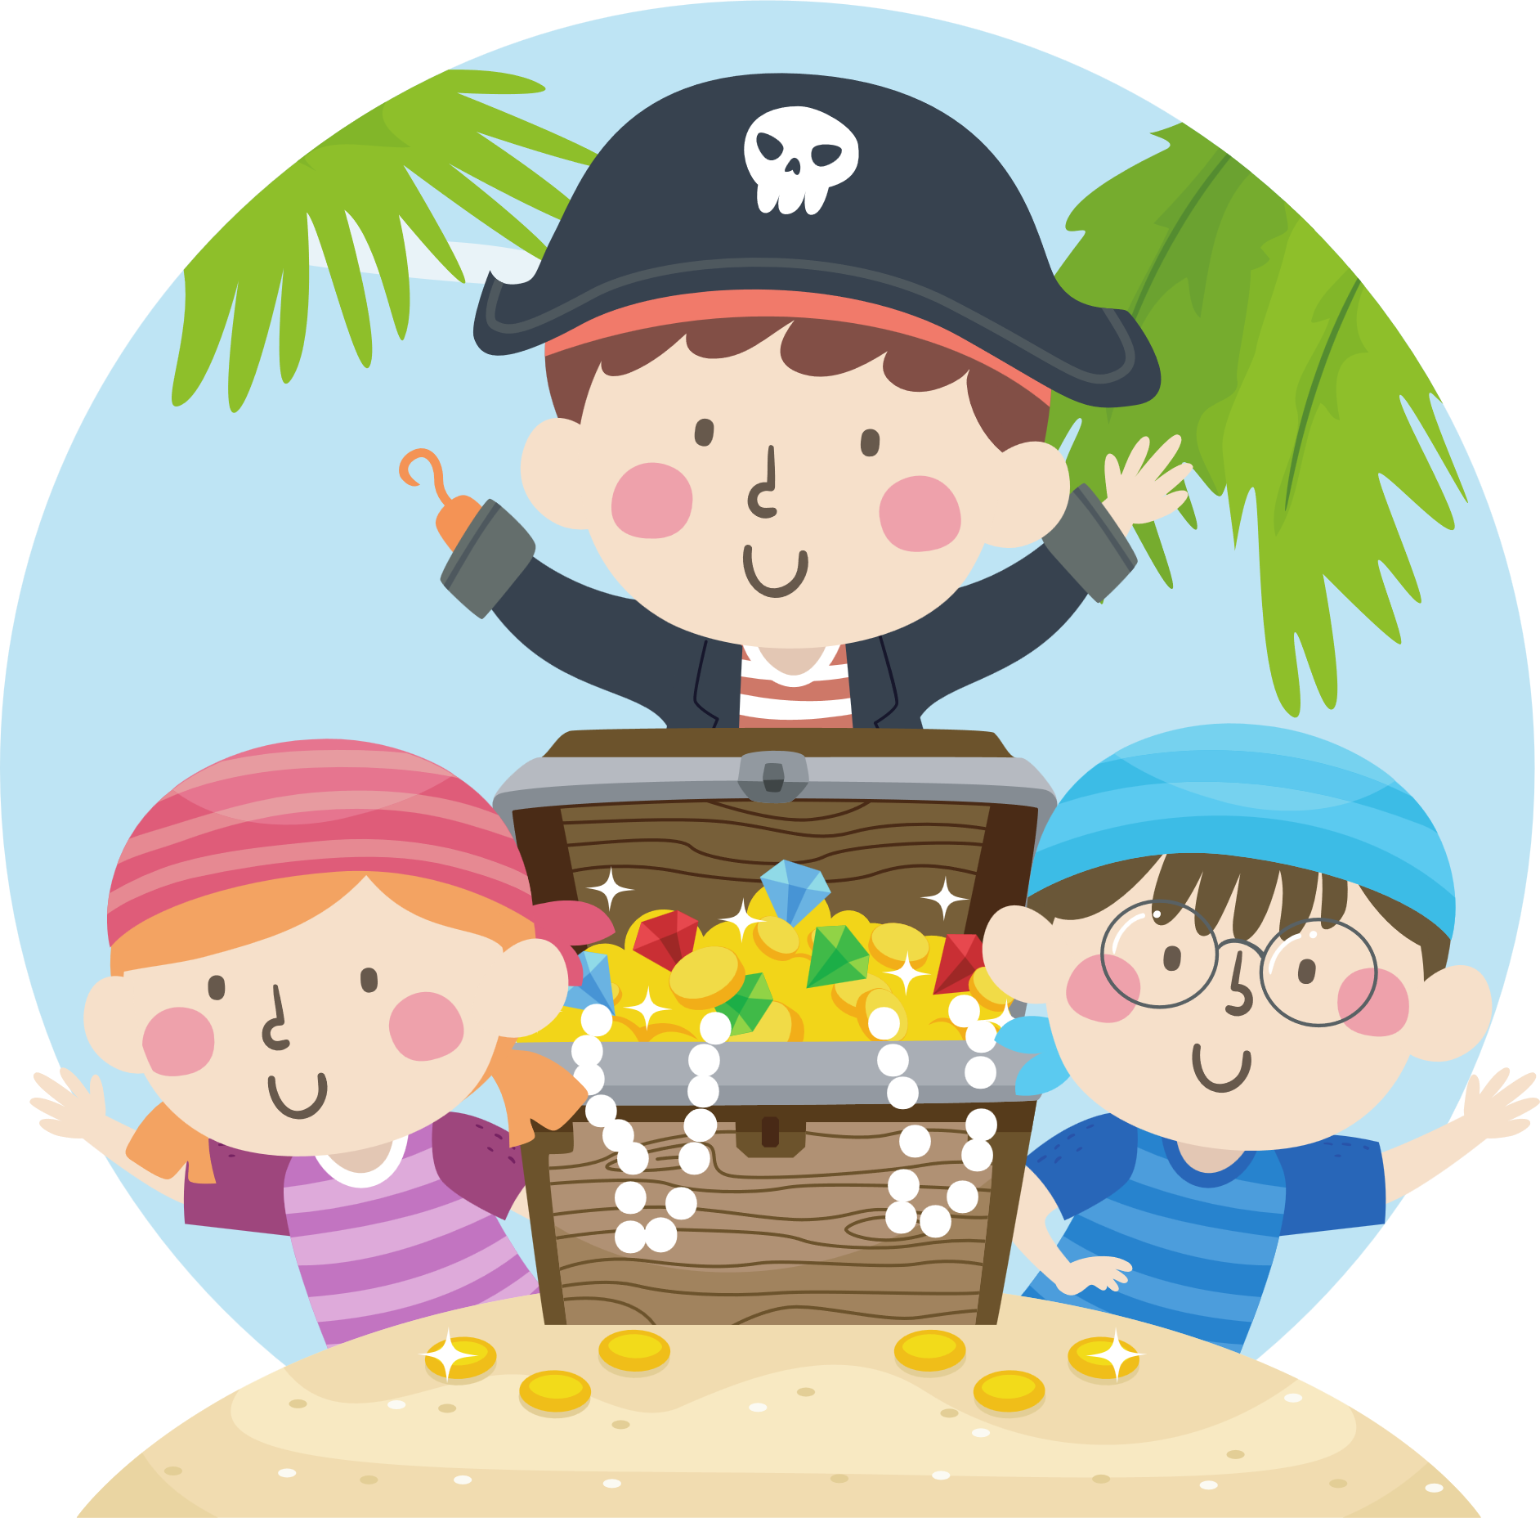
Group …
Notes:
Điền tên nhóm thắng cuộc.

Slide 59
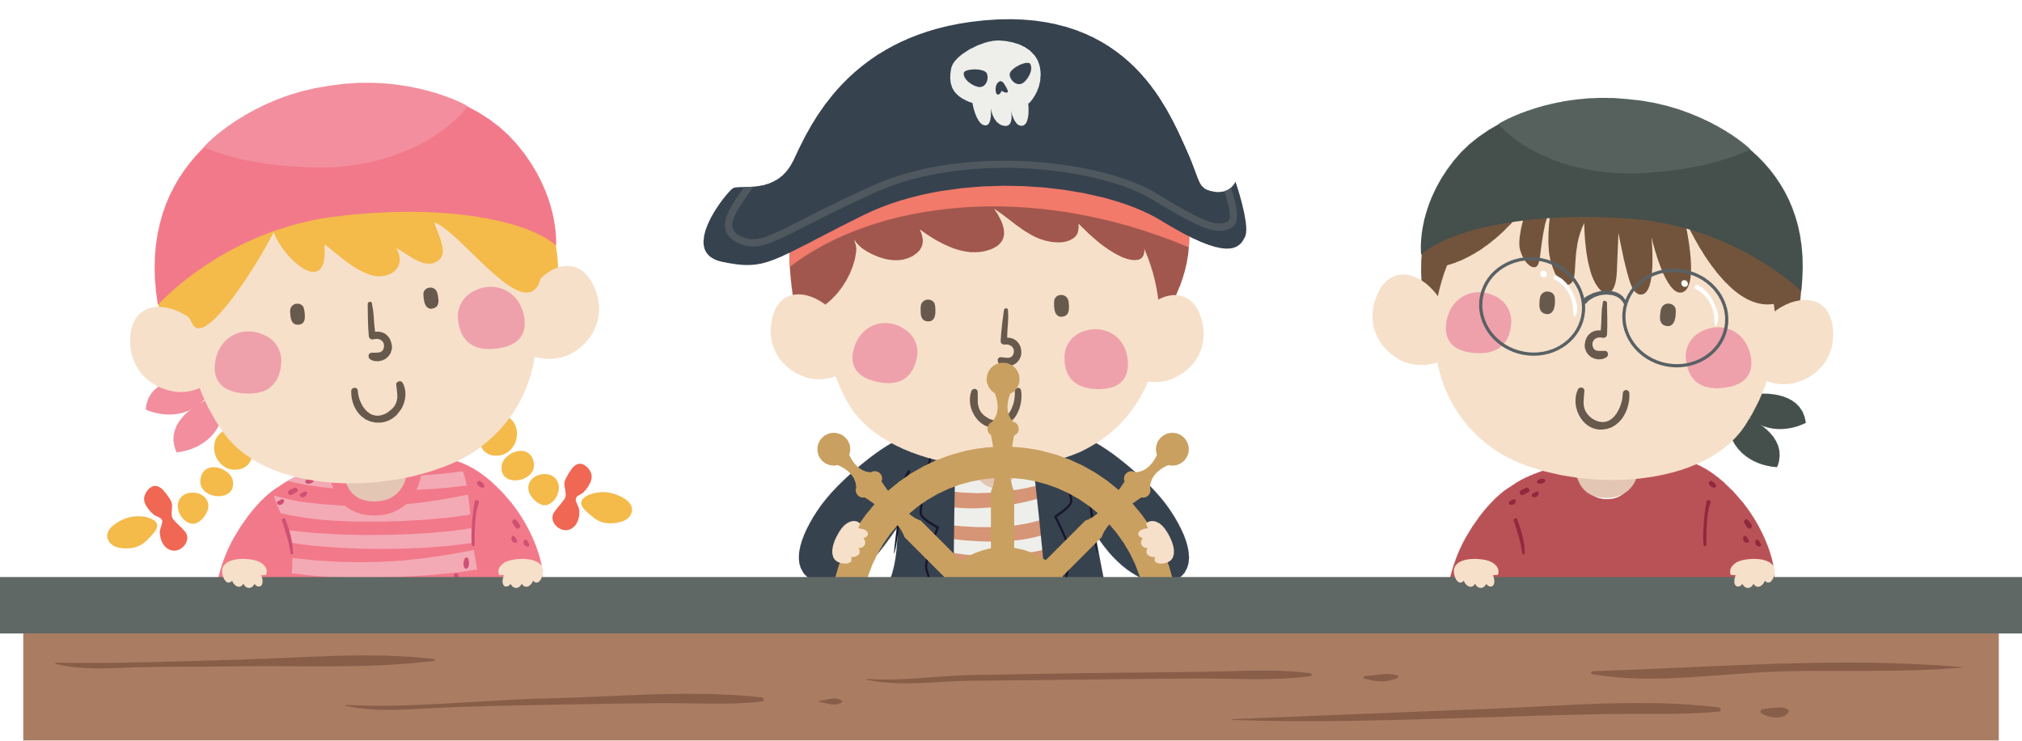
Congratulations!

