Slide 2






UNIT 17
STORIES
FOR CHILDREN
Lesson 3 – Period 5

Slide 3











Table of Contents
Warm-up and Review
Listen and repeat.
Listen and repeat.
Pay attention to the intonation.
Let’s chant.
Fun corner and Wrap-up

Slide 4






01
Warm-up and Review

Slide 5


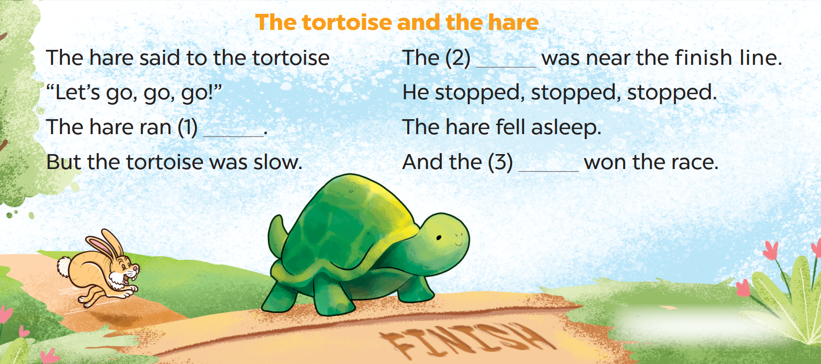
Listen, sing and clap.
Notes:
- Introduce the activity.
- Play the song for pupils to listen.
- Play the song for pupils to listen and sing in chorus.
- Invite a few groups to the front of the class to sing the song. The class may sing along and clap to reinforce the activity.
- Praise pupils if they perform well.

Slide 6



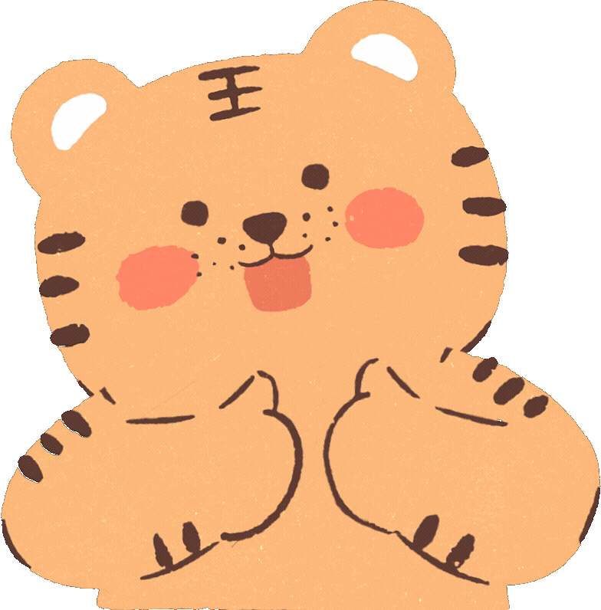



Slide 7
02
Listen and repeat.

Slide 8

Listen and point.
Is this your storybook?
Notes:
Step 1: Have pupils look at the questions. Draw their attention to the mark (↗) at the end of the questions. Explain that the questions with the mark (↗) should be said with a rising tune. Check comprehension.

Slide 9
Listen and repeat.
Is this your storybook?
Notes:
Step 2: Play the recording for pupils to listen and repeat the questions until they feel confident. Correct the intonation and pronunciation where necessary.

Slide 10
Listen and point.
Are you reading a story?
Notes:
Step 1: Have pupils look at the questions. Draw their attention to the mark (↗) at the end of the questions. Explain that the questions with the mark (↗) should be said with a rising tune. Check comprehension.

Slide 11
Listen and repeat.
Are you reading a story?
Notes:
Step 2: Play the recording for pupils to listen and repeat the questions until they feel confident. Correct the intonation and pronunciation where necessary.

Slide 12
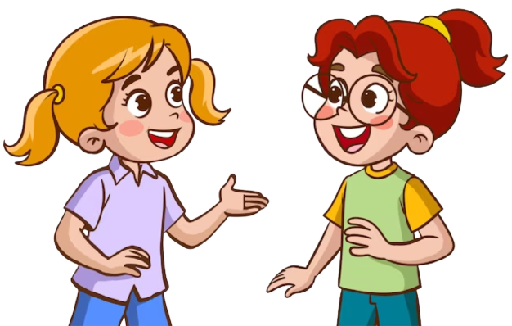
Work in pairs.
Is this your storybook?
Are you reading a story?
Notes:
Step 3: Let pupils work in pairs or groups to say the questions. Invite a few pupils to say the language in front of the class. Praise pupils when they perform well.

Slide 14
03
Listen and repeat.
Pay attention to
the intonation.

Slide 15

Look and read aloud.
1. Did the hare run fast?
2. Was the prince intelligent?
3. Did the ant work hard?
4. Do you like the story?
Notes:
Step 1: Have pupils read the questions aloud. Draw their attention to the rising tune at the end of the question. Check comprehension.

Slide 16
Listen and point.
1. Did the hare run fast?
2. Was the prince intelligent?
3. Did the ant work hard?
4. Do you like the story?
Notes:
Step 2: Play the recording for pupils to listen. Draw their attention to the rising tune at the end of the questions.
(Click to show the arrow while playing the recording.)

Slide 17
Listen and repeat.
1. Did the hare run fast?
2. Was the prince intelligent?
3. Did the ant work hard?
4. Do you like the story?
Notes:
Then play it again, sentence by sentence, for pupils to listen to and repeat in chorus, until they feel confident. Correct their intonation and pronunciation where necessary.

Slide 18
Practice!!!!!
1. Did the hare run fast?
2. Was the prince intelligent?
3. Did the ant work hard?
4. Do you like the story?
Notes:
Step 3: Have pupils practise reading the questions in pairs or groups. Then invite a few pupils to read aloud the questions in front of the class. Encourage the class to praise or cheer their performance.

Slide 19
Let’s make Yes/No questions.
play football
Do you play football every day?
Notes:
Extension (For consolidation): Have each pupil say one Yes/No question that they have learnt based on the cues given. For example, Do you play football every day? Ask them to pay attention to the rising tune at the end of the question.

Slide 20
Let’s make Yes/No questions.
cook well
Did Snow White cook well?
Notes:
Extension (For consolidation): Have each pupil say one Yes/No question that they have learnt based on the cues given. For example, Do you play football every day? Ask them to pay attention to the rising tune at the end of the question.

Slide 21
Let’s make Yes/No questions.
sing beautifully
Did the crow sing beautifully?
Notes:
Extension (For consolidation): Have each pupil say one Yes/No question that they have learnt based on the cues given. For example, Do you play football every day? Ask them to pay attention to the rising tune at the end of the question.

Slide 22
Let’s make Yes/No questions.
run fast
Did the tortoise run fast?
Notes:
Extension (For consolidation): Have each pupil say one Yes/No question that they have learnt based on the cues given. For example, Do you play football every day? Ask them to pay attention to the rising tune at the end of the question.

Slide 23
Let’s make Yes/No questions.
like / grasshopper
Do you like the grasshopper?
Notes:
Extension (For consolidation): Have each pupil say one Yes/No question that they have learnt based on the cues given. For example, Do you play football every day? Ask them to pay attention to the rising tune at the end of the question.

Slide 24
Let’s make Yes/No questions.
like / seven dwarfs
Do you like the seven dwarfs?
Notes:
Extension (For consolidation): Have each pupil say one Yes/No question that they have learnt based on the cues given. For example, Do you play football every day? Ask them to pay attention to the rising tune at the end of the question.

Slide 26
04
Let’s chant.

Slide 27

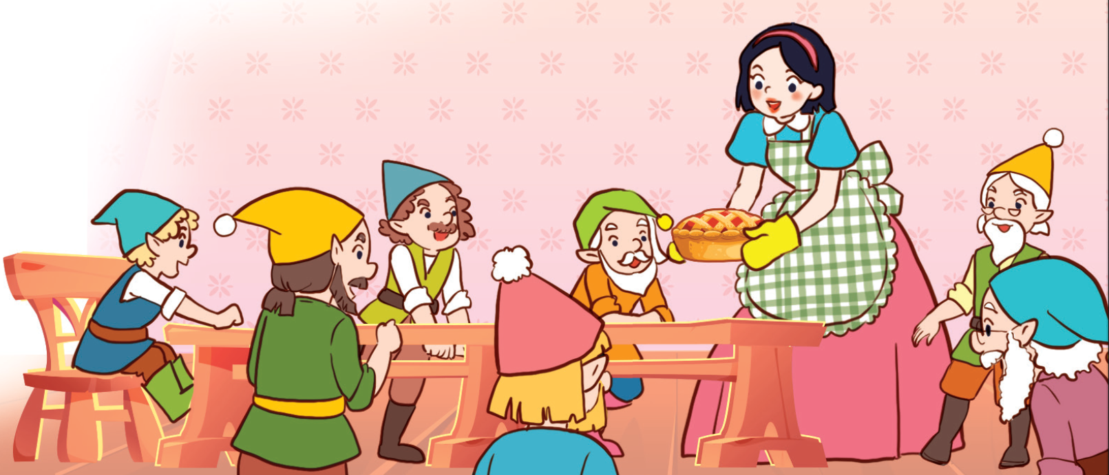
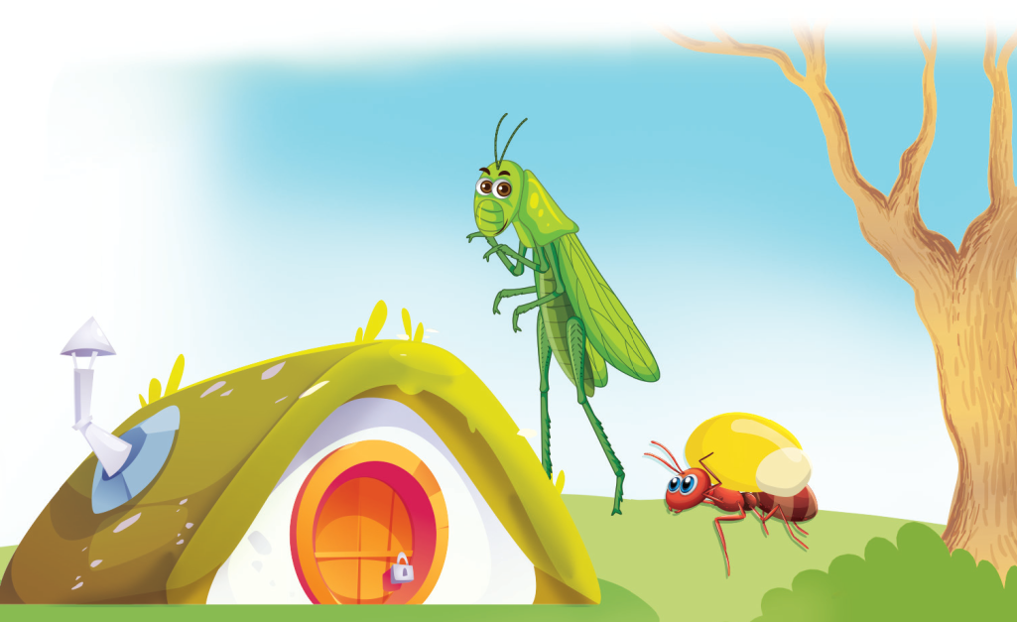

Look, listen and answer.
Do you like …?
Notes:
Ask pupils to look at the pictures. Then answer the question “Do you like….?”

Slide 28
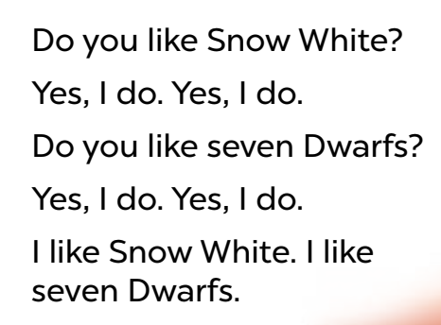
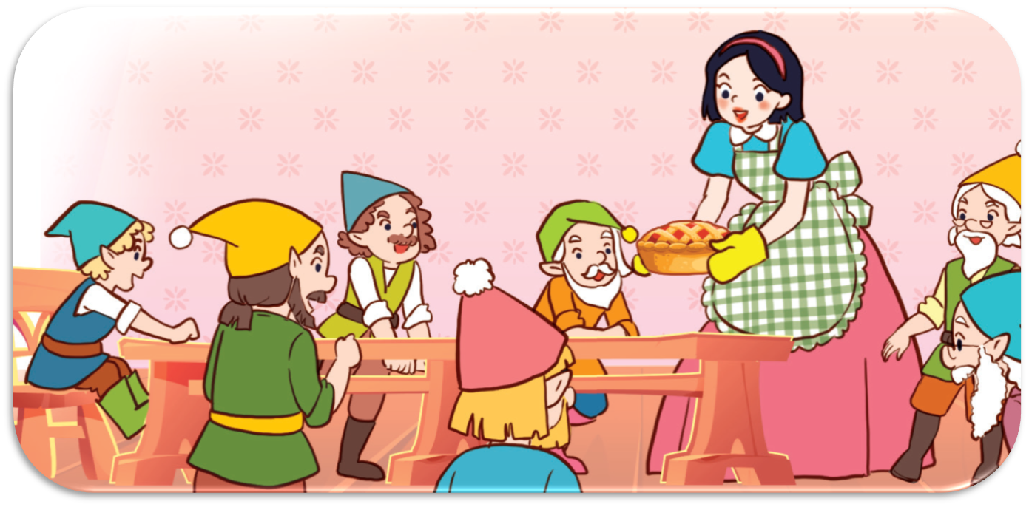
Look and read aloud.
Do you like Snow White?
Yes, I do. Yes, I do.
Do you like the seven dwarfs?
Yes, I do. Yes, I do.
I like Snow White. I like the
seven dwarfs.
Notes:
Step 1: Have pupils read the lyrics of the chant. Then get them to look at the picture to reinforce their understanding. Check comprehension.

Slide 29
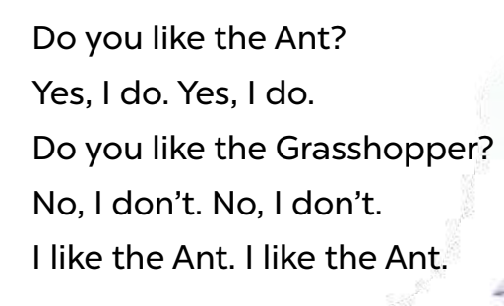
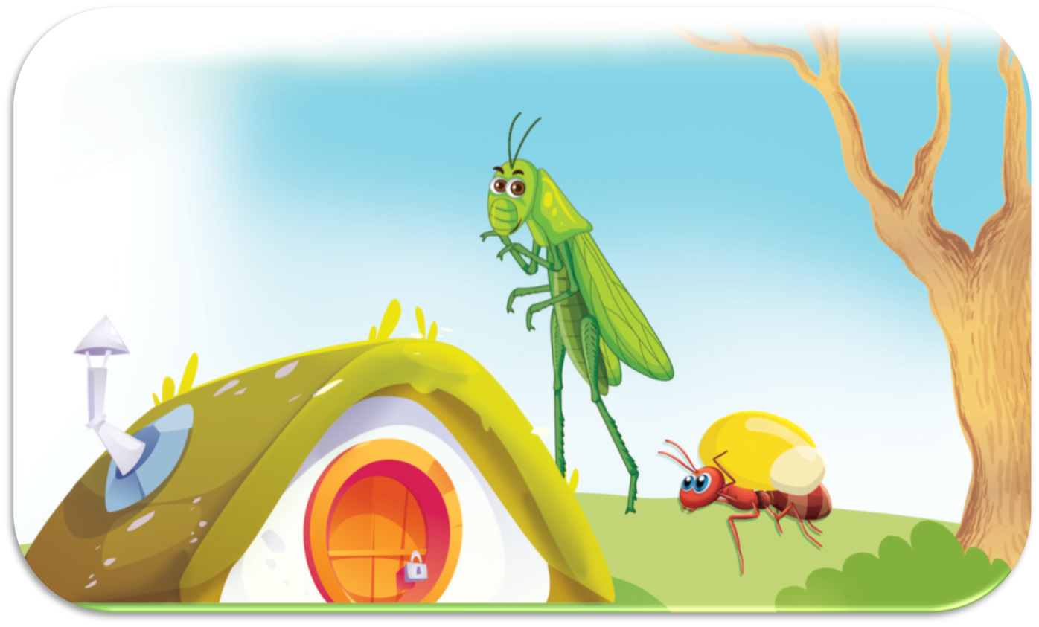
Look and read aloud.
Do you like the ant?
Yes, I do. Yes, I do.
Do you like the grasshopper?
No, I don’t. No, I don’t.
I like the ant. I like the ant.
Notes:
Step 1: Have pupils read the lyrics of the chant. Then get them to look at the picture to reinforce their understanding. Check comprehension.

Slide 30
Listen and point.
Do you like Snow White?
Yes, I do. Yes, I do.
Do you like the seven dwarfs?
Yes, I do. Yes, I do.
I like Snow White. I like the
seven dwarfs.
Notes:
Step 2: Play the recording all the way through for pupils to listen to the whole chant. Encourage them to listen carefully to the stressed words.

Slide 31

Listen and repeat.
Do you like Snow White?
Yes, I do. Yes, I do.
Do you like the seven dwarfs?
Yes, I do. Yes, I do.
I like Snow White. I like the seven dwarfs.
Notes:
Play it again line by line, for pupils to listen and repeat. Draw their attention to the pronunciation and rhythm. Encourage them to clap while chanting.

Slide 32

Listen and repeat.
Do you like the Ant?
Yes, I do. Yes, I do.
Do you like the Grasshopper?
No, I don’t. No, I don’t.
I like the Ant. I like the Ant.
Notes:
Play it again line by line, for pupils to listen and repeat. Draw their attention to the pronunciation and rhythm. Encourage them to clap while chanting.

Slide 33
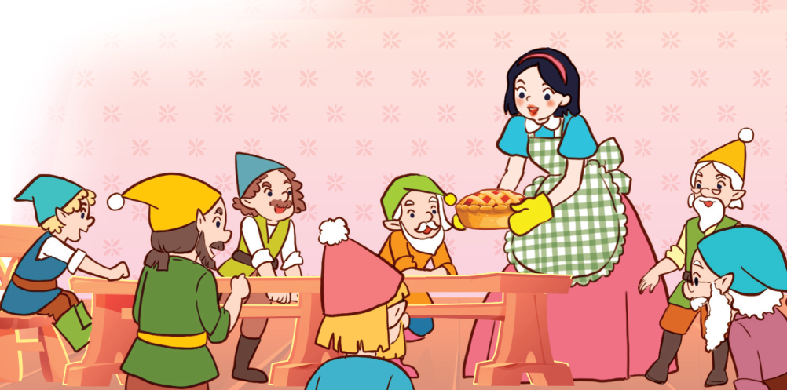
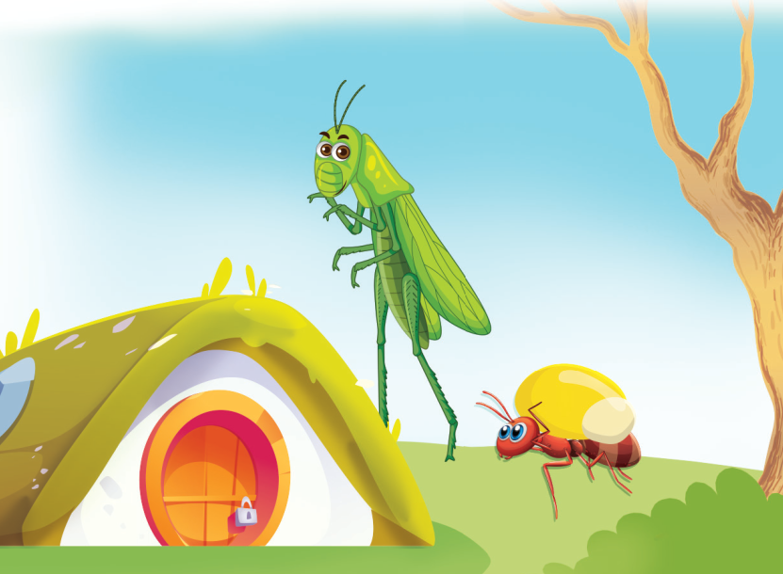
Listen and repeat.
Do you like Snow White?
Yes, I do. Yes, I do.
Do you like the seven dwarfs?
Yes, I do. Yes, I do.
I like Snow White. I like the
seven dwarfs.
Do you like the ant?
Yes, I do. Yes, I do.
Do you like the grasshopper?
No, I don’t. No, I don’t.
I like the ant. I like the ant.
Notes:
Step 3: Divide the class into two groups to take turns listening to and repeating the chant, while the rest of the class claps along.
Extension: If time allows, invite a few groups to say the chant in front of the class. The rest of the class chant and clap along.

Slide 35
05
Fun corner and Wrap-up

Slide 36




Let’s play
Inside
my bag!
Start

Slide 37


Round 1
Let's go!

Slide 38

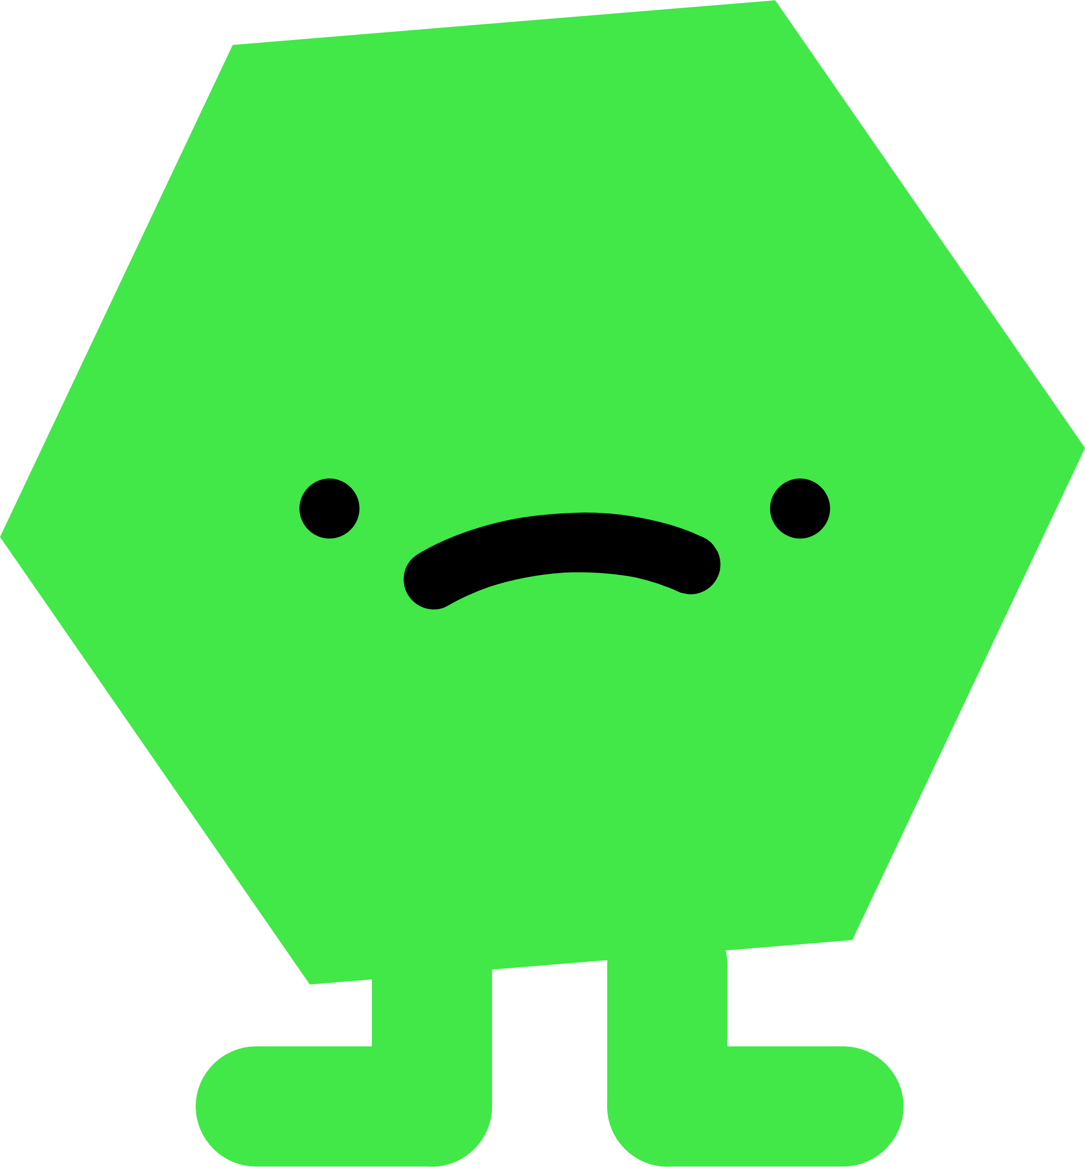


Are you ready to
get scores?
Lets’ make a dialogue!

Slide 39

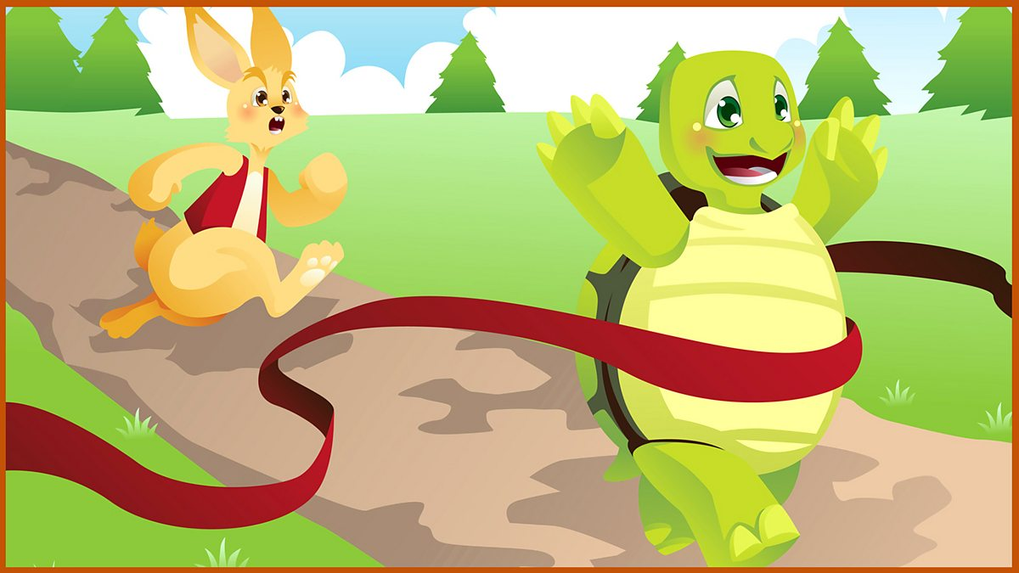
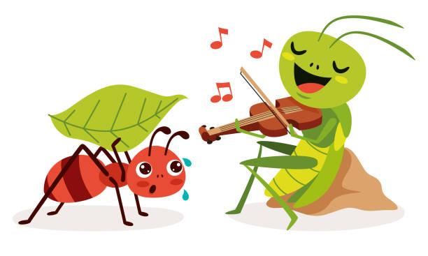
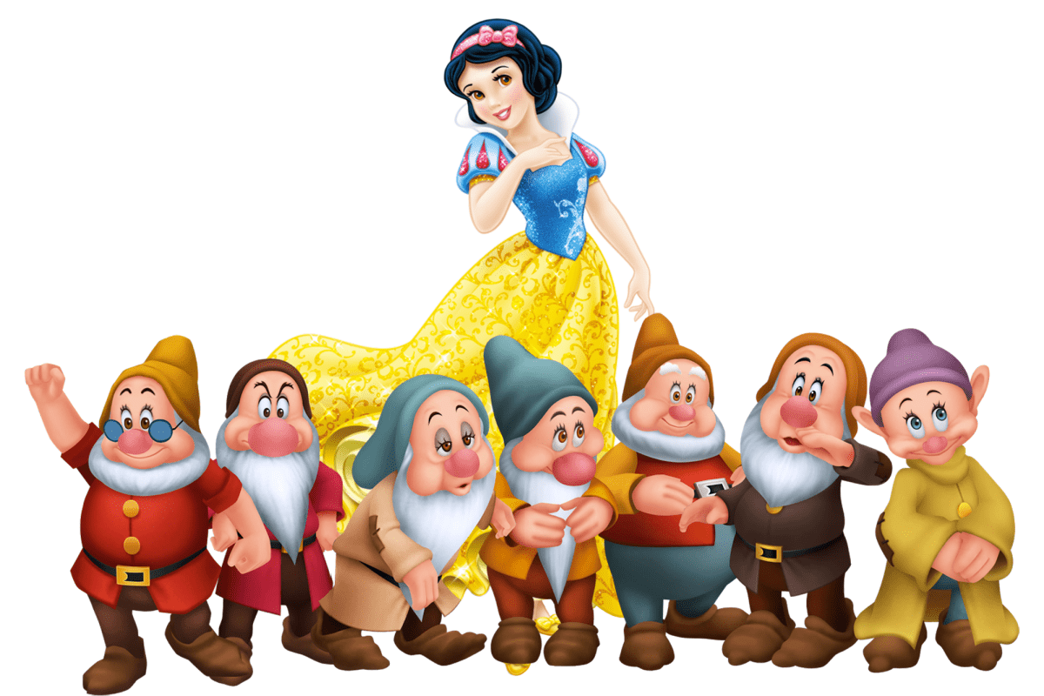
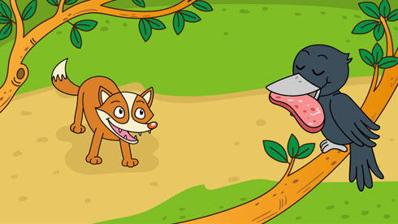




Snow White and the seven dwarfs
the Ant and
the Grasshopper
the Fox and
the Crow
the Hare and
the Tortoise
Notes:
Click to play the card show. Then click to move to the chosen card for pupils to make a dialogue.

Slide 40
Snow White and the seven dwarfs

Slide 41
Snow White
and the seven dwarfs
A: Who are the main characters in this story?
B: They’re Snow White and the seven dwarfs.
A: How did Snow White cook?
B: She cooked well.
A: Do you like Snow White/the seven dwarfs?
B: Yes, I do./ No, I don’t.

Slide 42



Round 2
Let's go

Slide 43

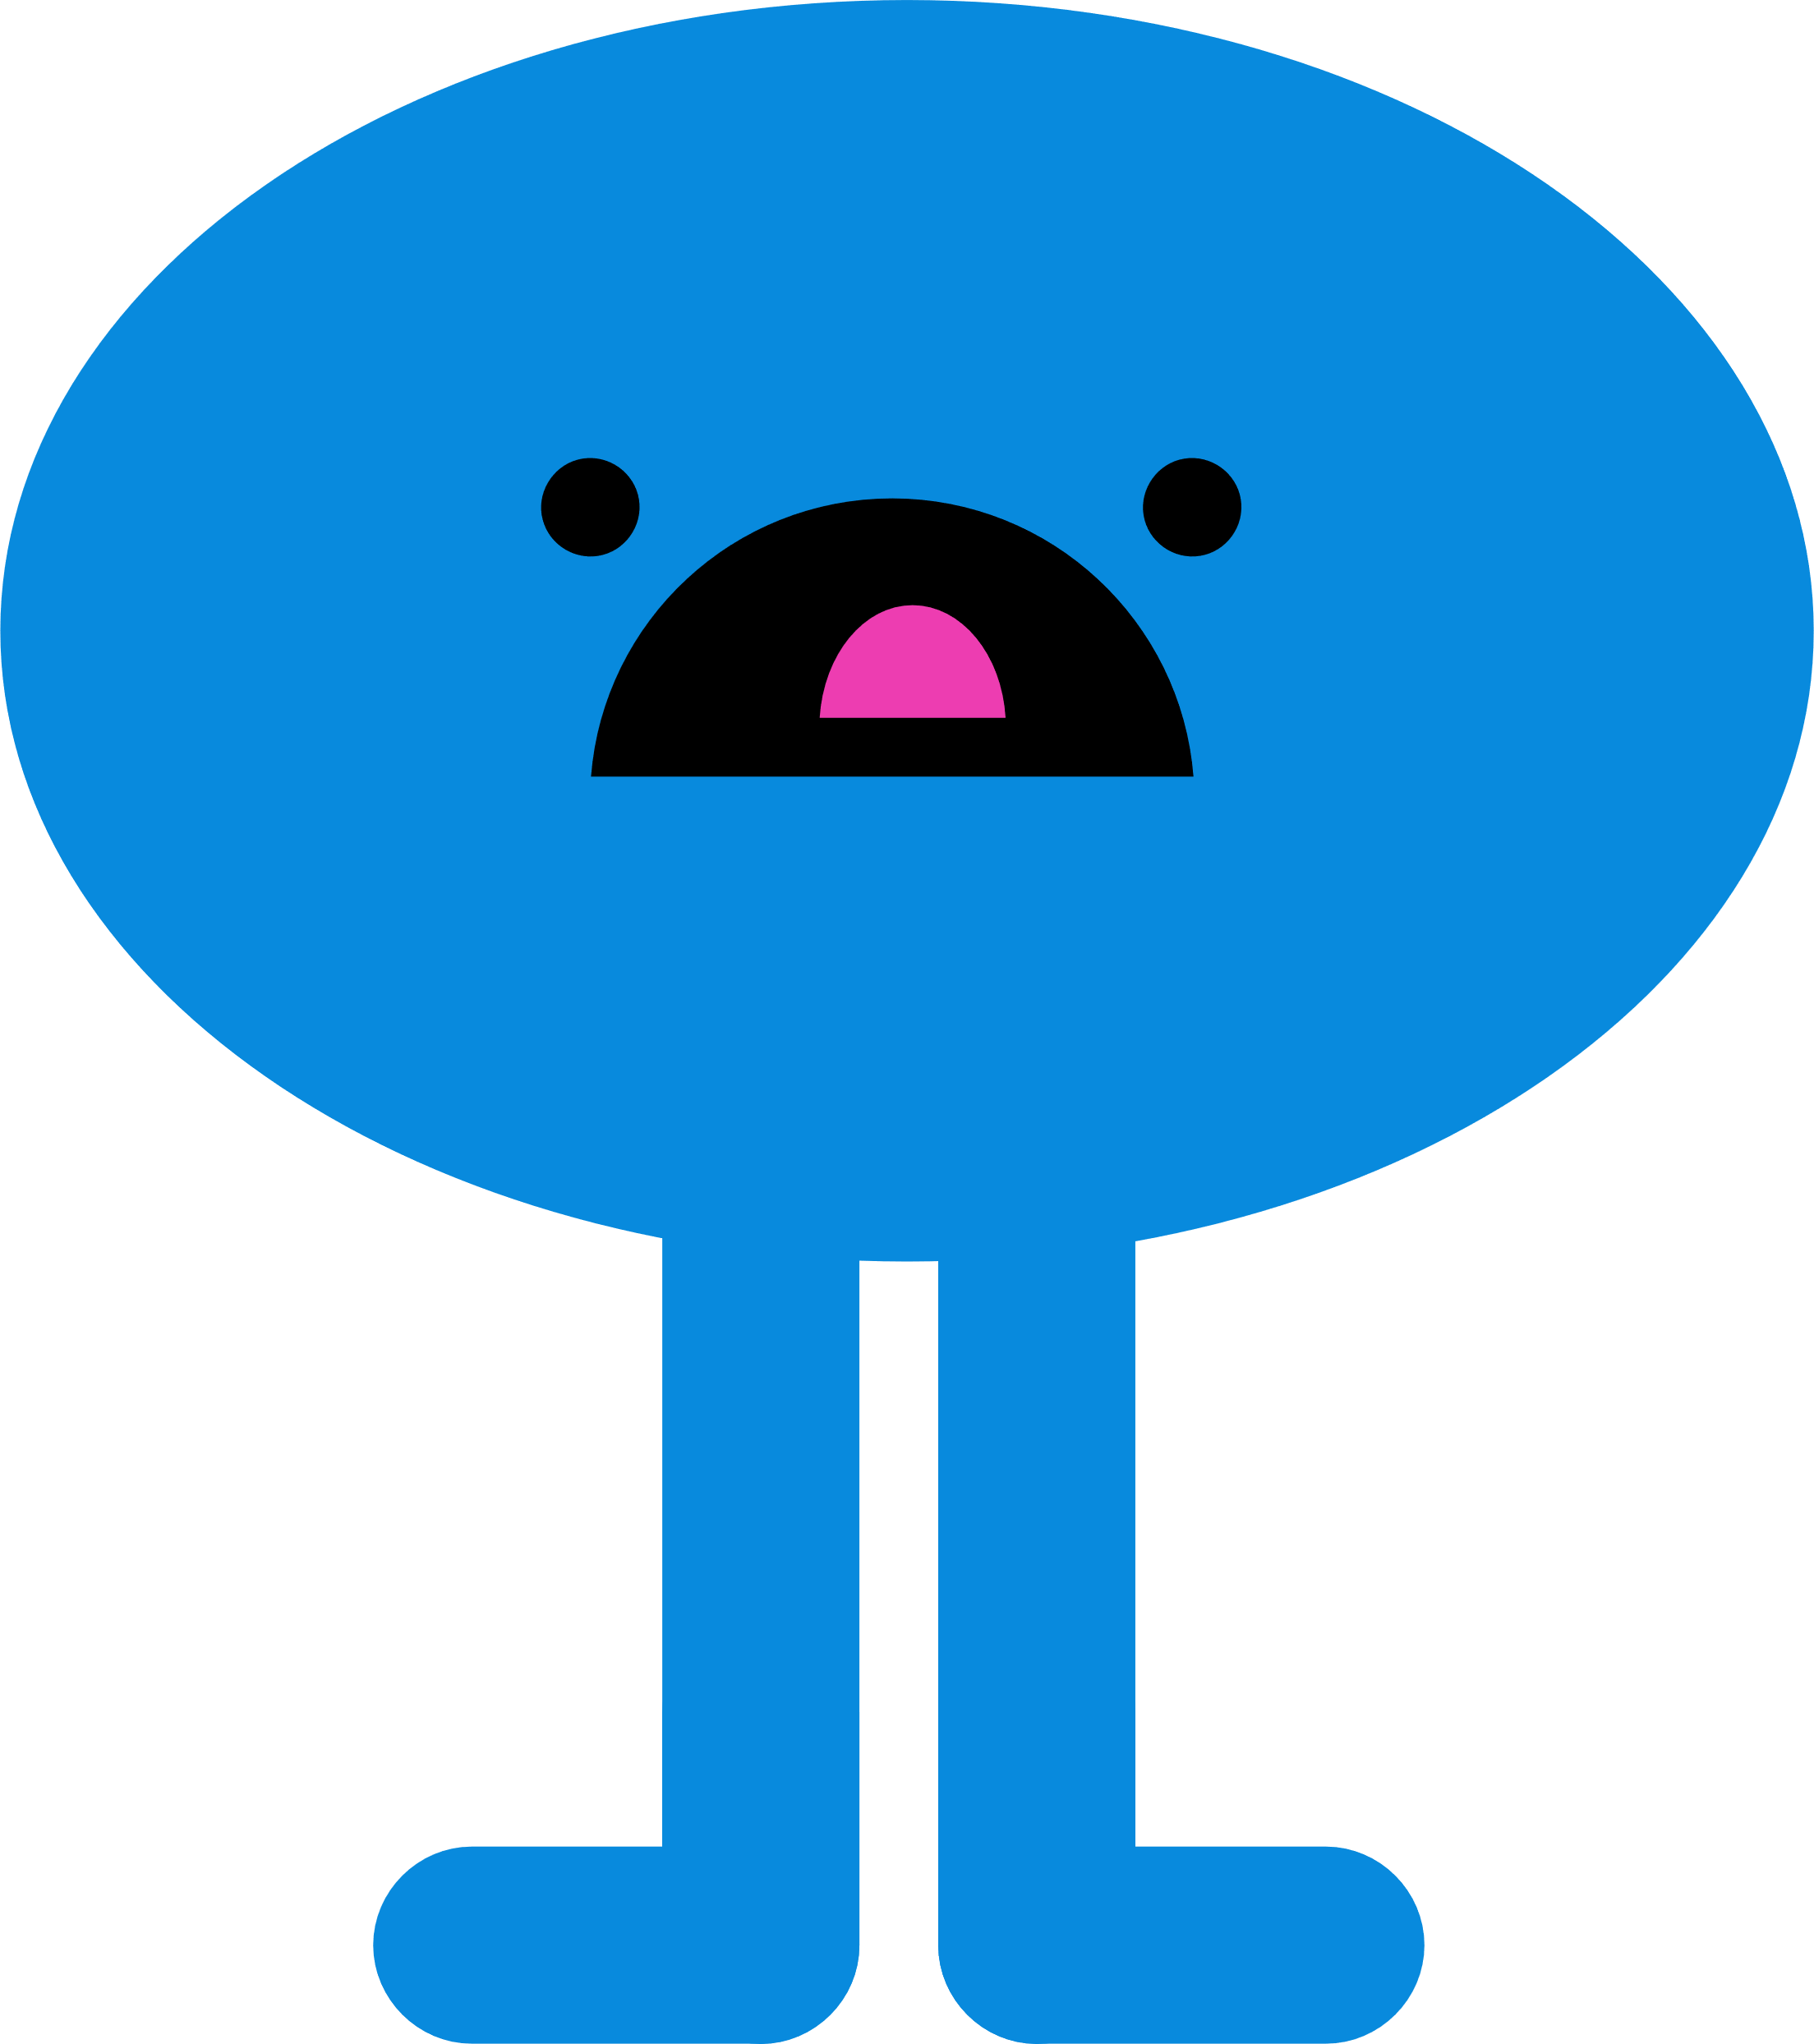

Who will win this round?
Raise your hand
and make a dialogue.

Slide 44


Snow White and the seven dwarfs
the Ant and
the Grasshopper
the Fox and
the Crow
the Hare and
the Tortoise
Notes:
Click to play the card show. Then click to move to the chosen card for pupils to make a dialogue.

Slide 46
A: Who are the main characters in this story?
B: They’re the Fox and the Crow.
A: How did the Crow sing?
B: He sang beautifully.
A: Do you like the Crow/the Fox?
B: Yes, I do./ No, I don’t.

Slide 47
Round 3
Let's go

Slide 48
Are you ready to
get scores?
Lets’ make a dialogue!

Slide 49
Snow White and the seven dwarfs
the Ant and
the Grasshopper
the Fox and
the Crow
the Hare and
the Tortoise
Notes:
Click to play the card show. Then click to move to the chosen card for pupils to make a dialogue.

Slide 51
A: Who are the main characters in this story?
B: They’re the Ant and the Grasshopper.
A: How did the Ant work?
B: He work hard.
A: Do you like the Ant/the Grasshopper?
B: Yes, I do./ No, I don’t.

Slide 52
Round 4
Let's go

Slide 53
Who will win this round?
Raise your hand
and make a dialogue.

Slide 54
Snow White and the seven dwarfs
the Ant and
the Grasshopper
the Hare and
the Tortoise
the Fox and
the Crow
Notes:
Click to play the card show. Then click to move to the chosen card for pupils to make a dialogue.

Slide 55
the Hare and
the Tortoise

Slide 56
the Hare and
the Tortoise
A: Who are the main characters in this story?
B: They’re the Hare and the Tortoise.
A: How did Hare run?
B: He ran fast.
A: Do you like the Hare/the Tortoise?
B: Yes, I do./ No, I don’t.

Slide 57


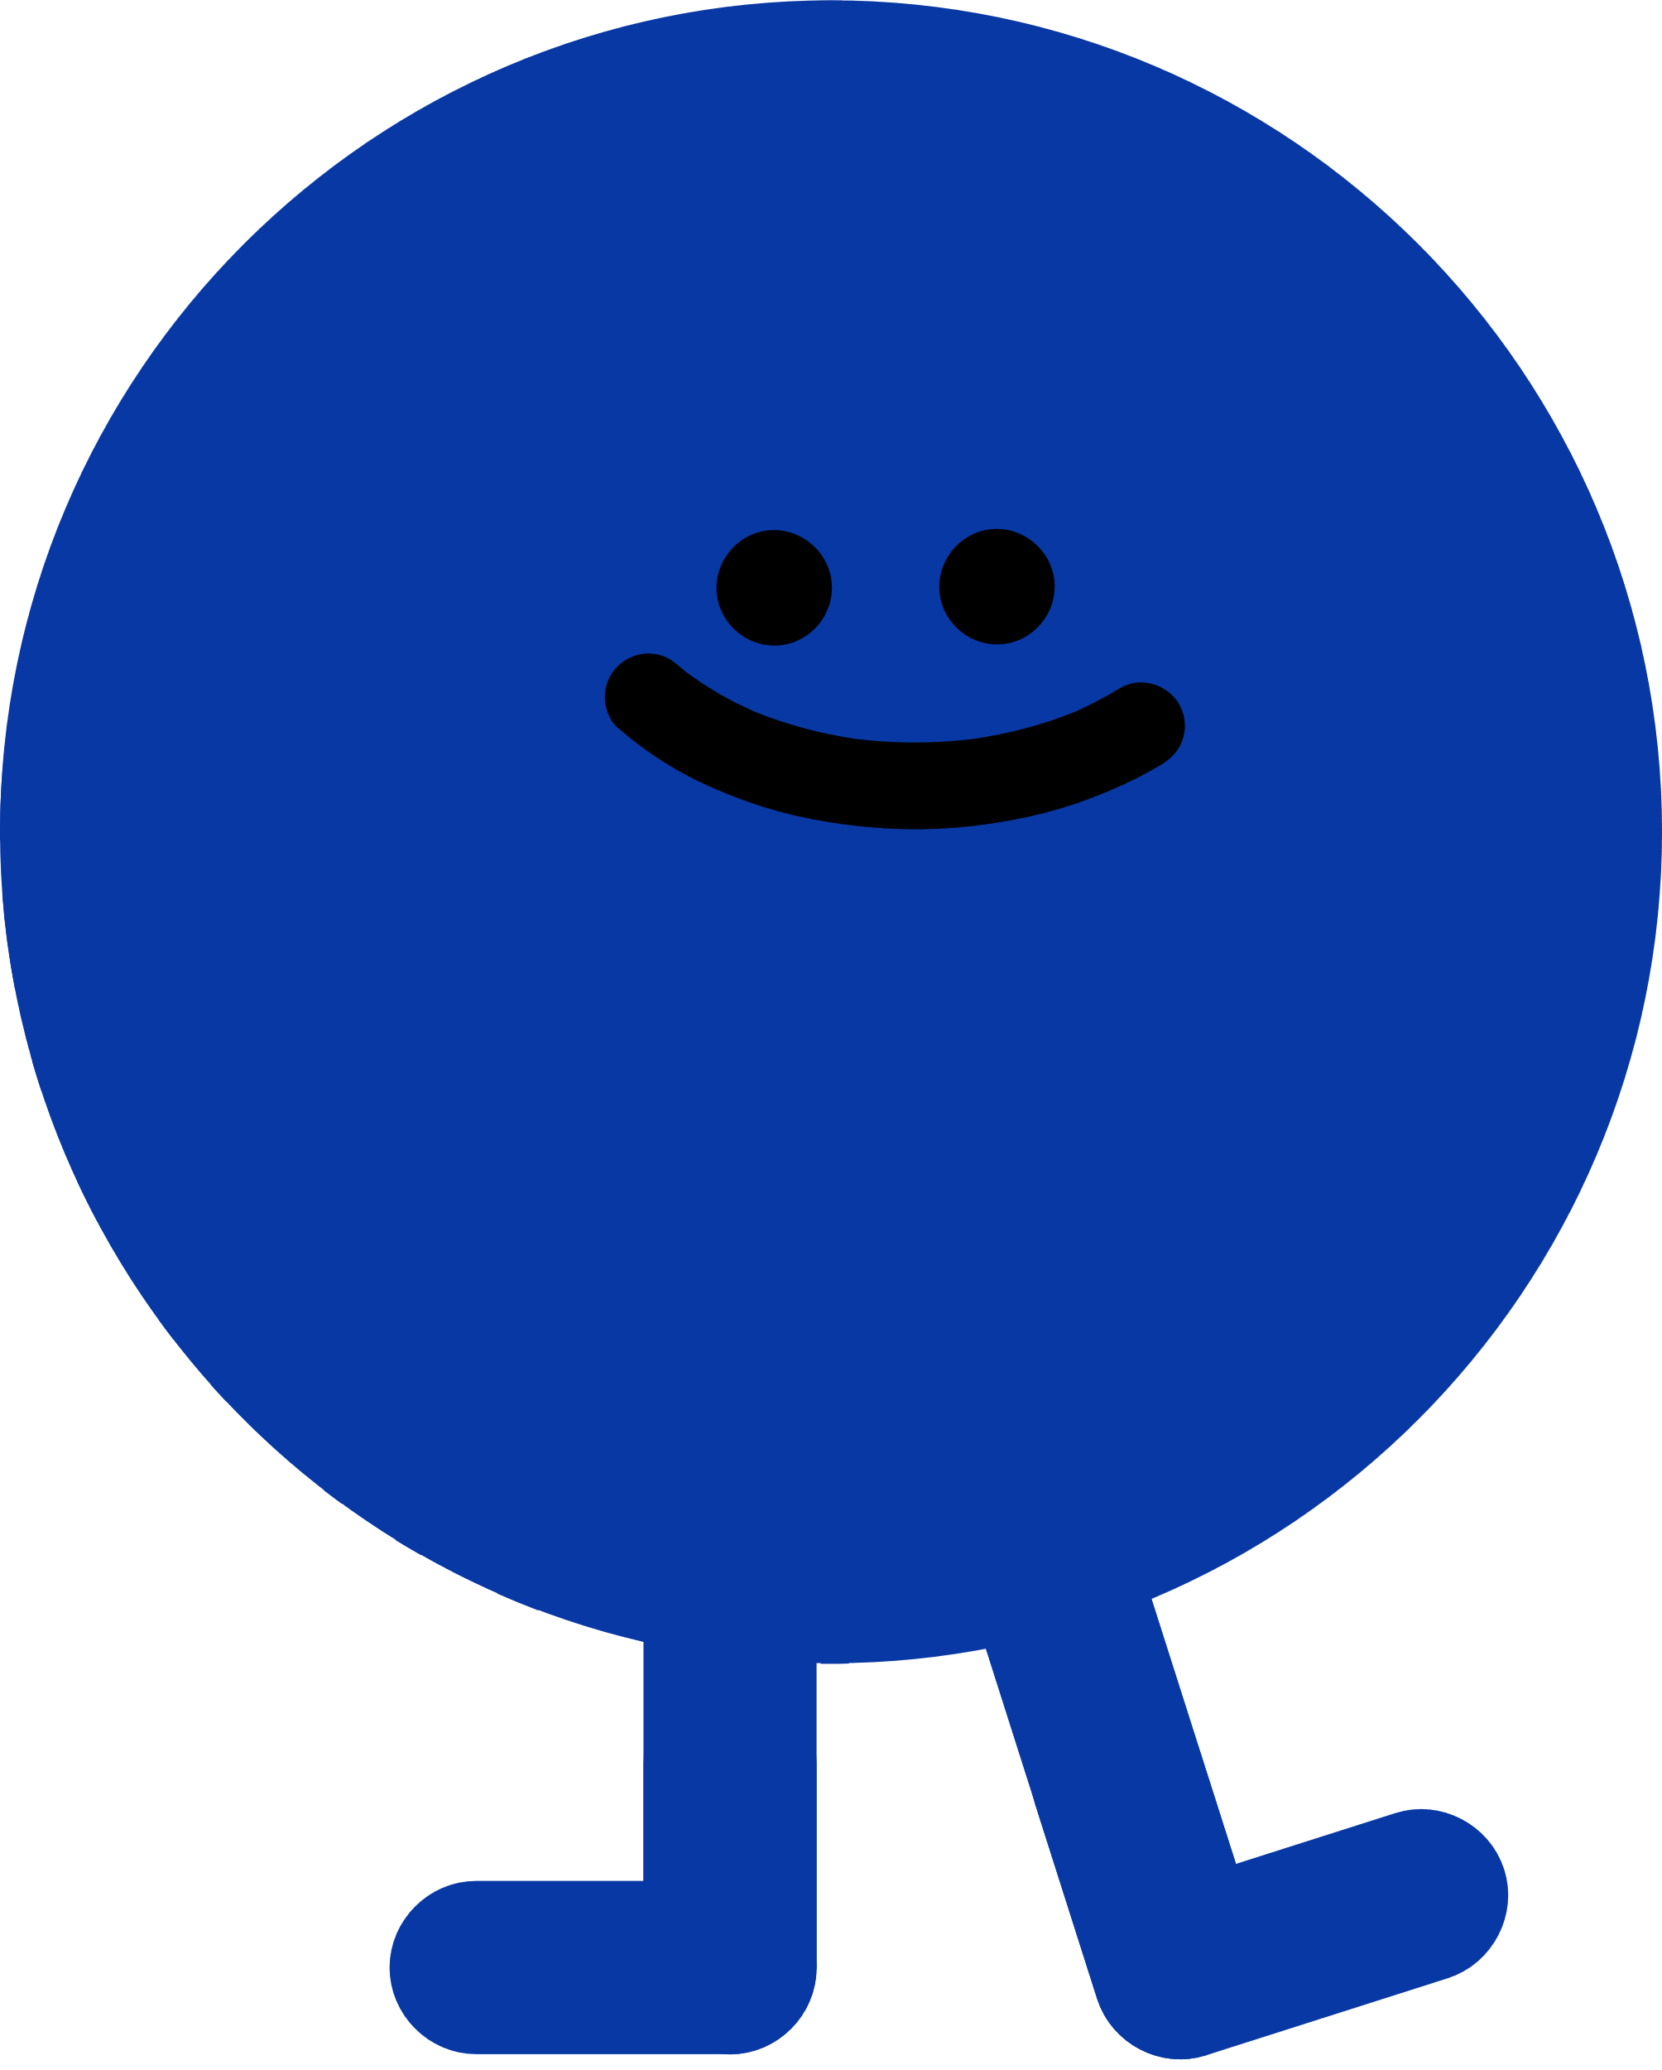

Good job!
See you!

Slide 58
Website: hoclieu.vn
Fanpage: https://www.facebook.com/tienganhglobalsuccess.vn/

