Slide 2






UNIT 17
STORIES FOR CHILDREN
Lesson 3 – Period 6

Slide 3











Table of Contents
Warm-up and Review
Read and tick True or False.
Let’s write.
Project.
Fun corner and Wrap-up

Slide 4


01
Warm-up and Review

Slide 5


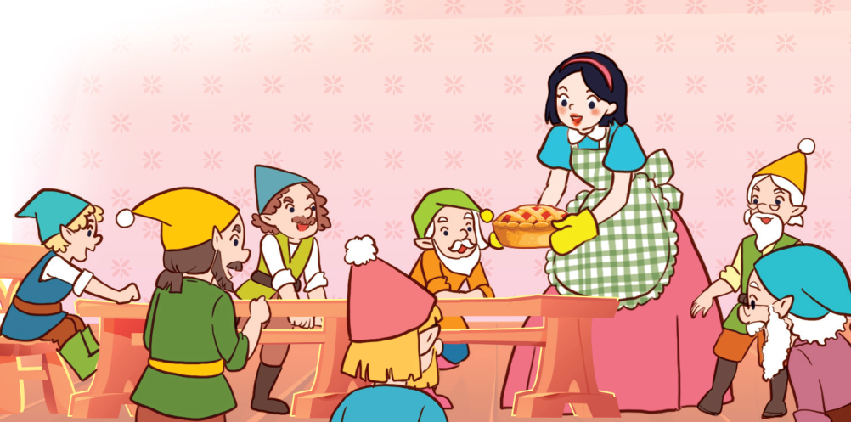
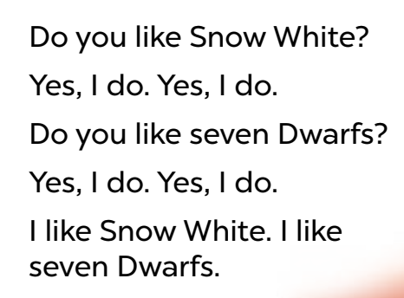

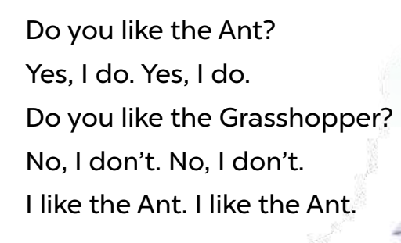
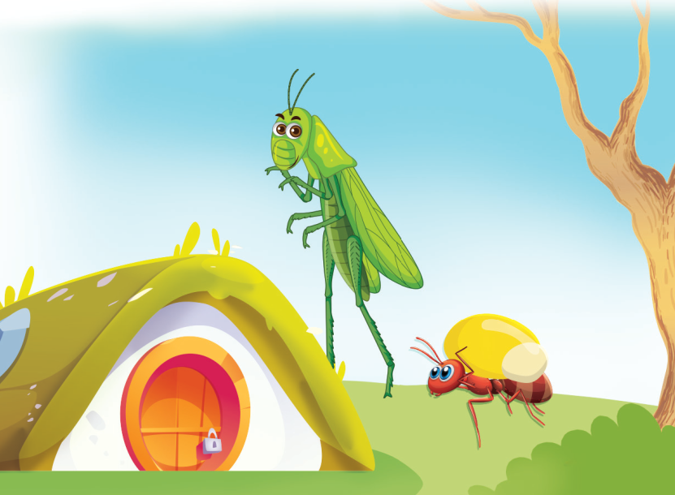
Listen, chant and clap.
Do you like Snow White?
Yes, I do. Yes, I do.
Do you like the seven dwarfs?
Yes, I do. Yes, I do.
I like Snow White. I like the
seven dwarfs.
Do you like the ant?
Yes, I do. Yes, I do.
Do you like the grasshopper?
No, I don’t. No, I don’t.
I like the ant. I like the ant.

Slide 6



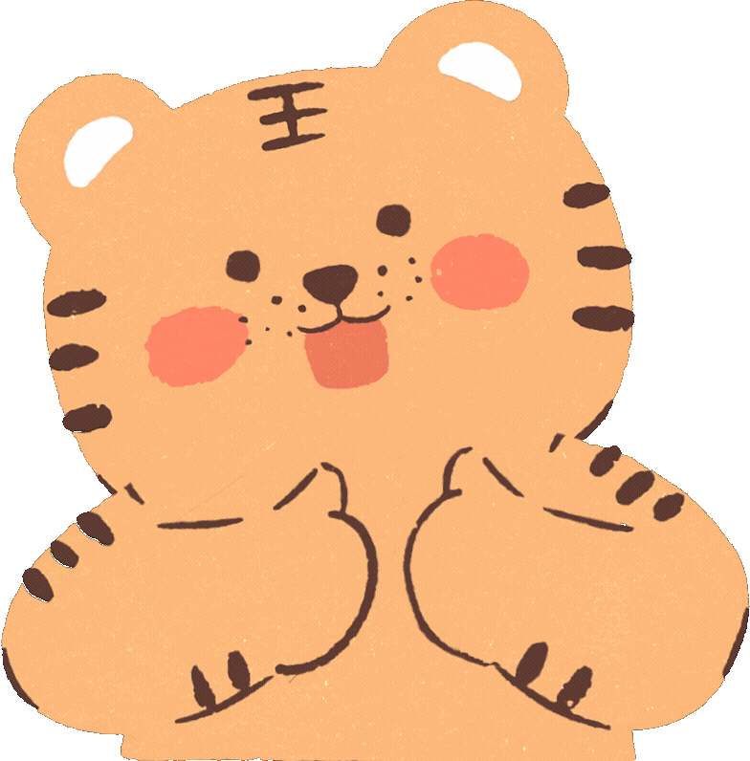



Slide 7
02
Read and tick True or False.

Slide 8

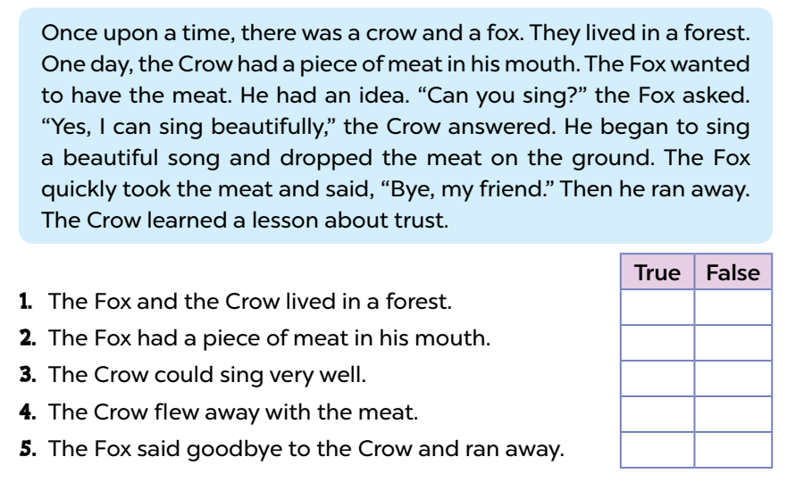

Look and listen.
Once upon a time, a crow and a fox lived in a big forest. The fox liked
to trick other animals. One day, the crow had a piece of meat in his
mouth. The fox saw the meat, and he wanted to have it. He had an
idea. He said to the crow, “You look amazing. Can you sing?” “Yes, I
can sing beautifully,” the crow replied. And he sang. As he answered
the fox, the meat dropped to the ground. The fox quickly took the
meat and said, “Bye, my friend.” Then he ran away. The crow learned
a lesson about trust.
READ
1. The fox and the crow lived in a forest.
2. The crow had a piece of fish in his mouth.
3. The fox wanted to have the meat.
4. The crow flew away with the meat.
5. The fox quickly took the meat.
✗
READ

Slide 9
True of False.
1. The fox and the crow lived in a forest.
Once upon a time, a crow and a fox lived in a big forest.
True

Slide 10
Page 51
Read and tick True or False.
Once upon a time, a crow and a fox lived in a big forest. The fox liked
to trick other animals. One day, the crow had a piece of meat in his
mouth. The fox saw the meat, and he wanted to have it. He had an
idea. He said to the crow, “You look amazing. Can you sing?” “Yes, I
can sing beautifully,” the crow replied. And he sang. As he answered
the fox, the meat dropped to the ground. The fox quickly took the
meat and said, “Bye, my friend.” Then he ran away. The crow learned
a lesson about trust.
READ
1. The fox and the crow lived in a forest.
2. The crow had a piece of fish in his mouth.
3. The fox wanted to have the meat.
4. The crow flew away with the meat.
5. The fox quickly took the meat.
✗
READ

Slide 11
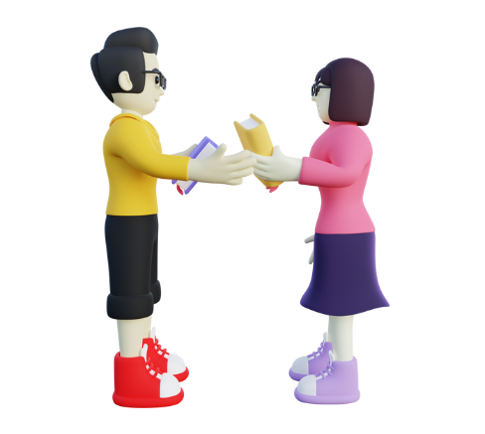
Swap your books and check your answers.

Slide 12
True of False.
2. The crow had a piece of fish in his mouth.
One day, the crow had a piece of meat in his
mouth.
False

Slide 13

True of False.
3. The fox wanted to have the meat.
The fox saw the meat, and he wanted to have it.
True

Slide 14
True of False.
4. The crow flew away with the meat.
He said to the crow, “You look amazing. Can you sing?” “Yes, I can sing beautifully,” the crow replied. And he sang. As he answered the fox, the meat dropped to the ground.
False

Slide 15
True of False.
5. The fox quickly took the meat.
The fox quickly took the meat and said, “Bye, my friend.” Then he ran away.
True

Slide 16
Read aloud with good voice and actions.
Page 51
Once upon a time, a crow and a fox lived in a big forest. The fox liked
to trick other animals. One day, the crow had a piece of meat in his
mouth. The fox saw the meat, and he wanted to have it. He had an
idea. He said to the crow, “You look amazing. Can you sing?” “Yes, I
can sing beautifully,” the crow replied. And he sang. As he answered
the fox, the meat dropped to the ground. The fox quickly took the
meat and said, “Bye, my friend.” Then he ran away. The crow learned
a lesson about trust.

Slide 18
03
Let’s write.

Slide 19

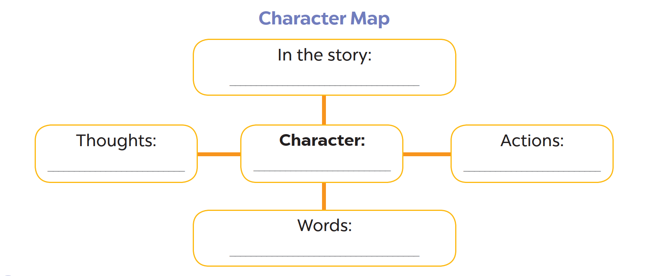

Slide 20
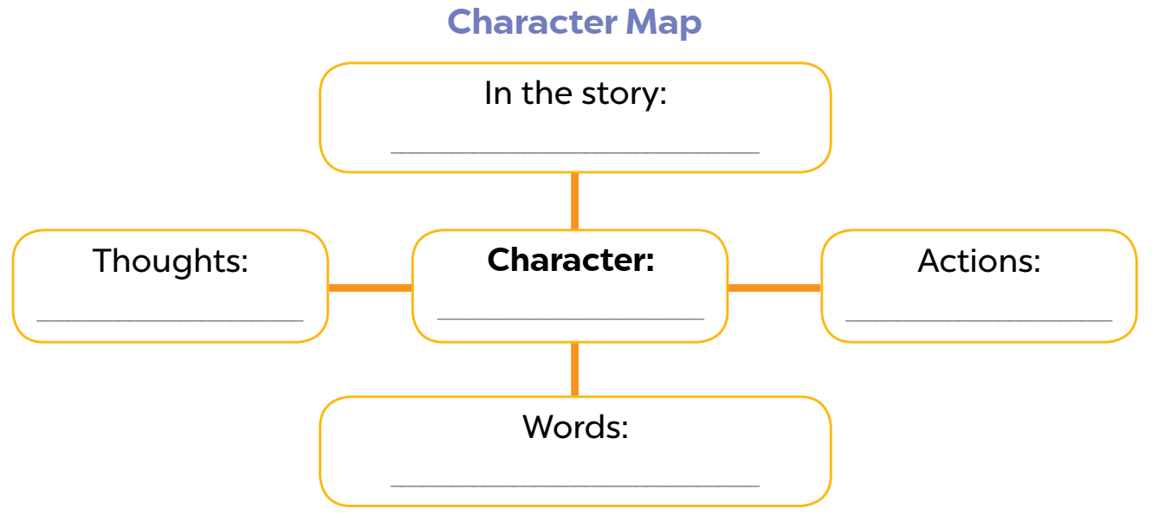
Read and choose ideas to write.
Once upon a time, a crow and a fox lived in a big forest. The fox liked to trick other animals. One day, the crow had a piece of meat in his mouth. The fox saw the meat, and he wanted to have it. He had an idea. He said to the crow, “You look amazing. Can you sing?” “Yes, I can sing beautifully,”
the crow replied. And he sang. As he answered the fox, the meat dropped to the ground. The fox quickly took the meat and said, “Bye, my friend.” Then he ran away. The crow learned
a lesson about trust.
the Fox

Slide 21
Read and choose ideas to write.
the Fox and the Crow
I want to have the meat.
the Fox
I take the meat from the Crow.
Can you sing? / Bye, my friend.

Slide 22
Think and write.

Slide 23
Swap your books and talk about the map.

Slide 24
Talk about your character map.

Slide 26
04
Project

Slide 27
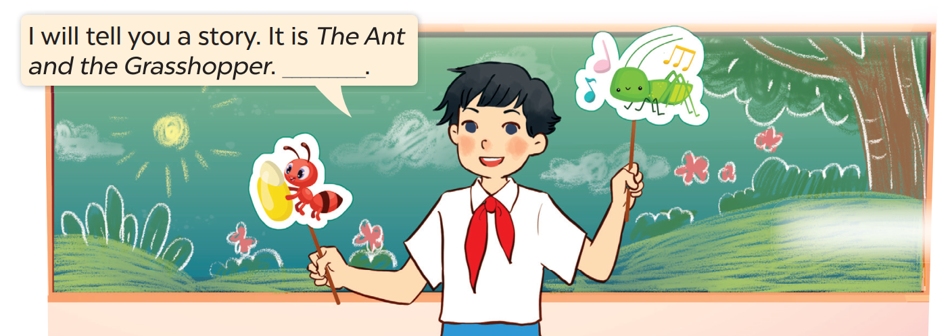
Look and listen.
Telling a story
I will tell you a story. It is The Ant and the Grasshopper.

Slide 28
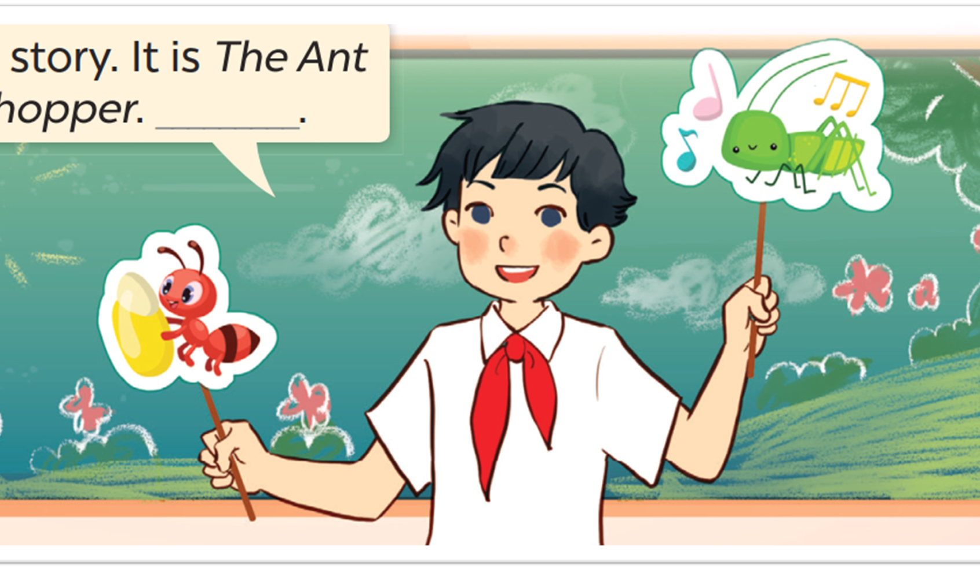
Work in groups.
Telling a story

Slide 29

Let’s tell a story.

Slide 31
05
Fun corner and Wrap-up

Slide 32








Let’s play
BINGO

Slide 33

BINGO
Write 6 characters.
Listen and circle.
Say BINGO when you get 5 circles.
the Ant
the Hare
the Crow
the seven dwarfs
the Grasshopper
Snow White

Slide 34




ARE YOU READY
TO WIN?

Slide 35


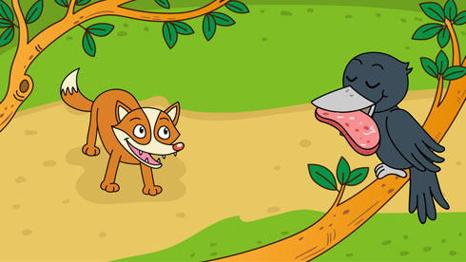




Slide 36
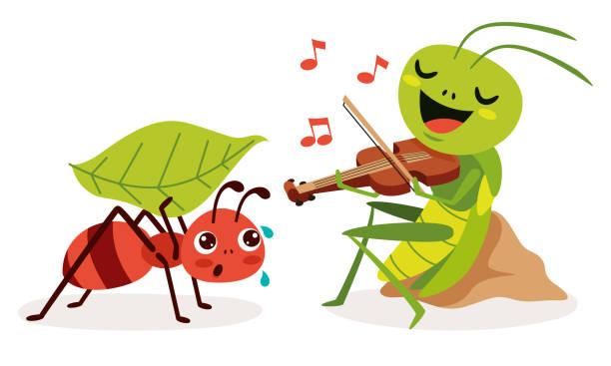

Slide 37
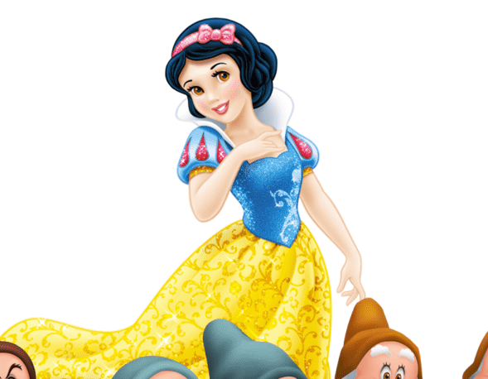

Slide 38
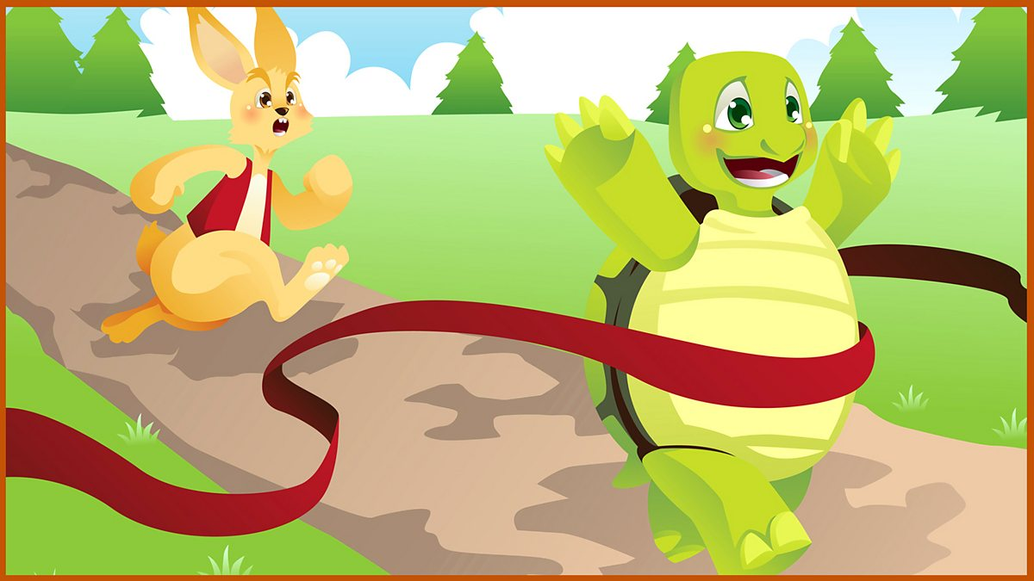

Slide 42



2
1
ND
ST
OUR WINNER IS ....
JOHN
KORINA
Notes:
Add your pupils’ name to the frames.

Slide 43



Let’s talk!
Notes:
- Pupils raise their hands to talk about their characters circled to get scores from the teacher, e.g., I like the ant because he worked hard.

Slide 45
Website: hoclieu.vn
Fanpage: https://www.facebook.com/tienganhglobalsuccess.vn/

