Slide 1





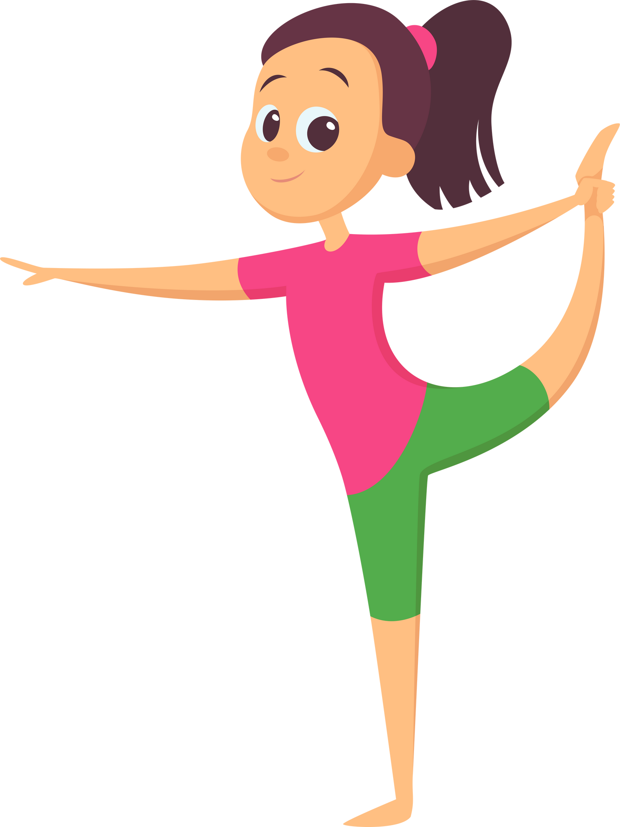


Unit 14: STAYING HEALTHY
Lesson 2 - Period 4

Slide 2




01
Warm-up and Review.

Slide 3







QUIZ TIME

Slide 4




Quiz Categories
YES / NO STATMENT
MULTIPLE CHOICE
TRUE / FALSE STATEMENT
FILL IN THE BLANKS
ANSWER THE QUESTION
ENUMERATION
ANSWER THE QUESTION

Slide 5


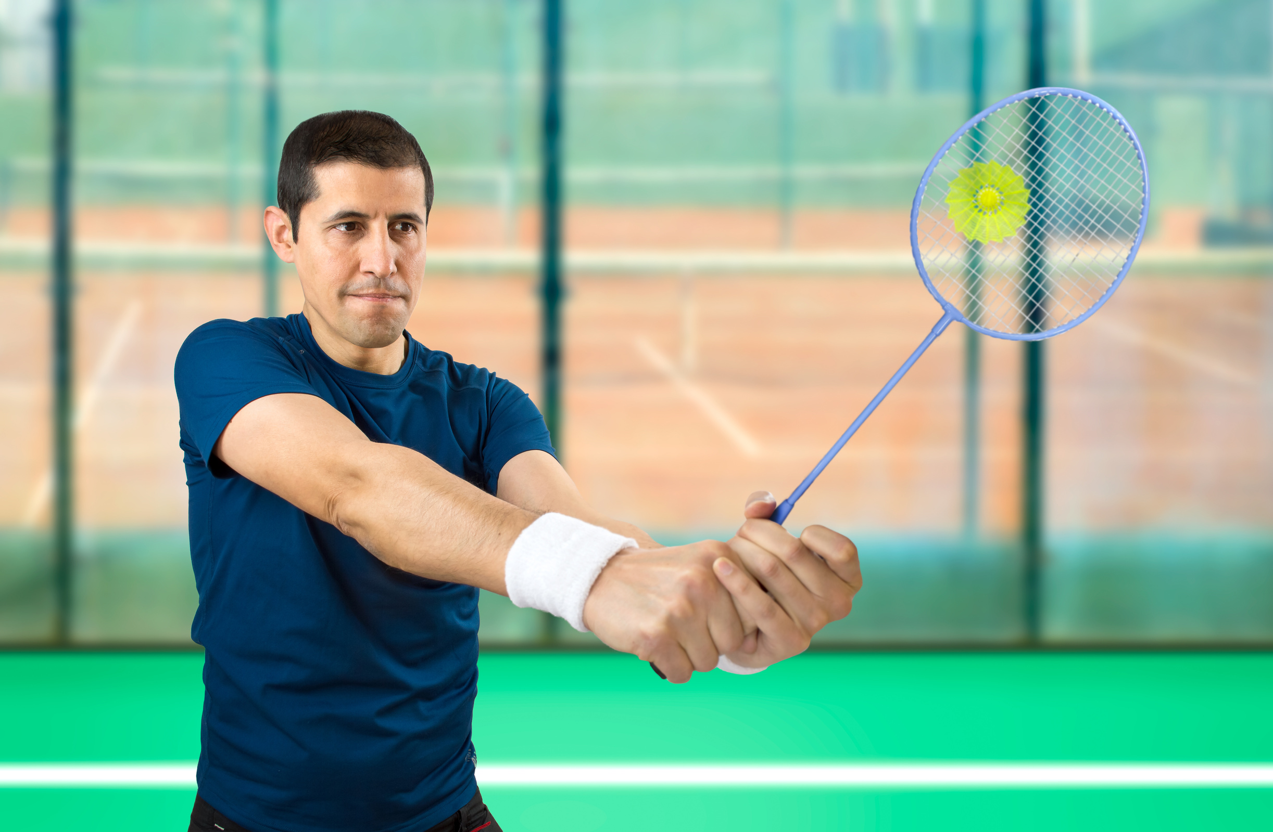
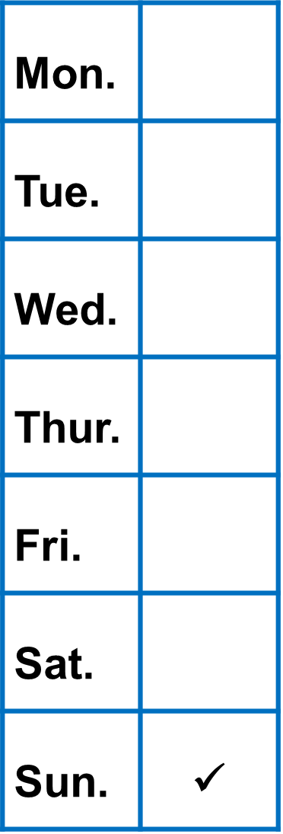


YES OR NO STATEMENT
My father plays badminton once a week.
YES / NO

Slide 6


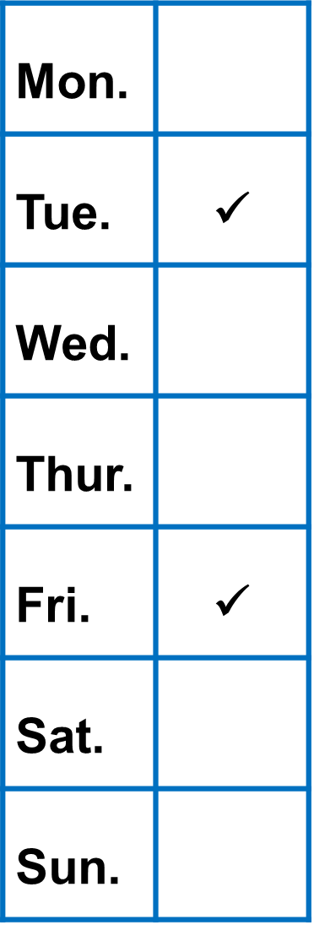


TRUE OR FALSE STATEMENT
My mother drinks orange juice every day.
TRUE / FALSE

Slide 7

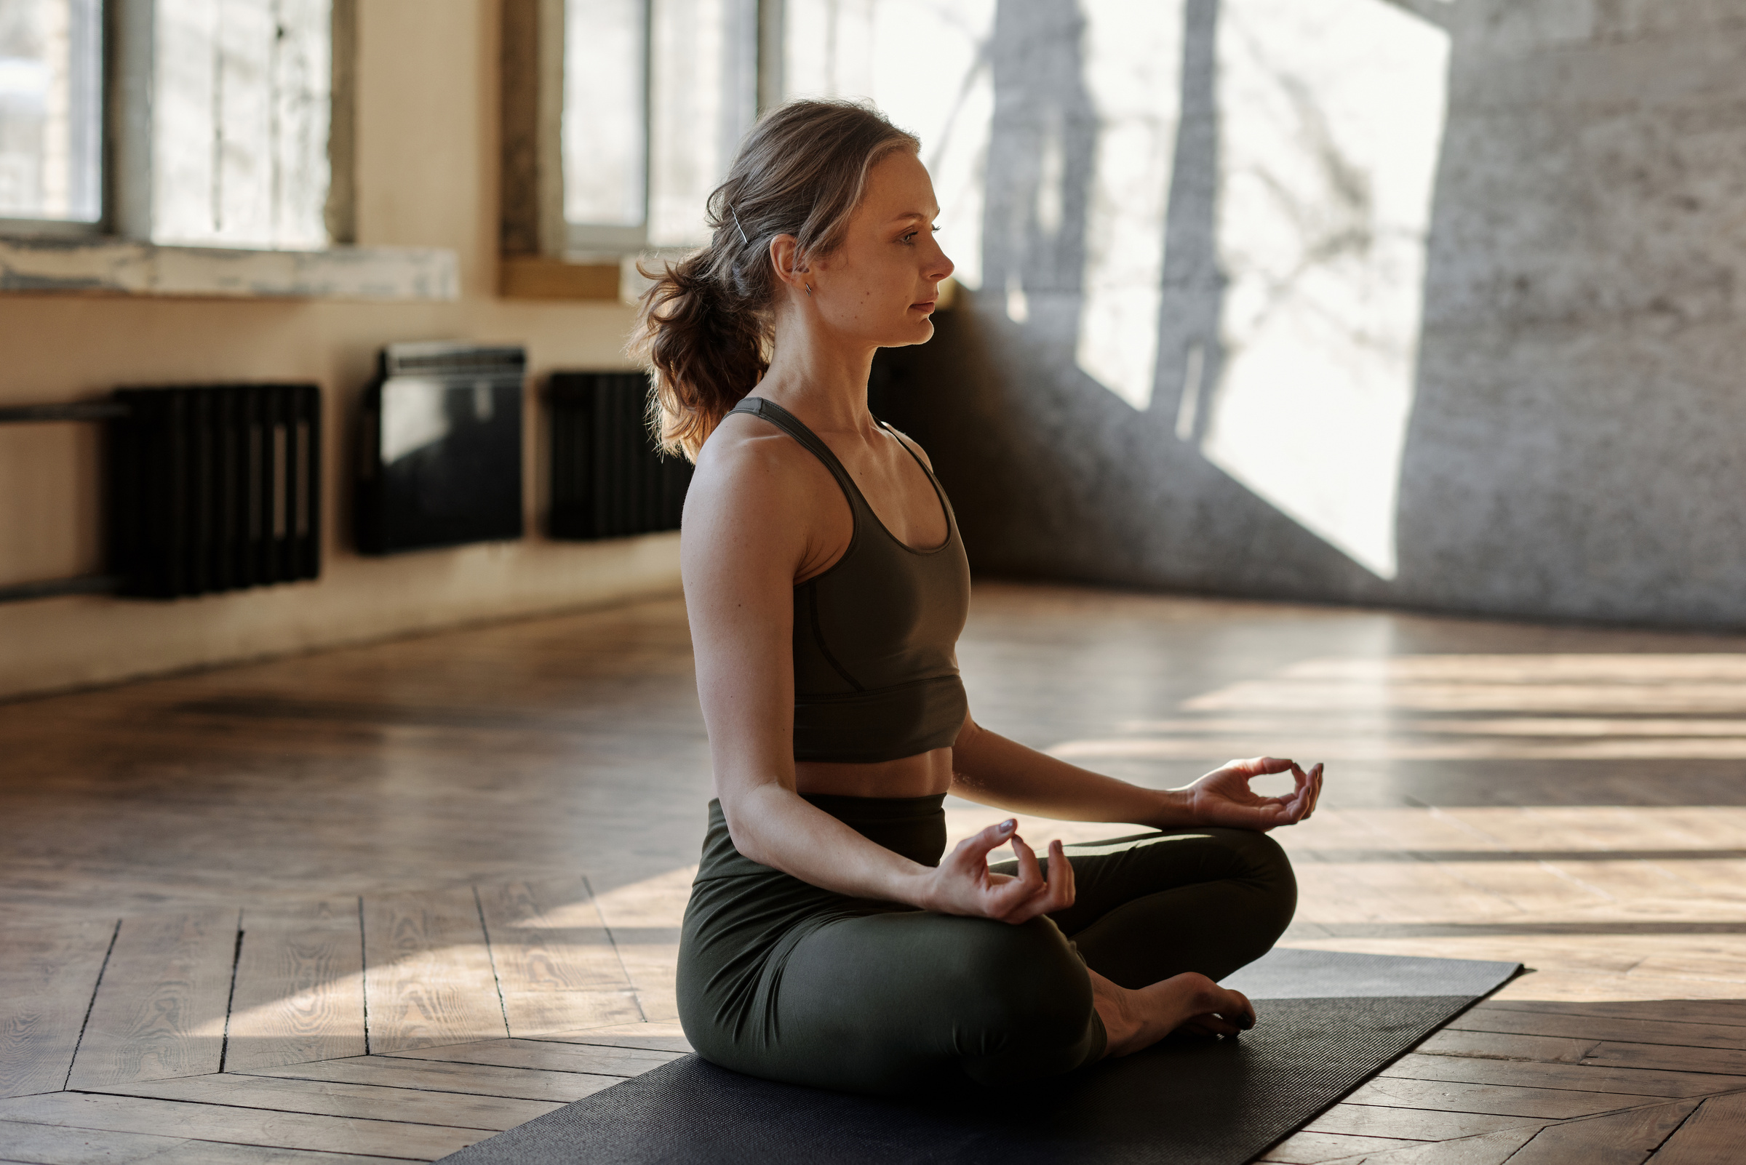

ANSWER THE QUESTION.
How often does your mother do yoga?

Slide 8




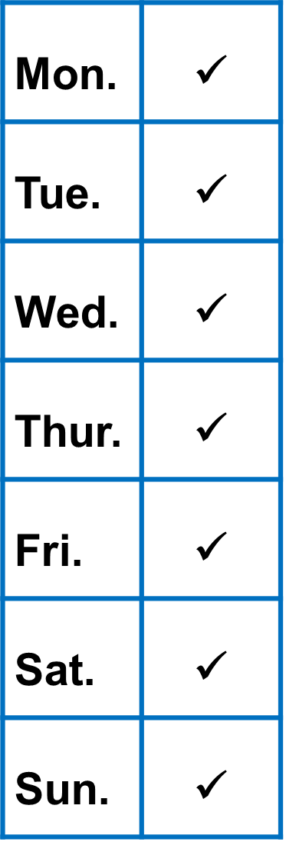
MULTIPLE CHOICE
My mother listens to music ______.
A
once a week
B
twice a week
C
three times a week
✓
D
every day

Slide 9





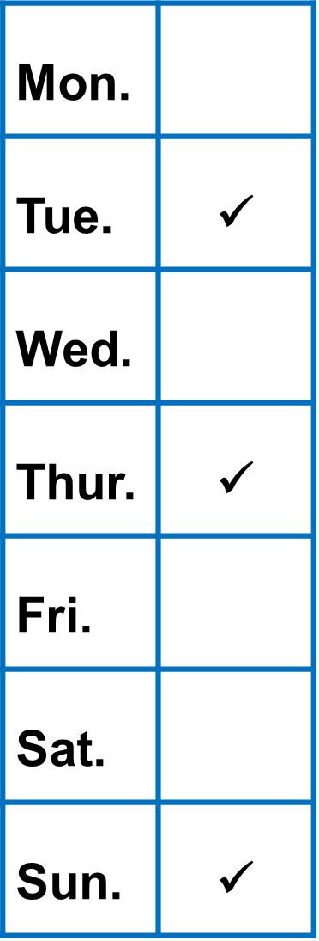
FILL IN THE BLANK
My brother eats vegetables
_________________.
three times a week

Slide 10



ENUMERATION
List 2 activities you do twice a week.
1
2

Slide 11
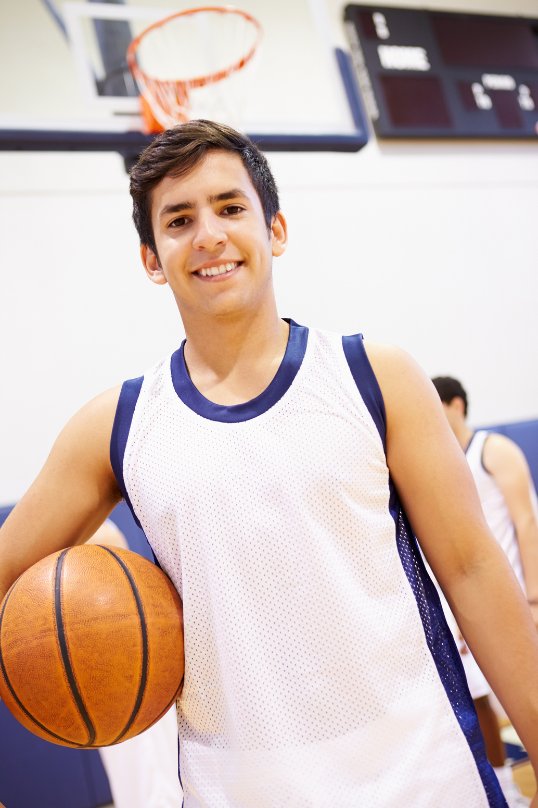
ANSWER THE QUESTION
How often does your brother play basketball?

Slide 12

THANK YOU
FOR PLAYING!

Slide 13
02
Activity 4
Listen and circle.

Slide 14


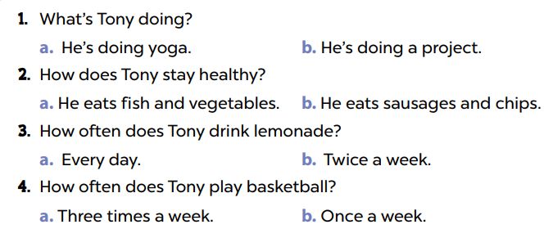


Look and say.
Notes:
Step 1: Ask pupils to read the questions and the options. Have them work in pairs to guess the correct options that can be the answers. Check comprehension.

Slide 15

Listen and circle.
Notes:
Step 2: Play the recording all the way through so that pupils can become familiar with the character’s voice. Then play the recording for them to listen to and circle the correct options.

Slide 16
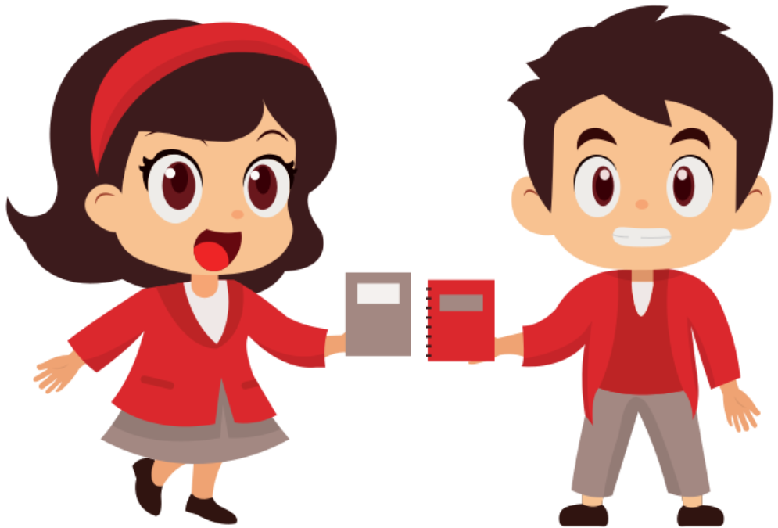
Swap books.
Notes:
Step 3: Get pupils to swap their books with a partner and check their answers before checking as a class. Then play the recording and stop at the sentence for the class to double-check their answers. Have pupil repeat the information in the recording to explain their answer, for example, He’s doing a project. He eats healthy food like fish and vegetables. He drinks lemonade twice a week. He plays basketball three times a week.

Slide 17
Listen and check.
Notes:
Step 3: Get pupils to swap their books with a partner and check their answers before checking as a class. Then play the recording and stop at the sentence for the class to double-check their answers. Have pupil repeat the information in the recording to explain their answer, for example, He’s doing a project. He eats healthy food like fish and vegetables. He drinks lemonade twice a week. He plays basketball three times a week.

Slide 18
03
Activity 5
Read and complete.

Slide 19


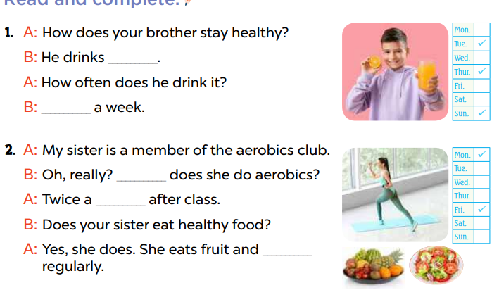


Look and say.
Notes:
Step 1: Model the first gapped exchange as an example. Have pupils read the dialogue and guess the missing words, for example, something to drink, orange juice, lemonade, apple juice. Then draw pupils’ attention to the picture and elicit the phrases to fill in the gaps (orange juice, three times a week).

Slide 20
Read and complete.
Notes:
Step 2: Give pupils a time limit to complete the gapped exchange 2 independently. Go around the classroom and help where necessary.

Slide 21
Swap books.
Notes:
Step 3: Get pupils to swap books with a partner and check their answers before checking as a class. Invite one pupil to write the answers on the board.

Slide 22
Check the answers.
orange juice
Three times
How often
week
vegetables
Notes:
Step 3: Get pupils to swap books with a partner and check their answers before checking as a class. Invite one pupil to write the answers on the board.

Slide 23
04
Activity 6
Let’s play.

Slide 24


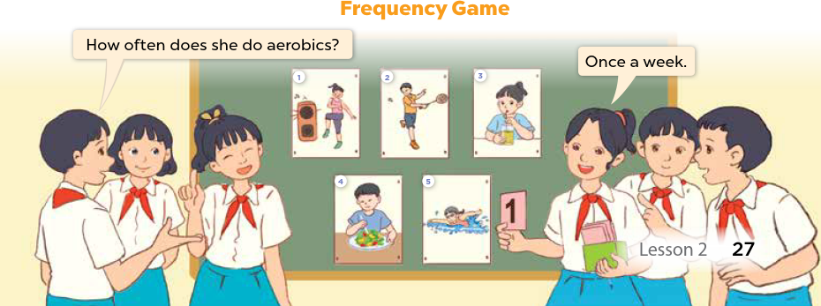


Let’s play.
Notes:
Step 1: Tell pupils the aim of the activity: They listen to the song and fill in the gaps in the lyrics and sing it with correct pronunciation, rhythm and melody.

Slide 25
05
Fun corner and wrap-up.

Slide 26
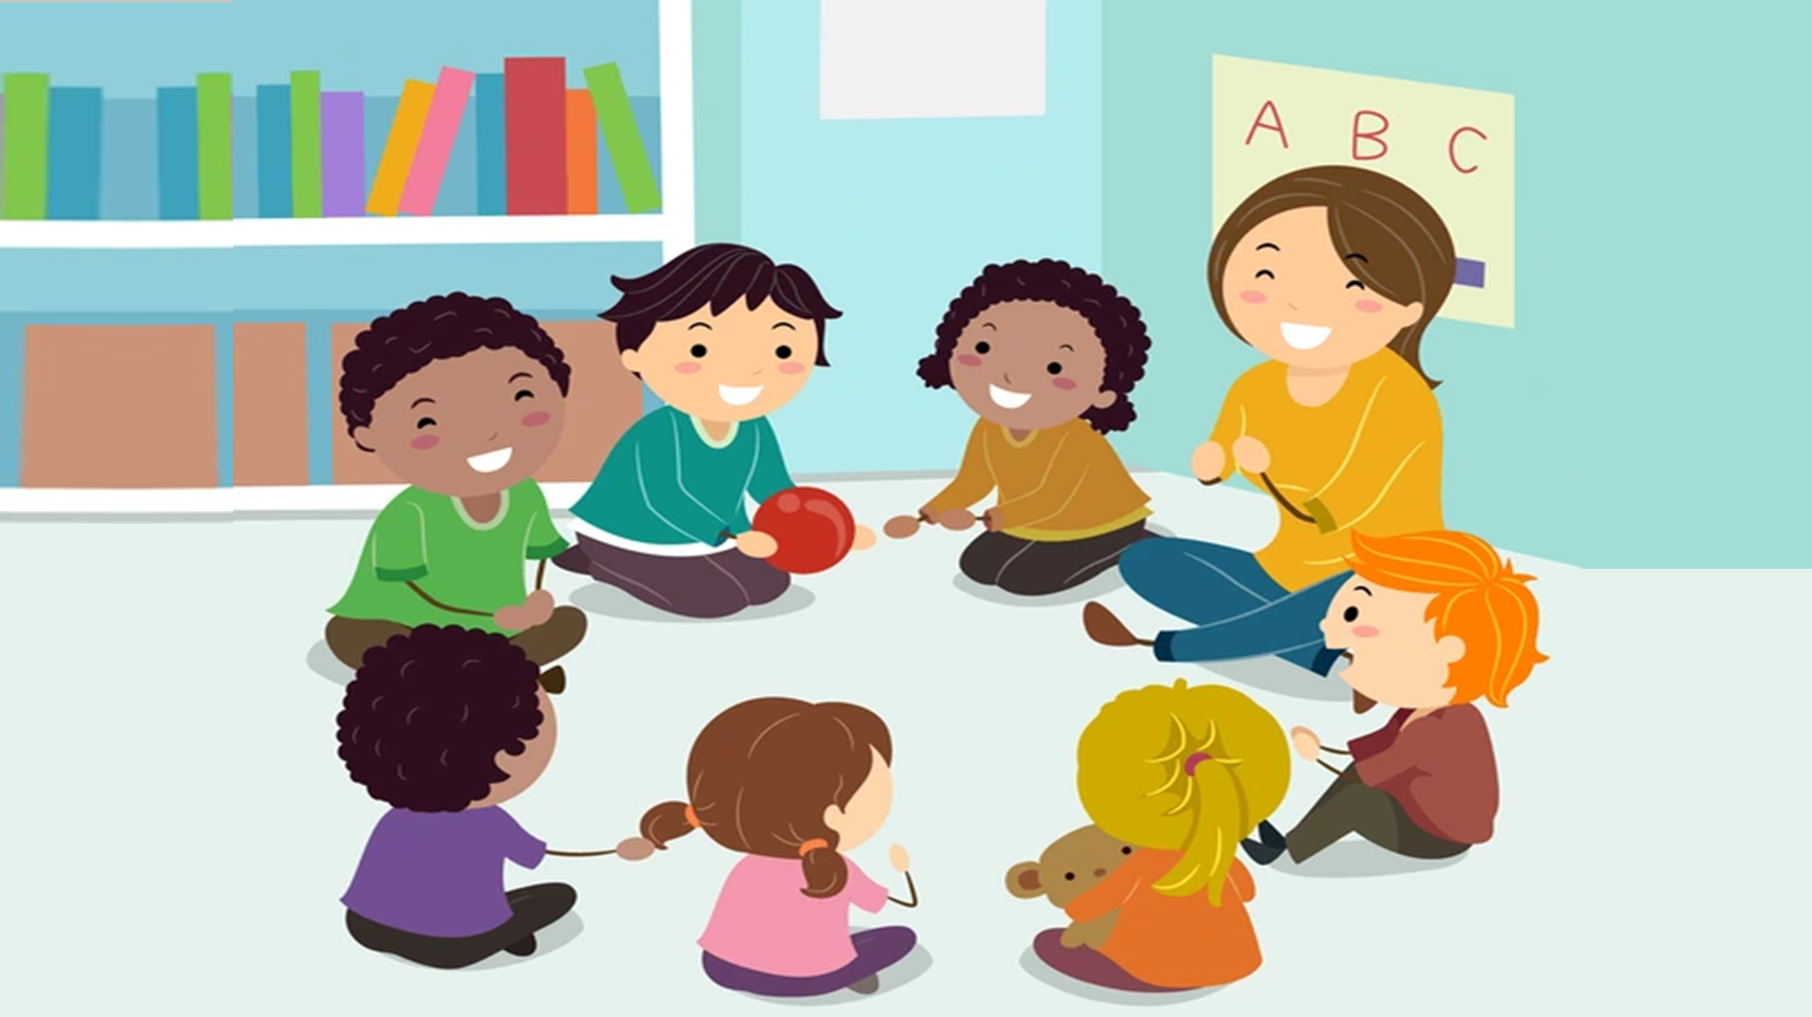
Pass the ball.

