Slide 1




Unit 15
OUR
HEALTH
Lesson 1 – Period 1

Slide 2



01
Warm-up and Review

Slide 3






Project
Presentation
Class: ………………………

Slide 4

Work
in groups.

Slide 5
Let’s talk
in the front!

Slide 6






Slide 7
02
Activity 1
Look, listen and repeat.

Slide 8

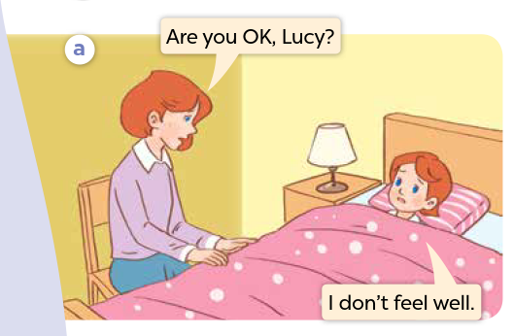


Look and say.
Notes:
Step 1: Ask pupils to look at Pictures a and b, and identify the characters and other details.

Slide 9
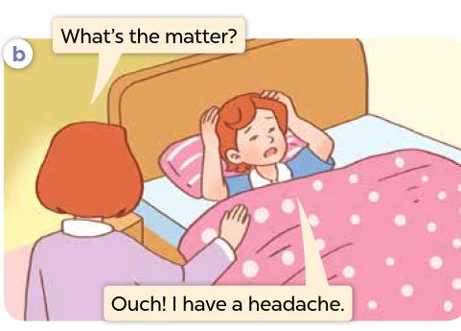
Look and say.
Notes:
Step 1: Ask pupils to look at Pictures a and b, and identify the characters and other details.

Slide 10
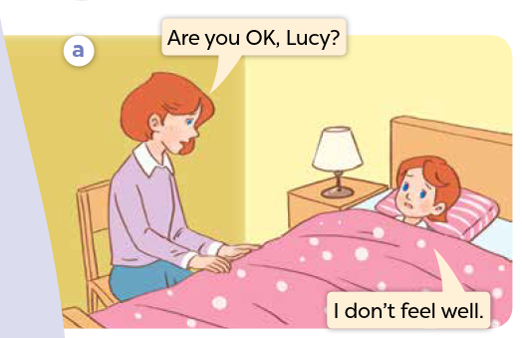

Listen and point.
Notes:
Step 2: Ask pupils to look at Picture a and b. Play the recording for them to listen to the entire
conversation several times and point to the characters.

Slide 11
Listen, point and repeat.
Notes:
Step 3: Play the recording again, sentence by sentence, for pupils to listen and repeat individually and in chorus. Correct their pronunciation where necessary. Repeat the same procedure with Picture b.

Slide 12
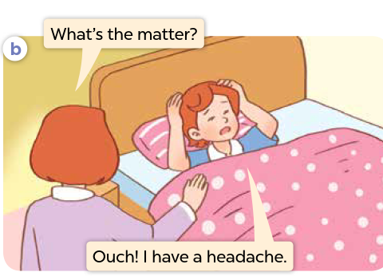
Listen, point and repeat.

Slide 13
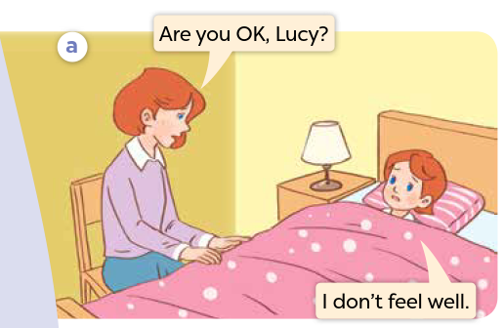
Listen and repeat.
Notes:
Step 4: Invite a few pairs to the front of the class to listen and repeat the sentences in the
recording. Check their pronunciation, and give corrections and feedback where
necessary.
Step 5: Direct pupils’ attention to the question What’s the matter? and the answer I have a headache. Explain that they are a question and an answer about someone’s health.

Slide 15
03
Activity 2
Listen, point and say.

Slide 16
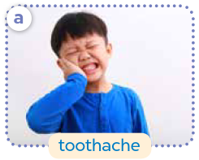
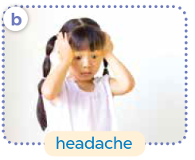
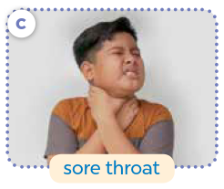
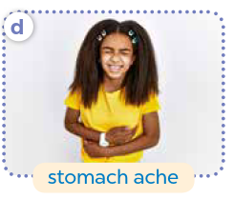
Look and say.
Notes:
Have pupils look at the pictures and say what they can see.

Slide 17
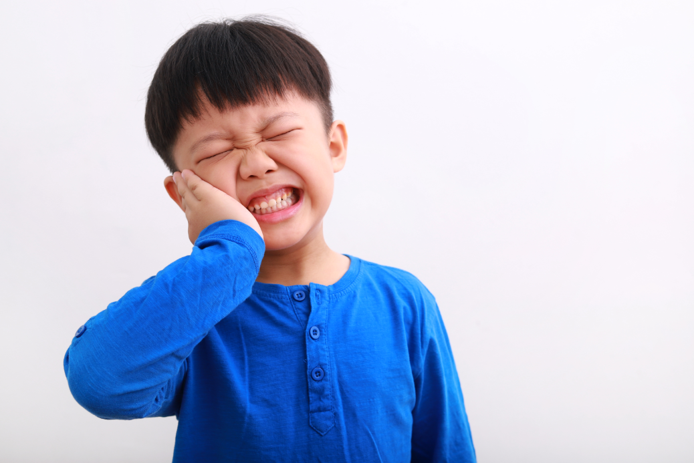
Listen and repeat.
a. toothache
Notes:
Step 1: Have pupils point at Picture a, listen to the recording and repeat the word toothache. Repeat the same procedure with Pictures b, c and d. Have the class repeat the words and phrases a few times.

Slide 18
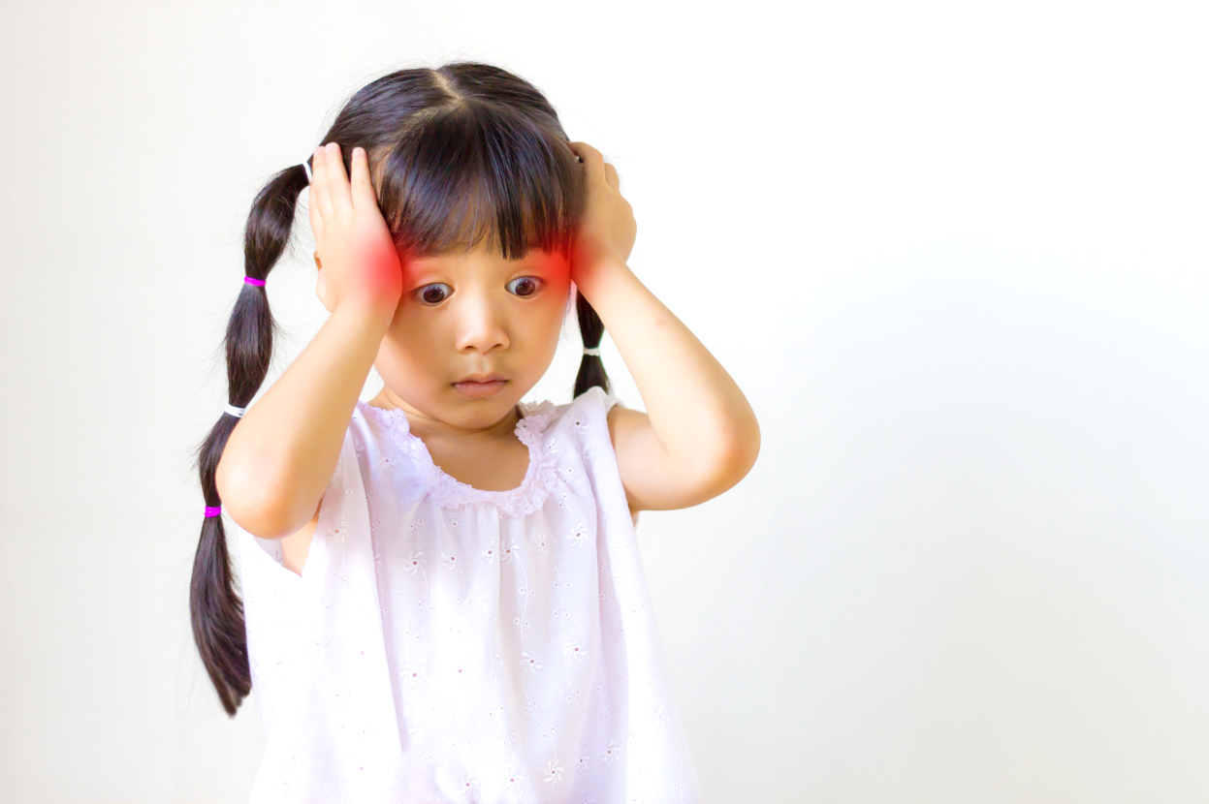
Listen and repeat.
b. headache
Notes:
Step 1: Have pupils point at Picture a, listen to the recording and repeat the word toothache. Repeat the same procedure with Pictures b, c and d. Have the class repeat the words and phrases a few times.

Slide 19
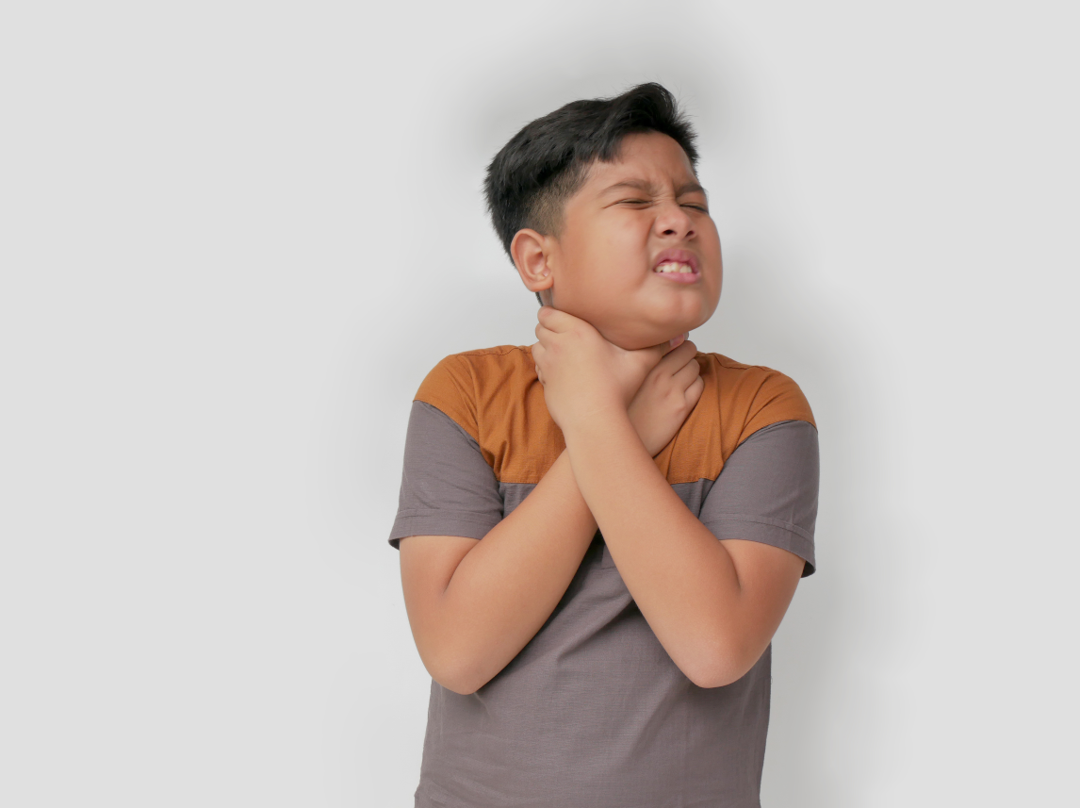
Listen and repeat.
c. sore throat
Notes:
Step 1: Have pupils point at Picture a, listen to the recording and repeat the word toothache. Repeat the same procedure with Pictures b, c and d. Have the class repeat the words and phrases a few times.

Slide 20

Listen and repeat.
d. stomach ache
Notes:
Step 1: Have pupils point at Picture a, listen to the recording and repeat the word toothache. Repeat the same procedure with Pictures b, c and d. Have the class repeat the words and phrases a few times.

Slide 21
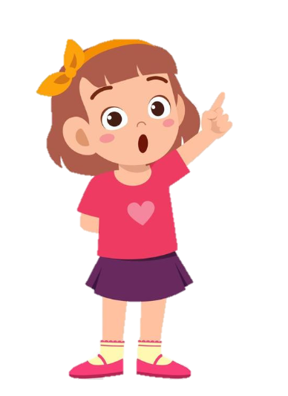
Listen and repeat.
I have a toothache.
What’s the matter?
Notes:
Step 2: Point at the question pattern What’s the matter? Read it aloud and have pupils repeat it several times. Repeat the procedure with the answer pattern I have ___.
Step 3: Point at Picture a and have pupils listen and repeat after the recording What’s the matter? - I have toothache. Repeat the same procedure with Pictures b, c and d.
Step 4: Divide the class into two groups to take turns repeating the question and the answer in Picture a until they feel confident. Repeat the same procedure with Pictures b, c and d.

Slide 22
Listen and repeat.
I have a headache.
What’s the matter?
Notes:
Step 3: Point at Picture a and have pupils listen and repeat after the recording What’s the matter? - I have toothache. Repeat the same procedure with Pictures b, c and d.
Step 4: Divide the class into two groups to take turns repeating the question and the answer in Picture a until they feel confident. Repeat the same procedure with Pictures b, c and d.

Slide 23
Listen and repeat.
I have a sore throat.
What’s the matter?
Notes:
Step 3: Point at Picture a and have pupils listen and repeat after the recording What’s the matter? - I have toothache. Repeat the same procedure with Pictures b, c and d.
Step 4: Divide the class into two groups to take turns repeating the question and the answer in Picture a until they feel confident. Repeat the same procedure with Pictures b, c and d.

Slide 24
Listen and repeat.
I have a stomach ache.
What’s the matter?
Notes:
Step 3: Point at Picture a and have pupils listen and repeat after the recording What’s the matter? - I have toothache. Repeat the same procedure with Pictures b, c and d.
Step 4: Divide the class into two groups to take turns repeating the question and the answer in Picture a until they feel confident. Repeat the same procedure with Pictures b, c and d.

Slide 25
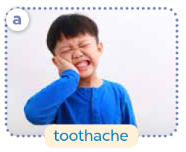


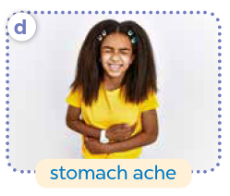
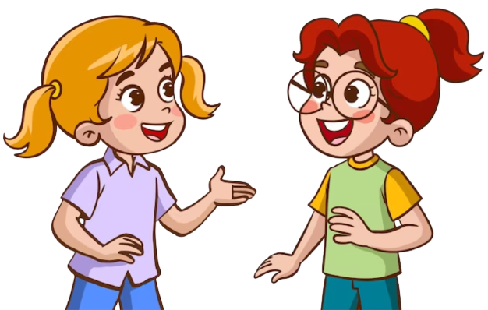
Ask and answer.
Notes:
Step 5: Put pupils in pairs and have them practise asking and answering questions using the pictures. Invite a few pairs to point at the pictures and say the questions and answers in front of the class. Give corrections and feedback where necessary.

Slide 27
04
Activity 3
Let’s talk.

Slide 28

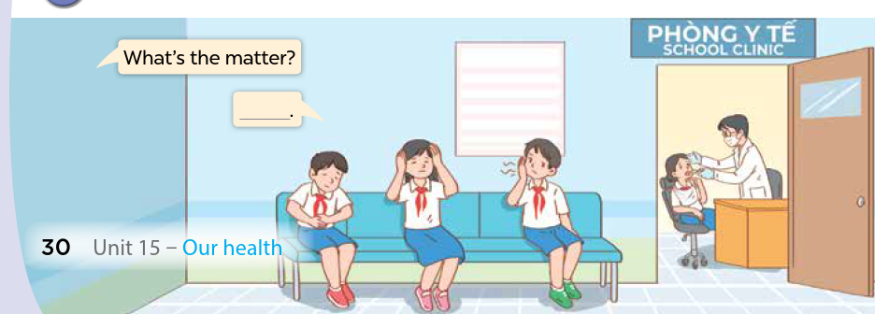

Look and say.
Notes:
Step 1: Direct pupils’ attention to the phrase Phòng Y tế (Clinic) to guess the context of the picture. Ask them about the health problems that the characters may have.

Slide 29

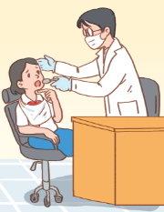
Look and say.
________________
What’s the matter?
Notes:
Step 2: Read the question in the speech bubble aloud and ask pupils to repeat it. Ask pupils to look at the second bubble and guess what the answer should be.

Slide 30
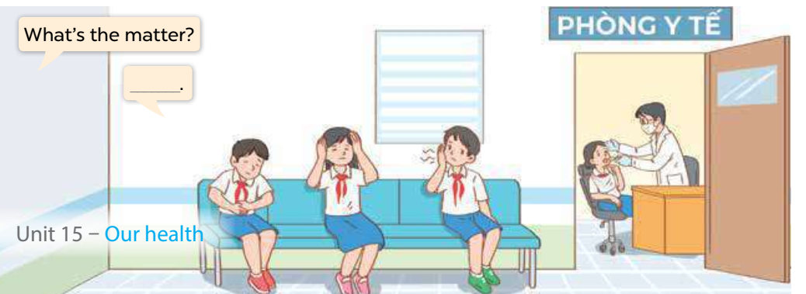
Ask and answer.
Notes:
Step 3: Have some pairs role-play by asking and answering questions about the health problems in the picture. Go around the classroom to observe and provide help.

Slide 31

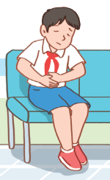

Ask and answer.
What’s the matter?
I have
a stomach ache.
Notes:
Step 4: Invite some pairs to role-play as a doctor and a pupil to ask and answer questions about health problems in front of the class. Give corrections and feedback where necessary. Then, encourage pupils to talk about the other health problems that they know.

Slide 32
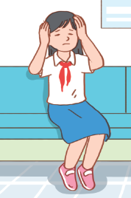
Look and say.
What’s the matter?
I have a headache.
Notes:
Step 2: Read the question in the speech bubble aloud and ask pupils to repeat it. Ask pupils to look at the second bubble and guess what the answer should be.

Slide 33
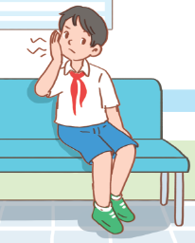
Look and say.
What’s the matter?
I have a toothache.
Notes:
Step 2: Read the question in the speech bubble aloud and ask pupils to repeat it. Ask pupils to look at the second bubble and guess what the answer should be.

Slide 34
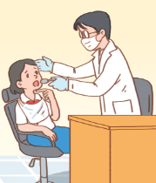
Look and say.
What’s the matter?
I have
a sore throat.
Notes:
Step 2: Read the question in the speech bubble aloud and ask pupils to repeat it. Ask pupils to look at the second bubble and guess what the answer should be.

Slide 36
05
Fun corner and Wrap-up

Slide 37





Yes or No Game
Let’s play!

Slide 38



The
Rules
  Answer the questions within limit time.
  If the answer is correct, the player will get 1 point.
  If the answer is wrong, the player will lose 1 point.
  Have fun!

Slide 39

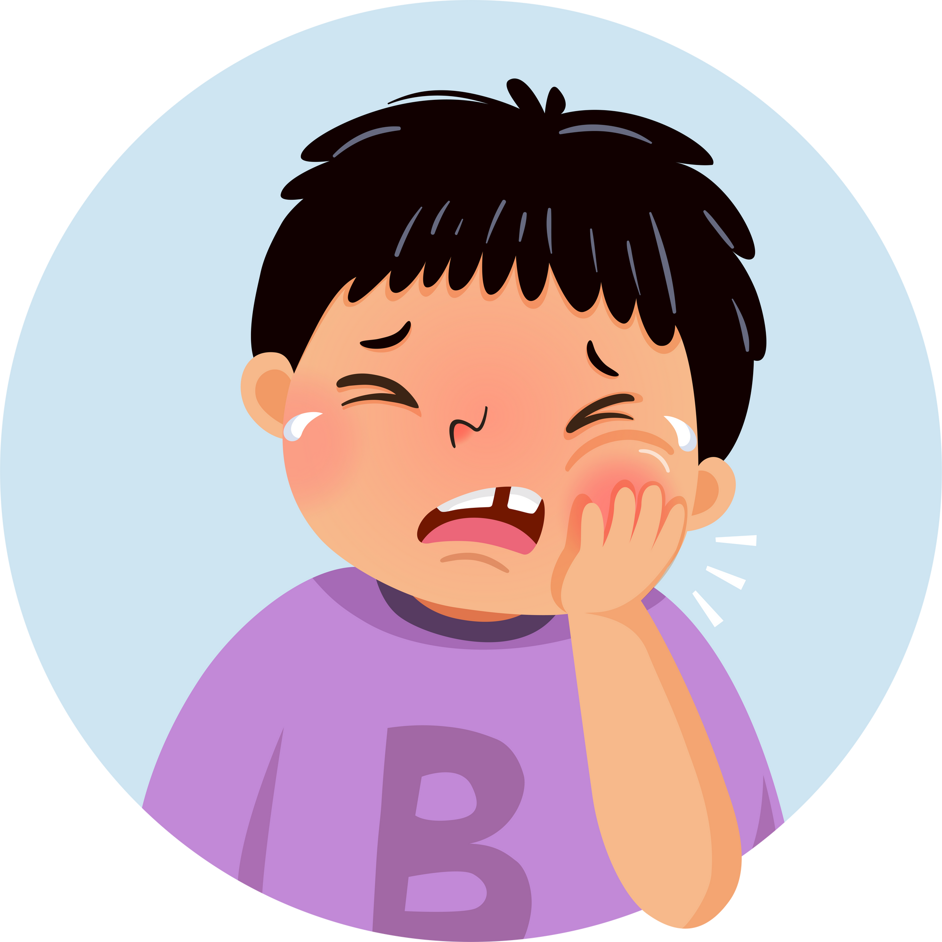

Question
  I have a toothache.
You have 5 seconds.

Slide 40

Answer
Yes

Slide 41
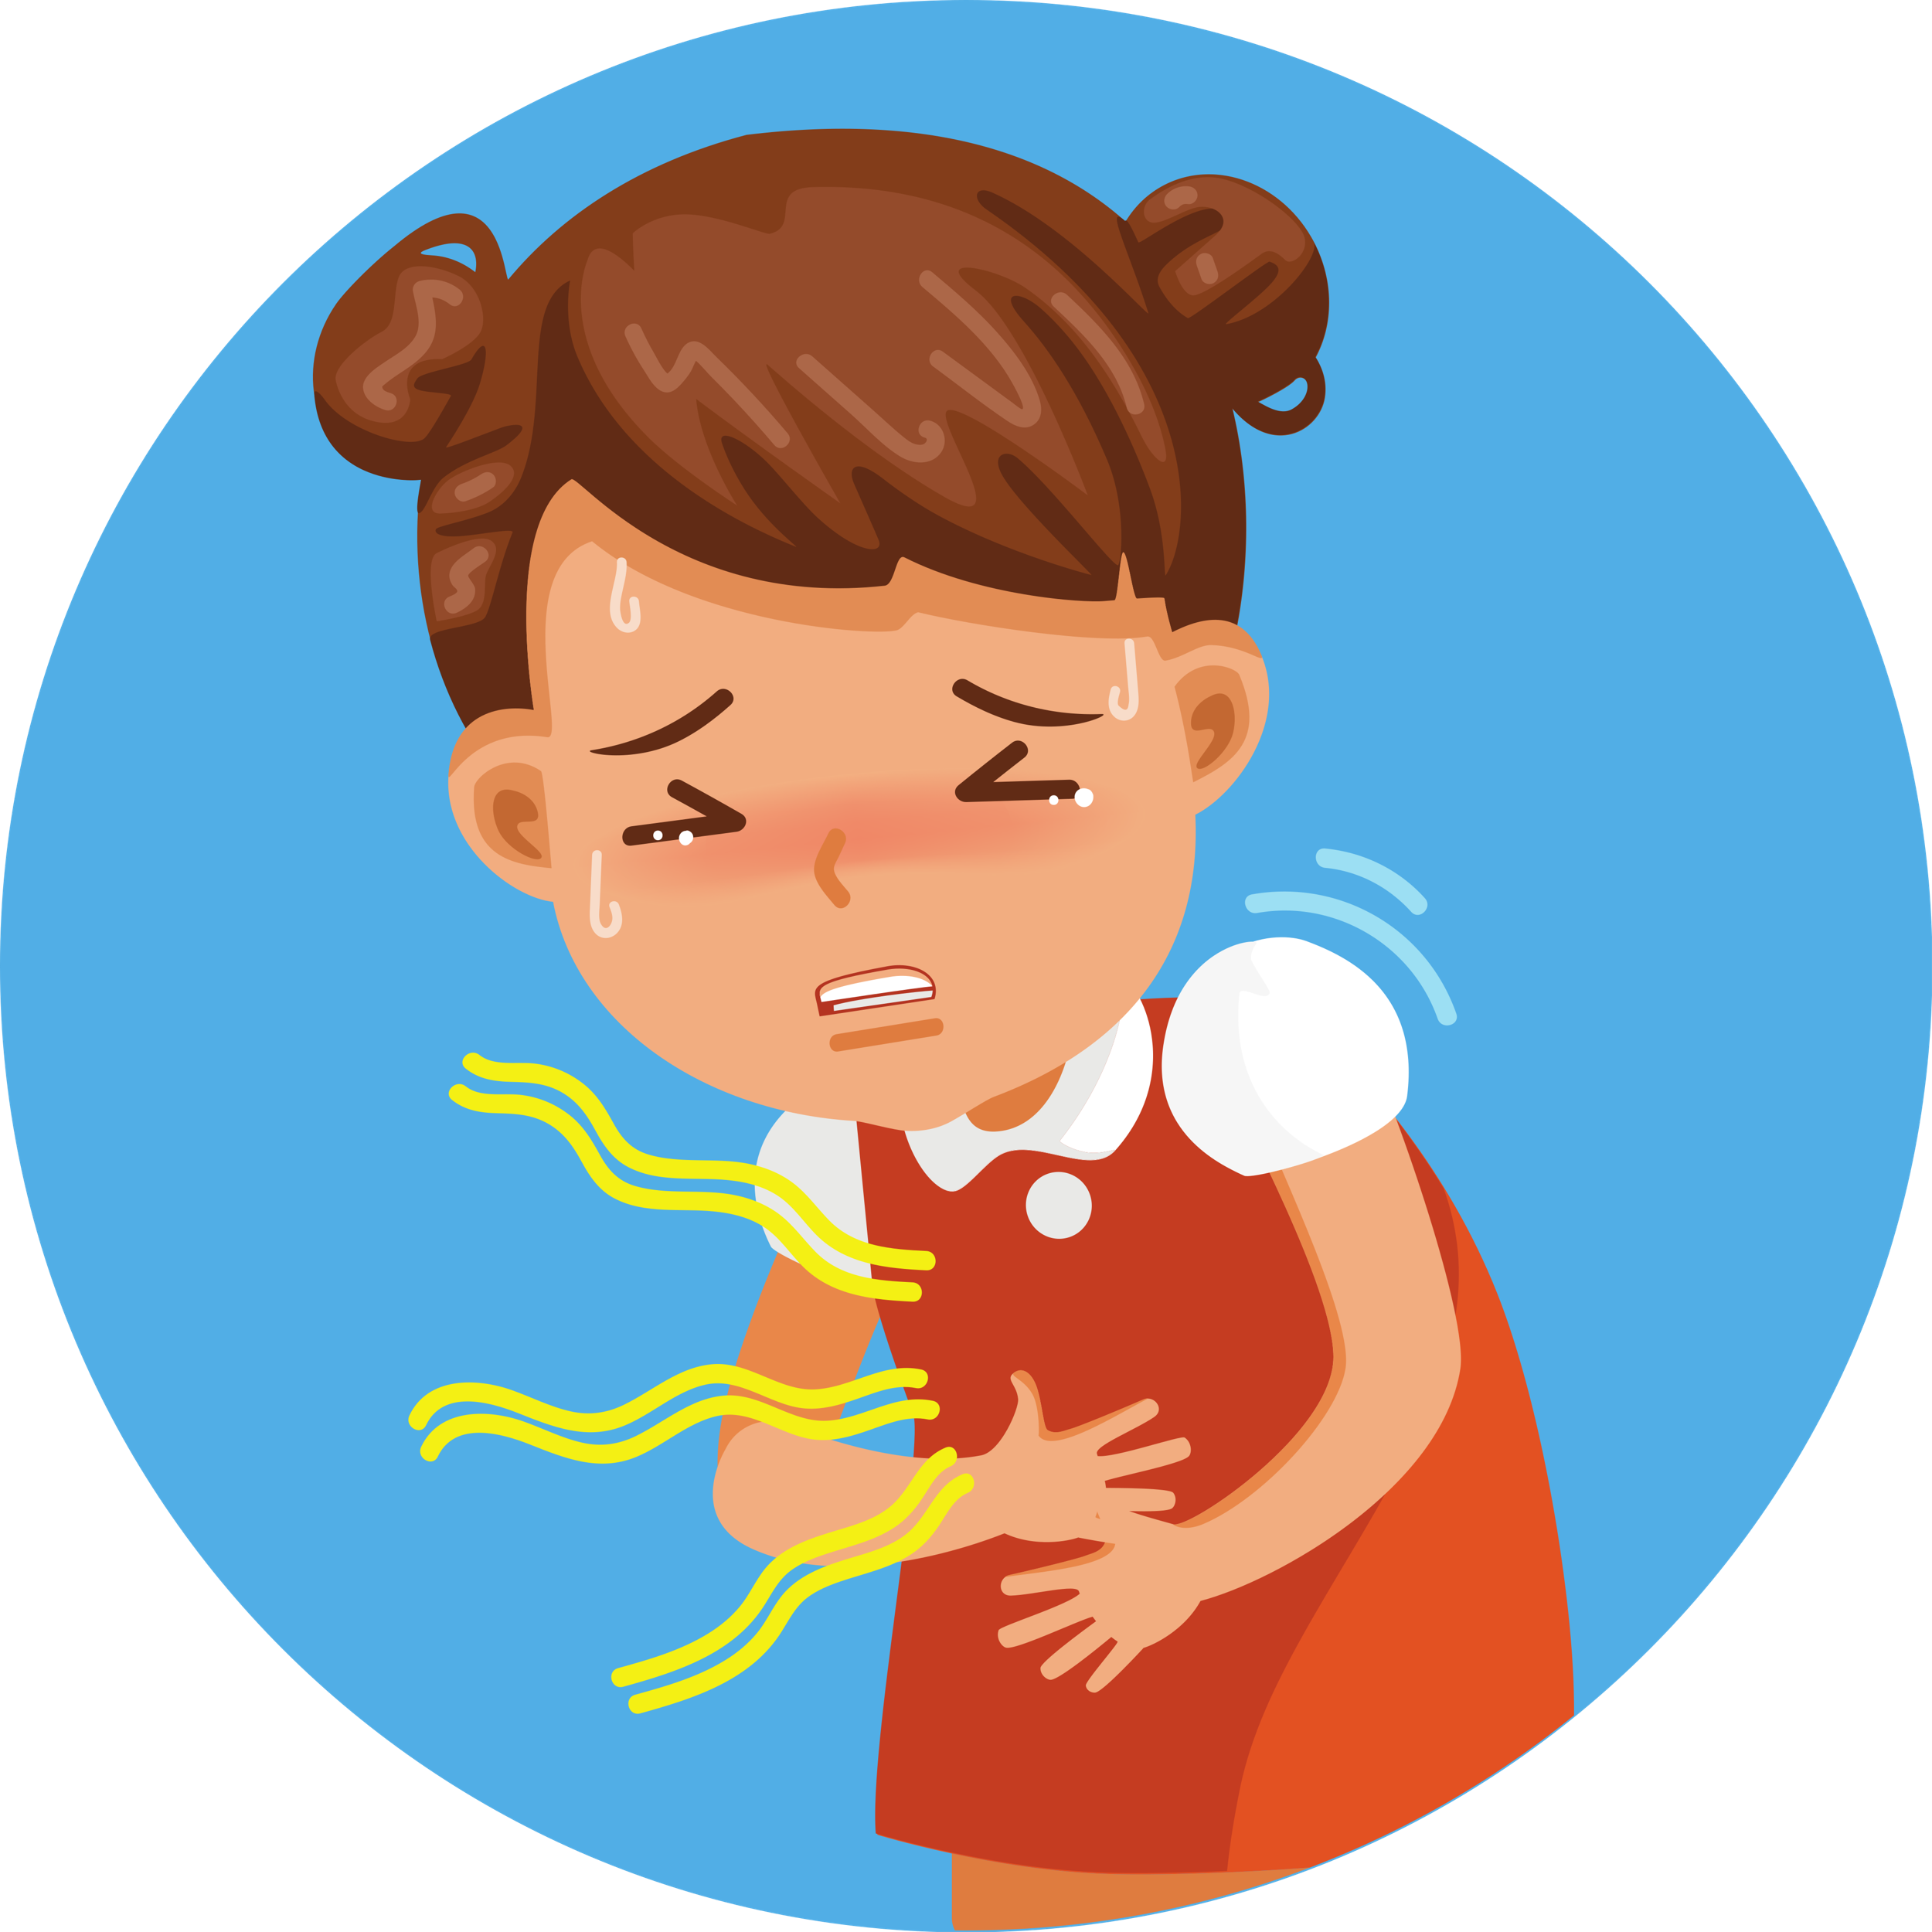
Question
  I have a headache.
You have 5 seconds.

Slide 42
Answer
No
I have a stomach ache.

Slide 43
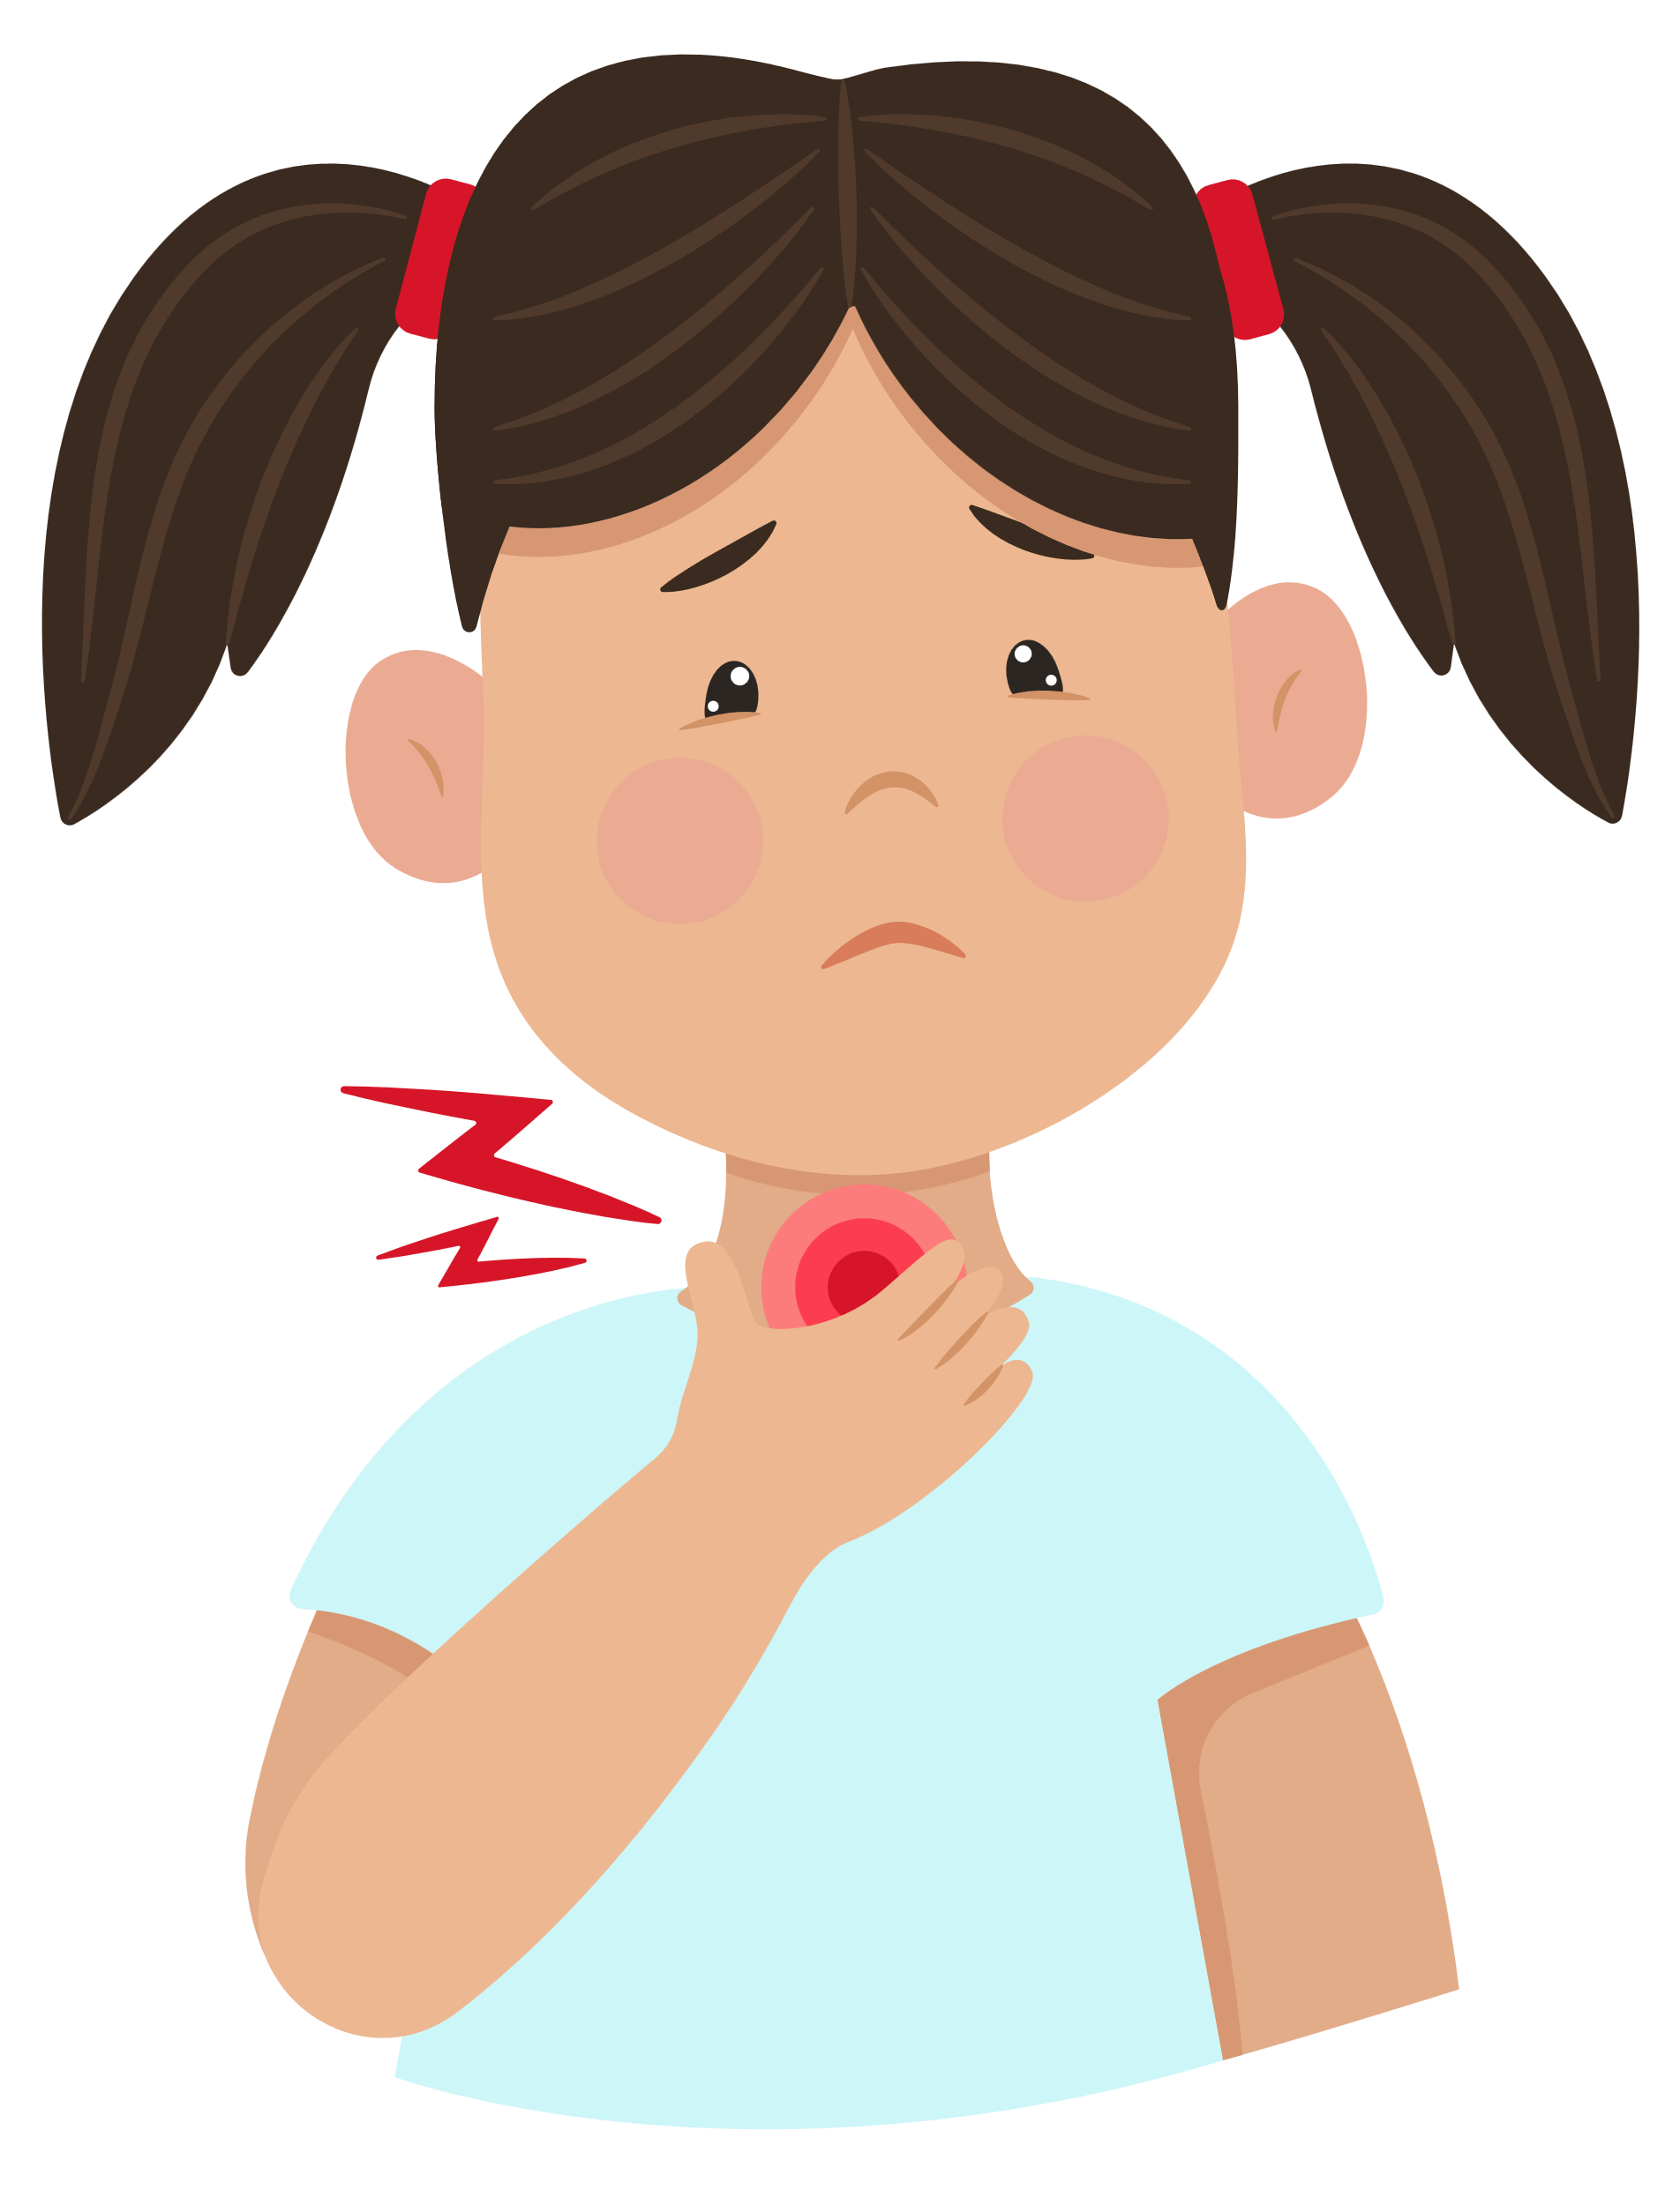
Question
  I have a sore throat.
You have 5 seconds.

Slide 44
Answer
Yes

Slide 45
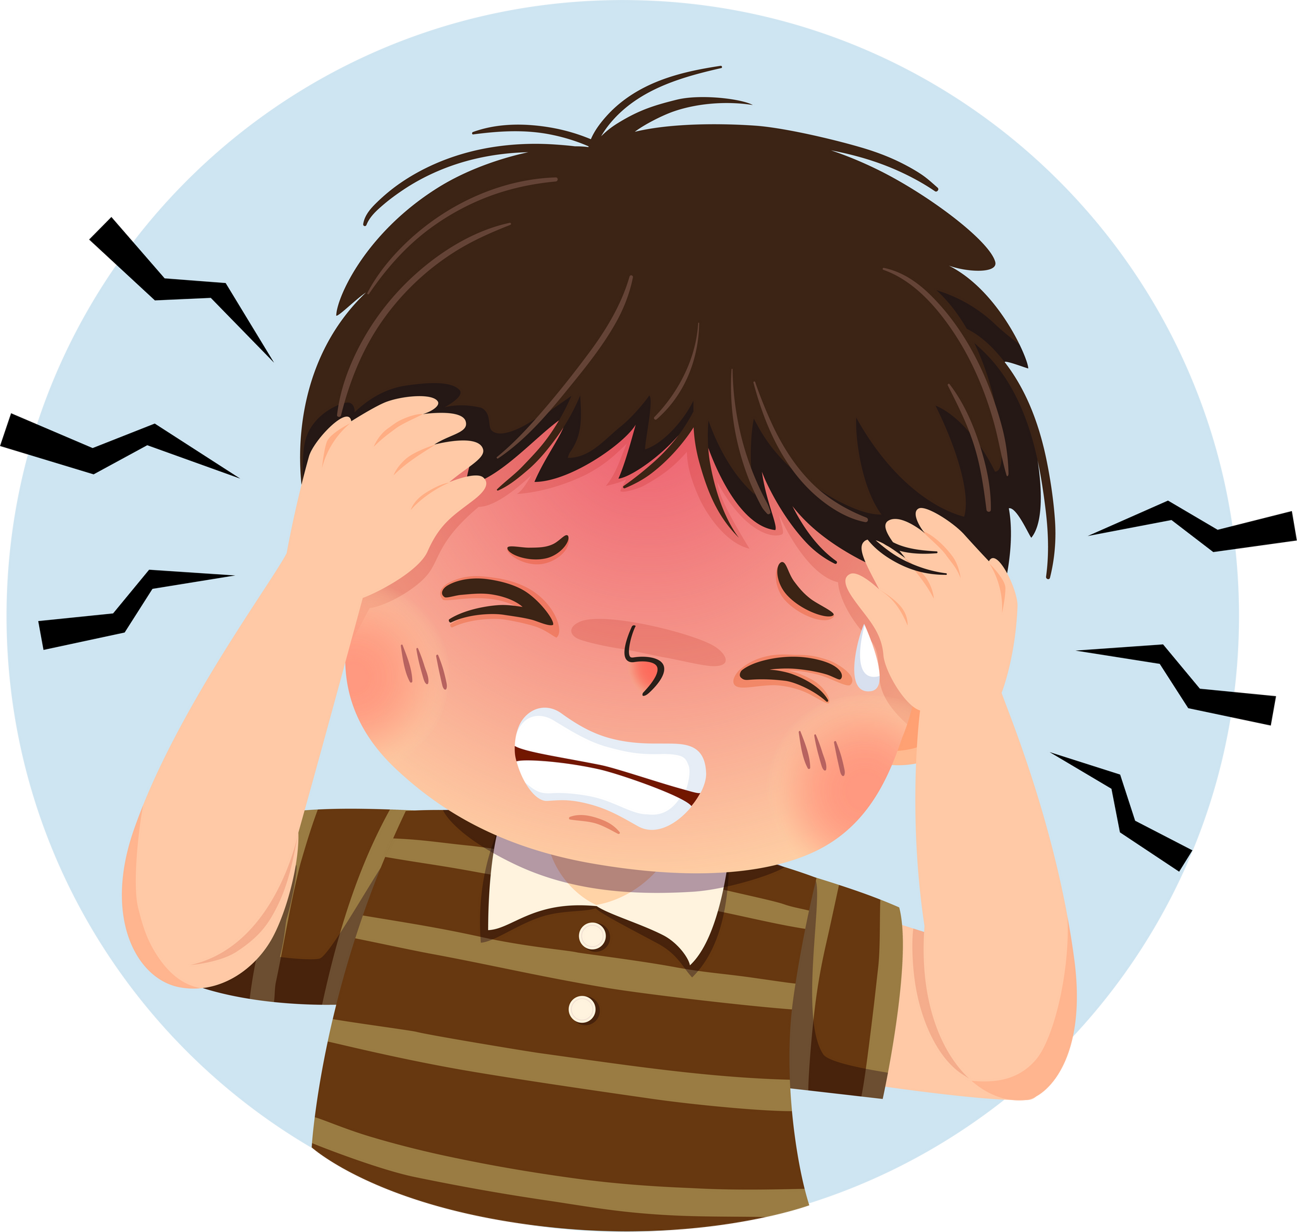
Question
  I am very well.
You have 5 seconds.

Slide 46
Answer
No
I have a headache.

Slide 47
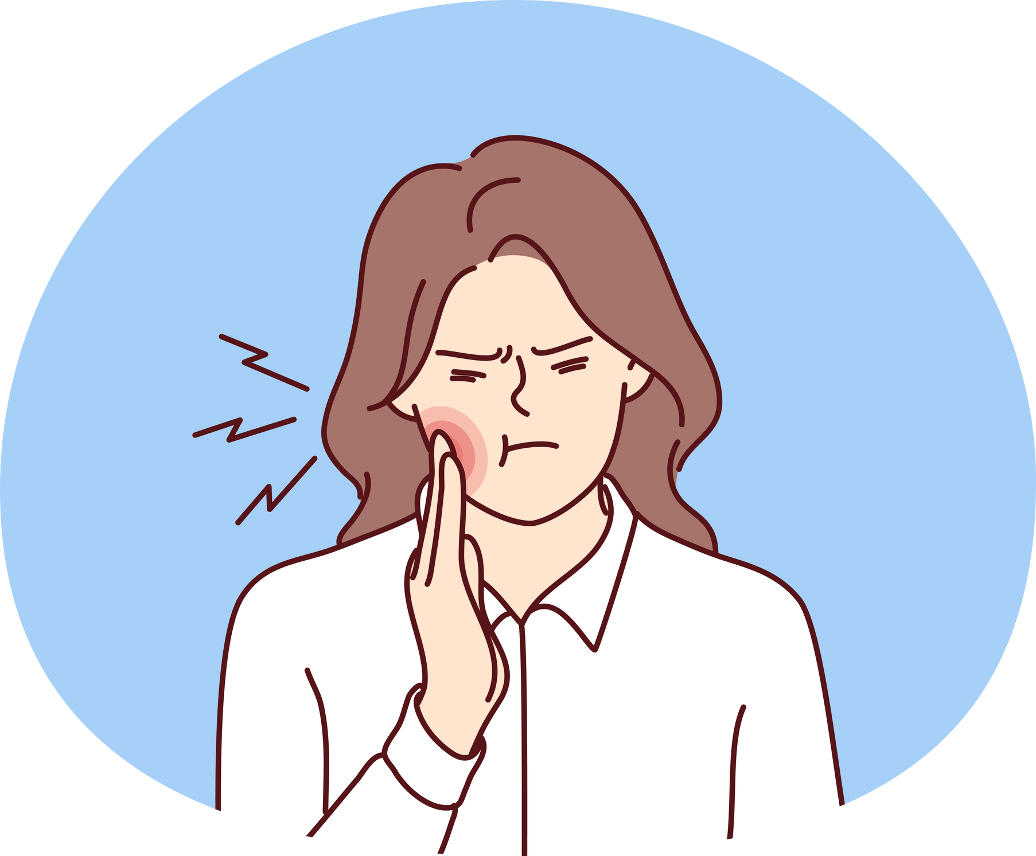
Question
  Do you have
  a stomach ache?
You have 5 seconds.

Slide 48
Answer
No
I have a toothache.

