Slide 1

Unit 18
Means of transport
Lesson 1 - Period 1

Slide 2
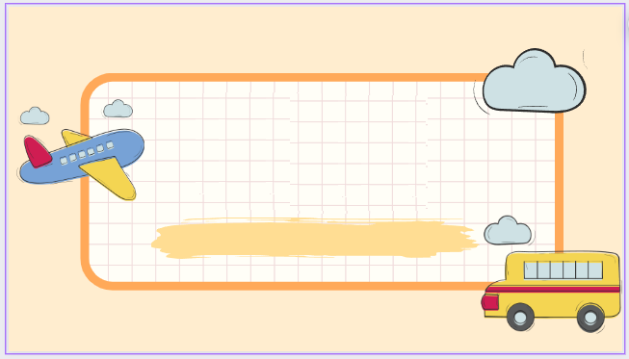

01
Warm-up and Review

Slide 3

Travel through the screen.

Slide 4
02
Look, listen and repeat.

Slide 5

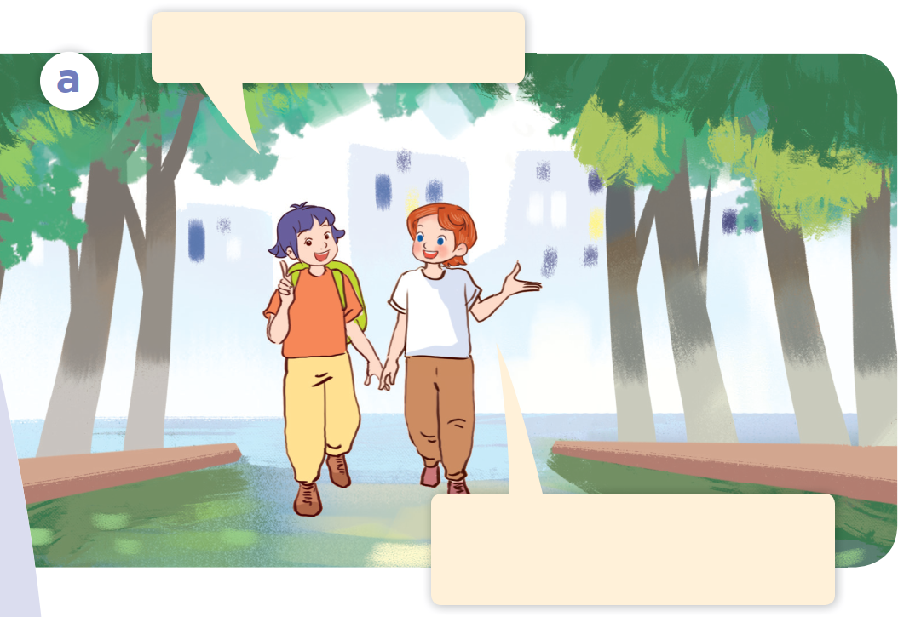
Look.

Slide 6
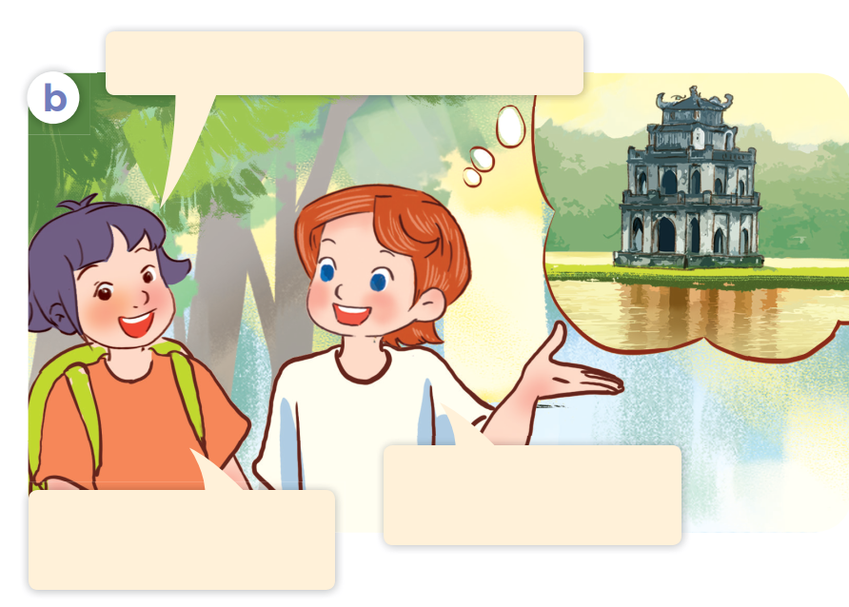
Look.

Slide 7
Look, listen and repeat.

Slide 8
Look, listen and repeat.
Is it time for a trip?
That’s a great idea!
Let’s go somewhere.
Notes:
Nháy vào hội thoại để nghe lại âm thanh từng câu.

Slide 9

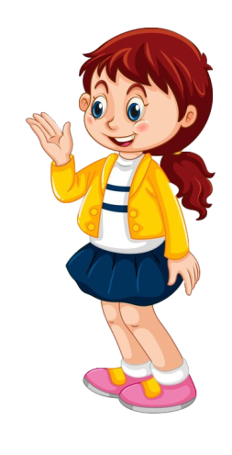
Look, listen and repeat.
Is it time for a trip?
Where do you want to visit?
I want to visit Hoan Kiem Lake.
That’s a great idea!
Let’s go somewhere.
Sounds good!
I can’t wait to go.

Slide 10
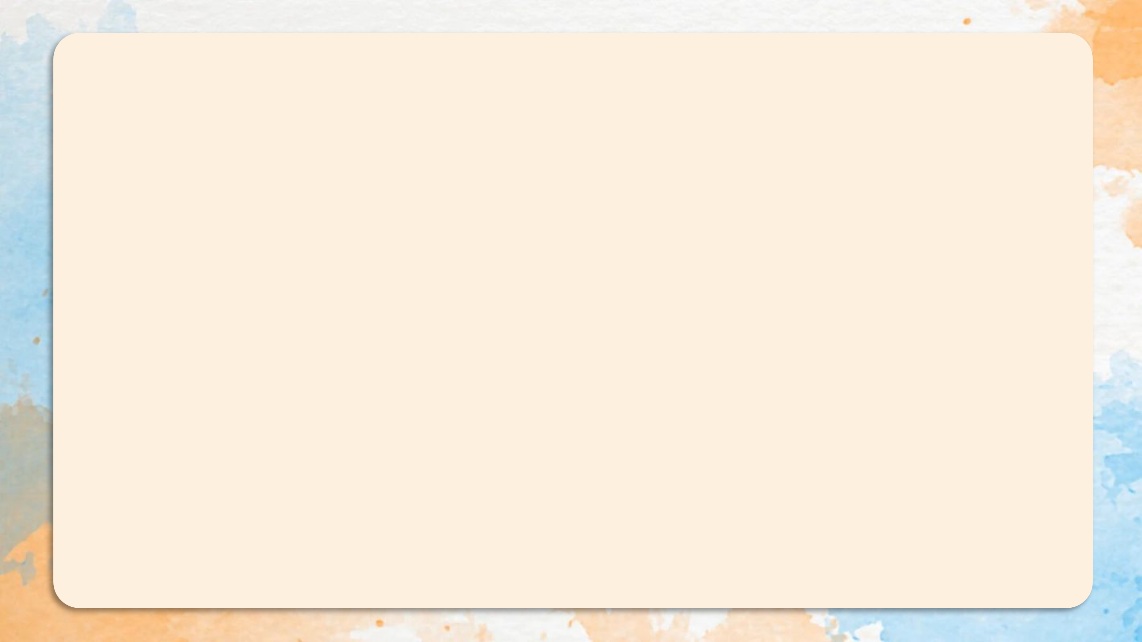
Where do you want to visit?
I want to visit Hoan Kiem Lake.

Slide 11
03
Listen, point and say.

Slide 12
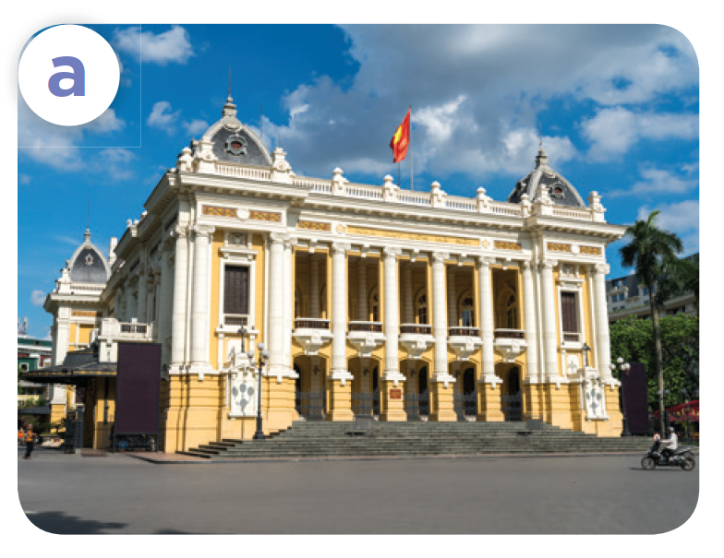
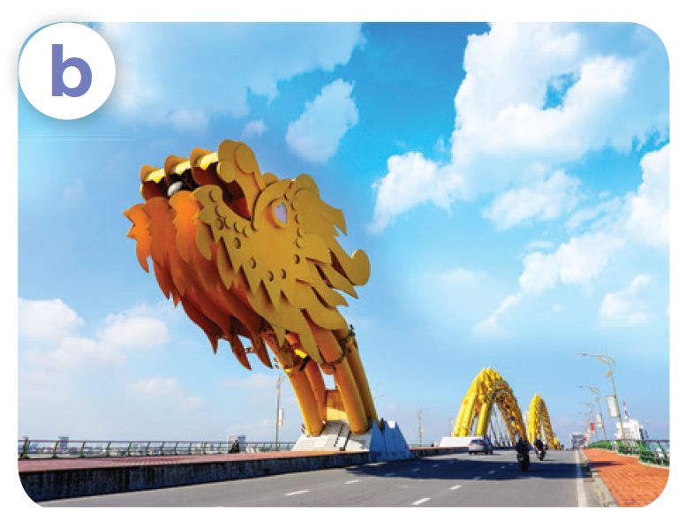
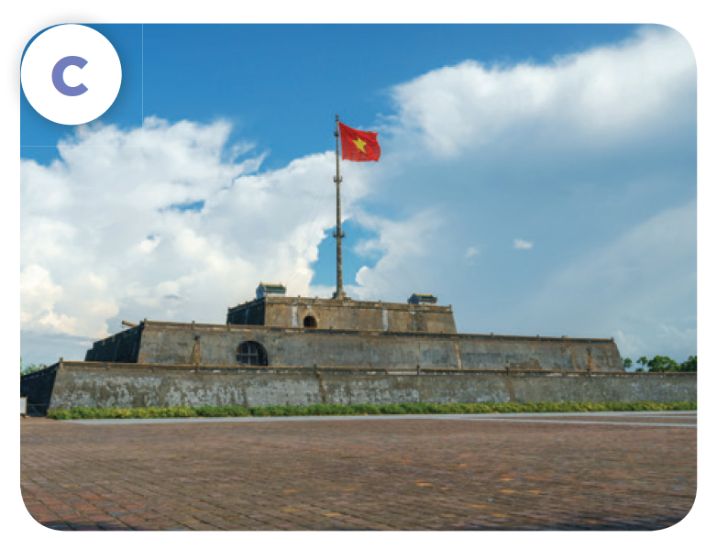
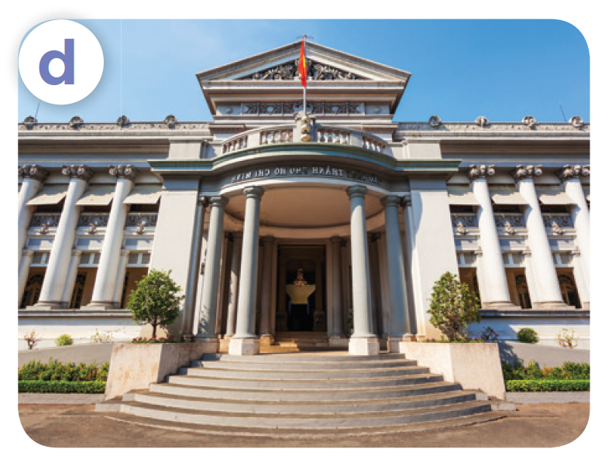
Listen, point and say.
Ha Noi Opera House
Dragon Bridge
Ho Chi Minh
City Museum
Ngo Mon Square

Slide 13
Where do you want to visit?
I want to visit ___.

Slide 14
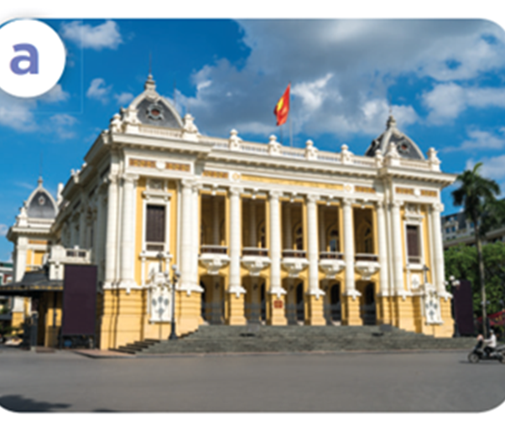
Listen, point and say.
Where do you want to visit?
I want to visit Ha Noi Opera House.
Ha Noi Opera House

Slide 15

Listen, point and say.
Where do you want to visit?
I want to visit Dragon Bridge.
Dragon Bridge

Slide 16

Listen, point and say.
Where do you want to visit?
I want to visit Ngo Mon Square.
Ngo Mon Square

Slide 17

Listen, point and say.
Where do you want
to visit?
I want to visit Ho Chi Minh City Museum.
Ho Chi Minh City Museum

Slide 18
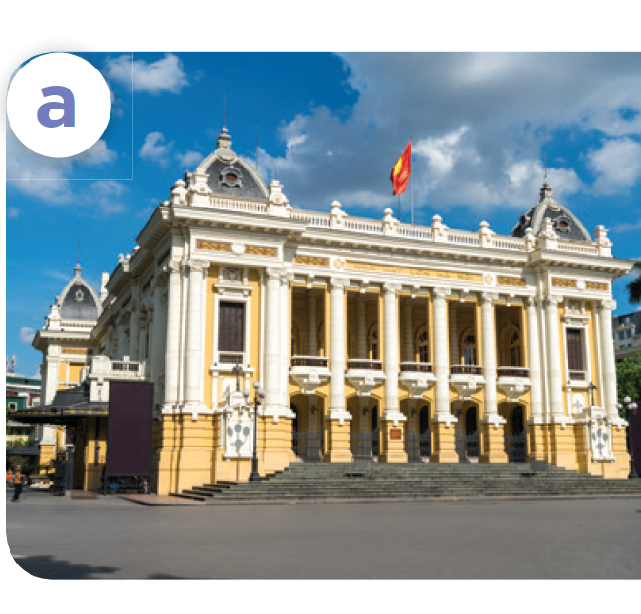
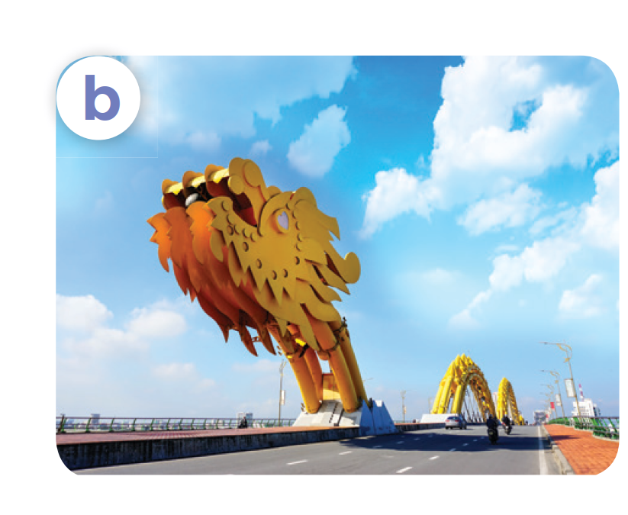
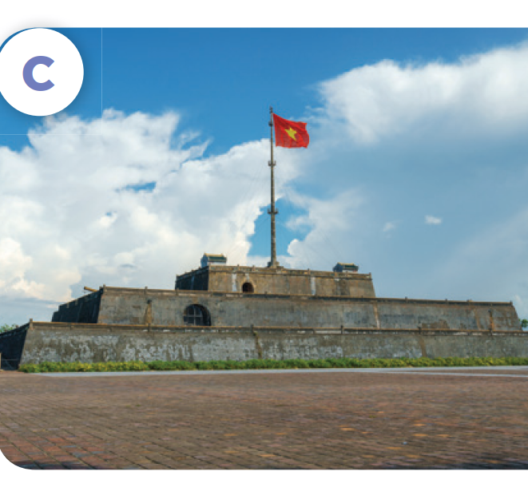
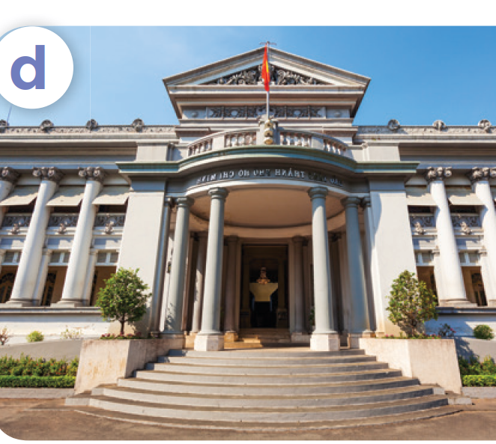
Where do you want to visit?
I want to visit ____.
Ha Noi Opera House
Dragon Bridge
Ngo Mon Square
Ho Chi Minh
City Museum

Slide 19
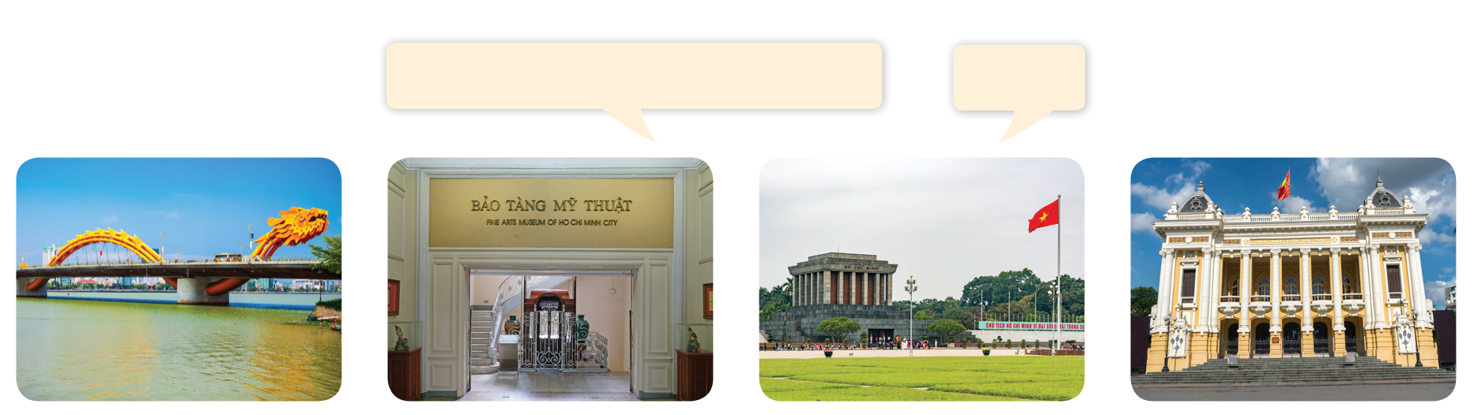
Let’s talk.
Where do you want to visit?
____.

Slide 20
Where do you want to visit?
_______.

Slide 21
05
Fun corner and Wrap-up

Slide 22

Questions and answers

Slide 23

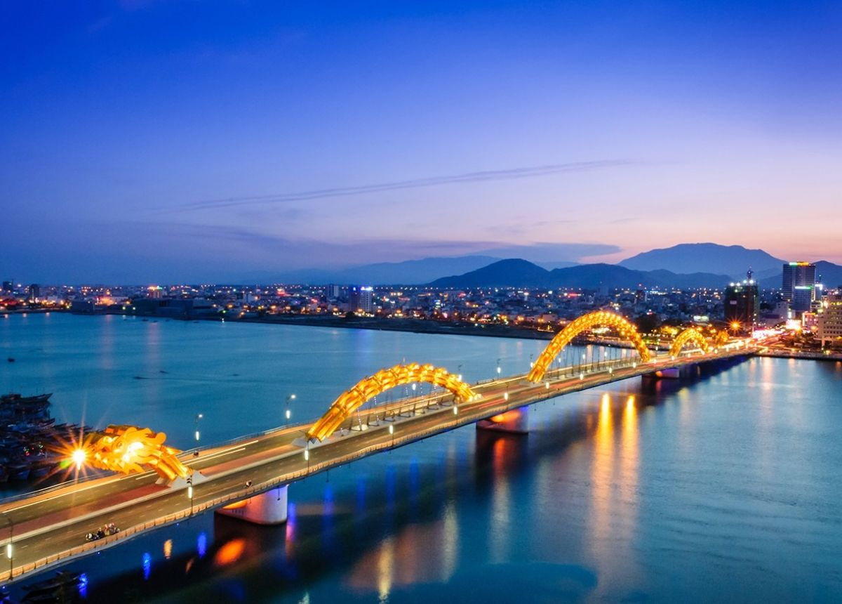
Questions and answers
______.
______?

Slide 24
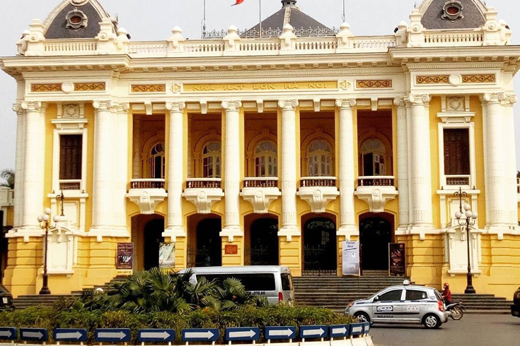
Questions and answers
______?
______.

Slide 25
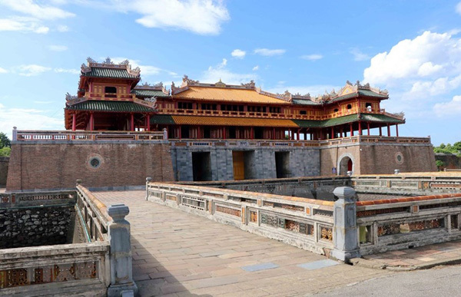
Questions and answers
______.
______?

Slide 26
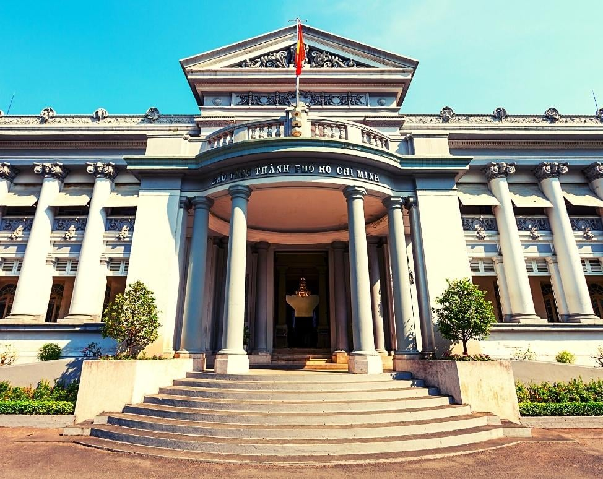
Questions and answers
_______.
______?

Slide 27
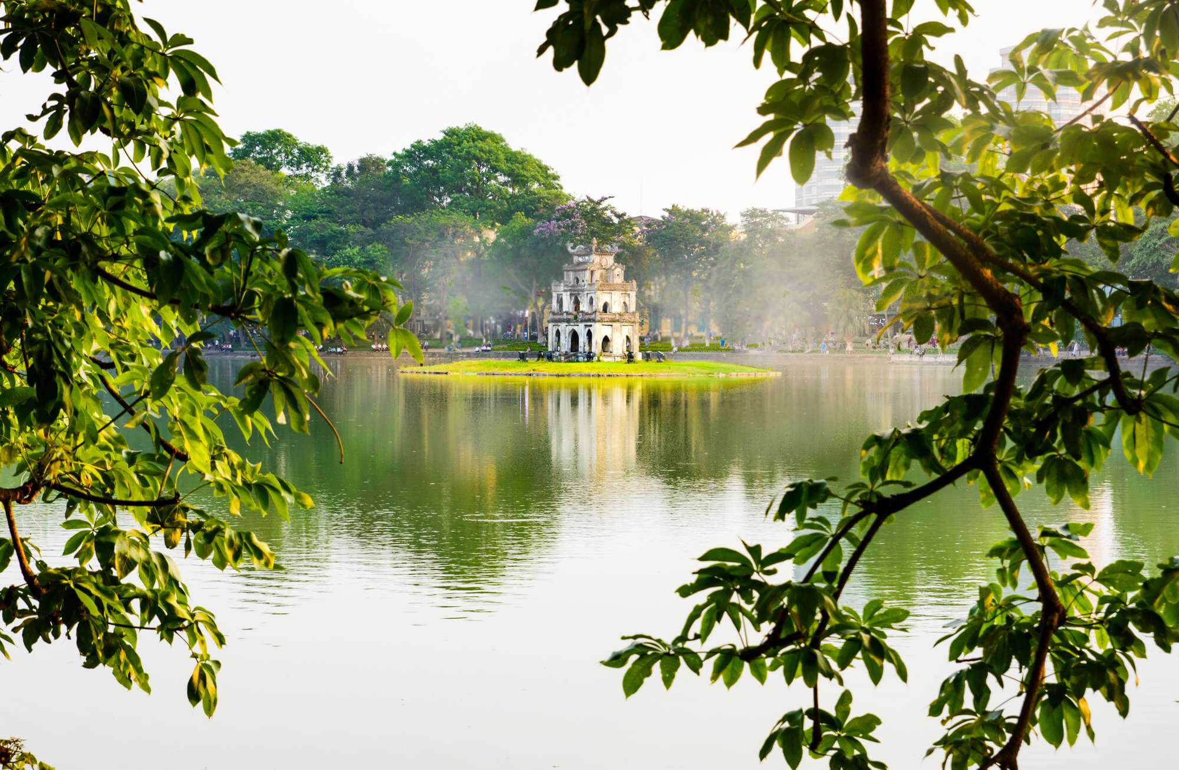
Questions and answers
______?
______.

