Slide 2

Unit 18 Means of transport
Lesson 1 - Period 2

Slide 3

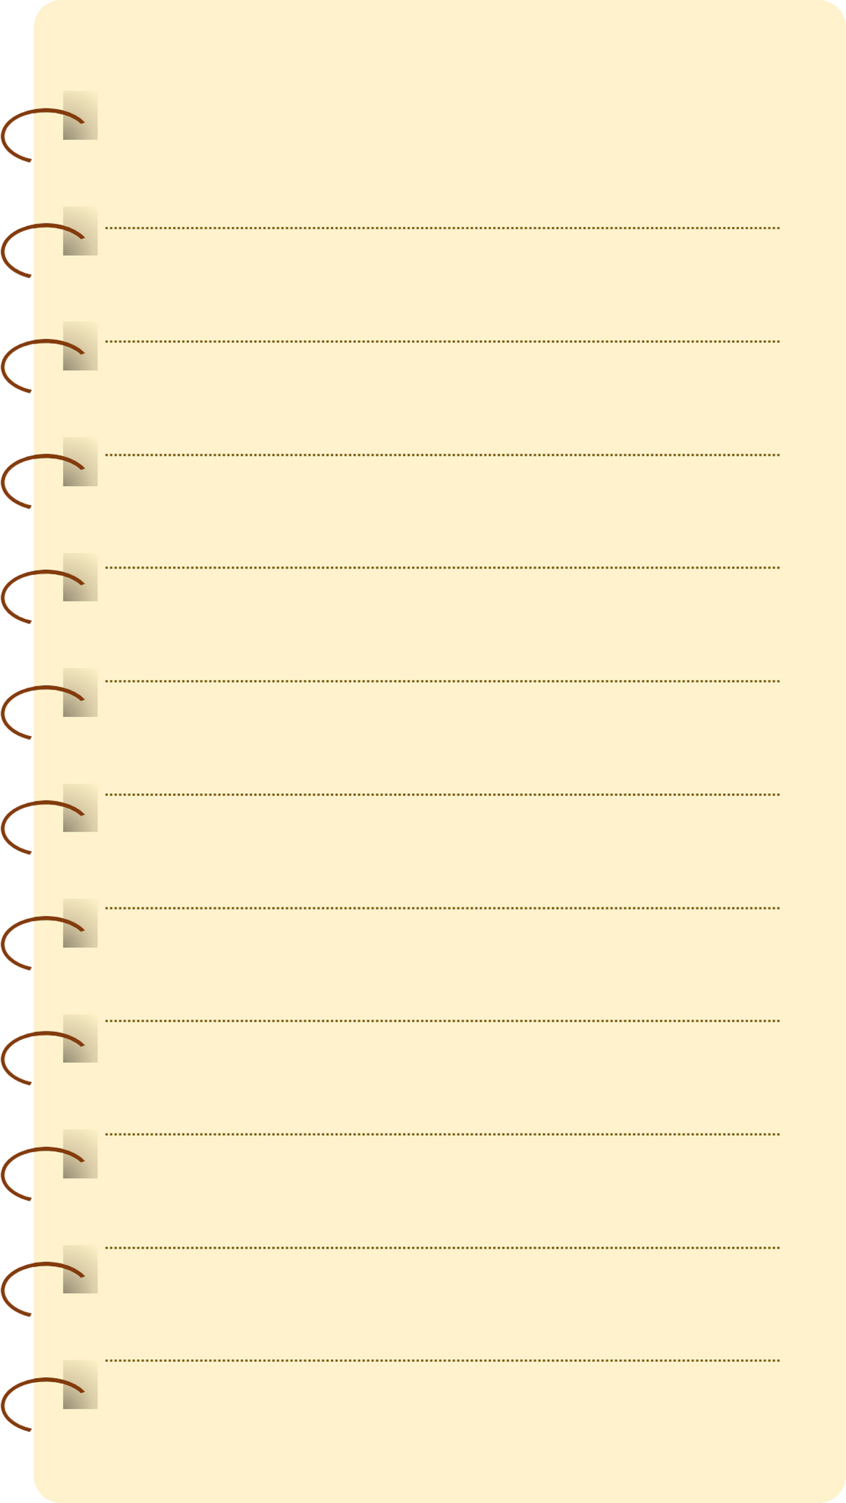
Table of contents
01
Warm-up and Review
02
Listen and number.
03
Read and complete.
04
Let’s sing.
05
Fun corner and Wrap-up

Slide 4
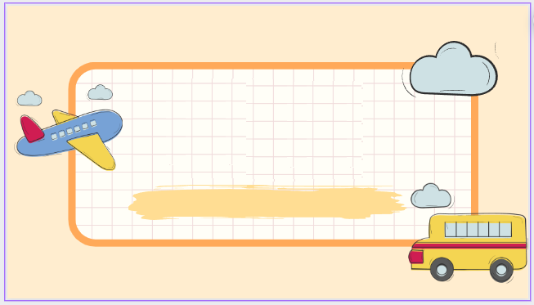

01
Warm-up and Review

Slide 5

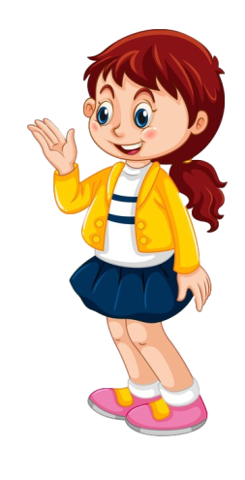

Where do you want to visit?
I want to visit ___.

Slide 6

Grow the trees
Game

Slide 7



Grow the trees
Team

Slide 8



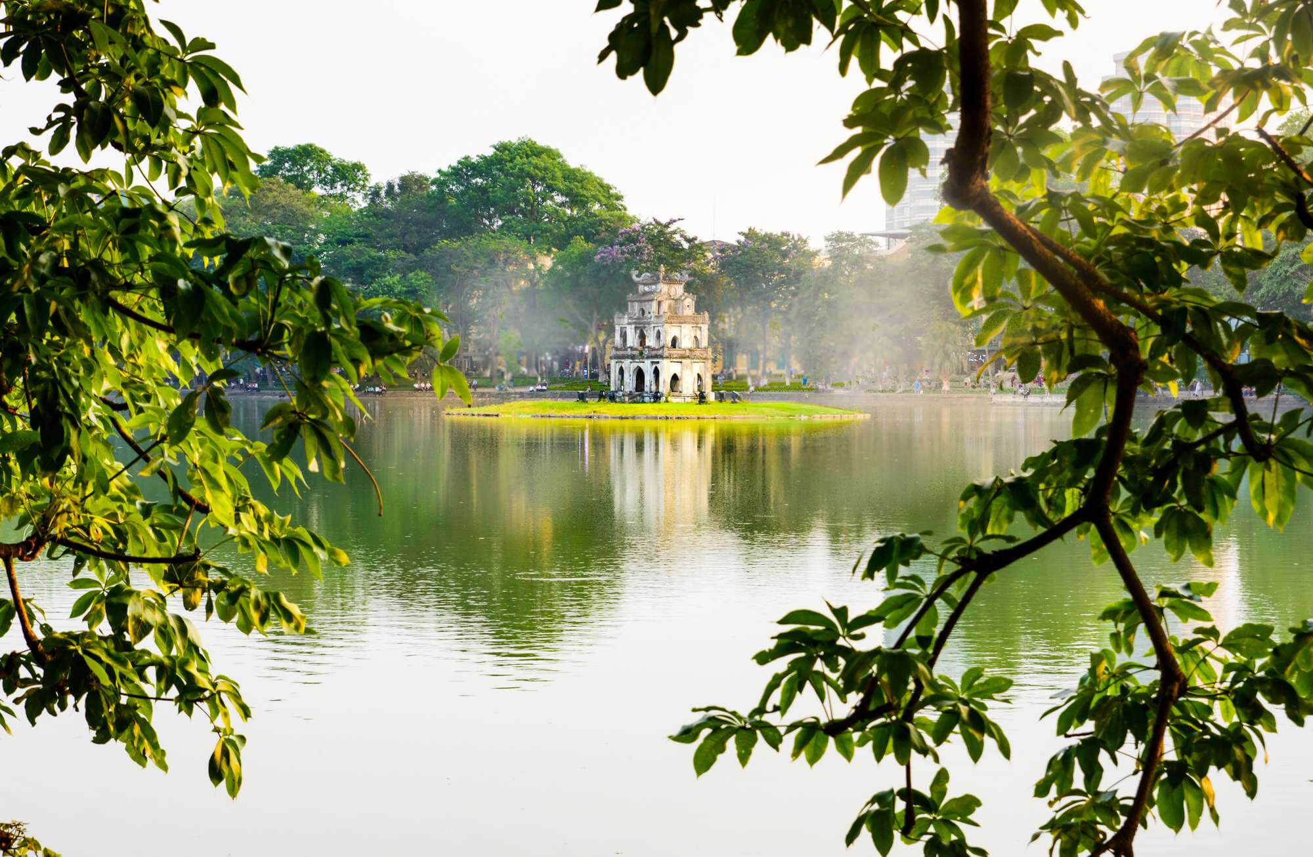
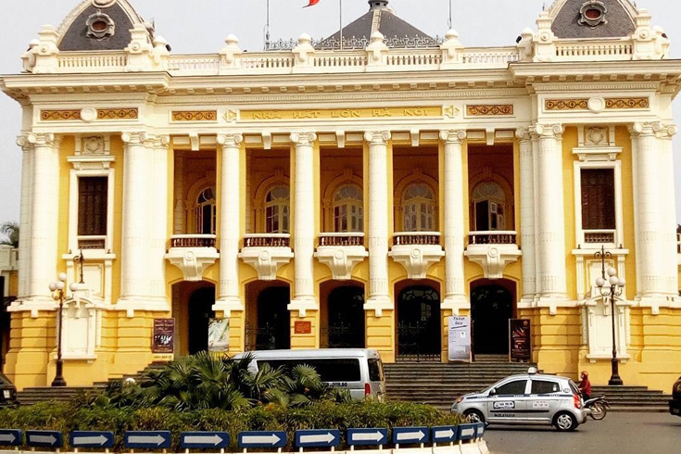
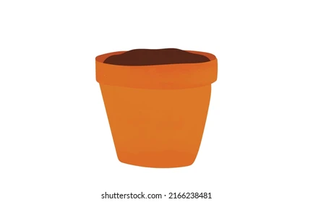
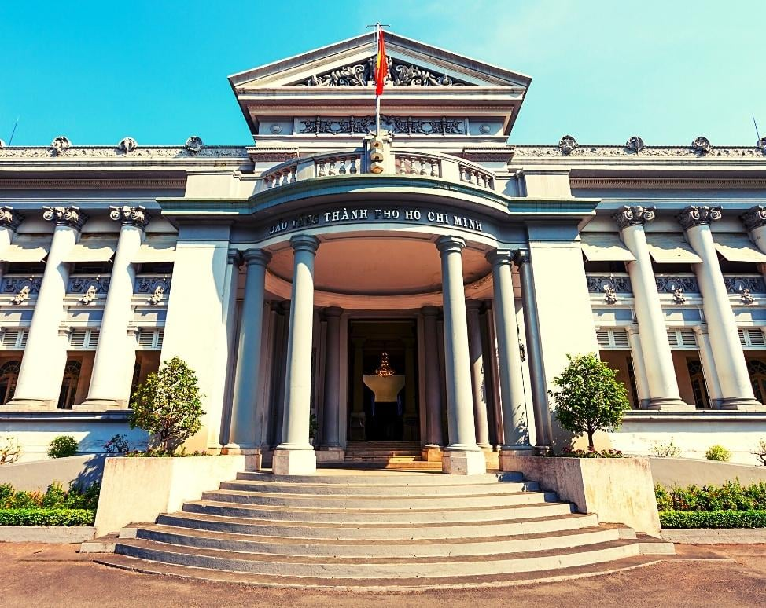
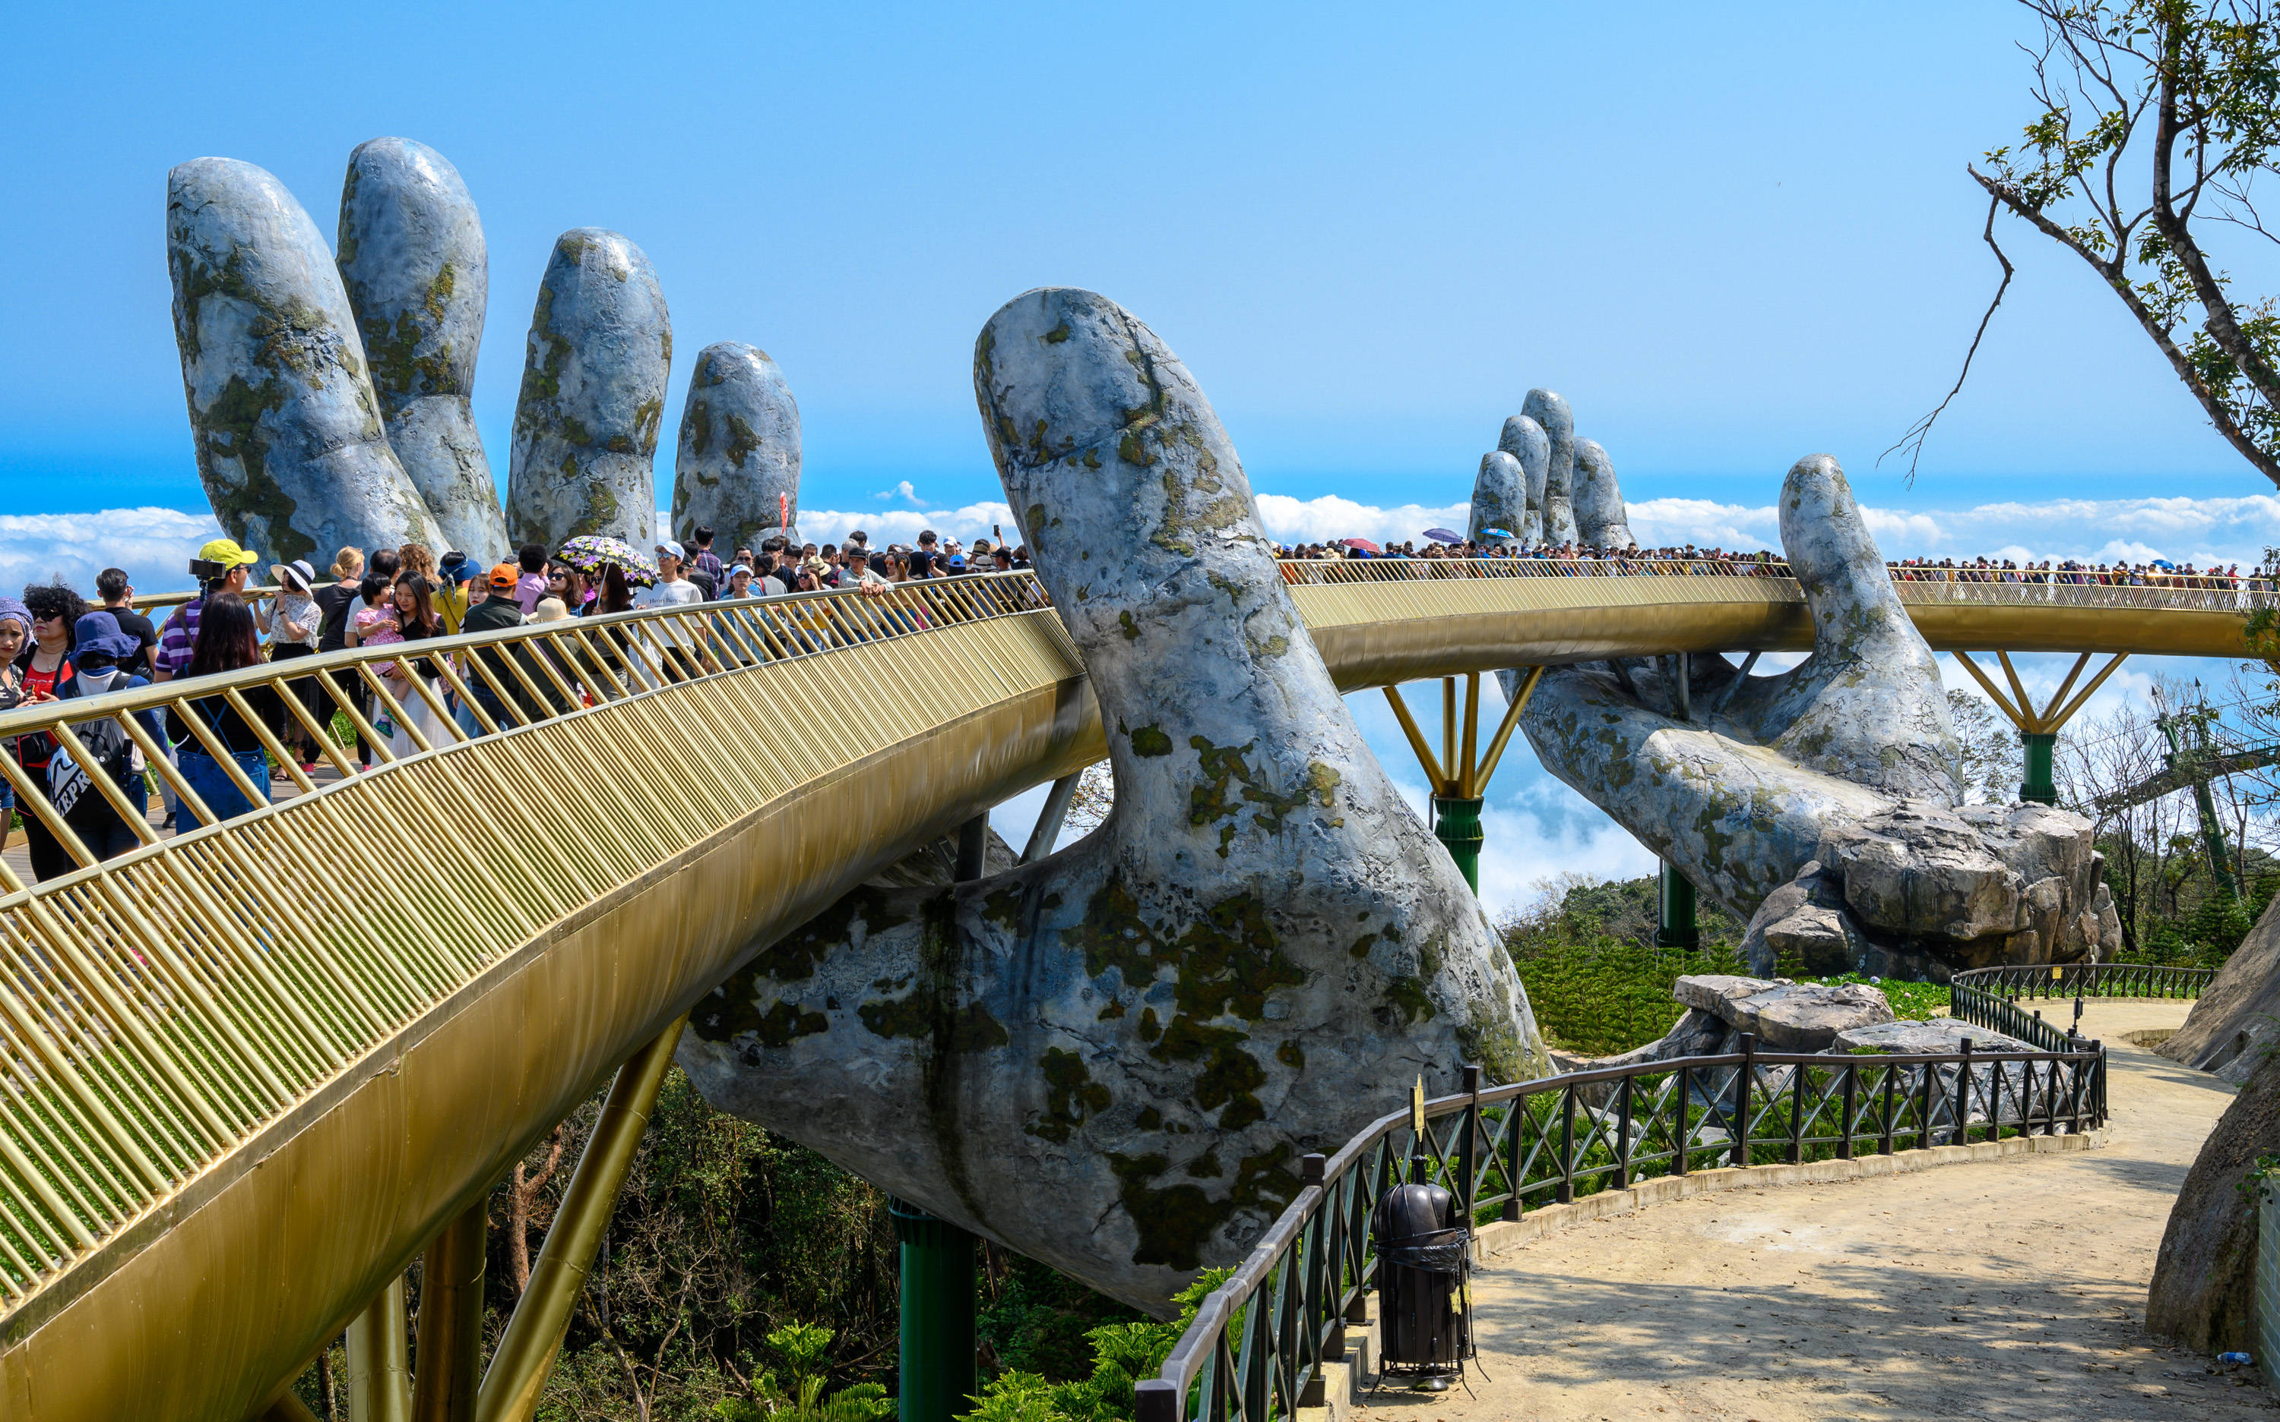
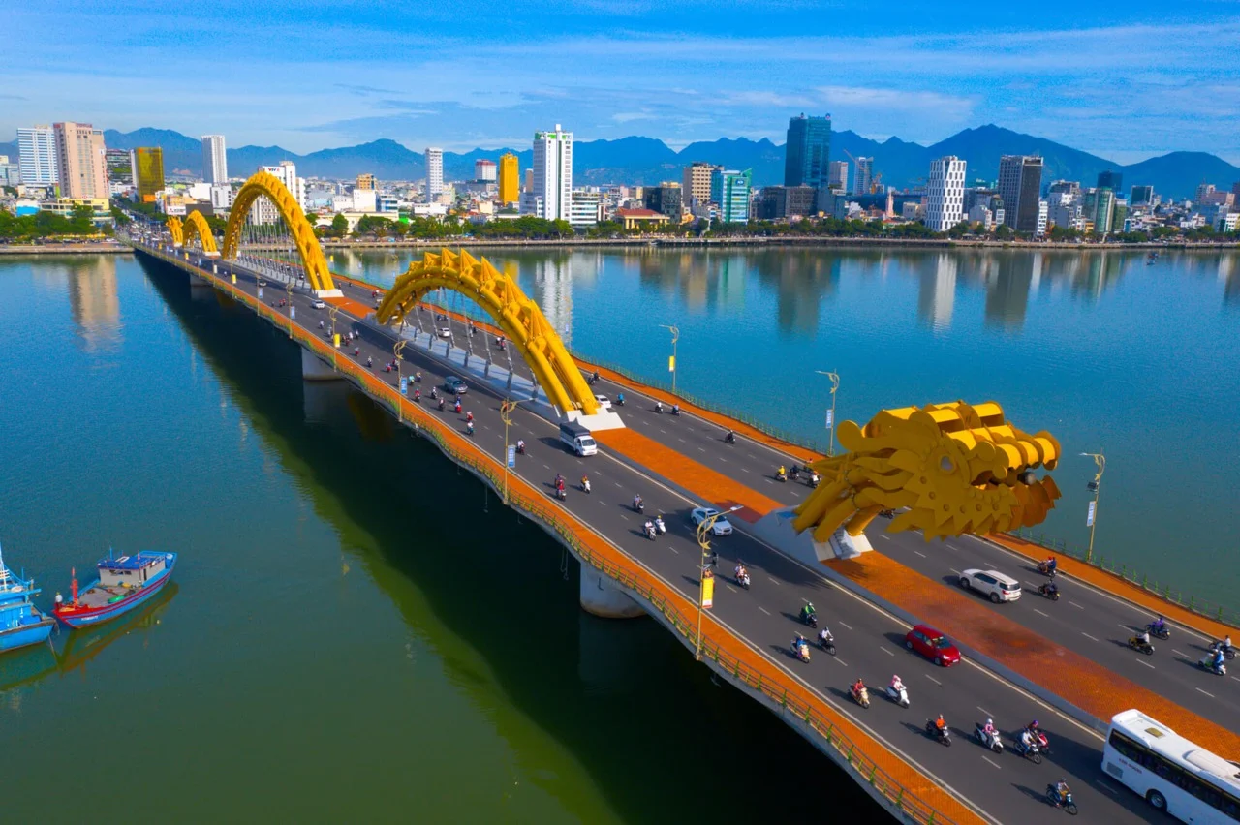
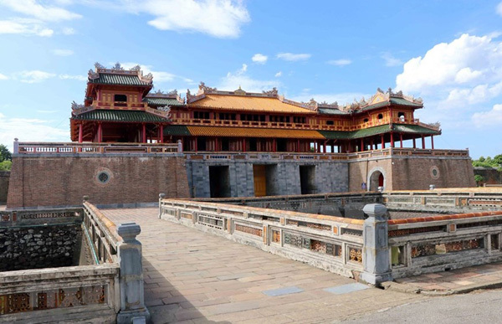
Grow the trees
Notes:
Cick và tên team chấm điểm (hoa xuất hiện)

Slide 9


Very Good!

Slide 10
02
Listen and number.

Slide 11
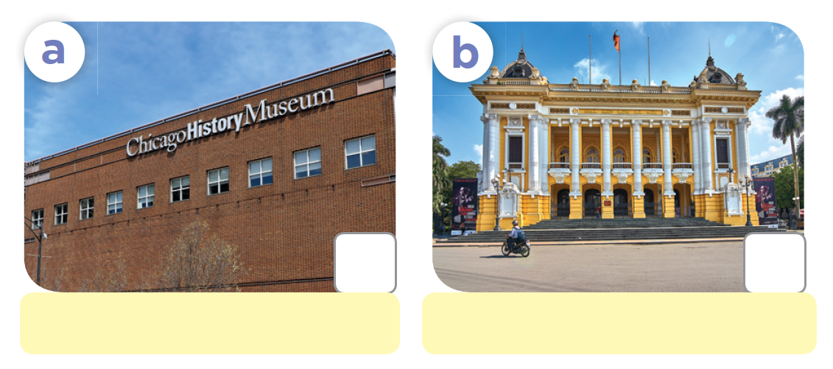
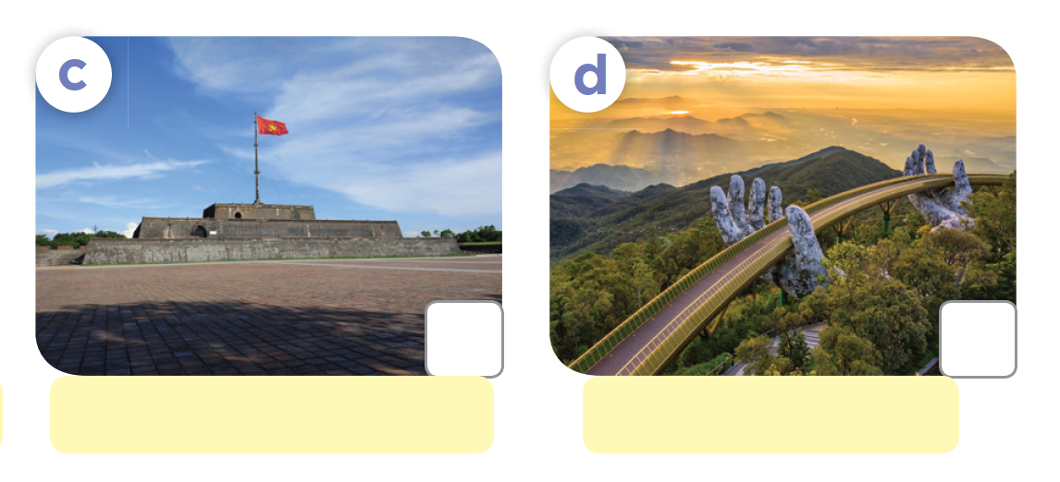
Listen and number.
2
4
Museum of History
Ha Noi Opera House
3
1
Ngo Mon Square
Golden Bridge

Slide 12
03
Read and complete.

Slide 13
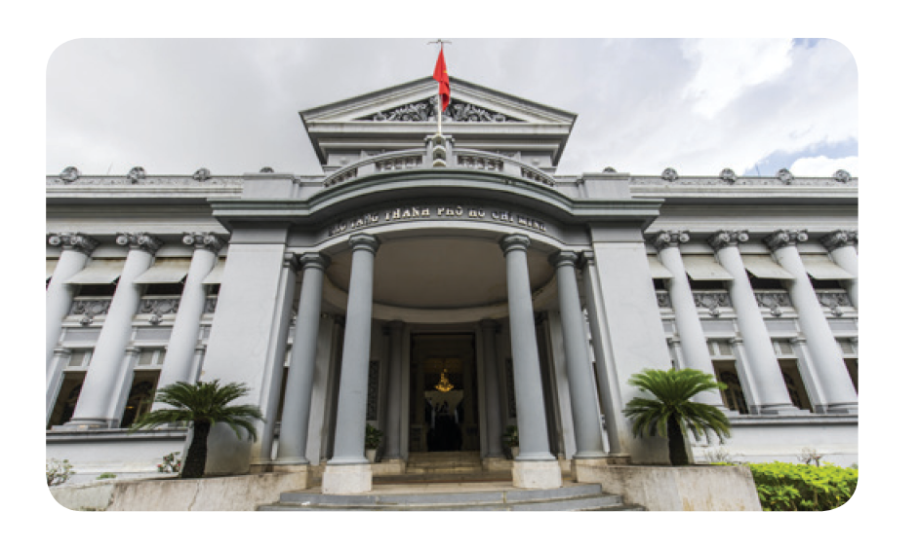
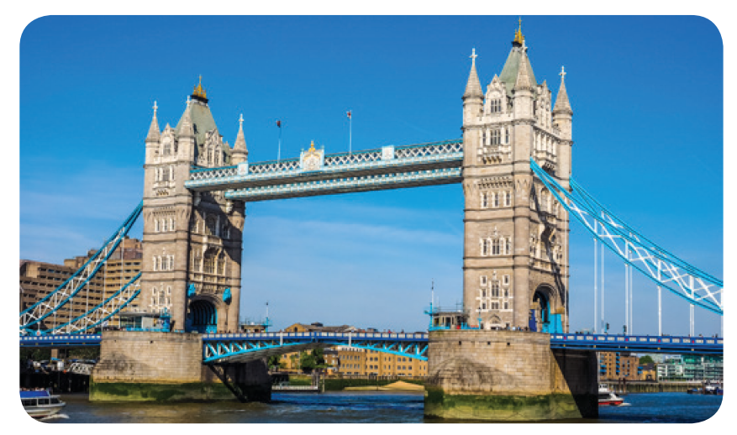
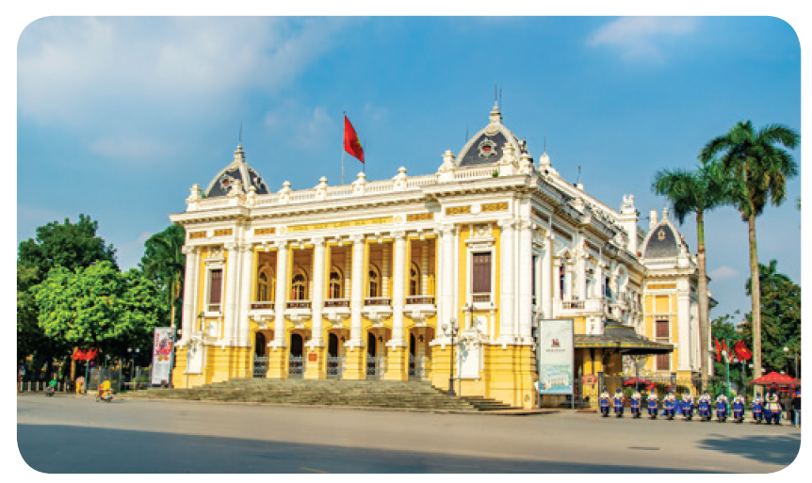
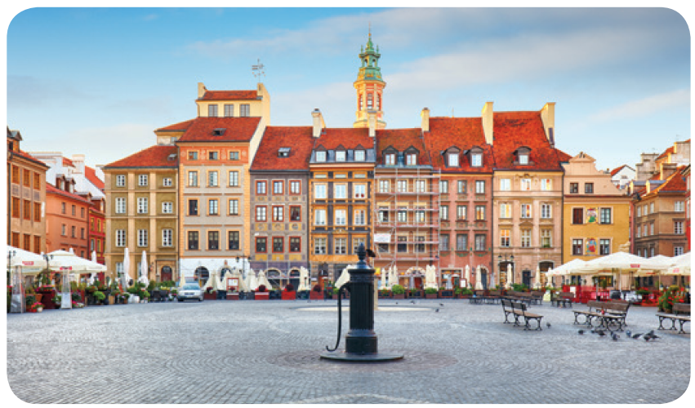
Read and complete.

Slide 14
Read and complete.
1. A: There are many interesting places in Ho Chi Minh City. Where do you want to ______?
B: I want to visit ______________ today.

Slide 15
Read and complete.
2. A: Welcome to London.
Where _____ you want to visit?
B: I __________ Tower Bridge.

Slide 16
Read and complete.
3. A: Where do you ___________?
B: I want __________________.
A: Good choice!

Slide 17
Read and complete.
4. A: _______ do you want to visit?
B: ___________ the city spuare.
Is it far from here?
A: No, it isn’t. We can walk there.

Slide 18


SWAP YOUR BOOKS AND LET’S CHECK.

Slide 19
Read and complete.
1.A: There are many interesting places in Ho Chi Minh City. Where do you want to _____?
B: I want to visit _________________________ today.
visit
Ho Chi Minh City Museum

Slide 20
Read and complete.
2. A: Welcome to London.
Where ___ you want to visit?
B: I _____________ Tower Bridge.
do
want to visit

Slide 21
Read and complete.
3. A: Where do you _____________?
B: I want ___________________________.
A: Good choice!
want to visit
to visit Ha Noi Opera House

Slide 22
Read and complete.
4. A: ________ do you want to visit?
B: ________________ the city square.
Is it far from here?
A: No, it isn’t. We can walk there.
Where
I want to visit

Slide 23
1.A: There are many interesting places in Ho Chi Minh City. Where do you want to ______?
B: I want to visit _____________________ today.
2.A: Welcome to London.
Where ___ you want to visit?
B: I ____________ Tower Bridge.
visit
do
Ho Chi Minh City Museum
want to visit
4. A: _______ do you want to visit?
B: _____________ the city spuare.
Is it far from here?
A: No, it isn’t. We can walk there.
Where
3.A: Where do you ___________?
B: I want _________________________.
A: Good choice!
want to visit
I want to visit
to visit Ha Noi Opera House

Slide 24
04
Let’s sing.

Slide 25
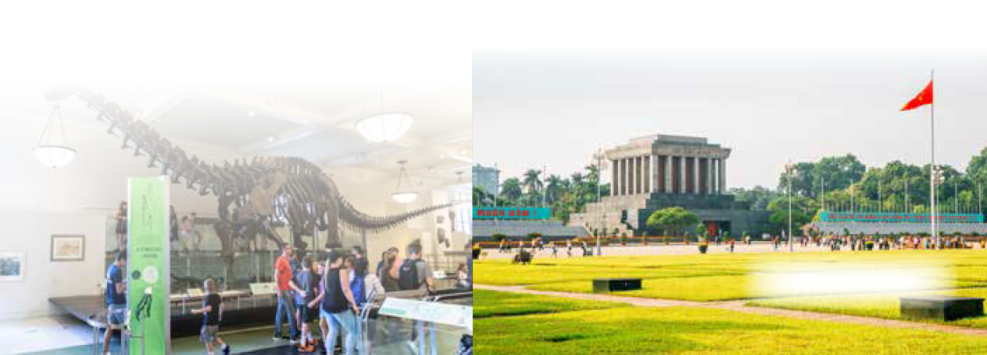
Let’s sing.
Where do you want to visit?
I want to visit somewhere.
Where do you want to visit?
I want to visit the museum.
That’s a great idea! Let’s go!
I want to visit somewhere.
Where do you want to visit?
I want to visit the square.
That’s a great idea! Let’s go!

Slide 26

Let’s sing.
Where do you want to visit?
I want to visit somewhere.
Where do you want to visit?
I want to visit the museum.
That’s a great idea! Let’s go!
I want to visit somewhere.
Where do you want to visit?
I want to visit the square.
That’s a great idea! Let’s go!

Slide 27
05
Fun corner and Wrap-up

Slide 28

Game
Picking apples

Slide 29
Where do you want to visit?
I want to visit ___.

Slide 30
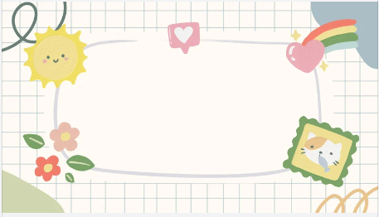
Team

Slide 31









End
Notes:
Click vào quả táo để đi tới câu tương ứng. Sau khi trả lời xong quay lại quả táo sẽ biến mất. Cick vào tên đội để tính điểm cho đội.

Slide 32

Back
Notes:
Click và Back để quay lại trang cây táo

Slide 33
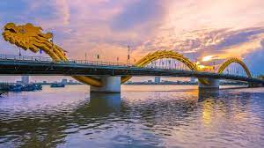
Back
Notes:
Click và Back để quay lại trang cây táo

Slide 34
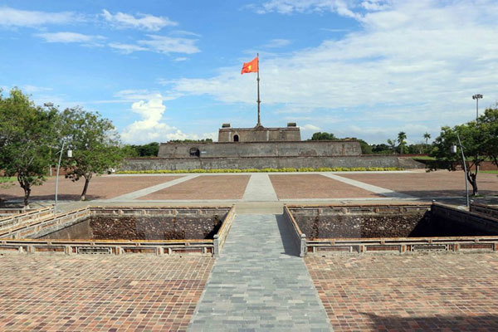
Back
Notes:
Click và Back để quay lại trang cây táo

Slide 35

Back
Notes:
Click và Back để quay lại trang cây táo

Slide 36
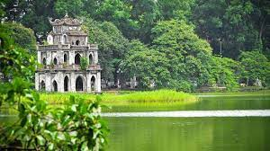
Back
Notes:
Click và Back để quay lại trang cây táo

Slide 37
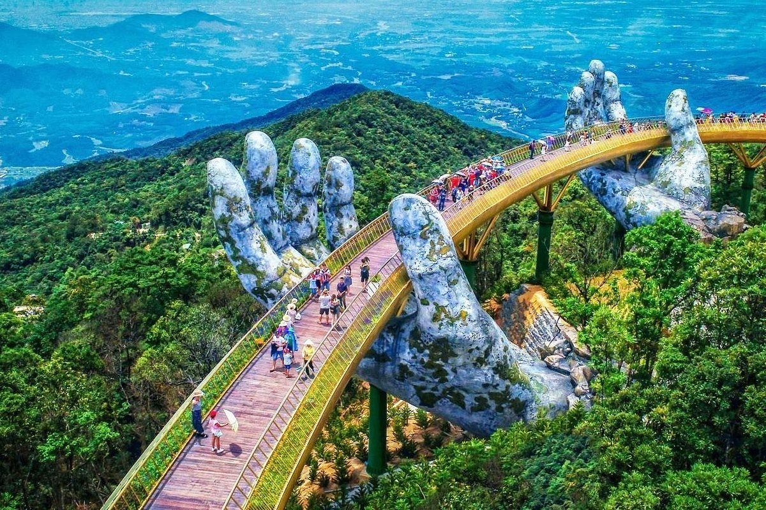
Back
Notes:
Click và Back để quay lại trang cây táo

Slide 38
Very Good!

Slide 39
Website: hoclieu.vn
Fanpage: https://www.facebook.com/tienganhglobalsuccess.vn/

