Slide 1

Unit 18 Means of transport
Lesson 1 - Period 1

Slide 2
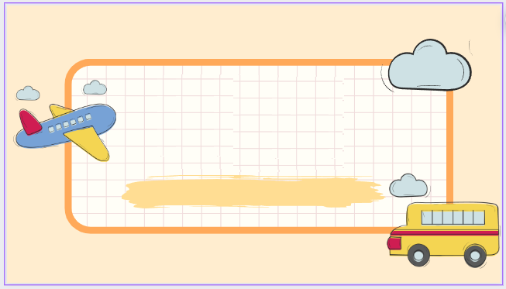

01
Warm-up and Review

Slide 3

Travel through the screen.

Slide 4
02
Look, listen and repeat.

Slide 5

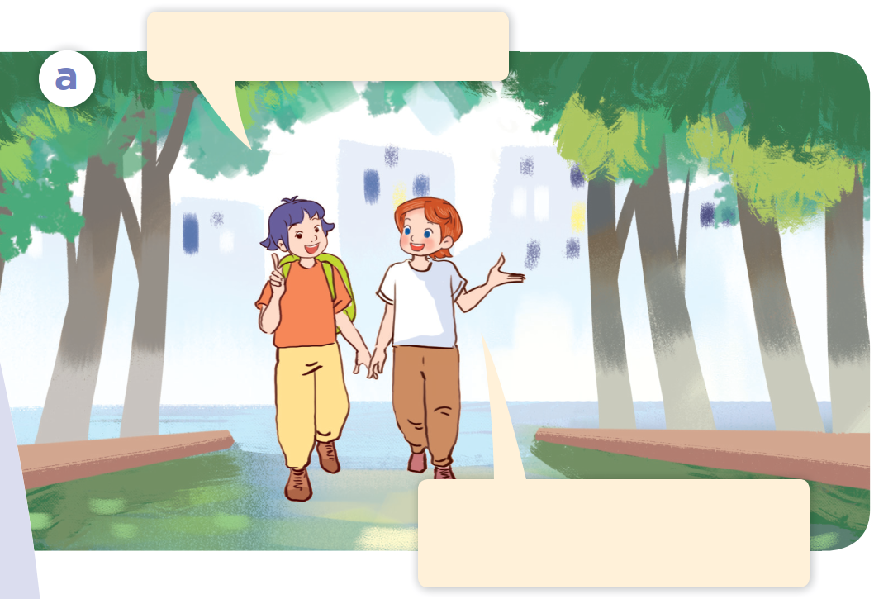
Look.

Slide 6
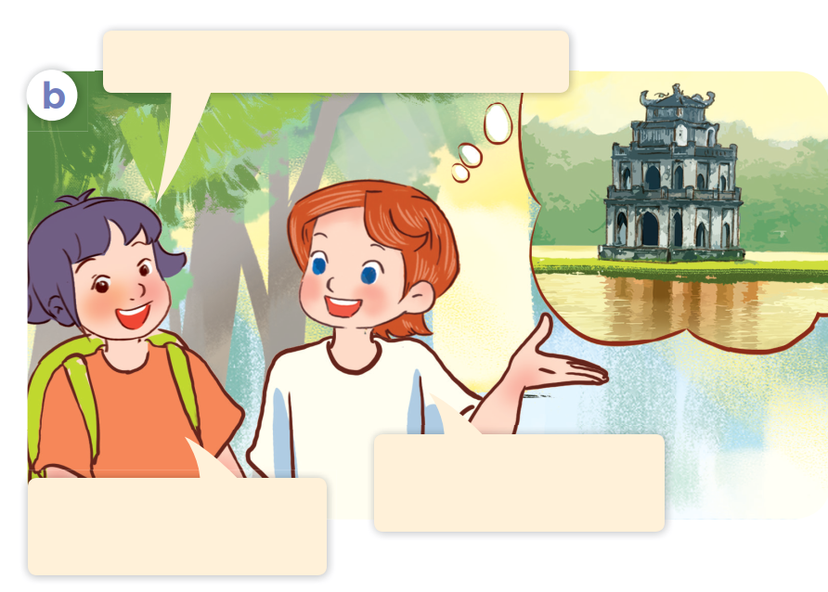
Look.

Slide 7
Look, listen and repeat.

Slide 8
Look, listen and repeat.
Is it time for a trip?
That’s a great idea!
Let’s go somewhere.
Notes:
Nháy vào hội thoại để nghe lại âm thanh từng câu.

Slide 9
Look, listen and repeat.
Where do you want to visit?
I want to visit Hoan Kiem Lake.
Sounds good!
I can’t wait to go.
Notes:
Nháy vào hội thoại để nghe lại âm thanh từng câu.

Slide 10

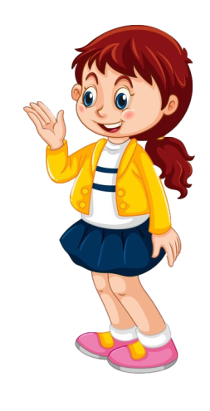
Look, listen and repeat.
Is it time for a trip?
Where do you want to visit?
I want to visit Hoan Kiem Lake.
That’s a great idea!
Let’s go somewhere.
Sounds good!
I can’t wait to go.

Slide 11
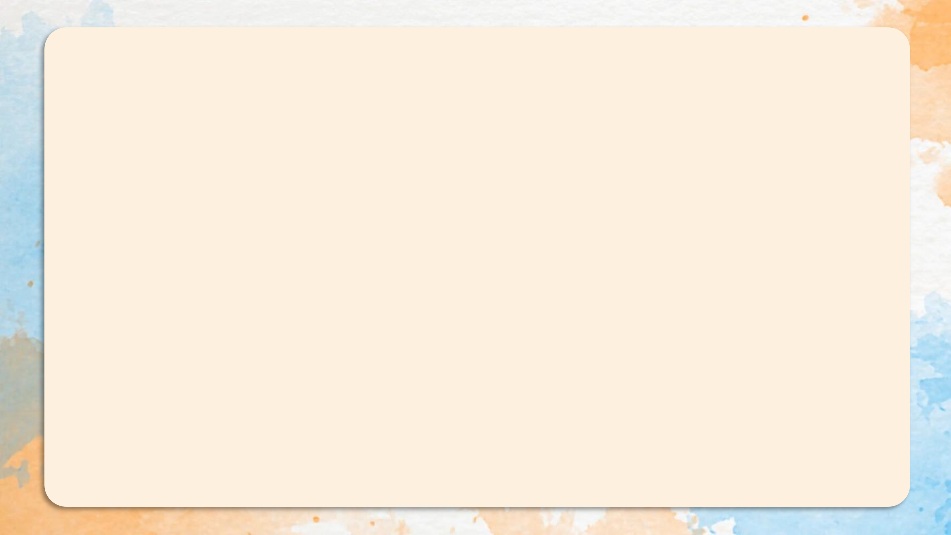
Where do you want to visit?
I want to visit Hoan Kiem Lake.

Slide 12
03
Listen, point and say.

Slide 13
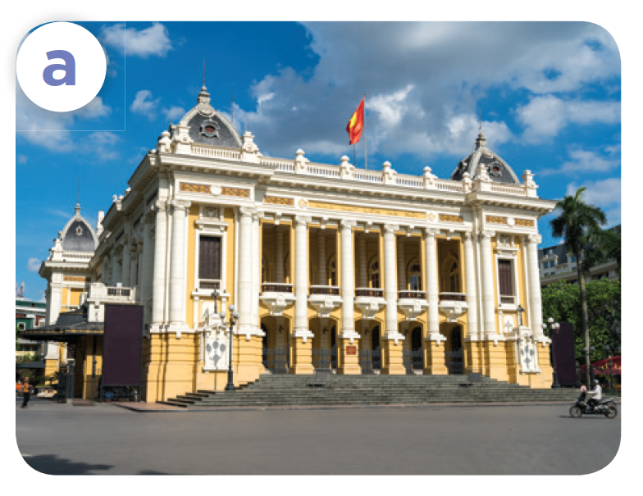
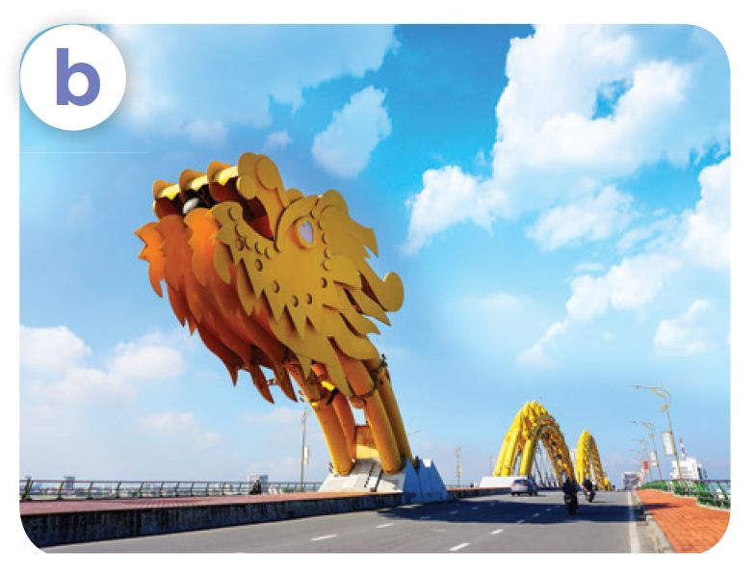
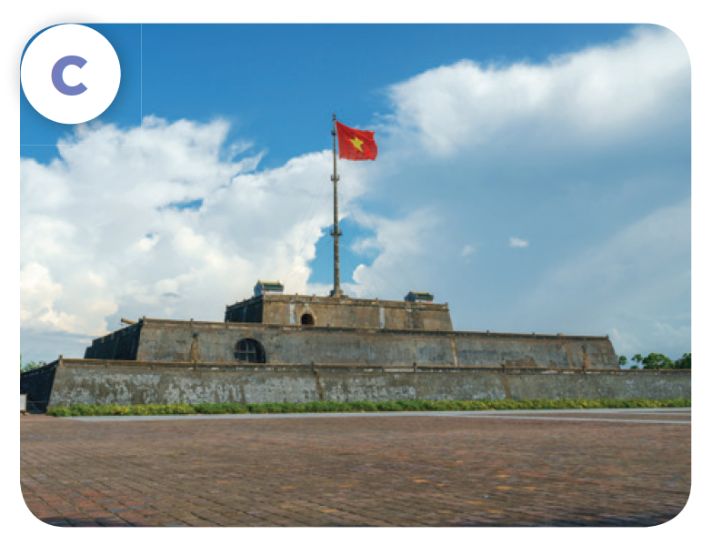
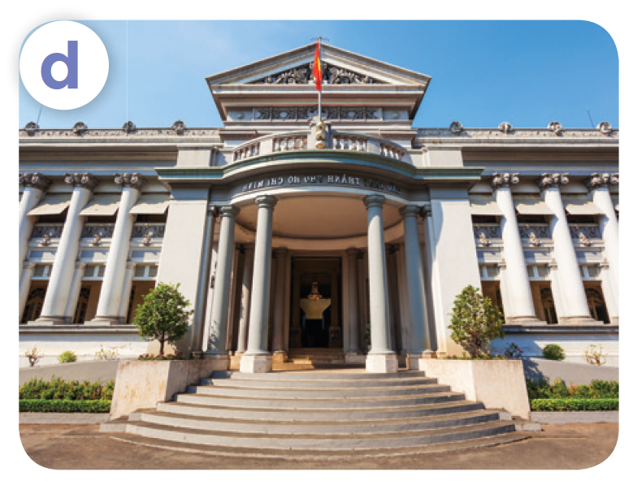
Listen, point and say.
Ha Noi Opera House
Dragon Bridge
Ho Chi Minh City Museum
Ngo Mon Square

Slide 14

Listen, point and say.
Ha Noi Opera House

Slide 15

Listen, point and say.
Dragon Bridge

Slide 16

Listen, point and say.
Ngo Mon Square

Slide 17

Listen, point and say.
Ho Chi Minh City Museum

Slide 18
Where do you want to visit?
I want to visit ___.

Slide 19
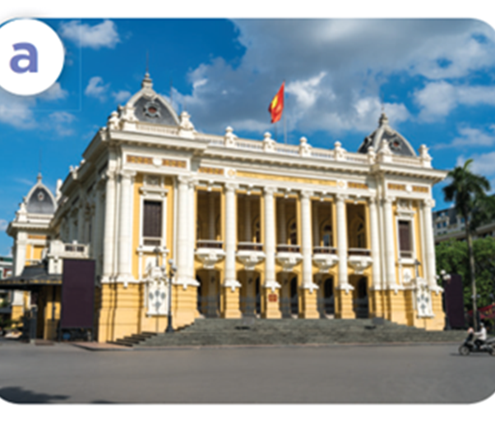
Listen, point and say.
Where do you want to visit?
I want to visit Ha Noi Opera House.
Ha Noi Opera House

Slide 20
Listen, point and say.
Where do you want to visit?
I want to visit Dragon Bridge.
Dragon Bridge

Slide 21
Listen, point and say.
Where do you want to visit?
I want to visit Ngo Mon Square.
Ngo Mon Square

Slide 22

Listen, point and say.
Where do you want
to visit?
I want to visit Ho Chi Minh City Museum.
Ho Chi Minh City Museum

Slide 23
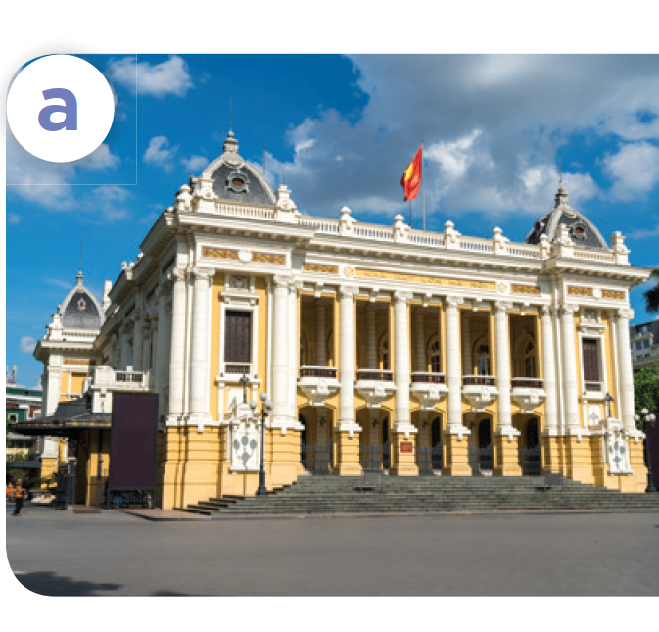
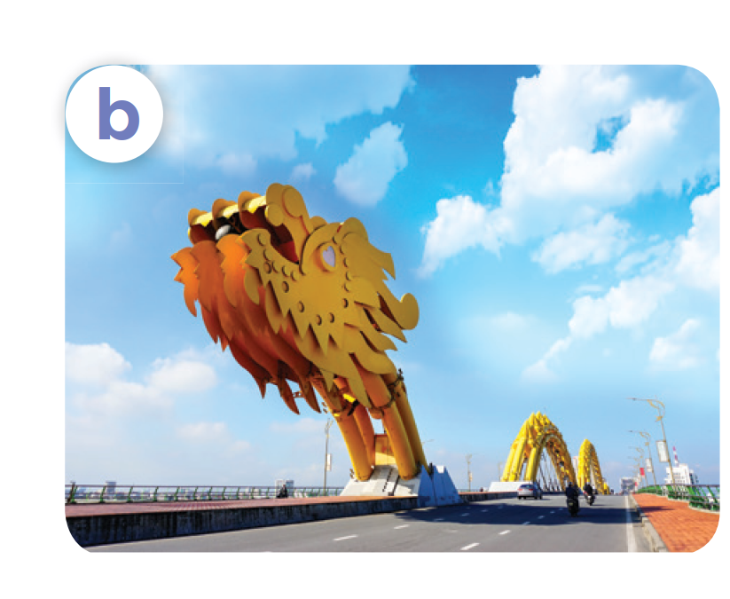
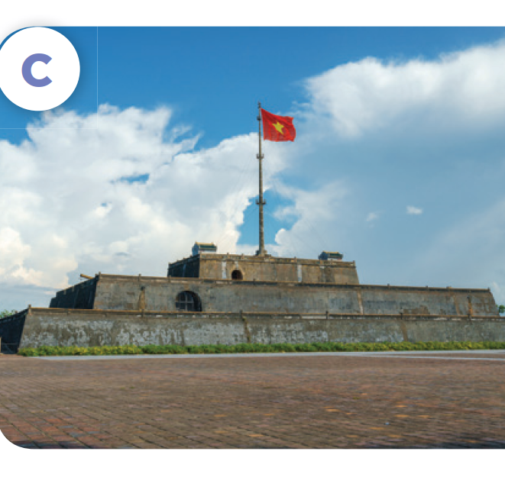
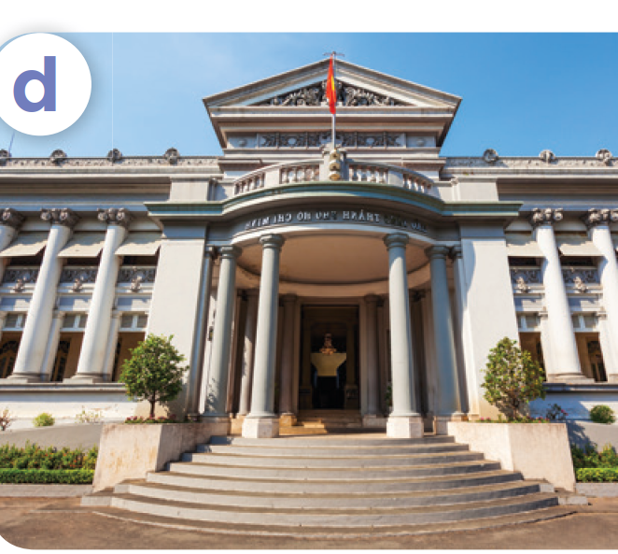
Where do you want to visit?
I want to visit ____.
Ha Noi Opera House
Dragon Bridge
Ngo Mon Square
Ho Chi Minh
City Museum

Slide 24
04
Let’s talk.

Slide 25
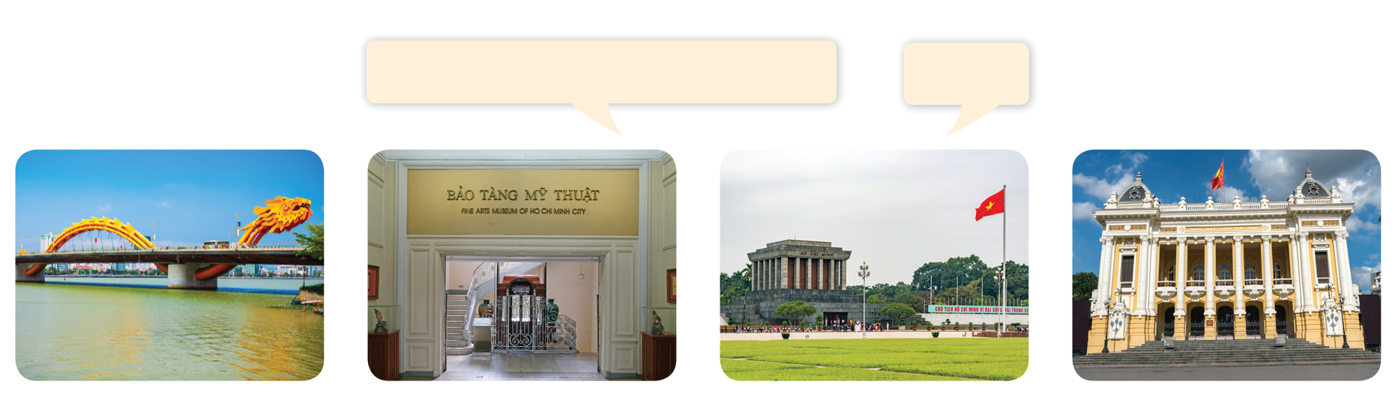
Let’s talk.
Where do you want to visit?
____.

Slide 26
Where do you want to visit?
_______.

Slide 27
05
Fun corner and Wrap-up

Slide 28

Questions and answers

Slide 29

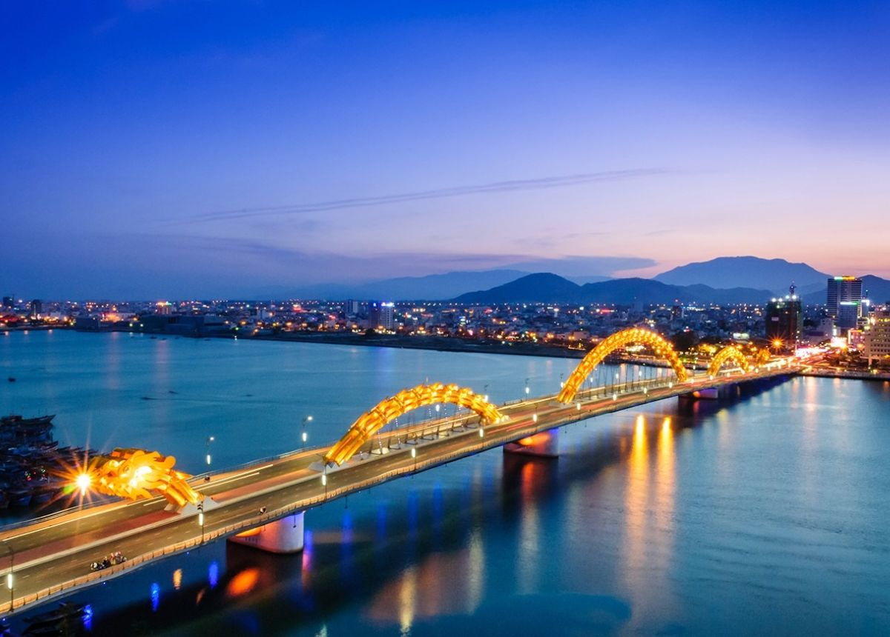
Questions and answers
______.
______?

Slide 30
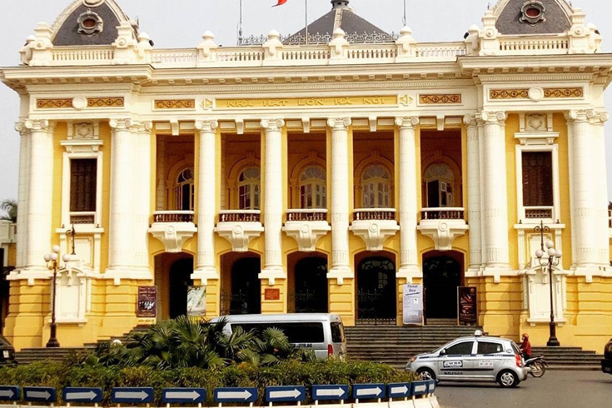
Questions and answers
______?
______.

Slide 31
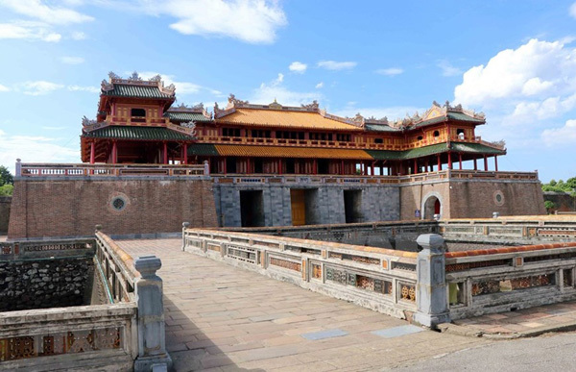
Questions and answers
______.
______?

Slide 32
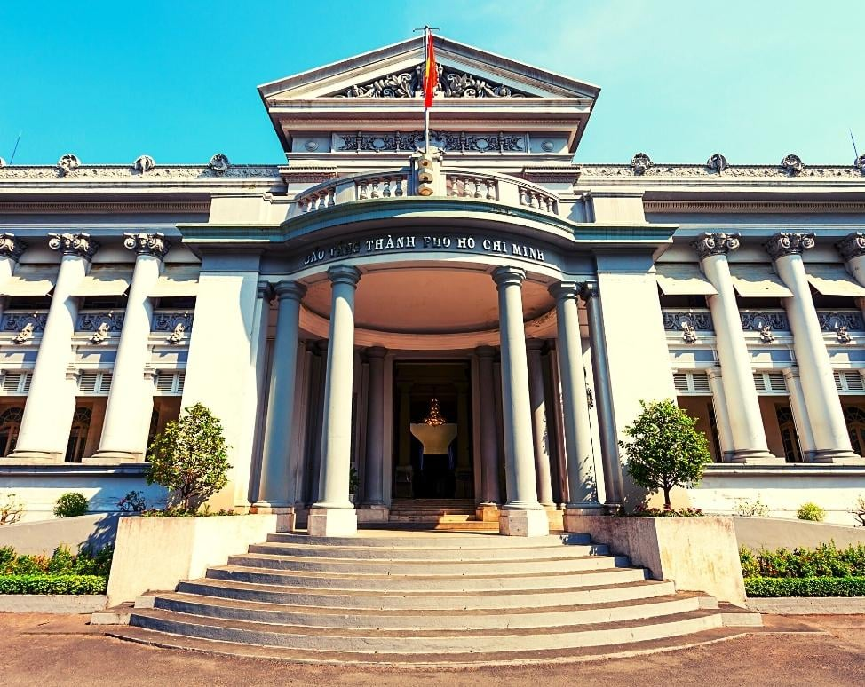
Questions and answers
_______.
______?

Slide 33
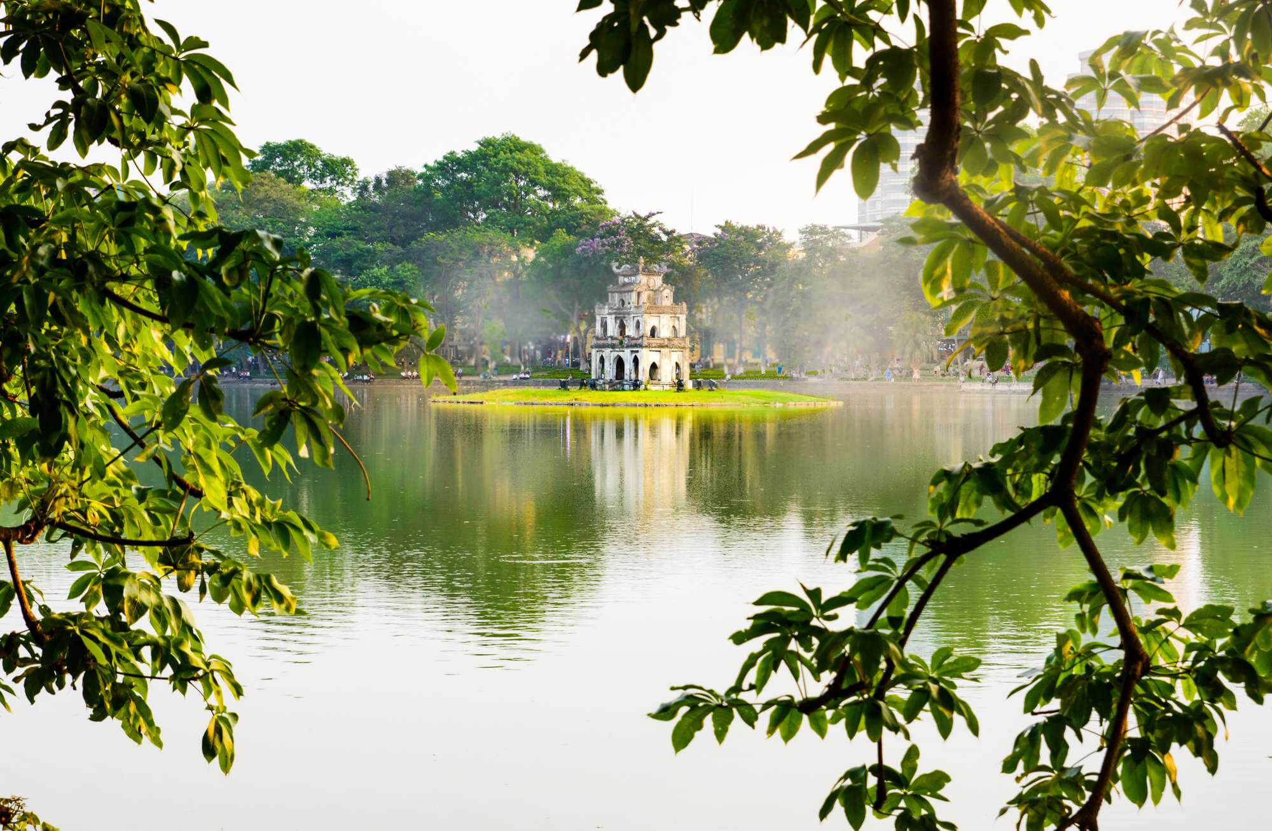
Questions and answers
______?
______.

