Slide 2

Unit 18 Means of transport
Lesson 2 - Period 4

Slide 3


Table of contents
01
Warm-up and Review
02
Listen and tick or cross.
03
Read and complete.
04
Let’s play.
05
Fun corner and Wrap-up

Slide 4
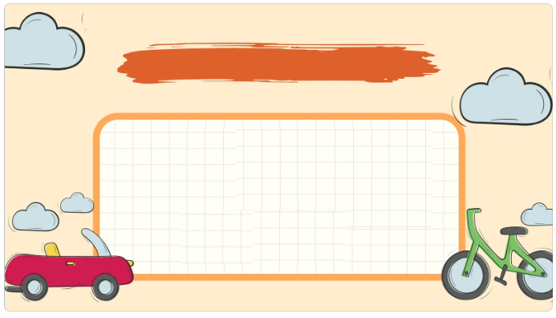

01
Warm-up and Review

Slide 5



Choose the correct answer

Slide 6

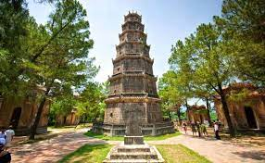

A: Where do you want to visit?
B: I want to visit ____.
a. Hoan Kiem Lake
b. Thien Mu Pagoda
c. Dragon Bridge

Slide 7

A: Where do you want to visit?
B: I want to visit ____.
a. Ho Chi Minh City Museum
b. Golden Bridge
c. Ngo Mon Square

Slide 8


A: How can you get to Dragon Bridge?
B: You can get there _____.
a. by taxi
b. on foot
c. by bicycle

Slide 9
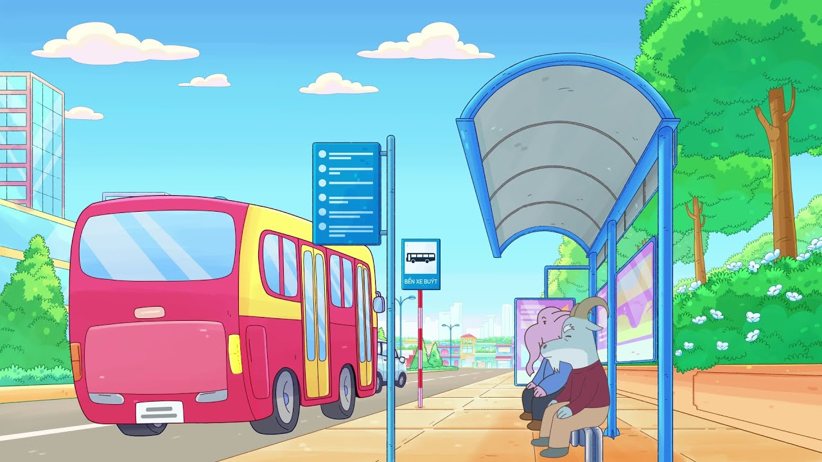
A: How can you get to Ha Noi Opera House?
B: You can get there _____.
a. by bus
b. by plane
c. by taxi

Slide 10

A: How can you get to Hoan Kiem Lake?
B: You can get there _____.
a. by bicycle
b. on foot
c. by plane

Slide 11

A: How can you get to the city square?
B: You can get there _____.
a. on foot
b. by plane
c. by taxi

Slide 12


Very Good!

Slide 13
02
Listen and tick or cross.

Slide 14

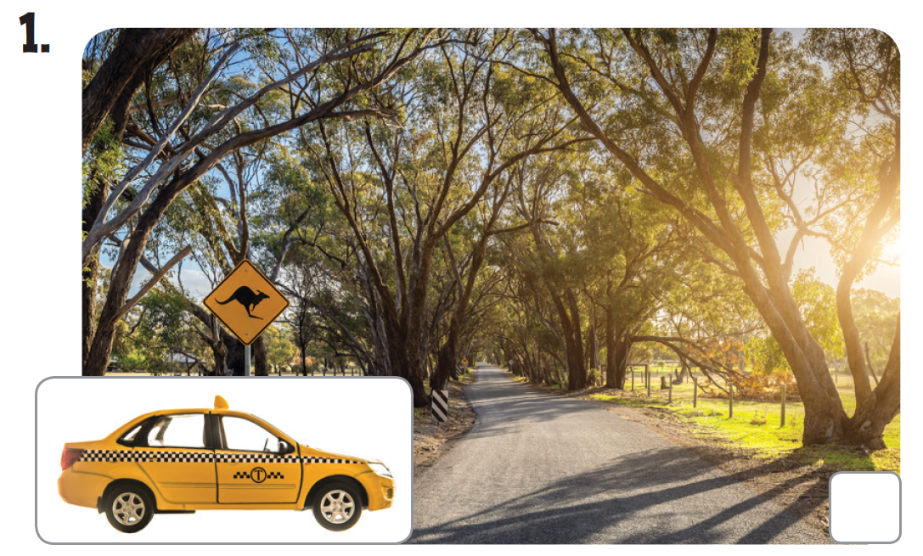
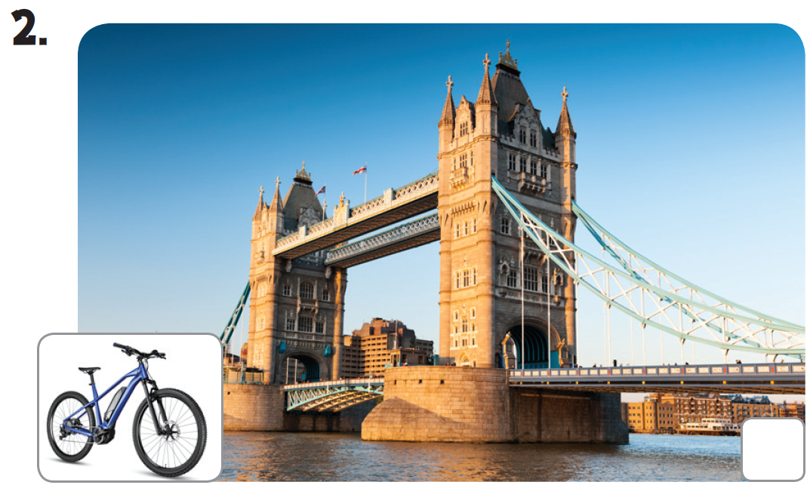
Look.

Slide 15
Listen and tick or cross.

Slide 16
Listen and tick or cross.

Slide 17


LET’S CHECK.

Slide 18
Let’s check.
✓
✗

Slide 19
03
Read and complete.

Slide 20
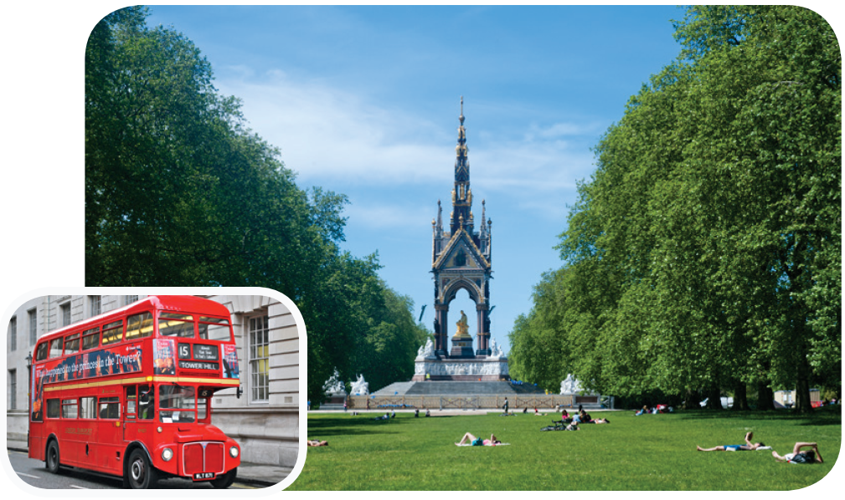
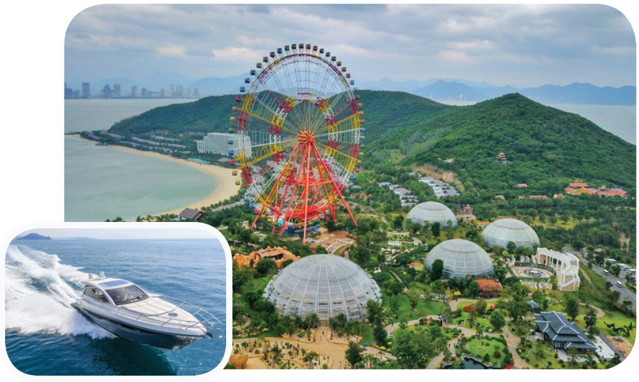
Look.

Slide 21
Read and complete.
A: Where do you want to visit?
B: I want to visit Hyde Park.
_______ can I get there?
A: You can get there _____.
It’s not far from here.
B: Thank you so much.

Slide 22
Read and complete.
2.A: Excuse me. I want to ______ Nha Trang Vinpearl Land.
How can I ______ there?
B: You can get there ______.
It’s very interesting. A: Thank you.

Slide 23
SWAP YOUR BOOKS AND CHECK.

Slide 24
Let’s check.
A: Where do you want to visit?
B: I want to visit Hyde Park.
____ can I get there?
A: You can get there ______.
It’s not far from here.
B: Thank you so much.
How
by bus

Slide 25
Let’s check.
2. A: Excuse me. I want to ____ Nha Trang Vinpearl Land.
How can I ____ there?
B: You can get there ______.
It’s very interesting. A: Thank you.
visit
get
by boat

Slide 26
Let’s check.
A: Where do you want to visit?
B: I want to visit Hyde Park.
_____ can I get there?
A: You can get there _______.
It’s not far from here.
B: Thank you so much.
How
by bus
visit
2. A: Excuse me. I want to _____ Nha Trang Vinpearl Land.
How can I ______ there?
B: You can get there ________.
It’s very interesting. A: Thank you.
get
by boat

Slide 27
04
Let’s play.

Slide 28
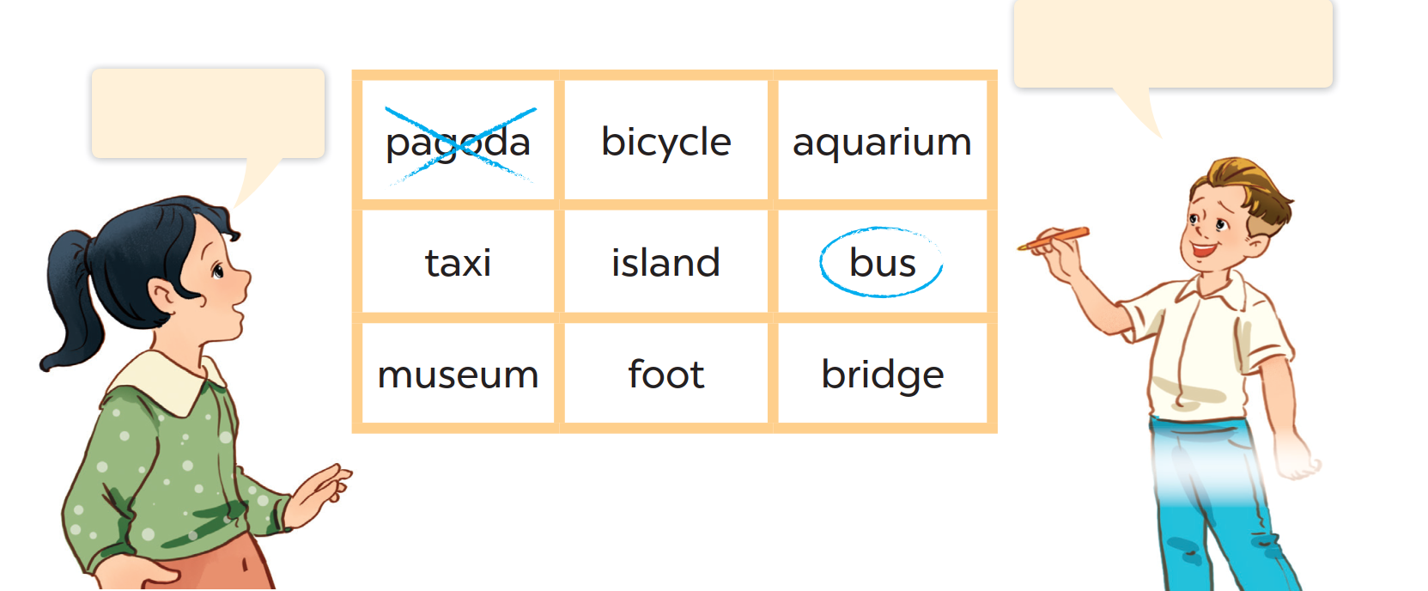
Let’s play.
I want to visit a pagoda.
You can get to the
city square by bus.

Slide 29
05
Fun corner and Wrap-up

Slide 30


Pass the balls

Slide 31
How do I get to the ____?
You can get there ____.
Notes:
Click vào loa để chạy và dừng nhạc.

Slide 32
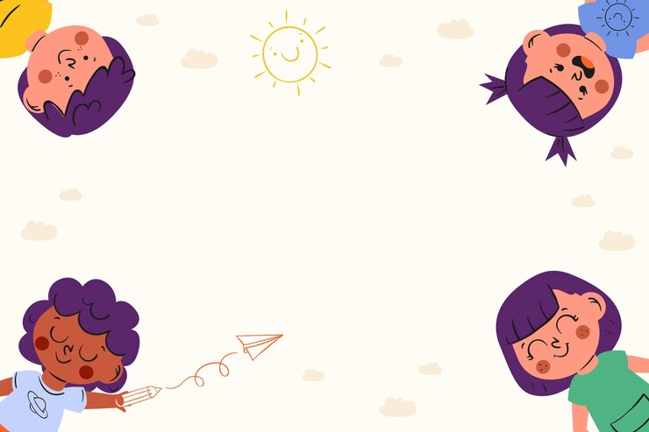
Very Good!

Slide 33
Website: hoclieu.vn
Fanpage: https://www.facebook.com/tienganhglobalsuccess.vn/

