Slide 2
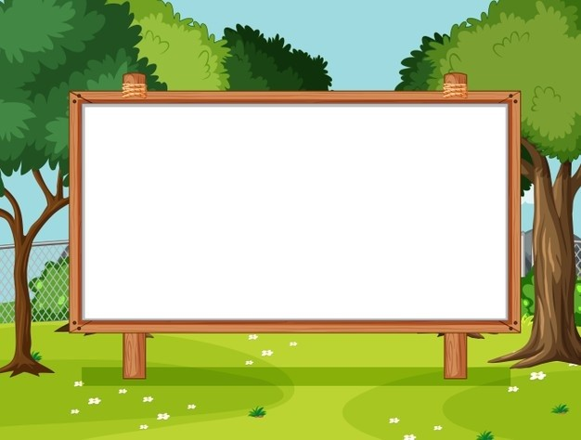
Unit 18
Means of transport
Lesson 3 - Period 5

Slide 3


Table of contents
01
Warm-up and Review
02
Listen and repeat.
03
Listen and repeat. Pay attention to the intonation.
04
Let’s chant.
05
Fun corner and Wrap-up

Slide 4
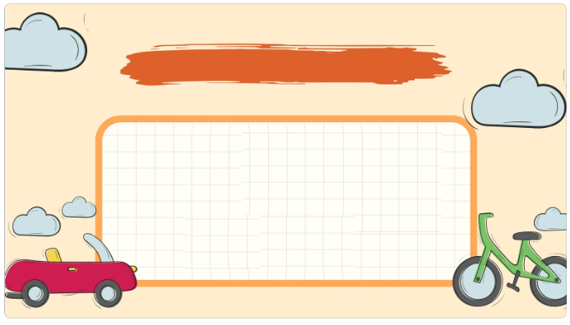

01
Warm-up and Review

Slide 5


Slide 6

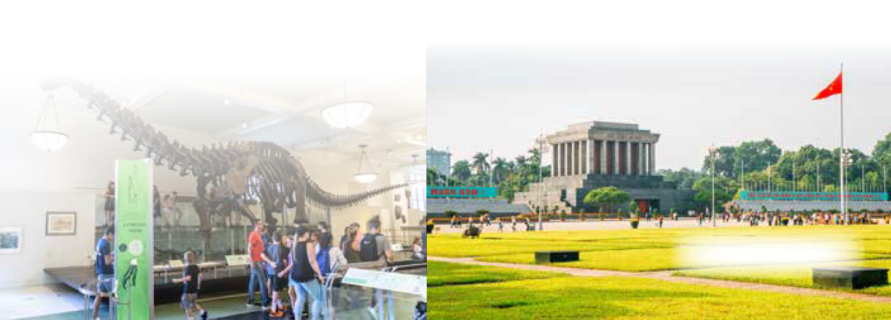
Let’s sing.
Where do you want to visit?
I want to visit somewhere.
Where do you want to visit?
I want to visit the museum.
That’s a great idea! Let’s go!
I want to visit somewhere.
Where do you want to visit?
I want to visit the square.
That’s a great idea! Let’s go!

Slide 7
02
Listen and repeat.

Slide 8

Listen and repeat.
Is it time for a trip?

Slide 9
Listen and repeat.
Is it far from here?

Slide 10

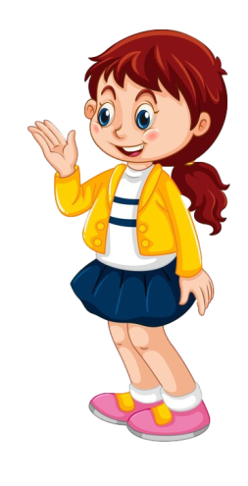
Listen and repeat.
Is it time for a trip?
Is it far from here?

Slide 11
03
Listen and repeat.
Pay attention to the intonation.

Slide 12
Read.
1. Would you like to go somewhere this morning?
2. Will we go to Golden Bridge?
3. Can I get there by bicycle?
4. Do you want to visit Hyde Park?

Slide 13
Listen and repeat.
Pay attention to the intonation.
Would you like to go somewhere this morning?

Slide 14
Listen and repeat.
Pay attention to the intonation.
2. Will we go to Golden Bridge?

Slide 15
Listen and repeat.
Pay attention to the intonation.
3. Can I get there by bicycle?

Slide 16
Listen and repeat.
Pay attention to the intonation.
4. Do you want to visit Hyde Park?

Slide 17
Listen and repeat.
1. Would you like to go somewhere this morning?
2. Will we go to Golden Bridge?
3. Can I get there by bicycle?
4. Do you want to visit Hyde Park?

Slide 18
04
Let’s chant.

Slide 19

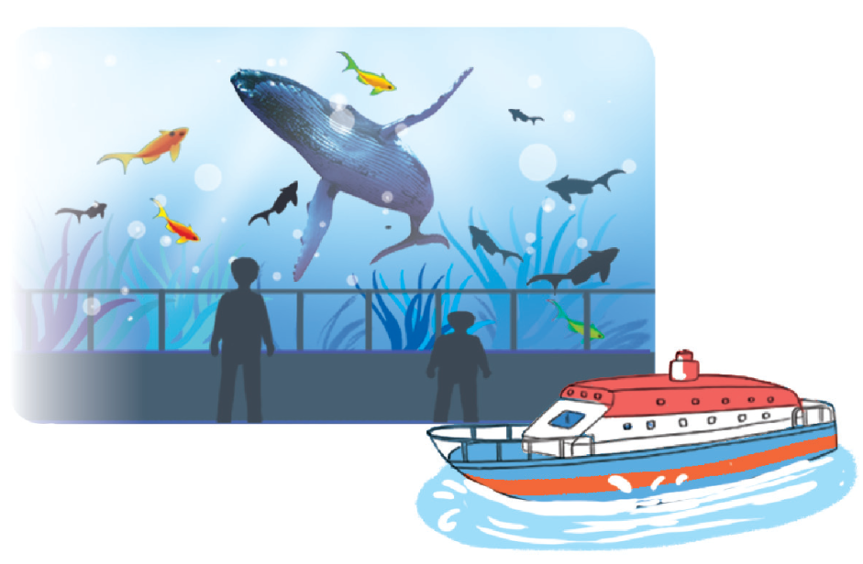
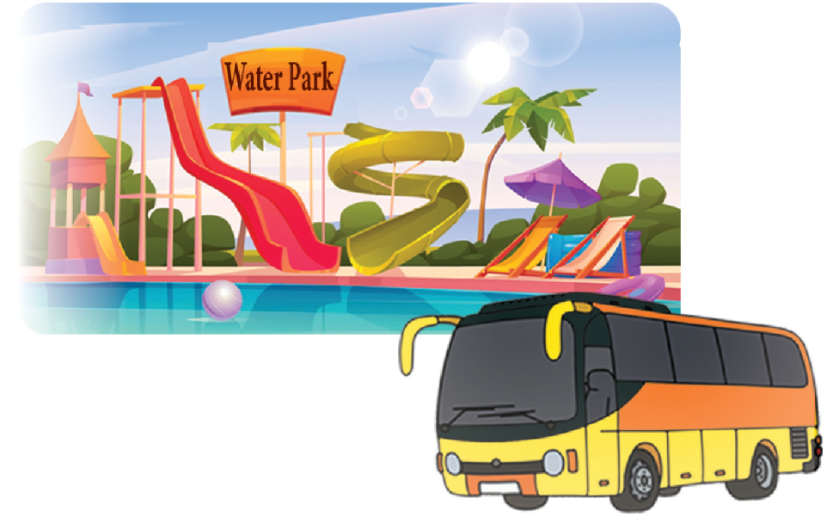
Let’s chant.
Will you visit the aquarium?
Yes, I will. Yes, I will.
Can you get there by boat?
Yes, I can. Yes, I can.
I can get there by boat.
Do you want to visit the water park?
Yes, I do. Yes, I do.
Can you get there by bicycle?
No, I can’t. No, I can’t.
I can get there by bus.

Slide 20
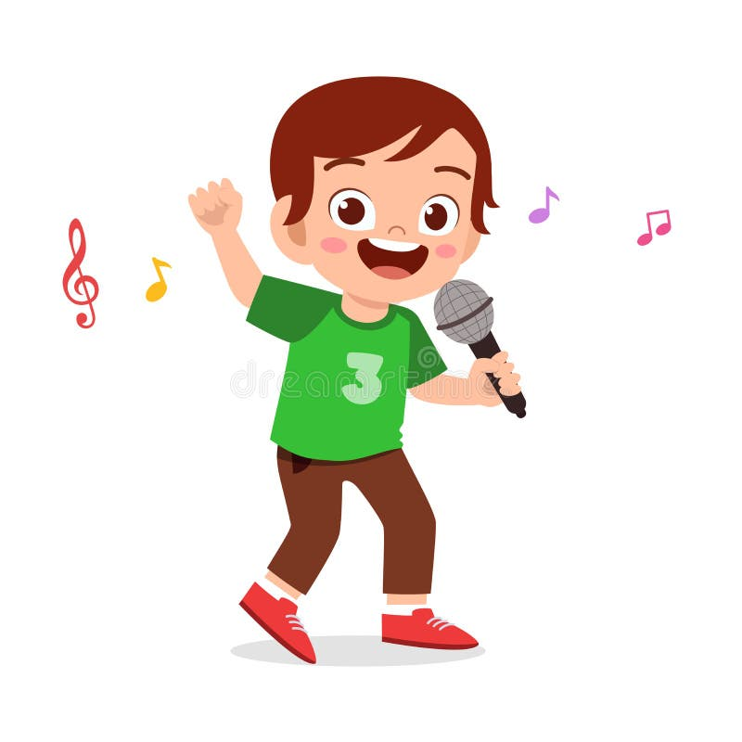

Let’s chant.
Will you visit the aquarium?
Yes, I will. Yes, I will.
Can you get there by boat?
Yes, I can. Yes, I can.
I can get there by boat.
Do you want to visit the water park?
Yes, I do. Yes, I do.
Can you get there by bicycle?
No, I can’t. No, I can’t.
I can get there by bus.

Slide 21
05
Fun corner and Wrap-up

Slide 22
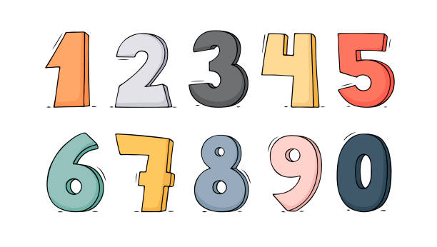


Slide 23
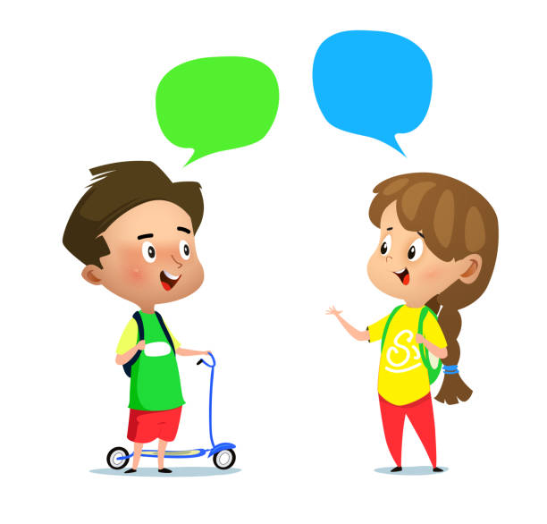
Review
Where do you want to visit?
I want to visit ___.

Slide 24
Review
How can I get to ___?
You can get there ____.

Slide 25



Team

Slide 26







10
20
30
End
30
10
20
Notes:
Click vào ngôi sao để đi tới câu hỏi tương ứng và làm biến mất ngôi sao để xuất hiện điểm.
GV ghi điểm lên bảng cho đội ghi được điểm.

Slide 27

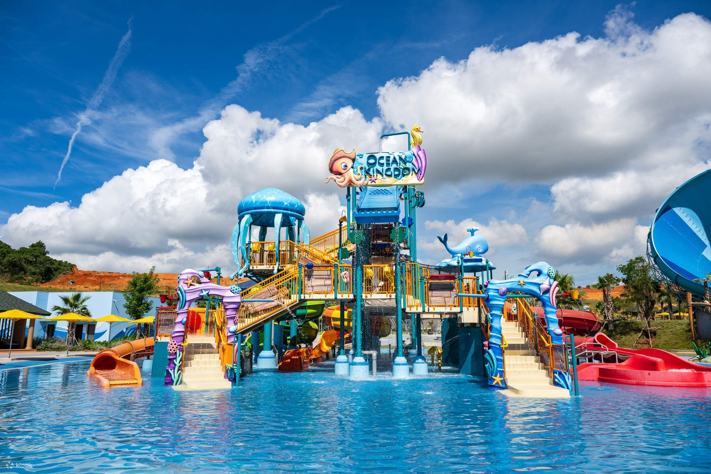

_______?
_______.
Back
Notes:
Nháy phím mũi tên để hiện kết quả
Click vào Back để về trang trò chơi

Slide 28
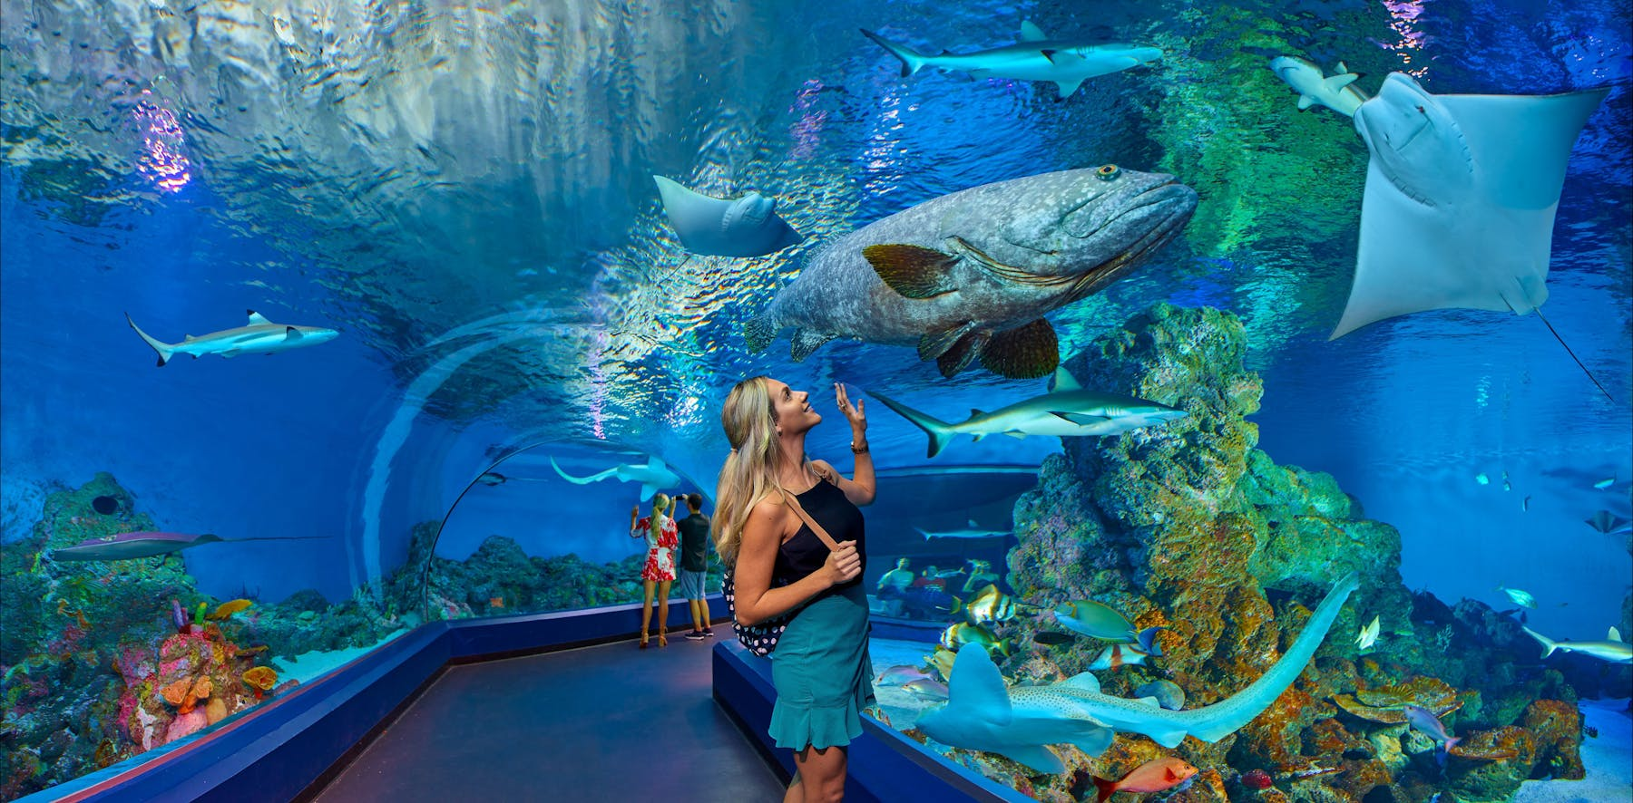
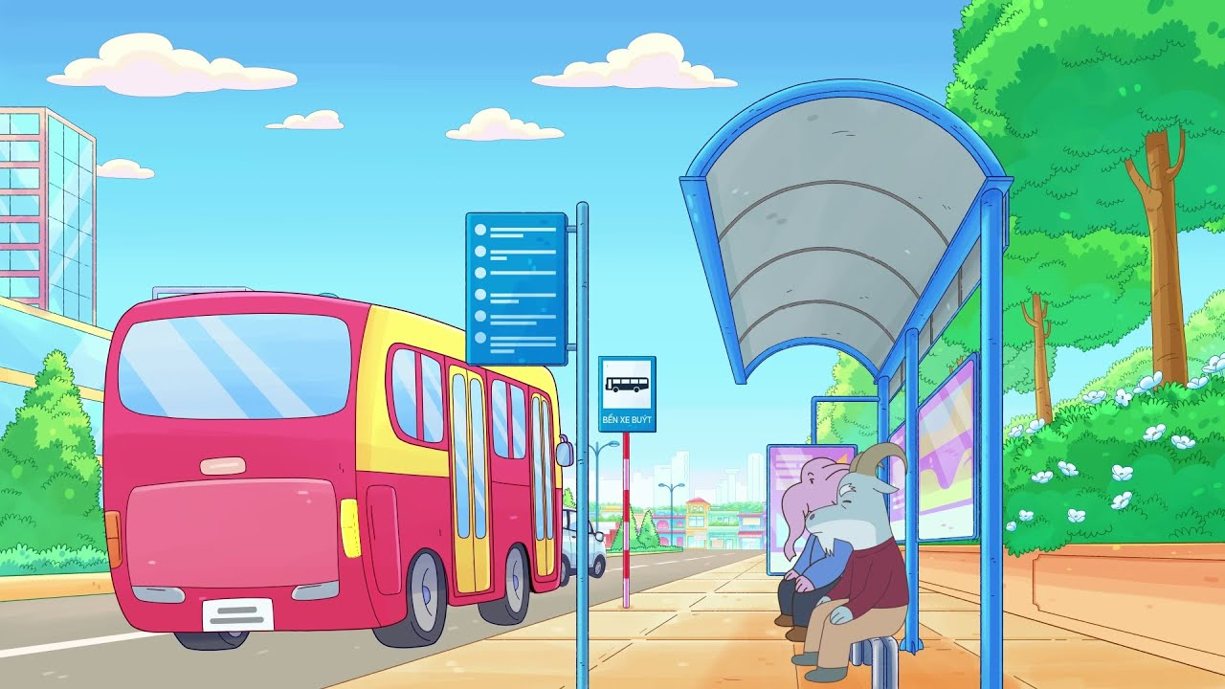
______?
______.
Back
Notes:
Nháy phím mũi tên để hiện kết quả
Click vào Back để về trang trò chơi

Slide 29
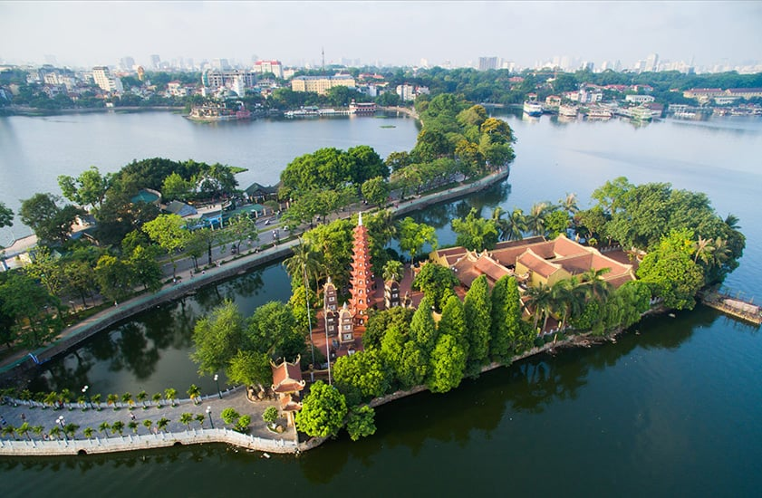

_______?
_____.
Back
Notes:
Nháy phím mũi tên để hiện kết quả
Click vào Back để về trang trò chơi

Slide 30
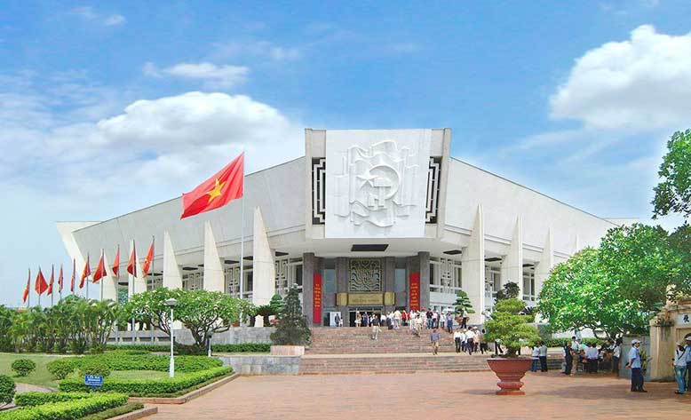
_______?
______.
Back
Notes:
Nháy phím mũi tên để hiện kết quả
Click vào Back để về trang trò chơi

Slide 31
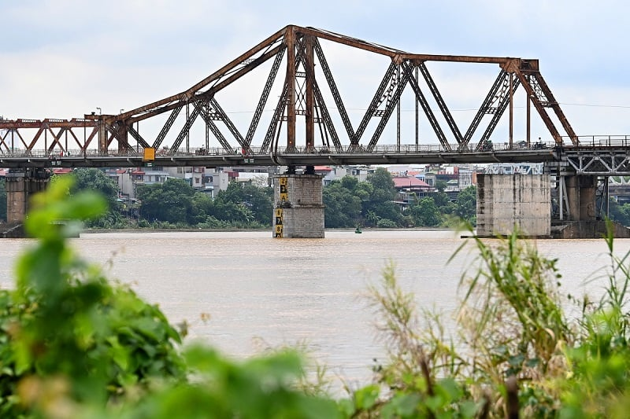

_______?
______.
Back
Notes:
Nháy phím mũi tên để hiện kết quả
Click vào Back để về trang trò chơi

Slide 32
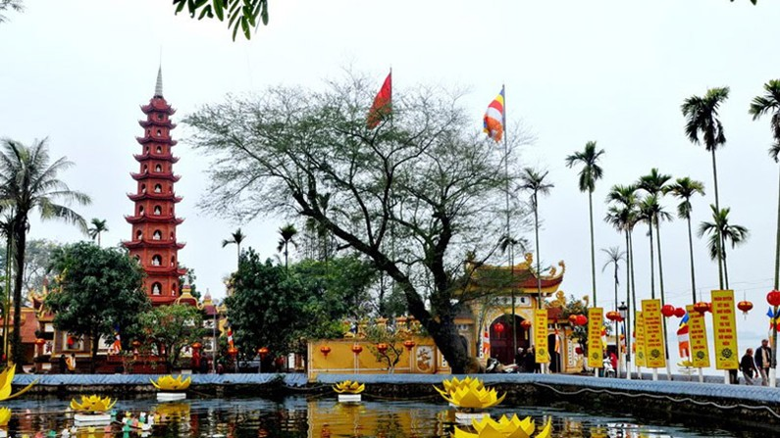
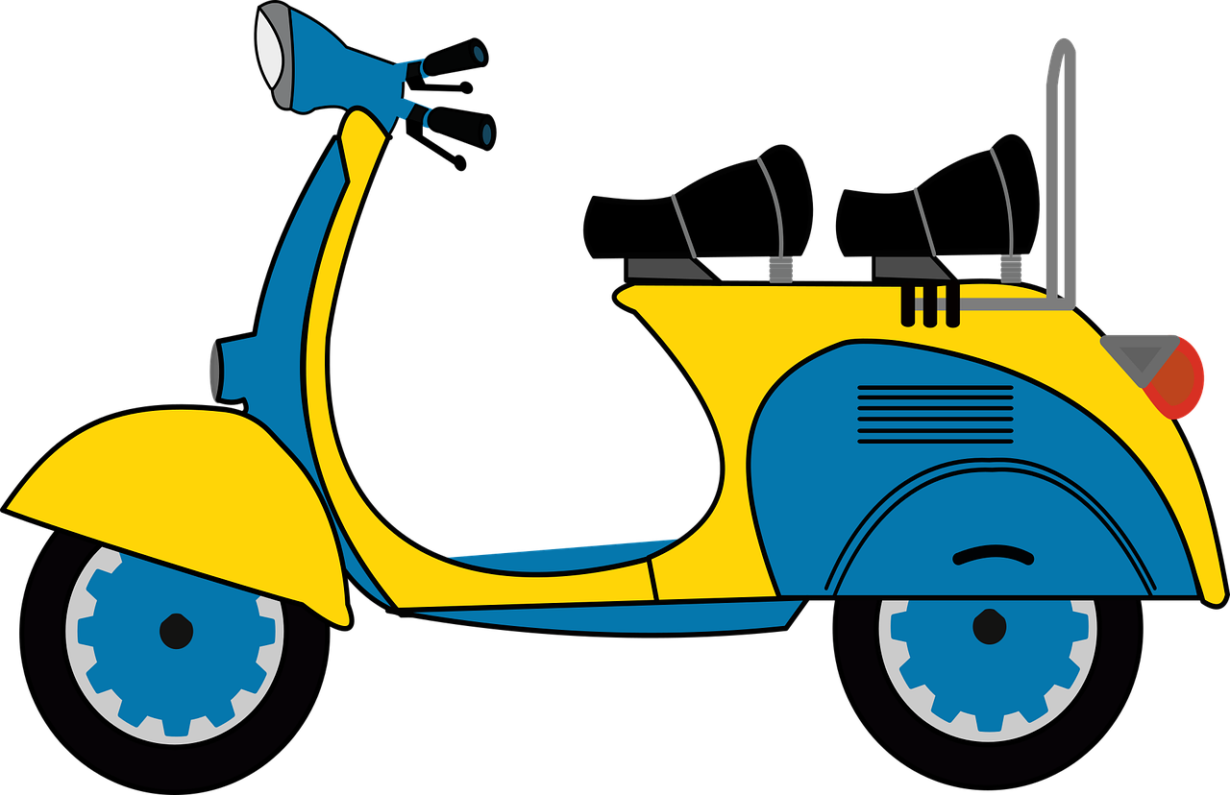
______?
______.
Back
Notes:
Nháy phím mũi tên để hiện kết quả
Click vào Back để về trang trò chơi

Slide 33


Slide 34
Website: hoclieu.vn
Fanpage: https://www.facebook.com/tienganhglobalsuccess.vn/

