Slide 1

Unit 18
Means of transport
Lesson 3 – Period 6

Slide 2
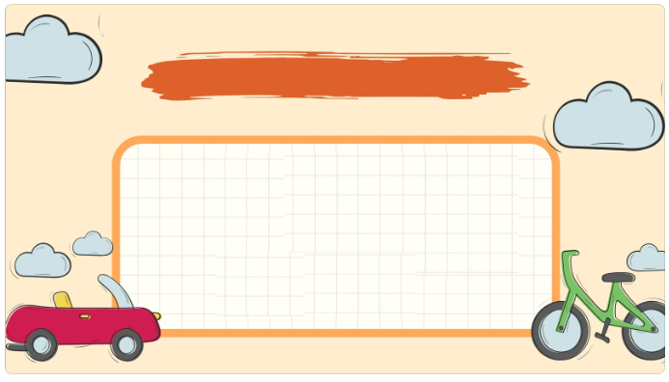
01
Warm-up and Review

Slide 3


Slide 4

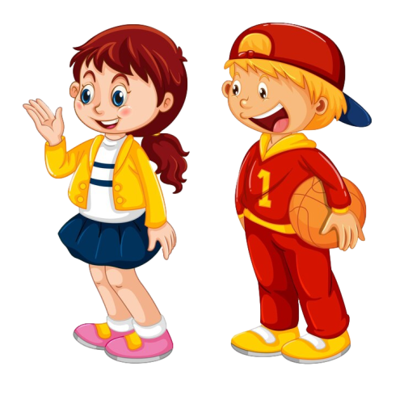

You can get there ____.
Tic-Tac-Toe
I want to visit ___.
museum | bus | pagoda
lake | bridge | taxi
bicycle | foot | aquarium

Slide 5
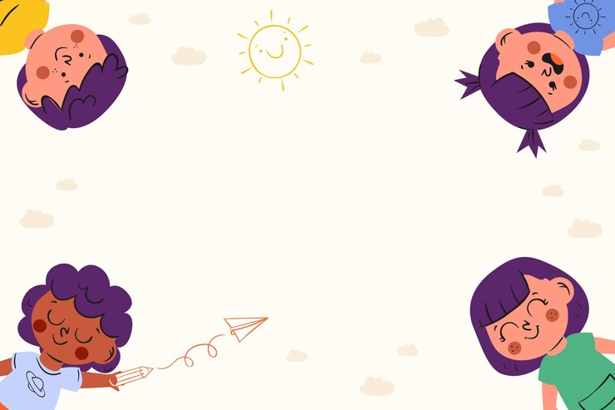



Slide 6
02
Read and answer.

Slide 7
Read.
Hi Linh,
Welcome to Sydney! Tomorrow, we can take a hop-on hop-off bus to explore the city centre in a day. Firstly, we will see Sydney Harbour Bridge and Sydney Opera House. Next, we can go to Sea Life Sydney Aquarium by train. Also, we can get to Circular Quay on foot from my house and then go to Taronga Zoo by ferry. It is home to over 4,000 animals. Then, we can go back to Circular Quay to watch a beautiful sunset.
See you soon,
Mary

Slide 8
Read and answer.
Hi Linh,
Welcome to Sydney! Tomorrow, we can take a hop-on hop-off bus to explore the city centre in a day. Firstly, we will see Sydney Harbour Bridge and Sydney Opera House. Next, we can go to Sea Life Sydney Aquarium by train. Also, we can get to Circular Quay on foot from my house and then go to Taronga Zoo by ferry. It is home to over 4,000 animals. Then, we can go back to Circular Quay to watch a beautiful sunset.
See you soon,
Mary
1. What sights will they see by taking a hop-on hop-off bus?
2. How can they get to Sea Life Sydney Aquarium?
3. How can they get to Circular Quay?
4. How many animals are there at Taronga Zoo?

Slide 9
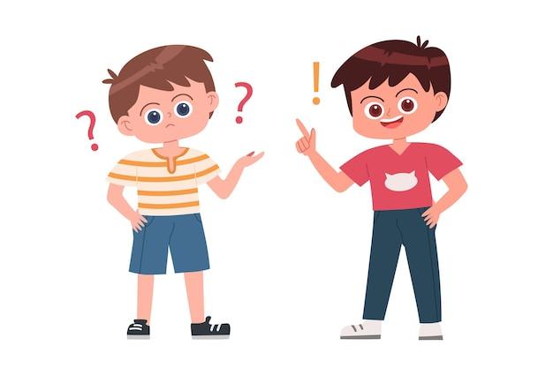
Ask
and answer

Slide 10
Hi Linh,
Welcome to Sydney! Tomorrow, we can take a hop-on hop-off bus to explore the city centre in a day. Firstly, we will see Sydney Harbour Bridge and Sydney Opera House. Next, we can go to Sea Life Sydney Aquarium by train. Also, we can get to Circular Quay on foot from my house and then go to Taronga Zoo by ferry. It is home to over 4,000 animals. Then, we can go back to Circular Quay to watch a beautiful sunset.
See you soon,
Mary
What sights will they see by taking a hop-on hop-off bus?
Sydney Harbour Bridge and Sydney Opera House.

Slide 11
Hi Linh,
Welcome to Sydney! Tomorrow, we can take a hop-on hop-off bus to explore the city centre in a day. Firstly, we will see Sydney Harbour Bridge and Sydney Opera House. Next, we can go to Sea Life Sydney Aquarium by train. Also, we can get to Circular Quay on foot from my house and then go to Taronga Zoo by ferry. It is home to over 4,000 animals. Then, we can go back to Circular Quay to watch a beautiful sunset.
See you soon,
Mary
How can they
get to Sea Life Sydney Aquarium?
By train
__________.

Slide 12
Hi Linh,
Welcome to Sydney! Tomorrow, we can take a hop-on hop-off bus to explore the city centre in a day. Firstly, we will see Sydney Harbour Bridge and Sydney Opera House. Next, we can go to Sea Life Sydney Aquarium by train. Also, we can get to Circular Quay on foot from my house and then go to Taronga Zoo by ferry. It is home to over 4,000 animals. Then, we can go back to Circular Quay to watch a beautiful sunset.
See you soon,
Mary
How can they get to Circular Quay?
On foot
__________.

Slide 13
Hi Linh,
Welcome to Sydney! Tomorrow, we can take a hop-on hop-off bus to explore the city centre in a day. Firstly, we will see Sydney Harbour Bridge and Sydney Opera House. Next, we can go to Sea Life Sydney Aquarium by train. Also, we can get to Circular Quay on foot from my house and then go to Taronga Zoo by ferry. It is home to over 4,000 animals. Then, we can go back to Circular Quay to watch a beautiful sunset.
See you soon,
Mary
How many animals are there at Taronga Zoo?
4,000
______.

Slide 14
03
Let’s write.

Slide 15
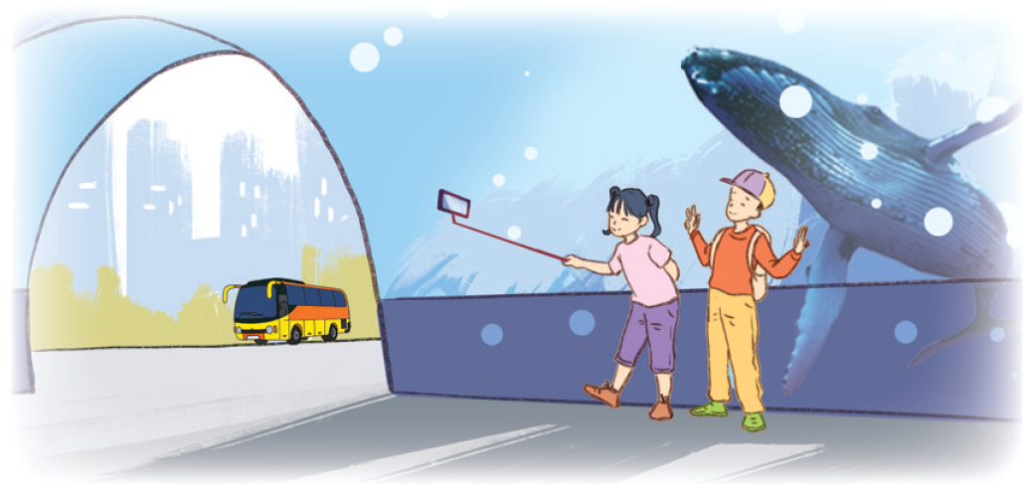
Let’s write.

Slide 16
Let’s write.
Write about a morning trip. (about 40 words)
Today is Sunday. We want to visit _______. We will get there by__________ ___________________________________________________________.

Slide 17
Let’s write.
Suggested answer:
Today is Sunday. We want to visit the aquarium in the city. We will get there by bus. We will take photos with the shark in the tank. Also, we want to learn more about the sharks and other fish.

Slide 18
Let’s write.
Write about a morning trip. (about 40 words)
Today is Sunday. We want to visit _________. We will get there by _______ ______________________________________________.

Slide 19

Let’s write.

Slide 20
04
Project

Slide 21
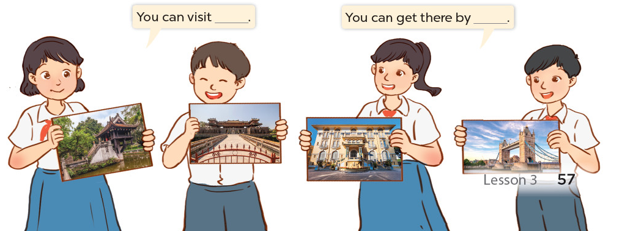
Project
Means of transport
You can visit ___.
You can get there by ___.

Slide 22

Project

Slide 23
05
Fun corner and Wrap-up

Slide 24
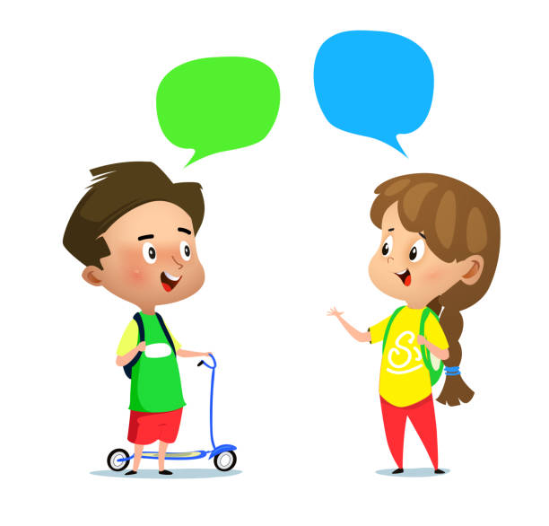
Review
How can I
get to __?
You can get there ___.

Slide 25


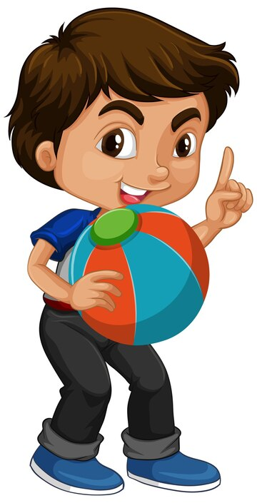
Pass the balls

Slide 26
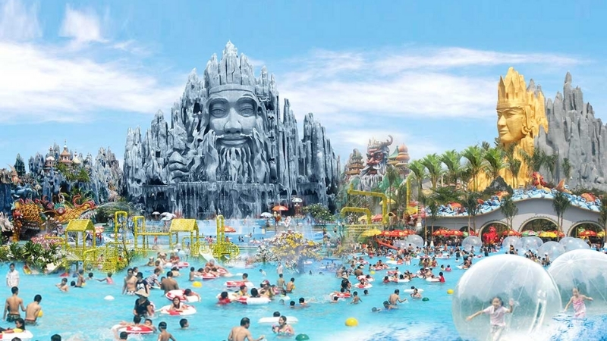
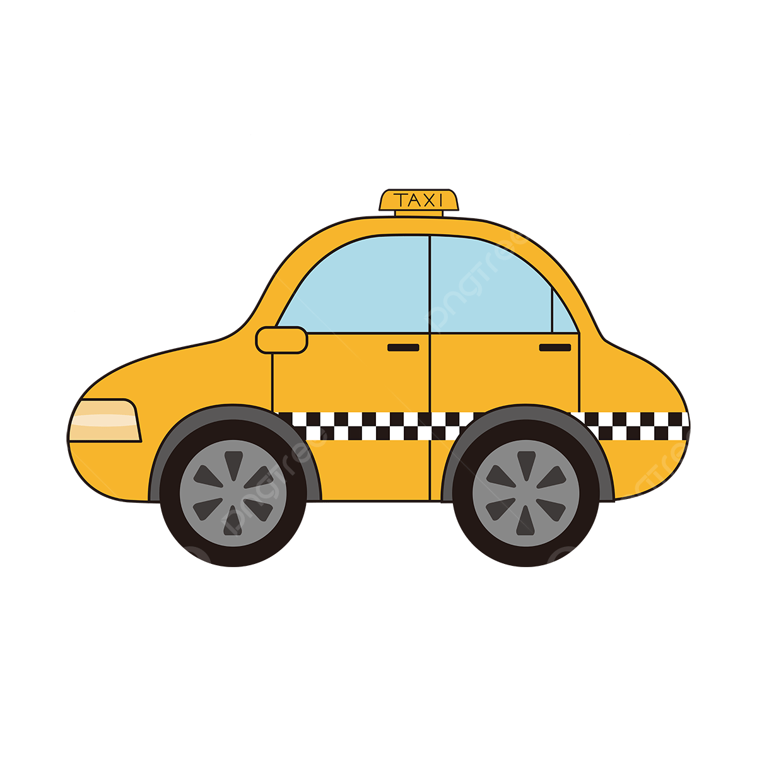
How can I
get to __?
You can get there ___.

Slide 27
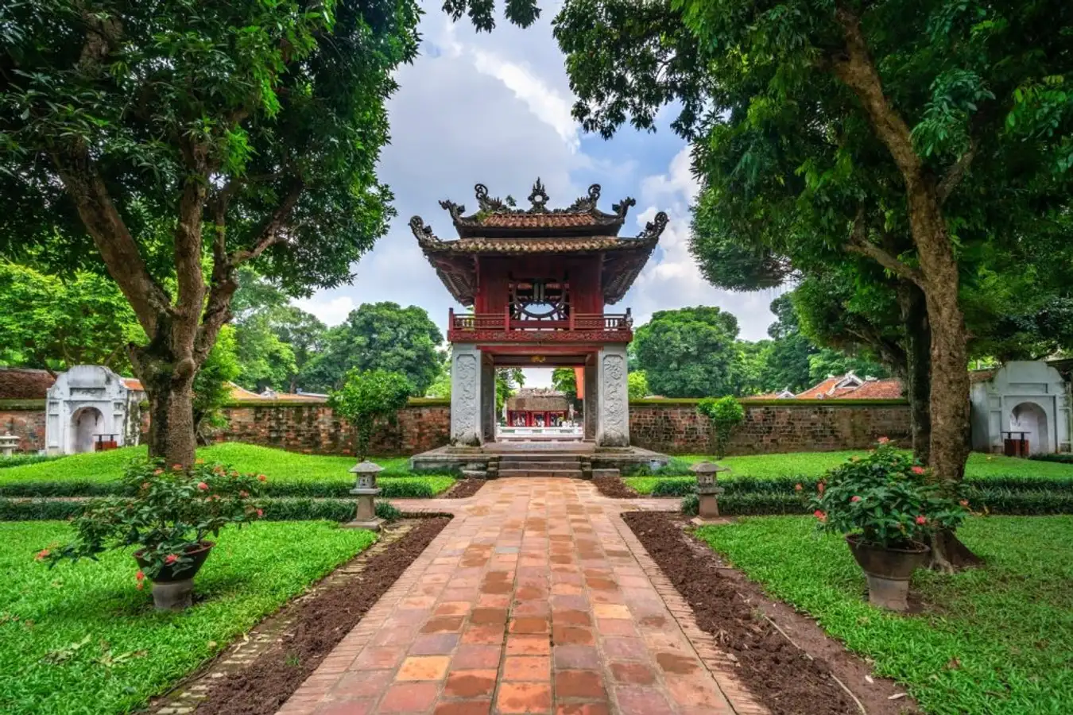
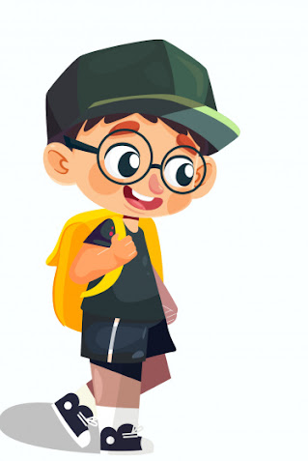
How can I
get to ___?
You can get there ___.

Slide 28
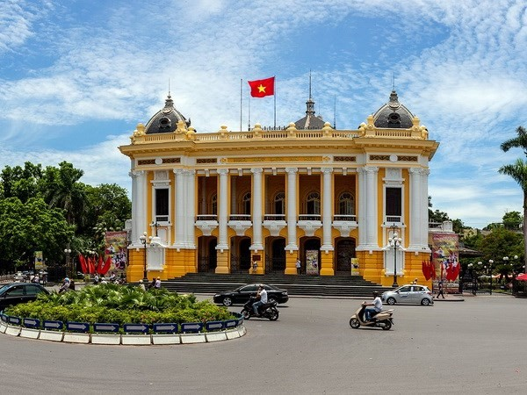

How can I
get to __?
You can get there ___.

Slide 29
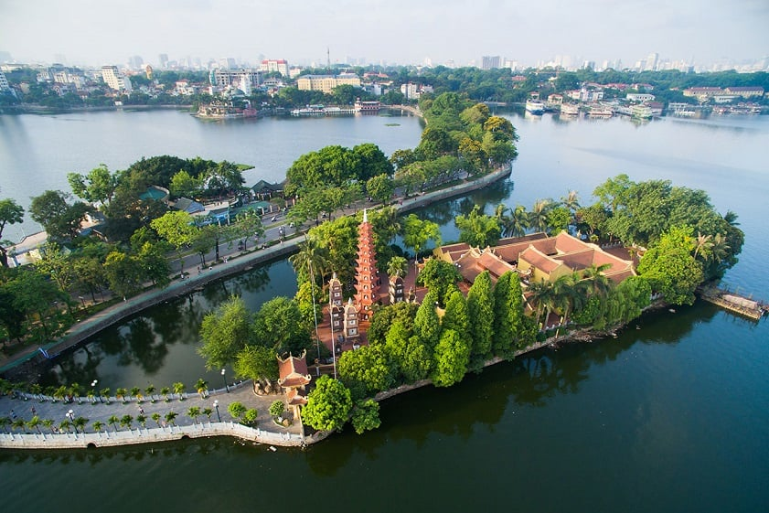
How can I
get to __?
You can get there ___.

Slide 30
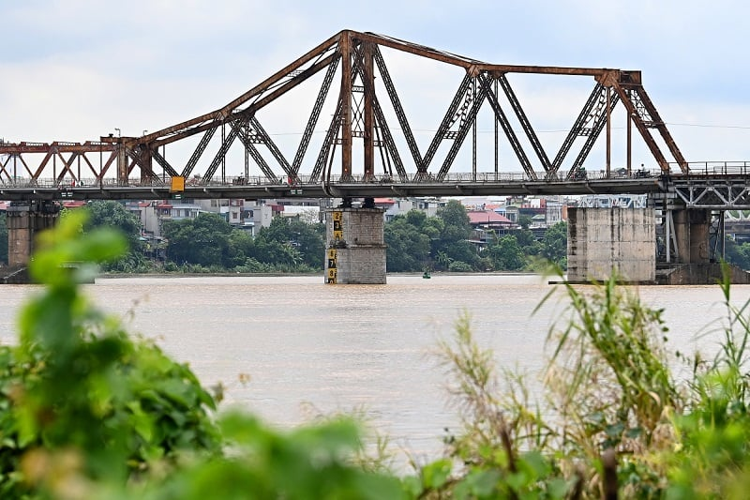

How can I get to ___?
You can get there ___.

