Slide 2













UNIT 19
Places of interest
Lesson 1- Period 2

Slide 3






行业PPT模板http://www.1ppt.com/hangye/
01
Warm-up and Review
02
Listen and circle.
CONTENTS
03
Read and complete.
04
Let's sing.
05
Fun corner and Wrap-up

Slide 4







01
Warm-up and Review
Guessing game

Slide 5
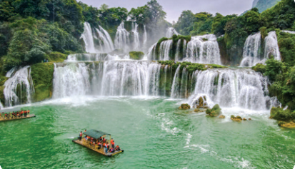
Ban Gioc Waterfall
SHOW

Slide 6
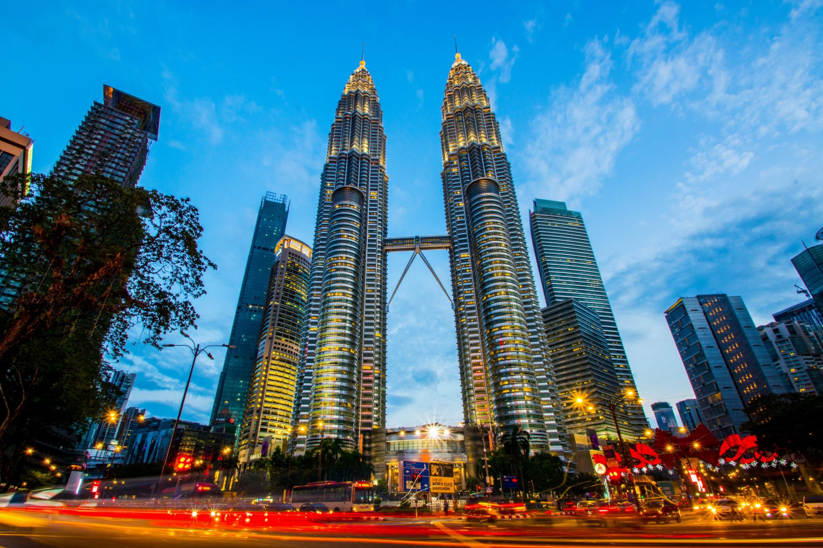
Petronas Twin Towers
SHOW

Slide 7
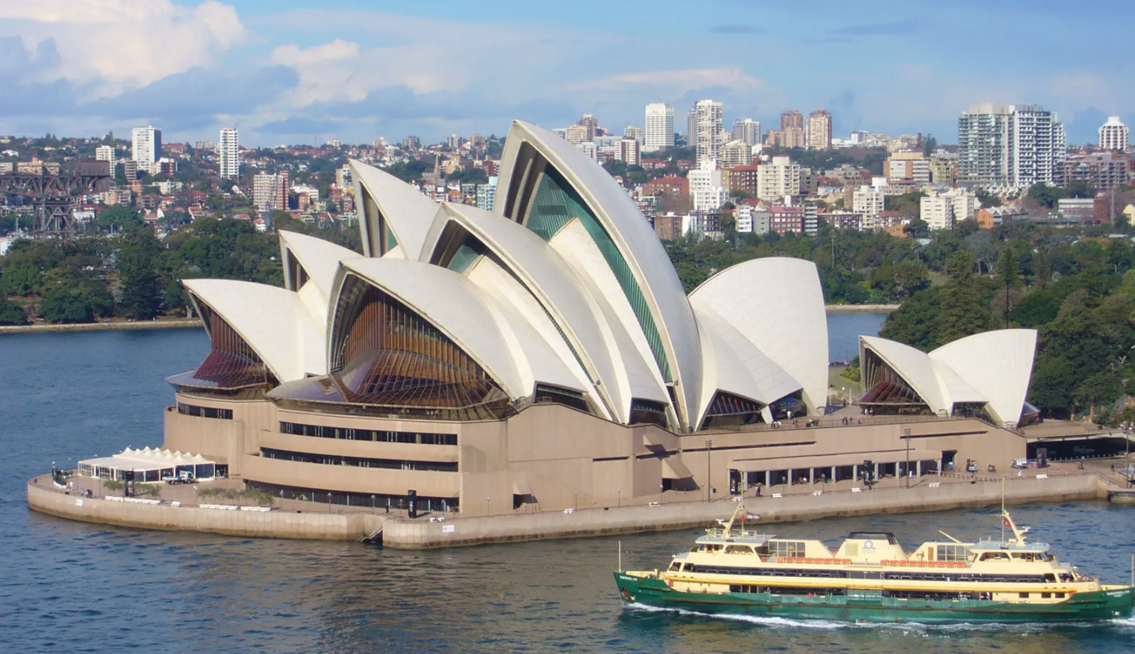
Sydney Opera House
SHOW

Slide 8
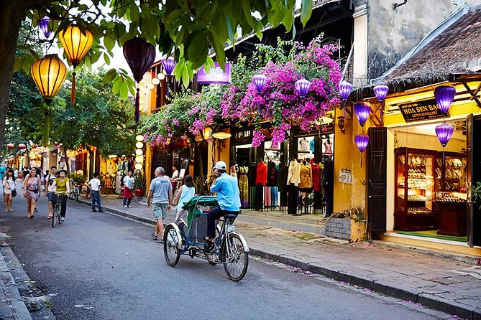
Hoi An Old Town
SHOW

Slide 9
02
Listen and circle.

Slide 10
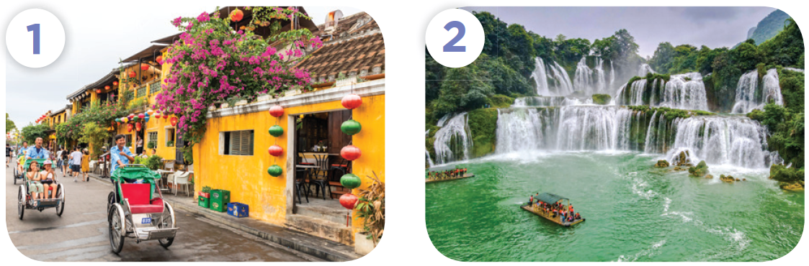
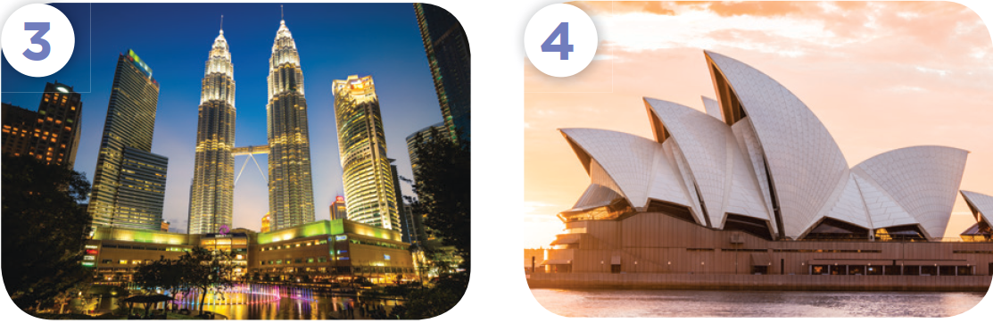
Name the places.

Slide 11
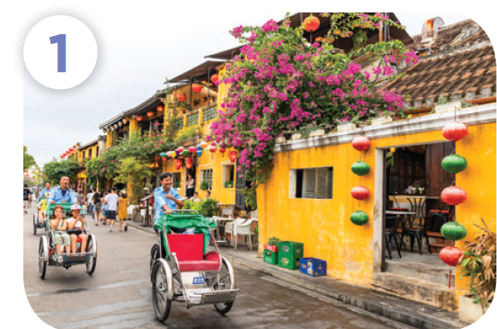
Name the places.
Hoi An Old Town

Slide 12
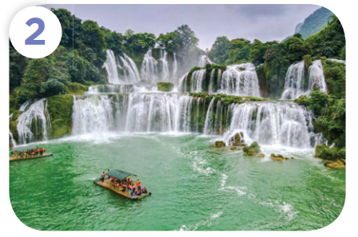
Name the places.
Ban Gioc Waterfall

Slide 13
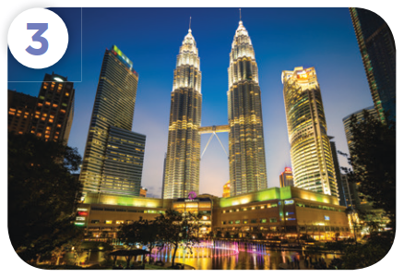
Name the places.
Petronas Twin Towers

Slide 14

Name the places.
Sydney Opera House

Slide 15
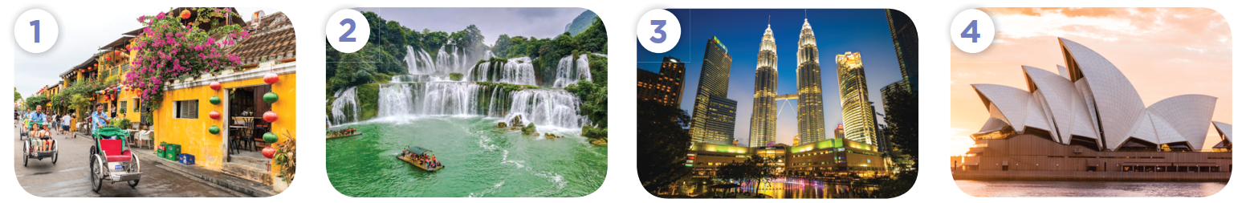
Point and say the words.
a. peaceful
b. exciting
a. fantastic
b. peaceful
a. fantastic
b. exciting
a. peaceful
b. beautiful

Slide 16

Listen and circle.
a. peaceful
b. exciting
a. fantastic
b. peaceful
a. fantastic
b. exciting
a. peaceful
b. beautiful

Slide 17
03
Read and complete.

Slide 18
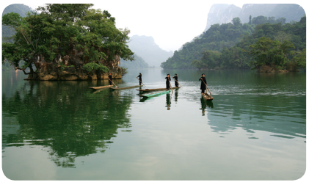
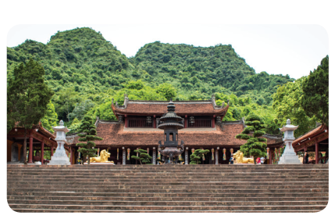
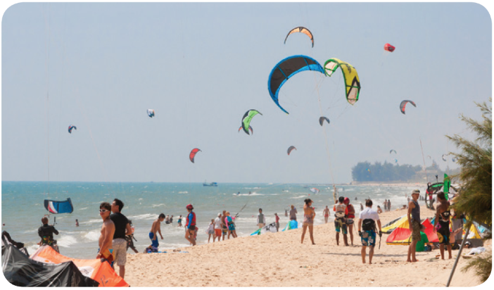
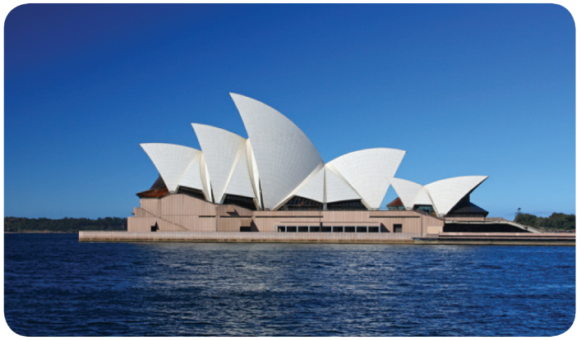
Name the places.

Slide 19
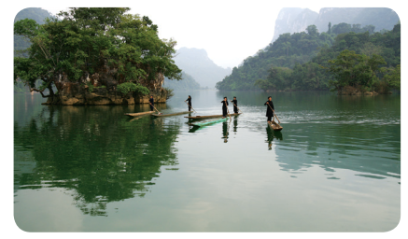
Name the places.
Ba Be Lake

Slide 20
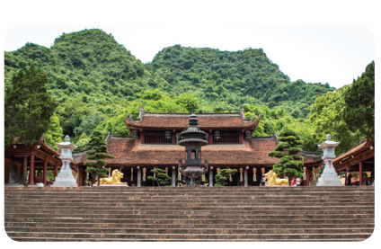
Name the places.
Huong Pagoda

Slide 21

Name the places.
Mui Ne Beach

Slide 22
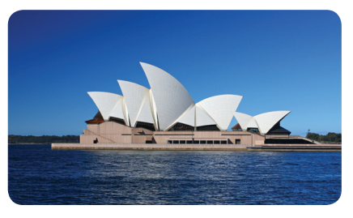
Name the places
Sydney Opera House

Slide 23
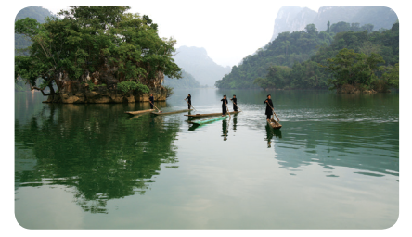
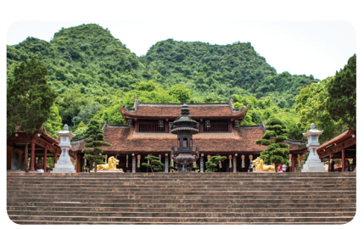


1. A: ________ do you think
of Ba Be Lake?
B: _______ it’s fantastic.
2. A: I visited Huong Pagoda last month.
B: What do you think of _______?
A: I think _____ beautiful and peaceful.
3. A: Do you think Mui Ne Beach
________ beautiful?
B: Yes, I do. I think it’s _______
and exciting.
4. A: ________ Sydney Opera House
is beautiful?
B: Yes, I do. I think _________.

Slide 24
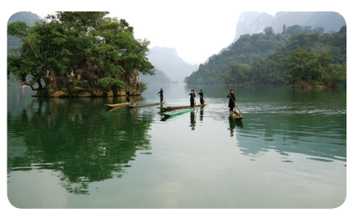
A: ______ do you think of
Ba Be Lake?
B: _______ it’s fantastic.
What
I think

Slide 25
2. A: I visited Huong Pagoda last month.
B: What do you think of ___?
A: I think ______________ beautiful
and peaceful.
it
Huong Pagoda

Slide 26

3. A: Do you think Mui Ne Beach ___
beautiful?
B: Yes, I do. I think it’s _________
and exciting.
is
beautiful

Slide 27
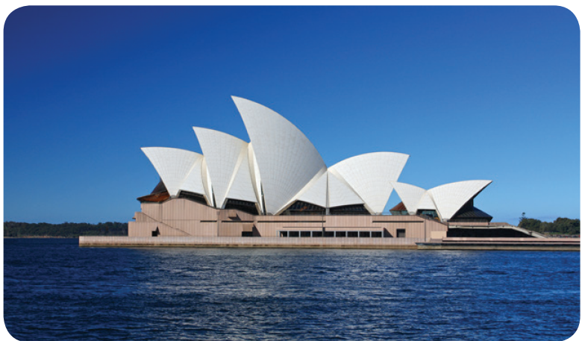
4. A: ____________ Sydney Opera House
is beautiful?
B: Yes, I do. I think ____________.
Do you think
it’s beautiful

Slide 28
04
Let’s sing.

Slide 29
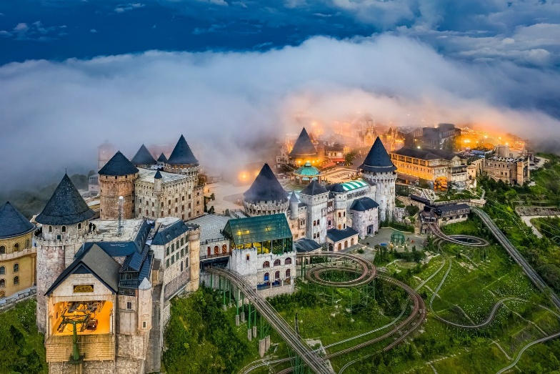
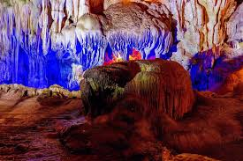
Let’s sing.
What do you think of ...?
What do you think of Ba Na Hills?
I think it’s fantastic.
I think it’s exciting.
Ba Na Hills is fantastic and exciting.
What do you think of Dau Go Cave?
I think it’s peaceful.
I think it’s beautiful.
Dau Go Cave is peaceful and beautiful.

Slide 30
Write your new song.
What do you think of ______?
I think it’s ______.
I think it’s ______.
Ba Na Hills is ______ and ______.
What do you think of ______?
I think it’s ______.
I think it’s ______.
Dau Go Cave is ______ and ______.

Slide 31

05
Fun corner and Wrap-up
Roll the dice

Slide 32

What do you think of ____?
I think it’s / they’re _____.

Slide 33
Website: hoclieu.vn
Fanpage: https://www.facebook.com/tienganhglobalsuccess.vn/

