Slide 2













UNIT 19
Places of interest
Lesson 2 Period 4

Slide 3






行业PPT模板http://www.1ppt.com/hangye/
01
Warm-up and Review
02
Listen and circle.
03
Read and complete.
CONTENTS
04
Let’s play.
05
Fun corner and Wrap-up

Slide 4







01
Warm-up and Review
Let’s sing.

Slide 5


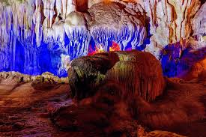
Let’s sing.
What do you think of ...?
What do you think of Ba Na Hills?
I think it’s fantastic.
I think it’s exciting.
Ba Na Hills is fantastic and exciting.
What do you think of Dau Go Cave?
I think it’s peaceful.
I think it’s beautiful.
Dau Go Cave is peaceful and beautiful.

Slide 6
02
Listen and circle.

Slide 7

1. Vung Tau Beach is (1) _____.
a. beautiful b. exciting
It’s about (2) ______ kilometres
from Ho Chi Minh City.
a. 96 b. 69
2. Ba Vi National Park is (1) ___ and peaceful.
a. beautiful b. fantastic
It’s about (2) ____ kilometres from the centre of Ha Noi.
a. 60 b. 63

Slide 8
03
Read and complete.

Slide 9
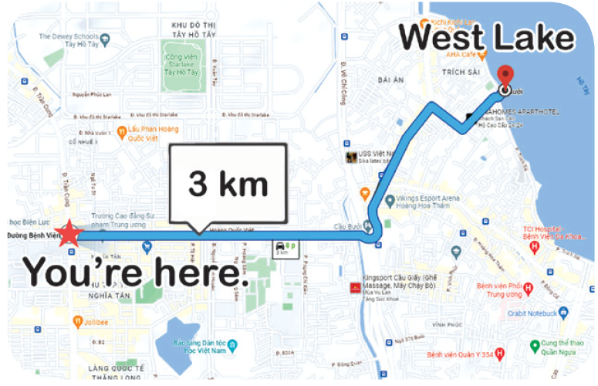
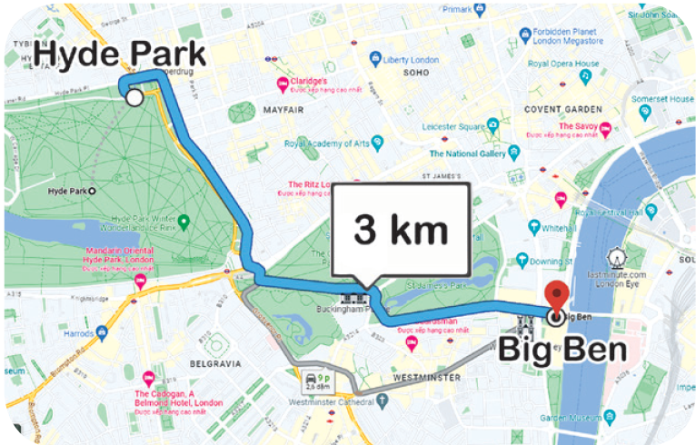
Read and complete.
1. A: We’re going to West Lake this weekend. Do you want to come with us?
B: Yes, I’d love to. _________ is it from here?
A: It’s about _______________.
West Lake
3 km
How far
You're here.
3 kilometres
2. A: What do you think of Hyde Park?
B: _______ it’s exciting.
A: How far _____ from Big Ben?
B: It’s about ______________.
A: OK. Thank you.
Hyde Park
I think
is it
3 km
3 kilometres
Big Ben

Slide 10
04
Let’s play.

Slide 11
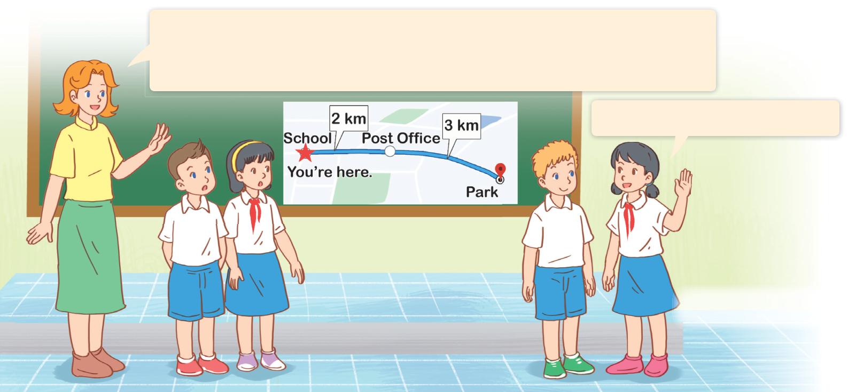
Solving maths problems
It’s about two kilometres from our school to the post office.
It’s about three kilometres from the post office to the park.
How far is it from our school to the park?
It’s about five kilometres.

Slide 12
05
Fun corner and Wrap-up

Slide 13


1
2
3
4
5
6
7
8
9

Slide 14

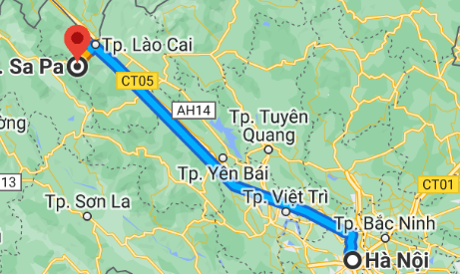


How far is it from Ha Noi to Sapa?
SA PA
314 km
HA NOI
It’s about 314km.

Slide 15

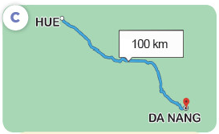

How far is it from Hue to Da Nang?
HUE
100 km
DA NANG
It’s about 100 km.

Slide 16
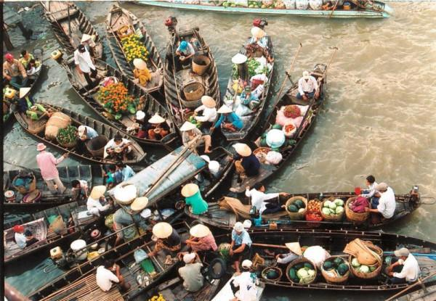

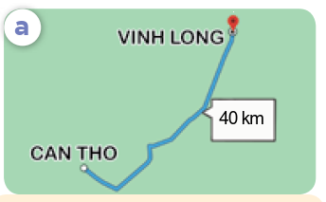
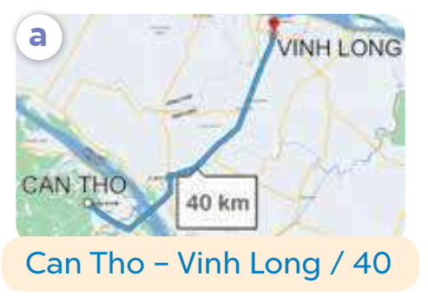

How far is it from Can Tho to Vinh Long?
VINH LONG
40 km
CAN THO
It’s about 40 km.

Slide 17

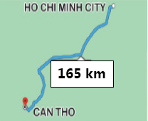
How far is it from Ho Chi Minh City
to Can Tho?
HO CHI MINH CITY
165 km
165 km
CAN THO
It’s about 165 km.

Slide 18

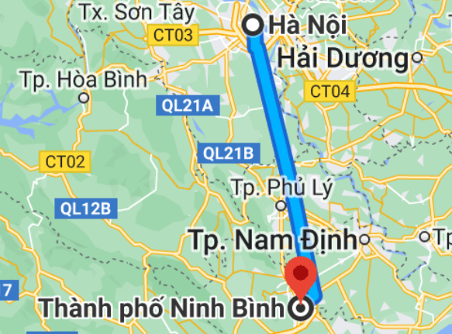
How far is it from Ha Noi to Ninh Binh?
HA NOI
90 km
NINH BINH
It’s about 90 km.

Slide 19

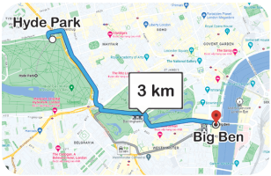
How far is it from Hyde Park to Big Ben?
Hyde Park
3 km
Big Ben
It’s about 3 km.

Slide 20


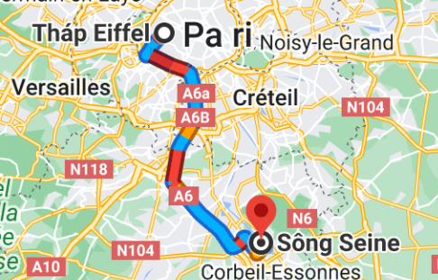
How far is it from Seine River to Eiffel Tower?
Eiffel Tower
40 km
Seine River
It’s about 40 km.

Slide 21

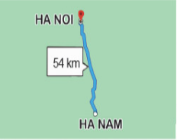
How far is it from Ha Noi to Ha Nam?
HA NOI
54 km
HA NAM
It’s about 54 km.

Slide 22
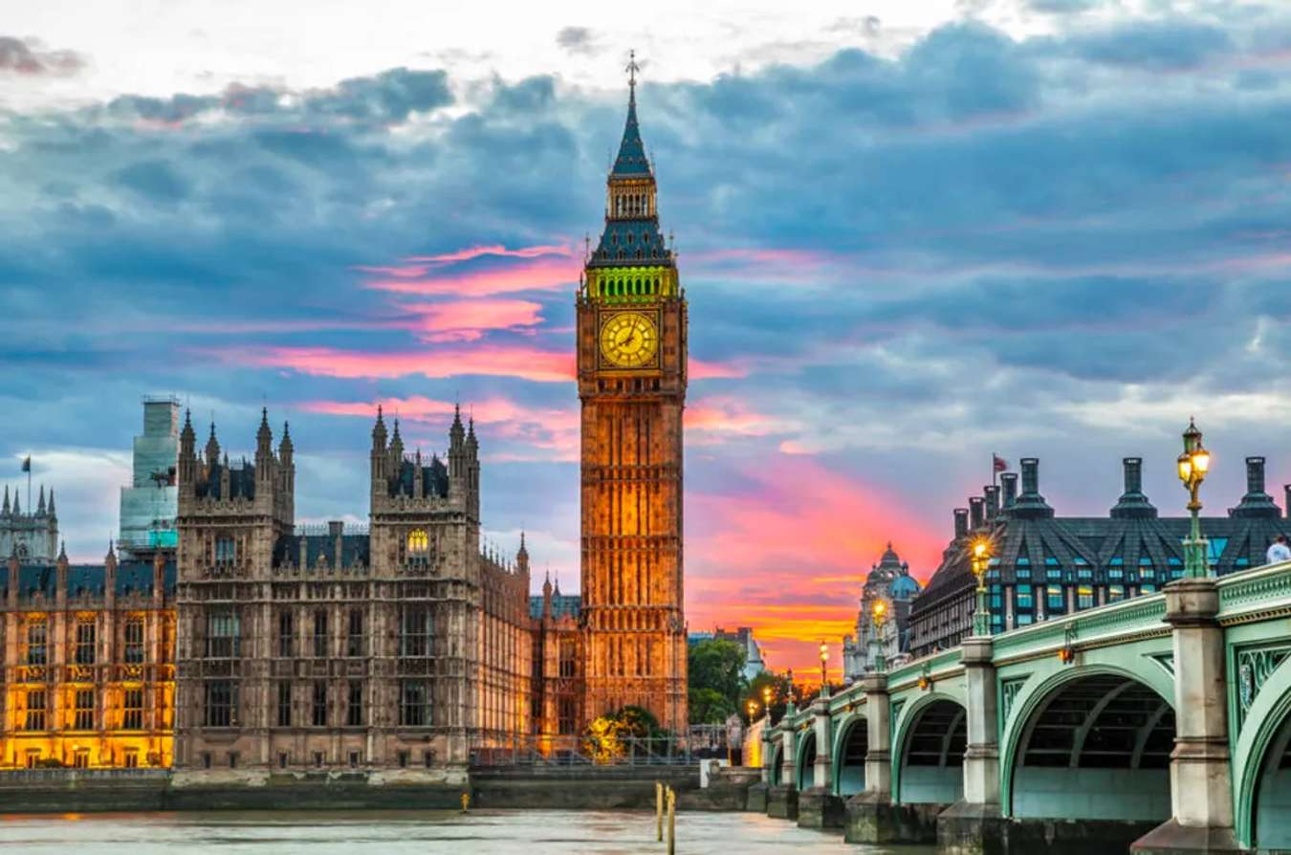
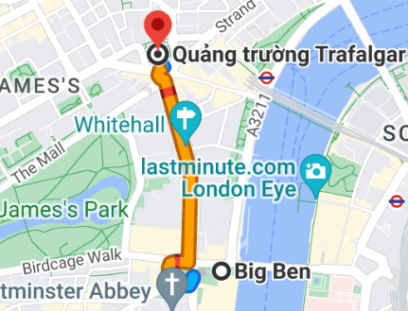
How far is it from Trafalgar Square to Big Ben Tower?
1 km
It’s about 1 km.

Slide 23
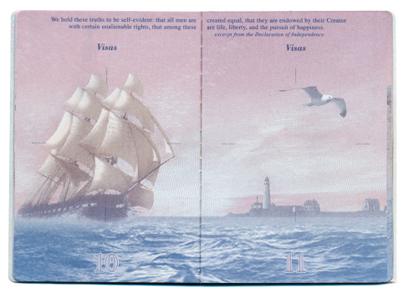
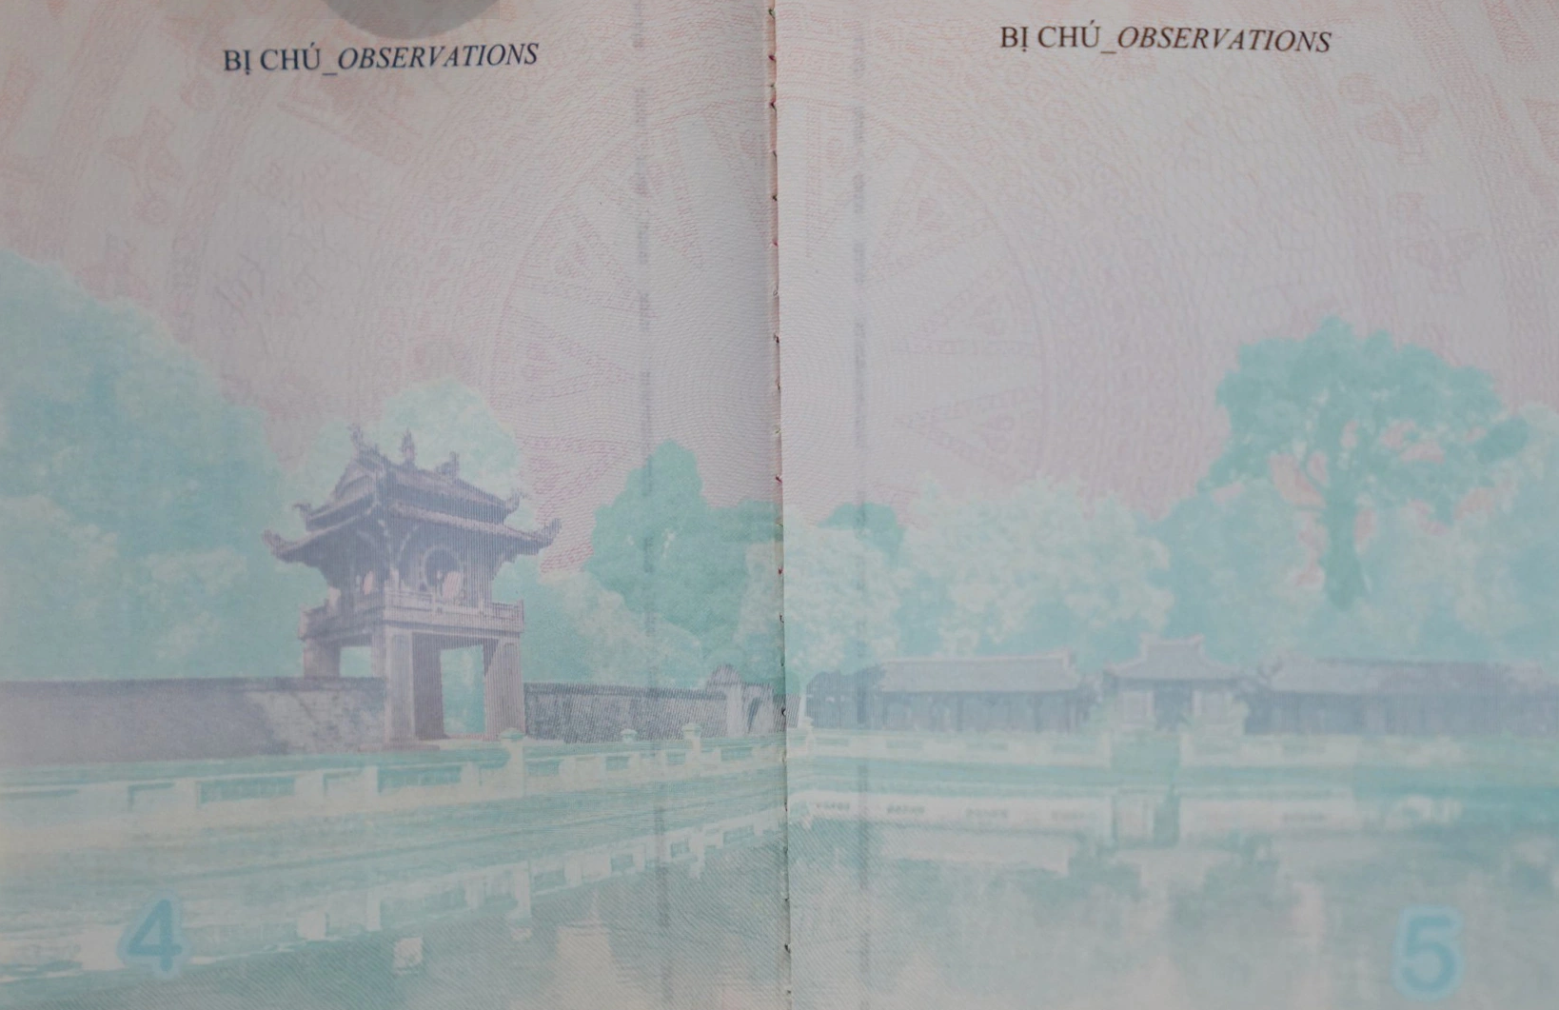


Slide 24


Slide 28

You accidently grabbed the wrong bag!
Switch points with another team.

Slide 29

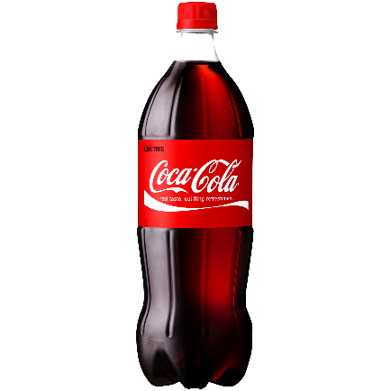
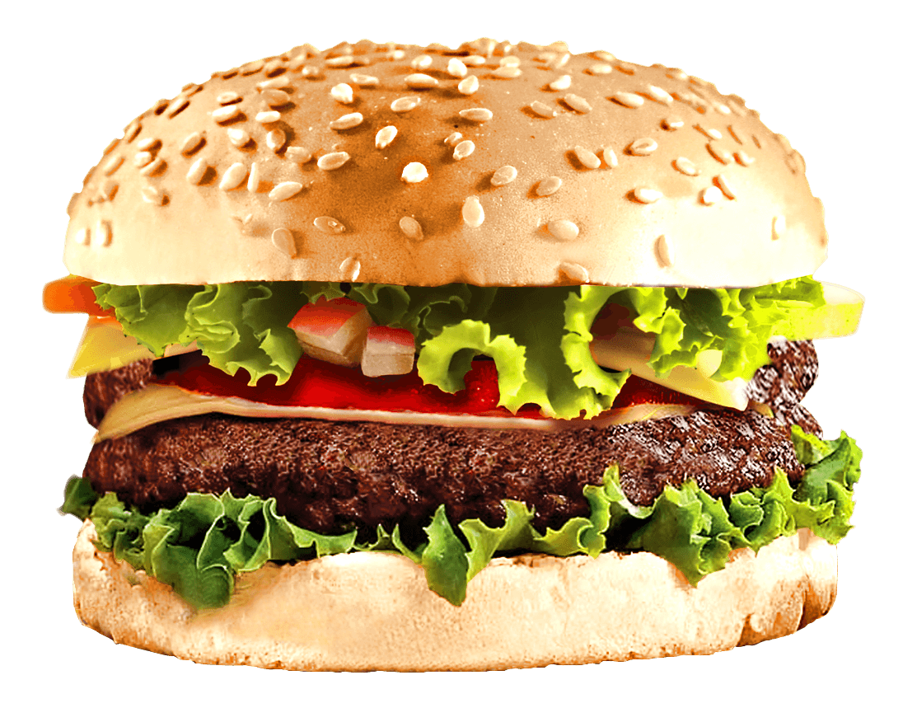


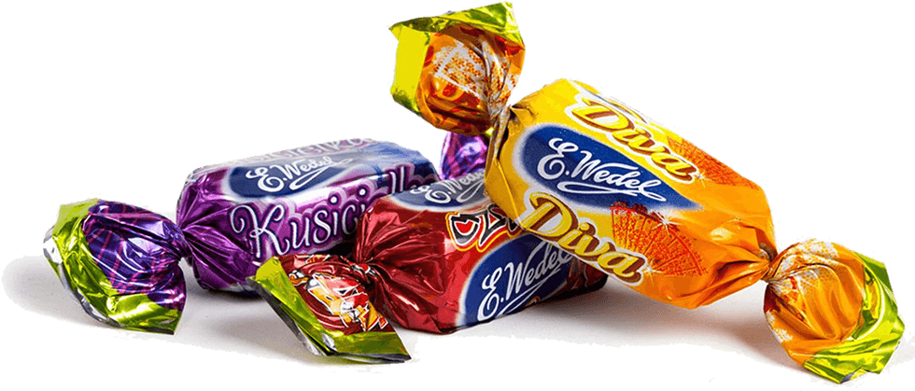



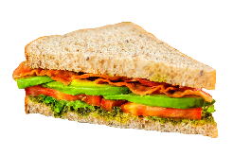

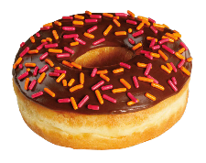



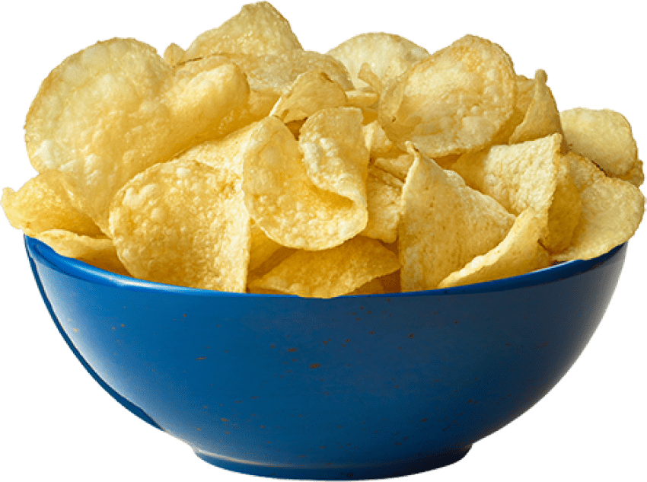
Choose 3:
Choose 1:
2
7
-4
÷2
X2
8
-3
9
steal
-6
5
4
+15
-5
1

Slide 30





The flight was bumpy.
This team loses all points!

Slide 31
Website: hoclieu.vn
Fanpage: https://www.facebook.com/tienganhglobalsuccess.vn/

