Slide 2
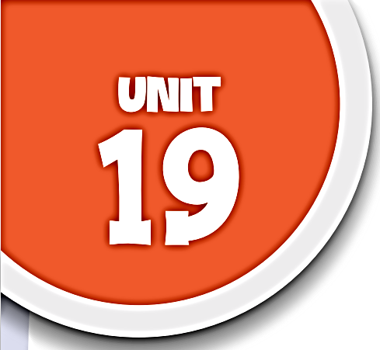













Places of interest
Lesson 3 Period 6

Slide 3






行业PPT模板http://www.1ppt.com/hangye/
01
Warm-up and Review
02
Read and complete.
03
Let’s write.
CONTENTS
04
Project
05
Fun corner and Wrap-up

Slide 4







01
WARM-UP and REVIEW
Let’s chant.

Slide 5

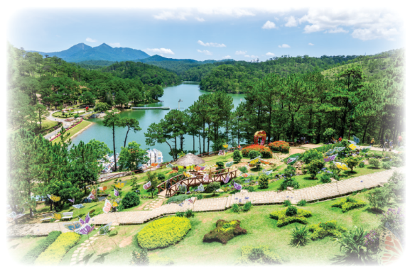
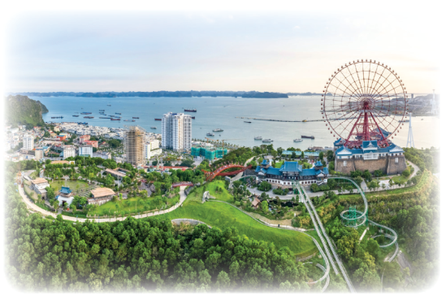
Let’s chant.
What do you think of Da Lat?
It’s pretty and peaceful.
How far is it from here?
It’s not far. It’s near.
80%
40%
54%
What do you think of Ha Long?
It’s pretty and exciting.
How far is it from here?
It’s not near. It’s far.

Slide 6
02
Read and complete.

Slide 7
Sentosa Island is a famous place in Singapore. It’s not very far from Viet Nam, but you need to travel by plane. There are many interesting things to see and do there. You can visit Universal Studios Singapore, play at Adventure Cove Waterpark and build sandcastles on Palawan Beach.
You can also enjoy a show with music and lights at Wings of Time in the
evening. You can eat a variety of Singaporean food. You can stay at a
beautiful hotel by the sea. Sentosa Island is a fantastic place to visit in
summer. Why not plan a trip with your family?
Sentosa Island, in Singapore
Place: (1) ____________________________________________________
How to get there: (2) __________________________________________
Activities: (3) ________________________________________________
________________________________________________
Food: (4) ____________________________________________________
Hotel: (5) ___________________________________________________
by plane
visit Universal Studios, play at Adventure Cove Waterpark and build sandcastles on Palawan Beach
eat a variety of Singaporean food
a beautiful hotel by the sea

Slide 8
03
Let’s write.

Slide 9
Think and say:
– Which place do you want to visit?
– Where is it?
– How far is it from your home town?
– How can you get there?
– What is it like?
– What can you do there?
80%
40%
54%

Slide 10
Think and write:
– Which place do you
want to visit?
– Where is it?
– How far is it from your
home town?
– How can you get there?
– What is it like?
– What can you do there?
My dream holiday
I want to visit ______ for a holiday. It is in ______________________________________________________________________________________________________.
80%
40%
54%

Slide 11
My dream holiday
I want to visit Ha Long Bay for my holiday. It is very beautiful and exciting. It is about two hundred kilometres from my village. I can go there by coach. I can take a board tour around the islands, swim in the sea, eat sea food and stay in a hotel by the sea. Go to Ha Long Bay and enjoy your holiday.
80%
Suggested answer:
54%
40%

Slide 12
Let’s share
your awesome work.

Slide 13
04
Project

Slide 14
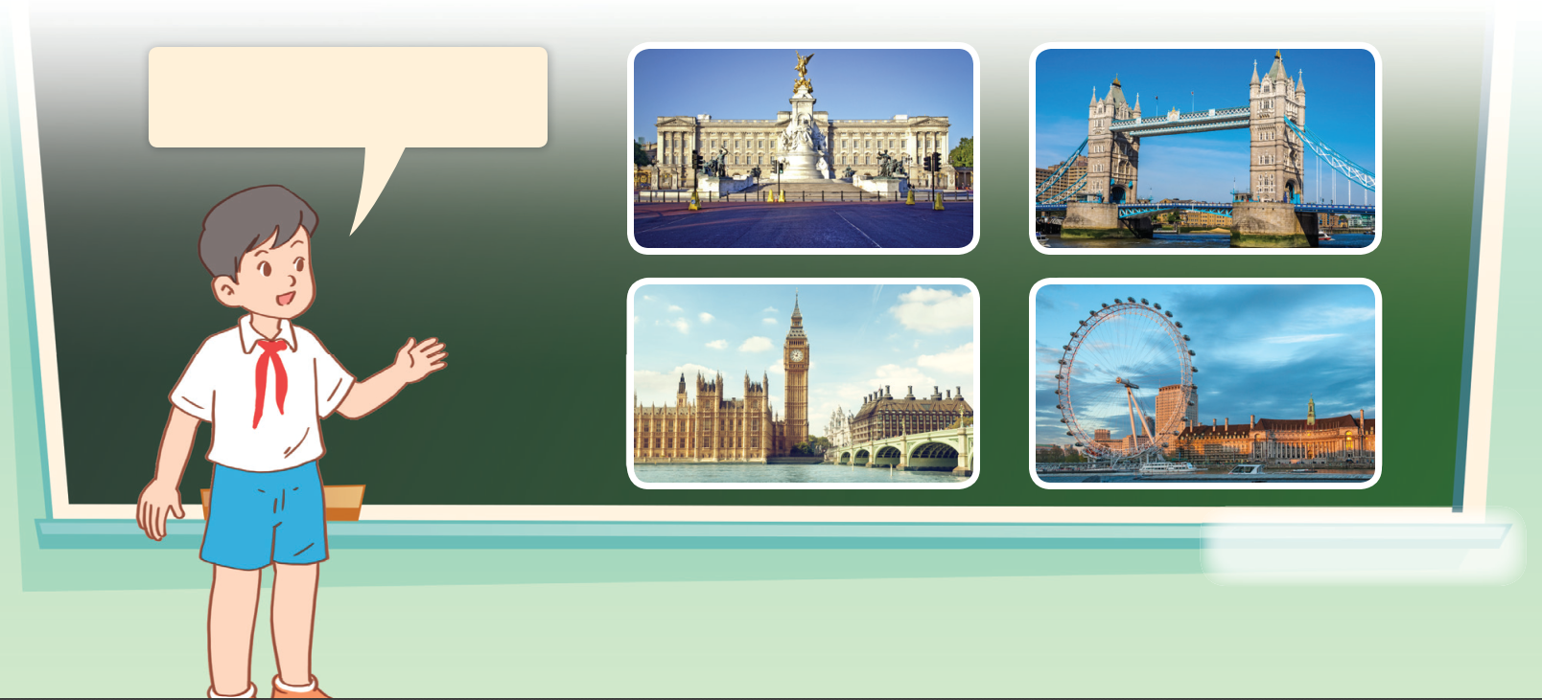
Places of interest.
I want to go to London
for a holiday. _______.
80%
40%
54%

Slide 15
05
Fun corner and Wrap-up

Slide 16


Slide 17




Please help me find them.
I’m hungry!
I can’t find my red bean cakes.

Slide 18

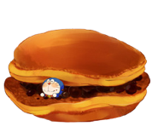
= Mystery
power-up
= points

Slide 19



1
2
3
4
5
6
7
8
END OF LESSON

Slide 20
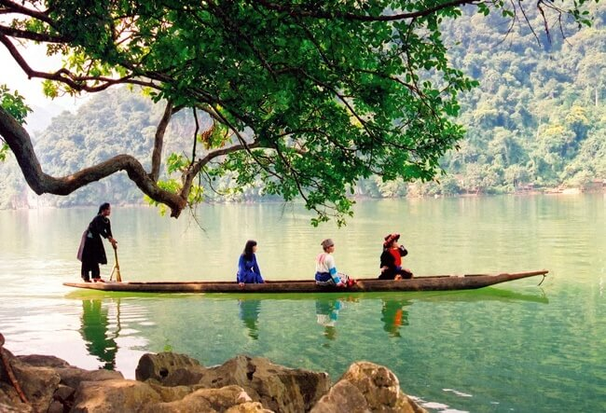

What do you think of Ba Be Lake?
I think it’s fantastic.

Slide 21
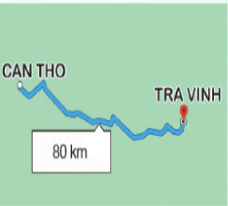
How far is it from Can Tho to Tra Vinh?
CAN THO
TRA VINH
80 km
It’s about 80 kilometres.

Slide 22
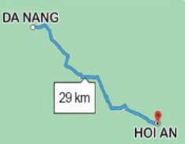
How far is it from Da Nang to Hoi An?
DA NANG
29 km
HOI AN
It’s about 29 kilometres.

Slide 23
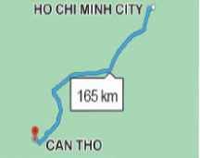
How far is it from Ho Chi Minh City to Can Tho?
HO CHI MINH CITY
165 km
CAN THO
It’s about 165 kilometres.

Slide 24
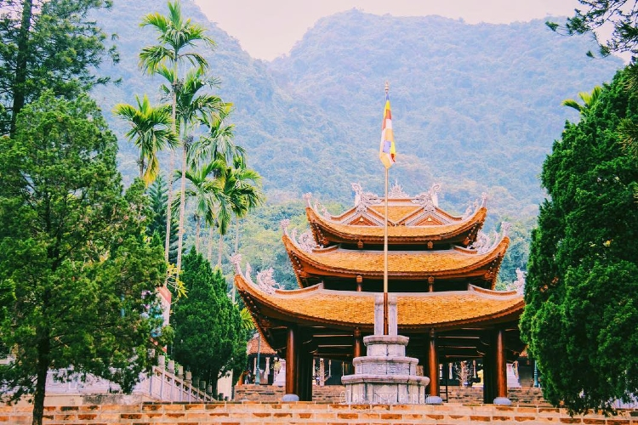
What do you think of Huong Pagoda?
I think it’s beautiful and peaceful.

Slide 25
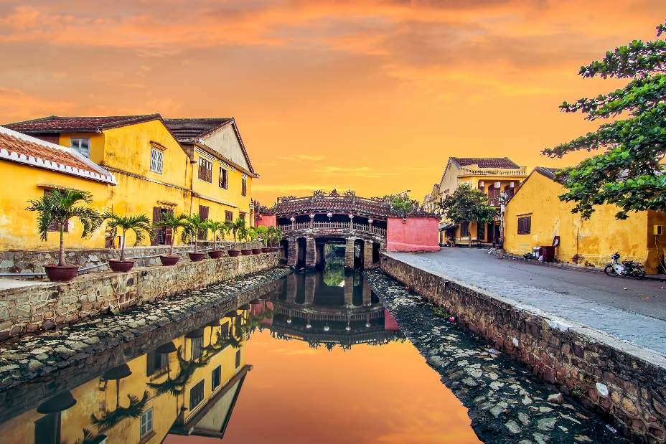
What do you think of Hoi An Old Town?
I think it’s exciting.

Slide 26
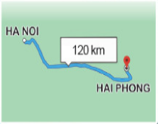
How far is it from Ha Noi to Hai Phong?
HA NOI
120 km
HAI PHONG
It’s about 120 kilometres.

Slide 27
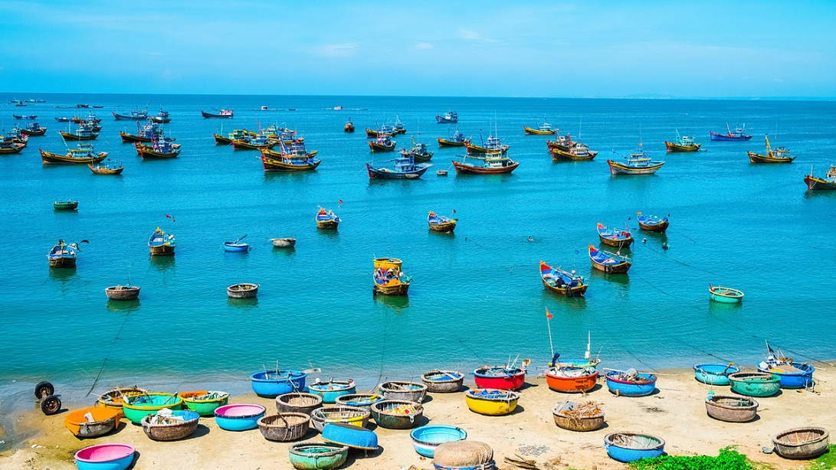
What do you think of Mui Ne Beach?
I think it’s beautiful.

Slide 28
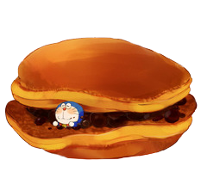

Slide 33




Slide 34
10 points!

Slide 35




Slide 36
Steal 5 points!

Slide 37

Change points!

Slide 38
Steal 3 points!

Slide 39
Website: hoclieu.vn
Fanpage: https://www.facebook.com/tienganhglobalsuccess.vn/

