Slide 2







Our Summer Holidays
Lesson 1 - Period 1

Slide 3
Table of contents
01
Warm-up and Review
Look, listen and repeat.
02
Listen, point and say.
03
Let’s talk.
04
05
Fun corner and Wrap-up

Slide 4
01
Warm-up and Review
Let's play!

Slide 5

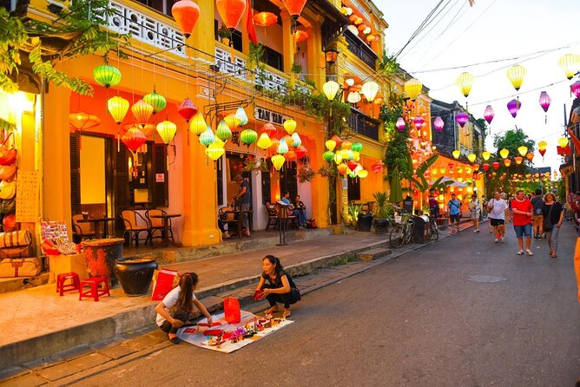
Guess the place
Hoi An Old Town
SHOW

Slide 6
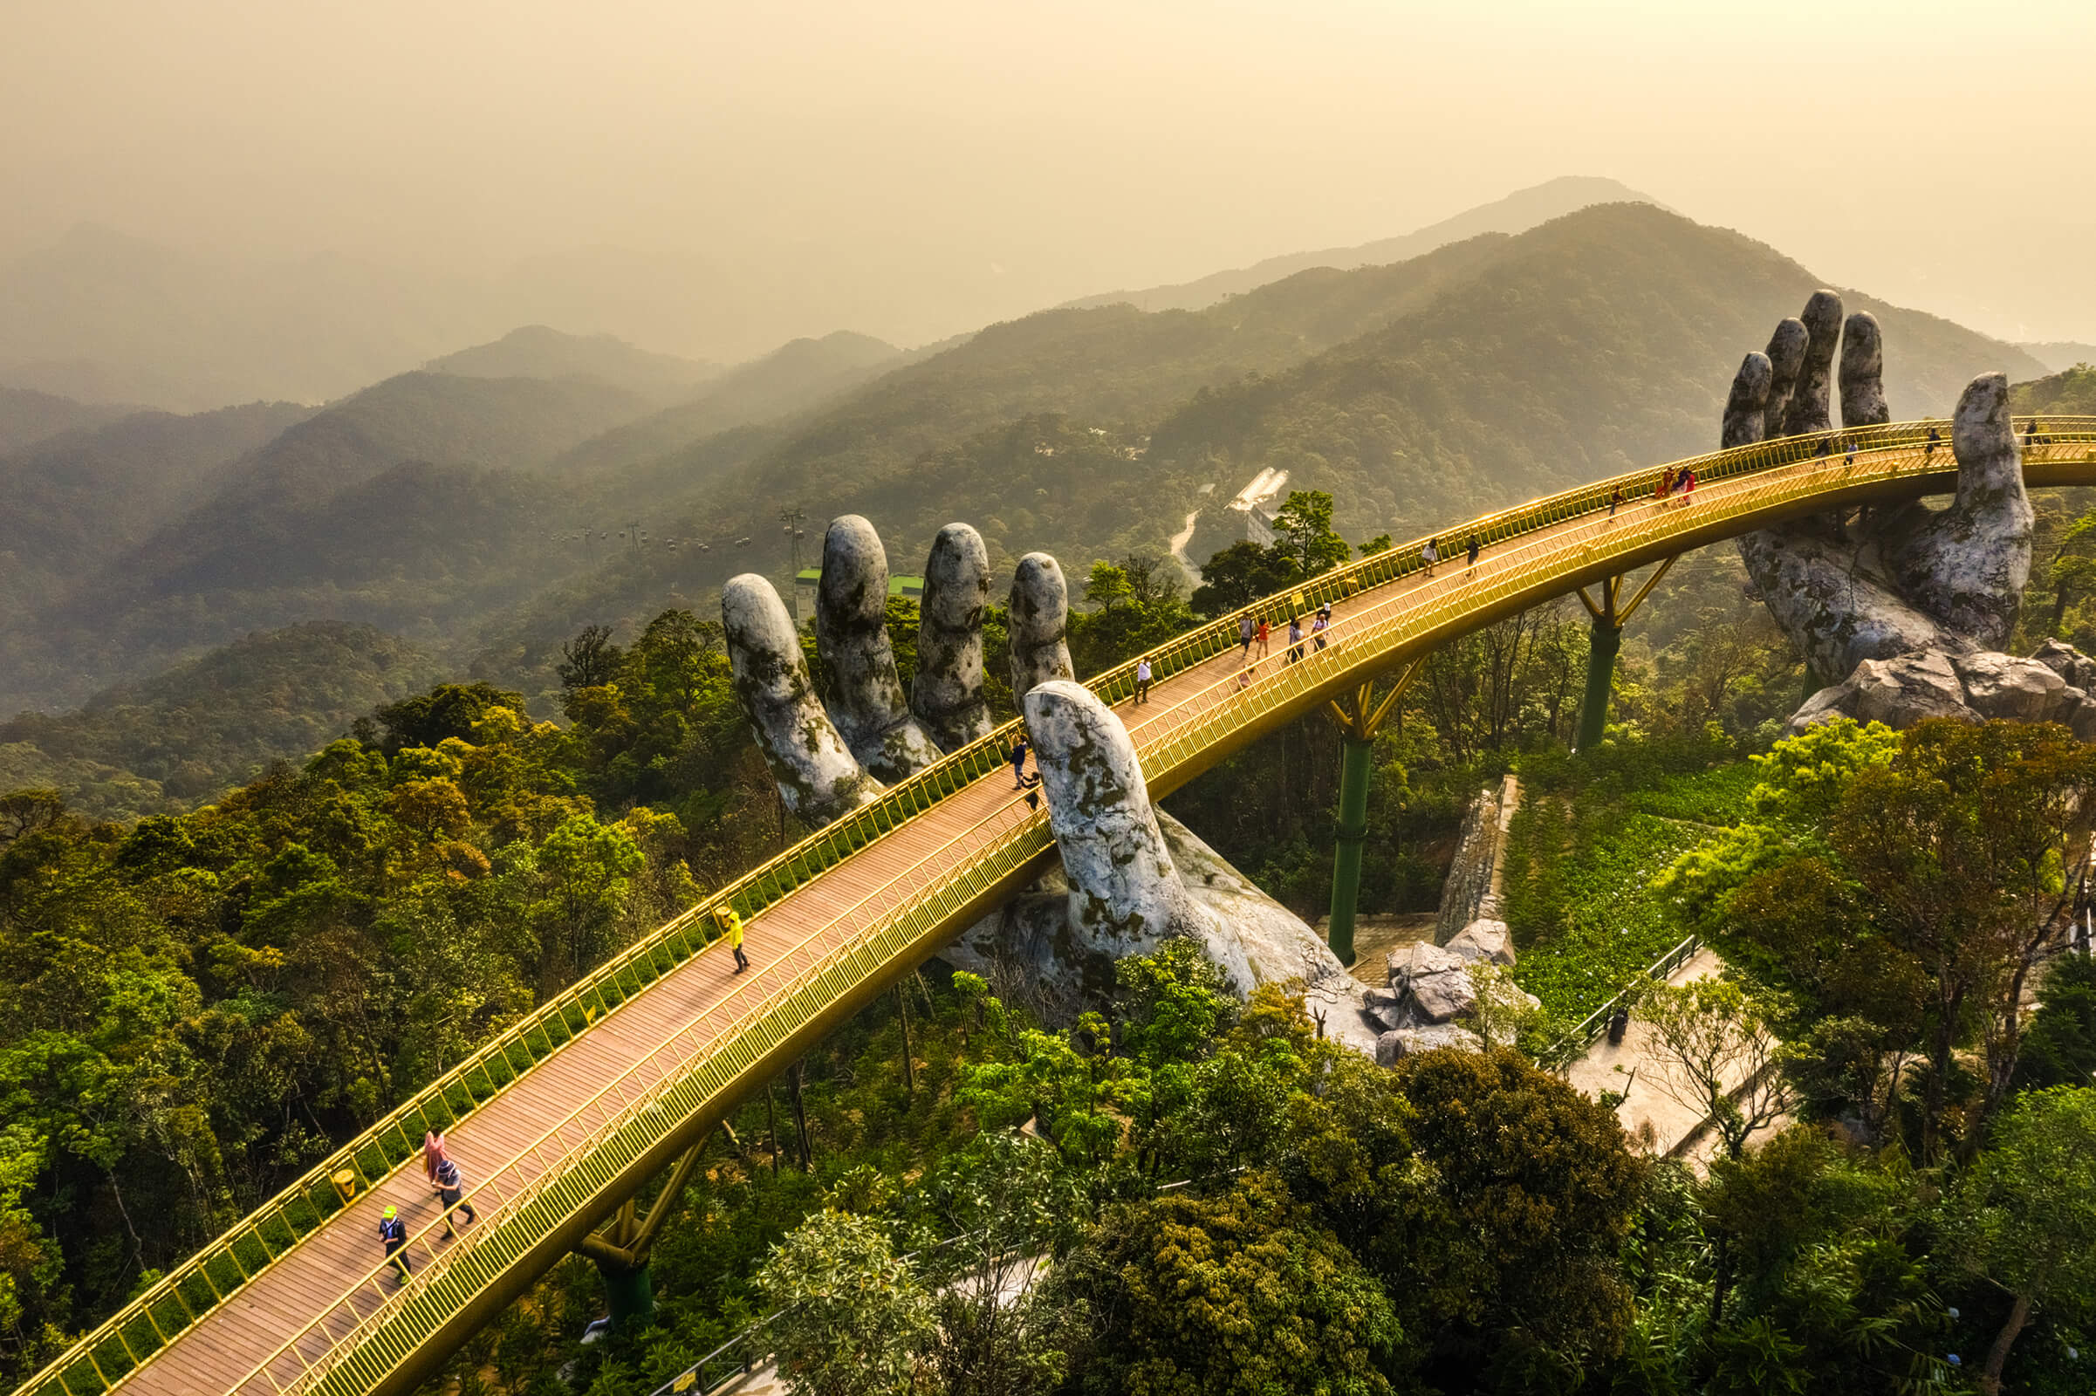
Guess the place
SHOW
Ba Na HillS

Slide 7
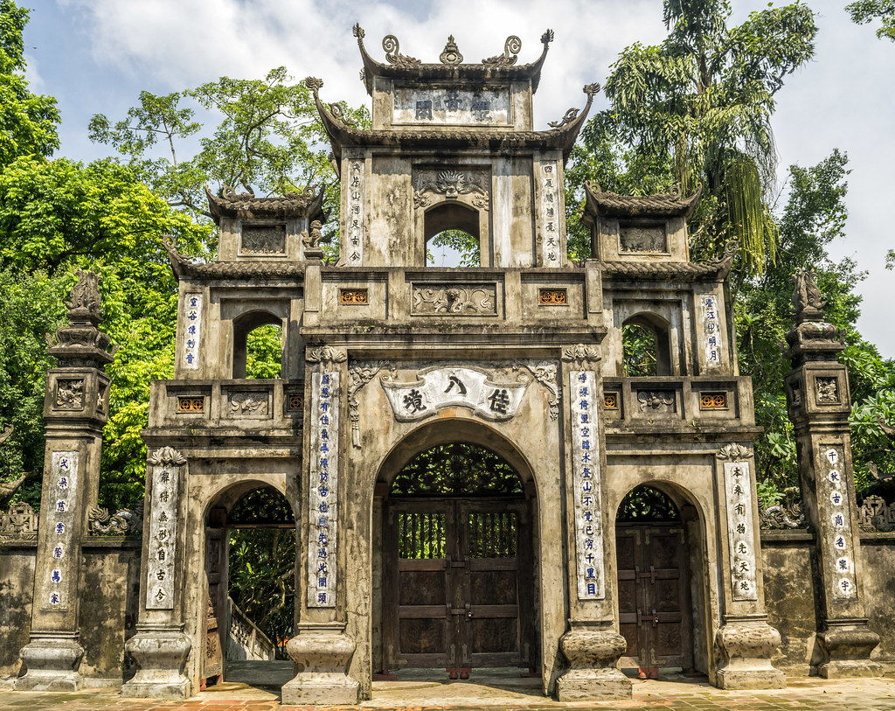
Guess the place
Huong Pagoda
SHOW

Slide 8
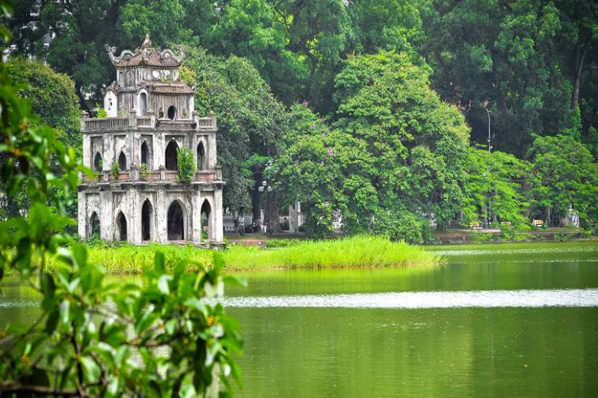
Guess the place
Hoam Kiem Lake
SHOW

Slide 9
02
Look, listen and repeat.

Slide 10

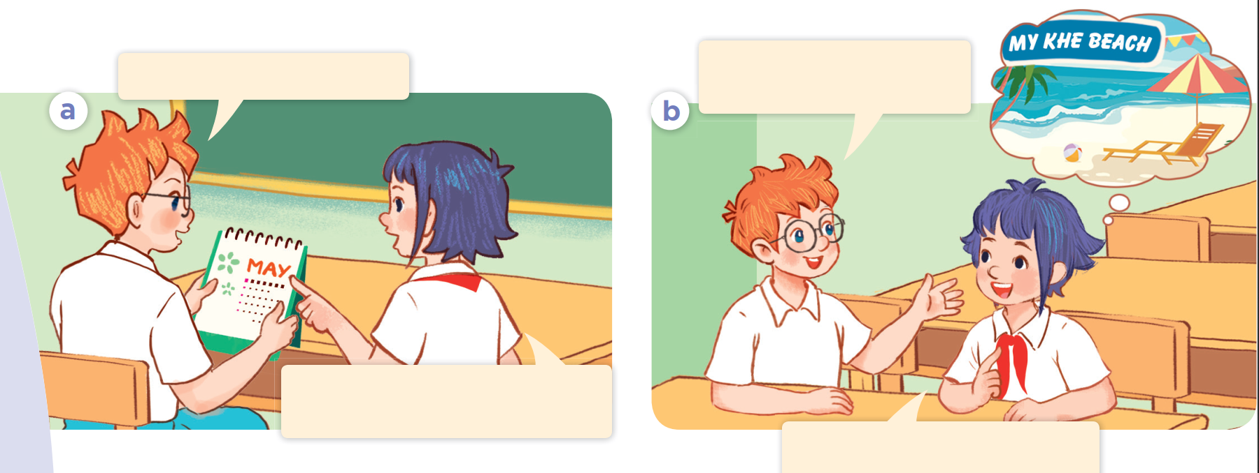
Look at the picture. Who are they?
What are they talking about?

Slide 11
Where are you going
to visit this summer?
Summer’s almost here!
Yes! Our summer holidays start next week.
I’m going to visit My Khe
Beach in Da Nang City.

Slide 12
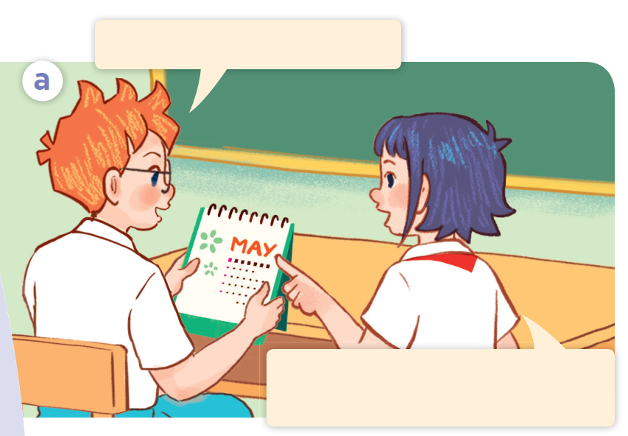
Look, listen and repeat.
Summer’s almost here!
Yes! Our summer holidays start next week.

Slide 13
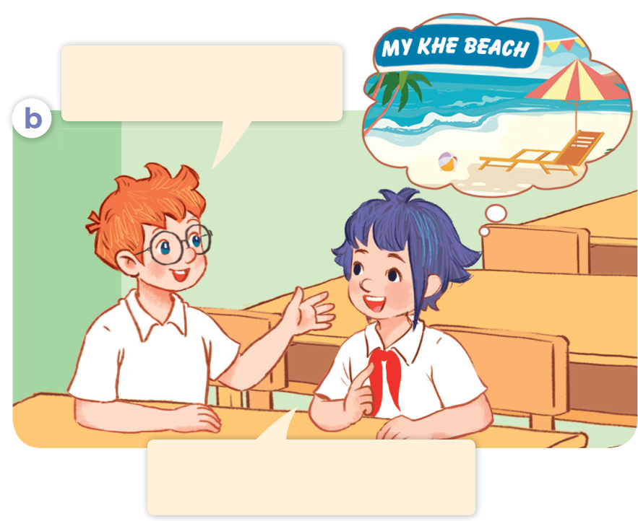
Look, listen and repeat
Where are you going
to visit this summer?
Where are you going
to visit this summer?
I’m going to visit My Khe
Beach in Da Nang City.

Slide 14


Where are you going
to visit this summer?
I’m going to visit My Khe
Beach in Da Nang City.

Slide 15
Act it out.
Where are you going
to visit this summer?
Summer’s almost here!
Yes! Our summer holidays start next week.
I’m going to visit My Khe
Beach in Da Nang City.

Slide 16
03
Listen, point and say.

Slide 17
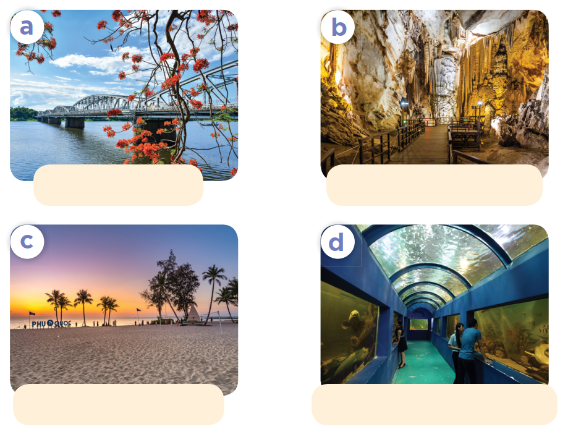
Look at the pictures. Listen and repeat.
Huong River
Phong Nha Cave
Phu Quoc Island
Dam Sen Aquarium

Slide 18

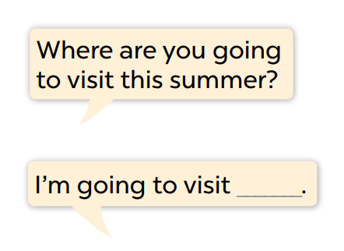
Look and read the question and answer.
Where are you going
to visit this summer?
Huong River
Phong Nha Cave
I’m going to visit ___.
Phu Quoc Island
Dam Sen Aquarium

Slide 19
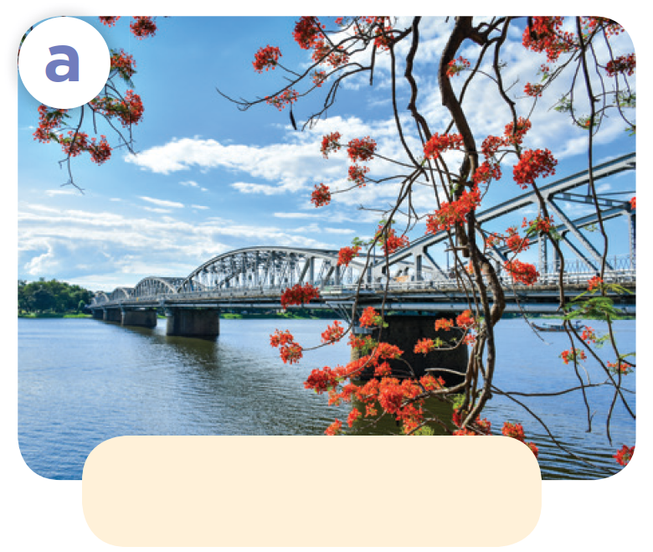
Where are you going to visit this summer?
Huong River
I’m going to visit Huong River.

Slide 20
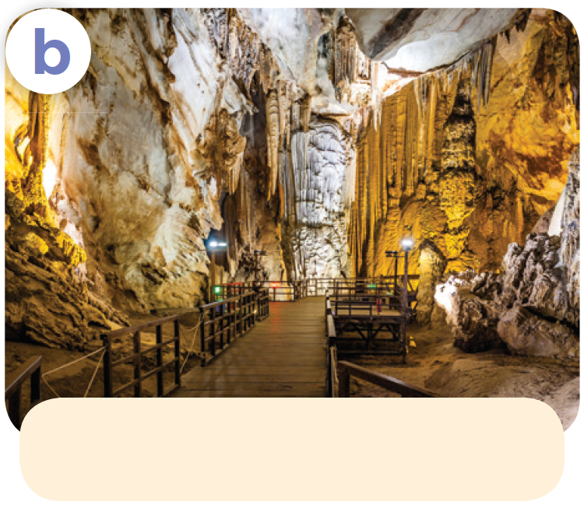
Where are you going to visit this summer?
Phong Nha Cave
I’m going to visit Phong Nha Cave.

Slide 21
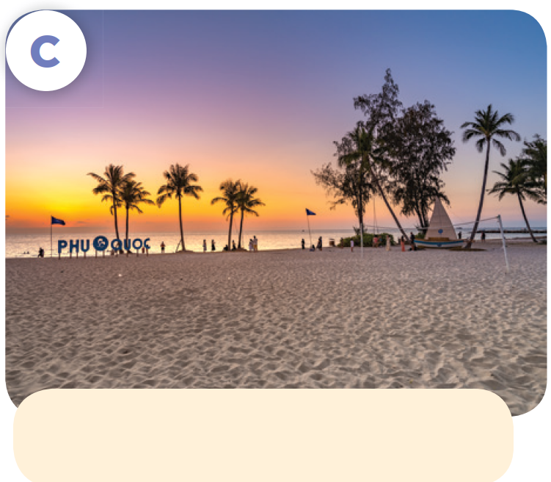
Where are you going to visit this summer?
Phu Quoc Island
I’m going to visit Phu Quoc Island.

Slide 22
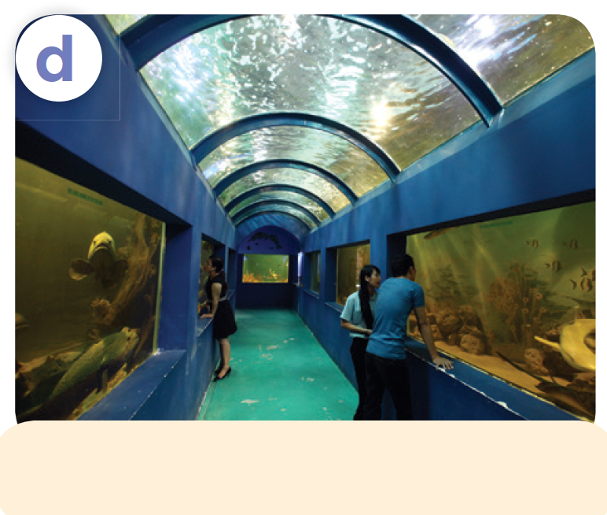
Where are you going to visit this summer?
Dam Sen Aquarium
I’m going to visit Dam Sen Aquarium.

Slide 23
Work in pairs. Ask and answer.
Listen and repeat.
Where are you going
to visit this summer?
Huong River
Phong Nha Cave
I’m going to visit ___.
Phu Quoc Island
Dam Sen Aquarium

Slide 24

04
Let's talk.

Slide 25

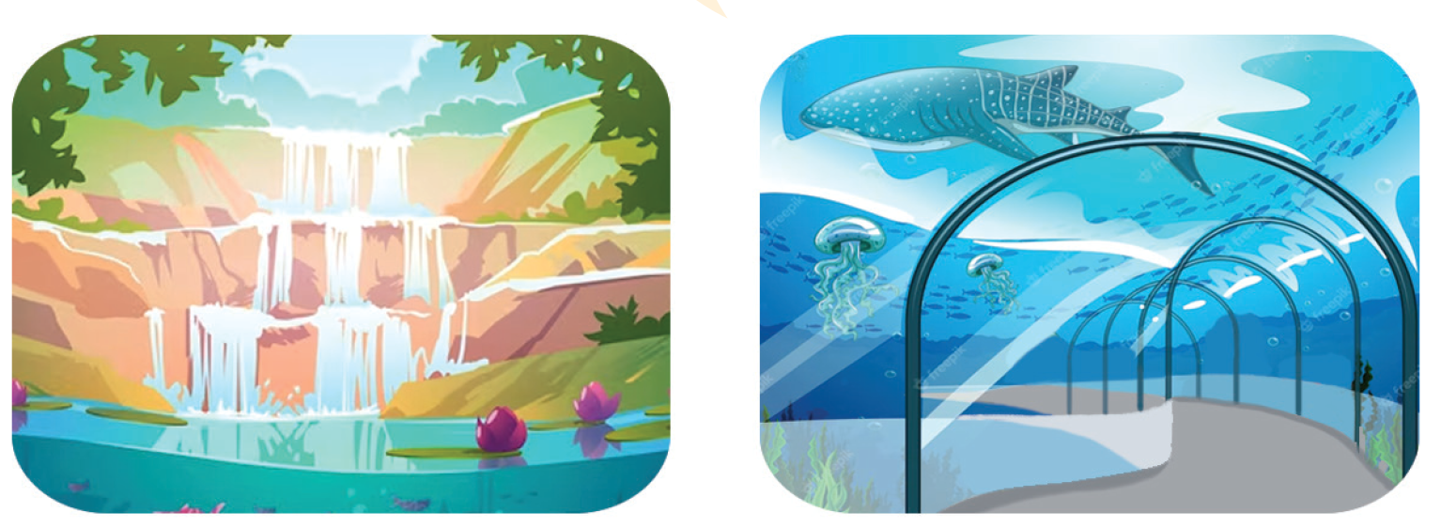
Look and say
Listen and repeat.
Work in pairs. Ask and answer.
Where are you going to visit this summer?
I’m going to visit ___.
river
cave
waterfall
aquarium

Slide 26
05
Fun corner and Wrap-up
Let’s play!
LUCKY MONSTERS

Slide 27





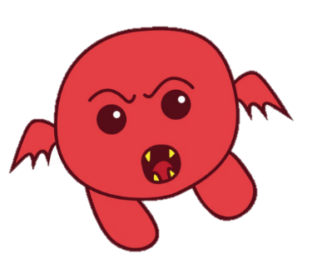




LUCKY MONSTERS
Notes:
bomb= 0 point

Slide 28

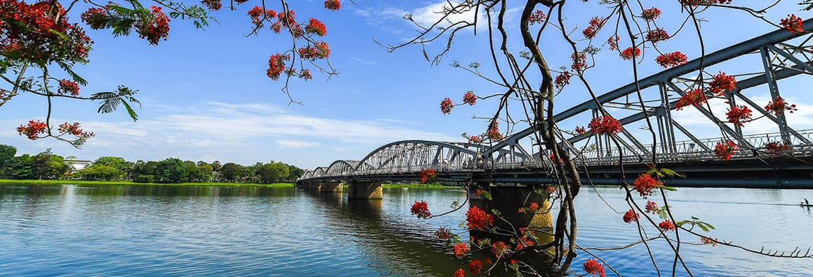

Where are you going to visit this summer?
Huong River
I’m going to visit Huong River.

Slide 29
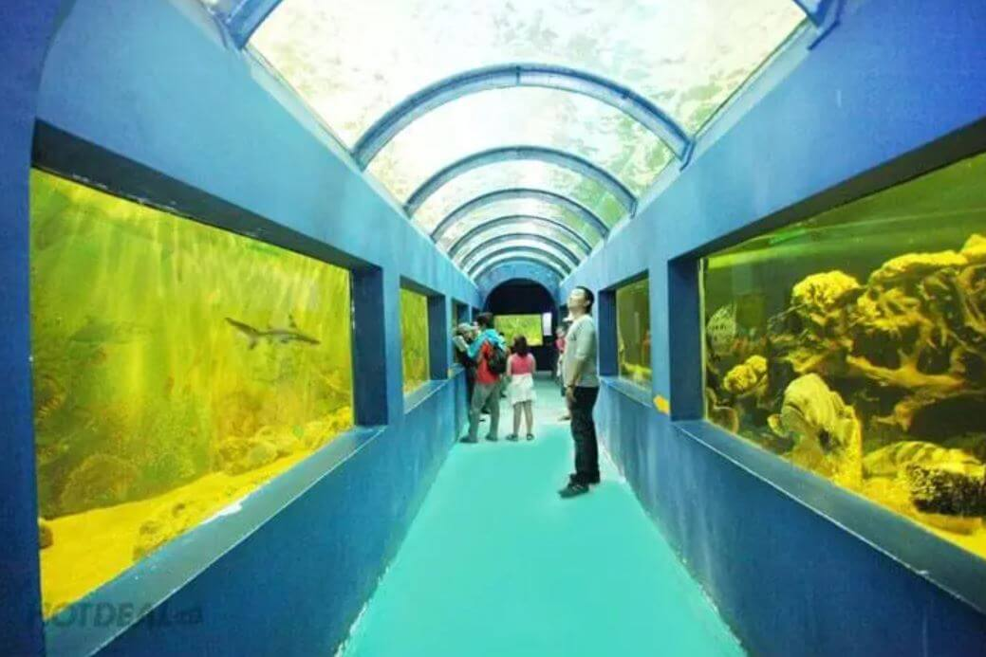

Where are you going to visit this summer?
Dam Sen Aquarium
rock - paper - scissors
Winner takes 5
I’m going to visit
Dam Sen Aquarium.

Slide 30
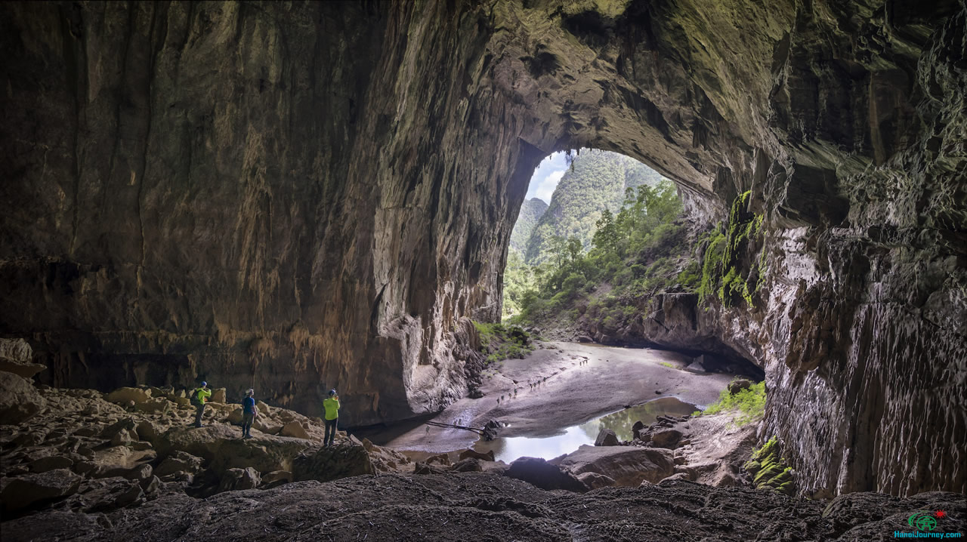
Where are you going to visit this summer?
Phong Nha Cave
I’m going to visit Phong Nha Cave .

Slide 31
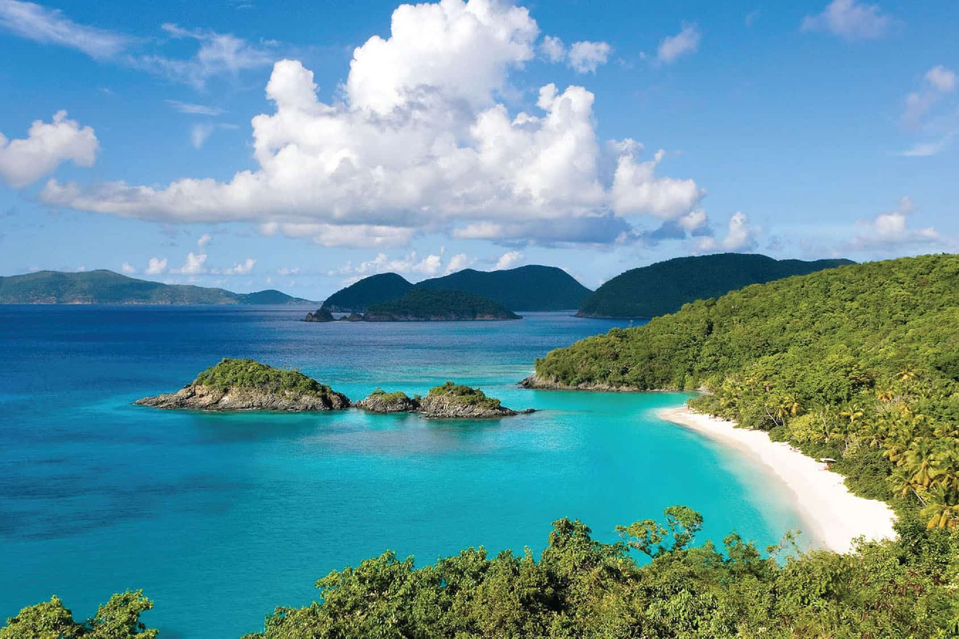
Where are you going to visit this summer?
Phu Quoc Island
I’m going to visit Phu Quoc Island.

Slide 32


are
going to
Where ___ you _______ visit this summer?
My sand castle

Slide 33
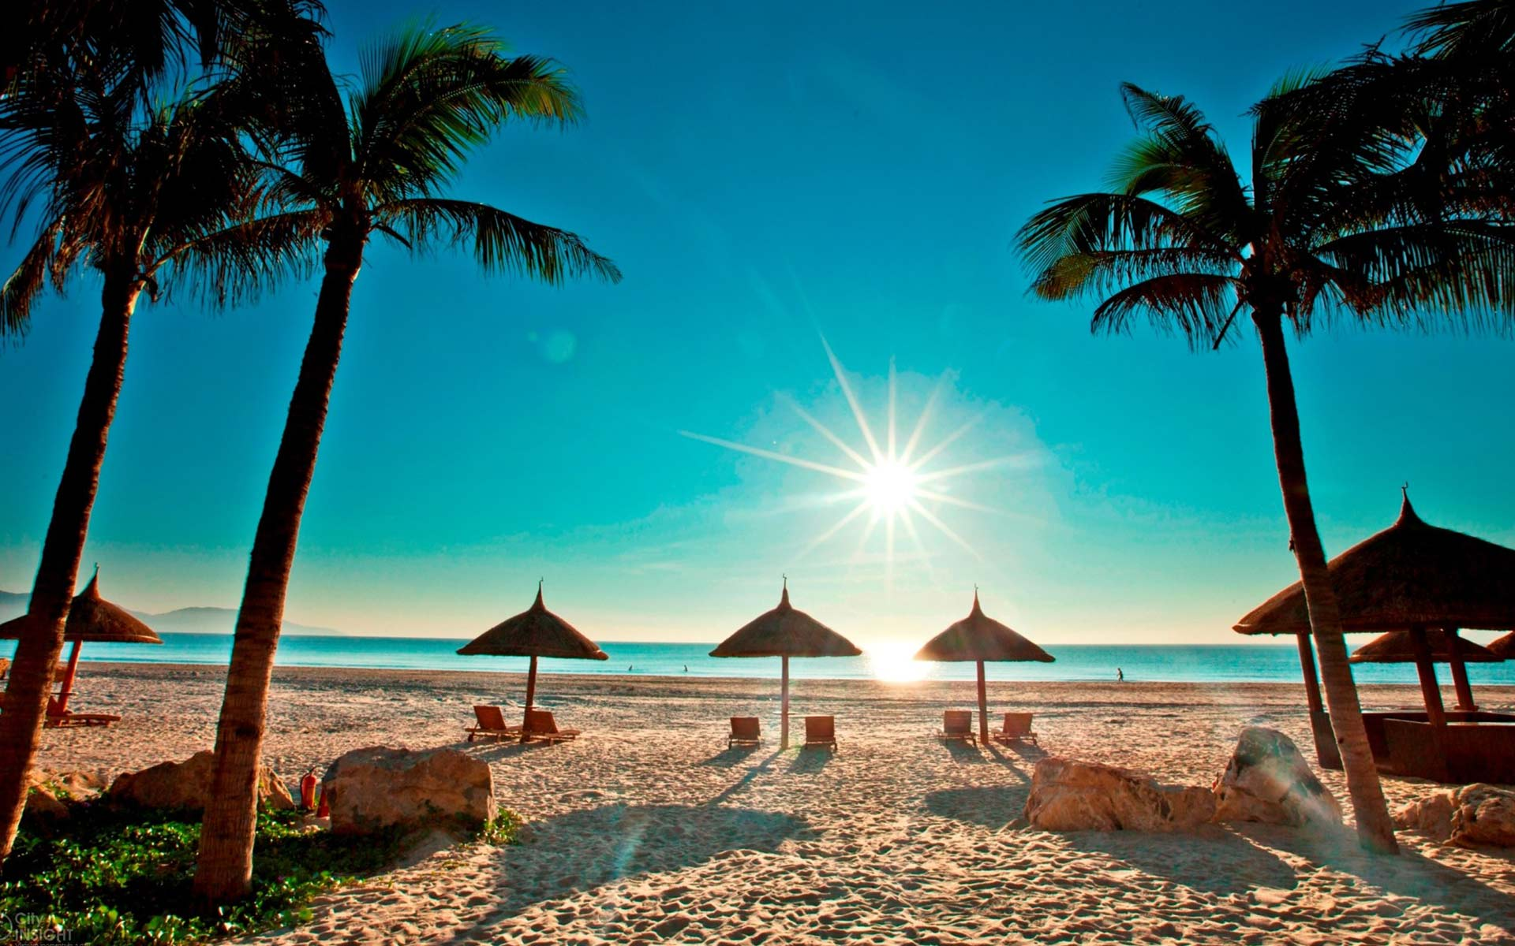
Where are you going to visit this summer?
My Khe Beach
I’m going to visit My Khe Beach.

Slide 34
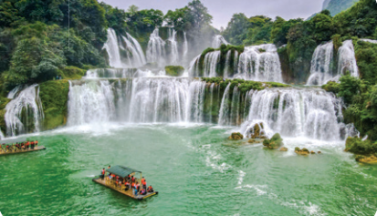
Where are you going to visit this summer?
Ban Gioc Waterfall
I’m going to visit Ban Gioc Waterfall.

Slide 35
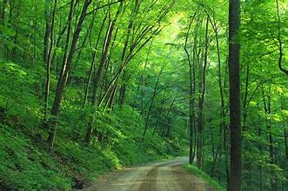
Where are you going to visit this summer?
I’m going to visit a forest.

Slide 36
Website: hoclieu.vn
Fanpage: https://www.facebook.com/tienganhglobalsuccess.vn/

