Slide 2







Our Summer Holidays
Lesson 1 - Period 2

Slide 3
Table of contents
01
02
Listen and number.
Warm-up and Review
03
04
05
Read and complete.
Listen, complete and sing.
Fun corner and Wrap-up

Slide 4
01
Warm-up and Review
Let's play!

Slide 5

catch THE sentence!
Notes:
This template is for educational, non-commercial purposes only. For more free game templates like this one, visit https://www.taysteachingtoolkit.com

Slide 6
HOW TO PLAY
Pictures or scrambled sentences will appear then disappear.
Read / Write them as quickly as possible.

Slide 7
Level 1
Notes:
Sentences appear then disappear after a certain amount of time

Slide 8
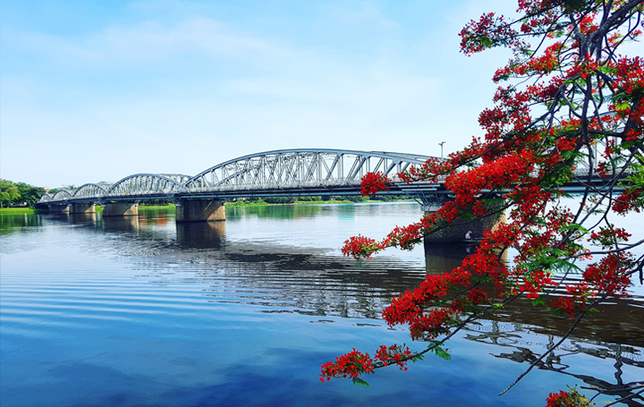
1
Notes:
Animation: Text appears, then disappears after 2 seconds

Slide 9
Huong River
WHAT’S THE answer?
Notes:
This is the answer slide. Type the same word or sentence as the previous slide.

Slide 10
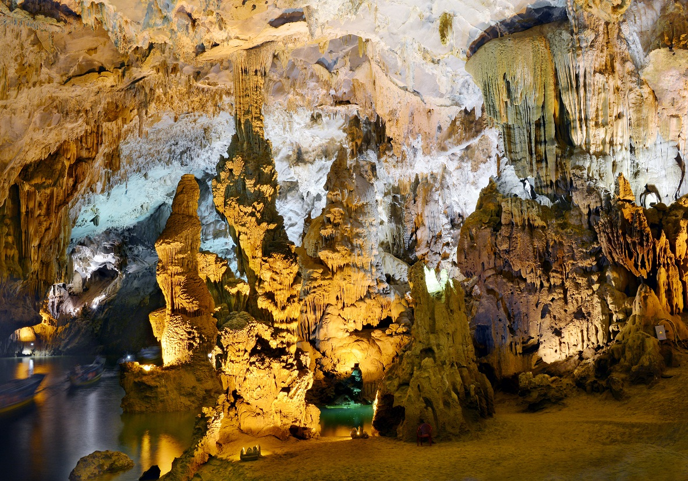
2
Notes:
Animation: Text appears, then disappears after 1.5 seconds

Slide 11
Phong Nha Cave
WHAT’S THE answer?
Notes:
This is the answer slide. Type the same word sentence as the previous slide.

Slide 12
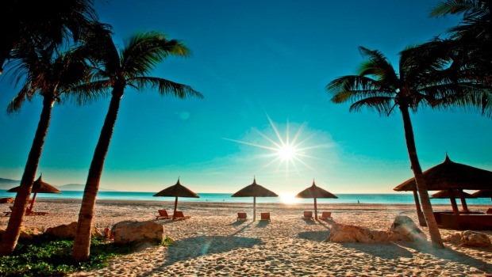
3
Notes:
Animation: Text appears, then disappears after 1.5 seconds

Slide 13
Phu Quoc Island
WHAT’S THE answer?
Notes:
This is the answer slide. Type the same word sentence as the previous slide.

Slide 14
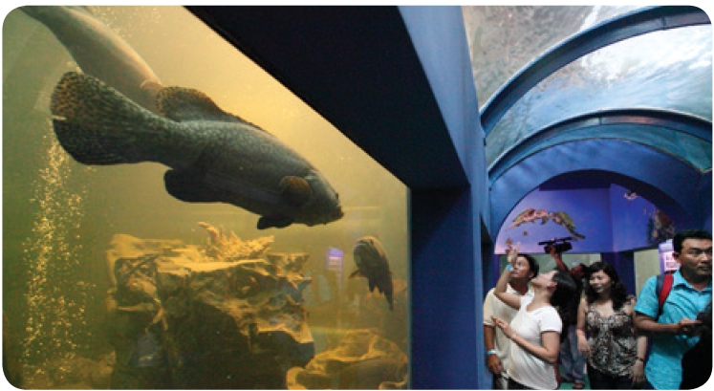
4
Notes:
Animation: Text appears, then disappears after 1.5 seconds

Slide 15
Dam Sen Aquarium
WHAT’S THE answer?
Notes:
This is the answer slide. Type the same word sentence as the previous slide.

Slide 16
Level 2
Notes:
Scrambled words appear then disappear after a certain amount of time

Slide 17
to
are
Where
5
visit?
you
going
Notes:
Animation: Words appear, then disappear after 3 seconds. Students unscramble the words to make sentence.

Slide 18
WHAT’S THE answer?
Where are you going to visit?
Notes:
This is the answer slide. Type the sentence the words make from the previous slide.

Slide 19
I'm
Island
going to
6
Phu Quoc
visit
Notes:
Animation: Words appear, then disappear after 3 seconds. Students unscramble the words to make sentence.

Slide 20
WHAT’S THE answer?
I'm going to visit
Phu Quoc Island.
Notes:
This is the answer slide. Type the sentence the words make from the previous slide.

Slide 21
the
holiday?
What's
your plan
7
for
summer
Notes:
Animation: Words appear, then disappear after 3 seconds. Students unscramble the words to make sentence.

Slide 22
WHAT’S THE answer?
What's your plan for
the summer holiday?
Notes:
This is the answer slide. Type the sentence the words make from the previous slide.

Slide 23
Great Job!
Notes:
Scrambled words move across the slide

Slide 24
02
Listen and number.

Slide 25
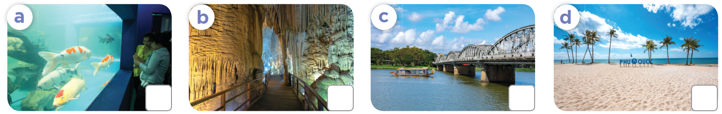
What place can you see in each picture?

Slide 26

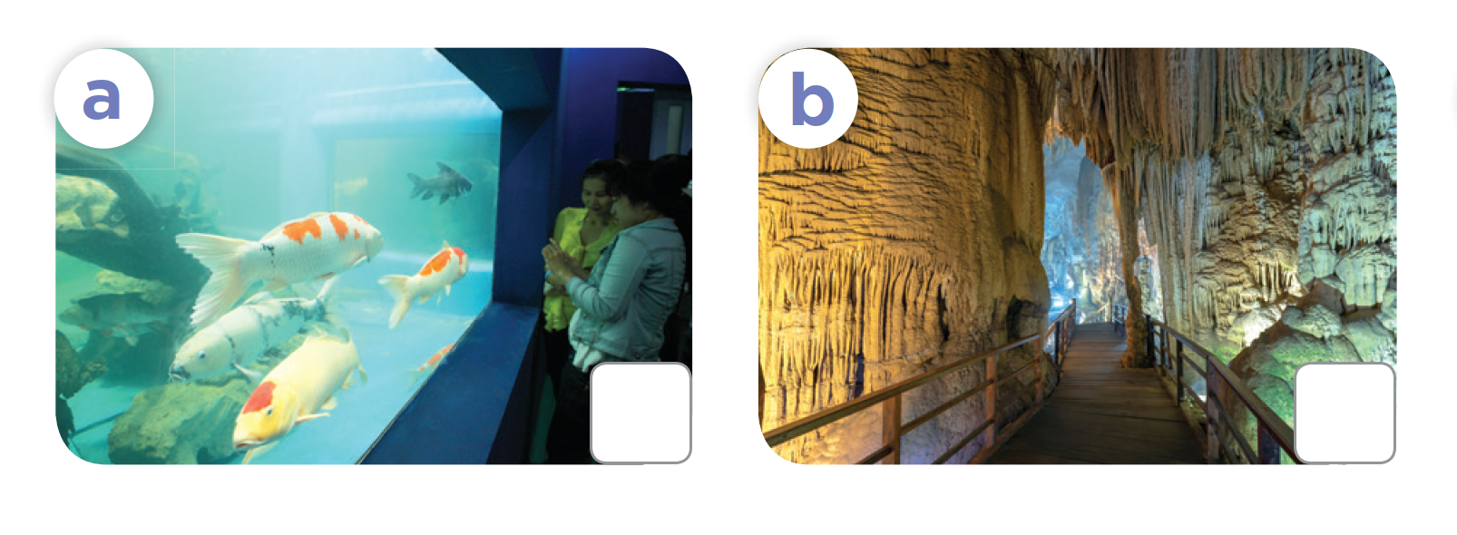
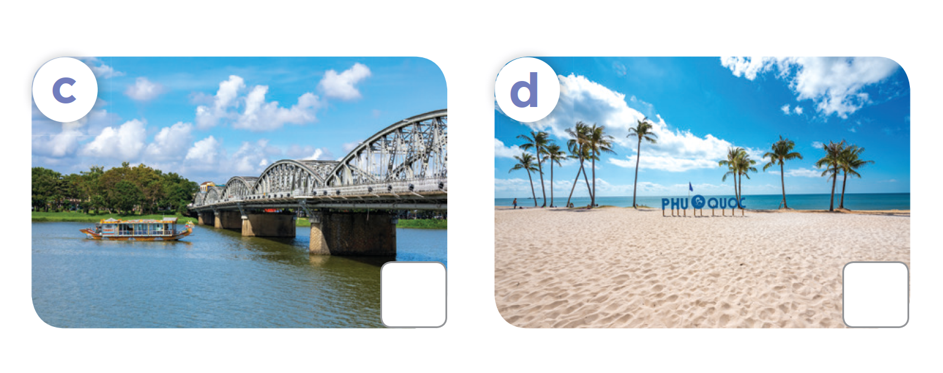
Listen and number.

Slide 27
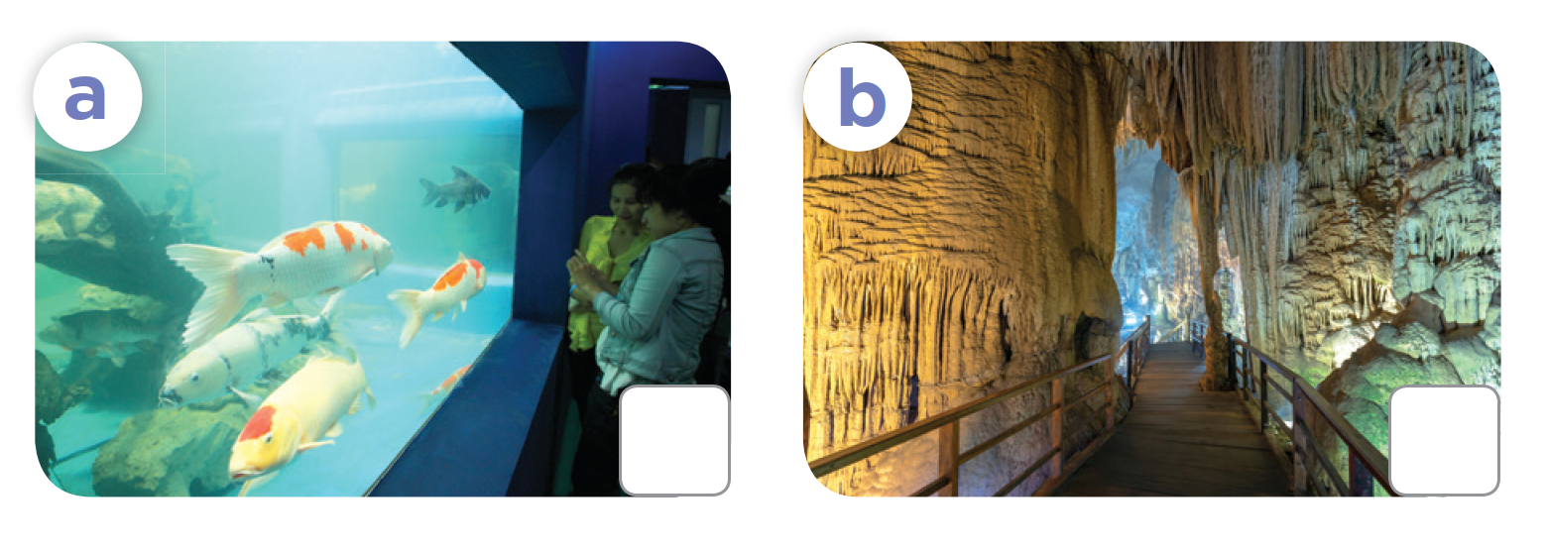
Let's check.
4
2
3
1

Slide 28
03
Read and complete.

Slide 29
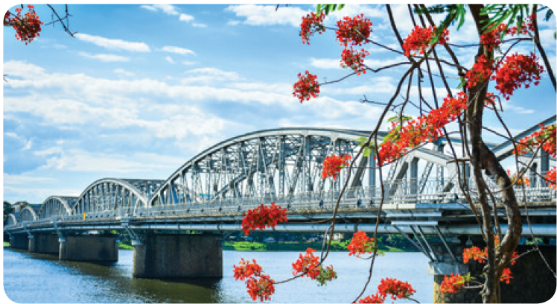
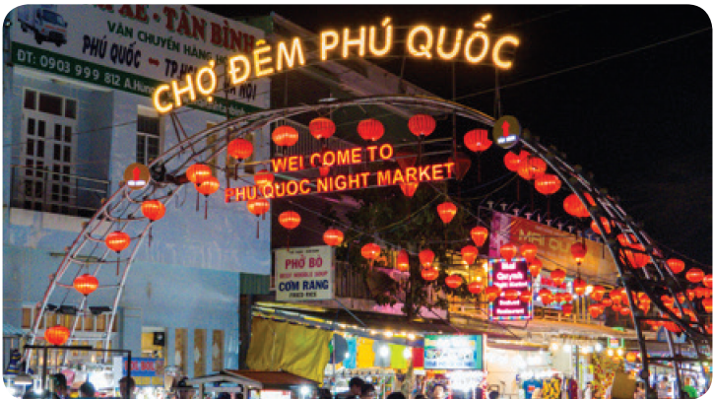
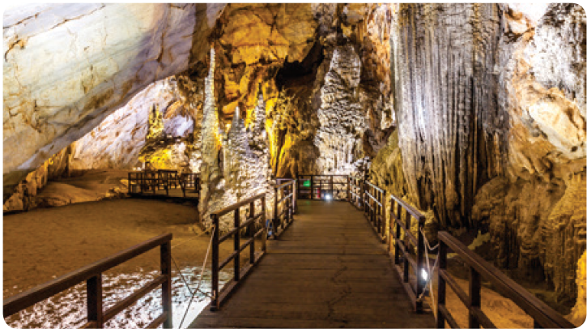
What places can you guess?

Slide 30
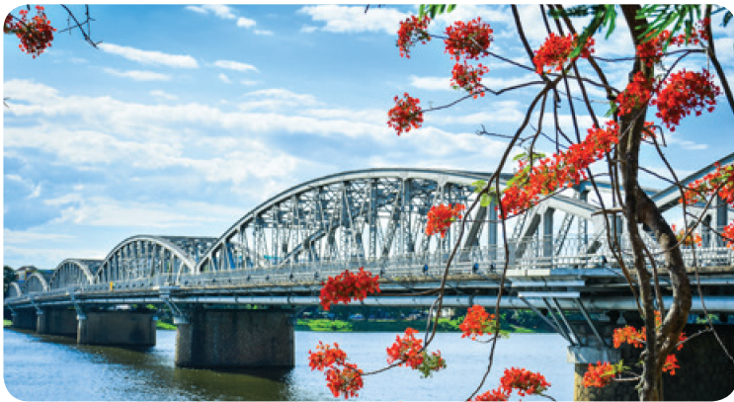
What's missing?
1. A: Have you got a plan for the summer holidays? Where are you going to visit?
B: I’m going to _______________.
visit Huong River

Slide 31



Read and complete.
1. A: Have you got a plan for the summer holidays? Where are you going to visit?
B: I’m going to ___________________.
2. A: Where are you ______ visit this summer?
B: I’m going to ________.
A: I hope you have a great time.
visit Huong River
3. A: What’s your plan for the summer holidays?
Where ____________ visit?
B: I’m going to _______________.
4. A: Where ____________ this summer?
B: I’m ____________.
A: Have a good time!

Slide 32
Let's check.
going to
2. A: Where are you _________ visit this summer?
B: I’m going to _______________________.
A: I hope you have a great time.
visit Phu Quoc Island

Slide 33
Let's check.
3. A: What’s your plan for the summer holidays? Where ______________ visit?
B: I’m going to _____________________.
are you going to
visit Dam Sen Aquarium

Slide 34
Let's check.
4. A: Where ______________________ this summer?
B: I’m ________________________________.
A: Have a good time!
are you going to visit
going to visit Phong Nha Cave

Slide 35

04
Listen, complete and sing.

Slide 36
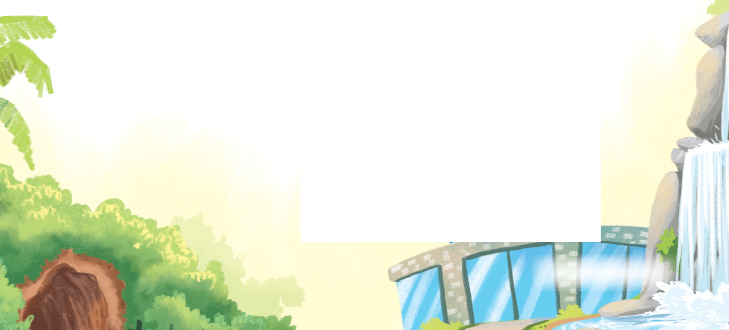
Read, look and guess.
Where are you going to visit this summer?
Summer’s almost here!
Where are you going to visit?
I’m going to visit a forest
and a (1) _______.
I’m going to learn about
trees and draw some pictures.
Summer’s almost here!
Where are you going to visit?
I’m going to visit an (2) ___ and
a waterfall.
I’m going to learn about (3) ___
and take some photos.

Slide 37
Listen and complete.
Listen and sing.
Where are you going to visit this summer?
Summer’s almost here!
Where are you going to visit?
I’m going to visit a forest
and a (1) _____.
I’m going to learn about
trees and draw some pictures.
Summer’s almost here!
Where are you going to visit?
I’m going to visit an (2) _________
and a waterfall.
I’m going to learn about (3) ____
and take some photos.
aquarium
cave
fish

Slide 38
Fun corner
and Wrap-up
05
Let's play!

Slide 39


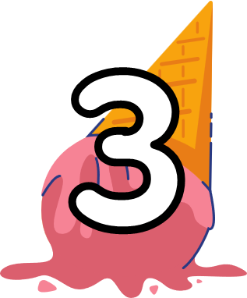






Spin the wheel
3 jumping jacks
1 star
5 stars
3 stars
Spin around
2 stars
Click here to spin
No star
5 high knees
-5 stars
-2 stars
10 stars
3 squats

Slide 40

Where are you ___ visit this summer?
A. going
B. going to
C. will
Notes:
Click on the ice-cream to return to the Wheel.

Slide 41
I'm going to visit _________. I'm going to learn about fish.
A. a cave
B. a forest
C. an aquarium
Notes:
Click on the ice-cream to return to the Wheel.

Slide 42
Summer's almost here. Where are you going ___?
A.visit
B.to visit
C.visiting
Notes:
Click on the ice-cream to return to the Wheel.

Slide 43
I'm going to visit a forest to learn about ___.
A. trees
B. fish
C. the beach
Notes:
Click on the ice-cream to return to the Wheel.

Slide 44

I'm going to visit ___.
A. a cave
B. a waterfall
C. an aquarium
Notes:
Click on the ice-cream to return to the Wheel.

Slide 45
Where ___ this summer?
A. you are going to visit
B. are you going to visit
C. are you go to visiting
Notes:
Click on the ice-cream to return to the Wheel.

Slide 46

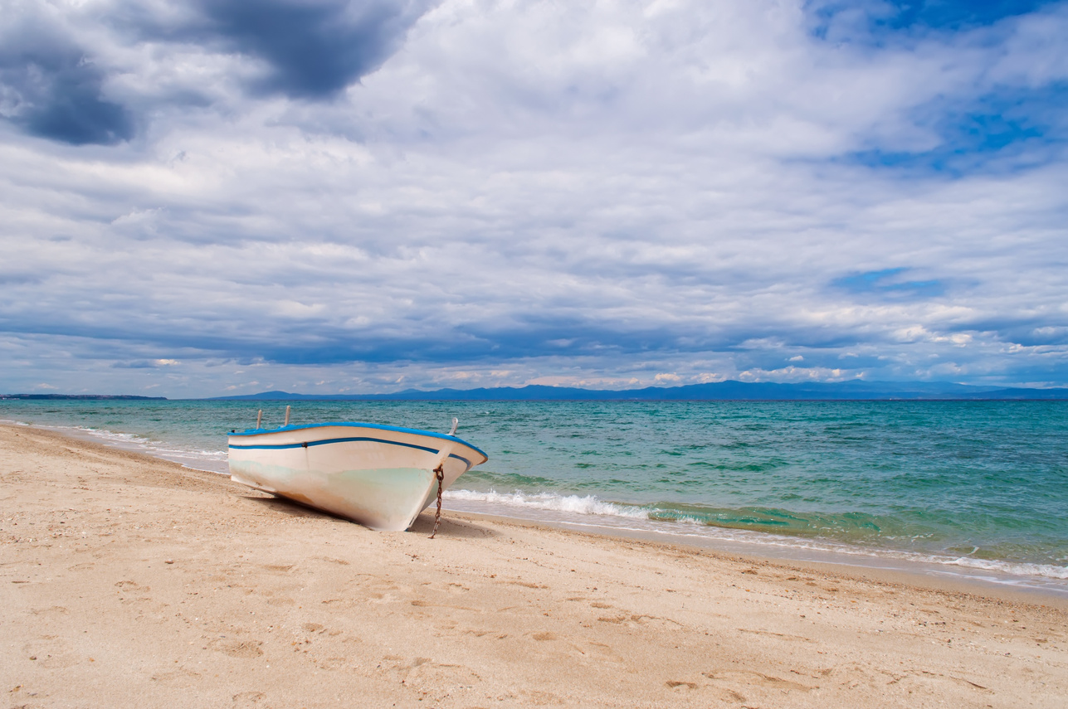

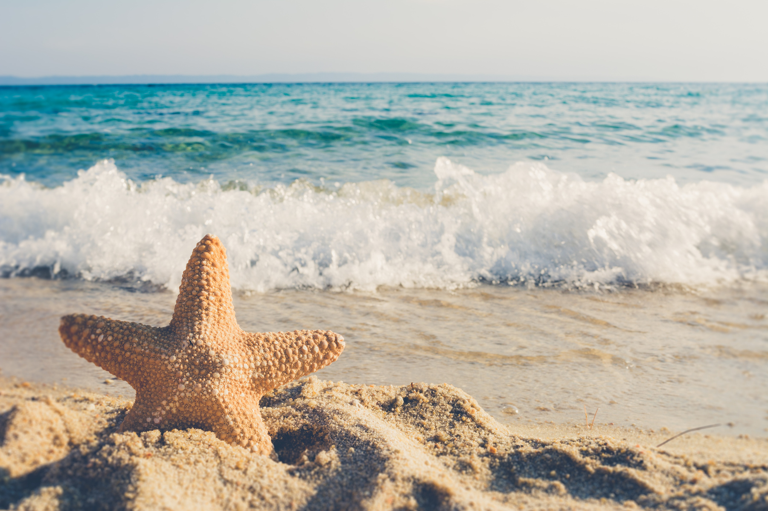
I'm going ___ some pictures.
A.taking
B.take
C.to take
Notes:
Click on the ice-cream to return to the Wheel.

Slide 47




What's your ___ for summer?
A. plan
B. visit
I'm going to visit Phu Quoc Island.
C. going
Notes:
Click on the ice-cream to return to the Wheel.

Slide 48
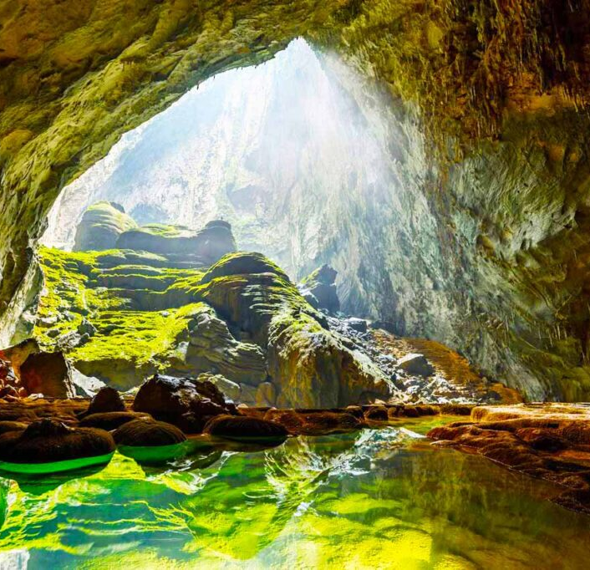
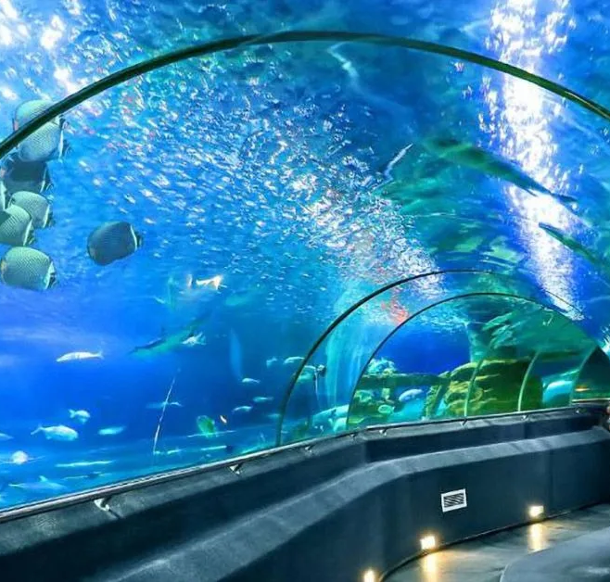

Listen and choose. Where is she going to visit?
A
C
B
Notes:
Click on the ice-cream to return to the Wheel.

Slide 49
Website: hoclieu.vn
Fanpage: https://www.facebook.com/tienganhglobalsuccess.vn/

