Slide 2







Our Summer Holidays
Lesson 2 - Period 3

Slide 3
Table of contents
01
Warm-up and Review
Look, listen and repeat.
02
Listen, point and say.
03
Let’s talk.
04
05
Fun corner and Wrap-up

Slide 4
01
Warm-up and Review
Guessing game

Slide 5


My Khe Beach
SHOW

Slide 6
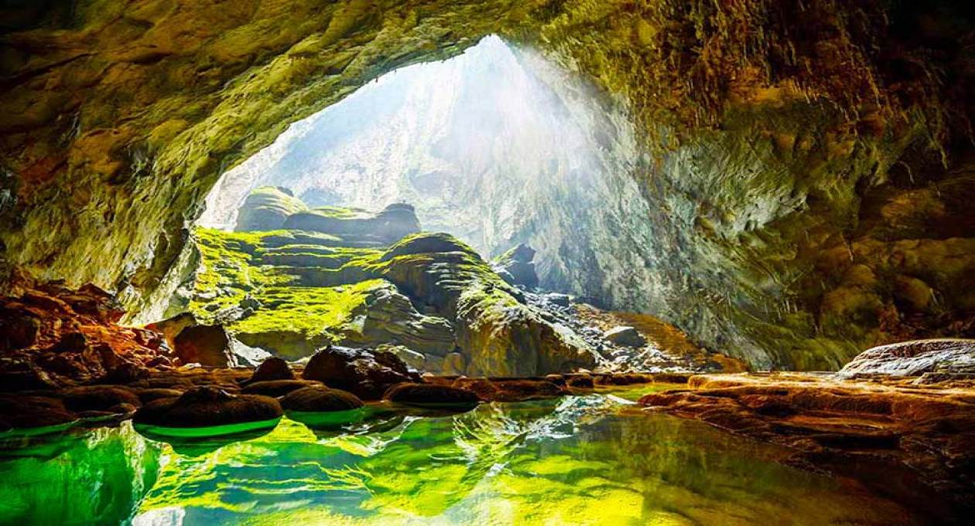
Phong Nha Cave
SHOW

Slide 7
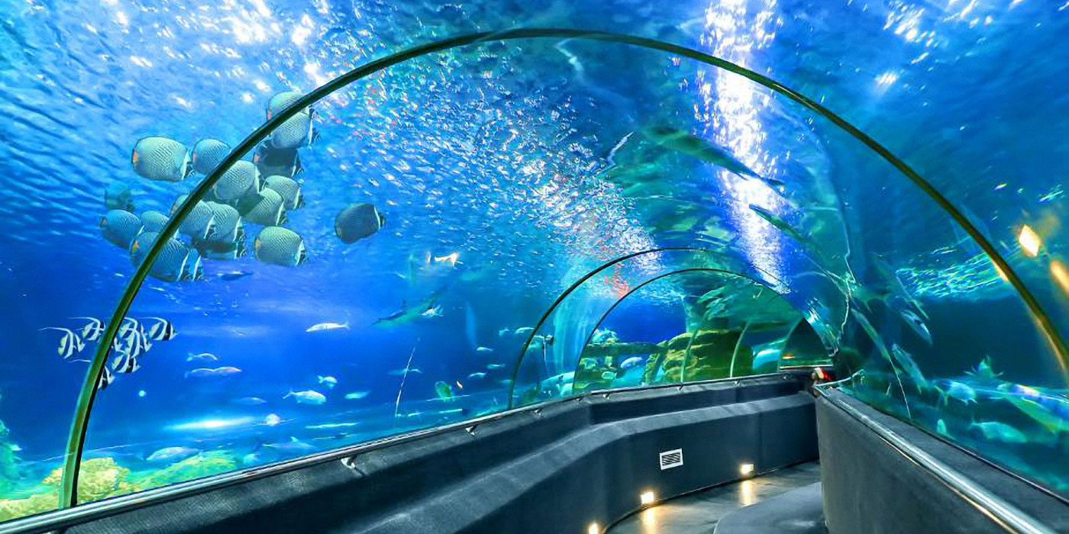
Dam Sen Aquarium
SHOW

Slide 8

Phu Quoc Island
SHOW

Slide 9
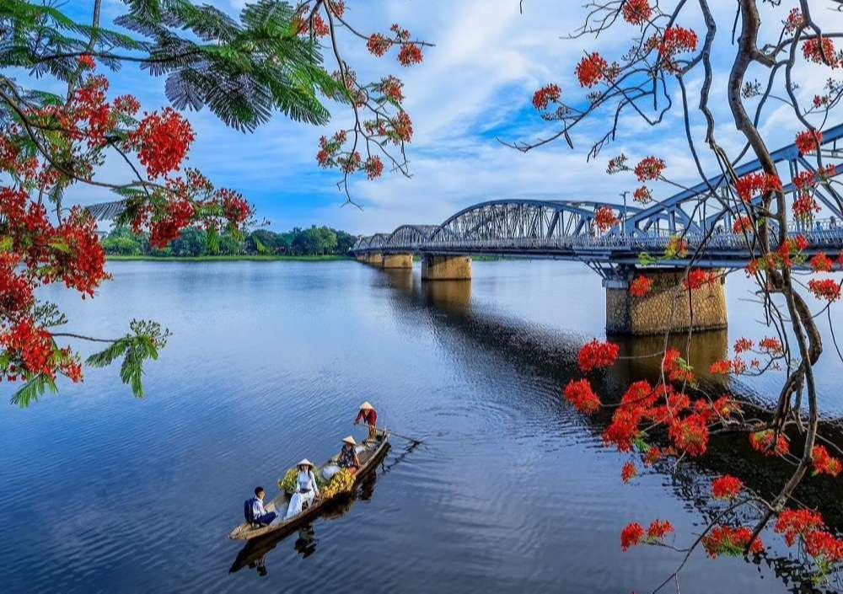
Huong River
SHOW

Slide 10
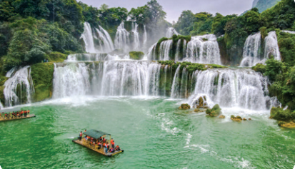
Ban Gioc Waterfall
SHOW

Slide 11
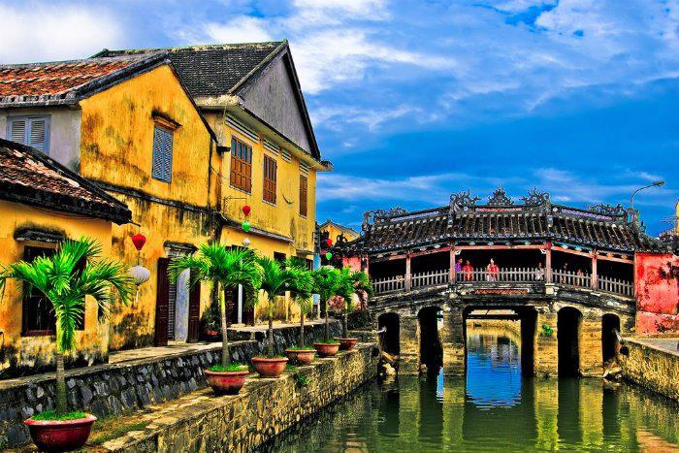
Hoi An Old Town
SHOW

Slide 12
Where are you going to visit this summer?
My sand castle

Slide 13
02
Look, listen and repeat.

Slide 14
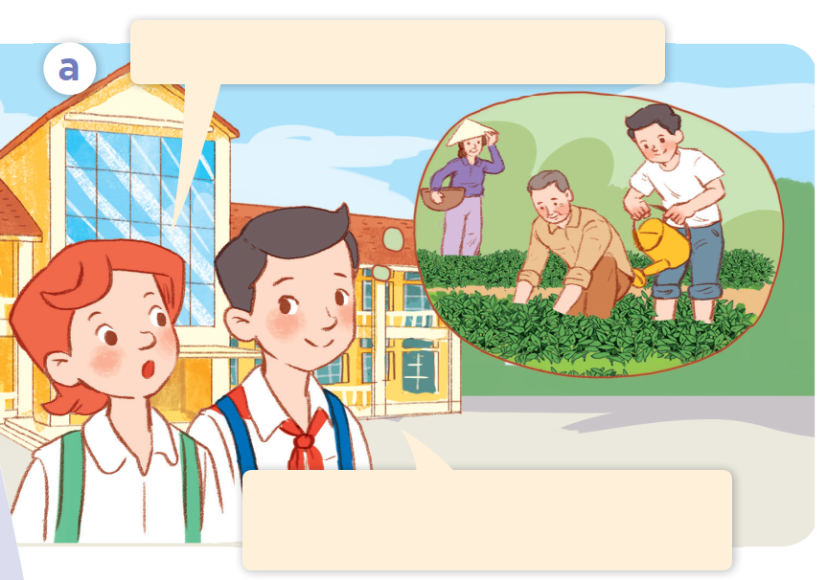
Who are they?
What are they doing?

Slide 15

Listen and repeat.
What did you do last summer?
I grew vegetables on a farm
with my grandparents.

Slide 16
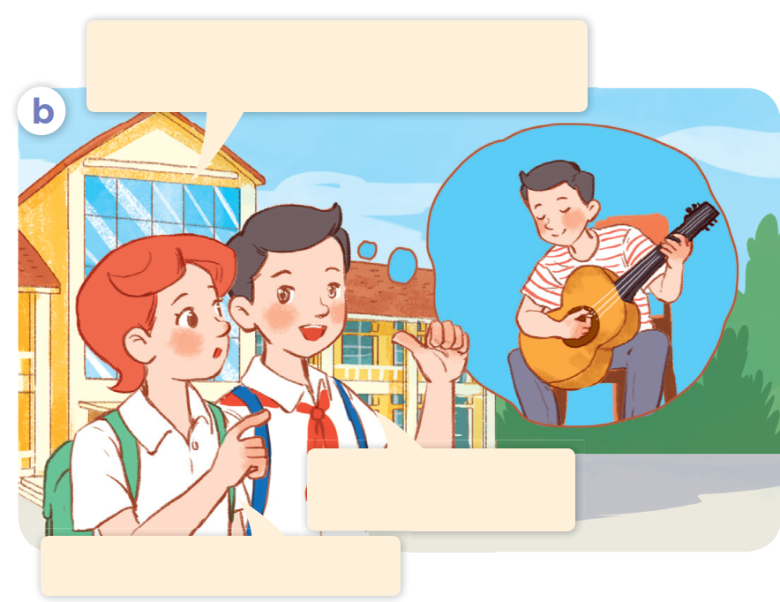
Listen and repeat.
What about this year? What are
you going to do this summer?
I’m going to join a music club.
That sounds fantastic!

Slide 17

What are you going to do this summer?
I’m going to join
a music club.

Slide 18
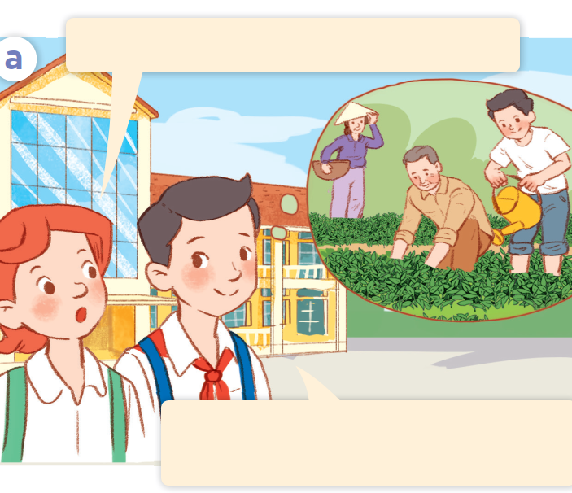
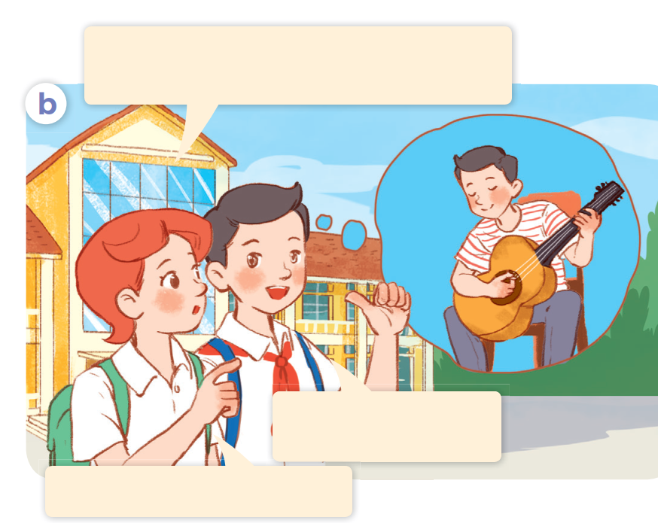
Act it out.
What did you do last summer?
What about this year? What are
you going to do this summer?
I’m going to join a music club.
I grew vegetables on a farm
with my grandparents.
That sounds fantastic!

Slide 19


03
Listen, point and say.

Slide 20
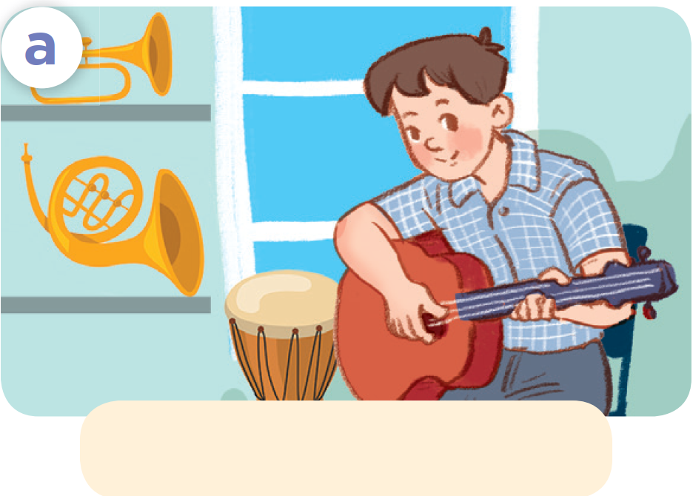
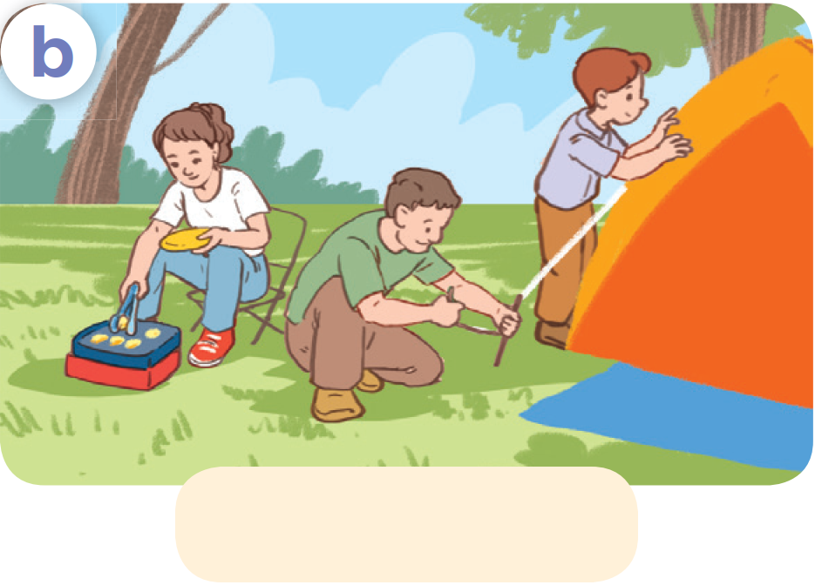
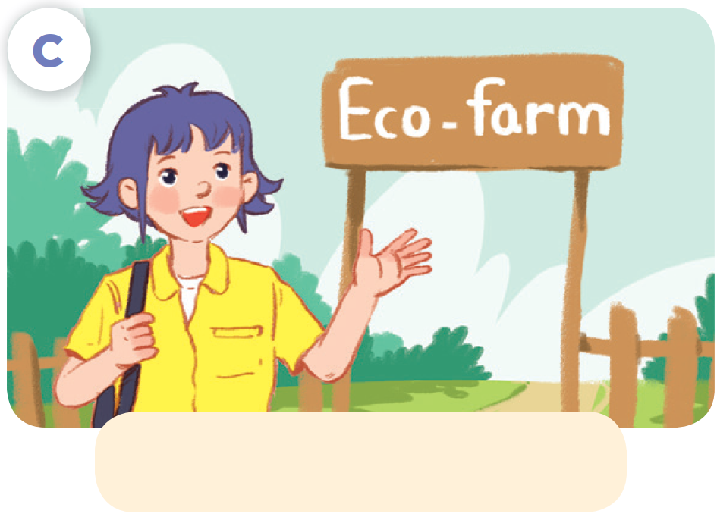
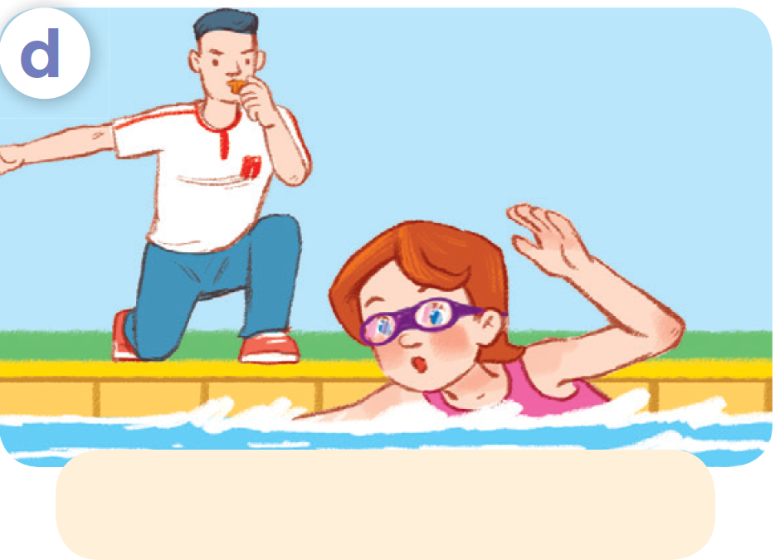
Listen, point and say.
join a music club
go camping
First day
visit an eco-farm
practise swimming

Slide 21
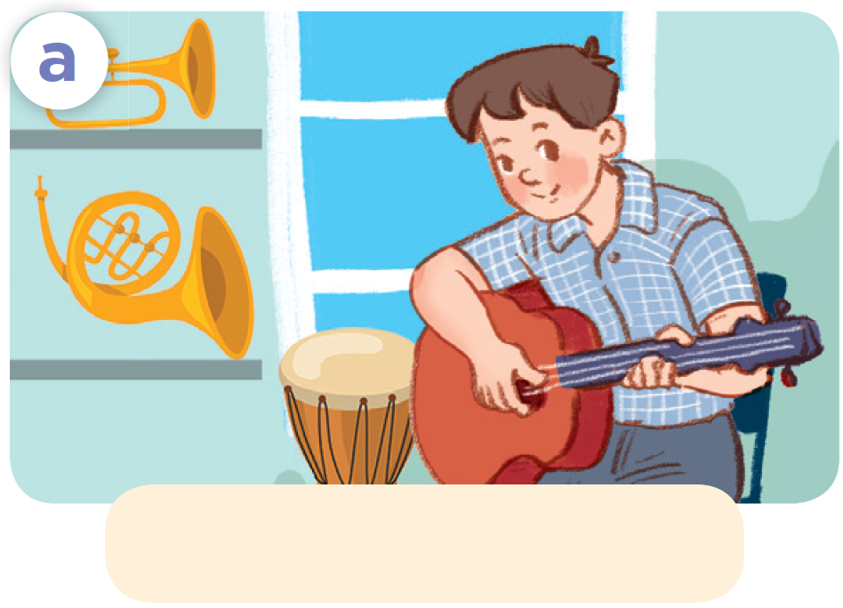
Listen, point and say.
join a music club
First day

Slide 22

Listen, point and say.
go camping
First day

Slide 23

Listen, point and say.
visit an eco-farm
First day

Slide 24

Listen, point and say.
practise swimming
First day

Slide 25
Listen, point and say.
What are you going
to do this summer?
I’m going to ___.
join a music club

Slide 26
Listen, point and say.
What are you going
to do this summer?
I’m going to ___.
go camping
First day

Slide 27
Listen, point and say.
What are you going
to do this summer?
I’m going to ___.
visit an eco-farm
First day

Slide 28
Listen, point and say.
What are you going
to do this summer?
I’m going to ___.
practise swimming
First day

Slide 29
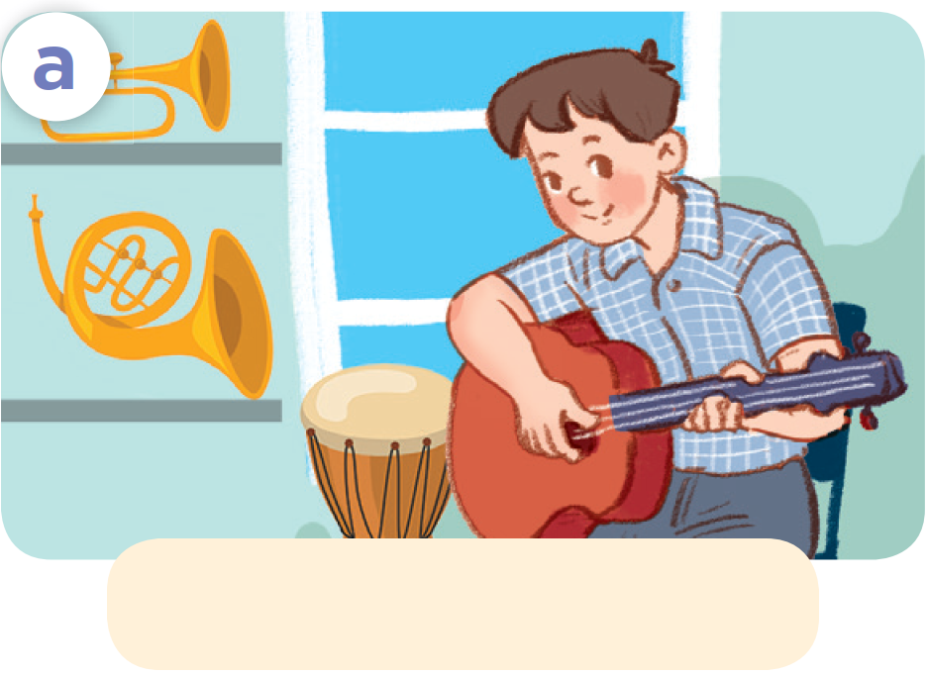
Ask and answer.
What are you going
to do this summer?
join a music club
go camping
I’m going to ___.
First day
visit an eco-farm
practise swimming

Slide 30


04
Let's talk.

Slide 31
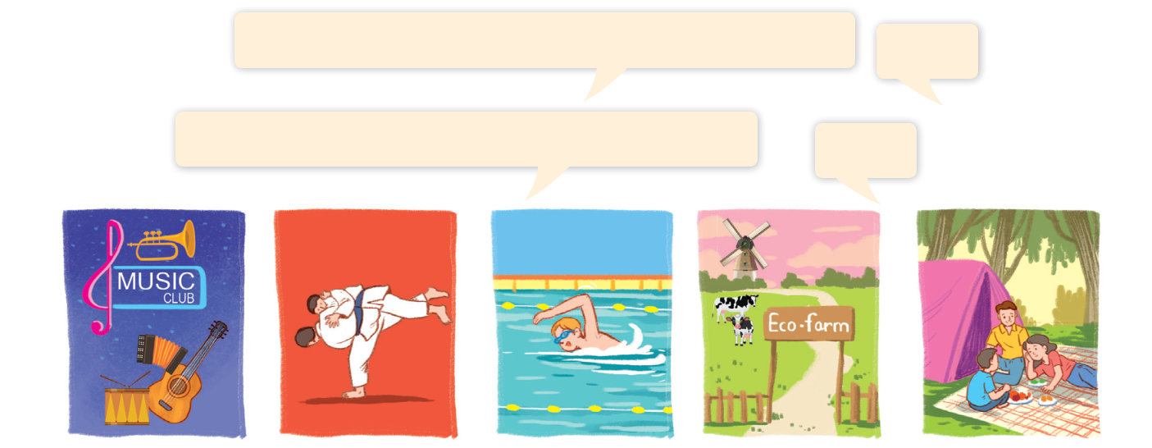
Let’s talk.
Where are you going to visit this summer?
___.
What are you going to do this summer?
___.

Slide 32
05
Fun corner and Wrap-up
Let’s play!
ROLL THE DICE

Slide 33
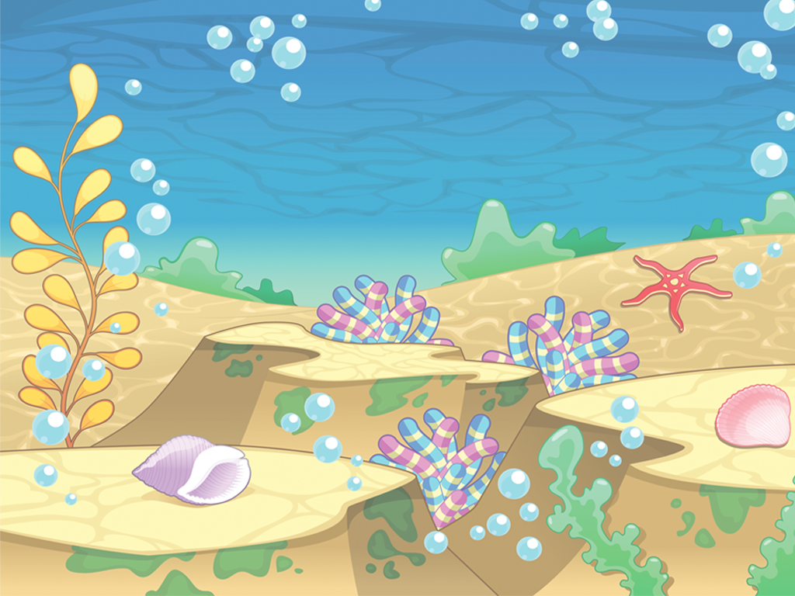



















END OF LESSON
Notes:
- CHOOSE THE NUMBER - CLICK TO THE SEA ANIMALS – It links to the question
- Roll the dice to get the points

Slide 34

Where are you going to visit this summer?
I am going to visit
Ban Gioc Waterfall.

Slide 35
Where are you going to visit this summer?
I am going to visit Huong River.

Slide 36

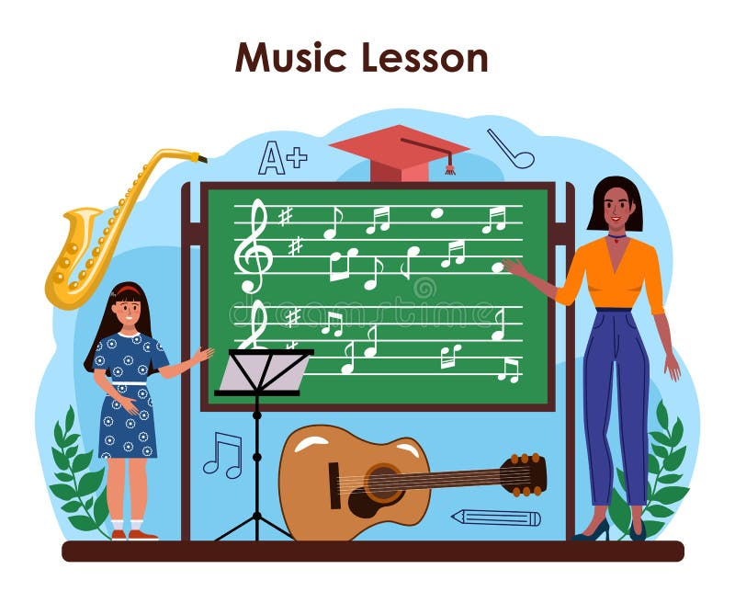
What are you going to do this summer?
I am going to join a music club.

Slide 37
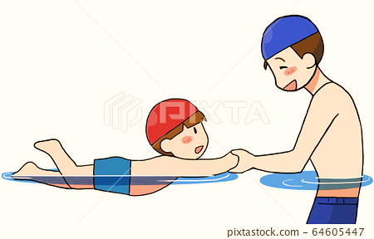
What are you going to do this summer?
I am going to
practise swimming.

Slide 38

Where are you going to visit this summer?
I am going to visit
Phu Quoc Island.

Slide 39
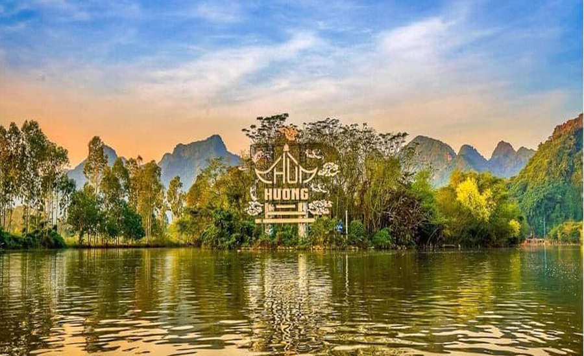
Where are you going to visit this summer?
I am going to visit
Huong Pagoda.

Slide 40
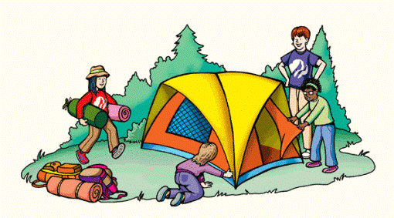
What are you going to do this summer?
I am going to go camping.

Slide 41
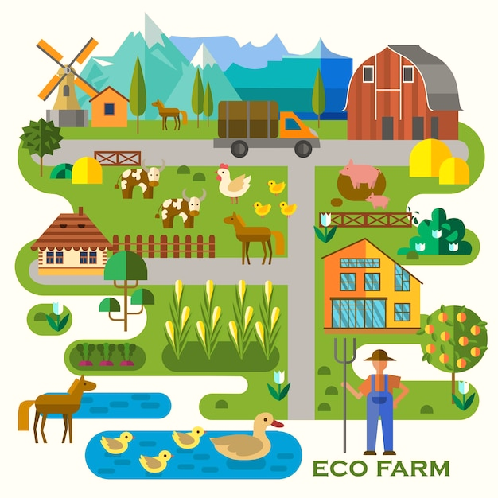
What are you going to do this summer?
I am going to visit
an eco-farm.

Slide 42
Website: hoclieu.vn
Fanpage: https://www.facebook.com/tienganhglobalsuccess.vn/

