Slide 2







Our Summer Holidays
Lesson 3 - Period 5

Slide 3
Table of contents
01
Warm-up and Review
Listen and repeat.
02
03
Listen and repeat. Pay attention to the intonation.
Let’s chant.
04
05
Fun corner and Wrap-up

Slide 4
01
Warm-up and Review
Let's play!

Slide 5
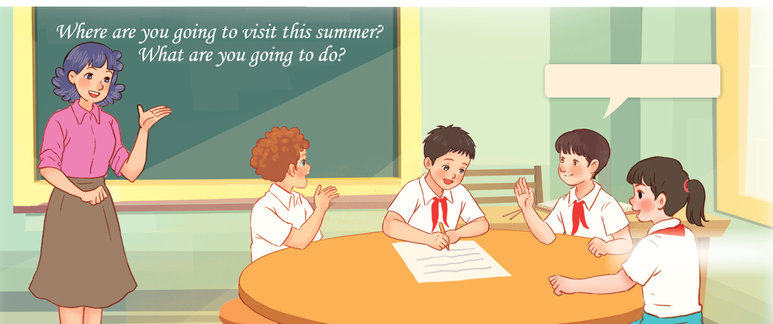
Let’s play.
Who has more correct answers?
I’m going to ___.

Slide 6
02
Listen and repeat.

Slide 7


Look at the question and the red mark.
When asking Wh-questions,
our voice goes down at the end.
falling intonation
Where are you going to visit this summer?
What are you going to do this summer?

Slide 8

Listen and repeat.
Work in pairs.
Say the questions.
Where are you going to visit this summer?
What are you going to do this summer?

Slide 9
03
Listen and repeat. Pay attention to
the intonation.

Slide 10
Read the questions aloud.
Listen and repeat.
Listen and focus on the falling intonation at the end.
Work in pairs and read the quetions.
1. What nationality is she?
2. Where did you go last summer?
3. Why didn’t you go to school?
4. How can I get to the supermarket?

Slide 11

04
Let's chant.

Slide 12
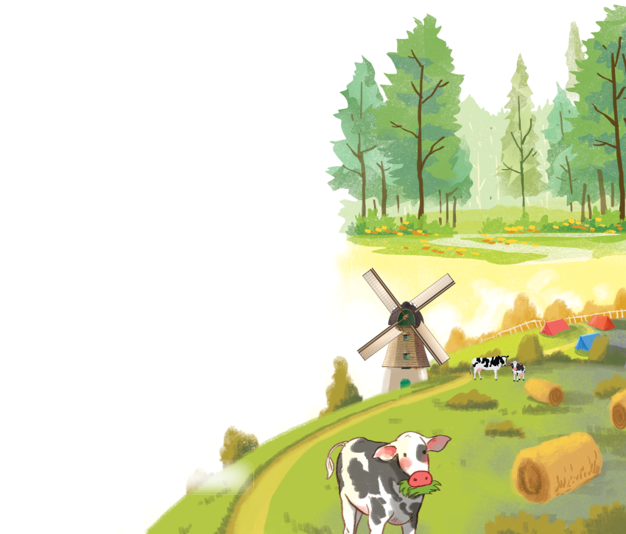
Listen and repeat.
Look at the questions.
Chant and clap along.
Read aloud.
Where are you going this summer?
I’m going to the forest.
Where are you going this summer?
I’m going to the mountains.
What are you going to do this summer?
I’m going to visit a farm.
What are you going to do this summer?
I’m going to join a guitar club.

Slide 13
05
Fun corner
and Wrap-up
Get the money to travel

Slide 14



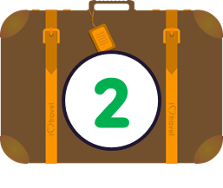
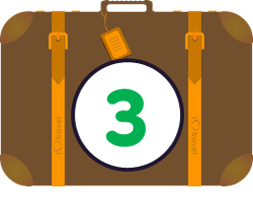
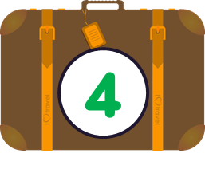
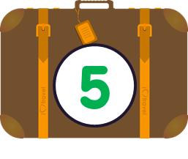
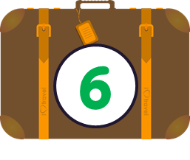

Slide 15


Put in order. Say aloud.
Pay attention to the intonation.
are / visit / you / Where / this / to / summer? / going
Where are you going to visit this summer?
Notes:
Click the globe to move back.

Slide 16
Put in order. Say aloud.
Pay attention to the intonation.
do / going / are / summer? /
you / What / to / this
What are you going to do this summer?
Notes:
Click the globe to move back.

Slide 17
Put in order. Say aloud.
Pay attention to the intonation.
nationality / What / she? / is
What nationality is she?
Notes:
Click the globe to move back.

Slide 18
Put in order. Say aloud.
Pay attention to the intonation.
summer? / did / Where / go / last / you
Where did you go last summer?
Notes:
Click the globe to move back.

Slide 19
Put in order. Say aloud.
Pay attention to the intonation.
didn’t / Why / go /
school? / to / you
Why didn’t you go to school?
Notes:
Click the globe to move back.

Slide 20
Put in order. Say aloud.
Pay attention to the intonation.
get/ How / I / supermarket? /
to / can / the/
How can I get to the supermarket?
Notes:
Click the globe to move back.

Slide 21
Website: hoclieu.vn
Fanpage: https://www.facebook.com/tienganhglobalsuccess.vn/

