Slide 1







Our Summer Holidays
Lesson 3 - Period 6

Slide 2
Table of contents
01
Warm-up and Review
Read and tick True or False.
02
Let's write.
03
Project
04
05
Fun corner and Wrap-up

Slide 3
01
Warm-up and Review
Let's play.

Slide 4


ROCK, PAPER, SCISSORS

Slide 5
How to play
There are 8 questions. Use rock, paper, scissors signs to answer each question.

Slide 6






A: Where are you going to visit
this summer?
B: I'm going to visit Phu Quoc ___.
Q1
Aquarium
Island
Waterfall

Slide 7
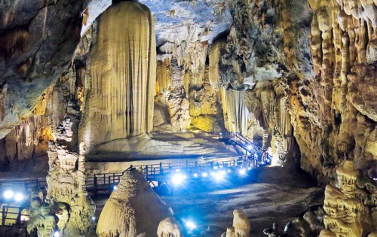
A: Where are you going to visit this summer?
B: I'm going to visit Phong Nha ___.
Q2
Cave
River
Beach

Slide 8
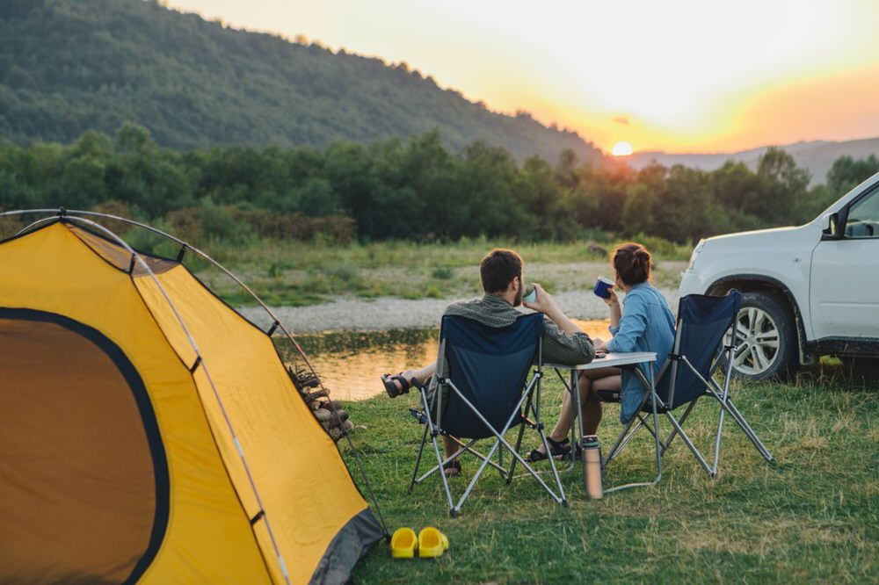
A: What are you going to do
this summer?
B: I'm going to ______.
Q3
practise swimming
join a music club
go camping
Notes:
We can say “math” or “maths”.

Slide 9
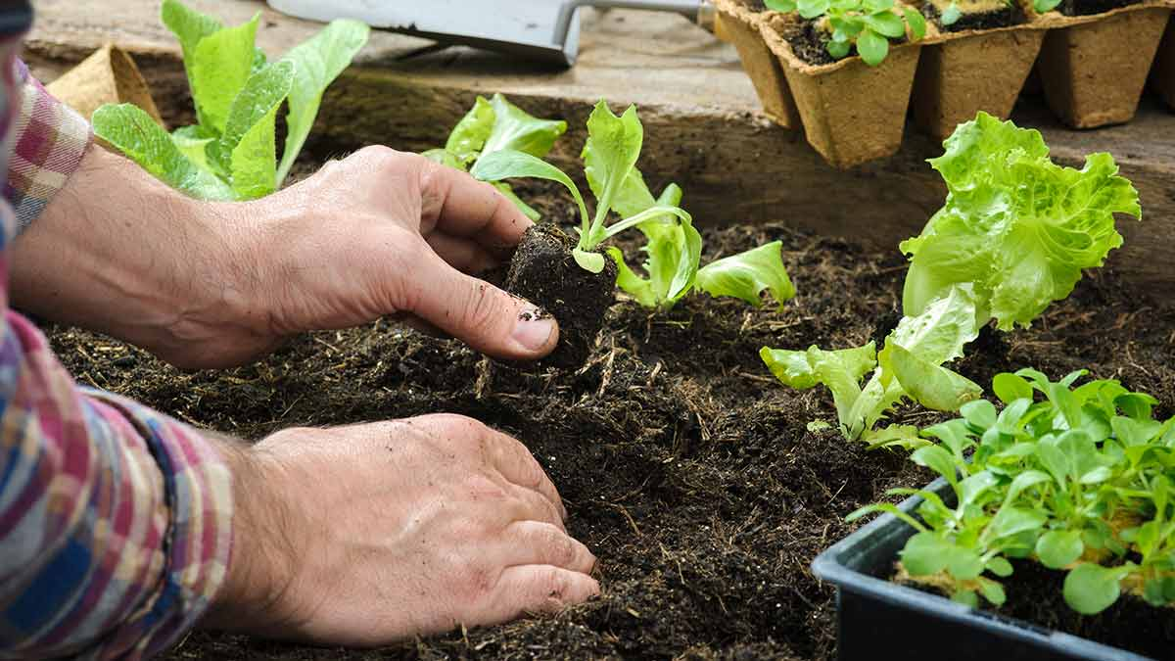
A: ______ are you going to do
this summer?
B: I'm going to grow vegetables.
Q4
What
Where
How

Slide 10
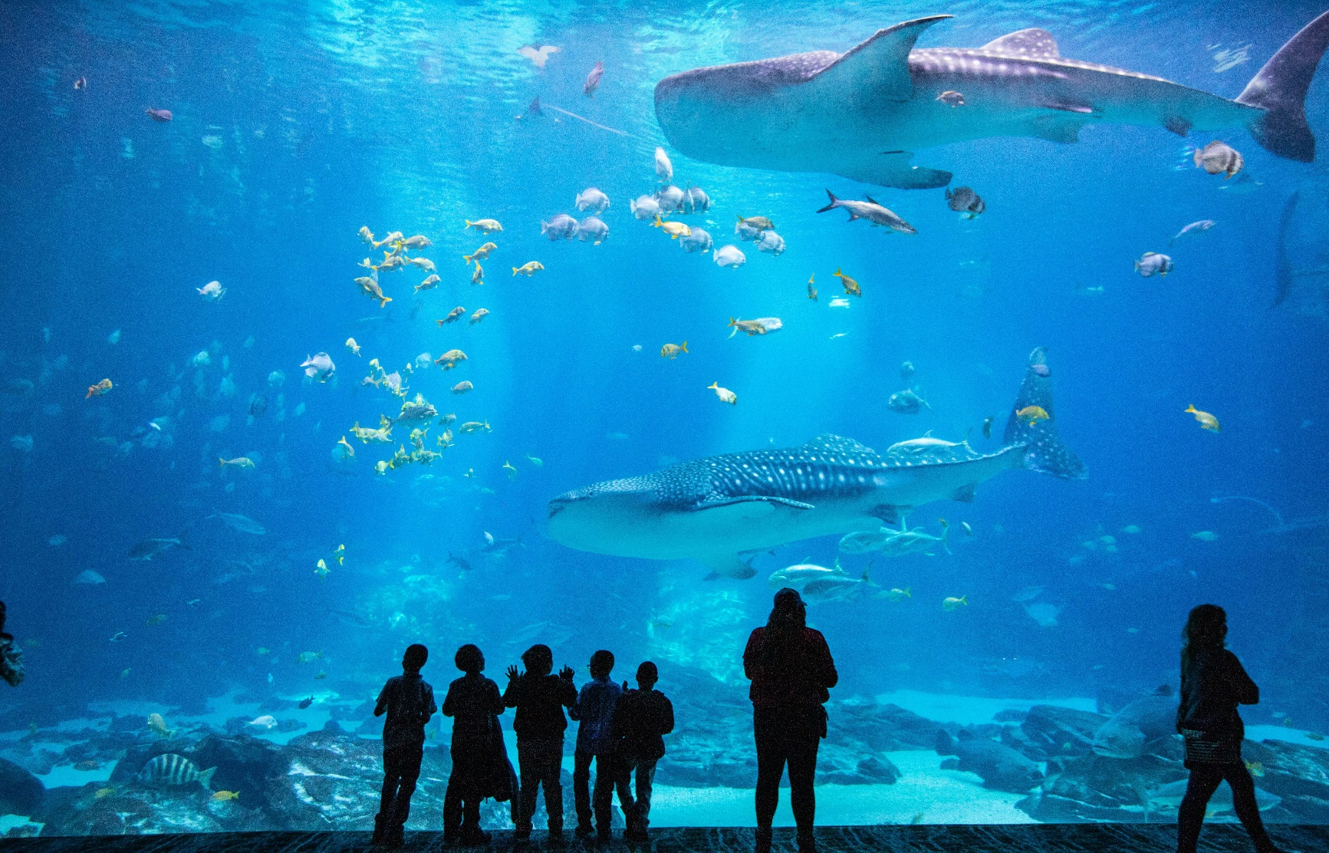
A: Where are you going to visit
this summer?
B: I'm going to visit ________.
Q5
a forest
an aquarium
a beach

Slide 11
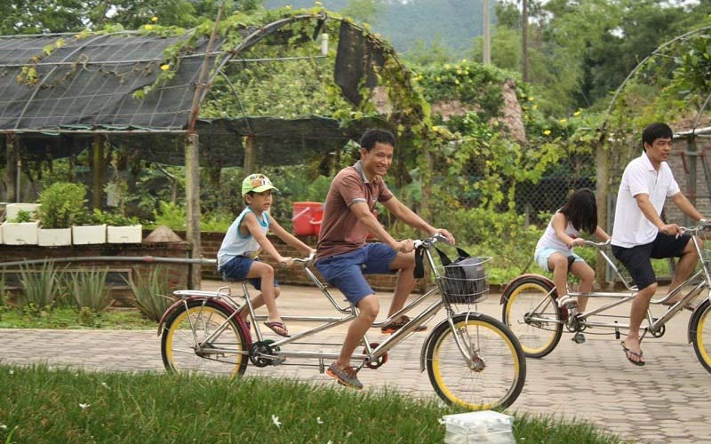
A: ______ are you going to visit
this summer?
B: I'm going to visit an eco-farm.
Q6
When
What
Where

Slide 12
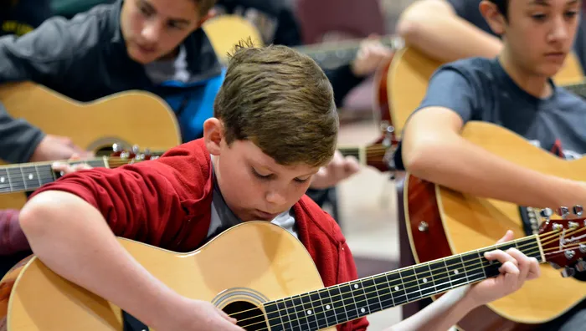
A: What are you going to do
this summer?
B: I'm going _________.
Q7
to join a music club
join a music club
joining a music club

Slide 13

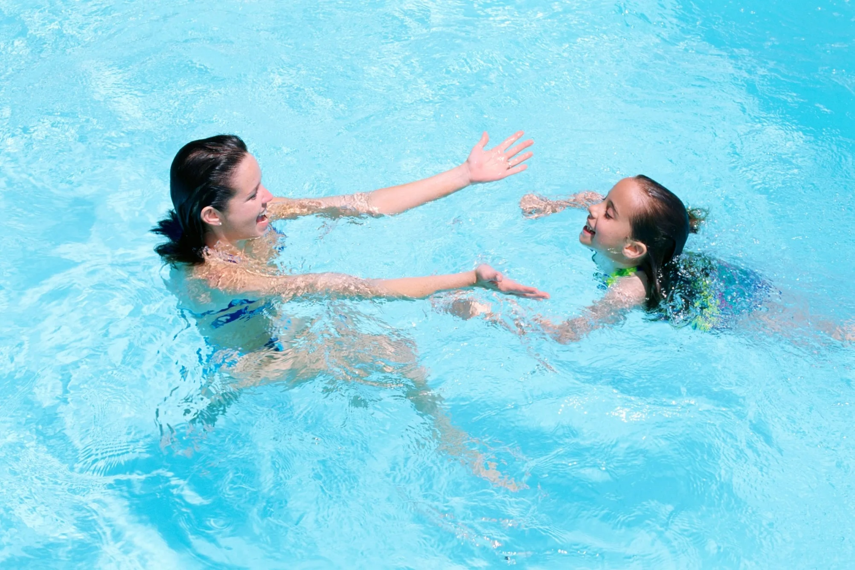
A: What are you going to do
this summer?
B: I'm going to ________.
Q8
grow vegetables
Âm thanh kiểm tra đáp án
practise swimming
join a judo club
Notes:
We can say “ICT” or “computer science”

Slide 14
02
Read and tick True or False.

Slide 15
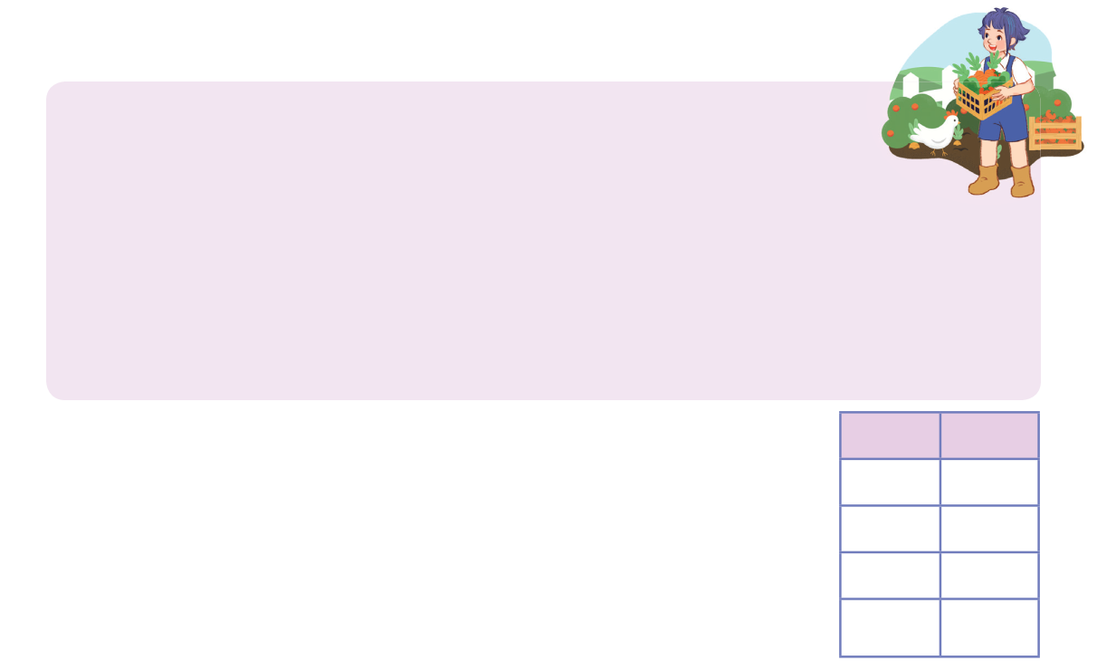





Read and tick True or False.
Last summer, I went to an eco-farm. I had a great time there.
This summer, we are going to visit Da Lat and Nha Trang. We
are going to Cam Ly Waterfall in Da Lat and the aquarium in
Nha Trang. We are excited to explore the local food there. When we get home, I am going to join a music club. I am going to take some guitar lessons. In my free time, I am going to learn a new language with my friends. We like learning foreign languages.
True
False
1. Linh went to an eco-farm last summer.
2. She is going to visit some caves this summer.
3. She is going to join a music club.
4. She is going to play badminton with her friends in her free time.

Slide 16
03
Let's write.

Slide 17
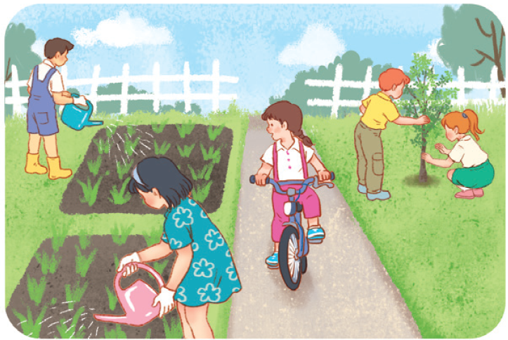

Where are you going to visit?
What are you going to do here?
Eco-farm
ride a bike
water vegetables
plant trees

Slide 18

My summer
Summer is coming. We are going to visit _____________________________________________________________________________________________________________________________.

Slide 19

04
Project

Slide 20
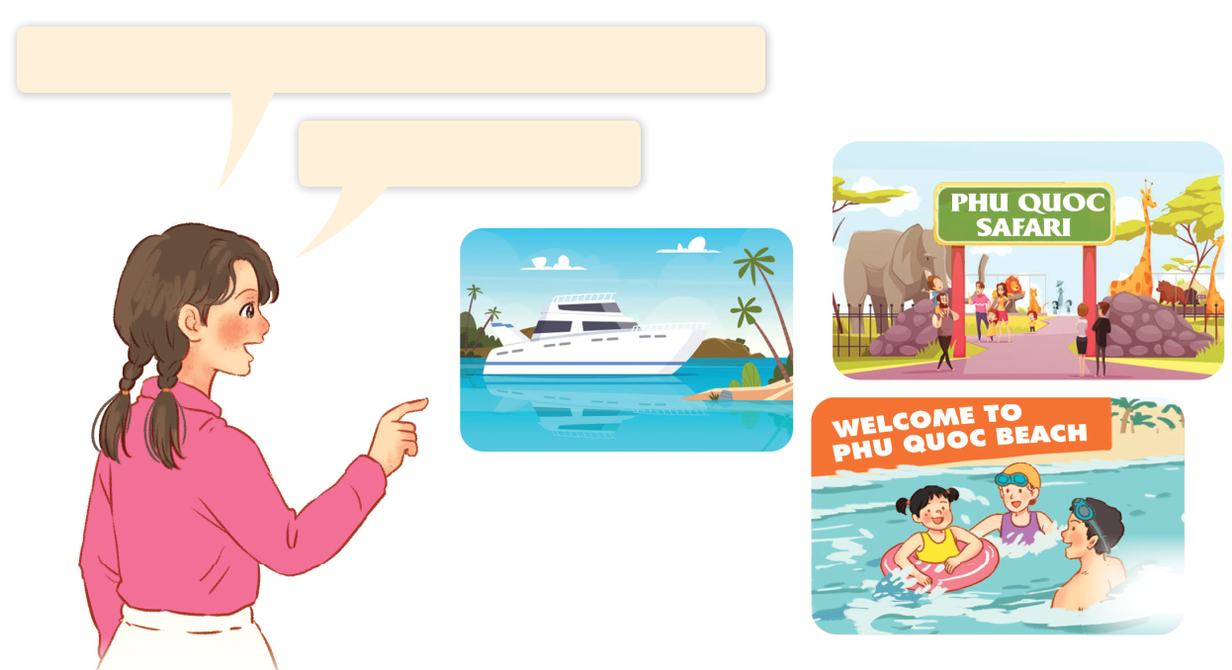

Phu Quoc
I’m going to visit _________ for my holiday.
I’m going to ____.
swim at the beach
visit Phu Quoc safari

Slide 21


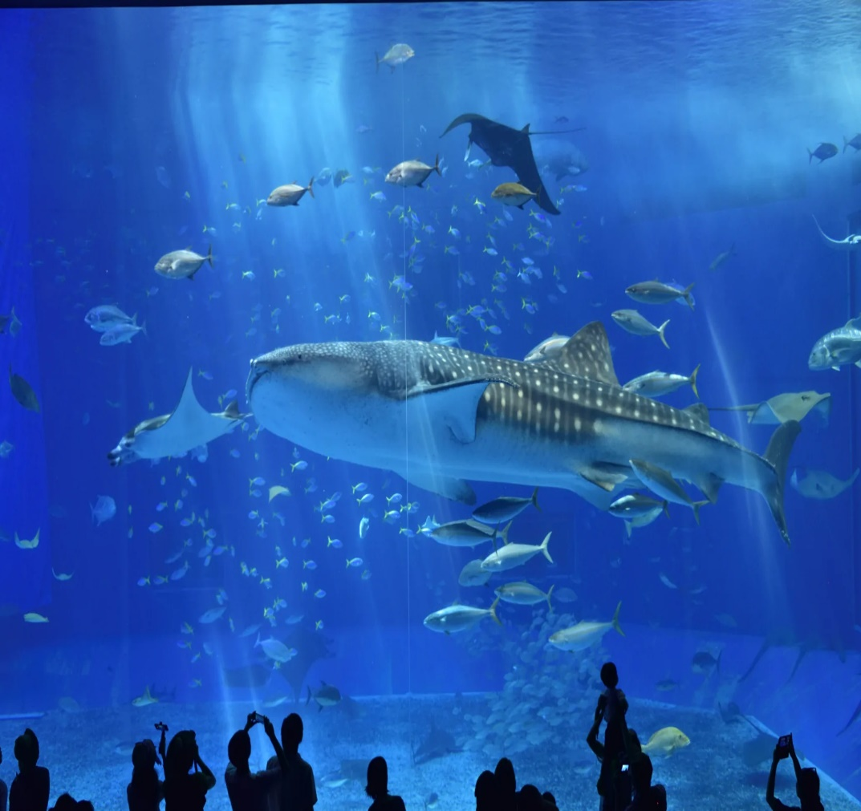
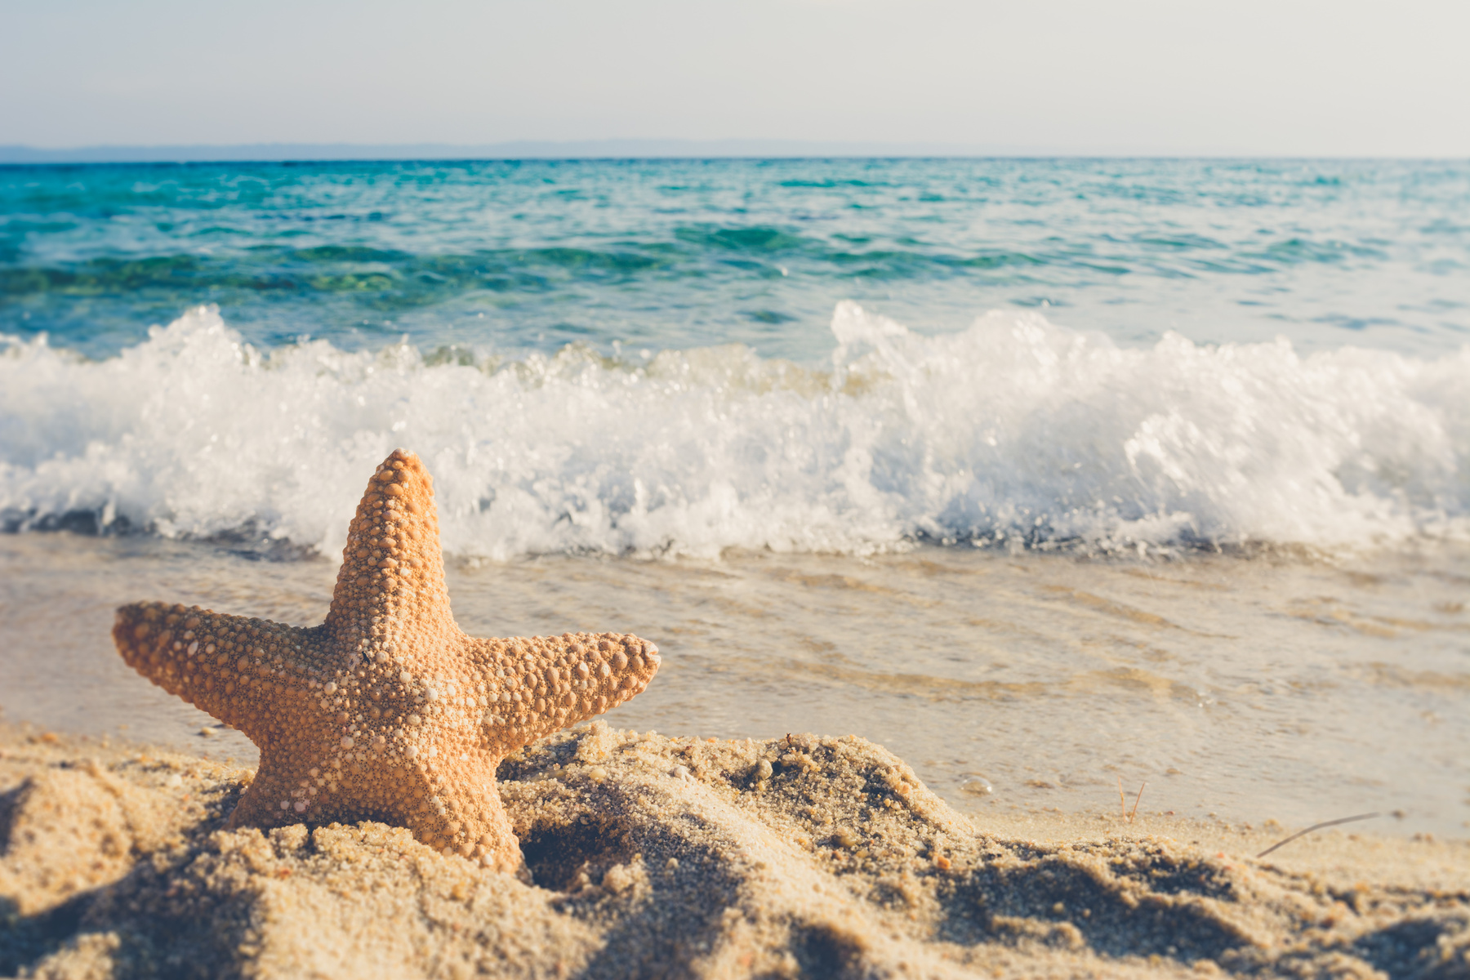

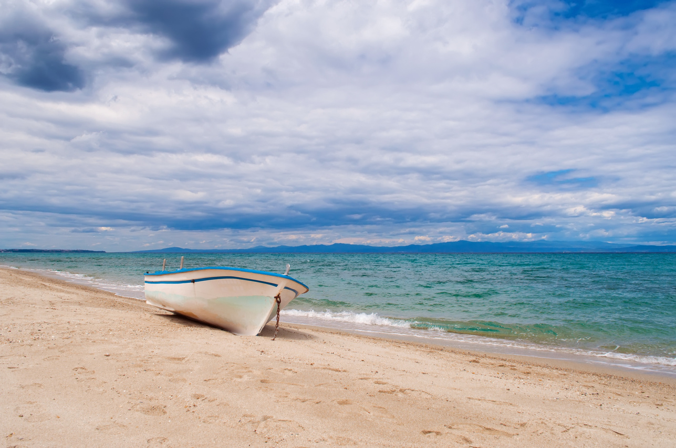
I'm going to ____.
Aquarium
take pictures

Slide 22
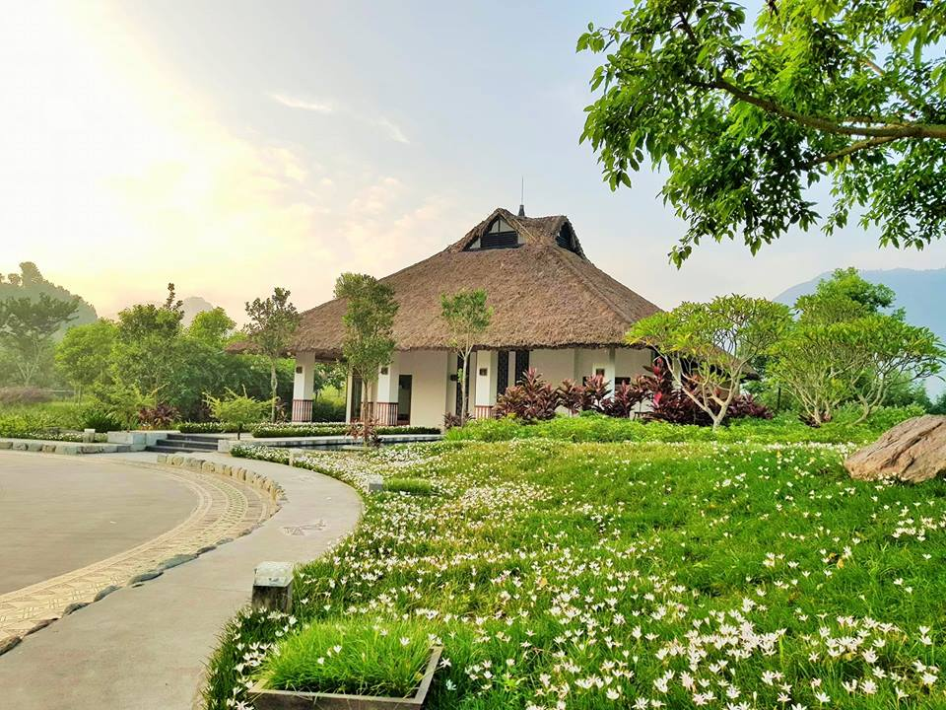
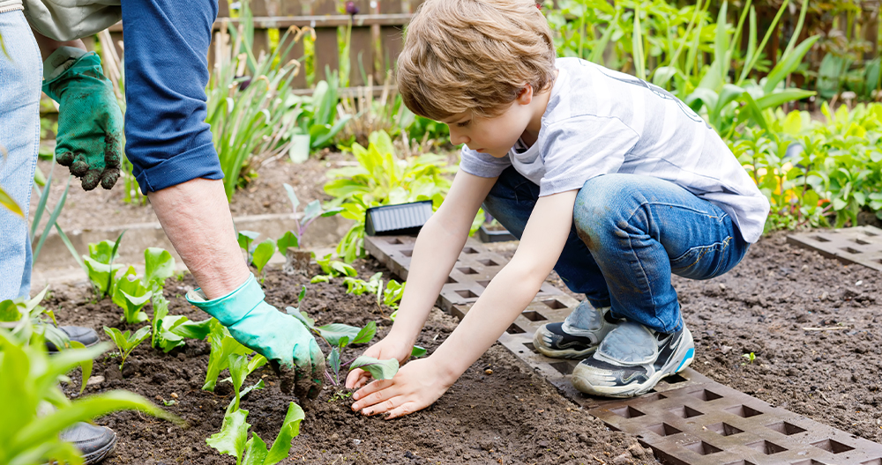
I'm going to ___.
Eco-farm
grow vegetables

Slide 23
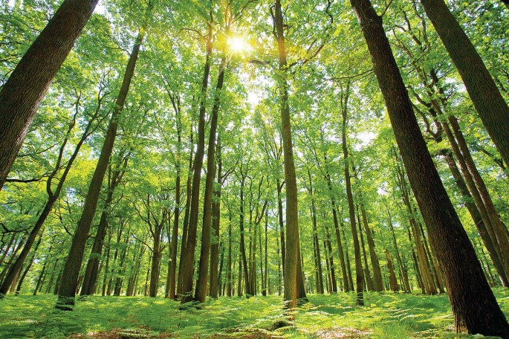
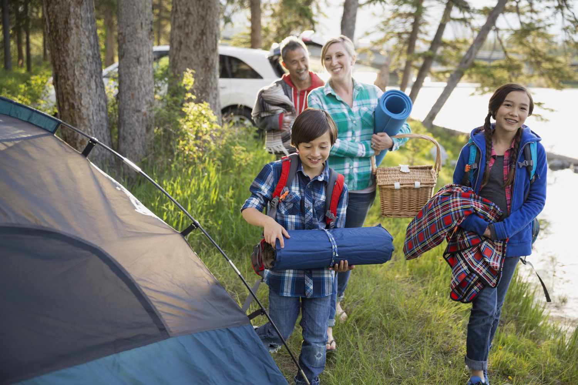
I'm going to ____.
forest
go camping

