Slide 1








starter
Period 1 – Back to school

Slide 2


Pass the ball
How are you?
- I’m fine, thanks. And you?
Notes:
Ask How are you? to the friend sitting in front of you.

Slide 3
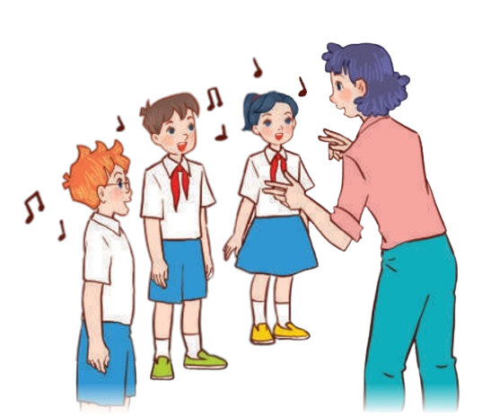

02
Let’s sing.

Slide 4


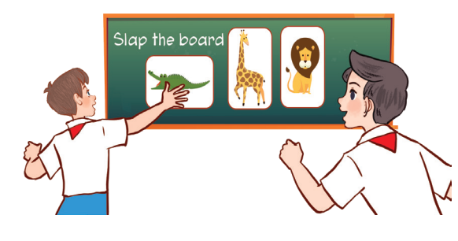
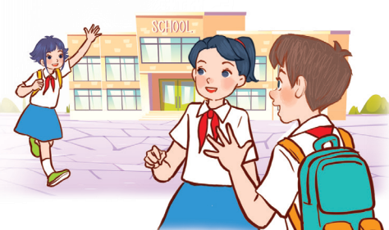
Look AND SAY.
What can you see?
Happy to learn and play!
Happy to see friends!

Slide 5






Look and read.
Back to school
Back to school.
Happy to see my friends!
Back to school.
Learning and playing are really cool!
Notes:
Step 1: Draw pupils’ attention to the title and lyrics of the song. Encourage them to point at the pictures to say what they see.

Slide 6
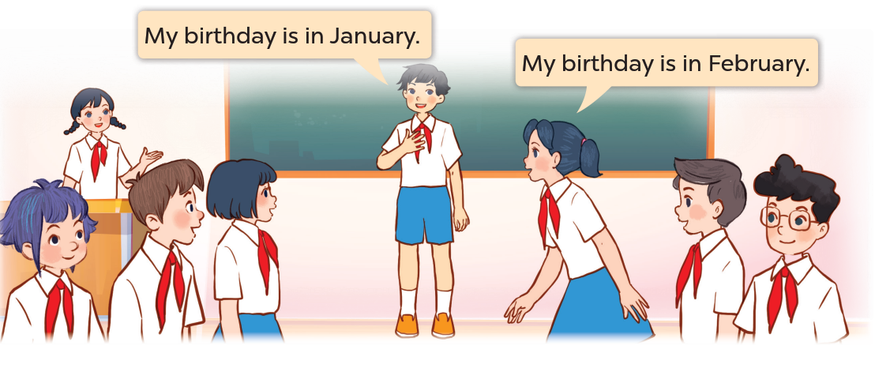
03
Let’s play.

Slide 7

04
Write
and share.

