Slide 1


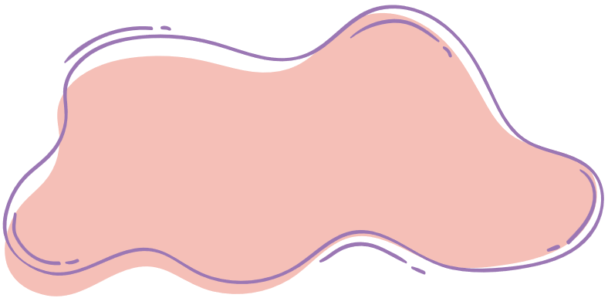



starter
Period 2 – Last summer

Slide 2

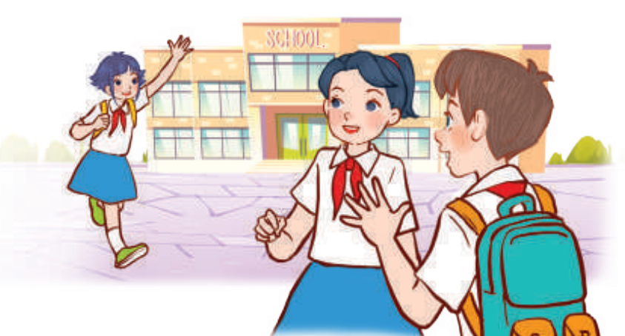


01
WARM-UP
and review

Slide 3

03
LISTEN
AND MATCH.

Slide 4

Work in pairs.
Notes:
Pupils work in pairs to peer-check their answers and talk about children’s last summer.

Slide 5
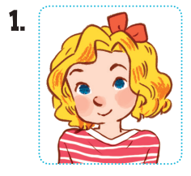
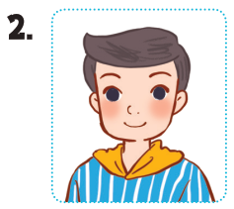
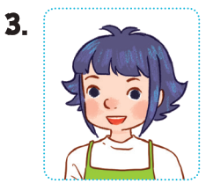
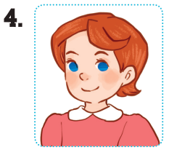




Let’s check!
Notes:
*Key: 1. b, 2. a, 3. d, 4. c

Slide 6
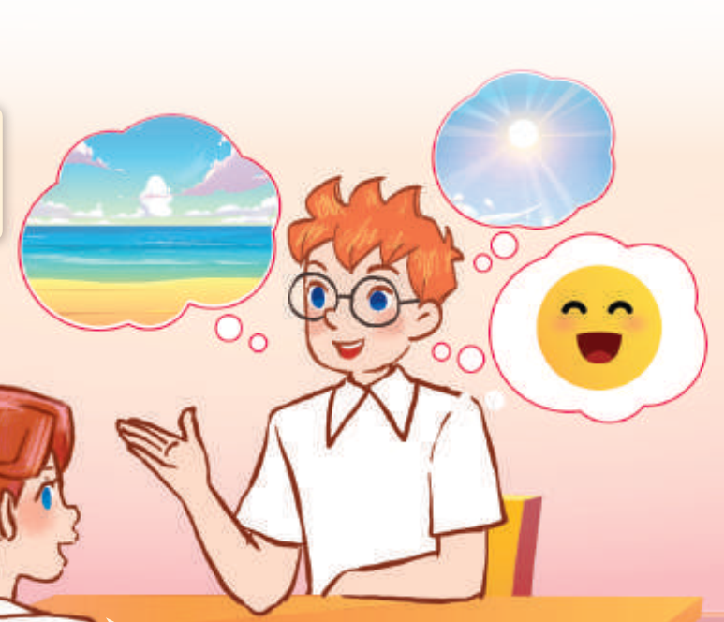
04
LET’S TALK.

Slide 7
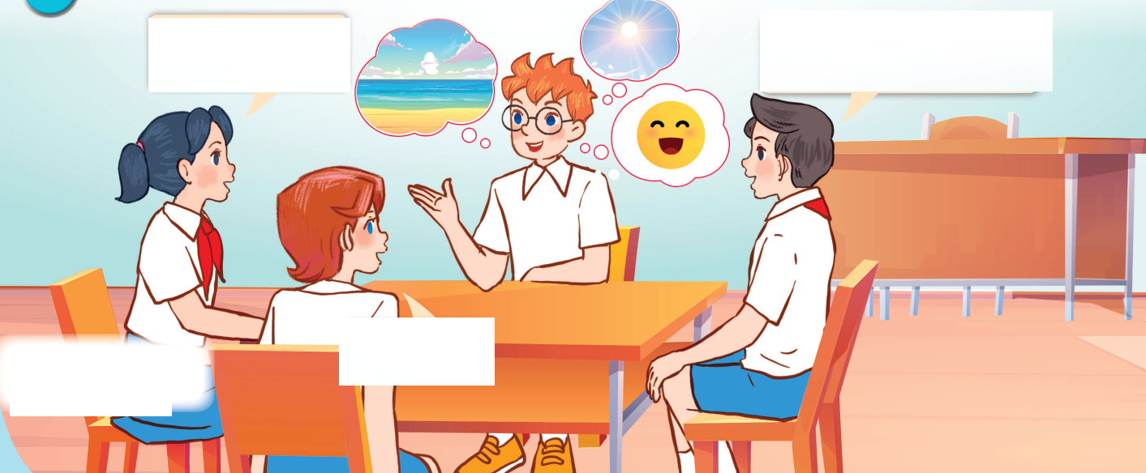
Look AND ANSWER.
Notes:
Step 1: Draw pupils’ attention to the picture. Ask questions to help them identify the context (see Input).

Slide 8
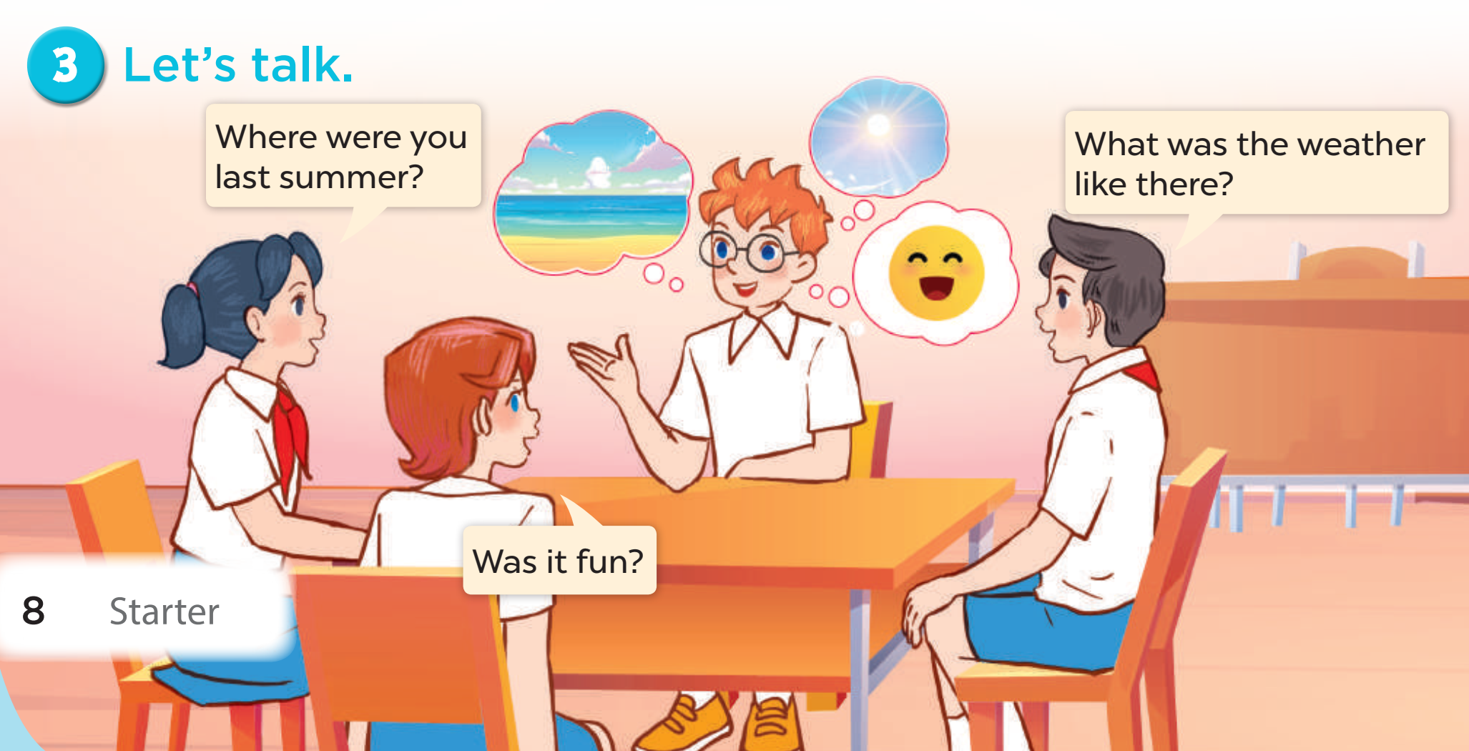


Look AND Read.
Where were you
last summer?
What was the weather
like there?
Was it fun?
Notes:
Step 2: Get pupils to read the speech bubbles and elicit possible answers.

