Slide 1

Unit 1. All about me!
Lesson 1 - Period 1

Slide 2

Table of contents
01
Warm-up and review
02
Look, listen and repeat.
03
Listen, point and say.
04
Let’s talk.
05
Fun corner and wrap-up

Slide 3

01
Warm-up and review

Slide 4
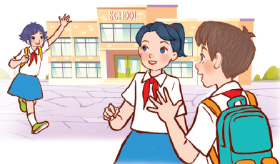
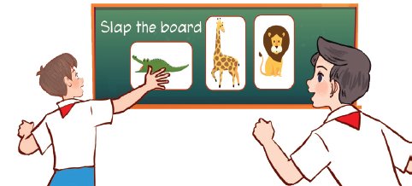
Let’s sing.
Back to school
Back to school.
Happy to see my friends!
Back to school.
Learning and playing are really cool!
Back to school.
Happy to see my teachers!
Back to school.
Learning and playing are really cool!

Slide 5


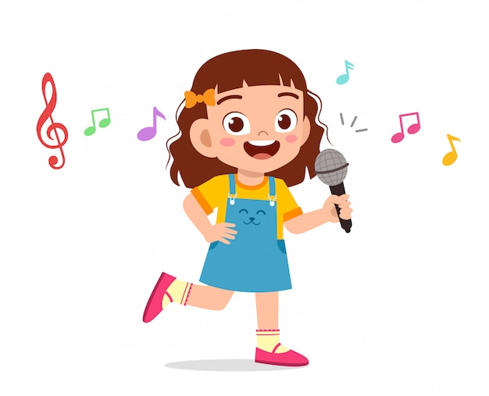
Perform

Slide 6
02
Look, listen and repeat.

Slide 7

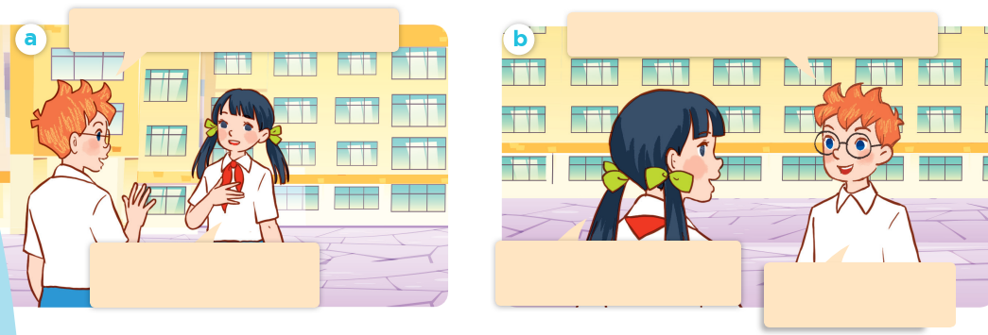
Look, listen and repeat.
Hello. I’m Ben. Nice to meet you.
Can you tell me about yourself, Lan?
Hello, Ben. I’m Lan.
Nice to meet you, too.
Well, I’m in Class 5C.
I live in the countryside.
I’m in Class 5B.
I live in the city.

Slide 8
Can you tell me about yourself, Lan?
Well, I’m in Class 5C. I live in the countryside.

Slide 9
03
Listen, point and say.

Slide 10
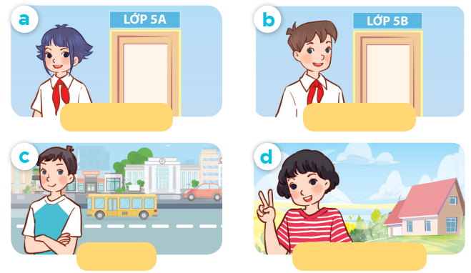
Listen, point and say.
Class 5A
Class 5B
city
countryside

Slide 11
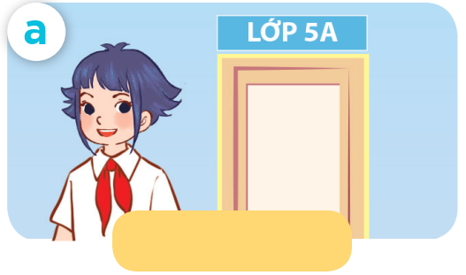
Listen, point and say.
Class 5A

Slide 12
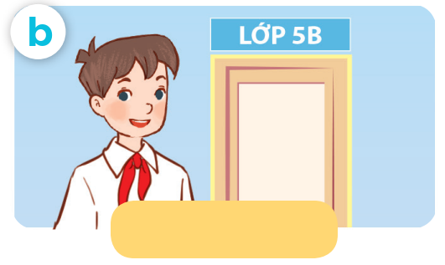
Listen, point and say.
Class 5B

Slide 13
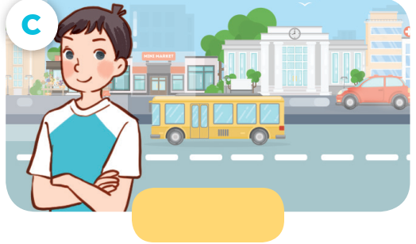
Listen, point and say.
city

Slide 14
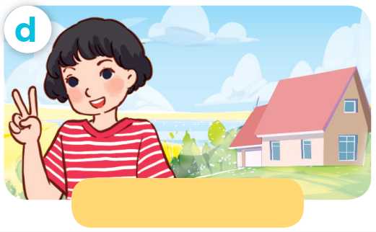
Listen, point and say.
countryside

Slide 15
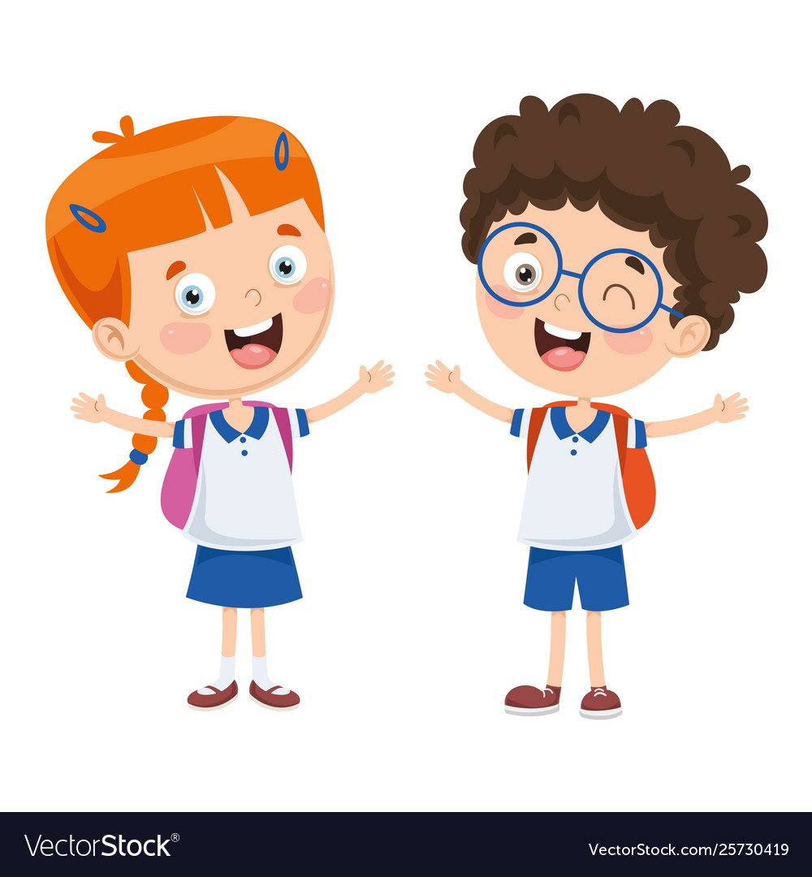
Can you tell me about yourself?
I’m in ____ .
I live in the ___.

Slide 16
Listen, point and say.
Can you tell me about yourself?
I’m in Class 5A .
Class 5A

Slide 17
Listen, point and say.
Can you tell me about yourself?
I’m in Class 5B.
Class 5B

Slide 18
Listen, point and say.
Can you tell me about yourself?
I live in the city.
city

Slide 19
Listen, point and say.
Can you tell me about yourself?
I live in the countryside.
countryside

Slide 20
Can you tell me about yourself?
Class 5A
Class 5B
I’m in ____.
I live in the __.
city
countryside

Slide 21
04
Let’s talk.

Slide 22
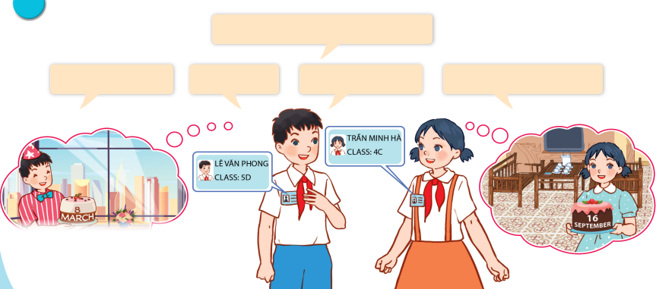
Let’s talk.
Can you tell me about yourself?
My name's ___.
I'm in ___.
I live in the ___.
My birthday is in ___.

Slide 23
Can you tell me about yourself?
I’m in ____.
I live in the ___.

Slide 24
05
Fun corner and wrap-up

Slide 25


Slide 26

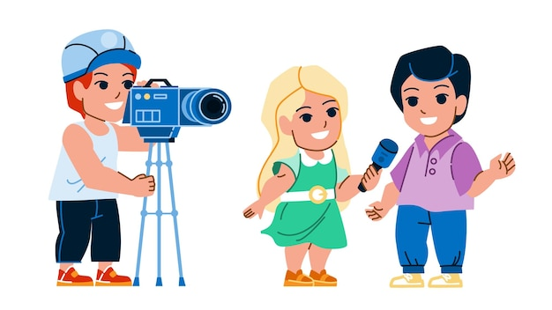
Can you tell me about yourself?
____.

