Slide 1

Unit 1. All about me!
Lesson 2 - Period 3

Slide 2

Table of contents
01
Warm-up and review
02
Look, listen and repeat.
03
Listen, point and say.
04
Let’s talk.
05
Fun corner and wrap-up

Slide 3

01
Warm-up and review

Slide 4

Game

Slide 5
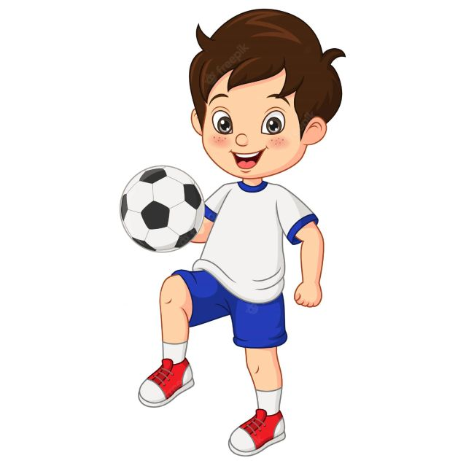




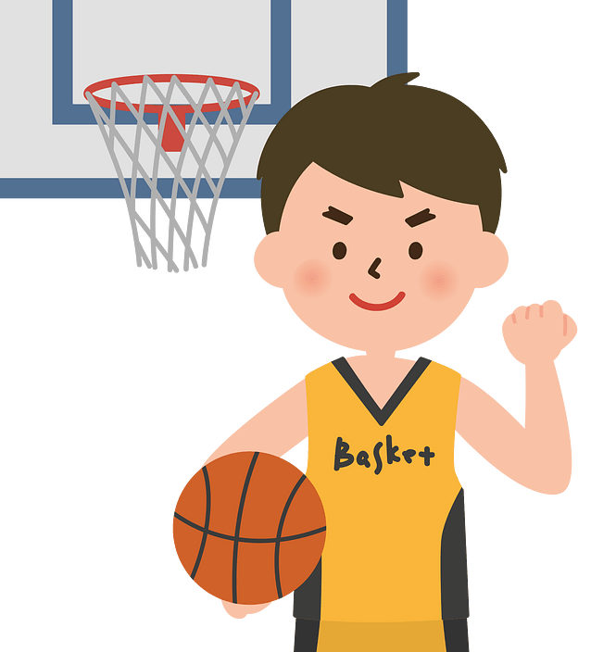


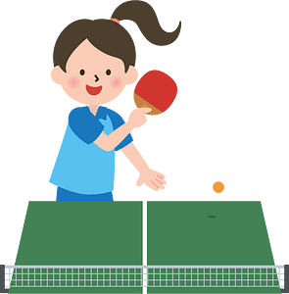

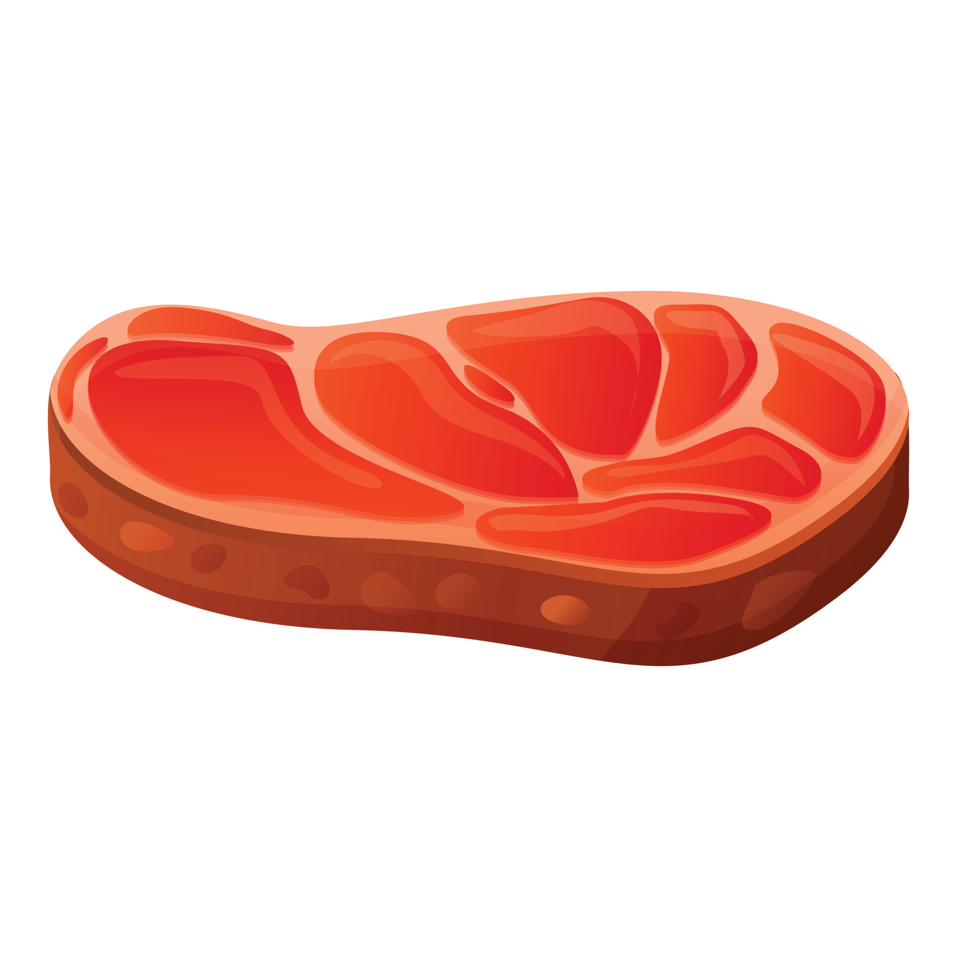
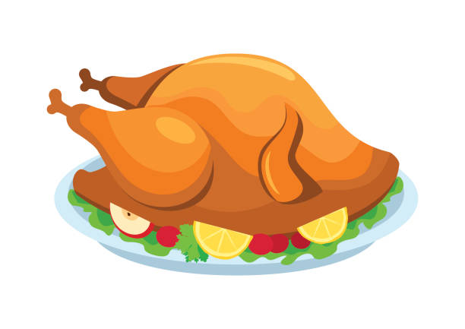





swim
Notes:
Nháy chuột để biến mất hình ảnh và xuất hiện hình ảnh tiếp theo

Slide 6



Slide 7
02
Look, listen and repeat.

Slide 8

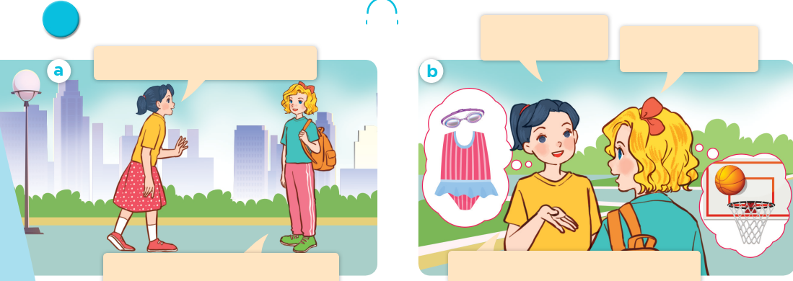
Look, listen and repeat.
Look, listen and repeat.
What’s your favourite sport?
It’s basketball. What about you?
Where are you going, Mary?
I’m going to the sports centre.
My favourite sport is swimming.

Slide 9

What’s your favourite sport?
It’s basketball.

Slide 10

03
Listen, point and say.

Slide 11
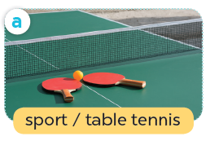
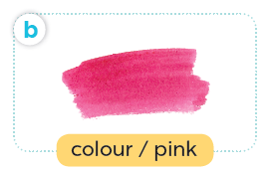
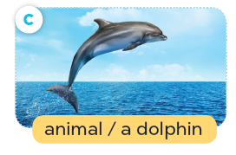
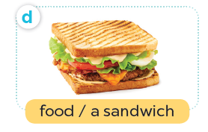
Listen, point and say.

Slide 12
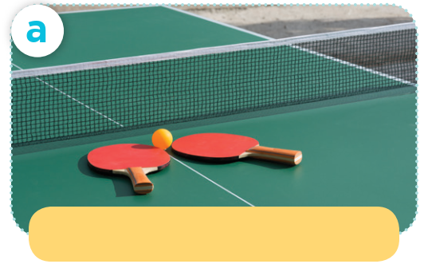
Listen, point and say.
sport / table tennis

Slide 13
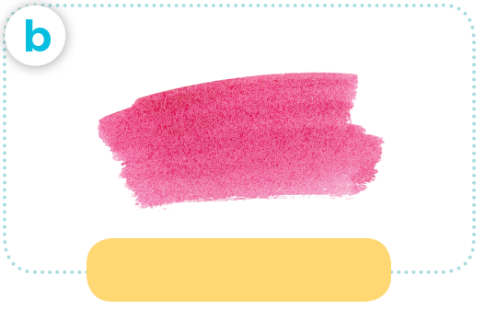
Listen, point and say.
colour / pink

Slide 14
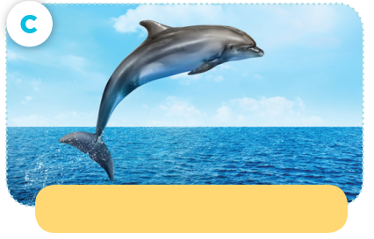
Listen, point and say.
animal / a dolphin

Slide 15
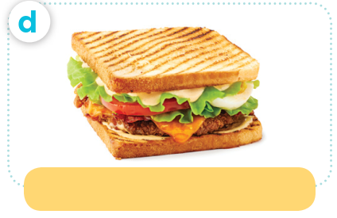
Listen, point and say.
food / a sandwich

Slide 16

What’s your favourite ____?
It’s ____.

Slide 17
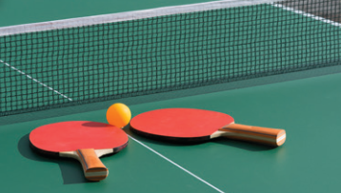
Listen, point and say.
What’s your favourite sport?
It’s table tennis.

Slide 18

Listen, point and say.
What’s your favourite colour?
It’s pink.

Slide 19
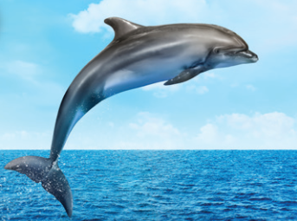
Listen, point and say.
What’s your favourite animal?
It’s a dolphin.

Slide 20
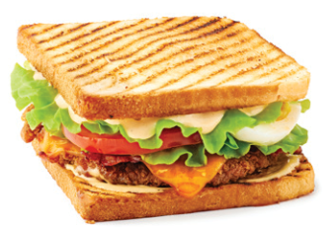
Listen, point and say.
What’s your favourite food?
It’s a sandwich.

Slide 21
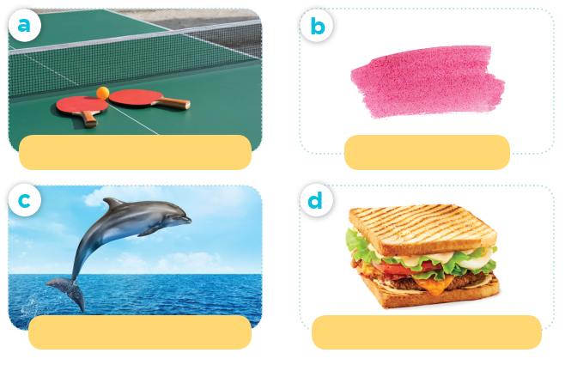
What’s your favourite ____?
sport / table tennis
colour / pink
It’s ____.
animal / a dolphin
food / a sandwich

Slide 22
04
Let’s talk.

Slide 23
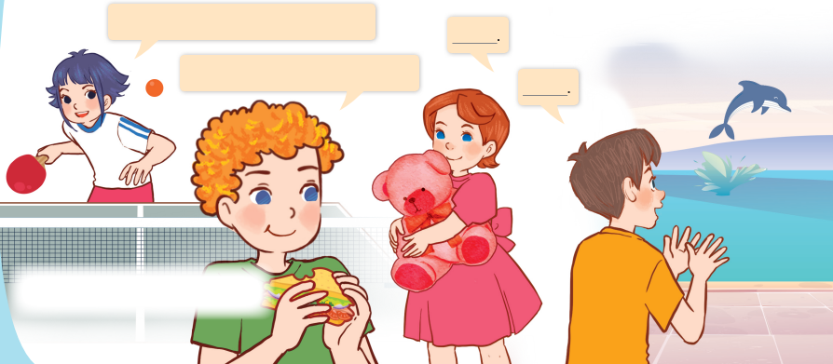
Let’s talk.
Can you tell me about yourself?
What’s your favourite ___?

Slide 24
Can you tell me about yourself?
It’s ____.
What’s your favourite ____?
____.

Slide 25
05
Fun corner and wrap-up

