Slide 1





Slide 2
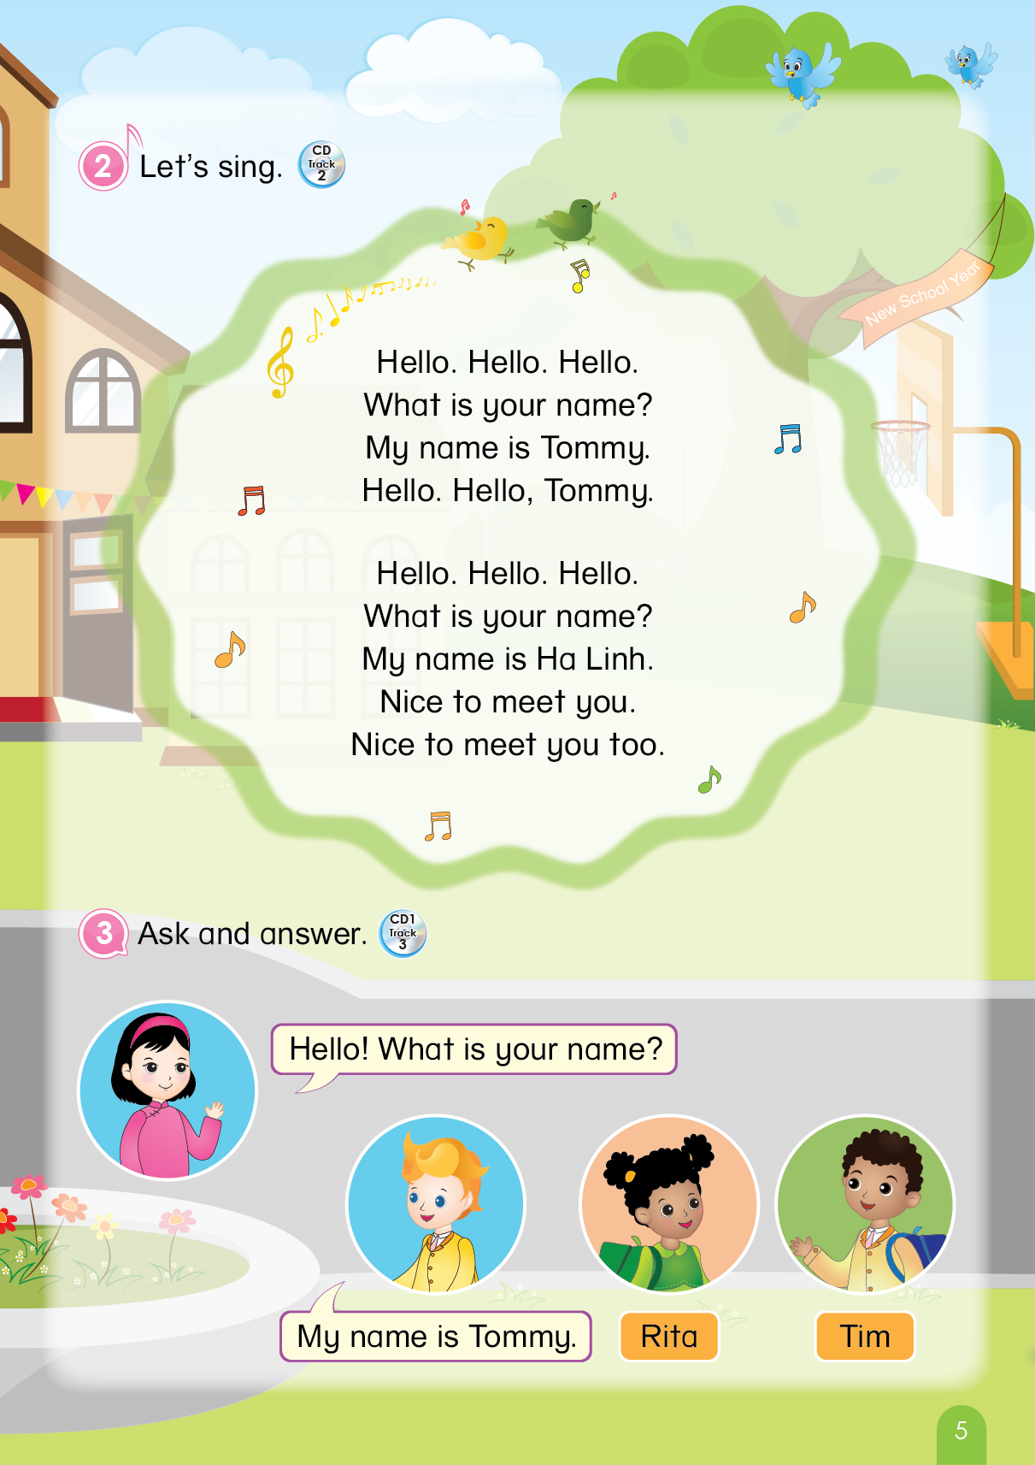

Notes:
T says “ Hello, everyone. How are you? How’s the weather? Is it sunny? Great! Now, let’s sing a song with me.”
Warm up: Sing “Hello song” – “Excellent! You sing very well.”
Divide class into 2 groups (optional) – “Today, we will have 2 groups – Group 1 and Group 2. You are Group 1, you are Group 2.”

Slide 3



Game: Guessing game
Notes:
Guessing game:
1. T says “Let’s play Guessing game.”
2. Sts work in groups
3. T asks sts “Group 1, what colour do you like?”
4. T clicks that colour and asks “What is it?”
5. T shows the picture and checks the answer (1 group/ one picture) – “Yeah, right.”
6. Group having a correct answer will get 1 flower. – “One flower for group 1”

Slide 4
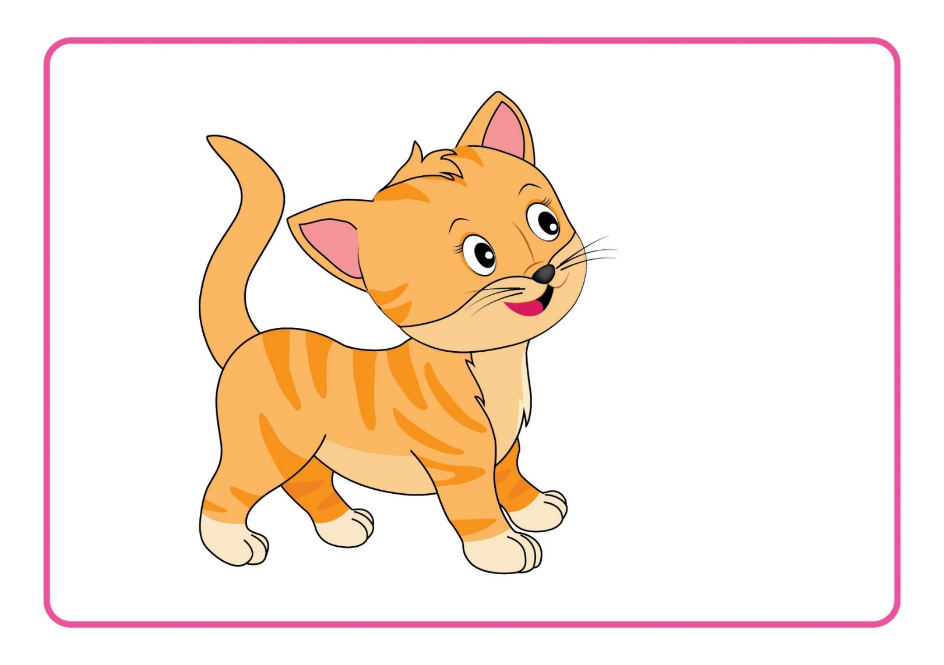
Game: Guessing game
Notes:
“Group 2, what colour do you like?”
“What is it?”
“Good job! One flower for group 2.”

Slide 5

Game: Guessing gamec
Notes:
“Group 1, what colour do you like?”
“What is it?”
“Great! One flower for group 1.”

Slide 6
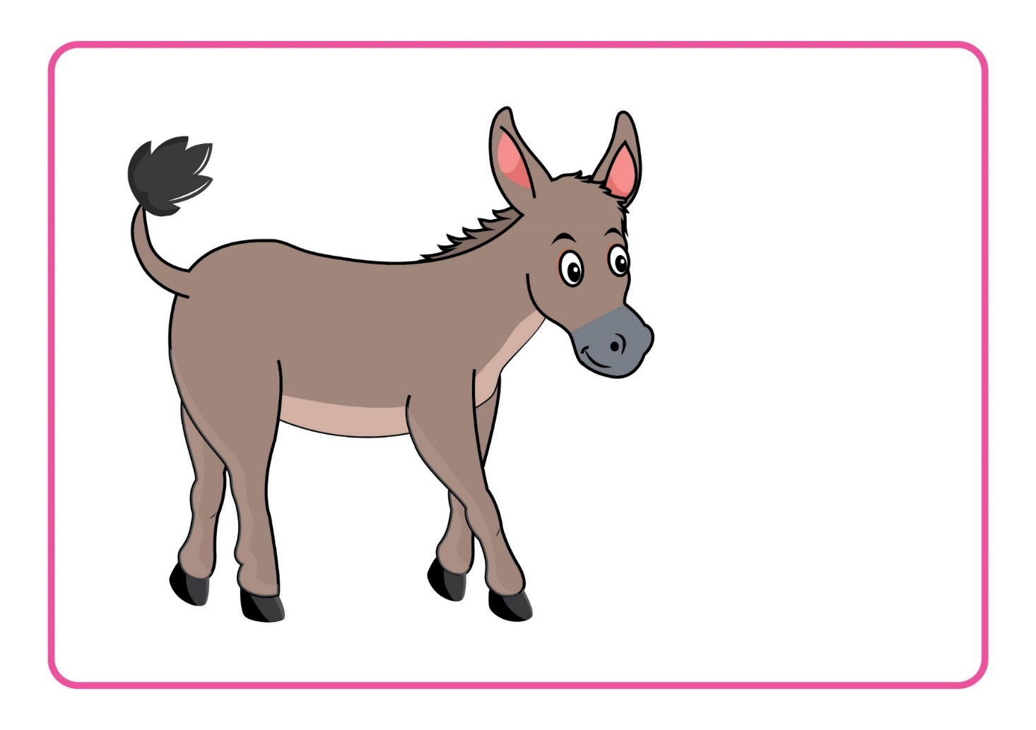
Game: Guessing gamec
Notes:
“Group 2, what colour do you like?”
“What is it?”
“Right! One flower for group 1.”

Slide 7

Notes:
T says “Good job, everyone!”

Slide 8

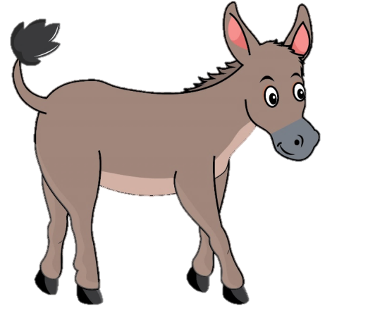

Unit 4
Lesson 4
Notes:
Introduce new lesson “Now, class! look at the picture and tell me what it is.”
T points at the pictures of duck and donkey and asks “What is it?”
T says “Great! Today, we will learn Unit 4 – Lesson 4. We will meet two new friends. Who are they? Now, look and listen.”

Slide 9
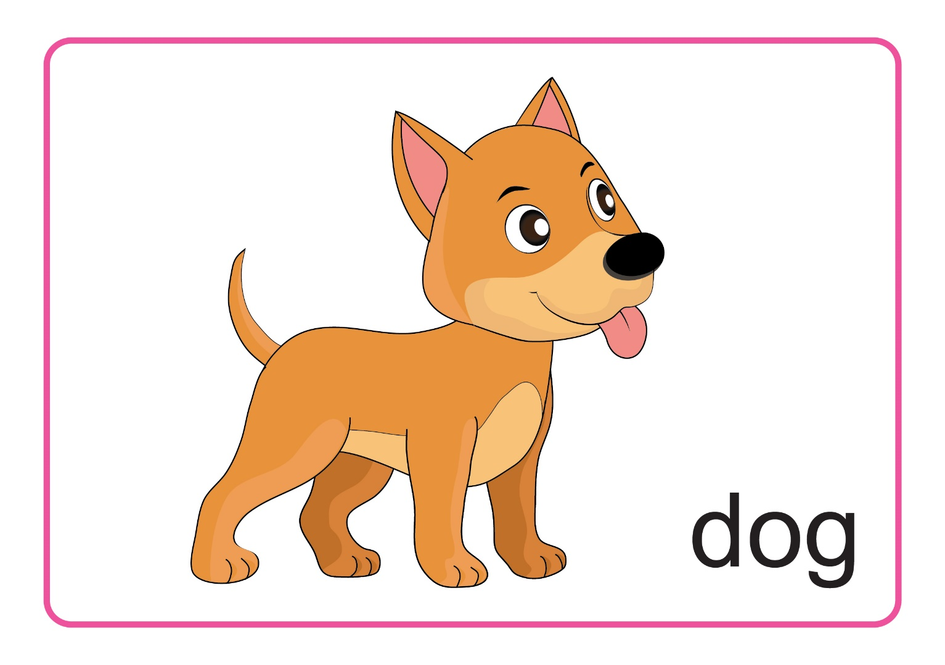
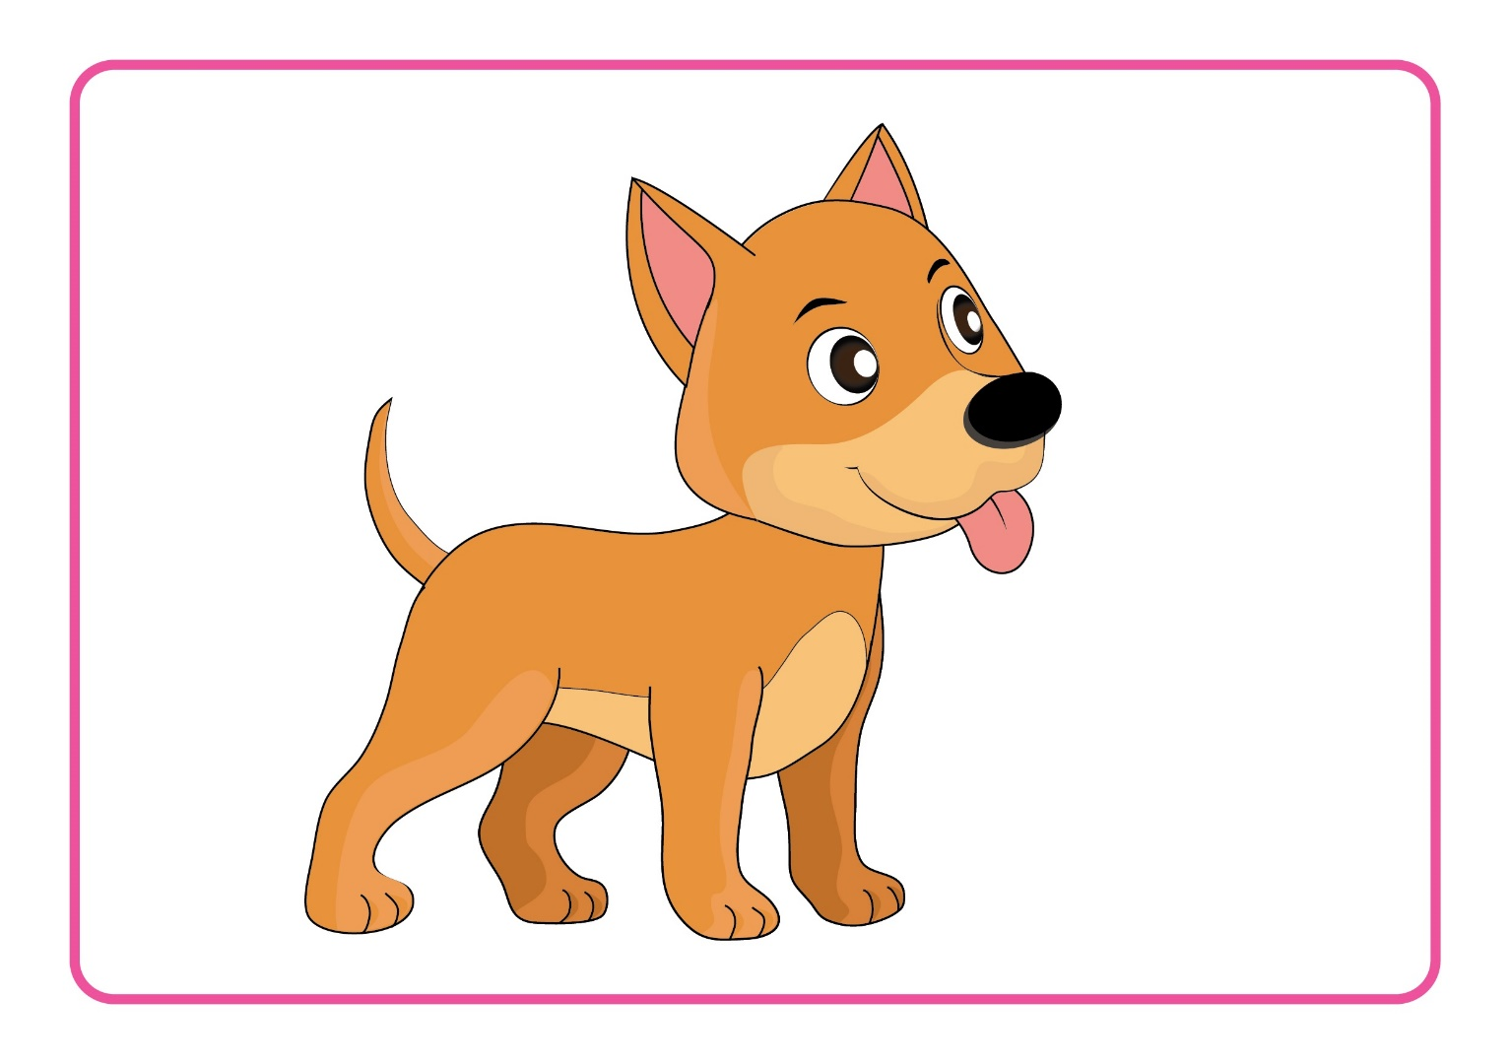
Lesson 4:
D d
1. Listen and repeat.
Notes:
Introduce picture “Class, what is it? OK! Now, listen 3 times”
Ask sts to listen 3 times
Ask sts to listen and repeat (class, group, individual) – “Listen and repeat. Class! Group 1, please! Group 2, please! You, you and you!
T can use body language (or sound) to describe the word – “Look at me and listen. Dog! Class, what is it? Good!”
Click to make the word “dog” disappear – Ask “What is it?”
T can use body language or sound to check sts’ understanding
“Look and tell me what it is./Listen and tell me what it is.

Slide 10

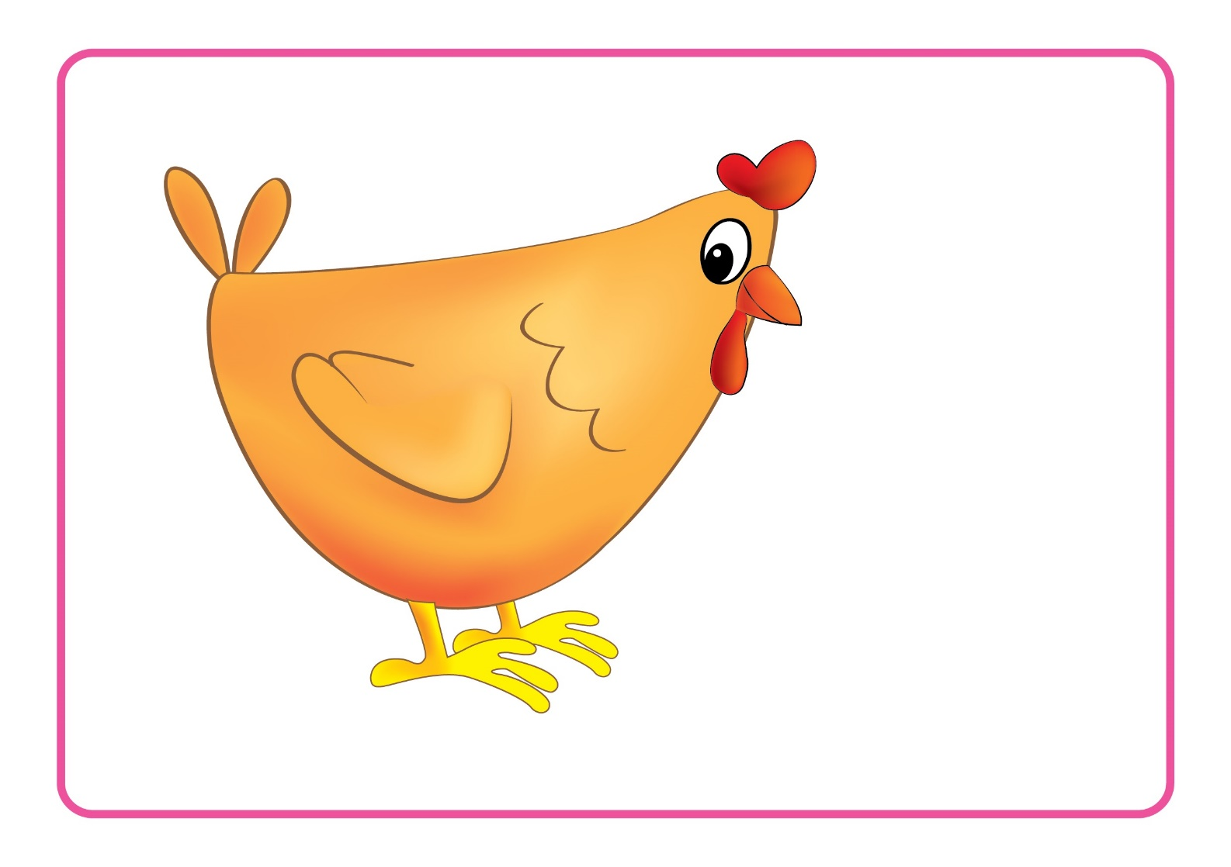
Unit 4:
Lesson 4:
D d
1. Listen and repeat.
Notes:
Introduce picture “Class, what is it? OK! Now, listen 3 times”
Ask sts to listen 3 times
Ask sts to listen and repeat (class, group, individual) – “Listen and repeat. Class! Group 1, please! Group 2, please! You, you and you!
T can use body language (or sound) to describe the word – “Look at me and listen. Chicken! Class, what is it? Good!”
Click to make the word “chicken” disappear – Ask “What is it?”
T can use body language or sound to check sts’ understanding
“Look and tell me what it is./Listen and tell me what it is.

Slide 11
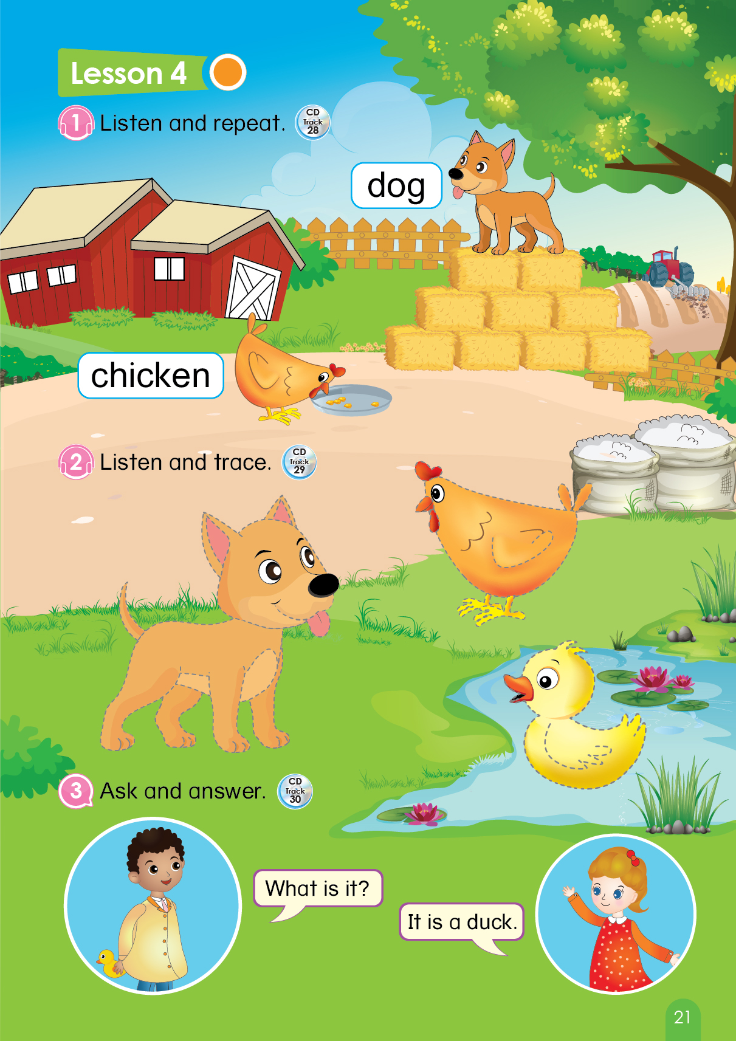
Page 21
Notes:
Book using – Look, point and say
1. T says “Class, open your book page 21. Let’s look, point and tell me what it is.”
2. T points at the picture and asks “What is it?”
3. T gives 1 flower to each group – “Great! One flower for each group.”

Slide 12


Unit 4:
Lesson 4:
D d
1. Listen and repeat.
Game
What’s missing?
Notes:
Game: What’s missing?
T says “Let’s play game with me.”

Slide 13
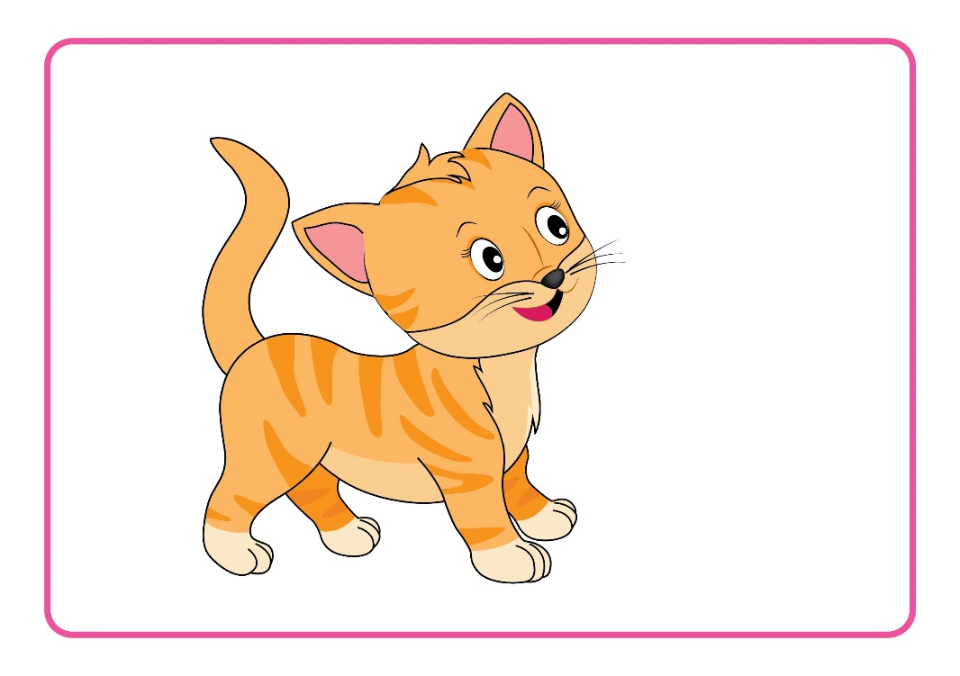

Unit 4:
Lesson 4:
D d
Game
What’s missing?
Notes:
T points at the pictures and asks “Class, what is it?”
Click to make the picture disappear and ask “What’s missing?”
Click again to make the picture appear and check the answer. – “Right!”

Slide 14


Unit 4:
D d
Game
What’s missing?
Notes:
T points at the pictures and asks “Next, what is it?”
Click to make the picture disappear and ask “What’s missing?”
Click again to make the picture appear and check the answer. – “Great!”

Slide 15



Unit 4:
Lesson 4:
D d
Game
What’s missing?
Notes:
T points at the pictures and says “Now, we have 3 pictures. Class, what is it?”
Click to make the picture disappear and ask “What’s missing?”
Click again to make the picture appear and check the answer. – “Great!”

Slide 16


Unit 4:
Lesson 4:
D d
Game
What’s missing?
Notes:
T points at the pictures and says “Now, we have 4 pictures. It’s harder. Are you ready? Class, what is it?”
Click to make the picture disappear and ask “What’s missing?”
Click again to make the picture appear and check the answer. – “Great!”

Slide 17

Notes:
“Excellent! One flower for each group.”

Slide 18



Unit 4:
Lesson 4:
D d
1. Listen and repeat.
2. Listen and trace.
Notes:
T says “Now, class! Look at the picture and tell me what it is.”
T says “Now, let’s open your book page 21, listen and trace.”

Slide 19

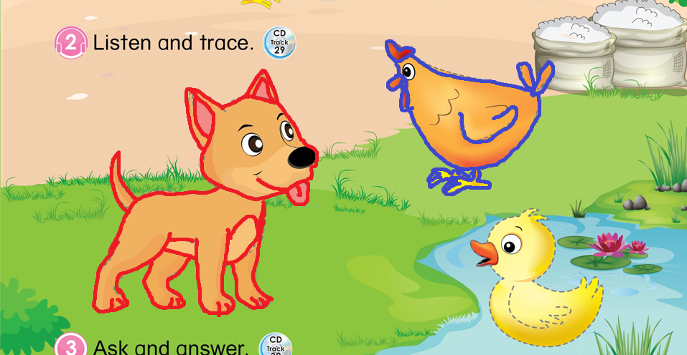
Unit 4:
Lesson 4:
D d
2. Listen and trace.
Page 21
Notes:
1. Ask sts to listen 2 times and trace the pictures – “Now, listen 2 time and trace the pictures.”
2. Ask sts to listen again and check the answer. – “Now, listen and check your answer. Number 1, we trace the dog? Yes! Number 2, we trace the chicken? Good!”
3. Give 1 flower to each group. – “You are so good. I will give you one flower.”

Slide 20
Unit 4:
Lesson 4:
D d
1. Listen and repeat.
2. Listen and trace.
3. Ask and answer.
Notes:
1. T says “Let’s move to next part – Ask and answer”

Slide 21

Unit 4:
Lesson 4:
D d
3. Ask and answer.
Notes:
Ask sts to listen 2 times. – “Now, listen 2 times.”
Ask sts to listen and repeat. – “Now, listen and repeat.”

Slide 22



Unit 4:
Lesson 4:
D d
3. Ask and answer.
Notes:
T asks sts to look the pictures and practice (Teacher-Students, Group-Group, Pairs)
“ Look at the pictures, I will ask and you answer.”
“ Look at the pictures, Group 1 will ask and Group 2 will answer.”
“Let’s practice with your pair.”
T call some pairs practice the dialog. – “I will call some pairs. You, please! Now, you will ask and you will answer.”
“Well done, class!”

Slide 23


Unit 4:
Lesson 4:
D d
1. Listen and repeat.
2. Listen and trace.
3. Ask and answer.
Notes:
Sum up – Ask “Look at these pictures again, what is it? Good!”
Count the flowers of each groups – “Let’s count your flowers.”
Group having more flowers will be the winner. – “So the winner is group …. Group …, you also good, too.”
Say goodbye “ Now, let’s say ‘Goodbye chicken, Goodbye dog’. Now, goodbye class.”

