Slide 1






















Unit 8
My Town
Lesson 3 – Task 1,2,3

Slide 2










1 Warm up

Slide 3


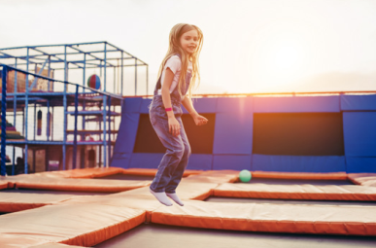
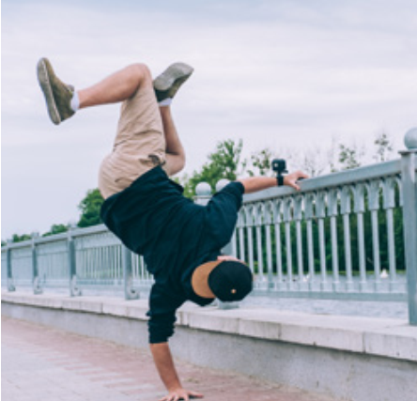
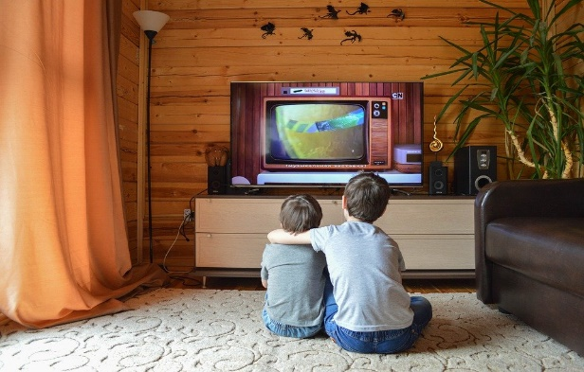

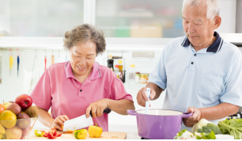
Word search game
b | c | f | g | r | s | c
l | w | d | y | q | p | o
i | e | a | c | d | b | o
s | s | n | t | b | c | k
t | u | c | w | c | r | o
e | r | e | a | d | h | n
n | g | h | j | u | m | p
1
4
c
2
5
3
6
Notes:
Prepare a table that contains a lot of letters:
-Ask Ss to find words (watch , cook, dance, listen, jump, read)
-Students focus on the table and quick look and raise the hand when finding the word.

Slide 4
2 Presentation

Slide 5


Vocabulary
Notes:
-Teacher shows pictures to teach vocab.

Slide 6
drink

Slide 7
eat

Slide 8
have fun

Slide 9
look at

Slide 10
see

Slide 11
take photos

Slide 12
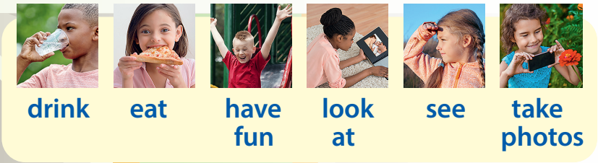
Task 1. Listen and point. Repeat.

Slide 13


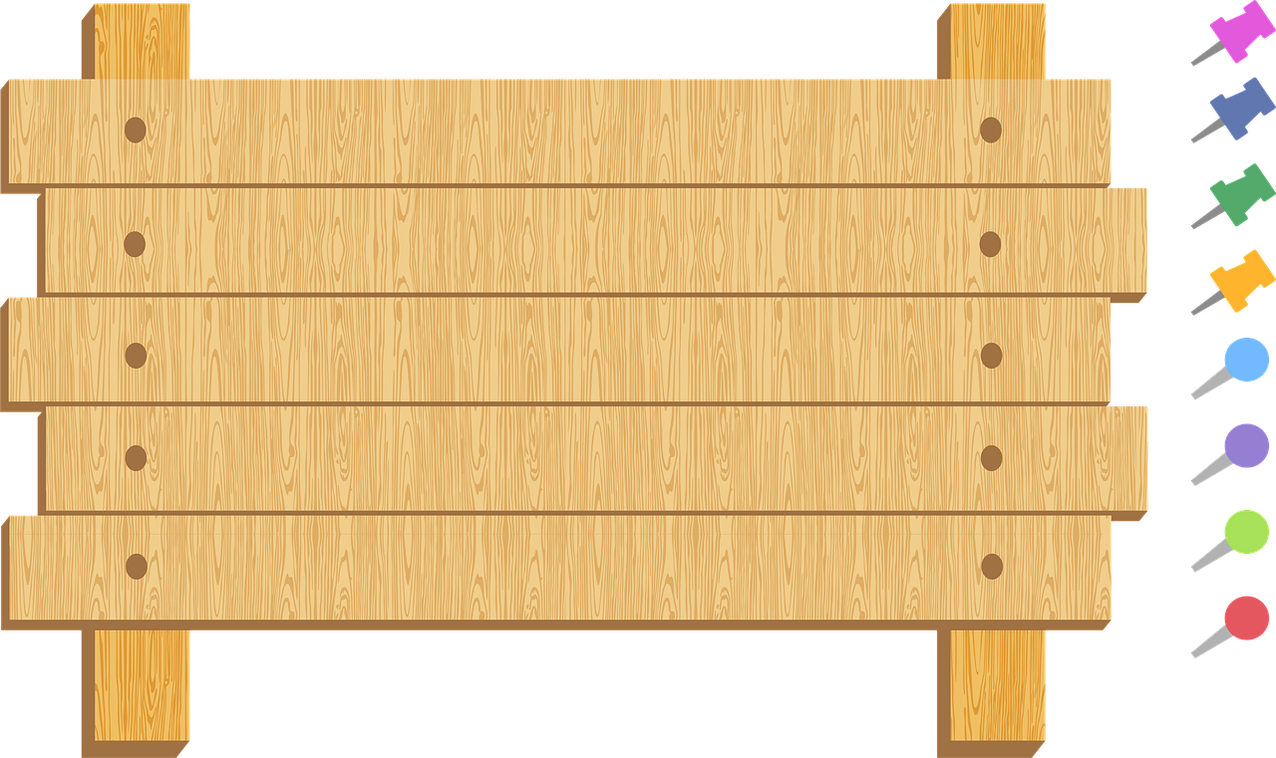

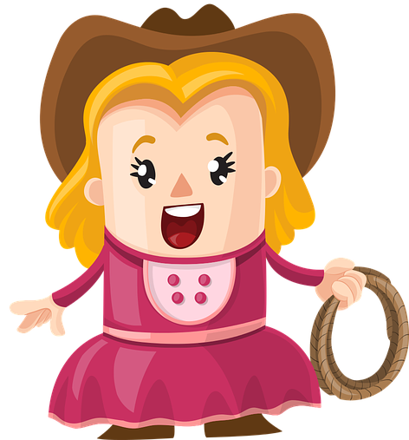
COWBOY GAME
Notes:
+ Invite two Ss go to the board and back to back
+ Those two Ss will choose one picture ( keep secret )
+ T counts one,two three they will turn their back and read the opponent’s picture.
₋Who is faster will be the winner.

Slide 14
3 Practice

Slide 15



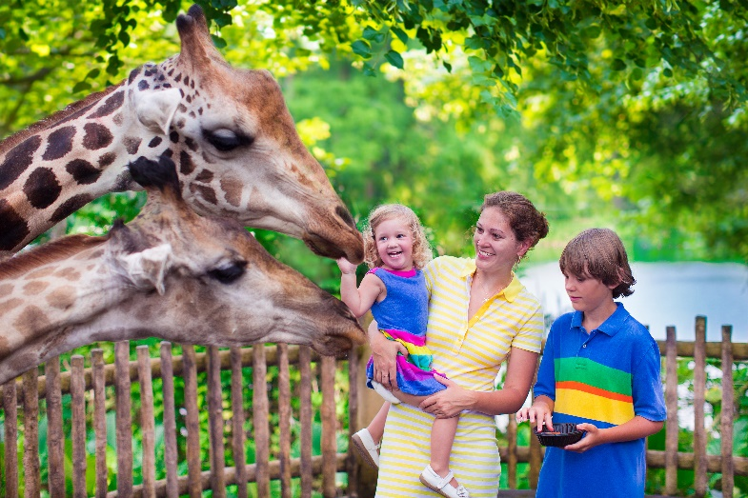
Task 2. Listen and match.
Notes:
T lets Ss guess and talk about the pictures (where they are, what we can do at these places)

Slide 16

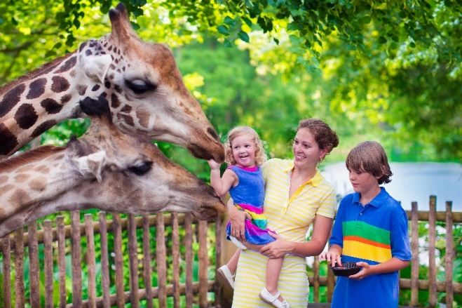

Let’s have a city tour.
Let’s go to the park!
We can have fun.
Let’s go to the museum!
We can look at old paintings.
Let’s go to the zoo!
We can take photos of the monkeys.

Slide 17

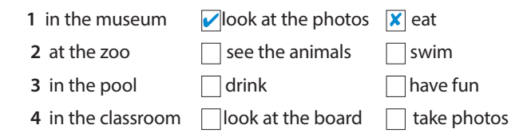
Task 3. Ask and answer. Then tick or cross.
May I look at the photos in the museum?
Yes, you can.
May I eat in the museum?
No, you can’t.
✓
x
x
✓
✓
x

Slide 18
4 Production
Draw and say

Slide 19



Place | Yes | No
Museum | Take photo | Eat
May I eat in the museum?
No, you can’t.

Slide 20
5 Assessment

Slide 21

have fun
take photos
see
drink
eat
1 May I _________ water?
Yes, you can.
2 We can _________ in the park.
We can _________ the animals at the zoo.
May I _________ in the museum?
No, you can’t.
We can __________ at the zoo.
Notes:
HOẠT ĐỘNG TƯƠNG TÁC

Slide 22




Thank you & goodbye!

