Slide 1



Slide 2


Warm - up
Game: Crazy claps
Notes:
When T puts his hands up – Ss clap quickly and loudly.
When T puts his hands down – Ss clap slowly and quietly.
When T says and does action of STOP – who has one more clap will loose.

Slide 3
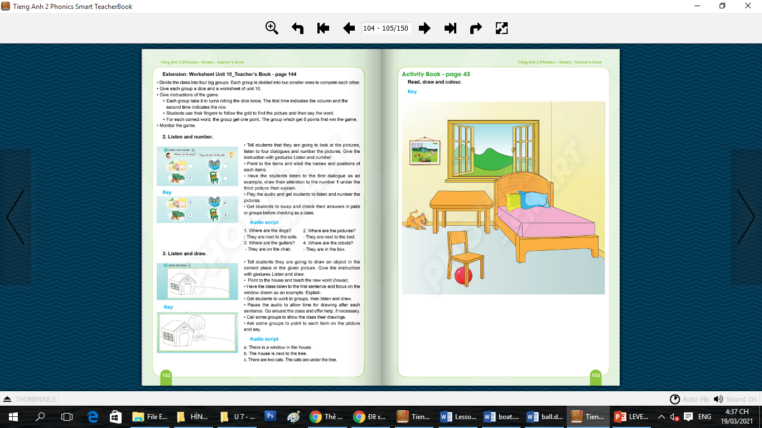
Unit 10: Lesson 4 Ww
Notes:
- Giáo viên hỏi học sinh nhìn thấy những gì trong tranh để dẫn dắt vào bài học.

Slide 4

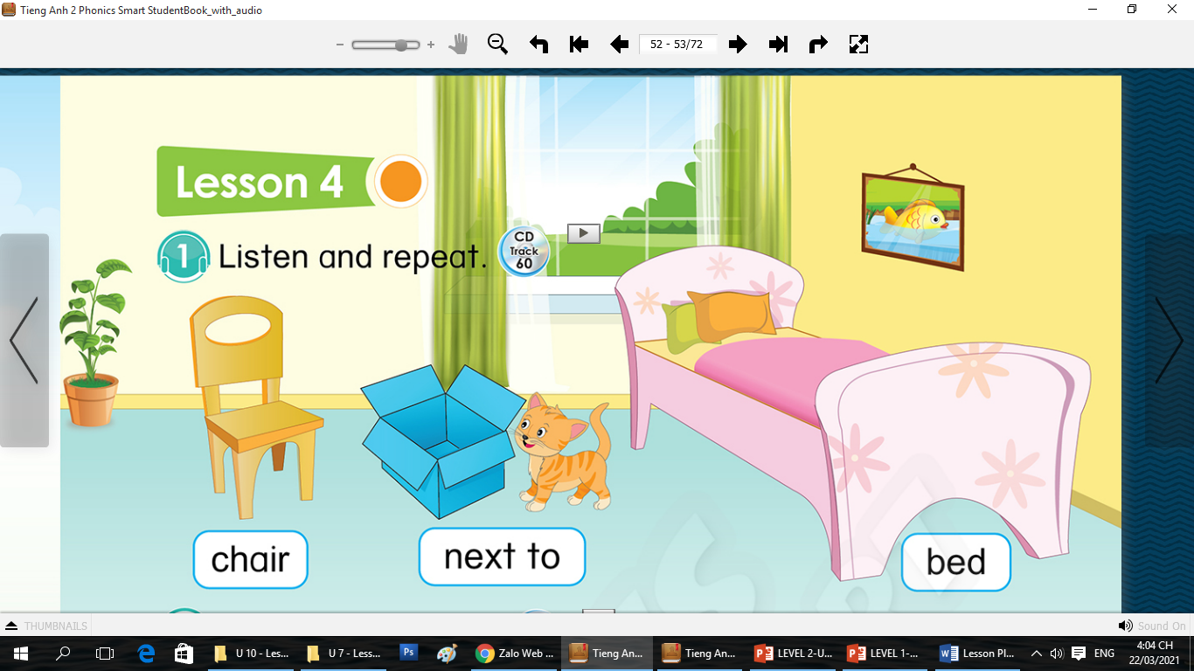

Unit 10: Lesson 4 Ww
51
Notes:
- Giáo viên hỏi học sinh nhìn thấy những gì trong tranh để dẫn dắt vào bài học.

Slide 5
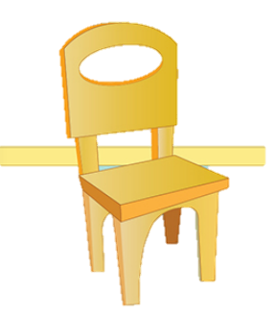

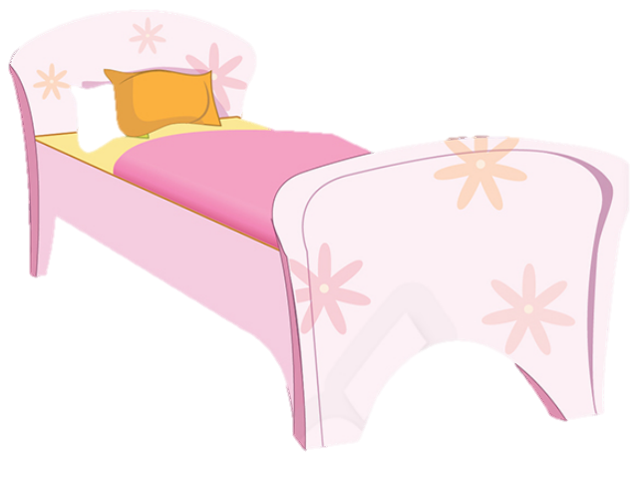
Unit 10: Lesson 4 Ww
1. Listen and repeat.
chair
next to
bed

Slide 6
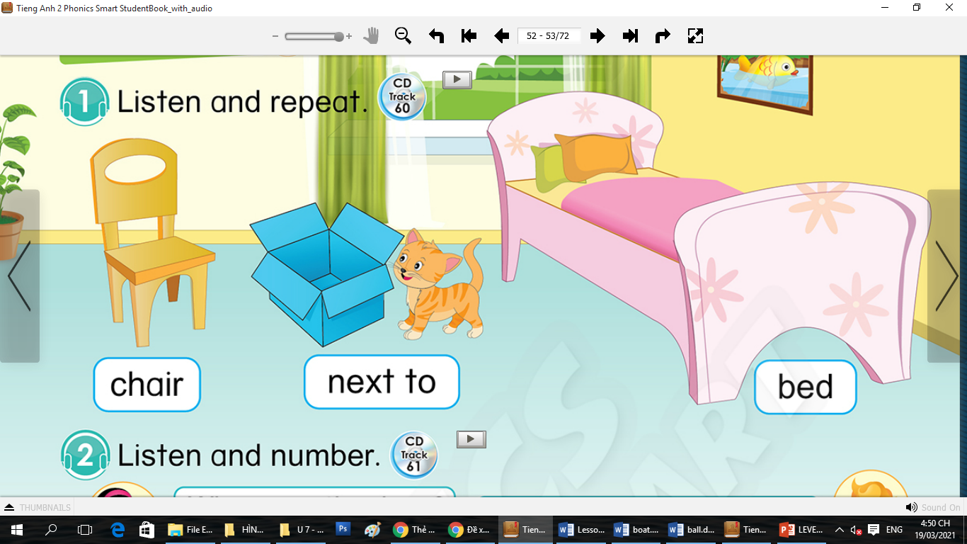
Unit 10: Lesson 4 Ww
1. Listen and repeat.
51
Notes:
Hướng dẫn HS sử dụng sách: nghe, chỉ tay vào sách và nhắc lại

Slide 7



Unit 10: Lesson 4 Ww
What's this?
Notes:
Hoạt động hỗ trợ. GV ôn lại các từ trước khi bắt đầu vào hoạt động. Mỗi slide sẽ có 2 từ được đổi chỗ cho nhau. HS cần tìm 2 từ bị sai này.

Slide 8
Unit 10: Lesson 4 Ww
What's wrong?
table
bed
behind

Slide 9
Unit 10: Lesson 4 Ww
What's wrong?
table
bed
chair
next to
behind

Slide 10
Unit 10: Lesson 4 Ww
What's wrong?
bed
chair
next to

Slide 11
Unit 10: Lesson 4 Ww
What's wrong?
chair
bed
bed
chair
next to

Slide 12
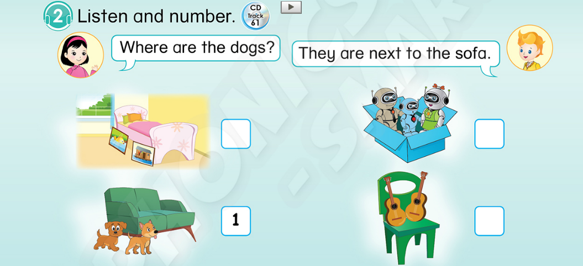
Unit 10: Lesson 4 Ww
1. Listen and repeat.
51
2. Listen and number.

Slide 13


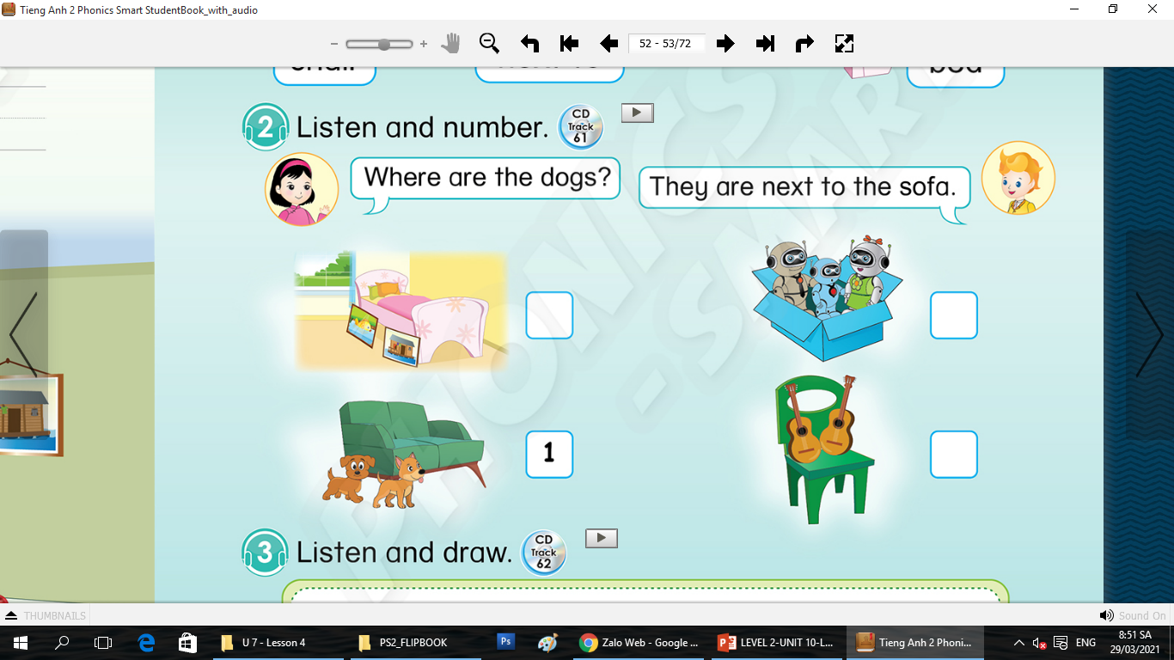
Unit 10: Lesson 4 Ww
2. Listen and number.
51
Where are the dogs?
They are next to the sofa
1

Slide 14
Unit 10: Lesson 4 Ww
2. Listen and number.
51
Where are the pictures?
They are next to the bed
2

Slide 15
Unit 10: Lesson 4 Ww
2. Listen and number.
51
Where are the guitars?
They are on the chair
3

Slide 16
Unit 10: Lesson 4 Ww
2. Listen and number.
51
Where are the robots?
They are in the box
4

Slide 17
Unit 10: Lesson 4 Ww
2. Listen and number.
51
2
4
3

Slide 18
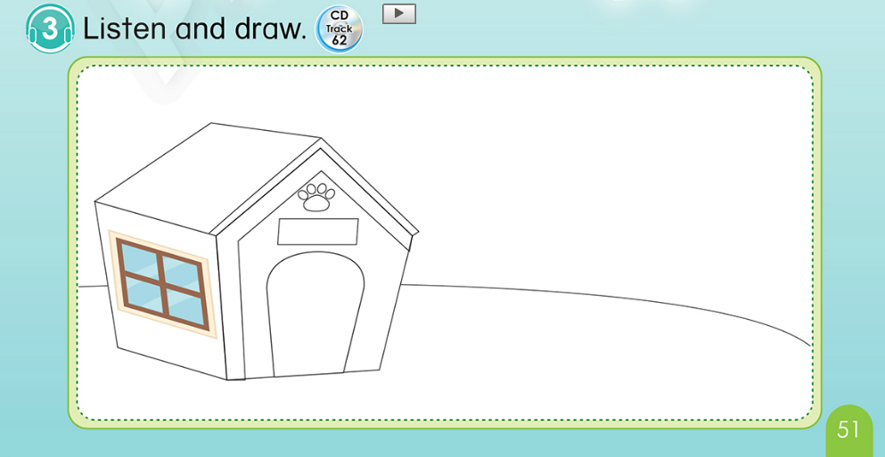
Unit 10: Lesson 4 Ww
1. Listen and repeat.
2. Listen and number.
51
3. Listen and draw.

Slide 19
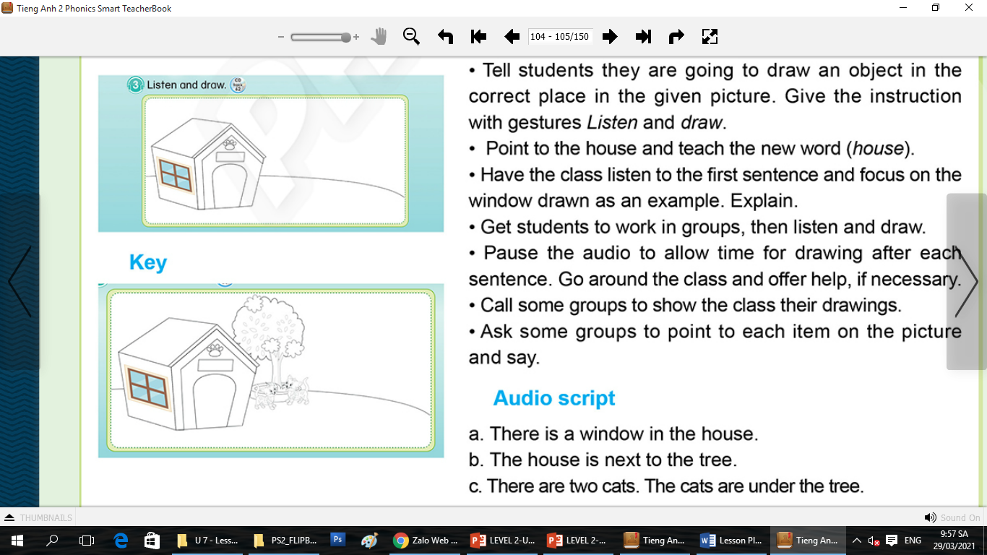
Unit 10: Lesson 4 Ww
3. Listen and draw.
There is a window in the house.
The house is next to the tree.
There are two cats. The cats is under the tree

Slide 20
Unit 10:
Lesson 4
3. Listen and draw.
51

