Slide 1











TOY SHOP
Notes:
Toy shop

Slide 2



CINEMA
Notes:
cinema

Slide 3



Tower
Buildings
Notes:
Building , tower

Slide 4
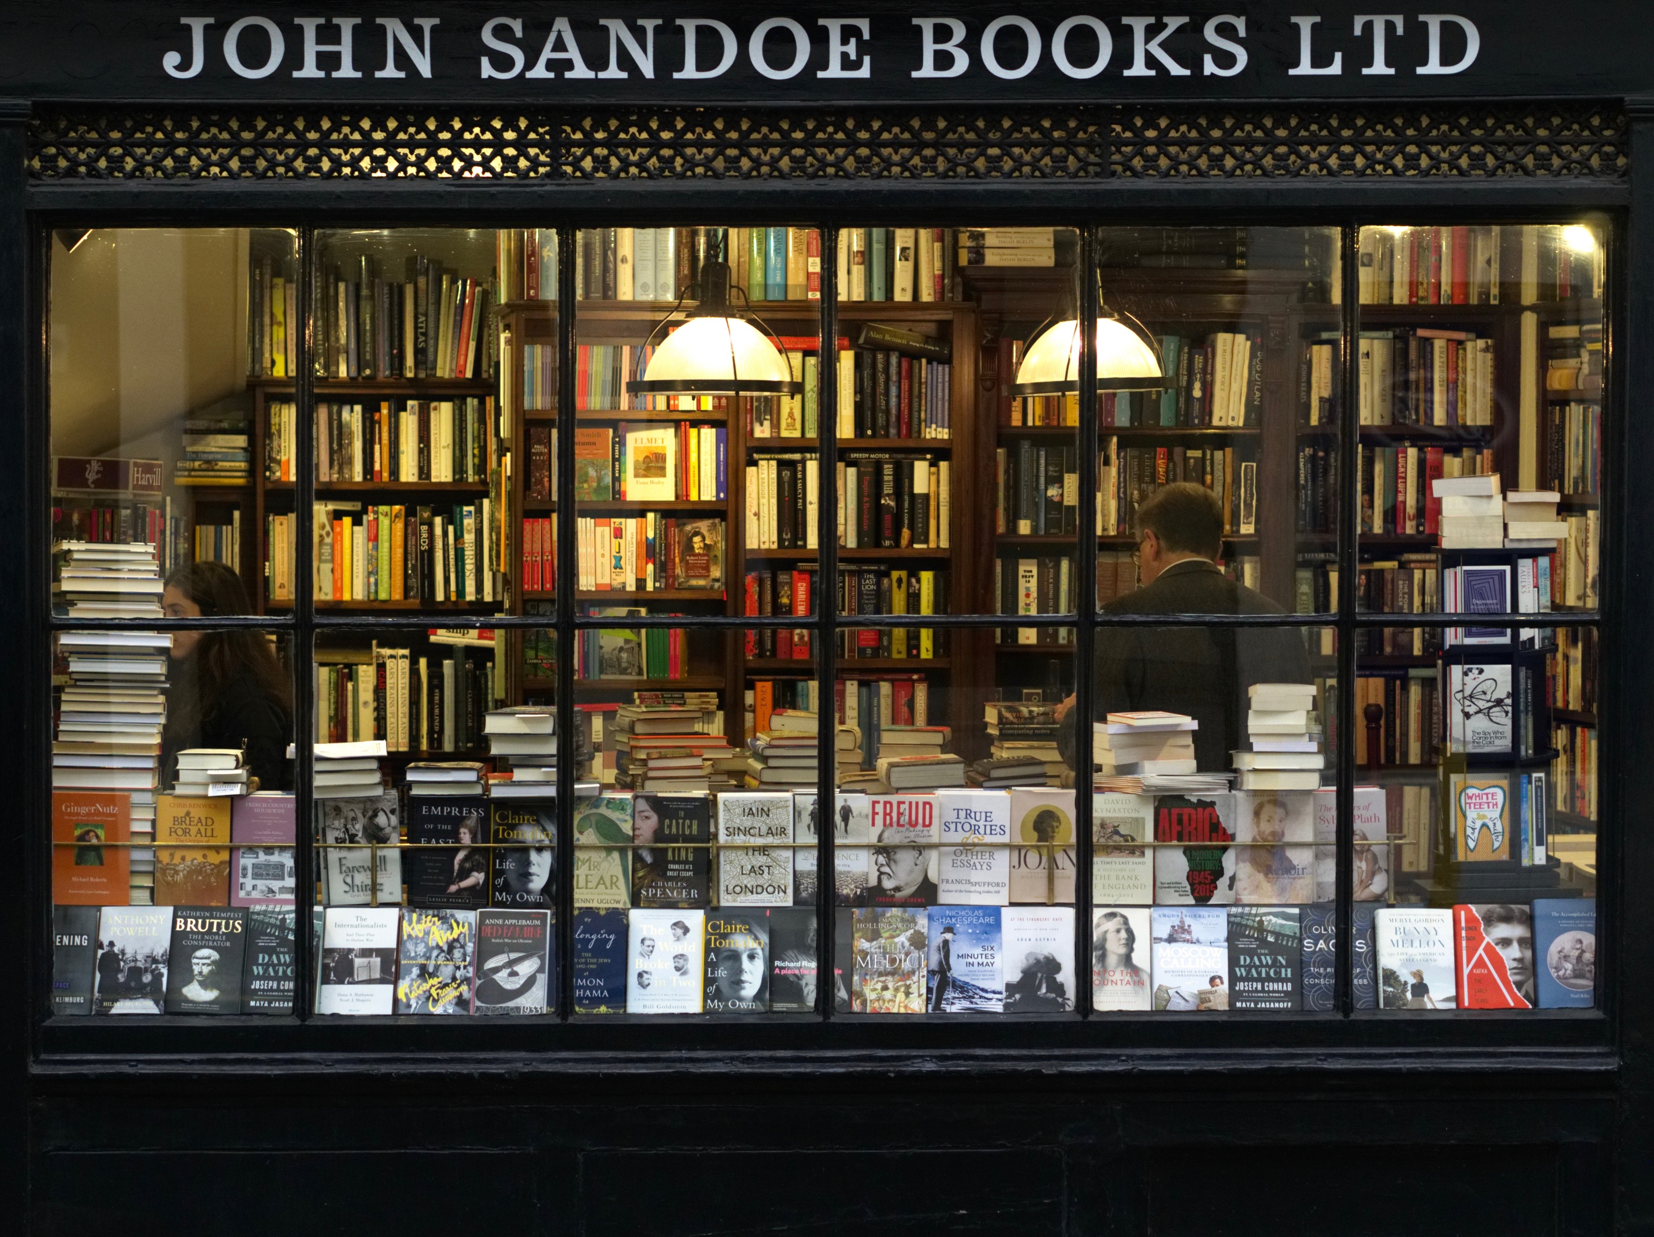
bookshop
Notes:
Nhấn vào khung chữ để nghe lại từ .

Slide 5
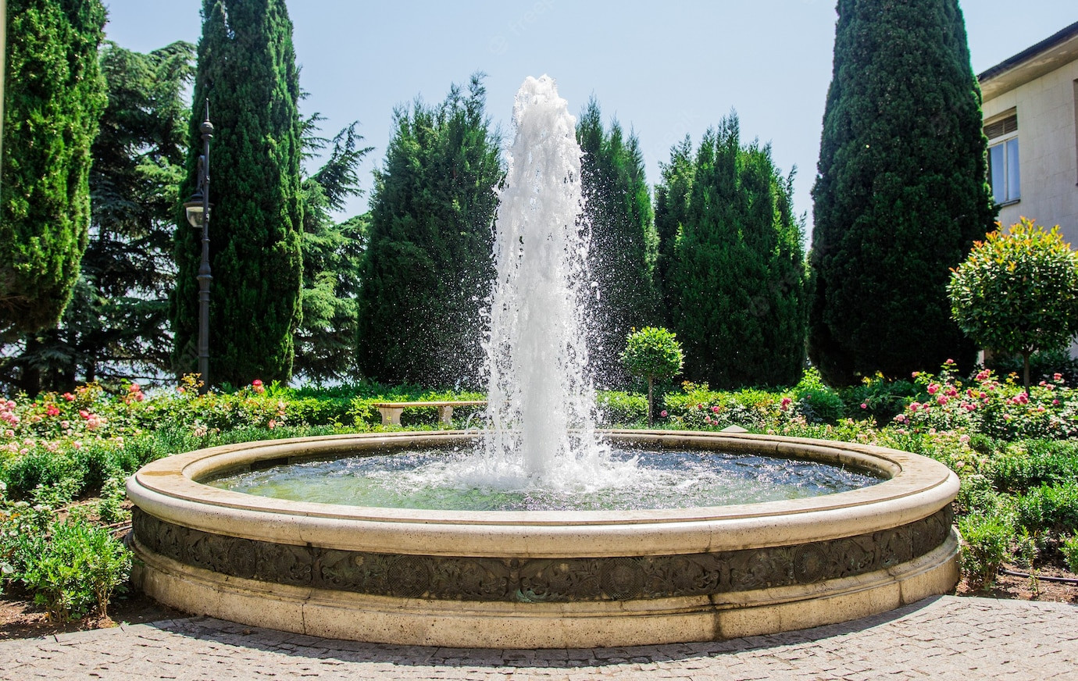

fountain

Slide 6
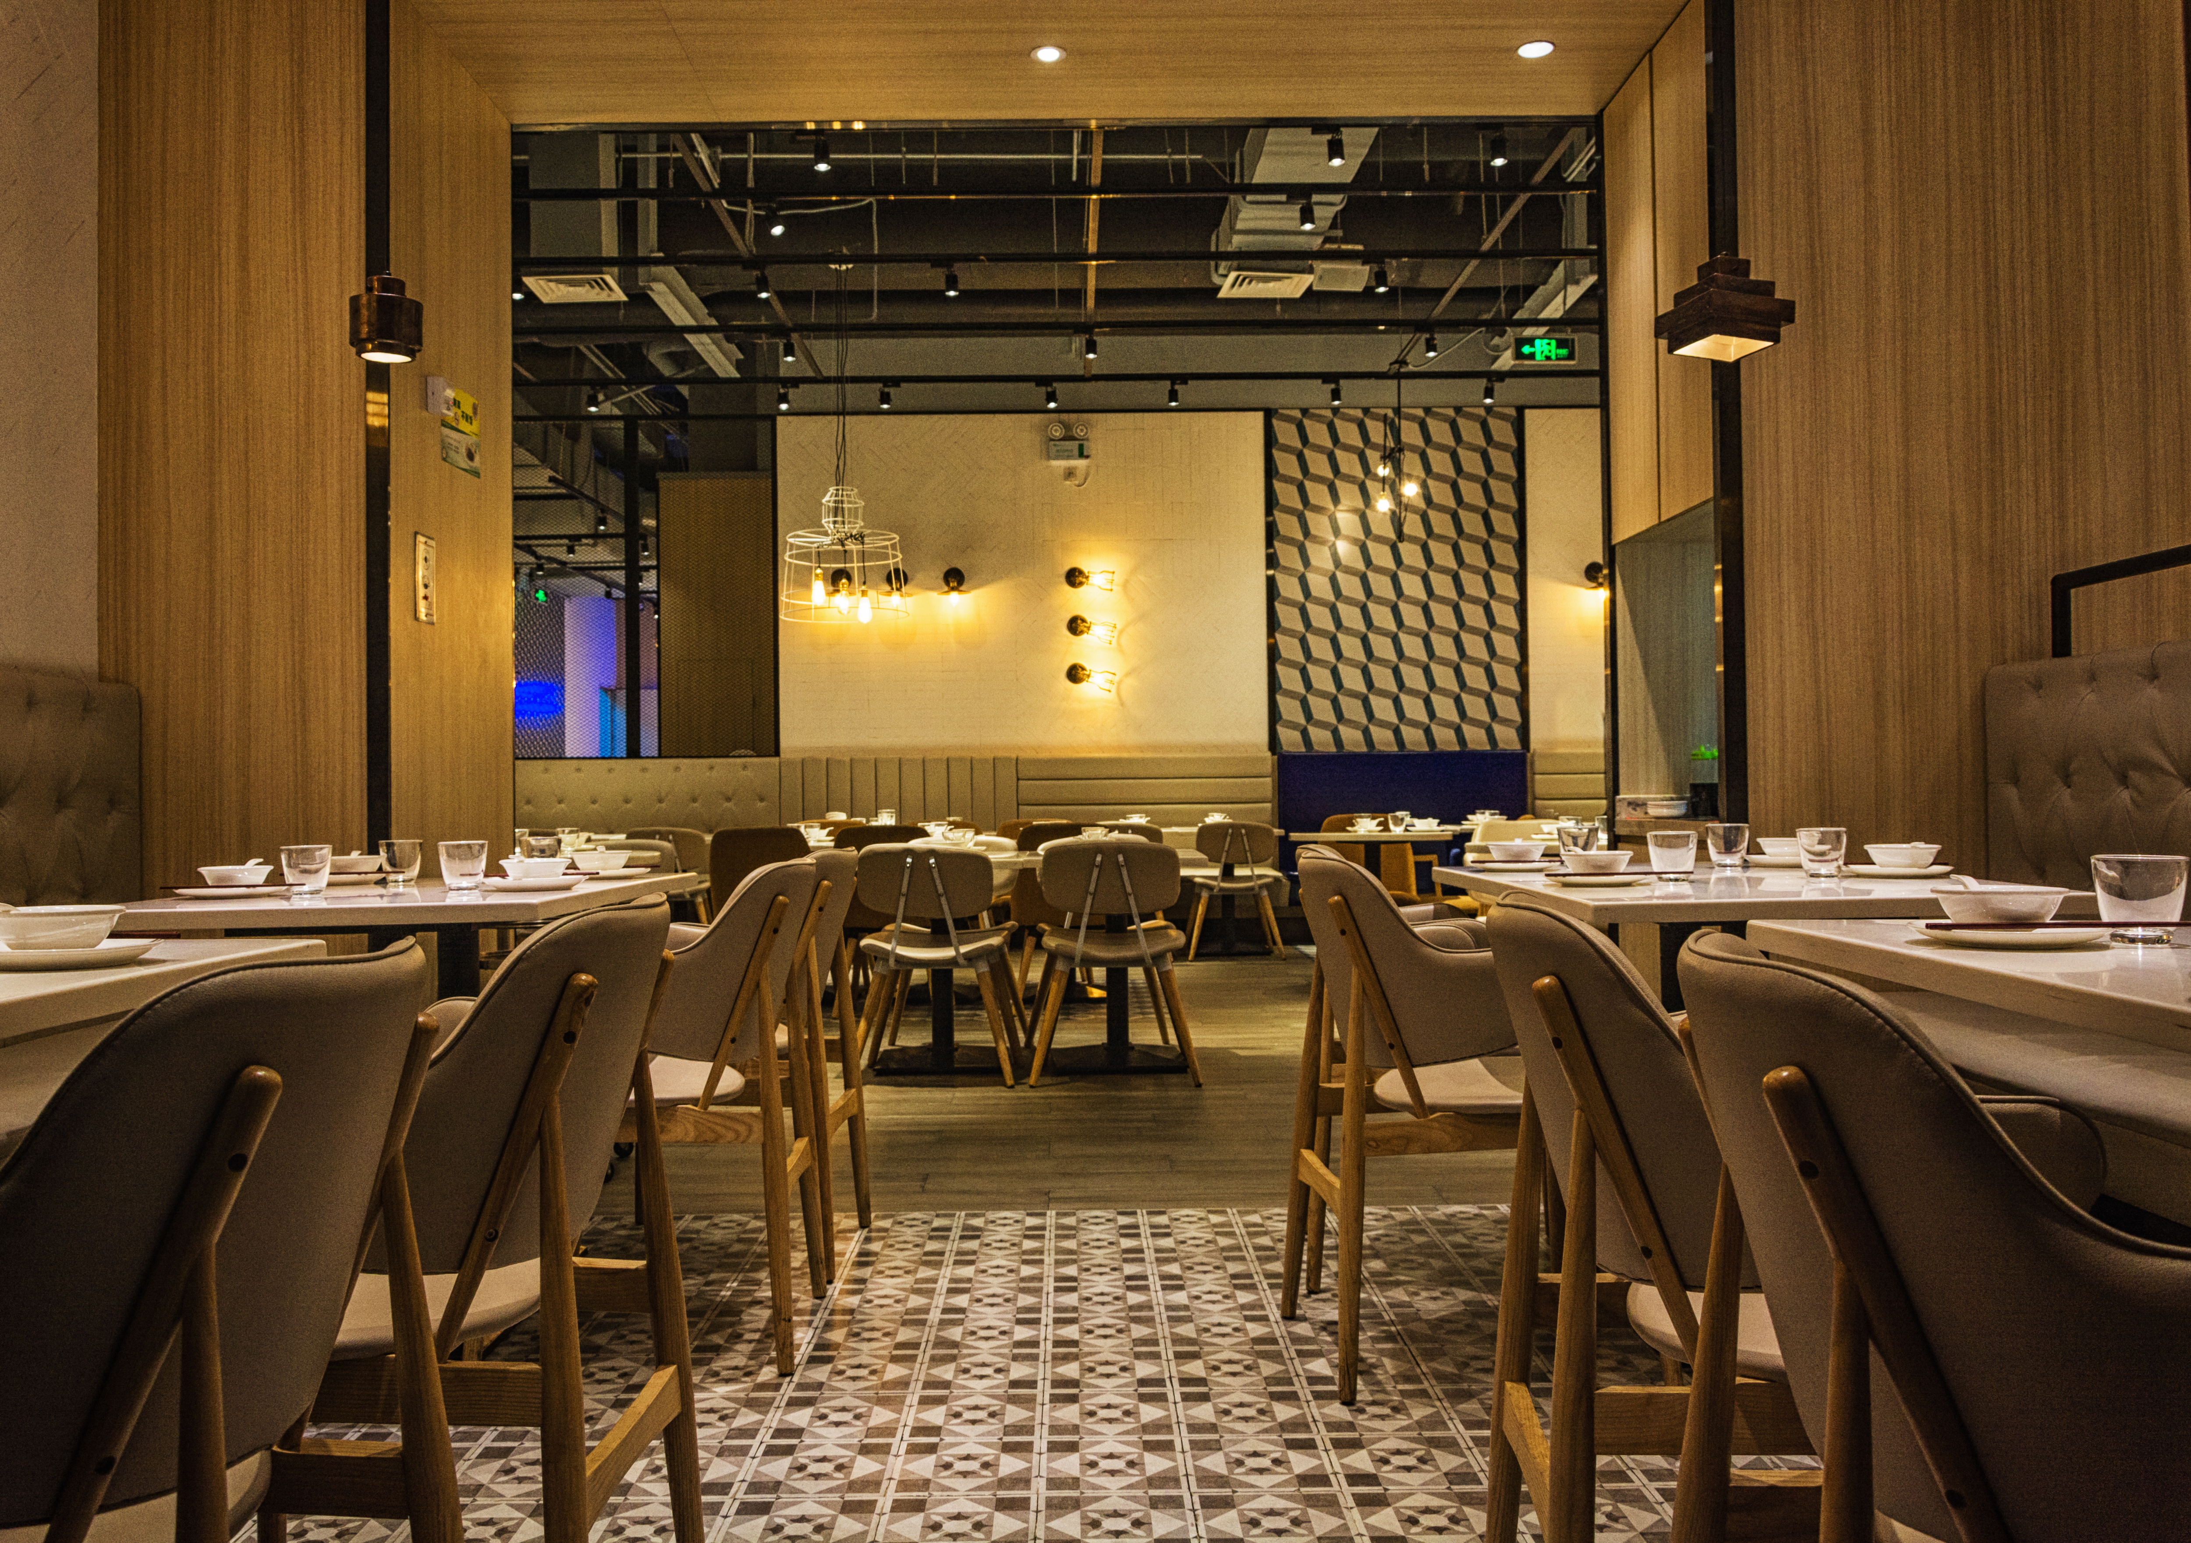
restaurant

Slide 7




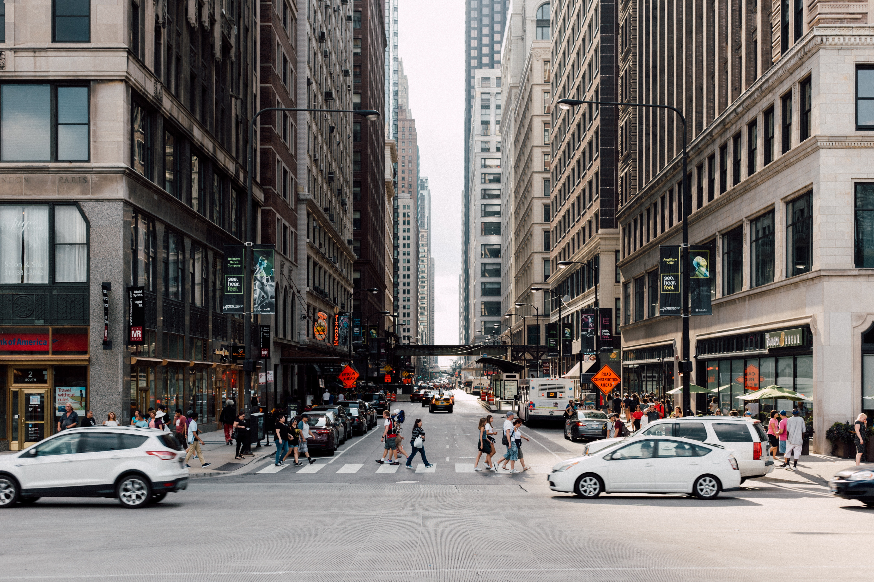
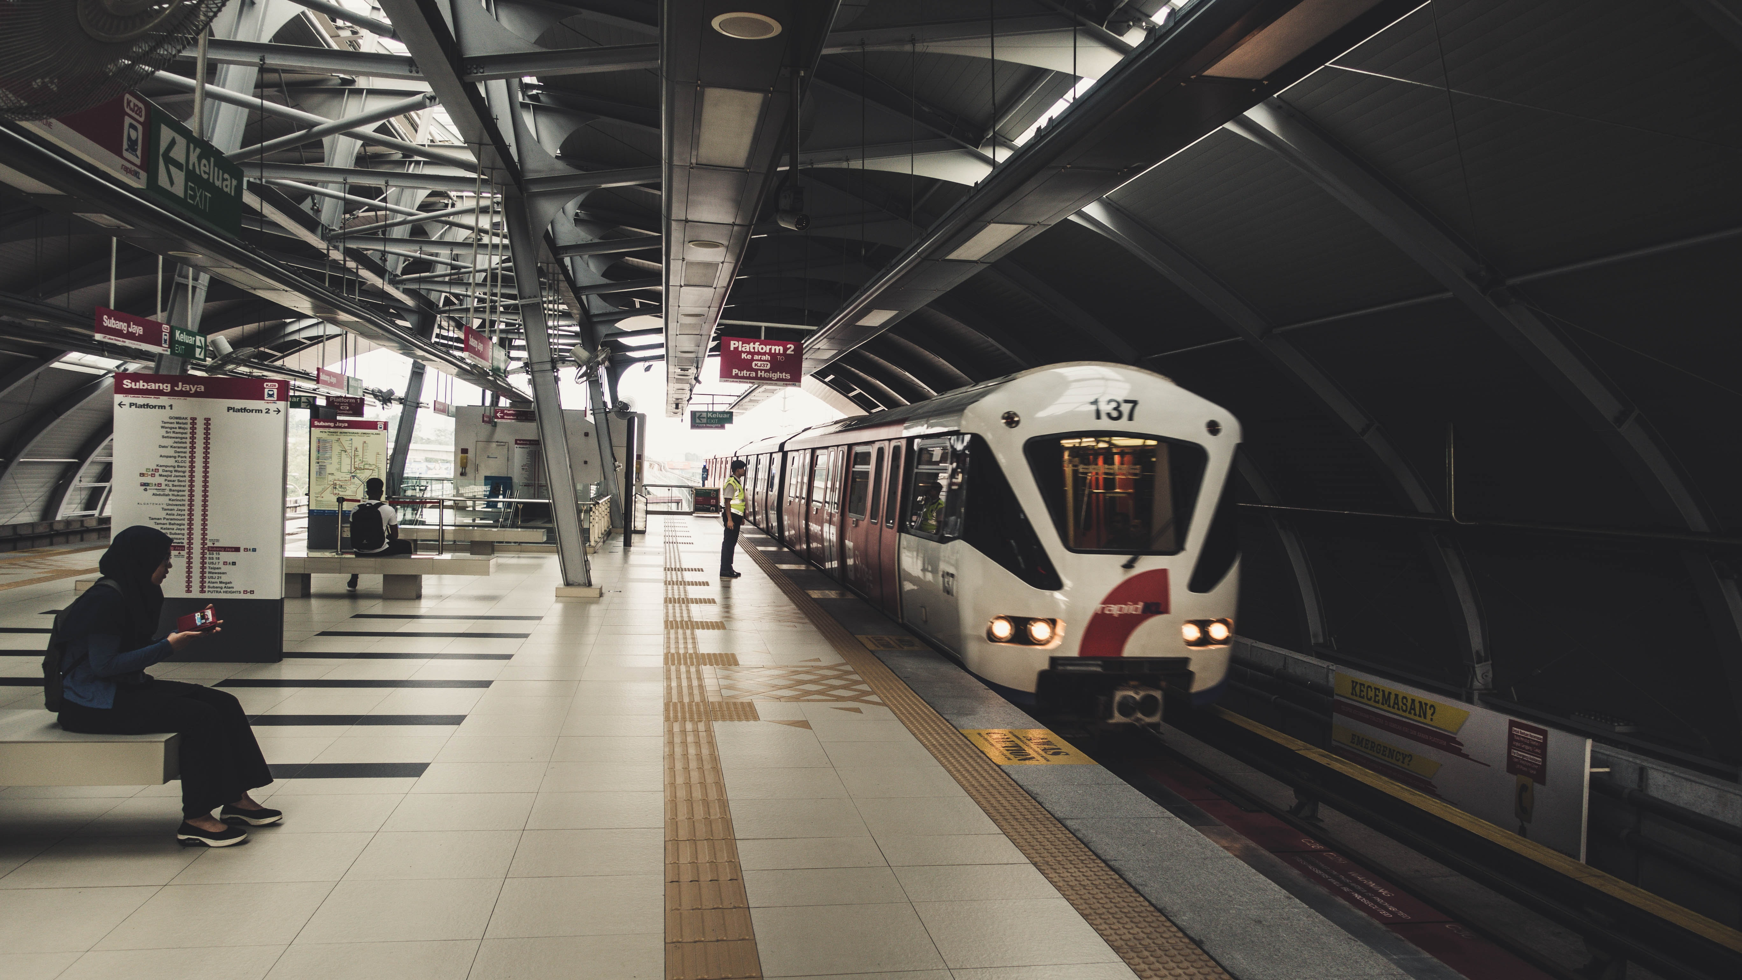
1 Listen and point. Repeat
fountain
street
train station
bookshop
restaurant

Slide 8



2 Listen again and tick.
The fountαin is | in front of | behind the restαurαnt.

Slide 9

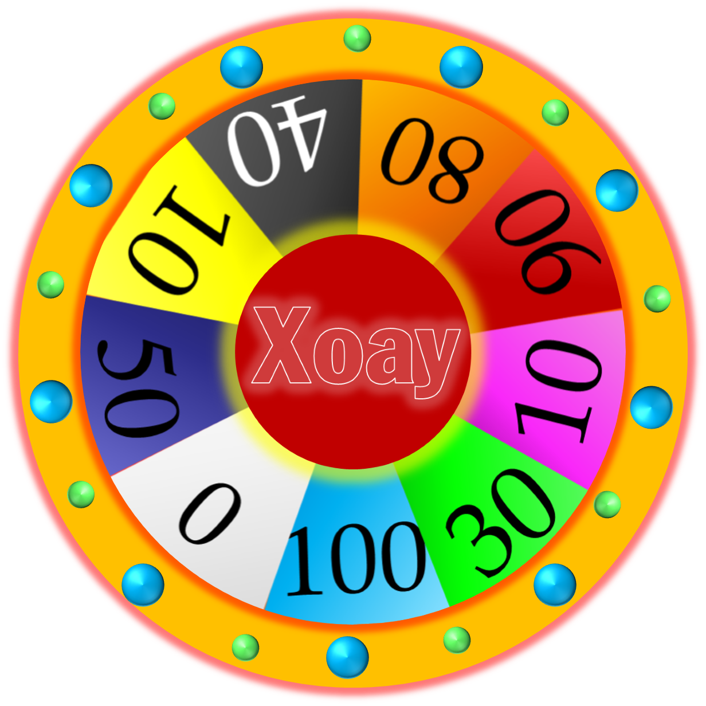




WHEEL OF FORTUNE
30
20
40
10
1
2
3
50
80
60
70
4
5
Next
START
Notes:
CLICK Start để quay => click vào vòng quay/dấu cách để dừng.

Slide 10



3 Look and say
The trαin stαtion is on
Elizαbeth street.
1 trαin stαtion / on / Elizαbeth street

Slide 11

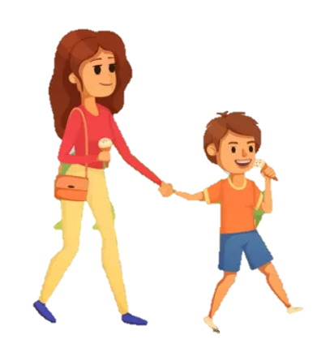
3 Look and say
The fountain is in front of the bookshop.
2 fountαin / in front of/ bookshop

Slide 12
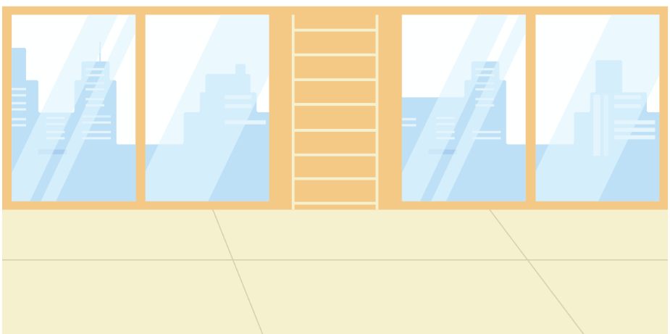

3 Look and say
The restaurant is behind the park.
3 restαurαnt / behind / pαrk

Slide 13


3 Look and say
4 bookshop / between / toy shop αnd museum
The bookshop is between the toy shop and the museum.

Slide 14
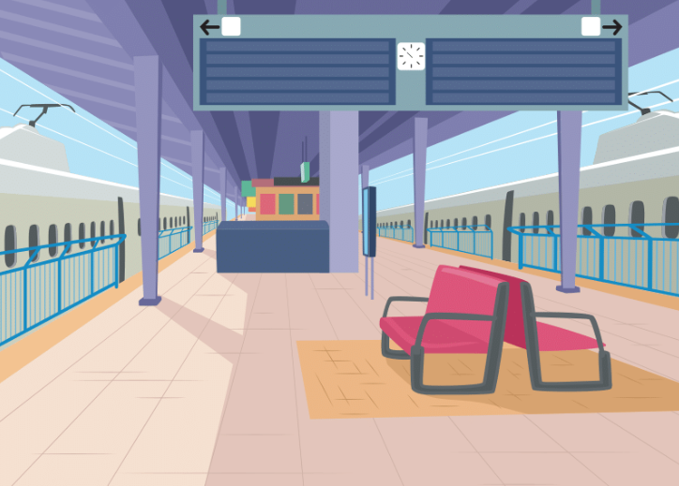
3 Look and say
Tran Hung Dao street is in front of the train station.
5 Tran Hung Dao street / in front of / train station

