Slide 1


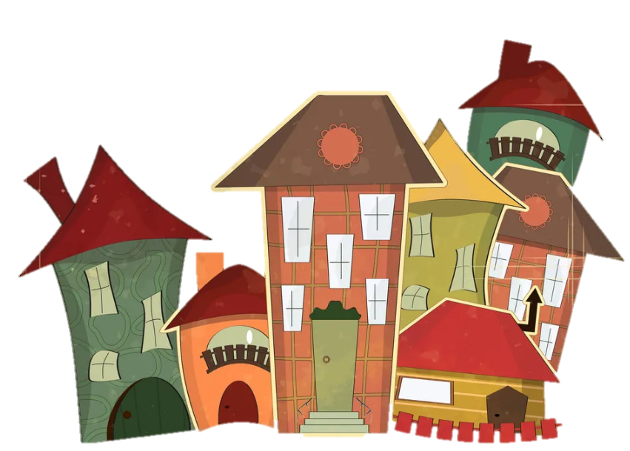


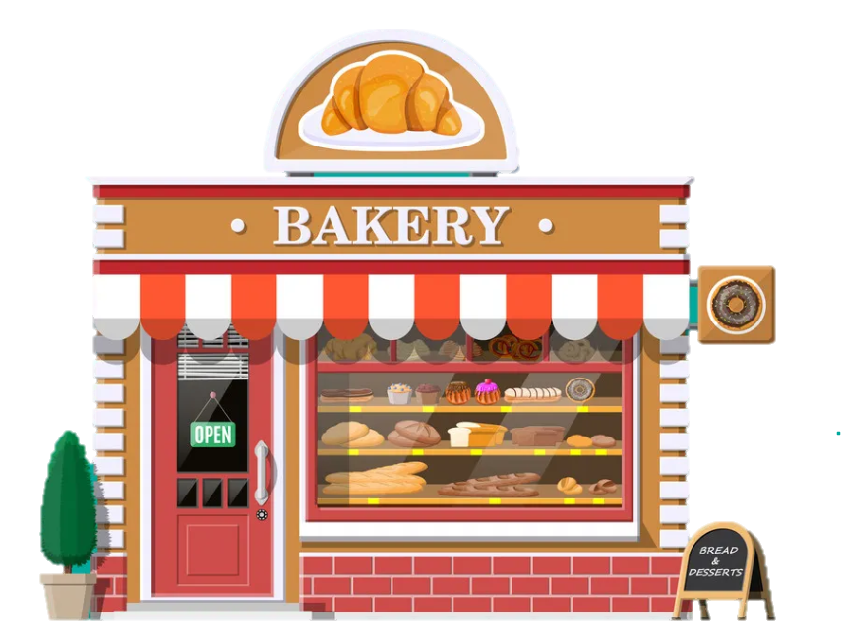




1
Warm Up

Slide 2



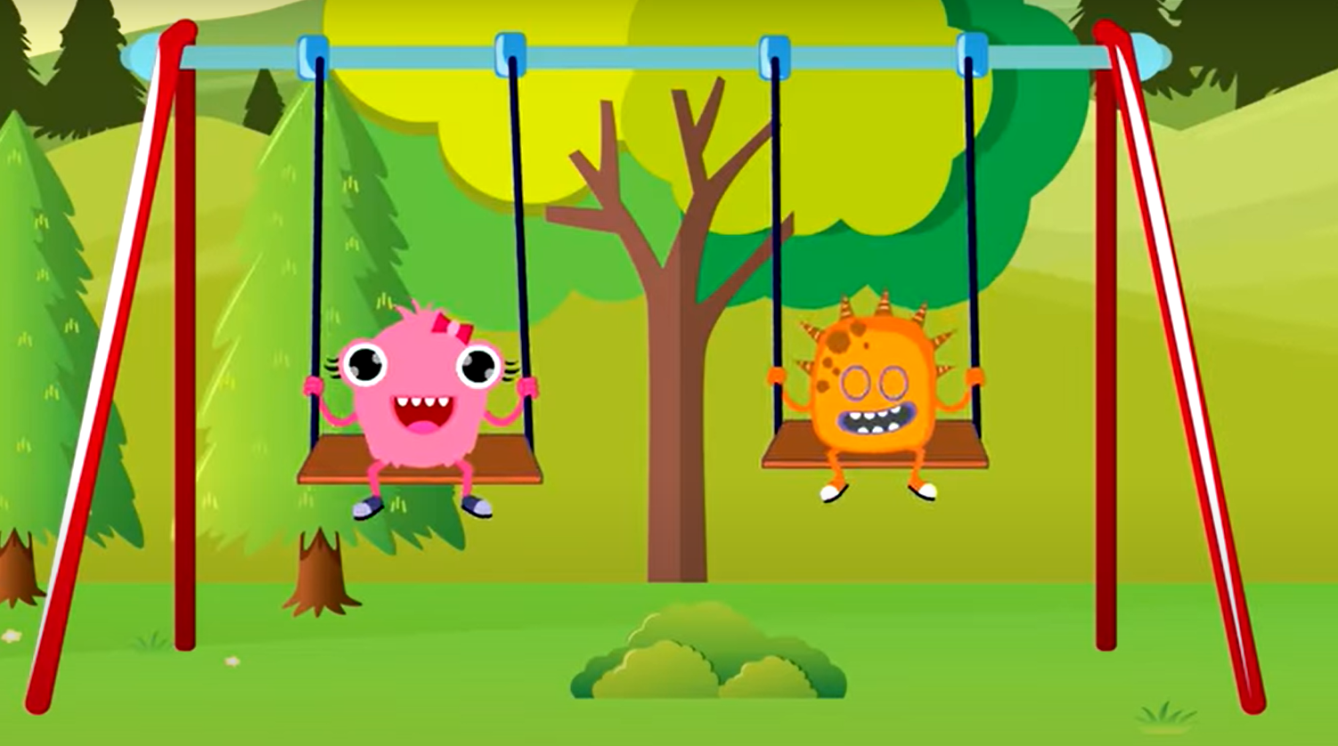


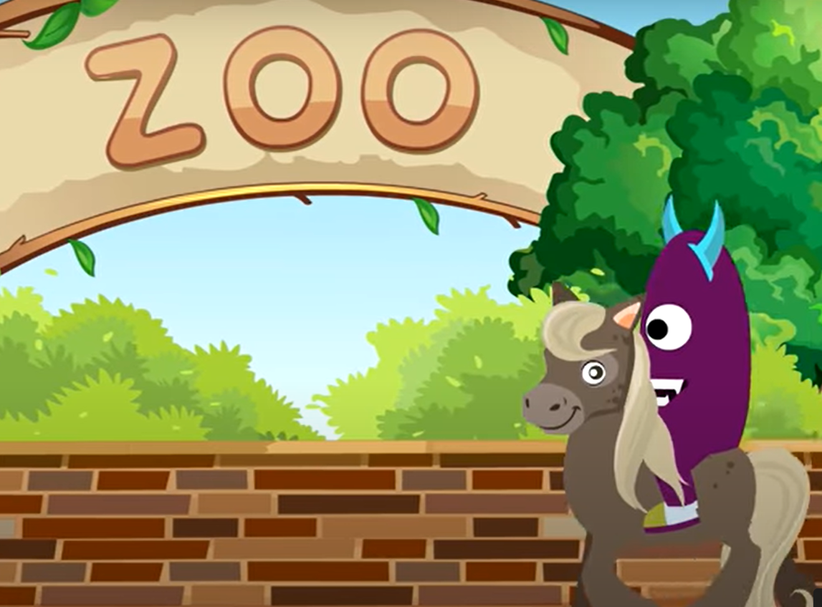

Notes:
T asks Sts about the places in the song . Give stars for the correct answer and give them some suggestions .

Slide 3
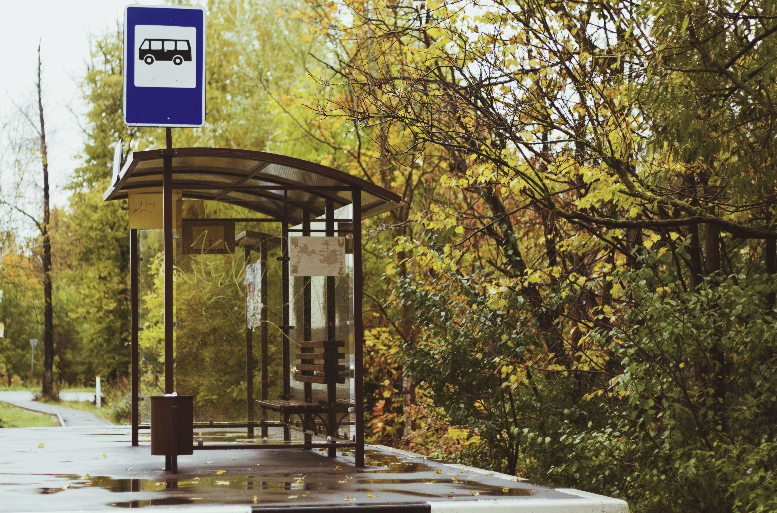
Bus stop

Slide 4
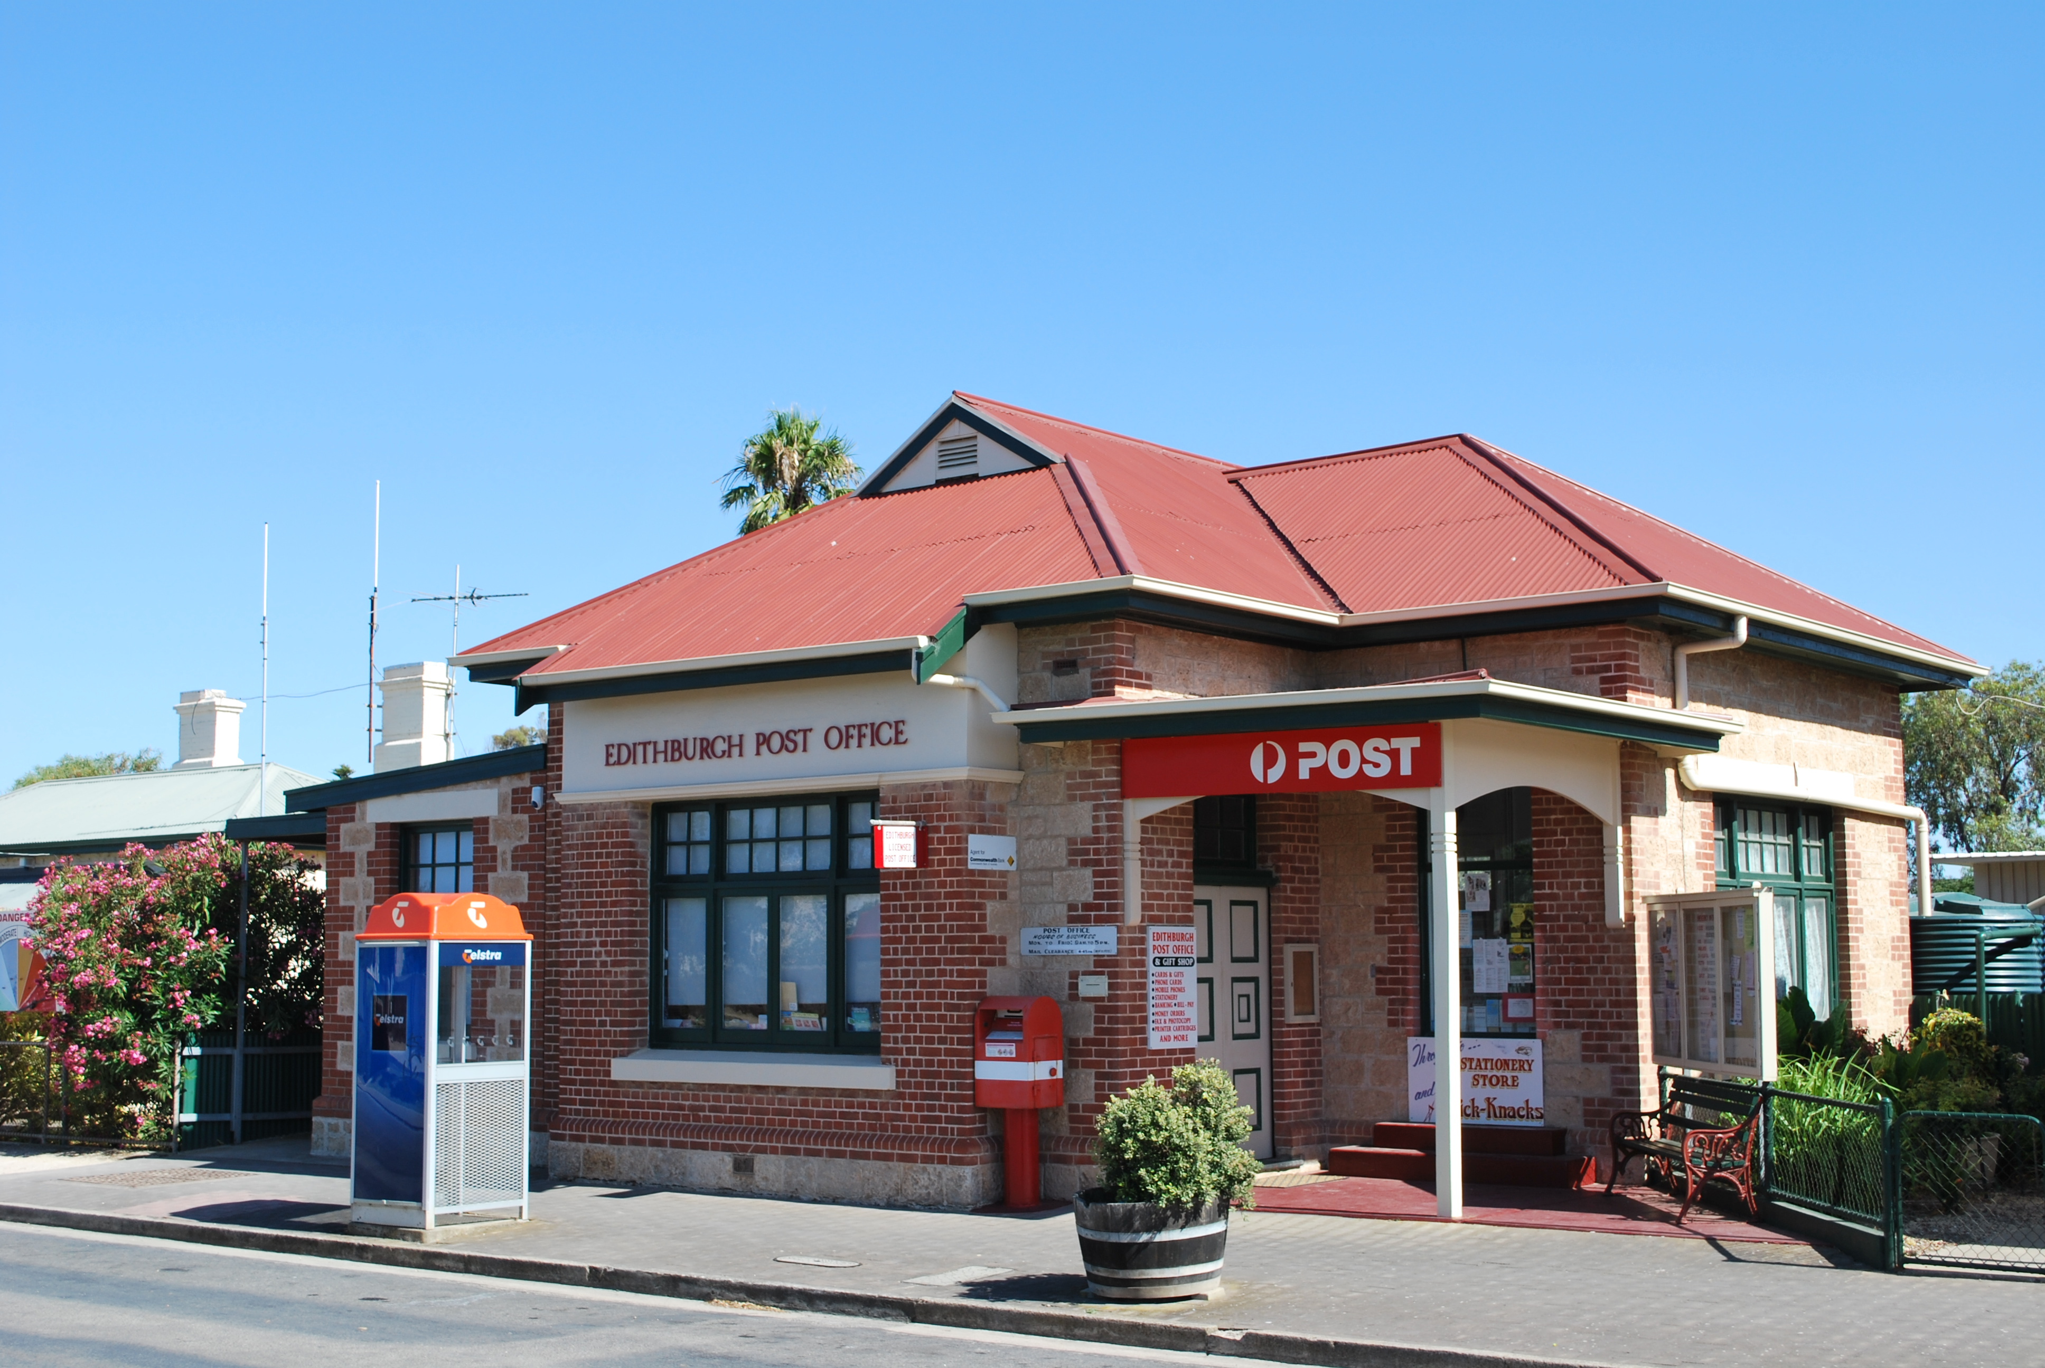
Post Office

Slide 5
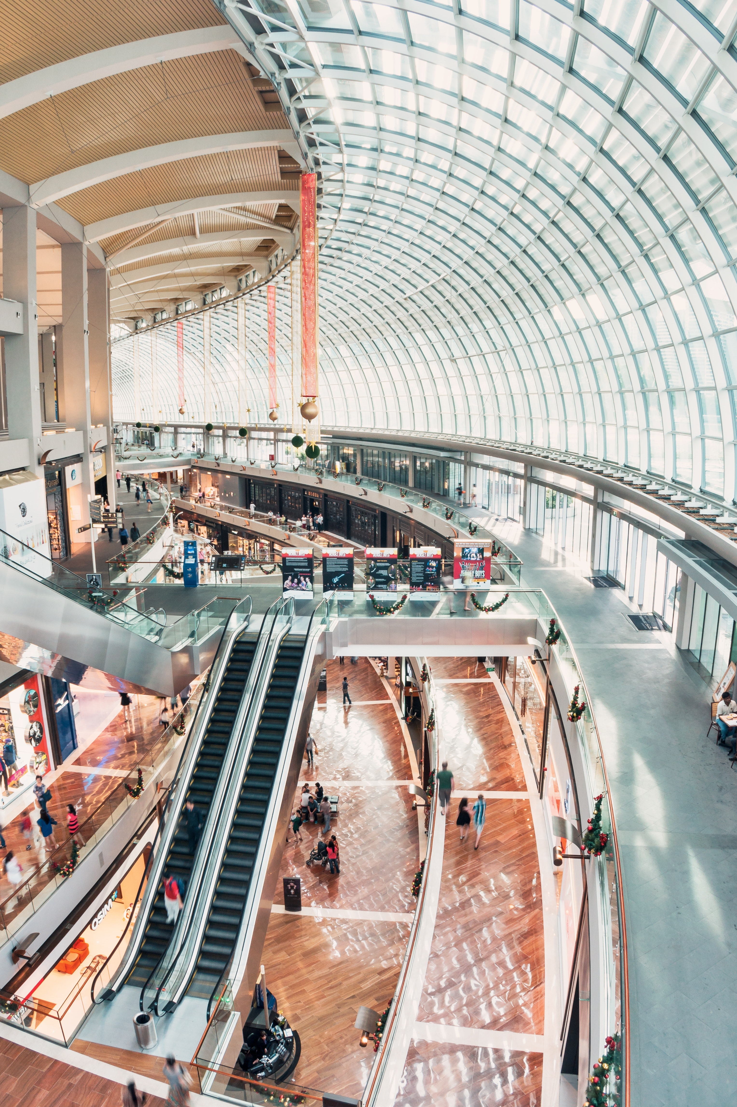
Shopping centre

Slide 6
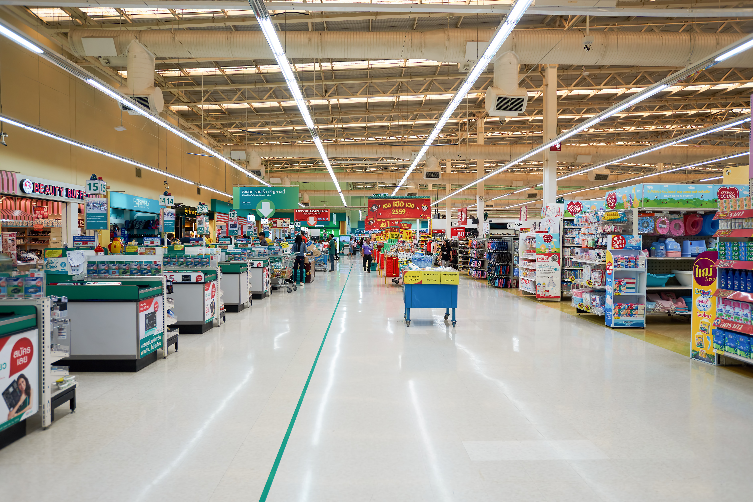
Supermarket

Slide 7



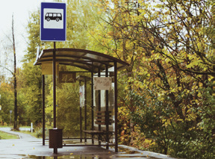
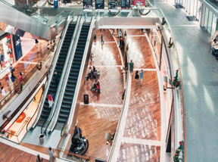
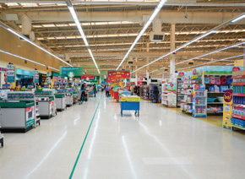
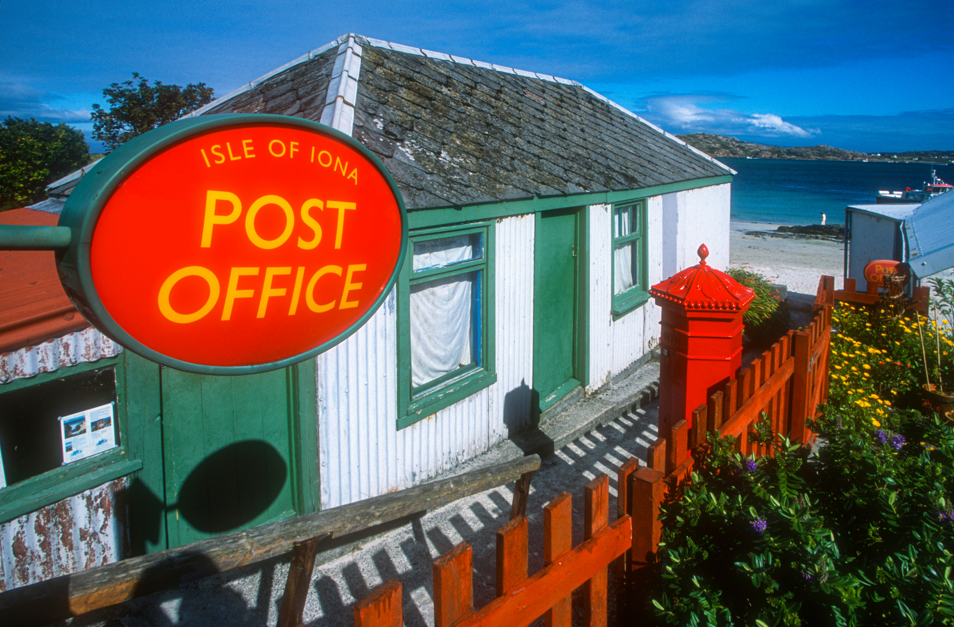
1 Listen and point. Repeat

Slide 8
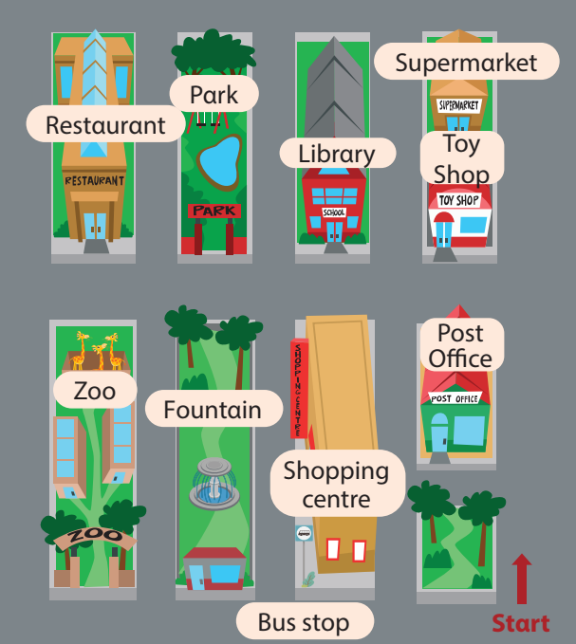


2 Listen and read. Write
Hi Tom, where do we go shopping in this town?
Thαt’s fun. Cαn we go there by bus?
Greαt!
We go shopping αt the supermαrket.
On Sundαy, we often go to the shopping centre becαuse we cαn plαy
in the gαme centre.
Yes. There’s α bus stop in front of the shopping centre.

Slide 9

Listen and read. Write
They go shopping
αt the _________
supermarket
2. On Sundαy, they often
plαy in the _________.
game centre

Slide 10


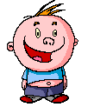
Who Wants To Be A Millionaire?

Slide 11

Question 1

Slide 12
Where do we buy food ?
A. at the bus stop
B. at the toy shop
C. at the supermarket
D. at the zoo

Slide 13
Where do we buy food ?
A. at the bus stop
B. at the toy shop
C. at the supermarket
D. at the zoo

Slide 14
£100

Slide 15
Question 2

Slide 16
Where do we see many shops ?
A. at the bus stop
B. at the shopping centre
C. at the post office
D. at the fountain

Slide 17

Where do we see many shops ?
A. at the bus stop
B. At the shopping centre
C. at the post office
D. at the fountain

Slide 18
£200

Slide 19
Question 3

Slide 20
Where do we get a bus?
A. at the supermarket
B. at the bus stop
C. at the zoo
D. at the restaurant

Slide 21
Where do we get a bus ?
A. at the supermarket
B. at the bus stop
C. at the zoo
D. at the restaurant

Slide 22
£300

Slide 23
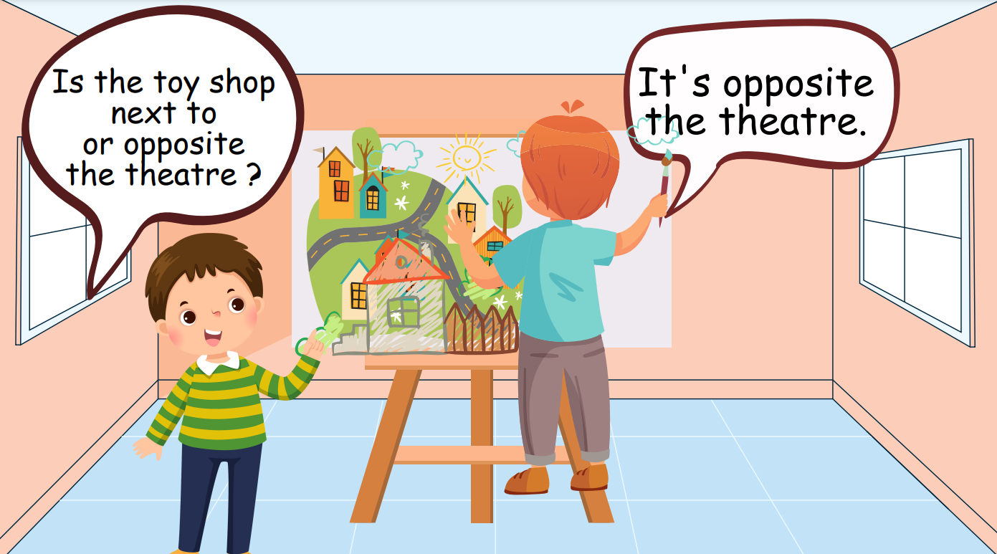
Draw. Ask and Answer
Notes:
Sts draw their town. The sts will ask and answer each other.
Hs vẽ tranh về thị trấn của mình. Sau đó, các hs hỏi và trả lời về vị trí các địa điểm bất kỳ.

Slide 24
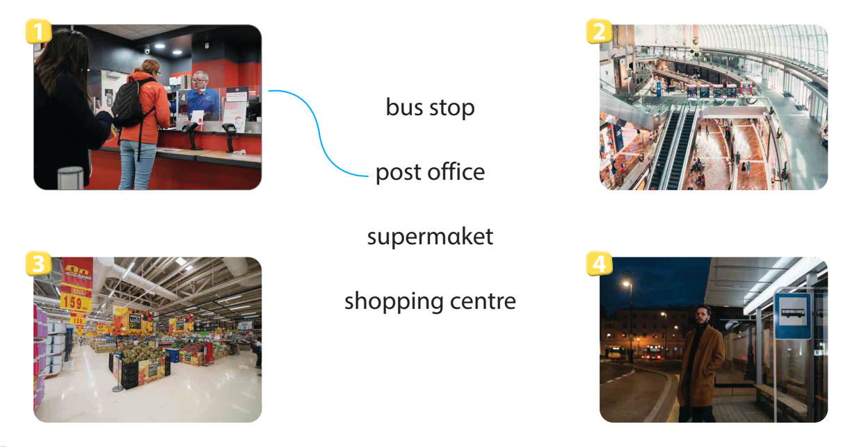
Match

Slide 25
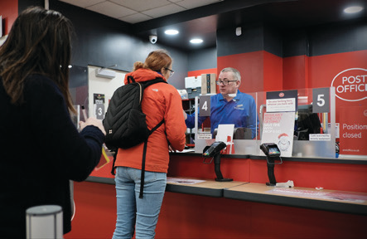
Remember
VOCABULARY
Structure
Bus stop
The post office is in front of the toy shop.
Post Office
Shopping centre
Supermarket
Where + present simple to ask and answer about places in town

