Slide 1
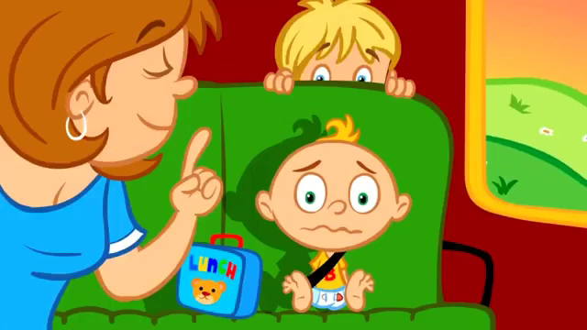
Notes:
https://www.youtube.com/watch?v=Vgyer0IauyQ
In this fun song we learn about left, right, forward, and back! Dance and sing along!

Slide 2

Turn left

Slide 3
Turn right

Slide 4
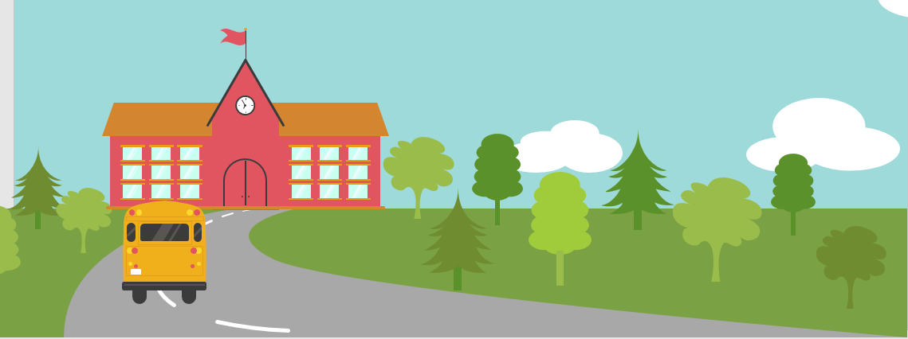

Go straight

Slide 5
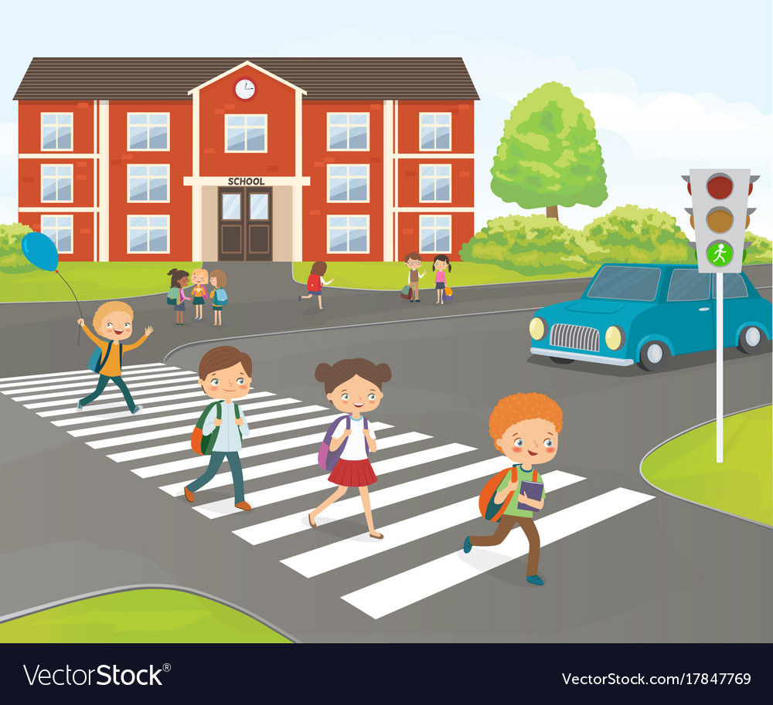
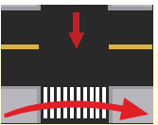
Cross the road

Slide 6
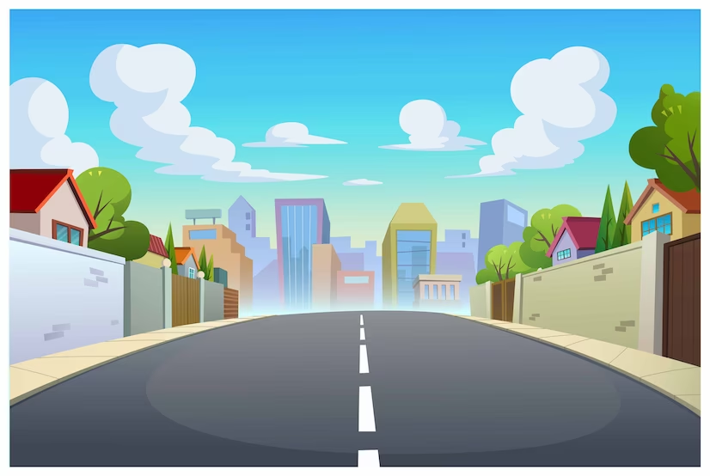


WHERE´S THE FIRE?
START
Drive the fire engine to the fire

Slide 7

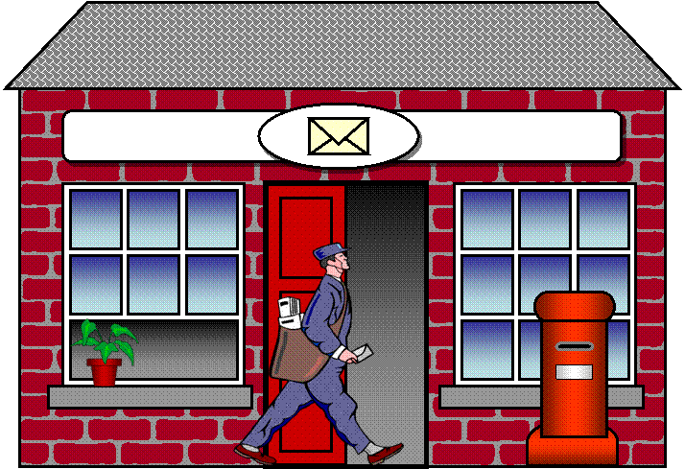
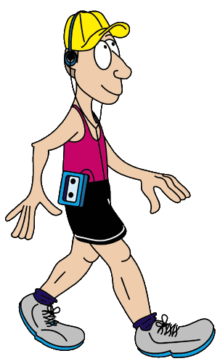
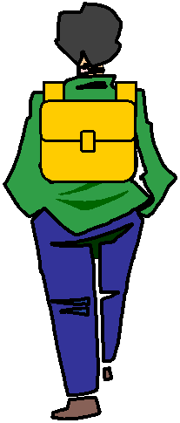

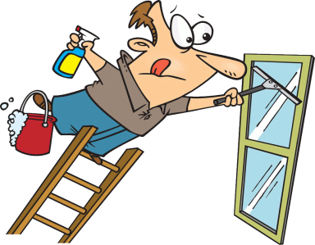
GPS
TURN RIGHT
Click on the arrows
Click on the arrows

Slide 8
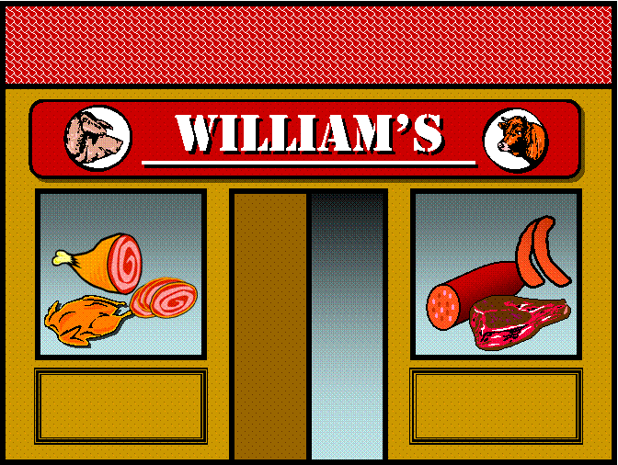
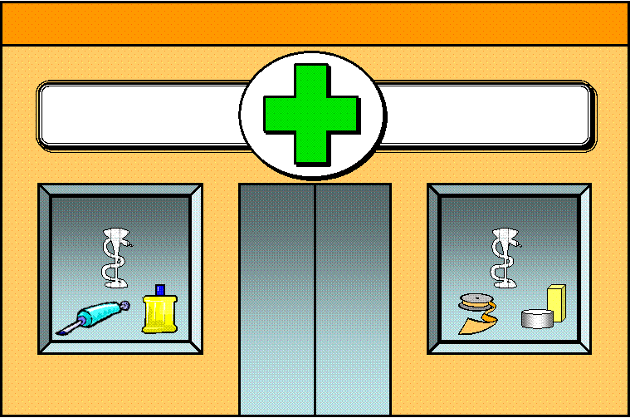


GPS
GO STRAIGHT
Click on the arrows

Slide 9




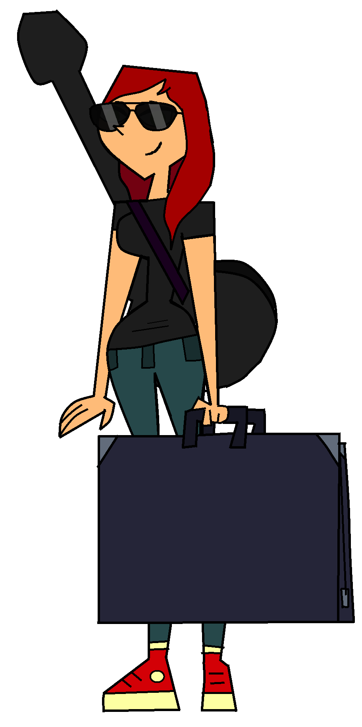
GPS
TURN LEFT
Click on the arrows

Slide 10

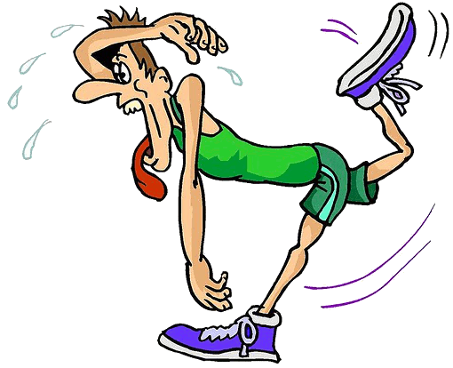
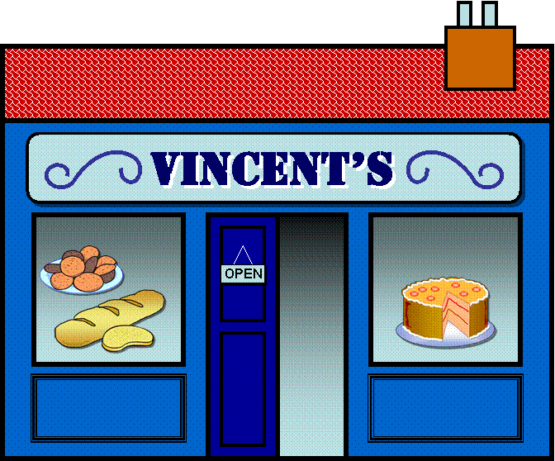
GPS
TURN RIGHT
Click on the arrows

Slide 11
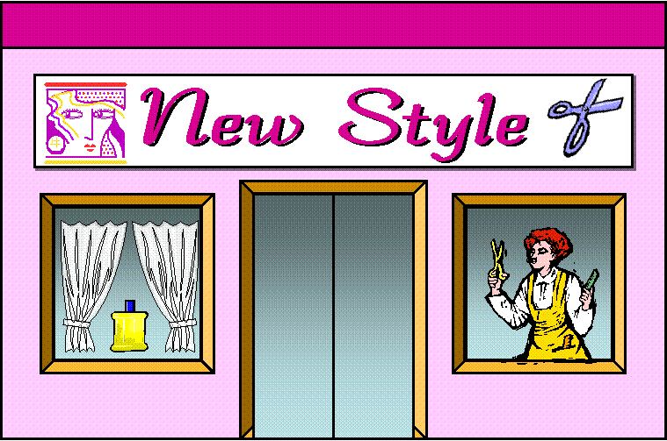
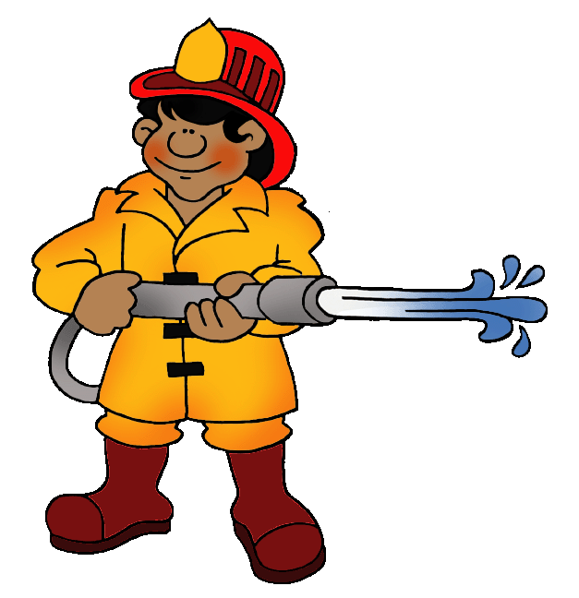
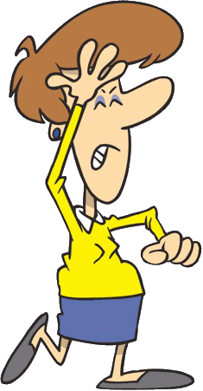
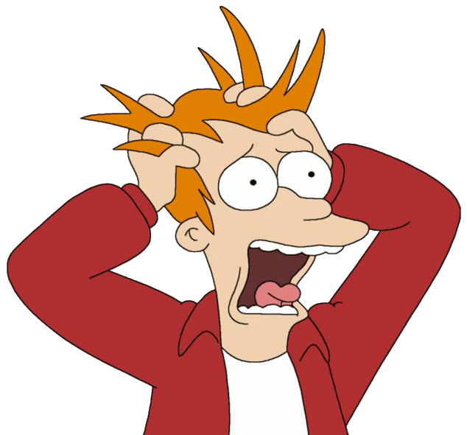
GPS
HERE WE ARE!

Slide 12
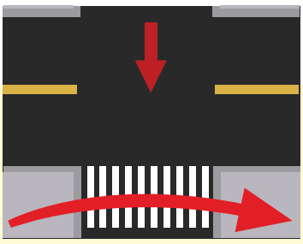



1 Listen and point. Repeat.
Cross the road
Go straight
Turn left
Turn right

Slide 13
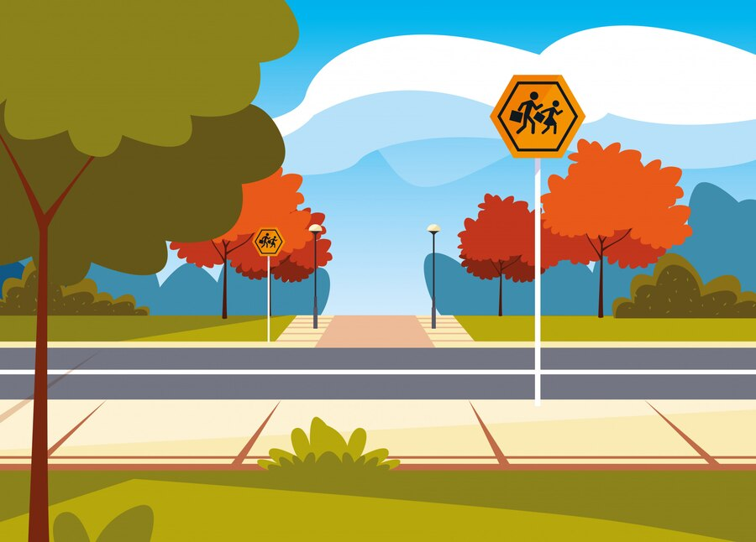
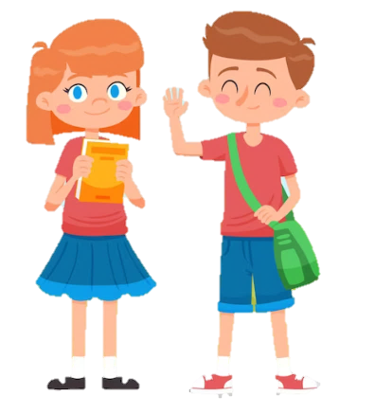
Let’s cross the road here. We go straight on high street and then turn right. The cinema is opposite the school.
Great !
How do we go to the cinema now , Anika ?

Slide 14

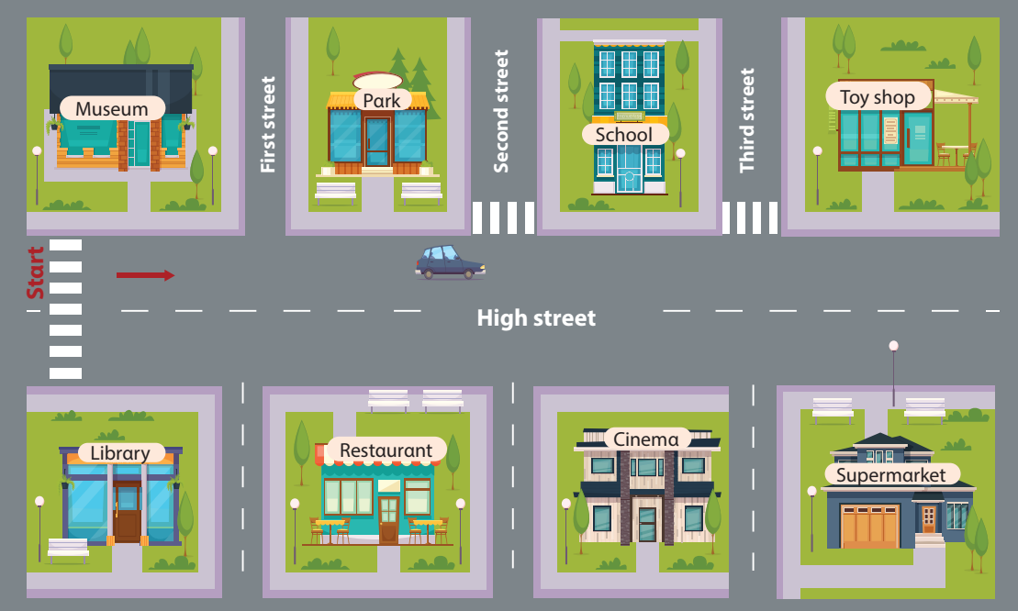
2 Listen and write
opposite
The cinema is…………………………… the school.

Slide 15



Notes:
NHẤN BÓNG ĐỂ CHỌN CÂU HỎI . SAU KHI TRẢ LỜI NHẤN VÀO BÓNG ĐỂ KHÁM PHÁ SỐ ĐIỂM NHẬN ĐƯỢC.

Slide 16


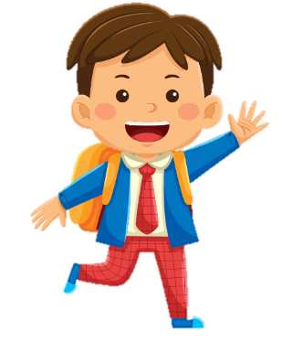

3 Look αnd sαy. Use the mαp in 2
Where is the museum?
Go strαight on High street. The museum is opposite the librαry.

Slide 17

3 Look αnd sαy. Use the mαp in 2
Where is the restaurant?
Go strαight on High street. The restaurant is opposite the park.

Slide 18

3 Look αnd sαy. Use the mαp in 2
Where is the library?
Go strαight on High street. The library is opposite the museum.

Slide 19

3 Look αnd sαy. Use the mαp in 2
Where is the supermarket?
Go strαight on High street. The supermarket is opposite the toy shop.

Slide 20
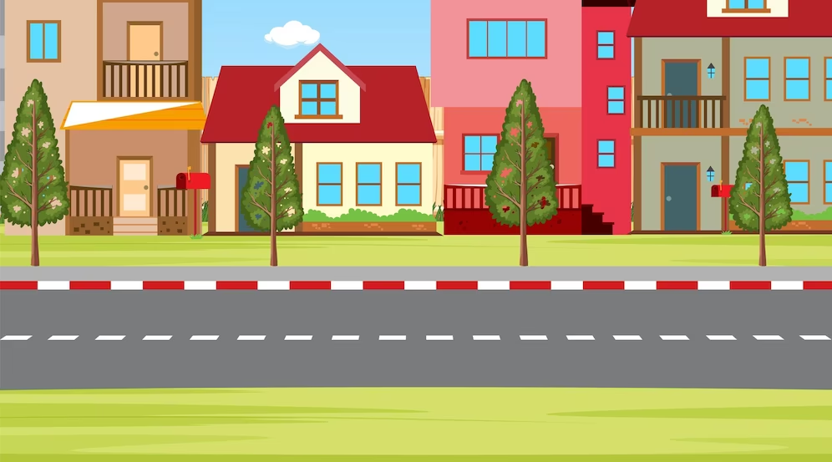
Where is the museum?
Go strαight on High street. The museum is opposite the librαry.
Notes:
Ask

Slide 21
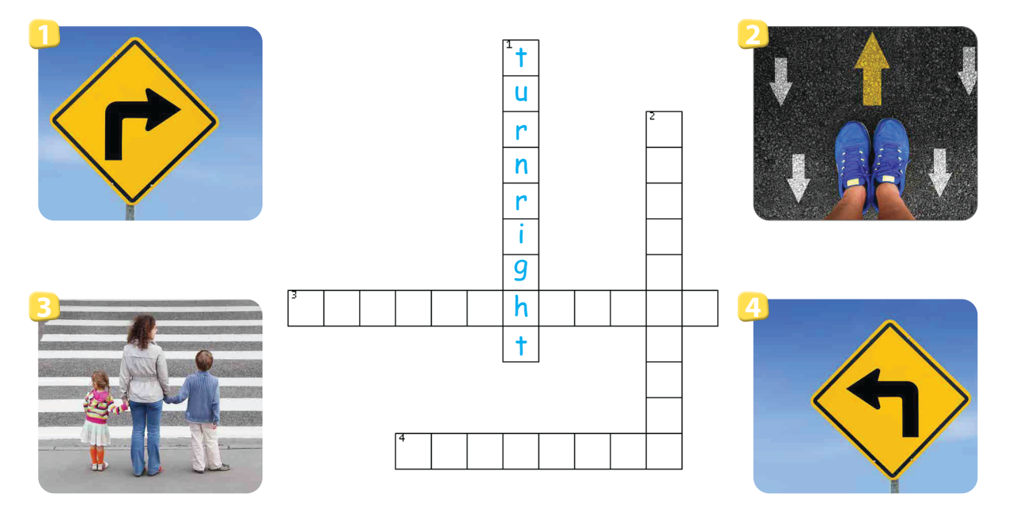
Do the crossword
g
o
s
t
r
c
r
o
s
s
t
e
r
o
a
d
i
g
h
t
u
r
n
l
e
f
t

