Slide 1








Spin the wheel
2 stars
3 stars
2 stars
7 stars
8 stars
role dice
4 stars
-1star
9 stars
10 stars
role dice
5 stars

Slide 2
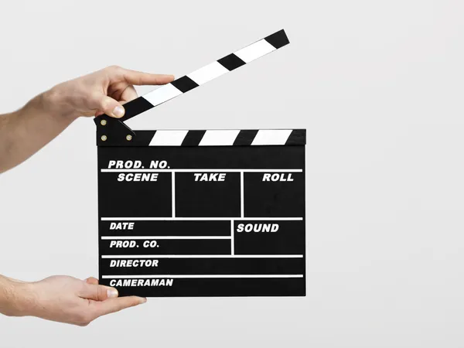
TIME’S UP
action
WHEEL

Slide 3
Spin the wheel
2 stars
3 stars
2 stars
7 stars
8 stars
Role dice
-1 stars
4 stars
9 stars
10 stars
Role dice
5 stars

Slide 4
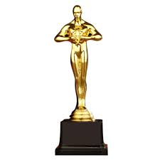
TIME’S UP
award
WHEEL

Slide 5
Spin the wheel
2 stars
3 stars
2 stars
7 stars
8 stars
Role dice
-1 stars
4 stars
9 stars
10 stars
Role dice
5 stars

Slide 6

-1 star
WHEEL

Slide 7
Spin the wheel
2 stars
3 stars
2 stars
7 stars
1 star
Role dice
10 stars
4 stars
1 star
9 stars
Role dice
5 stars

Slide 8

TIME’S UP
company
WHEEL

Slide 9
Spin the wheel
2 stars
3 stars
2 stars
7stars
8 stars
Role dice
-1 stars
4 stars
10 stars
9 stars
Role dice
5 stars

Slide 10
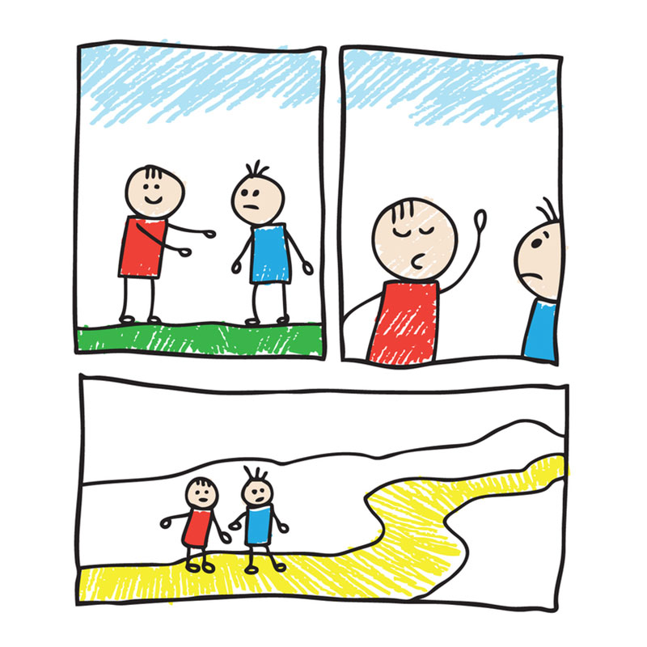
TIME’S UP
cartoon
WHEEL

Slide 11



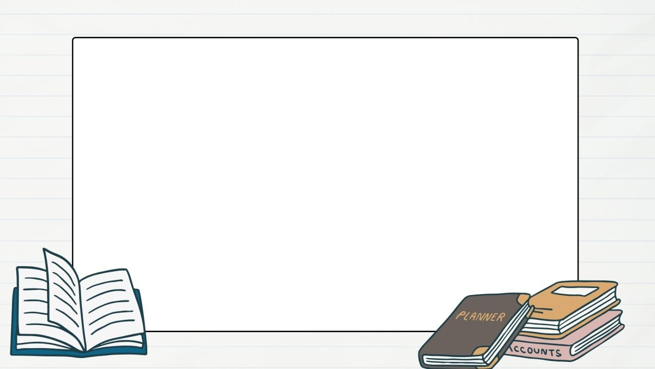



4 Read and complete the text about Charlie Chaplin with the given words.
Then listen and check.
in 1889 in 1914 when he was 21 in 1977 at age five
Charlie Chaplin was a famous actor and film director. He was born in London(1) _______ . His famous character was a very funny man. He wore big trousers, big shoes and a black hat. He did crazy things on stage. He sang on stage (2) _________ because his mother was sick. (3) ___________ , he went to America and found a job at Keystone Film Company. He was in his first comedy (4) _______ . Charlie Chaplin made films for 65 years. His films were famous all over the world. He died (5) ______.
in 1889
at age five
when he was 21
in 1914
In 1977

Slide 12




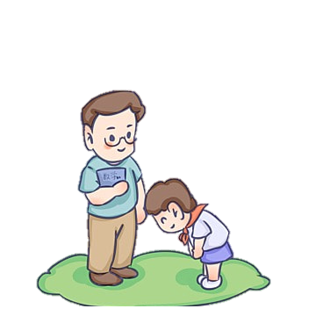

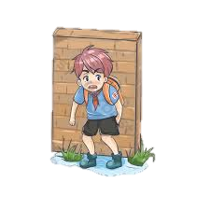



Wh-question: who/ what/ why/ when
who
what
Ex: Who was Charlie Chaplin?
Ex: What did she do yesterday?
/
asks about a person
asks about things or actions
why
where
Ex: Why did you play truant yesterday?
Ex: Where did you play football last weekend?
asks about the reason
asks about the places

Slide 13

8
1
5
9
7
2
3
6
10
4
LUCKY STAR

Slide 14




1 …………… is your English teacher?
- Ms. Huong
You are given 3 stars
Who
GO HOME

Slide 15
2. …………… is her wallet?
- On the table.
You are given 2 stars
Where
GO HOME

Slide 16
3. …………… does he hate physics?
- Because he knows nothing about it.
You are given 5 stars
Why
GO HOME

Slide 17
4. ………… did he buy yesterday?
- He bought a car yesterday.
You are given 8 stars
What
GO HOME

