Slide 1
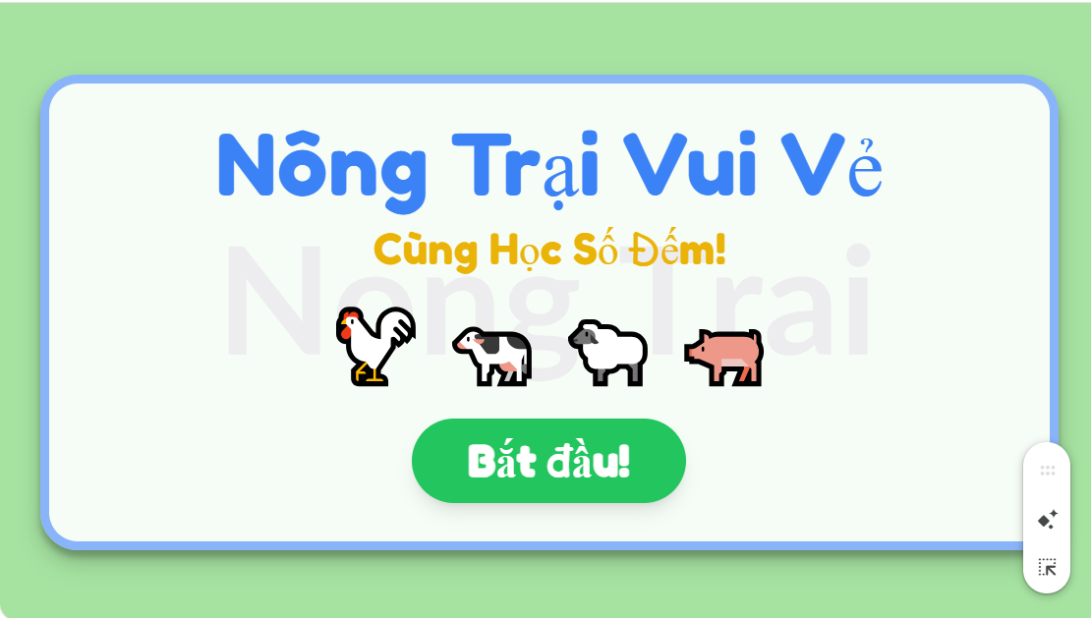

Slide 2
https://g.co/gemini/share/c23359d1d8d1

