Slide 1
REVIEW 2.2

Slide 2
Table of Contents
1
2
3
4
Warm-up and review
Read and match.
Look, complete and read.
Ask and anwer.
5
Fun corner and wrap-up

Slide 3
1
Warm-up and review

Slide 4
Look and guess!

Slide 5


Slide 6
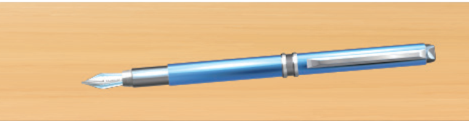

Slide 7
2
Read and match.

Slide 8
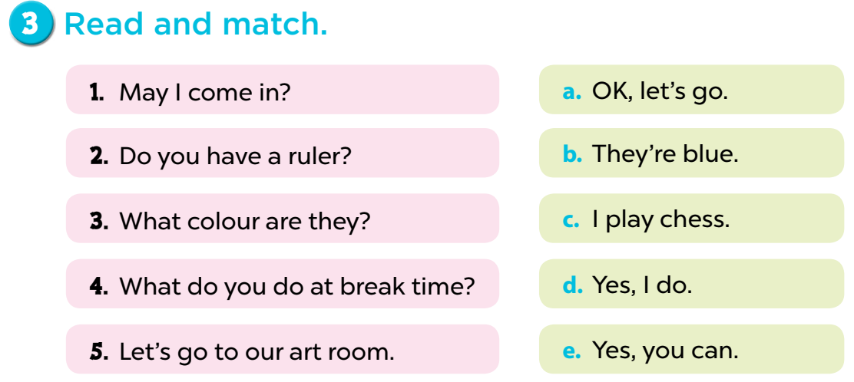

Slide 9
3
Look, complete and read.

Slide 10
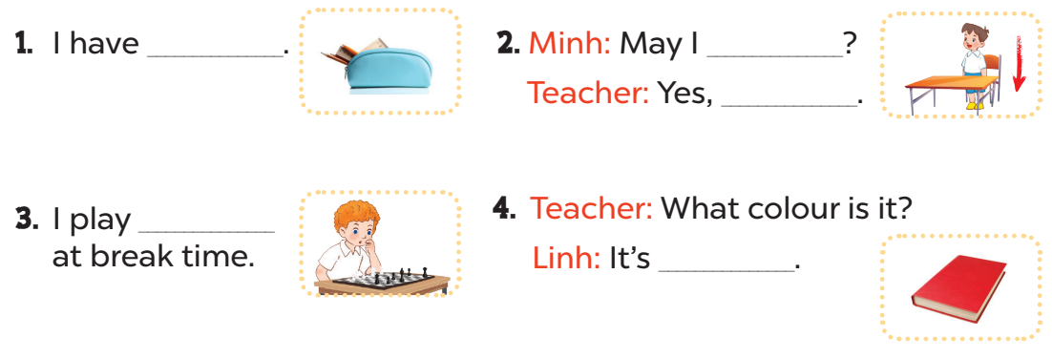
a pencil case
sit down
you can
chess
red

Slide 11
4
Ask and anwer.

Slide 12
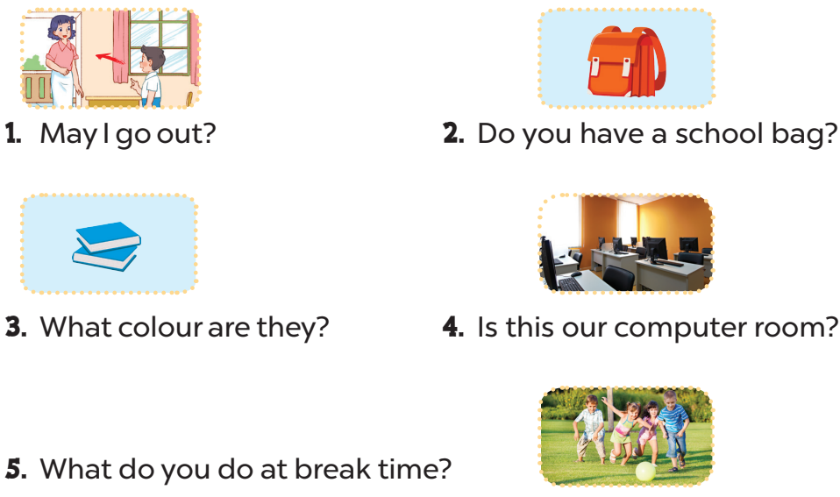
Yes, you can/No, you can’t.
Yes, I do.
They’re blue.
Yes, it is.
I play football.

Slide 13
5
Fun corner and wrap-up

Slide 14


Slide 15

1
2
3
4
TEAM 1
5
6
7
8
TEAM 2
9
10
11
12
TEAM 3
Notes:
Lucky number

Slide 16
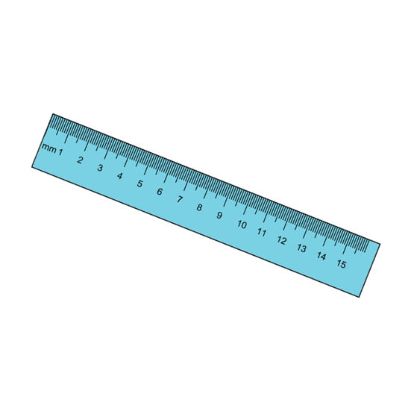

What colour is it?
+ 2 points
It’s blue.

Slide 17
What colour is it?
+ 5 points
It’s yellow.

