Slide 1




My foreign friends
Unit 3
Lesson 2 – Period 3

Slide 2



Slide 3

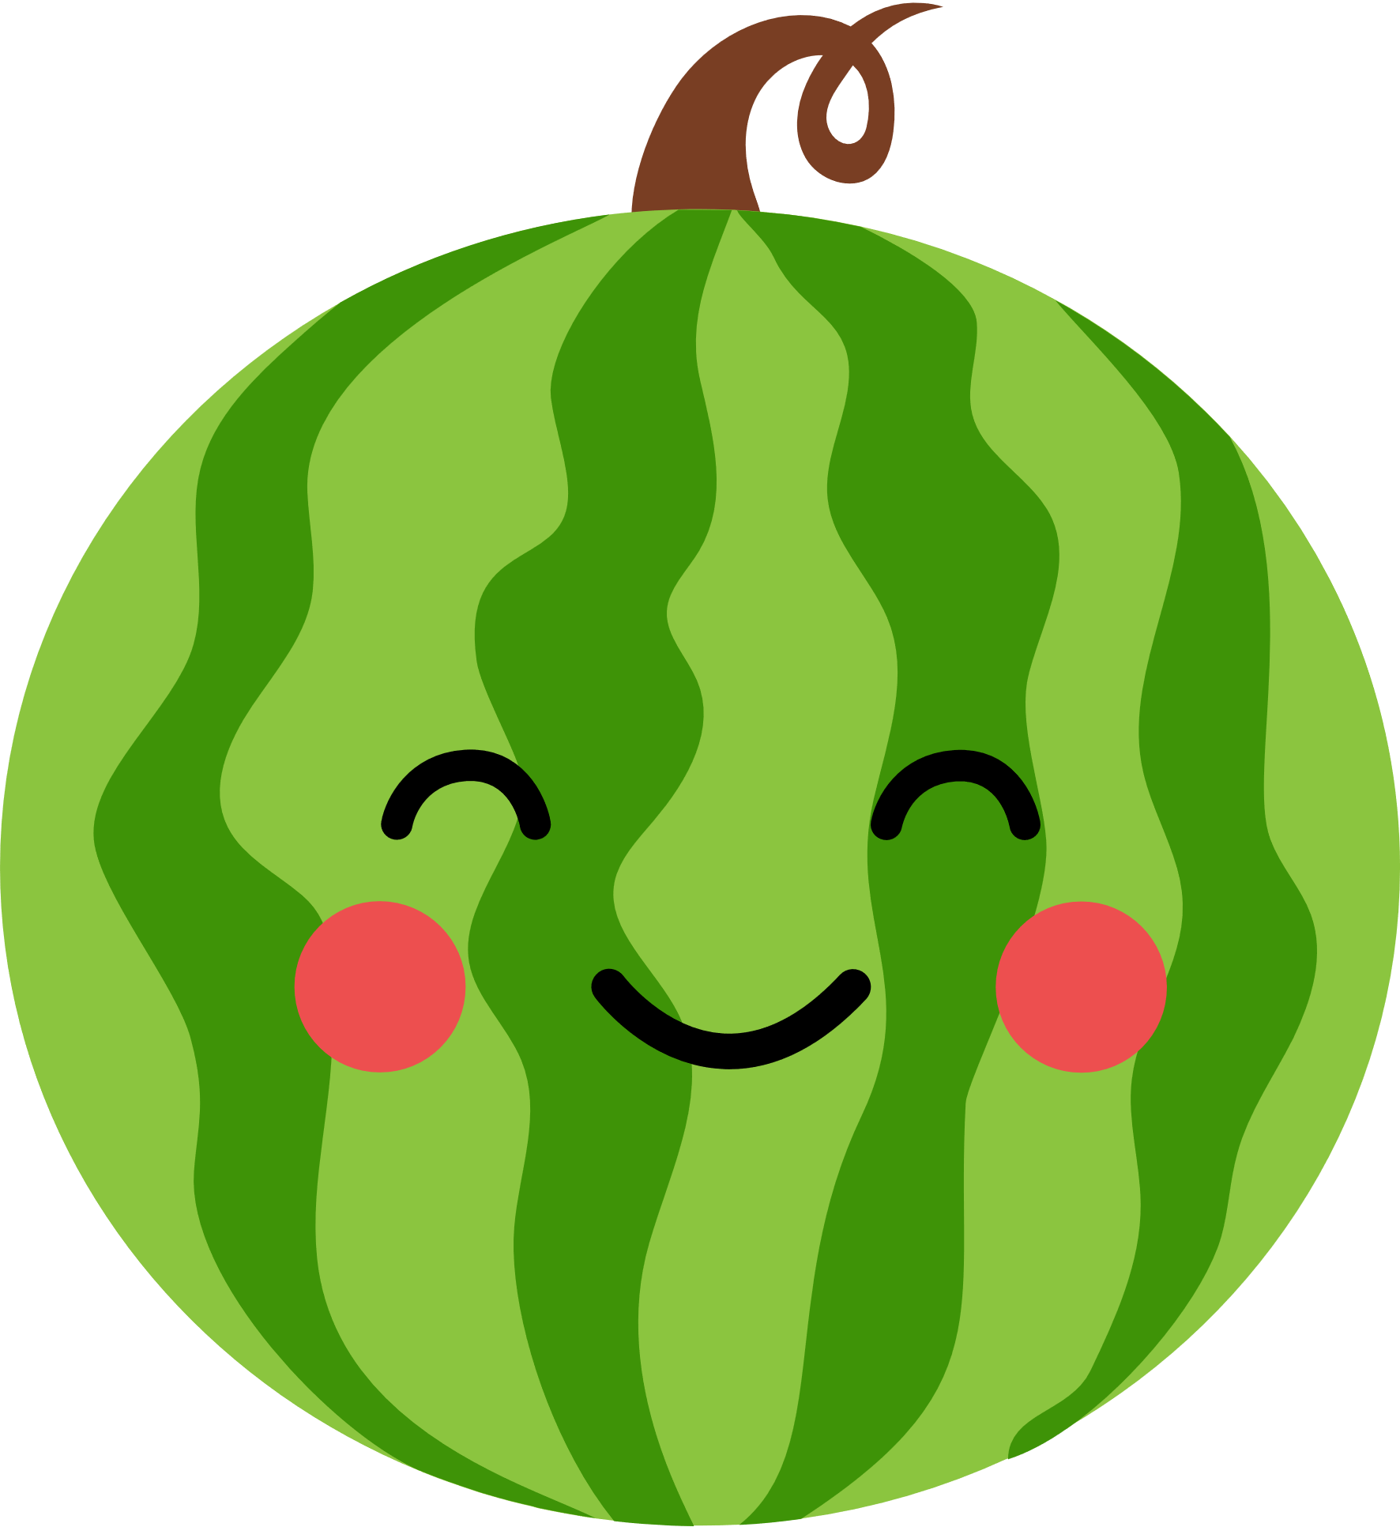













CHOOSE AND ANSWER.
Notes:
Click the numbers to link to the Question slide.
Click the watermelon to disappear it and show the scores.
Click CHOOSE and ANSWER to end the game.

Slide 4


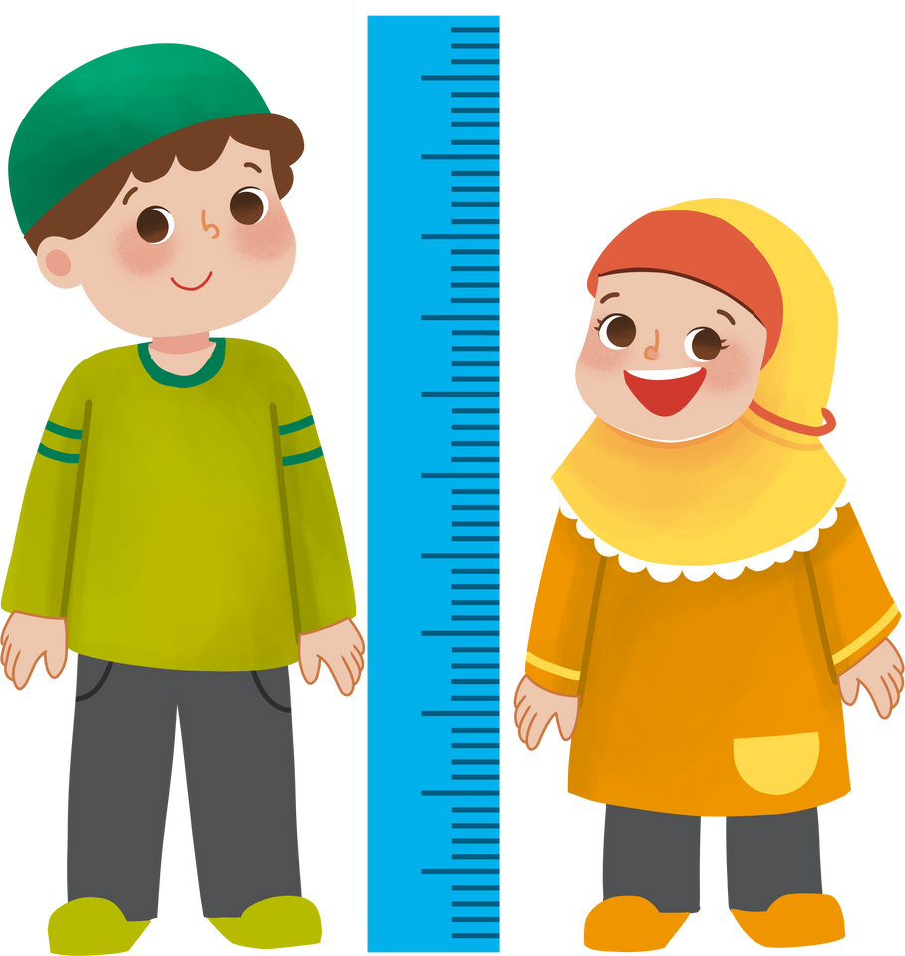


What does he look like?
He’s tall.

Slide 5


What does she look like?
She’s short.

Slide 6
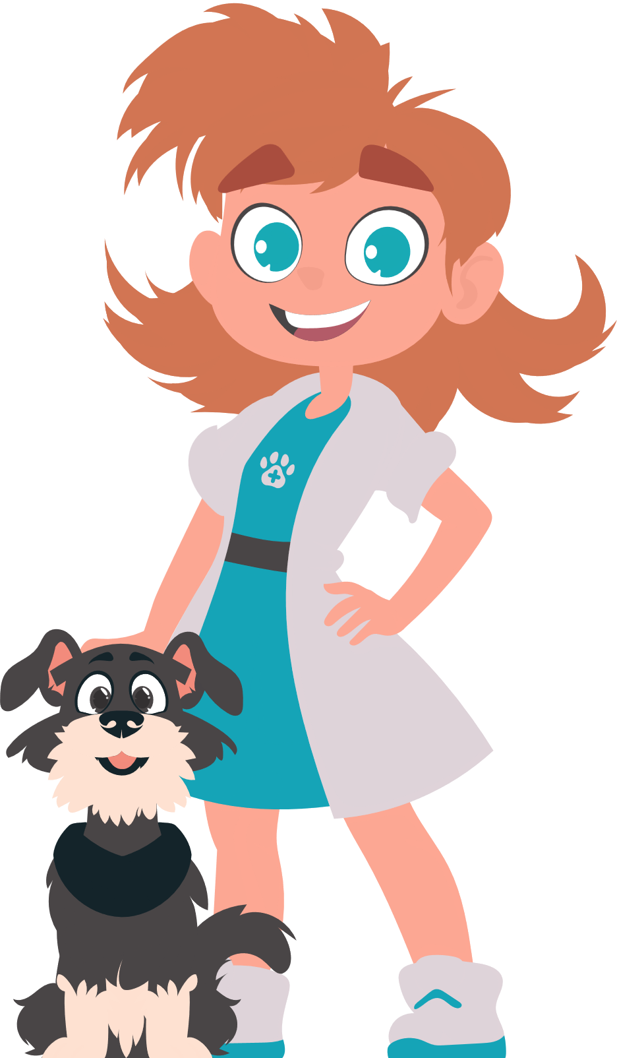




What does she look like?
She has big eyes.

Slide 7
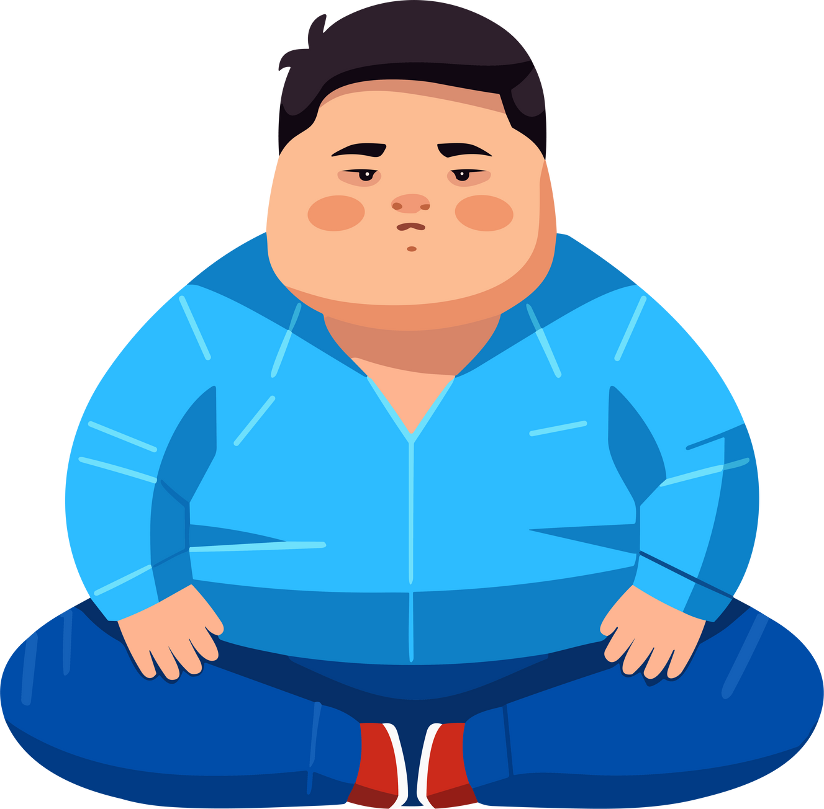


What does he look like?
He’s big and fat.

Slide 8

What does she look like?
She has long hair.

Slide 9
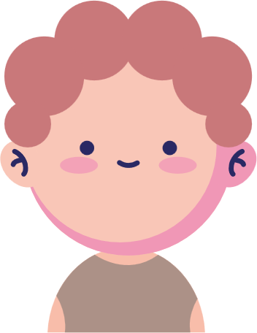
What does he look like?
He has a round face.

Slide 10


What does she look like?
She’s slim.

Slide 11
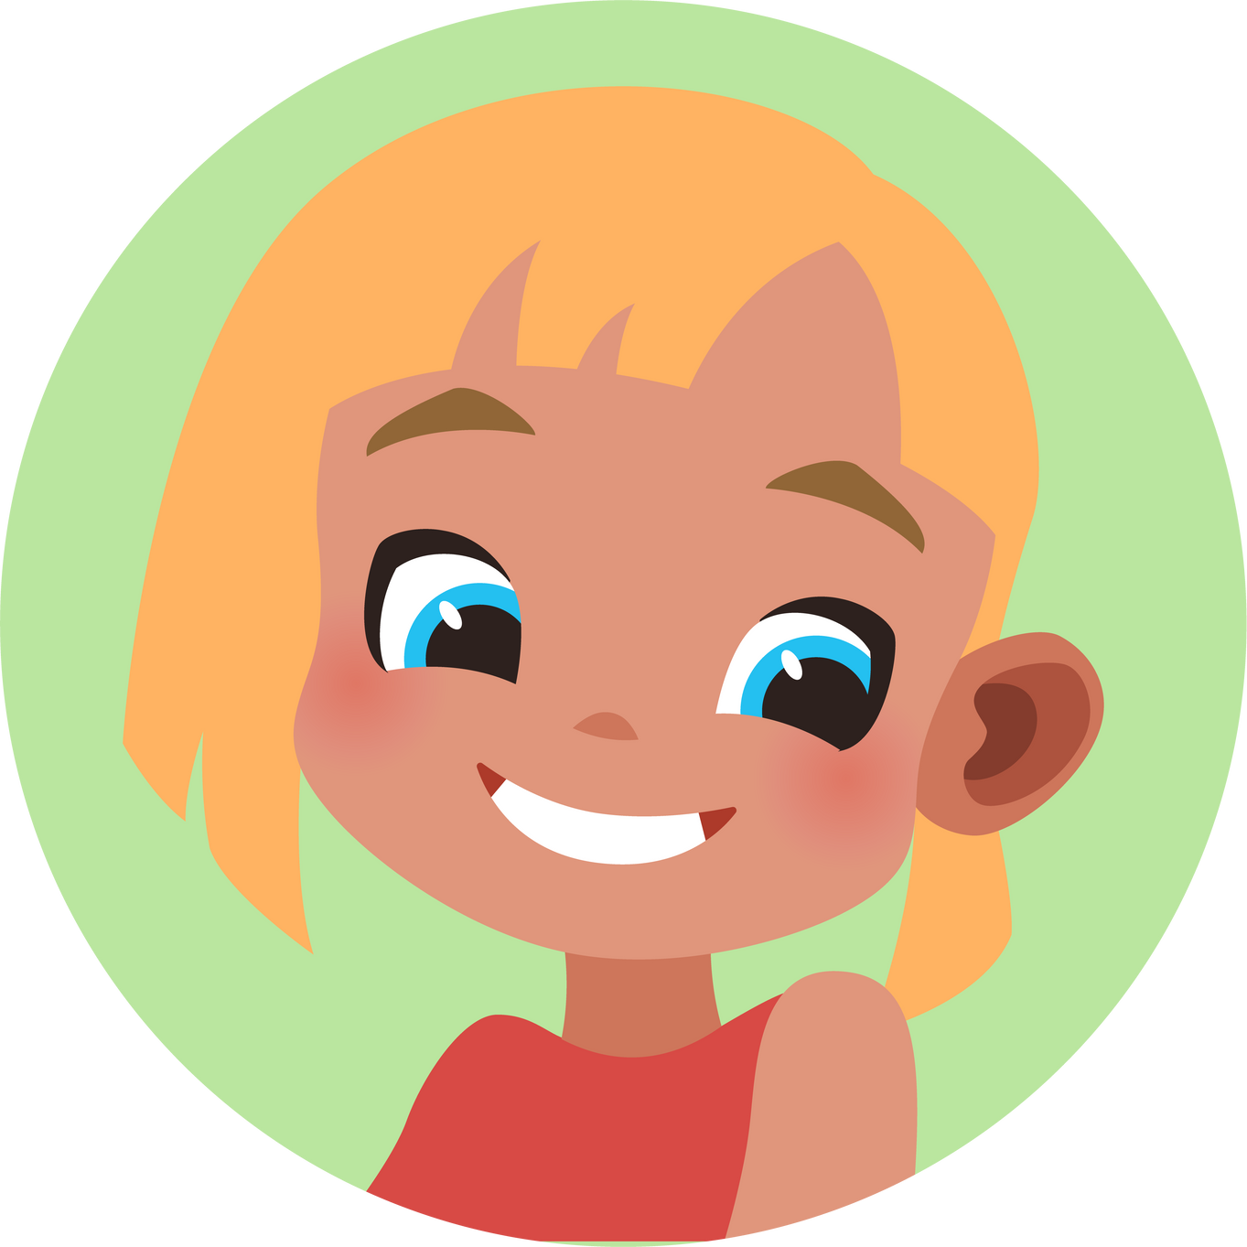
What does she look like?
She has short hair.

Slide 12




