Slide 1



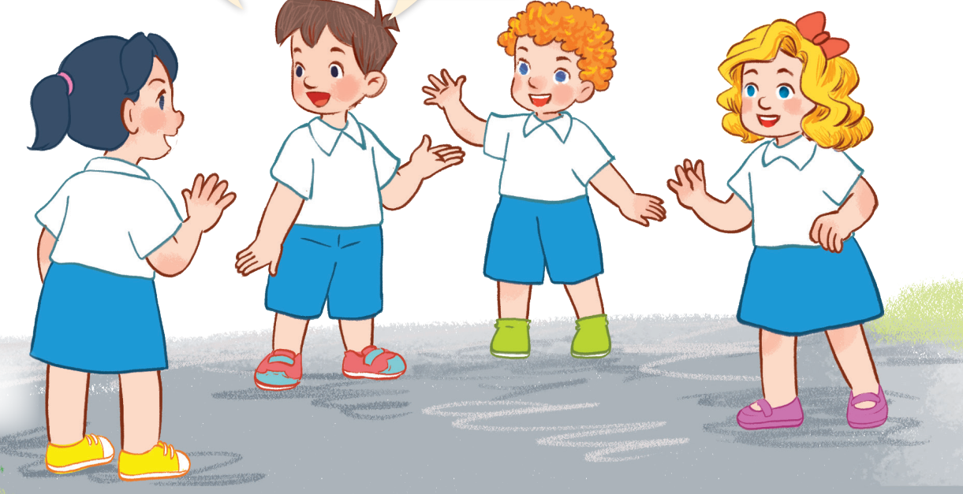
3
Our friends
LESSON 1 – PERIOD 2

Slide 2











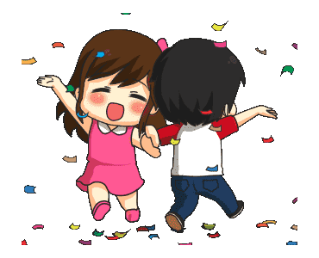
What’s your name?
How are you?
Good morning.
1
2
3
Time-meter

Slide 3



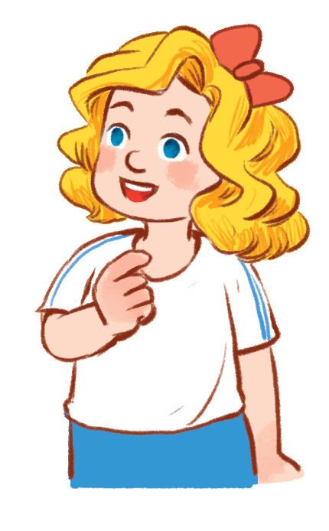
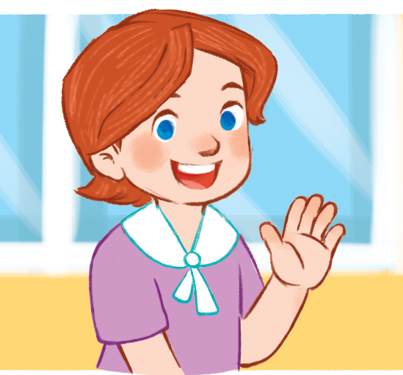

….. is Mary
….. is Lucy
….. is Ms Hoa
1
2
3
Time-meter

Slide 4

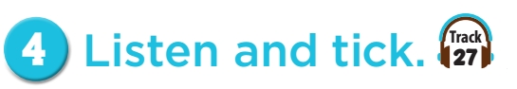
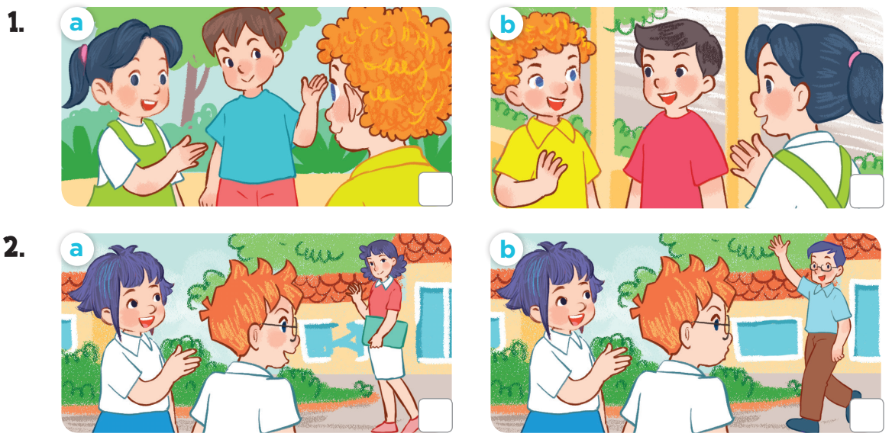


Slide 5
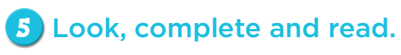
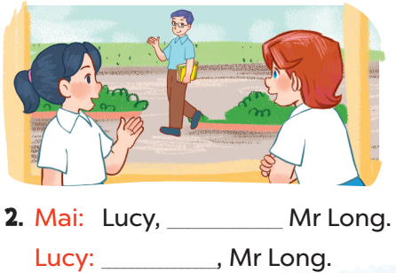
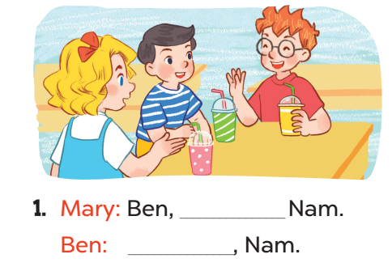
that’s
this is
Hello
Hi/Hello

Slide 6
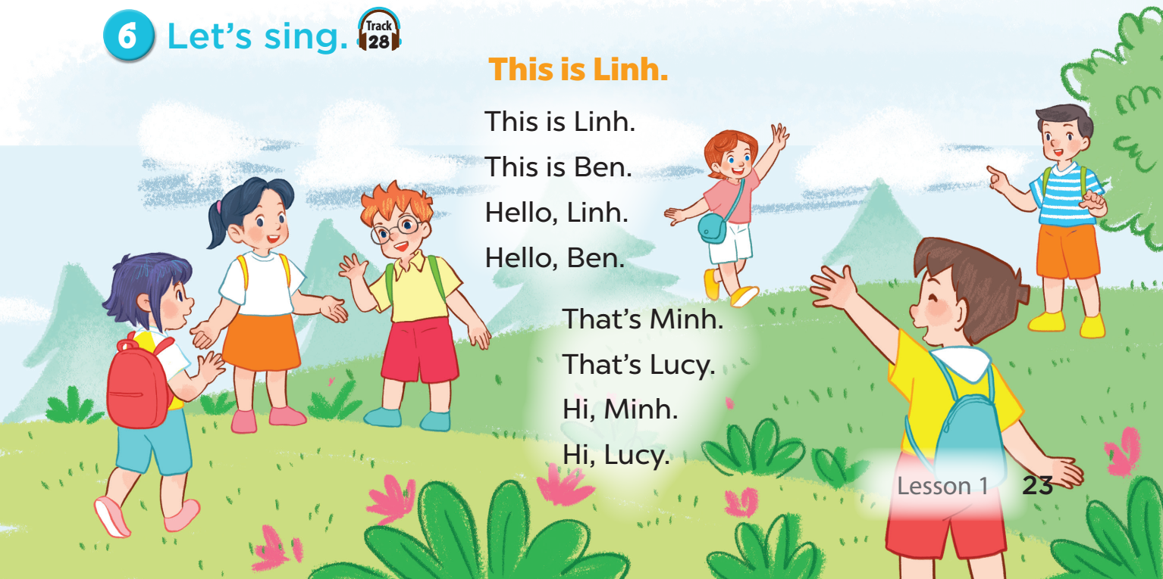

Slide 7
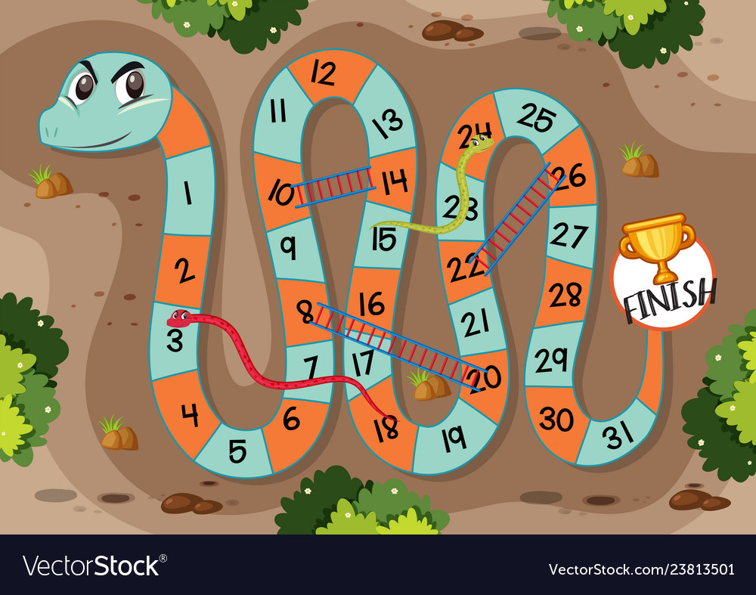










A
B
C
D
E
F
G
H

Slide 8
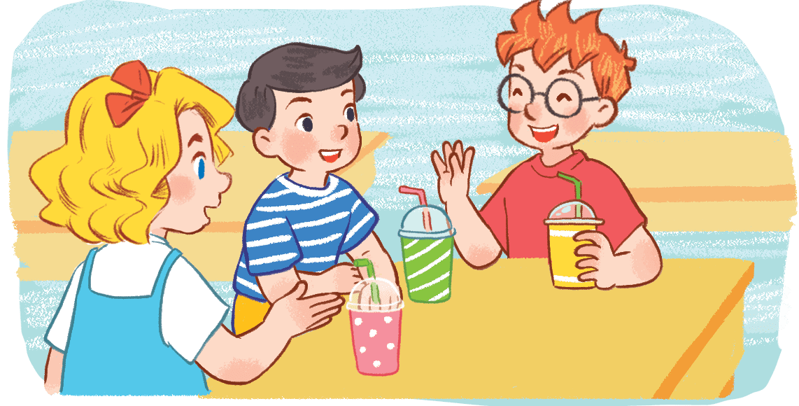



Mary: Ben, __________Nam.
Ben: __________, Nam.
A
This is/ this
B
This is/ Hi
C
This is/ that
MENU
Notes:
Hs chọn đúng, GV mời 2 bạn trong đội hội thoại

Slide 9
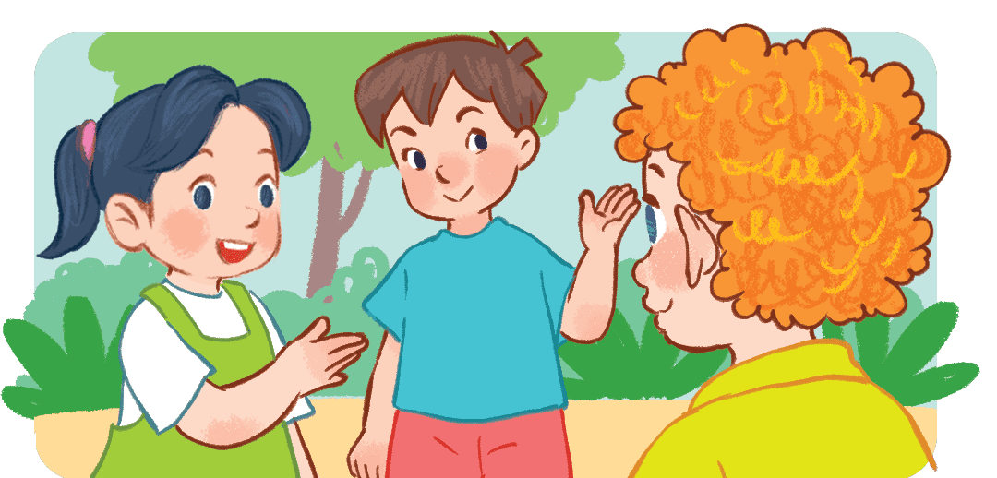
Mai: Bill, __________Minh.
Bill: __________, Minh.
B
this is/ Hello
A
this is/ this
C
this is/ that
MENU

