Slide 1




My foreign friends
Unit 3
Lesson 1 – Period 2

Slide 2


01
Warm-up and Review

Slide 3





1
2
3
4
5
6
7
8
FINISH
Notes:
Click the middle of the number to move to the Question slide.
Click the white circle to disappear the whole number card.
Click FINISH to end the game.

Slide 4








READ AND CIRCLE.
1. This is Sally. She’s from Britain / America.

Slide 5




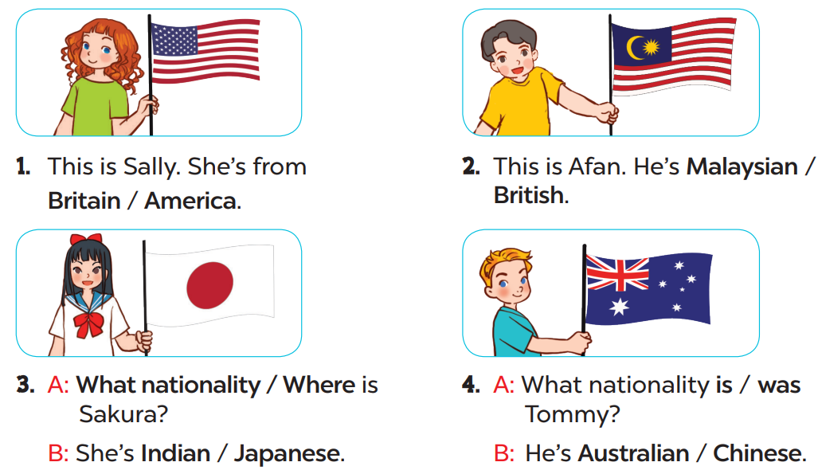


READ AND CIRCLE.
Page
23

Slide 6



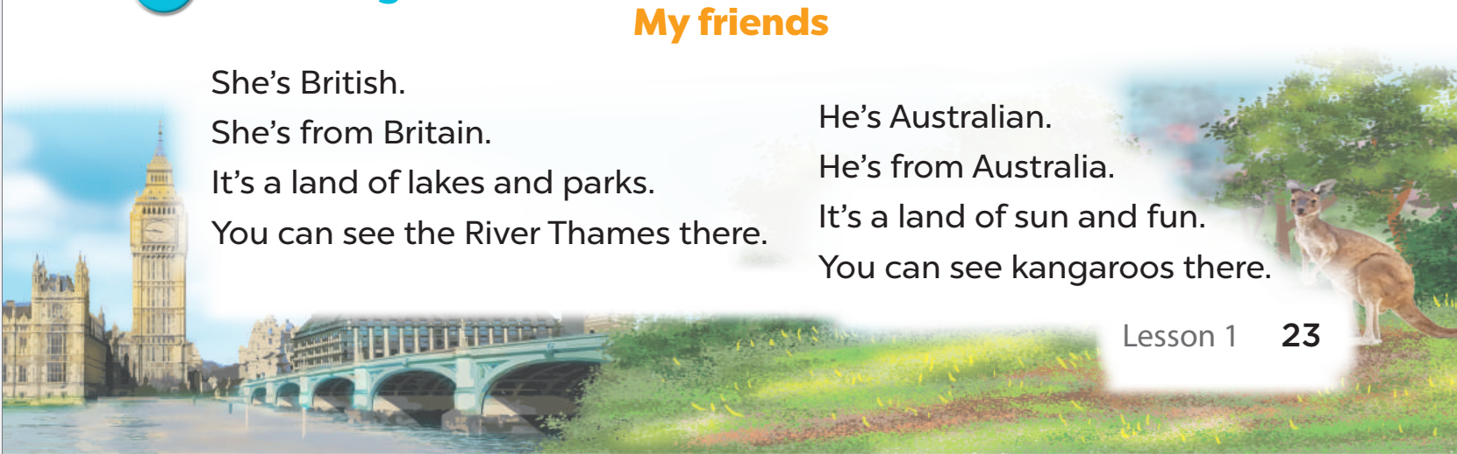


LISTEN, SING AND CLAP.
My friends

