Slide 2
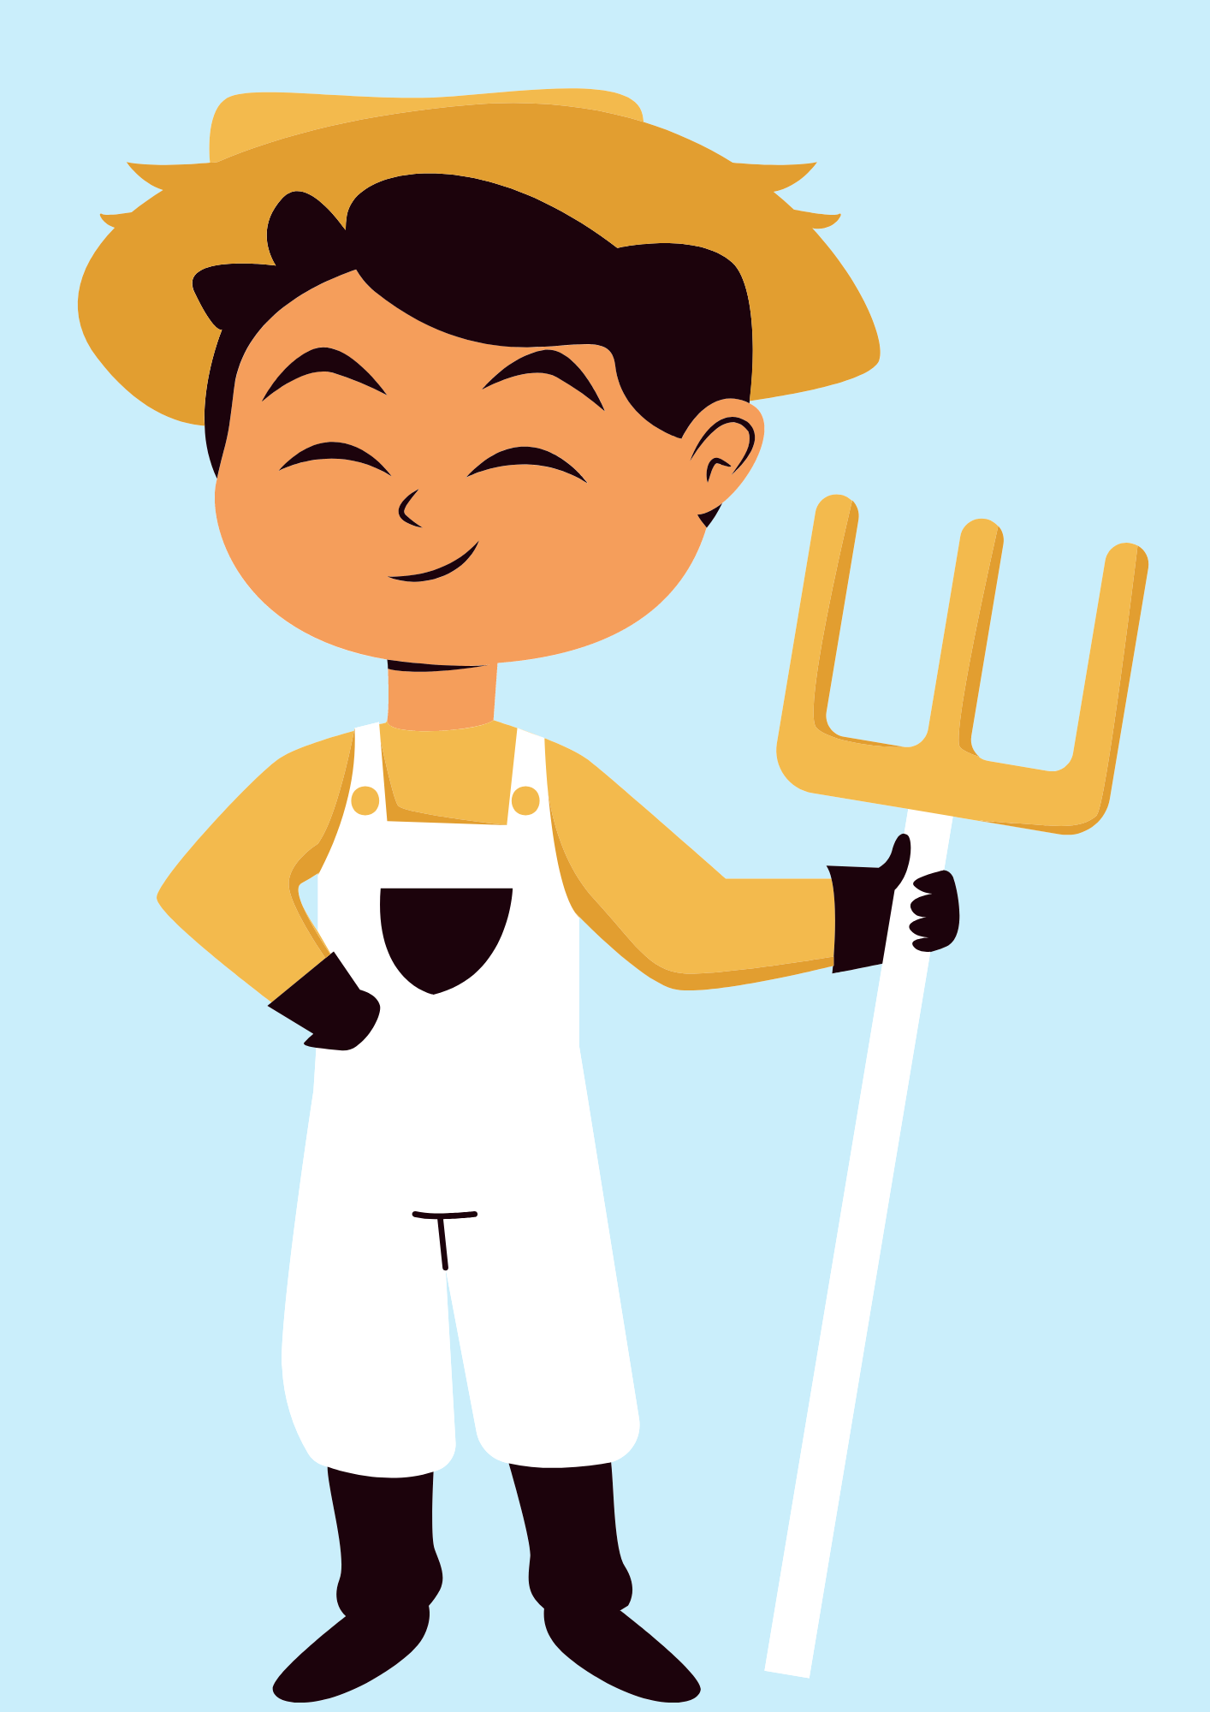
GUESS THE JOB!
a farmer

Slide 3

GUESS THE JOB!
an office worker

Slide 4
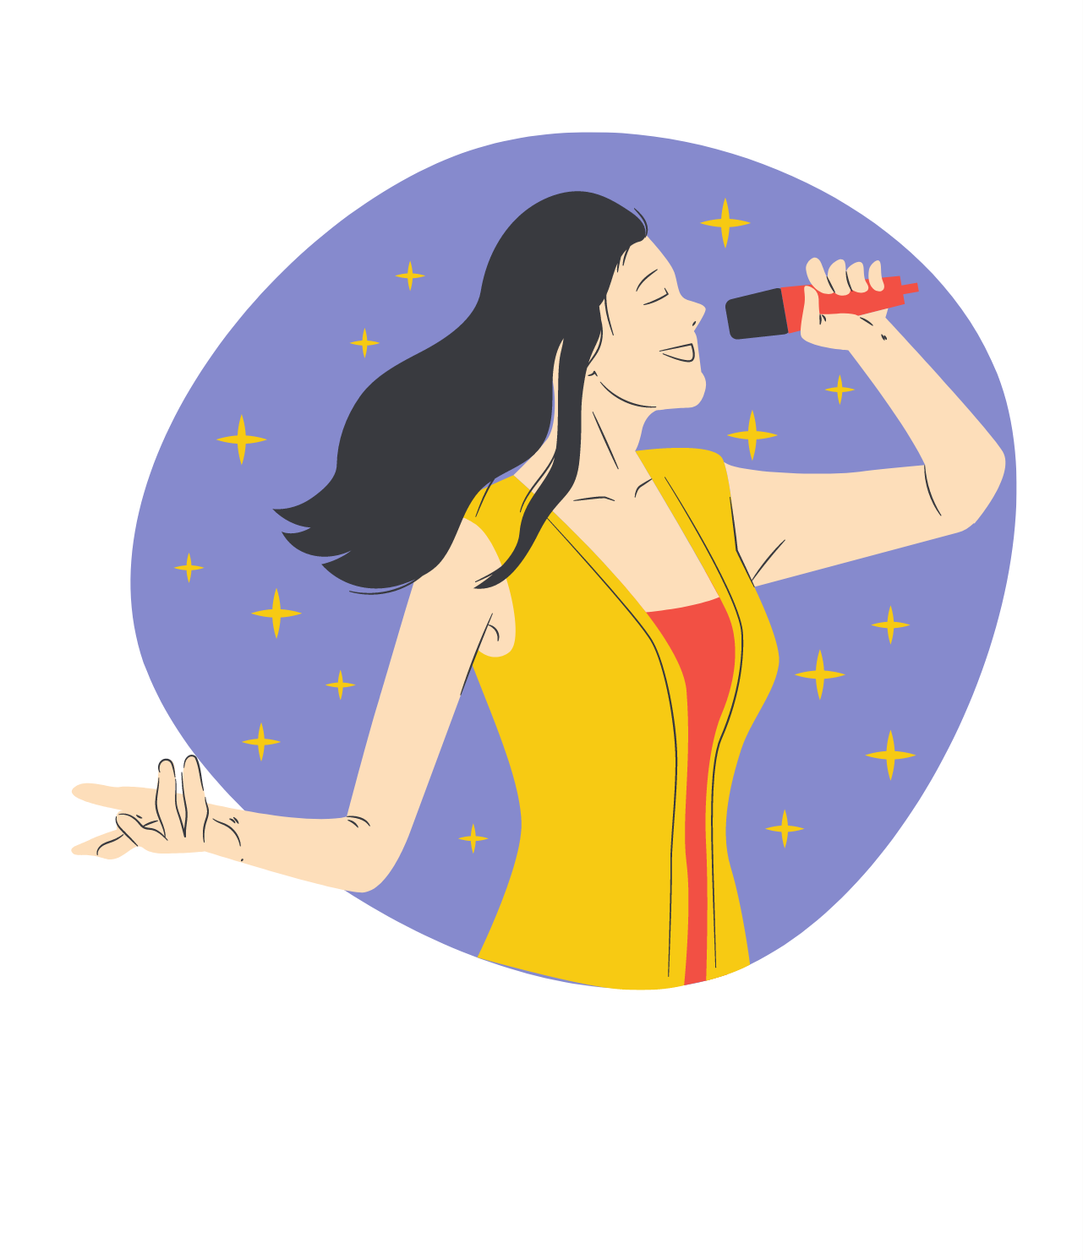
GUESS THE JOB!
a singer

Slide 5
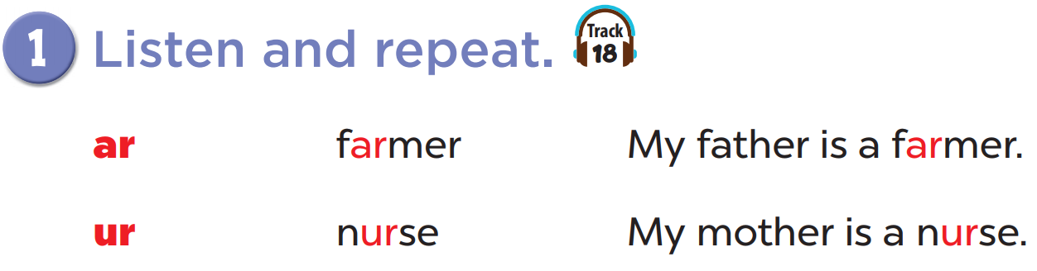

Slide 6
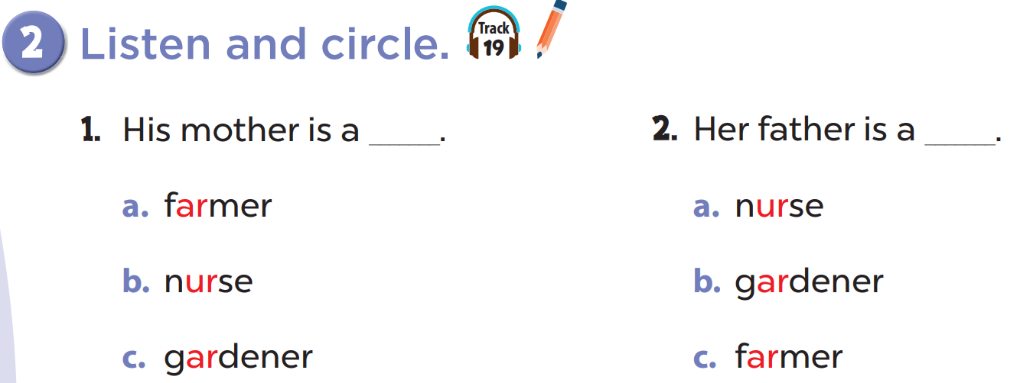

Slide 8

