Slide 1



13
MY house
LESSON 1 - PERIOD 1

Slide 2
1
Warm-up and review

Slide 3
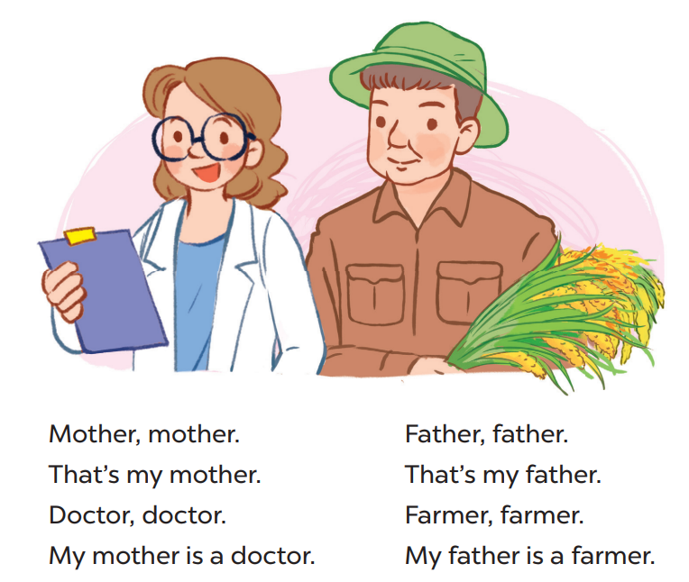
Say the chant

Slide 4
2
Look, listen and repeat. .

Slide 5
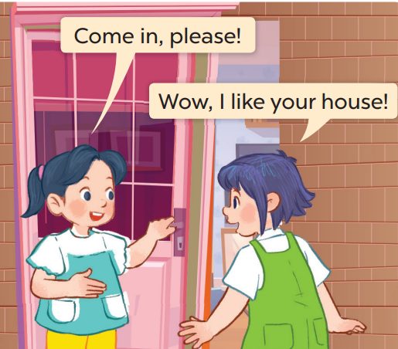
Who are they?
Where are they?

Slide 6
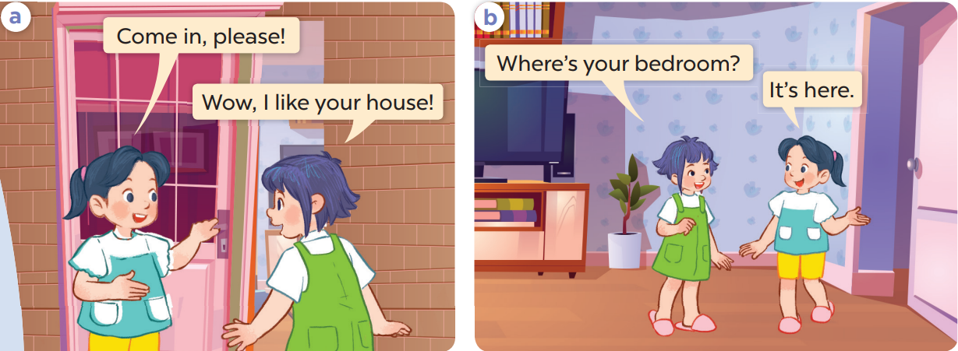
Work in pairs and repeat.

Slide 7
3
Listen, point and say..

Slide 8
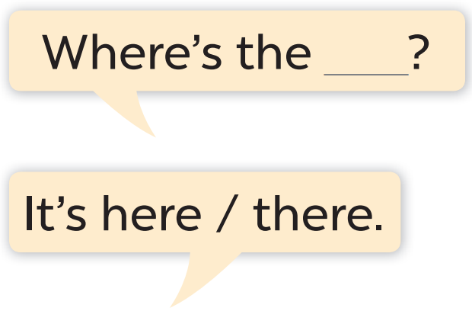
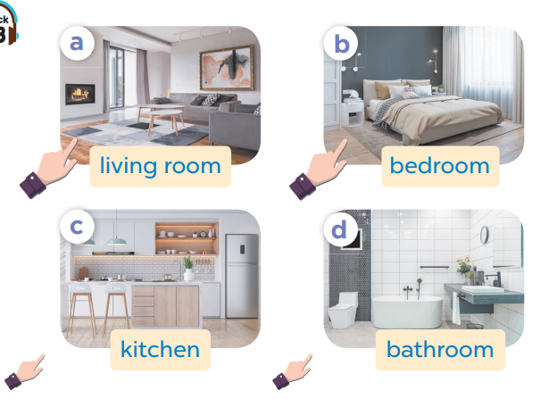

Slide 9
Work in pairs. Ask and answer.

Slide 10
Work in pairs.
Ask and answer.

Slide 11
4
Let’s talk.

Slide 12
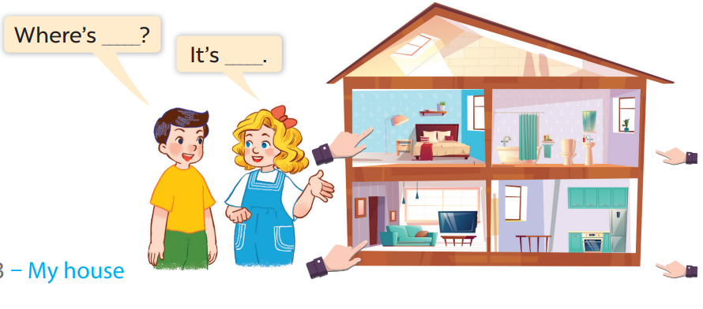
Work in pairs.
Ask and answer.

Slide 13
5
Fun corner and wrap-up

