Slide 2

OUR SPECIAL DAYS
Lesson 1 - Period 2

Slide 3
Table of contents
1
2
3
4
Warm-up
Activity 1
Listen and tick or cross.
Activity 2
Read and complete.
Activity 3
Listen, complete and sing.
Fun corner
5
Look, read and choose.

Slide 4
01
Warm-up

Slide 5
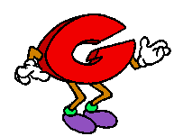
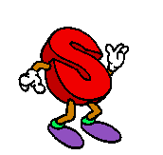
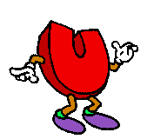

Can you?

Slide 6
02
Activity 1
Listen and tick or cross.

Slide 7
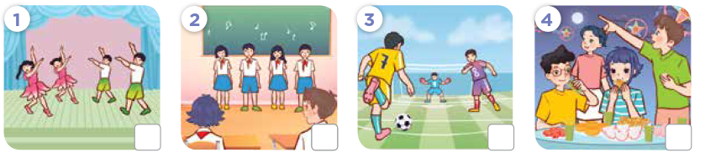

Listen and tick or cross.

Slide 8
03
Activity 2
Read and complete.

Slide 9
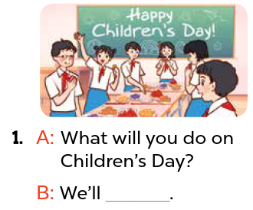
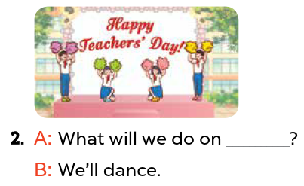
Read and complete.
Teachers’ Day
have a party

Slide 10
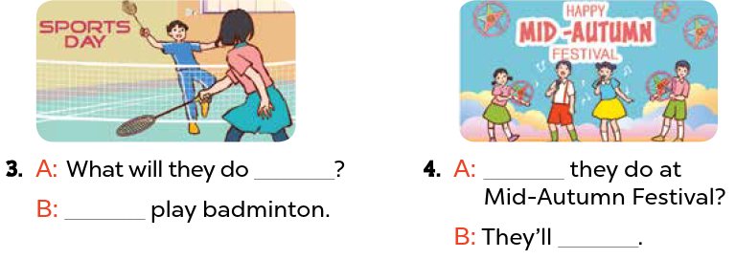
Read and complete.
on Sports Day
What will
We’ll
sing and dance

Slide 11
Activity 3
04
Listen, complete and sing.

Slide 12

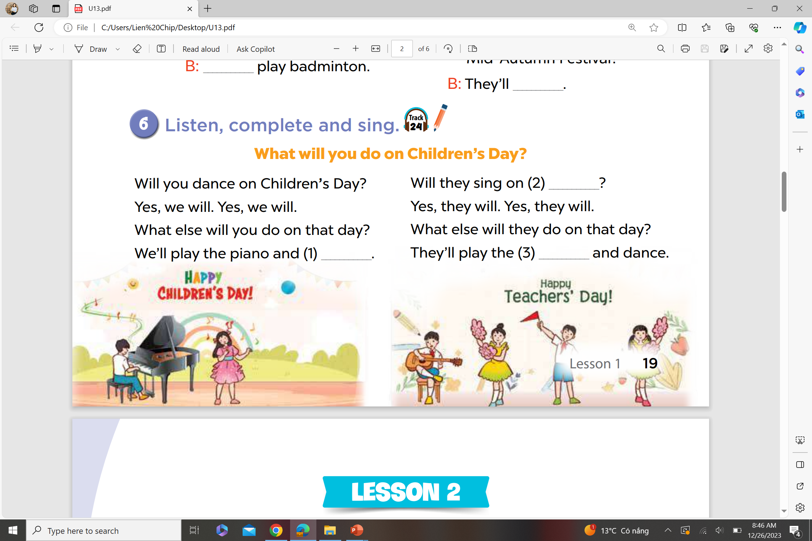
Listen, complete and sing.
Teachers’ Day
sing
guitar

