Slide 2

OUR SPECIAL DAYS Lesson 2 - Period 3

Slide 3
02
Activity 1
Look, listen and repeat.

Slide 4
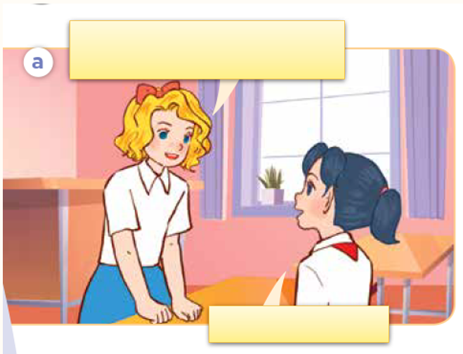
Look, listen and repeat.

Slide 5
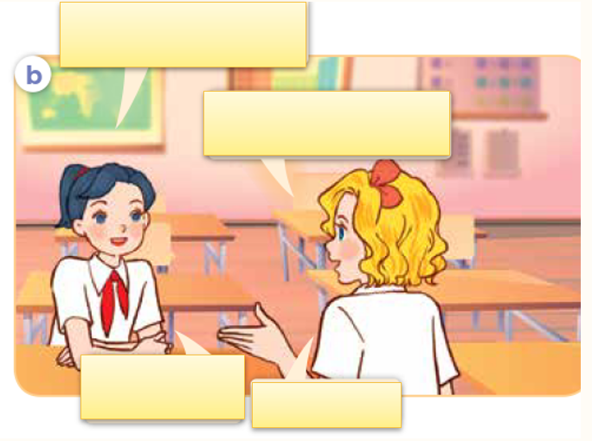
Look, listen and repeat.

Slide 6
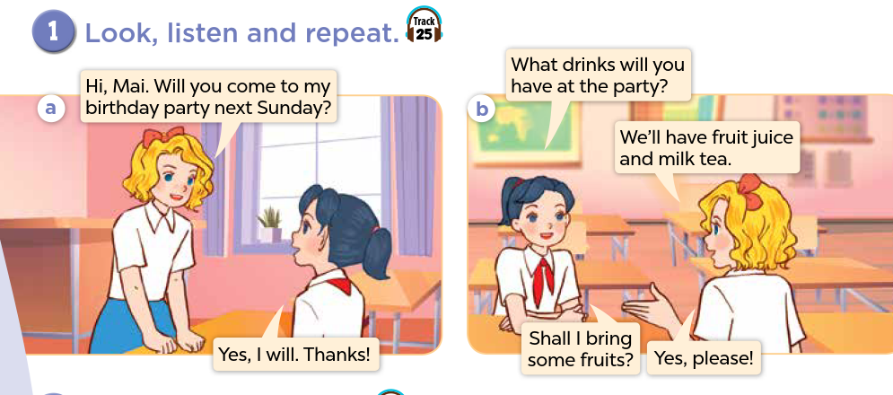

Slide 7
Sentence pattern
What drinks will you have at the party?
We’ll have fruit juice and milk tea.

Slide 8
03
Activity 2
Listen, point and say.

Slide 9
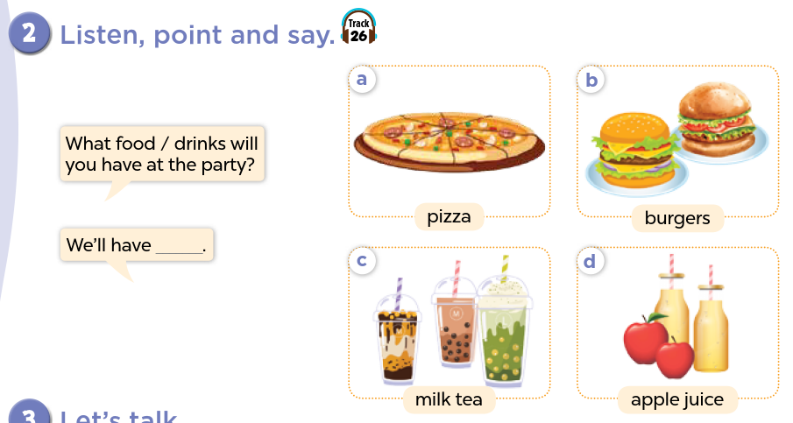

Slide 10
Activity 3
04
Let’s talk.

