Slide 1
Unit 13 Appearance
Lesson 3 - Period 5

Slide 2
02
Activity 1
Listen and repeat.

Slide 3
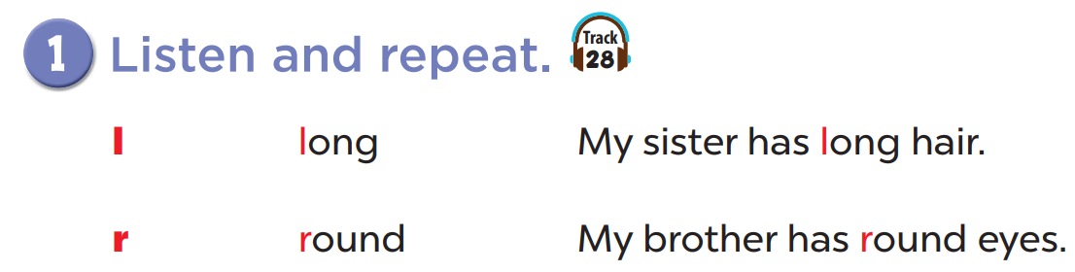

Slide 4
03
Look, listen and repeat.

Slide 5
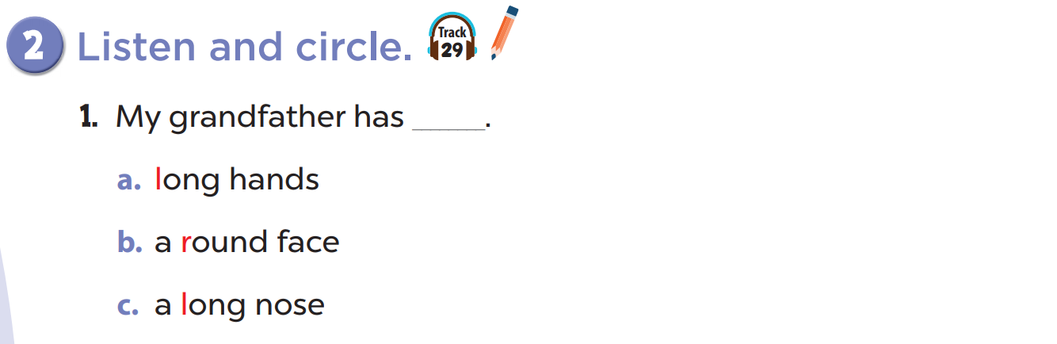
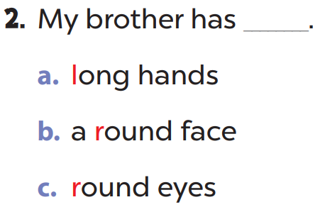

Slide 6
04
Activity 3
Let's chant.

Slide 7
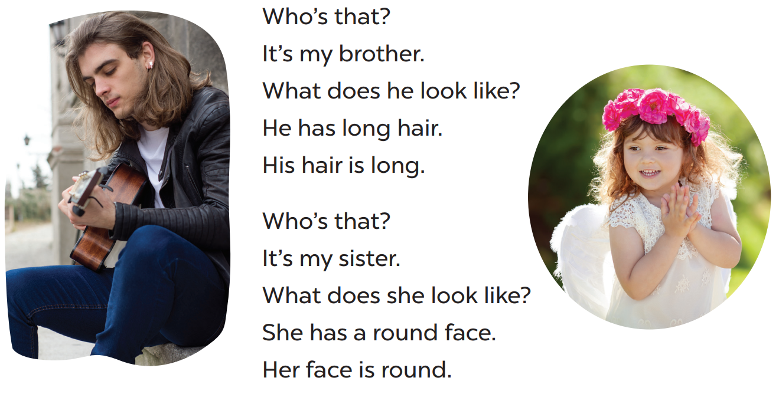

Slide 8
05
Fun corner and wrap-up
Listen and find the word with the given sounds.
Notes:
- Teacher plays the audio. Student listens and choose the number with the word containing the given sound.
- Teacher click on play / stop button to choose the point for that question.

Slide 9


Which word has the "L" sound?
He's
got
long
hair.
1
2
3
4



