Slide 1
Unit 13 Appearance
Lesson3 - Period 6

Slide 2
Warm-up
01

Slide 3
Sorting
He/She is ... | He/She has ...
a round face
beautiful
long legs
slim
a big nose
tall
small eyes
big

Slide 4
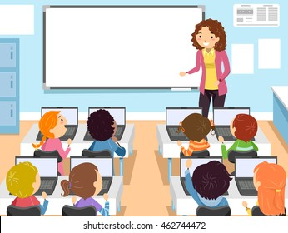
Number Race
1
2
1
2
3
4
3
4
Notes:
- Teacher devides class into teams.
- Teacher gives each pupil in one team a number so that each team has equal numbers.
- Teacher shows the questions, allow time for pupils to think. Then T calls out a number, pupils with that number from each team stands up and shouts out the answers. T praise and give points for the teams.

Slide 5

The monster _____ a big mouth.
has

Slide 6
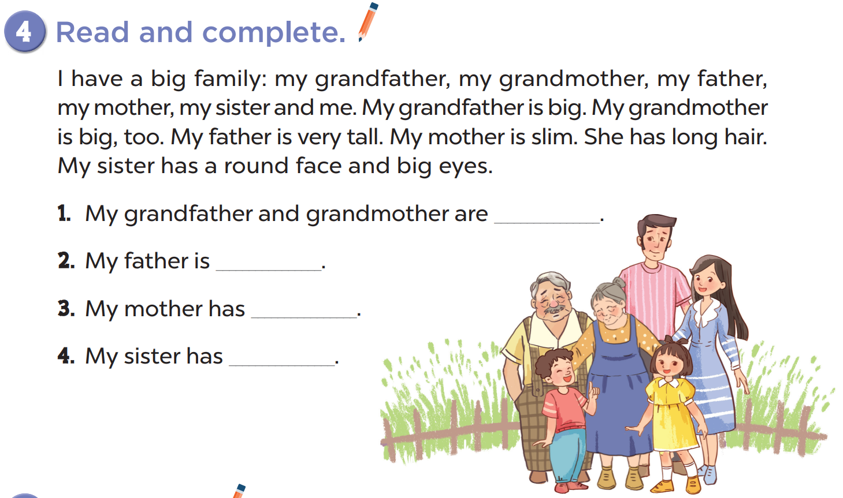
big
very tall
long hair
a round face and big eyes

Slide 7
03
Let's write.

Slide 8

There are __ people in my family.
My father is ____. He has _____.
My mother is ____. She has ____.
My_______________________.
I love my family!
Notes:
Teacher adds a picture and details about T's family

Slide 9
04
Project

Slide 10
