Slide 1

OUR SPECIAL DAYS
Lesson 2 - Period 3

Slide 2
02
Activity 1
Look, listen and repeat.

Slide 3
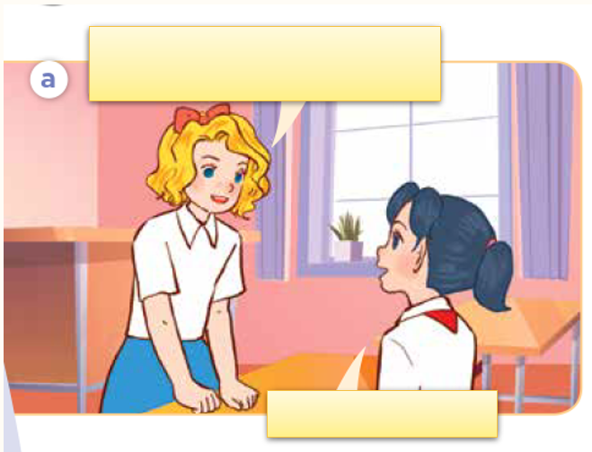
Look, listen and repeat.

Slide 4
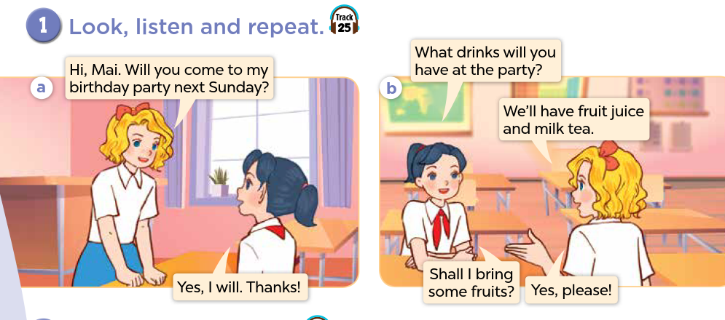

Slide 5
03
Activity 2
Listen, point and say.

Slide 6
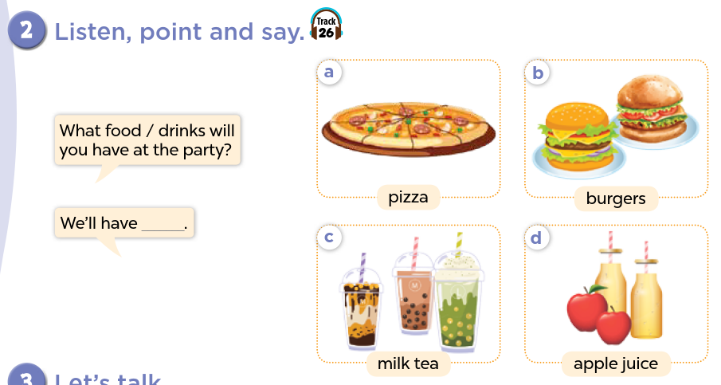

Slide 7
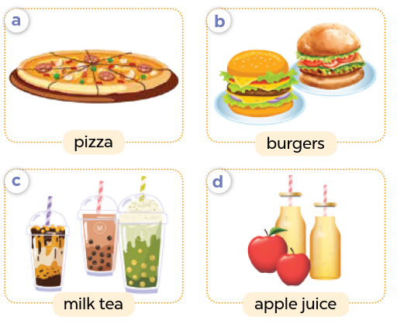
Name the food/drinks.

Slide 8

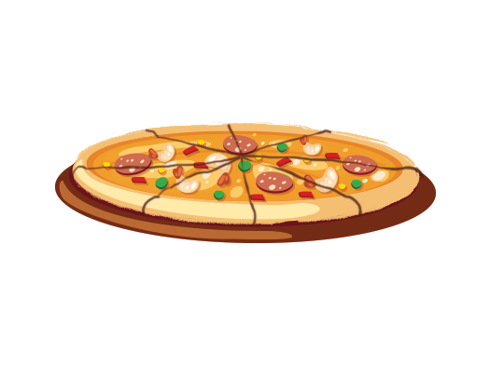
Listen, point and say.
a. pizza

Slide 9
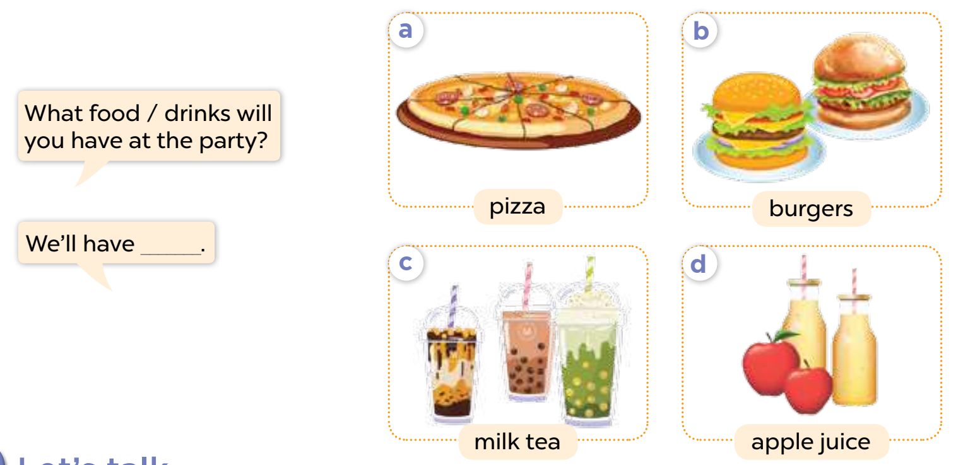
Listen, point, and say.

Slide 10
Activity 3
04
Let’s talk.

Slide 11
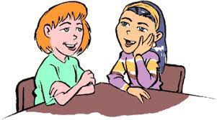
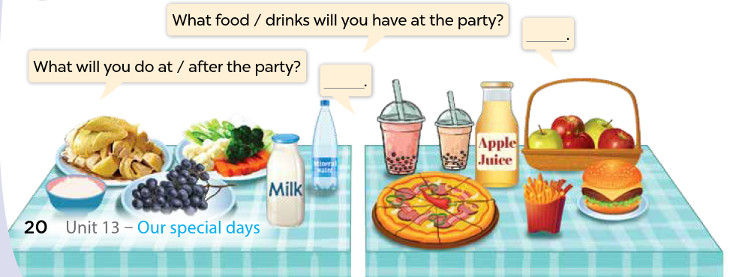
Look and name the food / drinks.
Let’s talk!

