Slide 1

OUR SPECIAL DAYS
Lesson 3 - Period 5

Slide 2
01
Warm-up
Guess the food and drinks.

Slide 3
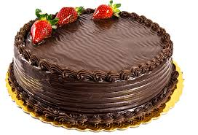
cake
SHOW

Slide 4
02
Activity 1
Listen and repeat.

Slide 5
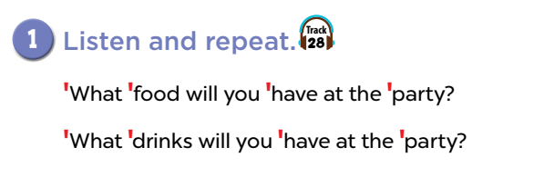

Slide 6
03
Activity 2
Listen and underline one more stressed word. Then repeat.

Slide 7
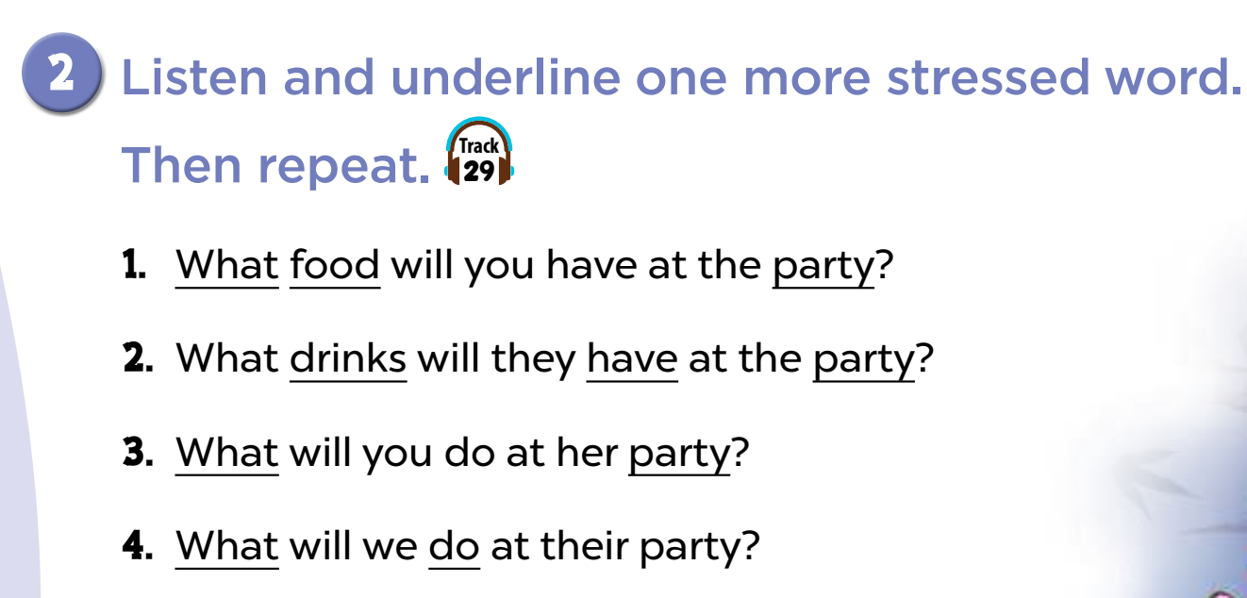

Slide 8
Activity 3
04
Let’s chant.

Slide 9
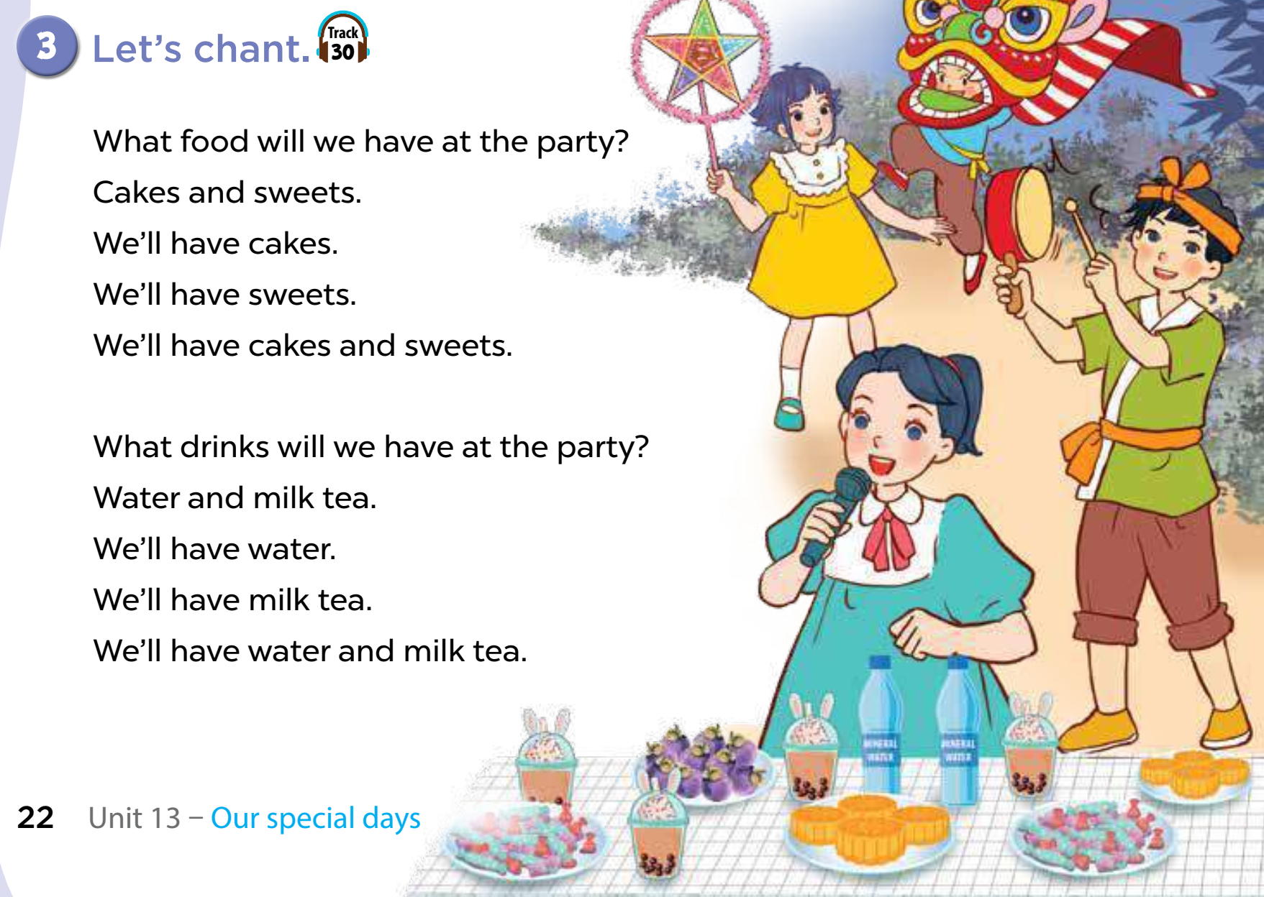
Look, name the food and drinks.
water
milk tea
sweets
cakes

Slide 10
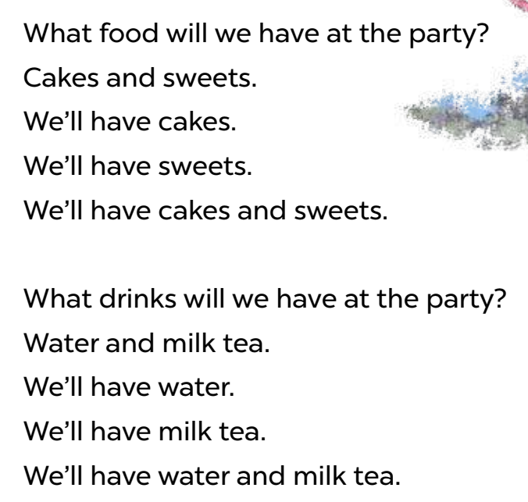
Let’s chant.

