Slide 1







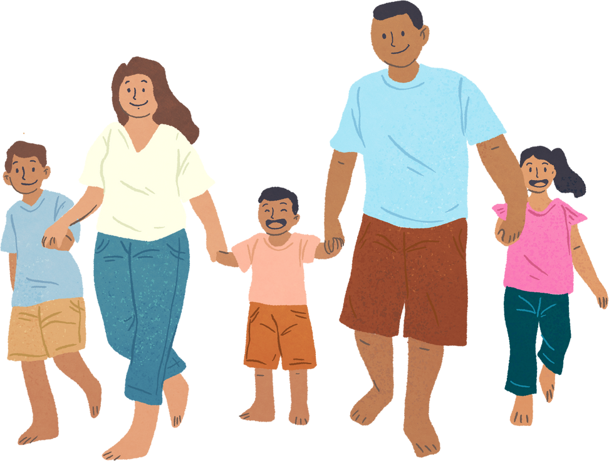


Unit 11: FAMILY TIME
Lesson 3 - Period 5

Slide 2






Table of content
Warm-up and Review.
Activity 1: Listen and repeat.
Activity 2: Listen and underline one more stressed word. Then repeat.
Activity 3: Let’s chant.
Fun corner and Wrap-up.

Slide 3








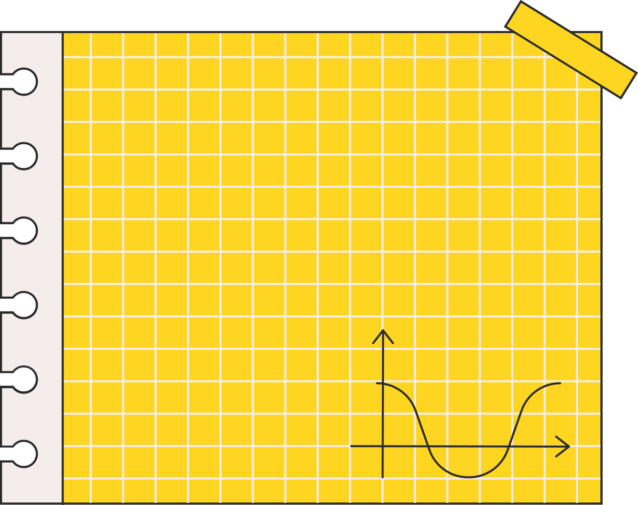



Warm-up and Review.
Let’s sing.

Slide 4





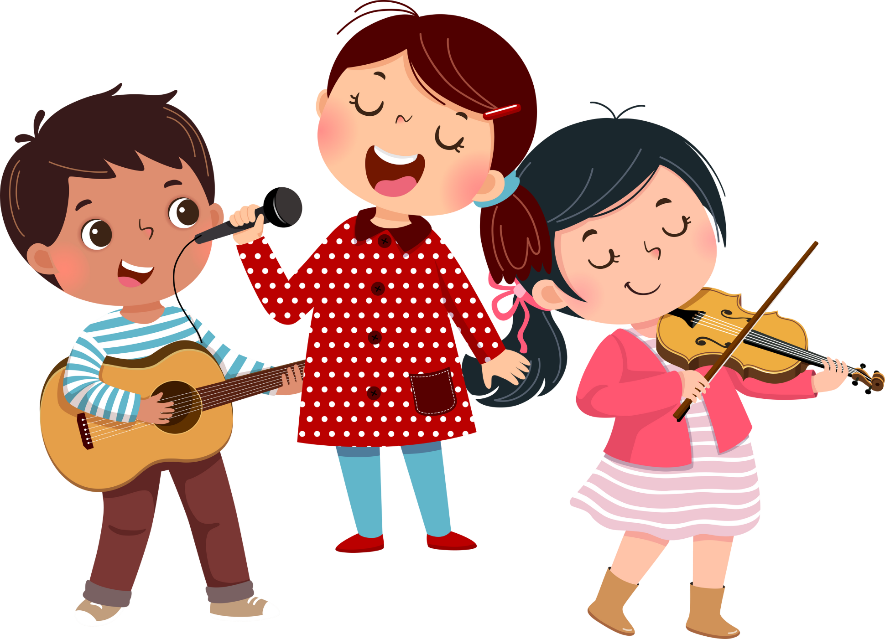
Did you swim last Sunday?
Where were you last Sunday?
I was on the beach.
Did you swim?
Yes, I did. I swam with my mum.
Where were you last weekend?
I was in the park.
Did you walk?
No, I didn't. I took photos there.

Slide 5

01
Activity 1
Listen and repeat.

Slide 6



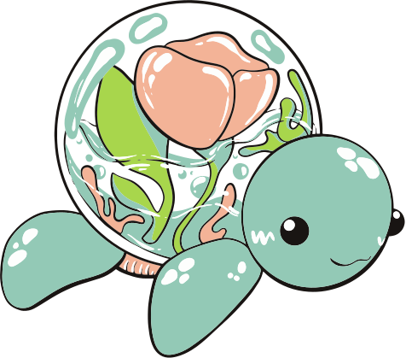
Listen and repeat.
‘When did you ‘go to ‘London?
Notes:
Step 3: Repeat Steps 1 and 2 for the question ‘What did they ‘do in ‘Finland?

Slide 7
Listen and repeat.
‘What did they ‘do in ‘Finland?
Notes:
Step 1: Draw pupils’ attention to the question ‘When did they ‘go to ‘London?. Play the recording and encourage pupils to point at the words with stressed syllables in 169 the question while listening.
Step 2: Play the recording again and encourage pupils to listen and repeat the question. Do this several times until pupils feel confident. Correct their pronunciation where necessary.

Slide 8
03
Activity 2
Listen and underline one more stressed word. Then repeat.

Slide 9



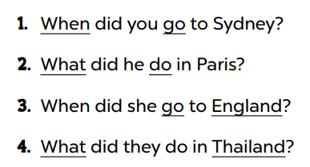


Listen and underline one more stressed word. Then repeat.
Notes:
Step 2: Play the recording all the way through for pupils to listen to the questions. Play the recording again for pupils to underline one more stressed word of the questions.

Slide 10

Swap your book.
Notes:
Step 3: Tell pupils to swap books with a partner, then check the answers together as a class. Write the correct answers on the board.

Slide 11
04
Activity 3
Let’s chant.

Slide 12


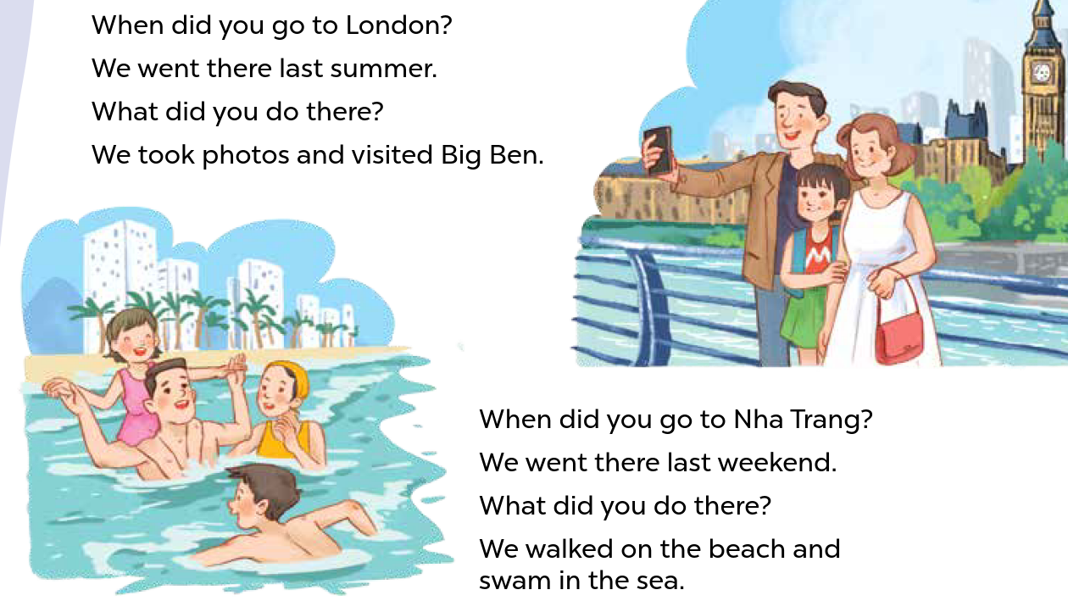


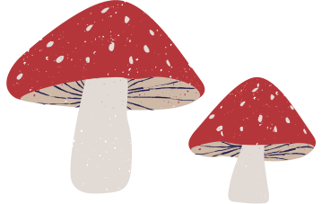
Listen and chant.
Notes:
Step 2: Play the recording all the way through for pupils to listen to the whole chant. Encourage them to listen carefully to the rhythm and pronunciation. Draw pupils’ attention to the word stress in the questions.
Step 3: Play the recording line by line while pupils listen and repeat. Correct their pronunciation, if necessary.

