Slide 1







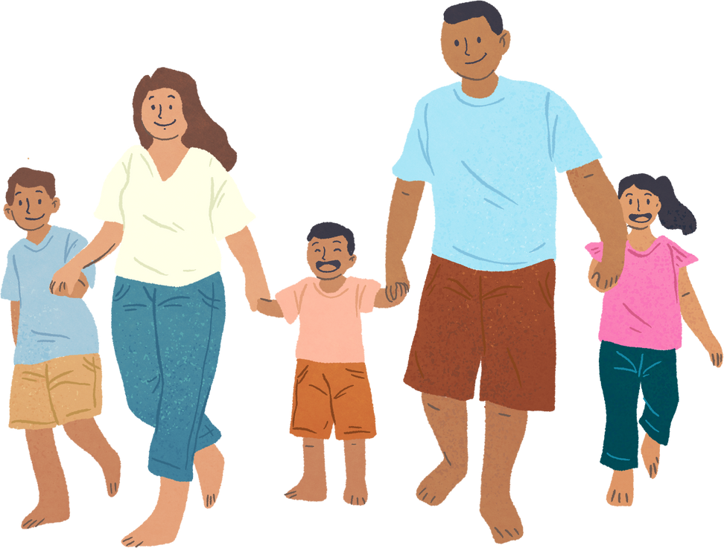


Unit 11: FAMILY TIME
Lesson 3 - Period 6

Slide 2








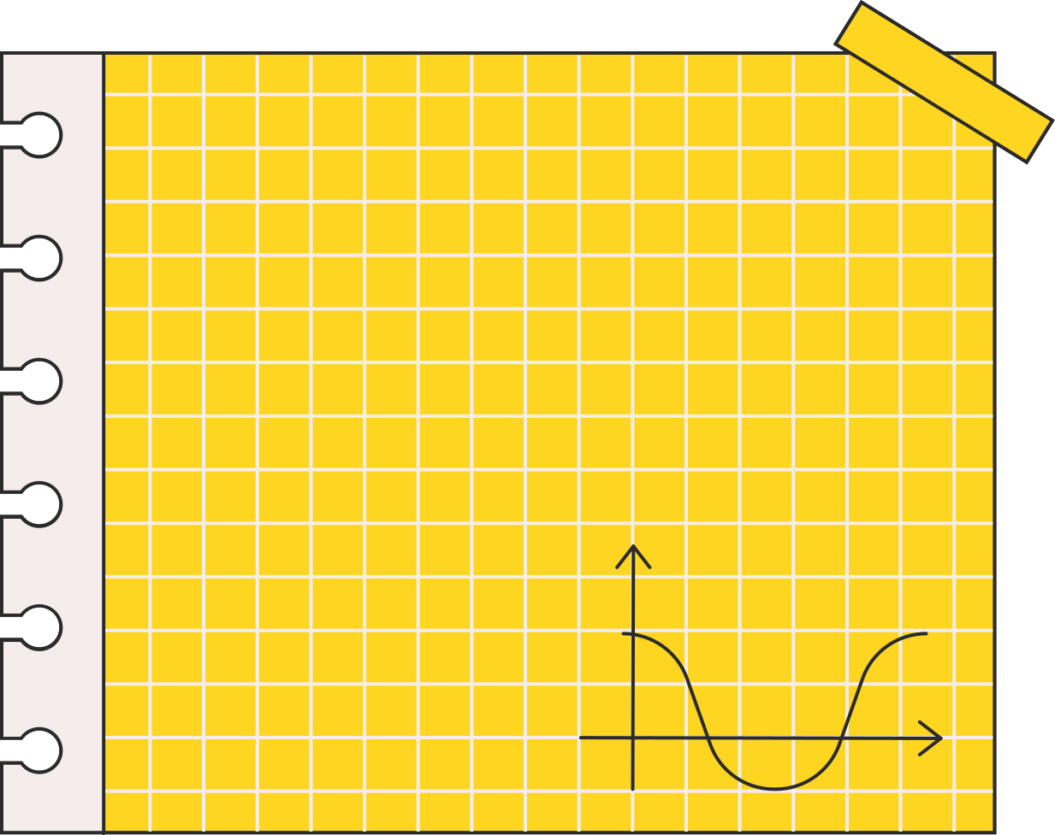



Warm-up and Review.
Let’s chant.

Slide 3




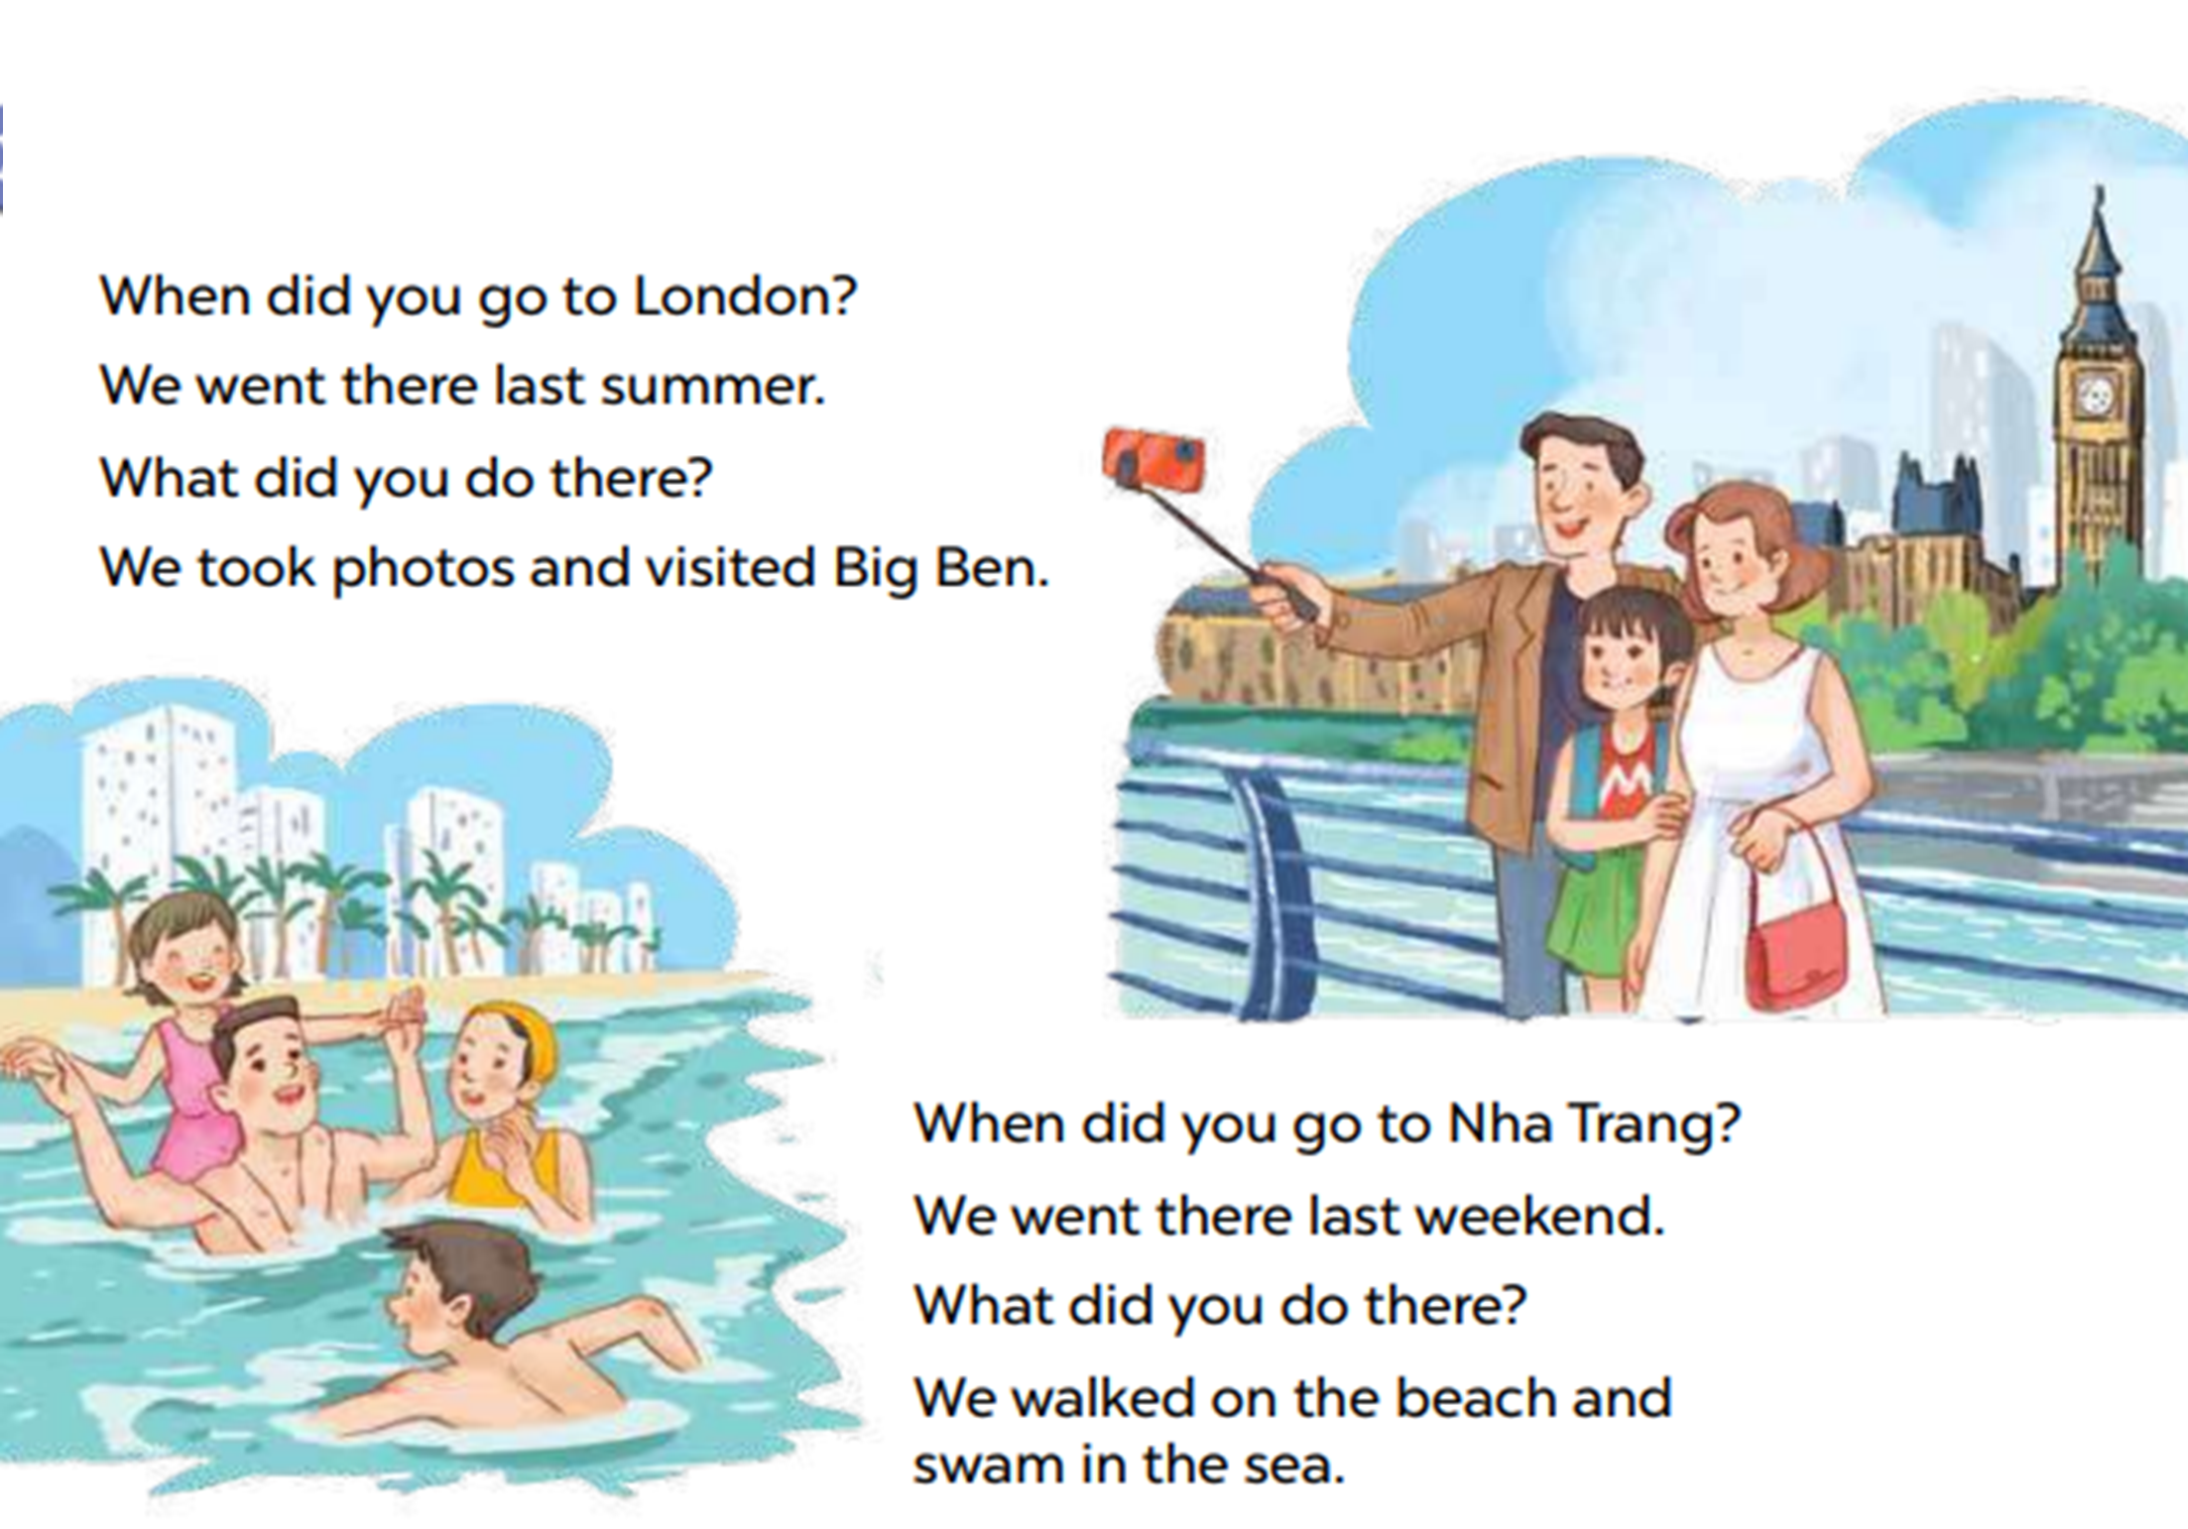


Let’s chant.

Slide 4

01
Activity 4
Read and answer.

Slide 5


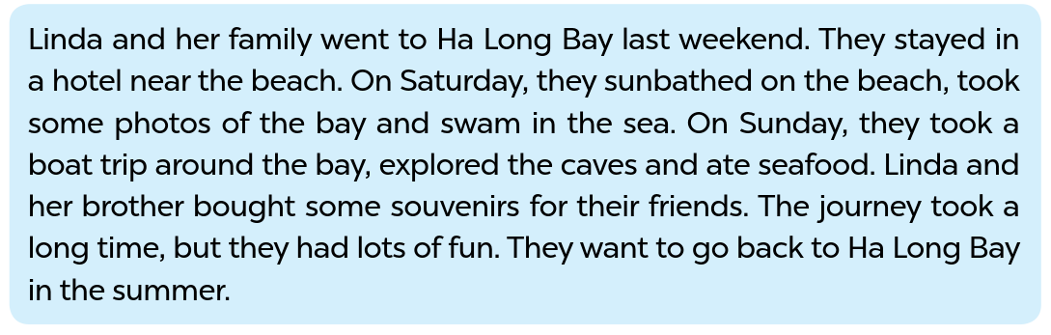
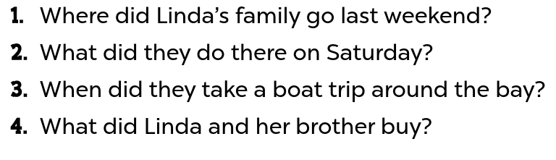


Look and read.
Notes:
Step 1: Have pupils read the questions carefully. Tell them to read Question 1 and pay attention to key words such as Where, Linda’s family, go. Then they should scan the text for relevant information.

Slide 6
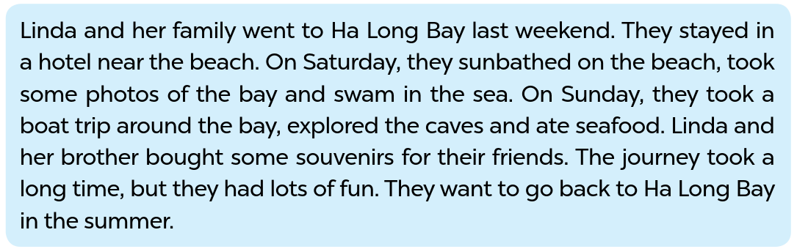
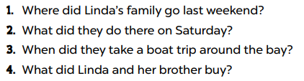
Read and answer.
They went to Ha Long Bay.
They sunbathed, took some photos and swam in the sea.
They took a boat trip around the bay on Sunday.
They bought some souvenirs for their friends.
Notes:
Step 3: Get pupils to swap books with their partners and check the answers before checking as a class.

Slide 7
03
Activity 5
Let’s write.

Slide 8



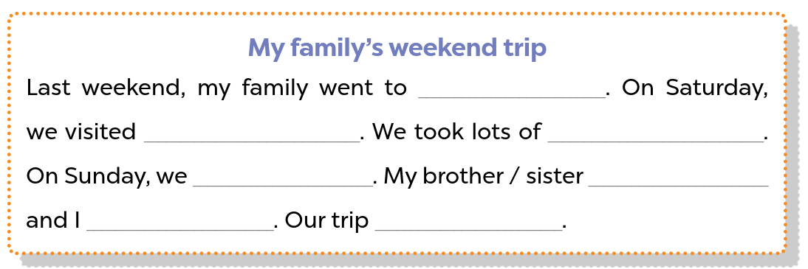


Look and say.
Notes:
Step 1: Ask pupils to read the gapped sentences and fill in the gaps with information about someone’s family’s weekend trip. Tell pupils that the gaps in the paragraph focus on their activities the previous weekend. Tell pupils that they should write about 40 words. Check comprehension.

Slide 9
04
Activity 6
Project.

Slide 10


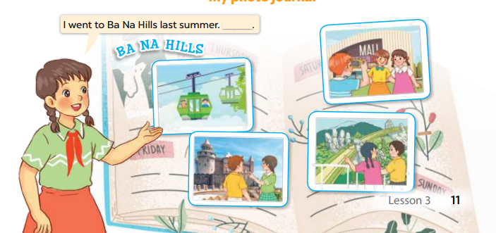



Ask and answer.
Notes:
Step 1: Explain that each pupil has to show his/her photo journal which includes some photos/ pictures of friends and their activities (they have prepared at home) and tell the class about where they went and what they did there.

Slide 11
Presentation.
Notes:
Step 3: Invite a few pupils representing some groups to show their photo journals and tell the class about the activities of the friends in the photos/pictures, e.g. I went to Ba Na Hills last summer with my friends. We took the cable car. We visited Golden Bridge…

