Slide 1
Unit 11: My home
Lesson 3 - period 5

Slide 2
01
Warm-up

Slide 3
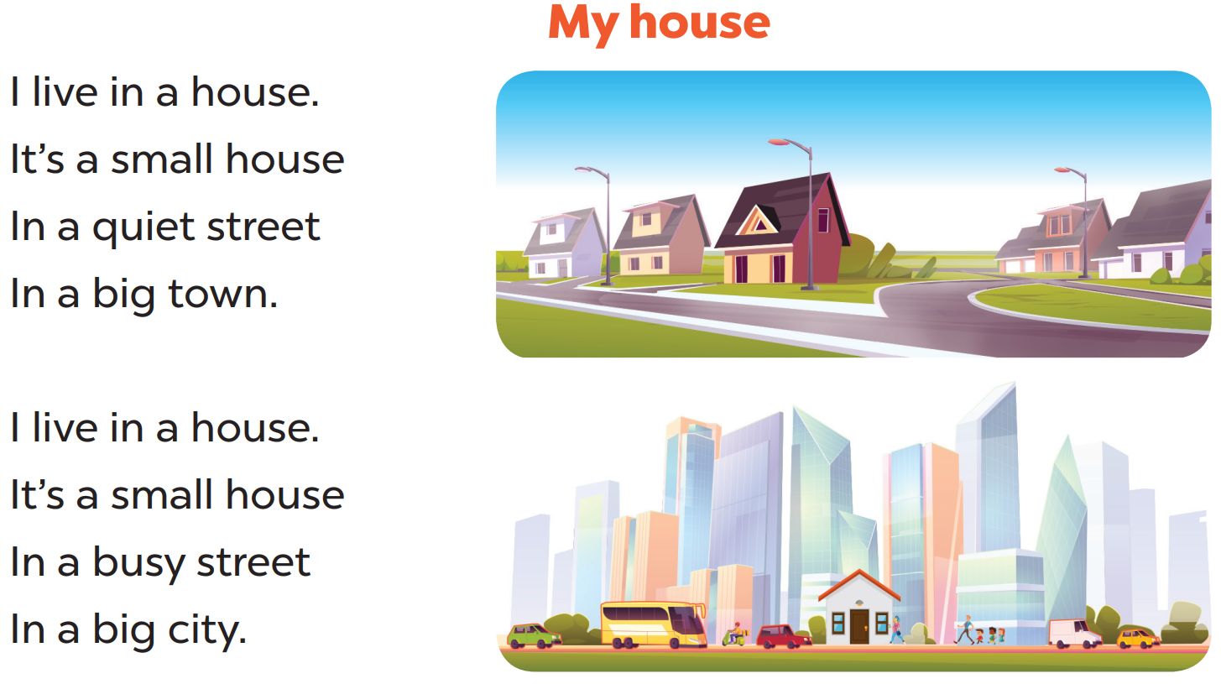

Slide 4
02
Listen and repeat.

Slide 5
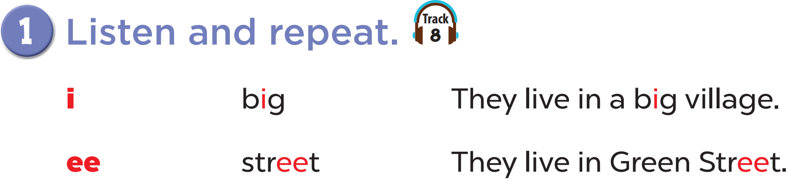

Slide 6
03
Listen and circle.

Slide 7
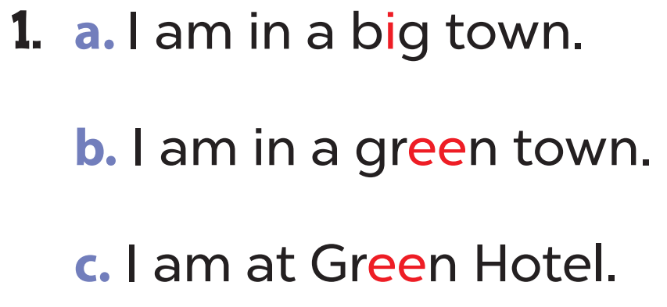
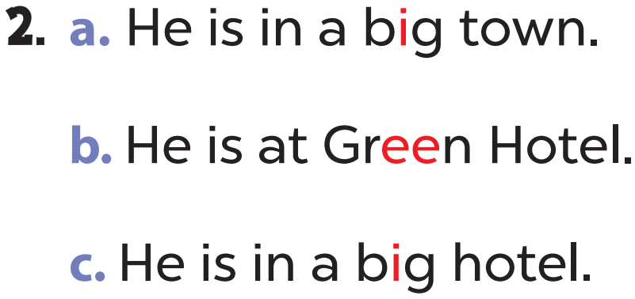

Slide 8


Slide 9
04
Let’s chant.

Slide 10
