Slide 1
Unit 11: My home
Lesson 3 - period 6

Slide 2
01
Warm-up

Slide 3
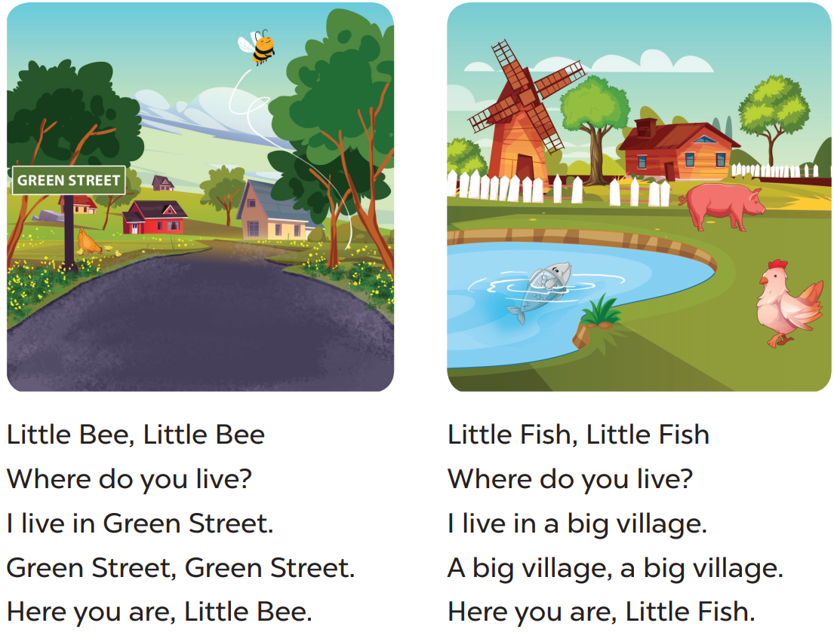

Slide 4
02
Read and circle.

Slide 5
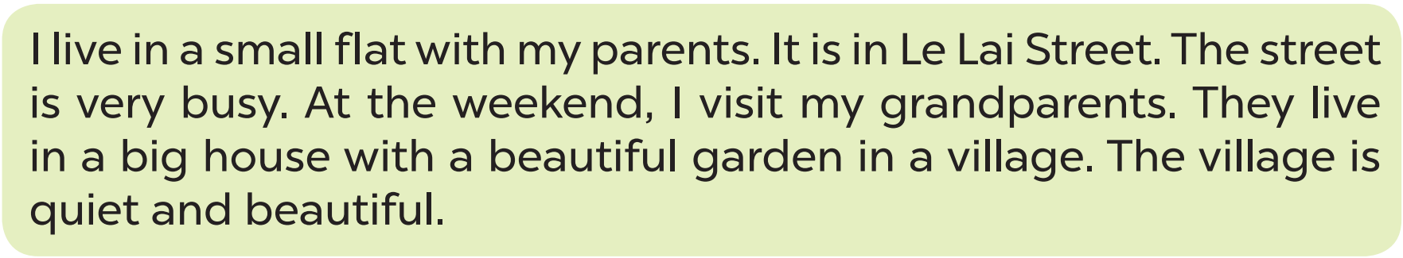

Slide 6
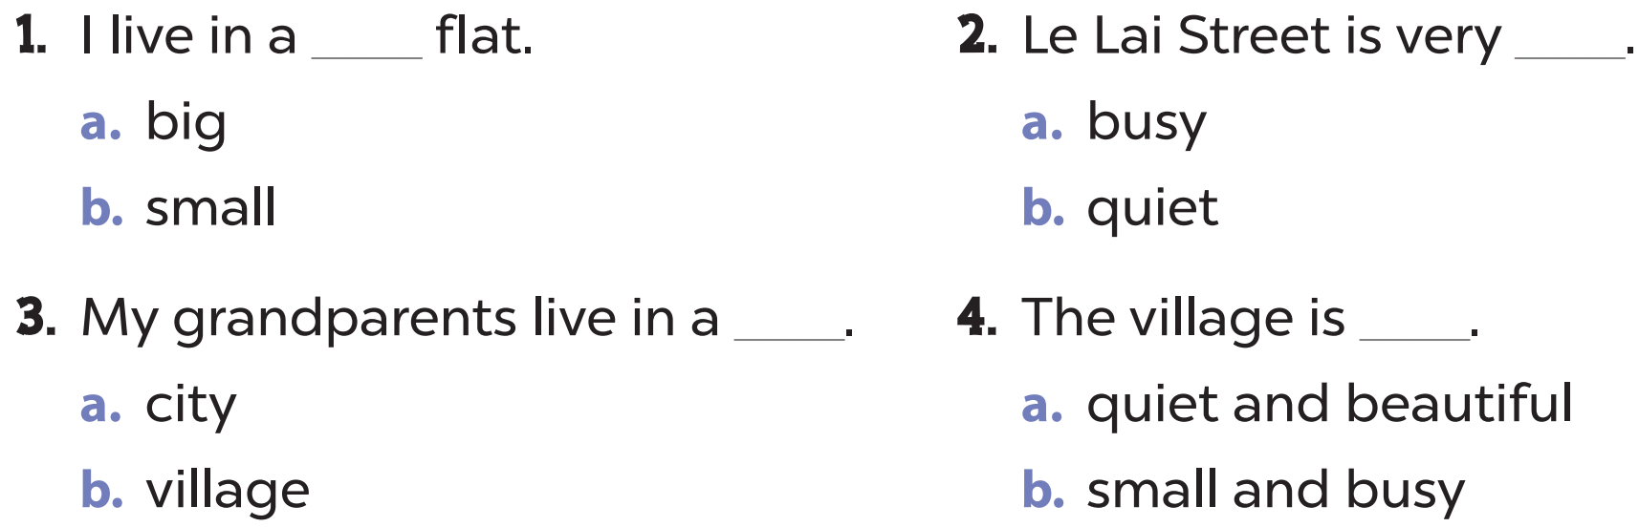


Slide 7
03
Let’s write.

Slide 8
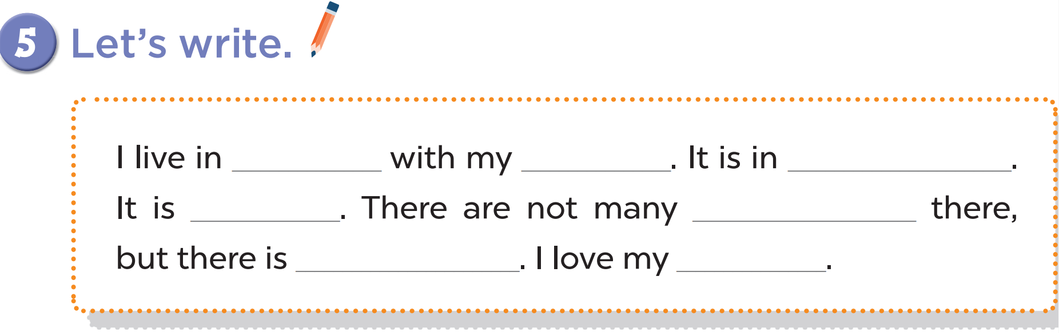

Slide 9
04
Project

Slide 10
